Slide 1
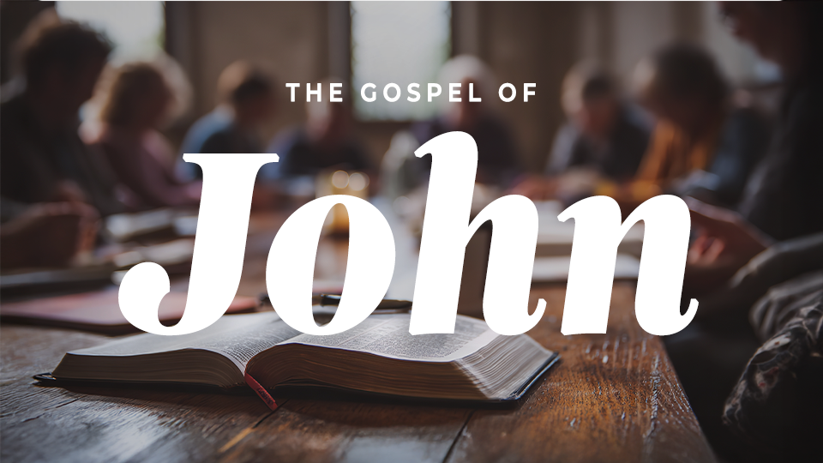

Slide 2
The gospel of
john
Session twenty-one: The Good Shepherd

Slide 3
THINK ABOUT THIS…
How is Jesus both the Gate and
the Good Shepherd for Christians? What does that mean for your life today?

Slide 4
Discuss
Can you think of a time that Jesus offered you supernatural protection, like a strong gate, or tenderness like a Good Shepherd? How does past experience build your faith for whatever you are facing today?

Slide 5
1. Jesus is the Gate—The
Only Door to Life.

Slide 6
John 10:1-10
“Truly I tell you, anyone who doesn’t
enter the sheep pen by the gate but climbs in some other way is a thief and a robber. The one who enters by the gate is the shepherd of the sheep. The gatekeeper opens it for him, and the sheep hear his voice.
→

Slide 7
John 10:1-10
He calls his own sheep by name and leads
them out. When he has brought all his own outside, he goes ahead of them. The sheep follow him because they know his voice. They will never follow a stranger; instead, they will run away from him, because they don’t know
the voice of strangers.” →

Slide 8
John 10:1-10
Jesus gave them this figure of speech, but they did not understand what He was telling them.
Jesus said again, “Truly I tell you, I am the gate for the sheep. All who came before me are thieves and robbers, but the sheep didn’t listen to them. I am the gate. →

Slide 9
John 10:1-10
If anyone enters by me, he will be saved
and will come in and go out and find pasture.
A thief comes only to steal and kill and destroy.
I have come so that they may have life and
have it in abundance.”

Slide 10
Discuss
What are some other
ways Jesus is different than theological thieves and robbers?

Slide 11
Discuss
Where are you tempted to look for life apart from the gate of Christ?

Slide 12
Discuss
What does it look like to repeatedly “enter through” Christ rather than through your own efforts?

Slide 13
2. Jesus is the Good
Shepherd—He Gathers and Protects His Flock .

Slide 14
John 10:11-15
“I am the good shepherd. The good shepherd lays down his life for the sheep. The hired hand, since he is not the shepherd and doesn’t own the sheep, leaves them and runs away when he sees a wolf coming. The wolf then snatches and scatters them. →

Slide 15
John 10:11-15
This happens because he is a hired hand and doesn’t care about the sheep.
I am the good shepherd. I know my own, and my own know me, just as the Father knows me, and I know the Father. I lay down my life for the sheep.”

Slide 16
Discuss
How did Jesus
distinguish Himself from
the hired hands?

Slide 17
Discuss
Timothy Keller, in his book “The Meaning of Marriage, wrote, “To be loved but not known is comforting but superficial. To be known and not loved is our greatest fear. But to be fully known and truly loved is…what it means to be loved by God.” →

Slide 18
Discuss
How might
understanding that God knows everything about us make us feel shame or vulnerability? How can today’s passage
encourage us?

Slide 19
Discuss
Where might God be
calling you to reflect shepherd-like love and acceptance toward someone else? How could that kind of love positively impact families, churches, schools, or even a workplace?

Slide 20
3. One Flock and One Shepherd—Jesus Gathers His People .

Slide 21
John 10:16-21
But I have other sheep that are not from this sheep pen; I must bring them also, and they will listen to my voice. Then there will be one flock, one shepherd. This is why the Father loves me, because I lay down my life so that I may take it up again. →

Slide 22
John 10:16-21
No one takes it from me, but I lay it down on my own. I have the right to lay it down, and I have the right to take it up again. I have received this command from my Father.”
→

Slide 23
John 10:16-21
Again the Jews were divided because of these words. Many of them were saying, “He has a demon and he’s crazy. Why do you listen to him?” Others were saying, “These aren’t the words of someone who is demon-possessed. Can a demon open the eyes of the blind?”

Slide 24
Discuss
Who are the “other sheep” Jesus referred to in verse 16? What implications does this have for today?

Slide 25
Discuss
How does knowing you belong to one united flock shape your view of other believers?

Slide 26
Discuss
If Jesus came to unite all nations in God’s Kingdom, what is our role in missions? How might God be stretching your view of what it means to participate in Christ’s mission?

Slide 27
Deeper focus

Slide 28
Reflect
What worldly “gates”
offer protection but ultimately bring harm?

Slide 29
Reflect
How have you
experienced the Shepherd’s voice guiding you?

Slide 30
Reflect
How can you discern Jesus’s voice amid the competing cultural voices?

Slide 31
Reflect
What would “abundant life” look like in your season of life?

Slide 32
Respond
Think about the promises Jesus made to His sheep in verses 7-10. What do you find humbling and what do you find comforting?

Slide 33
Apply
Where might God
be calling you to reflect shepherd-like care toward someone vulnerable?

Slide 34
Apply
How might our small
group reflect the unity of
“one flock”?

