Slide 1

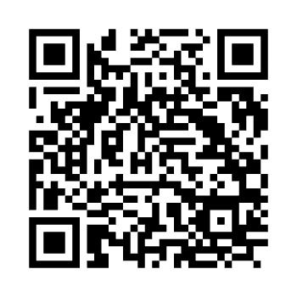


Slide 2
Free Methodist
A Shared Wesleyan Identity…

Slide 3

Timeline
1728
John Wesley ordained as an Anglican Priest in the Church of England.
1729
John Wesley started “Methodist” Holy Clubs at Oxford.
1735
John Wesley became a missionary to Georgia in New England.
1738
Aldergate Experience: John Wesley’s heart was “strangely warmed”, which brought him assurance of salvation and empowerment for ministry.
1739
The “Method” begins: Class Meetings, field preaching and lay preachers.
1784
The Methodist Episcopal Church is formed.

Slide 4
Timeline
1852
B.T. Roberts ordained as Elder in the Methodist Episcopal Church.
1853
Roberts attempted to reform the Methodist Episcopal Church.
1858
Roberts formally stripped of ordination credentials.
1860
Roberts meets with 15 preachers and 45 lay person in Pekin, NY.
1860
Roberts elected first Bishop of the Free Methodist Church.
1910
The Methodist Church restores Roberts’ credentials.

Slide 5
Early Free Methodism
Freedoms…
The Free Methodist Church was birthed in 1860 when Benjamin Titus Roberts, a pastor in the Methodist Episcopal Church, along with 15 preachers and 45 others. They could no longer serve in harmony with their practices.
They promoted freedom for all people from slavery, free seats in every house of worship, freedom for women to serve in all roles in the church, including pastoral ministry, and freedom for the Holy Spirit to move in public worship.
The Freedom of the laity to be given authority and decision-making positions within the church. The FMC ended the clergy leadership imbalance of the church and opened up a consistent partnership with clergy and laity working together. This elevated the laity to use their spiritual gifts alongside those given pastoral gifts.

Slide 6
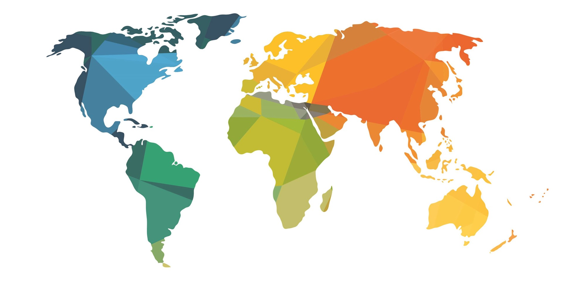

The Global Free Methodist Church
Birthed in1880

Slide 7
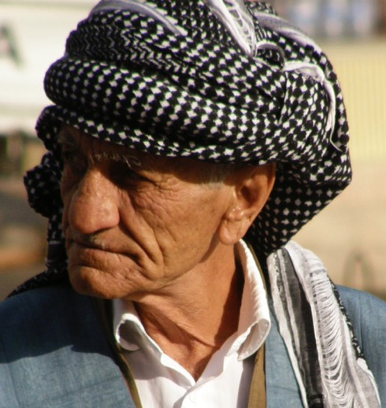
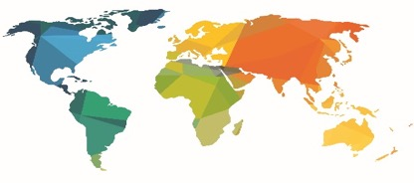
CONNECT WITH GOD’S
HEART FOR THE WORLD
The Free Methodist Church has ministry in over 100 countries
in six world areas:
Africa, Asia, Europe, Latin America,
Middle East and North America.

Slide 8
Worldwide Free Methodist
Church Membership

Slide 9
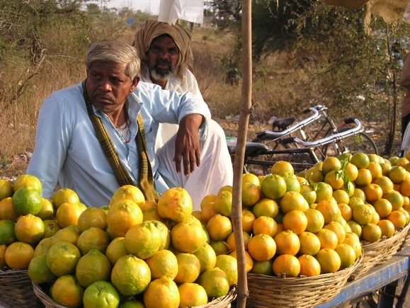
Total worldwide
Free Methodist membership
is over 1.7 million. (2025)

Slide 10

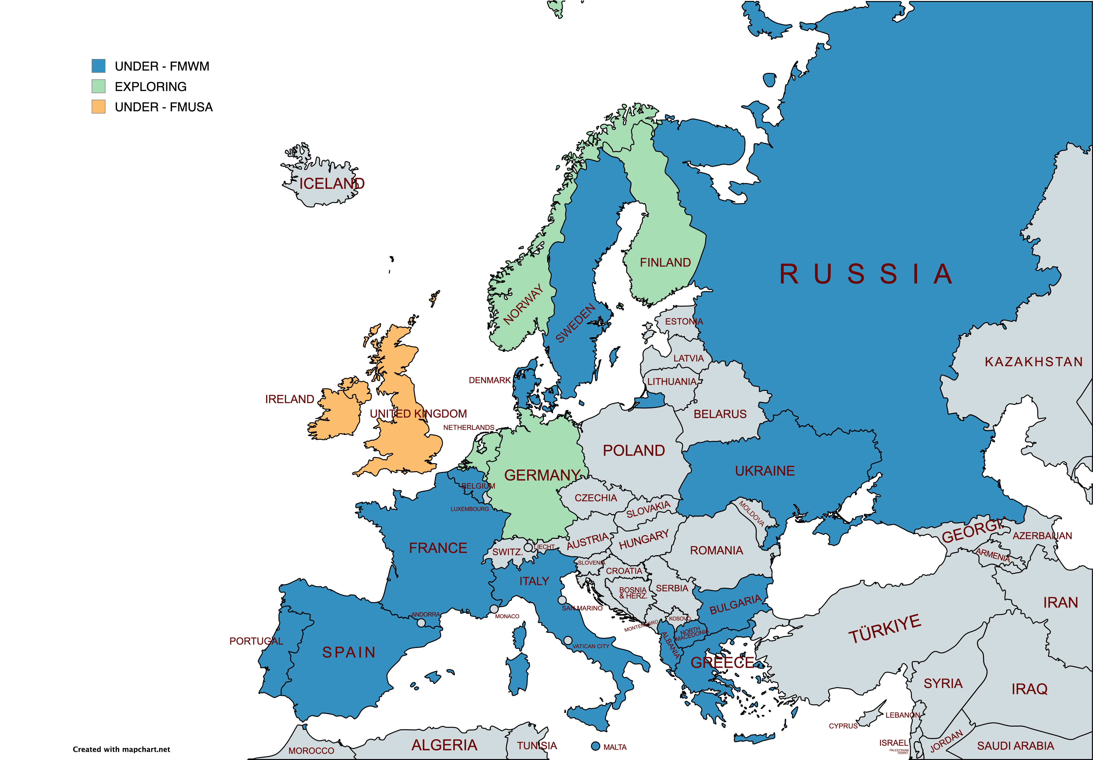
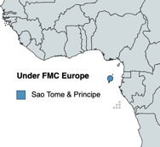
Europe Area
Annual Conference (USA)
U.K. & Ireland
FMWM EUROPE - 16
Albania
Bulgaria
Belgium
Denmark
France
Greece
Hungary
Italy
Malta
N. Macedonia
Portugal
Serbia
Spain
Sweden
Russia
Ukraine
*São Tomé & Principe
(under Portugal)

Slide 11
Our Values and Culture
We have asked God to give us a clear sense of who He is calling us to be as Free Methodists for such a time as this. With all God’s people, we first understand we are meant to be like a “city set on a hill” (Matthew 5:14–16 ),” living as “foreigners and exiles” (1 Peter 2:11) who refuse to be “conformed to this world,” but are continually being transformed by the renewing of our minds (Romans 12:2).

Slide 12


The Free Methodist Way
We have asked God to give us a renewed sense of our identity as Free Methodists that is both historical and aspirational. The result we are calling The Free Methodist Way.
It is not a vision or mission statement. It is not a strategic plan. It is a statement of core values that are meant to define who we are as a distinct movement within the kingdom of God today.

Slide 13
The Free Methodist Way
In a time of rising polarization in our world, we resist the pull toward both fundamentalism and theological liberalism — not out of a spirit of compromise, but from a radical commitment to what Wesley called “the middle way.”
Five Values: Life-Giving Holiness, Love-Driven Justice, Christ-Compelled Multiplication, Cross-Cultural Collaboration, and God-Given Revelation.

Slide 14
Christ-Compelled Multiplication
Jesus’ approach to discipleship was primarily a relational one in which He poured His life into a few with the full expectation that they would follow His example.
We want to see God’s kingdom expand exponentially as ordinary people are equipped by God’s power to do extraordinary things.
If we are to reach the people of Europe, it will be through the mobilization of the laity!

Slide 15
There are two BIG CHALLENGES facing church planting today in Europe
#1 challenge….
The Seed Within the Harvest
Every harvest contains within it the potential for more growth.
For God is the one who provides seed for the farmer and then bread to eat. In the same way, he will provide and increase your resources and then produce a great harvest of generosity in you. 2 Cor. 9:10

Slide 16
There are two BIG CHALLENGES facing church planting today in Europe
#2 challenge….
Pray to the Lord of the Harvest
2 These were his instructions to them: “The harvest is great, but the workers are few. So pray to the Lord who is in charge of the harvest; ask him to send more workers into his fields. Luke 10:2

Slide 17
Kingdom Multiplication
Kingdom multiplication: It requires a daring new attitude and a new way of thinking.
For leaders to create a culture of multiplication, it will mean dramatic shifts in their church paradigm from being the leader to developing leaders.

Slide 18
Kingdom Multiplication
Multiplication Mindset: A shift from thinking about growing others to multiplying leaders.
Becoming a Kingdom leader starts with a multiplication mindset.
This means taking the spotlight off themselves and shining the spotlight on Christ’s followers and emerging leaders. Giving them the spotlight!

Slide 19
Kingdom Multiplication
Permission Givers:
A shift from controlling the people God has placed in your leadership to leading with a ‘yes’, giving them permission to advance the mission.
Leaders of multiplying churches lead with a ‘yes’ and create a permission-giving culture where leaders feel free to innovate.
In this kind of permission-giving environment, leadership is demonstrated through encouragement and the freedom to succeed or fail, while also being encouraged continue.

Slide 20
Kingdom Multiplication
Kingdom Builders:
The leadership focus is not on counting what is happening inside the church walls but rather on their impact outside the church.
This new way of keeping score will encourage leaders to partner with other churches and networks for an even greater Kingdom ‘wins’.

Slide 21
Free Methodist
Historical Heritage and Perspective

Slide 22
Historical Heritage and Perspective
The Methodist heritage is shown in theological, ecclesiastical, and social concerns articulated by the Reverend John Wesley and his associates in the eighteenth century and reaffirmed through the holiness movement of the nineteenth.
Ecclesiastically, the Methodist heritage is continued in Free Methodist organization. At its most basic level, Free Methodists organize as local churches and have named them “societies.” In so doing, they
follow early Methodist practice and designate the local church as a transformed and transforming Society.

Slide 23
Historical Heritage and Perspective
There are lines of responsibility connecting local, district, conference, and denominational ministries. Small groups of believers are accountable to one another for growth in Christian life and service. Free Methodists are concerned for the whole church, not just the local congregation. They value the leadership of bishops, superintendents, pastors, and lay leaders who provide counsel and direction to the church.
Born at a time when representative government was being developed by free societies, the Free Methodist founders reaffirmed the biblical principle of lay ministry. Free Methodists recognize and license unordained persons for particular ministries. They mandate lay representation in numbers equal to clergy in the councils of the church.

Slide 24

ORGANIZATION CHART
WORLD CONFERENCE
General Conferences (19)
DR CONGO
RUWANDA
FMC USA
CANADA
INDIA
more…
Annual Conferences
World Missions
FMWM
Southeast Region
Ohio
UK and Ireland
more…
Mission Areas
Africa
29 countries
Asia
24 countries
Europe
17 countries
Latin America
24 countries
Middle East
5 countries
Mission Districts
Churches in Formation
Balkans
Portugal
Scandinavia
Spain
Albania
Hungary
Belgium & France
Scandinavia
Greece
more…

Slide 25
General Organization
¶200
A. Annual Conferences
Annual conferences are the normative Free Methodist organization at the regional level that provides for reasonable spans of care for ministers and congregations as well as the structure for effective kingdom expansion. Each annual conference in the Free Methodist Church shall be a member of a general conference.
B. General Conferences
The general conferences are the governing bodies of the Free Methodist Church. Each general conference shall consist of at least one annual conference or may, when necessary, make alternative provision for caring for annual conference functions as provided for in ¶220.B. (See details in ¶220-222).
C. World Conference
The Free Methodist World Conference exists to coordinate the visions of the general conferences by facilitating communication and harmonious relationships among the leaders of the general conferences. It also facilitates the resolution of constitutional issues. (See details in ¶230.) Additionally, the World Conference encourages its member general conferences to work together with neighboring annual and/or general conferences to partner
in ways that fulfil the Great Commission to make disciples of all nations.

Slide 26
Organization
Ministerial and Lay Delegates
¶5010
  A. The General Conference shall organize the work at large into annual conferences. Each annual conference shall be composed of all ministers in full membership and lay delegates elected by the several societies.
  B. One lay delegate shall be admitted from each Society. If there is more than one pastor in full membership appointed to a Society, the Society shall be entitled to one additional lay delegate for each additional pastor. A Society that has more than 100 adult members may elect an additional lay delegate; and for each additional 200 adult members, an additional lay delegate may be elected. The election of a delegate and any reserve delegate shall be by separate ballot and each shall require a majority vote of those present and voting.

Slide 27
Organization
Ministerial and Lay Delegates
¶5010
  C. Delegates are not members of the annual conference until they are present with their credentials and have been seated. Conference Ministerial Candidates are without vote except for those who are appointed as pastors in charge of a Society (See 5340.G).
  D. In consultation with the bishop of record, each annual conference shall provide for substantially equal ministerial and lay representation in its annual sessions.

Slide 28
Organization
Responsibilities of Delegates
¶5020
  In the Free Methodist connectional system, annual conference delegates have a twofold responsibility: to represent their societies and to act for the good of the conference. Delegates shall be considered as liaison between the Society and the conference during the interim between conference sessions. They are expected to report significant actions of the conference to the Society which elected them (see ¶6250.E.2).

Slide 29
Free Methodist
Organizational Structures

Slide 30
Provisional Annual Conferences of Mission Origin
¶4560+
  A. The normal minimum for the organization of a provisional annual conference is five ministers in full membership and 300 lay members within its bounds.
  B. All provisional annual conferences of mission origin shall be under the jurisdiction of the Board of Bishops and the overseeing Area Director except where provisional annual conferences have been organized from an existing annual conference, in which case they shall be administered by the bishop of the originating annual conference.
  C. The Board of Bishops, upon the recommendation of the Area Director, approves the formation of a provisional annual conference from a Mission District, it having adopted in principle the Book of Discipline of the Free Methodist Church USA and having filed the appropriate governmental registration documents (Constitution), adapted to local culture and circumstances.
  .

Slide 31
Organizational Structure
Nominating Committee
¶5080
  A. Each annual conference will have a standing Nominating Committee approved by the annual conference of not less than six members, giving consideration to equal representation of ministerial and lay members. General considerations in the selection of the Society Nominating Committee shall also apply to the annual conference (see ¶6310). Representation by districts/regions or other appropriate distinctions shall be determined in advance by the conference body.

Slide 32
Organizational Structure
Administrative Committee (BOA)
¶5200
Superintendent’s Cabinet(Not required, but recommended)
¶5210
Ministerial and Guidance and Appointments(MEGA) – (5 members)
¶5220
  Composed of, at a minimum, the Administrative Director (AD) as president, a superintendent as vice-president, and a lay member.

Slide 33
Organizational Structure
Finance Board (5 members)
¶5240
  The conference superintendent and treasurer will be ex officio members.

Slide 34
Organizational Structure
Local Global Partnership Team
¶5260
  A. The annual conference shall create a Local Global Partnership team or Board to advocate for engagement in local and global mission. The annual conference shall designate a person to serve as a liaison to Free Methodist World Missions.

Slide 35
Free Methodist
Our Shared Future

Slide 36

Multiplication Mindset
Discover: “How do we discover people with potential and help them with their calling and gifts?”
Develop: “How could we better develop leaders?” What resources can we share?
Deploy: "How could we better release leaders in ministry and into their communities?

Slide 37
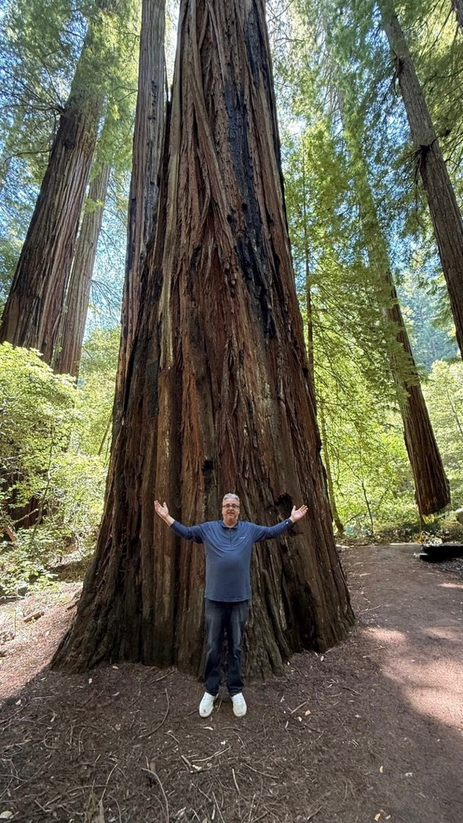

Slide 38
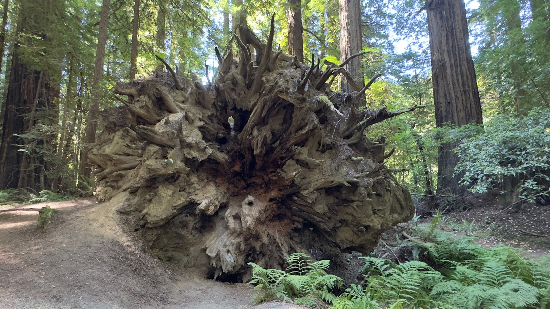

Slide 39
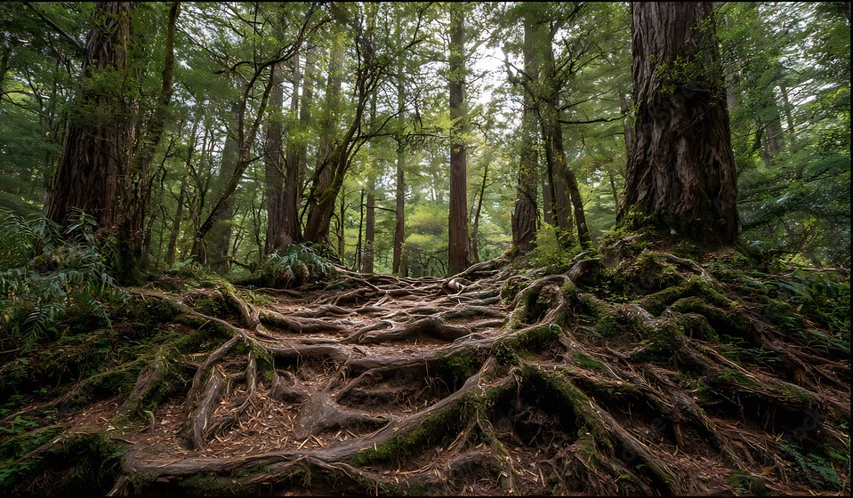

Slide 40
Free Methodist
A Shared Wesleyan Identity…

