Slide 1


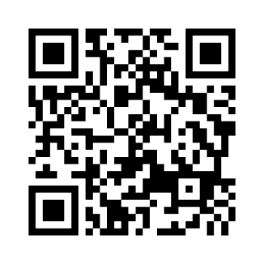

Europe Prayer Day
Day of Global Prayer for Europe
November 1, 2026
Subscribe your church and received material for the prayer day

