Slide 1
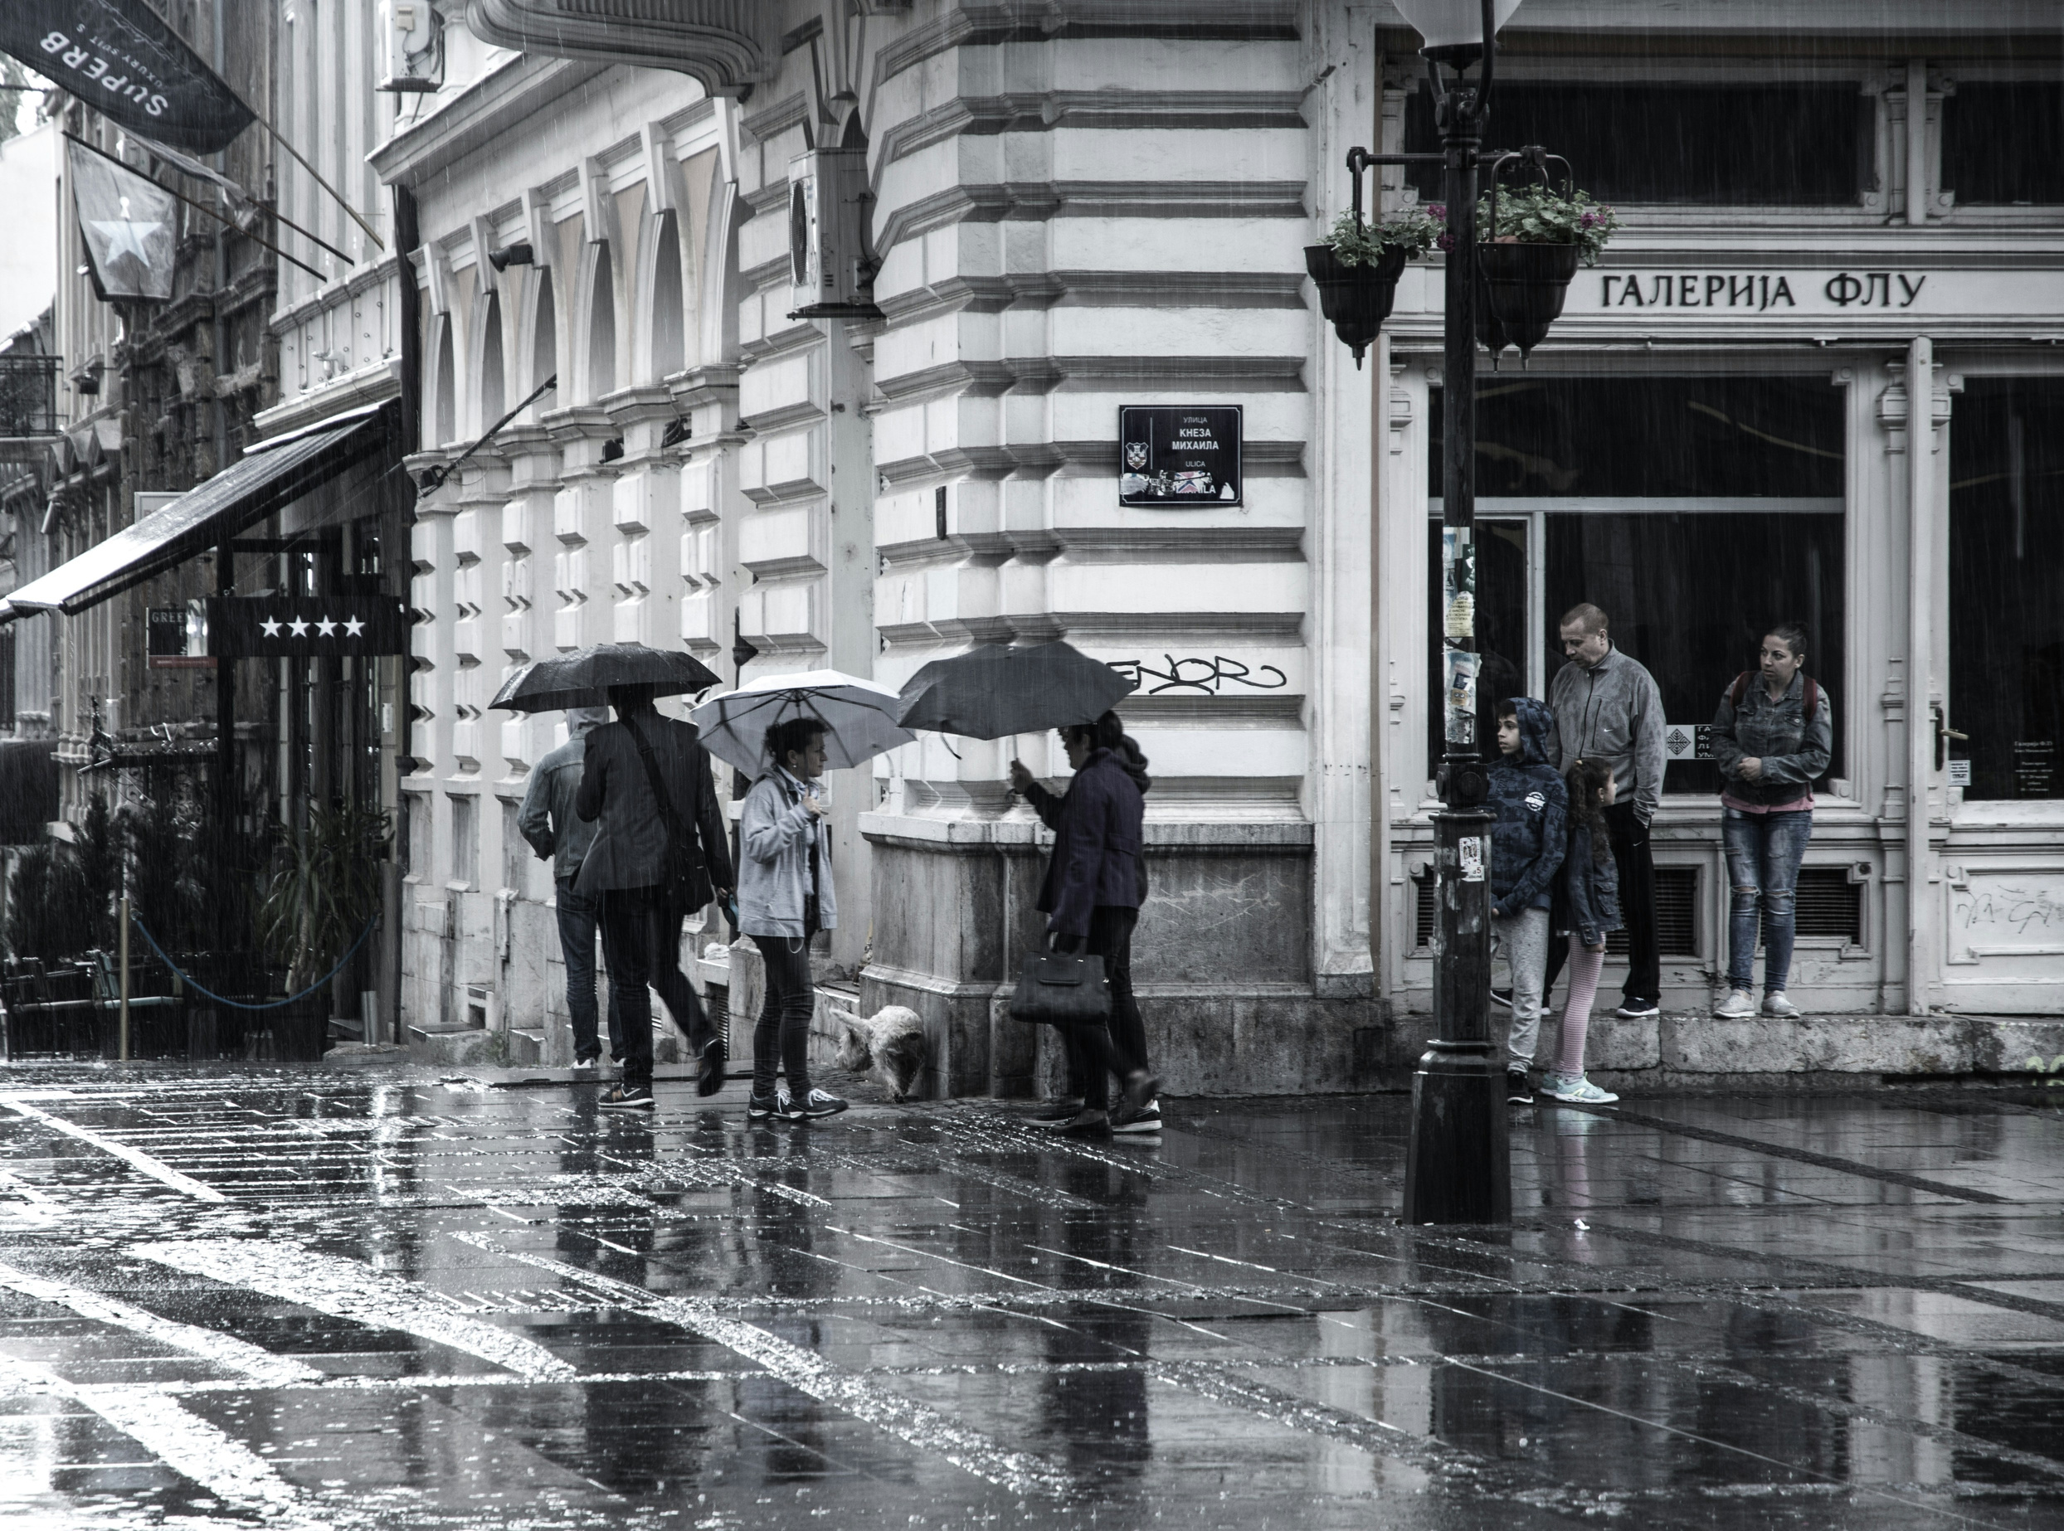

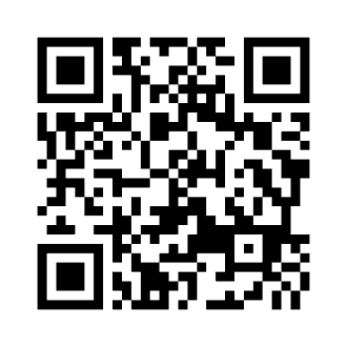

Vision and Prayer Tour
Reformation to Restoration
September 1 - 11, 2027
Germany • Netherlands • Belgium

