Slide 1

CARMEN CHRISTI & MARK 15 -16

Slide 2
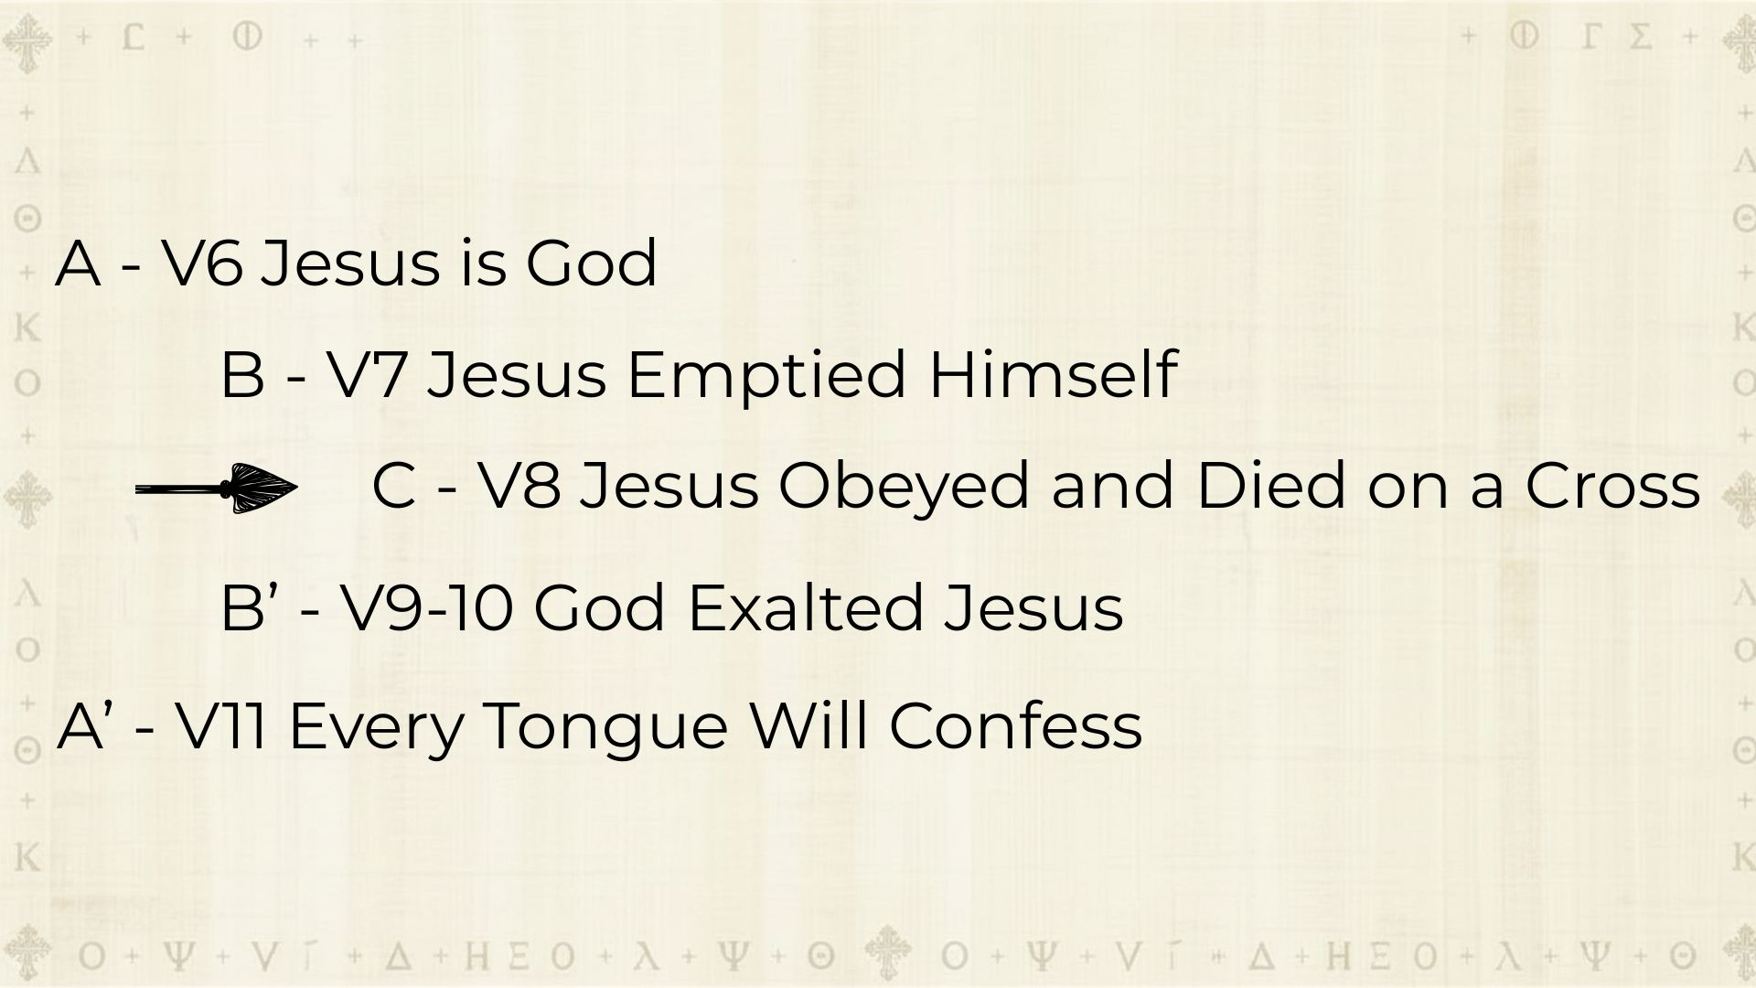

Slide 3
who, existing in the form of God, did not consider equality with God as something to be exploited.
Philippians 2:6–11
CSB

Slide 4
Instead he emptied himself by assuming the form of a servant, taking on the likeness of humanity. And when he had come as a man,
Philippians 2:6–11
CSB

Slide 5
he humbled himself by becoming obedient to the point of death— even to death on a cross.
Philippians 2:6–11
CSB

Slide 6
For this reason God highly exalted him and gave him the name that is above every name,
Philippians 2:6–11
CSB

Slide 7
so that at the name of Jesus every knee will bow— in heaven and on earth and under the earth—
Philippians 2:6–11
CSB

Slide 8
and every tongue will confess that Jesus Christ is Lord, to the glory of God the Father.
Philippians 2:6–11
CSB

Slide 9
EUTHEŌS

Slide 10
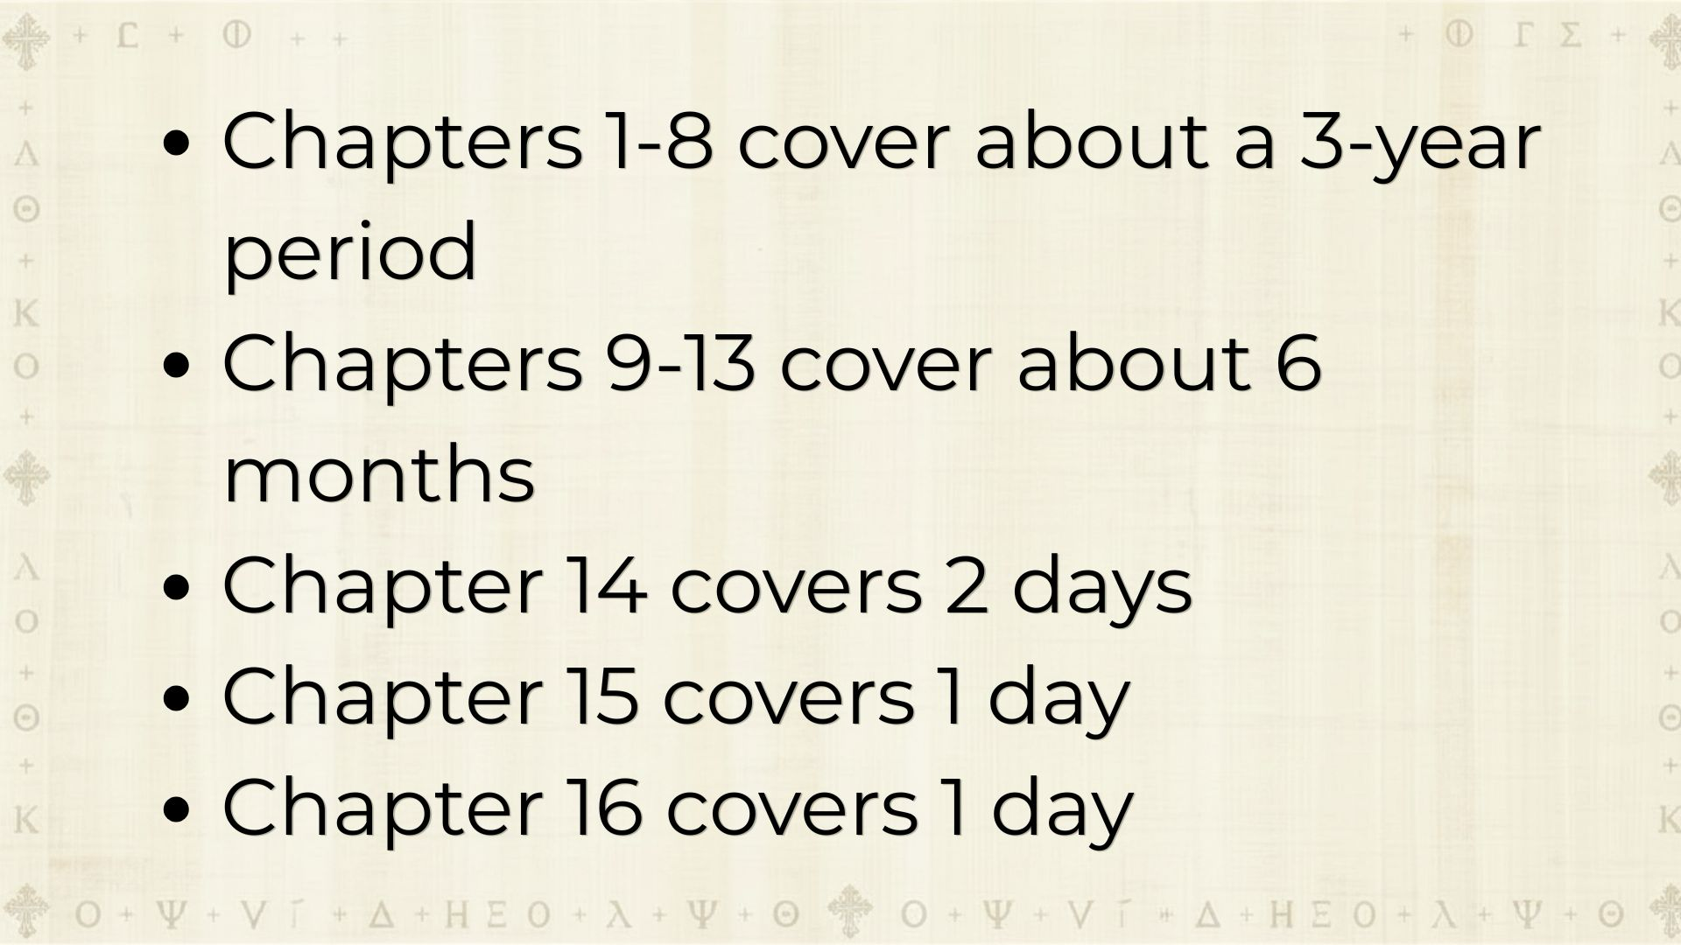

Slide 11
CARMEN CHRISTI IN MARK

Slide 12
JESUS - SELF EMPTYING AND HUMILITY

Slide 13
As soon as it was morning, having held a meeting with the elders, scribes, and the whole Sanhedrin, the chief priests tied Jesus up, led him away, and handed him over to Pilate.
Mark 15:1–5
CSB

Slide 14
So Pilate asked him, “Are you the king of the Jews?” He answered him, “You say so.”
Mark 15:1–5
CSB

Slide 15
And the chief priests accused him of many things.
Mark 15:1–5
CSB

Slide 16
Pilate questioned him again, “Aren’t you going to answer? Look how many things they are accusing you of!”
Mark 15:1–5
CSB

Slide 17
But Jesus still did not answer, and so Pilate was amazed.
Mark 15:1–5
CSB

Slide 18
JESUS - GOD ON THE CROSS

Slide 19
When it was noon, darkness came over the whole land until three in the afternoon.
Mark 15:33–37
CSB

Slide 20
And at three Jesus cried out with a loud voice, “Eloi, Eloi, lemá sabachtháni?” which is translated, “My God, my God, why have you abandoned me?”
Mark 15:33–37
CSB

Slide 21
When some of those standing there heard this, they said, “See, he’s calling for Elijah.”
Mark 15:33–37
CSB

Slide 22
Someone ran and filled a sponge with sour wine, fixed it on a stick, offered him a drink, and said, “Let’s see if Elijah comes to take him down.”
Mark 15:33–37
CSB

Slide 23
Jesus let out a loud cry and breathed his last.
Mark 15:33–37
CSB

Slide 24
he humbled himself by becoming obedient to the point of death— even to death on a cross.
Philippians 2:8
CSB

Slide 25
NAILS DID NOT KEEP CHRIST ON THE CROSS, LOVE DID.

Slide 26
He comforts us in all our troubles so that we can comfort others. When they are troubled, we will be able to give them the same comfort God has given us.
2 Corinthians 1:4
NLT

Slide 27
God Whispers To Us In Our Pleasures, Speaks In Our Conscience, But Shouts In Our Pains: It Is His Megaphone To Rouse A Deaf World.
- CS Lewis

Slide 28
JESUS - RAISED AND EXALTED

Slide 29
“Don’t be alarmed,” he told them. “You are looking for Jesus of Nazareth, who was crucified. He has risen! He is not here. See the place where they put him.
Mark 16:6
CSB

Slide 30
For this reason God highly exalted him and gave him the name that is above every name,
Philippians 2:9–10
CSB

Slide 31
so that at the name of Jesus every knee will bow— in heaven and on earth and under the earth—
Philippians 2:9–10
CSB

Slide 32
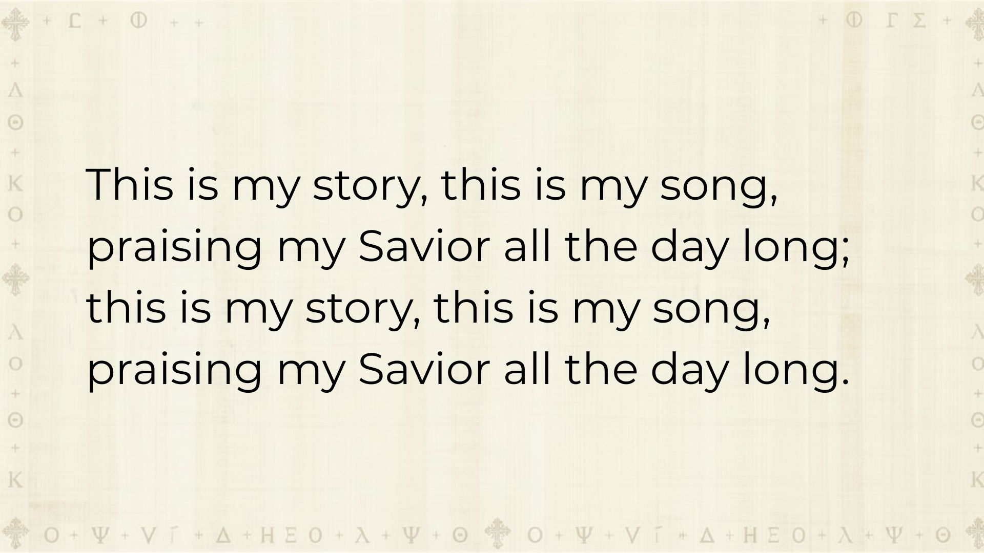

Slide 33
LOVE HELD JESUS ON THE CROSS AND LOVE RAISED HIM UP

Slide 34
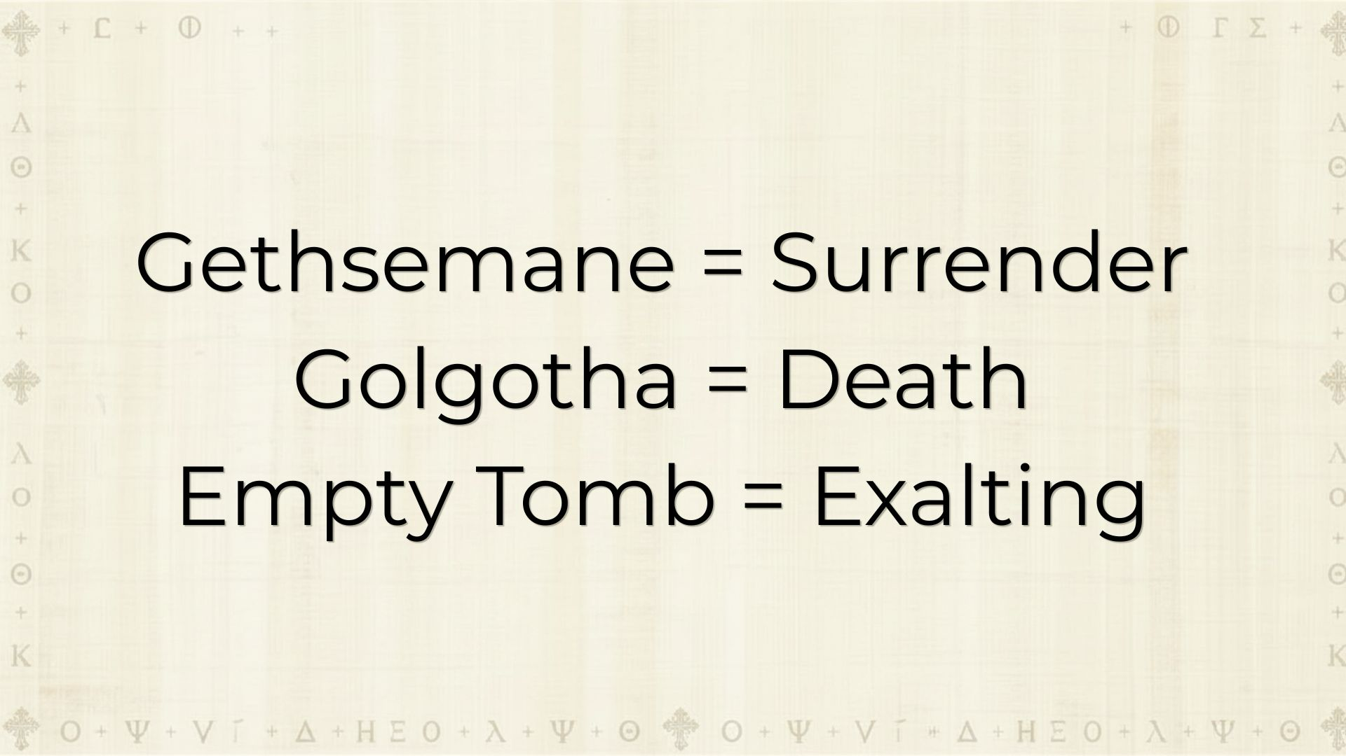

Slide 35
JESUS - THE NAME WORTH REPEATING

Slide 36
But go, tell his disciples and Peter, ‘He is going ahead of you to Galilee; you will see him there just as he told you.’ ”
Mark 16:7
CSB

Slide 37
and every tongue will confess that Jesus Christ is Lord, to the glory of God the Father.
Philippians 2:11
CSB

Slide 38
WE NOW GET TO GO TELL EVERYONE ABOUT THIS AMAZING NEWS.

Slide 39
JESUS - OUR NEW LIFE

Slide 40
EVERYTHING WE NEED IS BOUND UP IN THE RESURRECTED JESUS.

Slide 41
FAITH IN ACTION:
JESUS’ OBEDIENCE GIVES US LIFE

