Slide 1


Slide 2


Slide 3


Slide 4
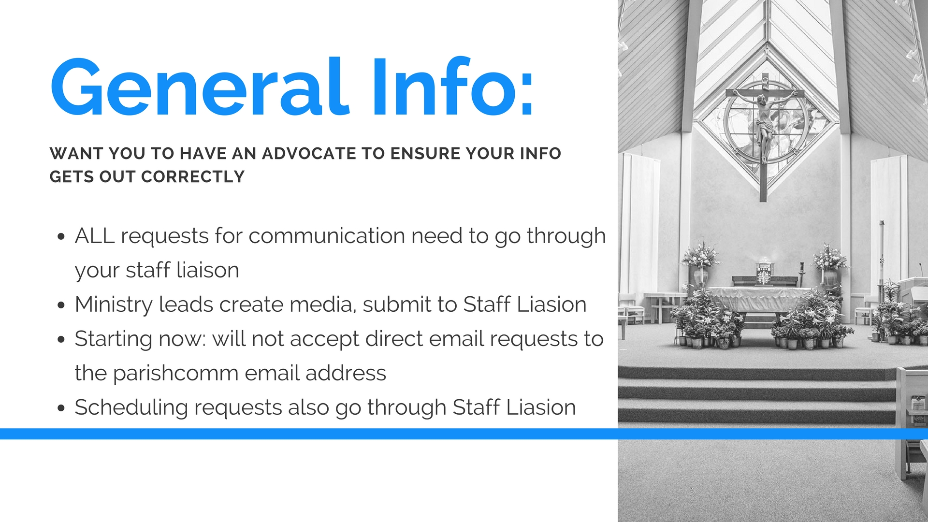

Slide 5


Slide 6


Slide 7


Slide 8


Slide 9


Slide 10
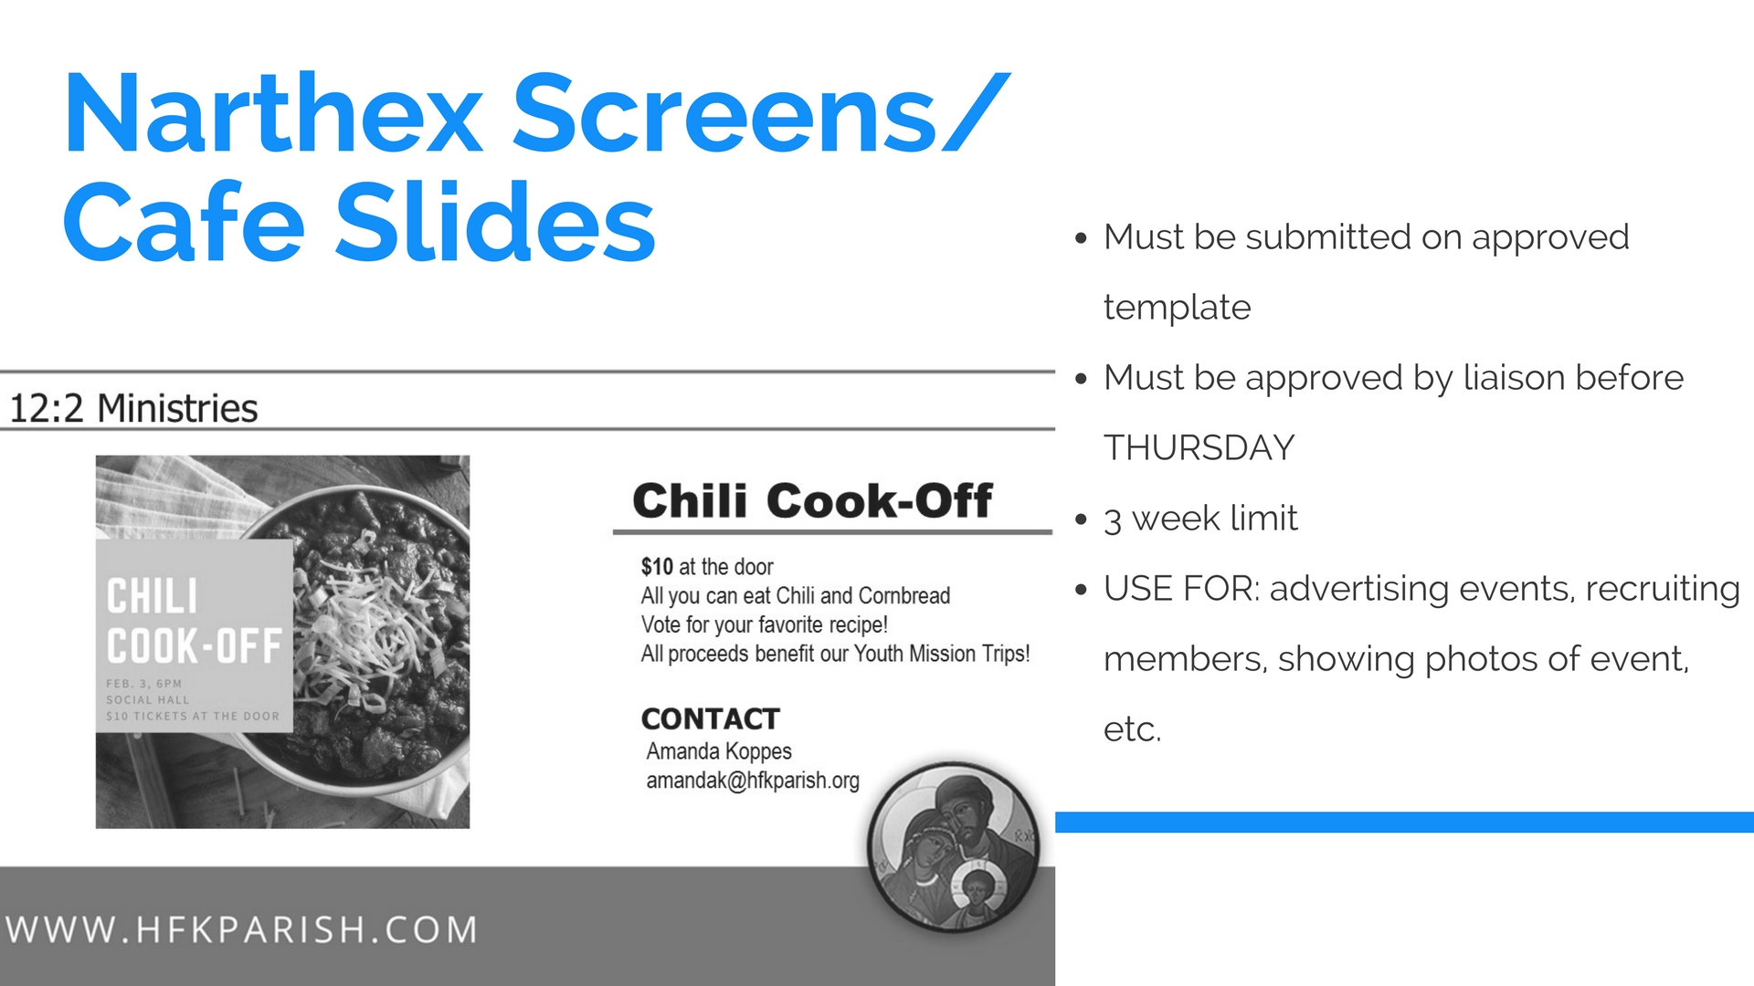

Slide 11


Slide 12
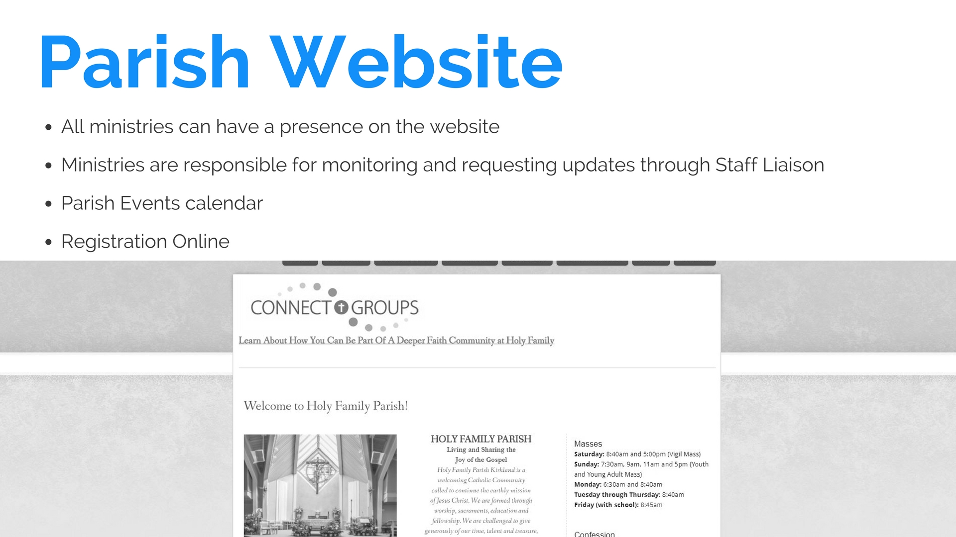

Slide 13


Slide 14


Slide 15
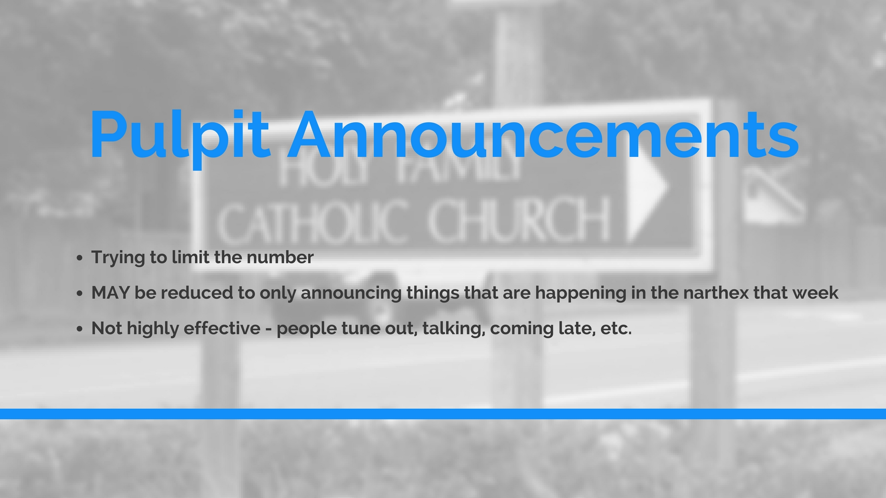

Slide 16


Slide 17
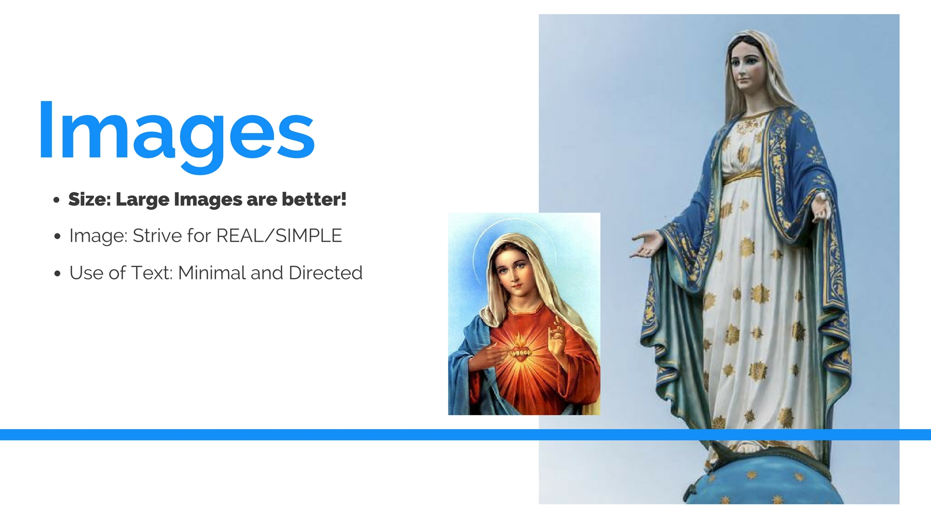

Slide 18


Slide 19


Slide 20


Slide 21


Slide 22


Slide 23


Slide 24

Organization Name Here
Event Name Here
Details here (target audience)
Use this space for the specifics: Date, time location, contact info, cost, etc.

Slide 25


Slide 26


MINISTRY OR EVENT NAME
EVENT NAME
Use this space for all of the details about your event. Date, time, cost, location, who is able to participate, etc.
Drop photo here
Dimensions (4x6)
CONTACT
Use this space for contact email and or phone

Slide 27

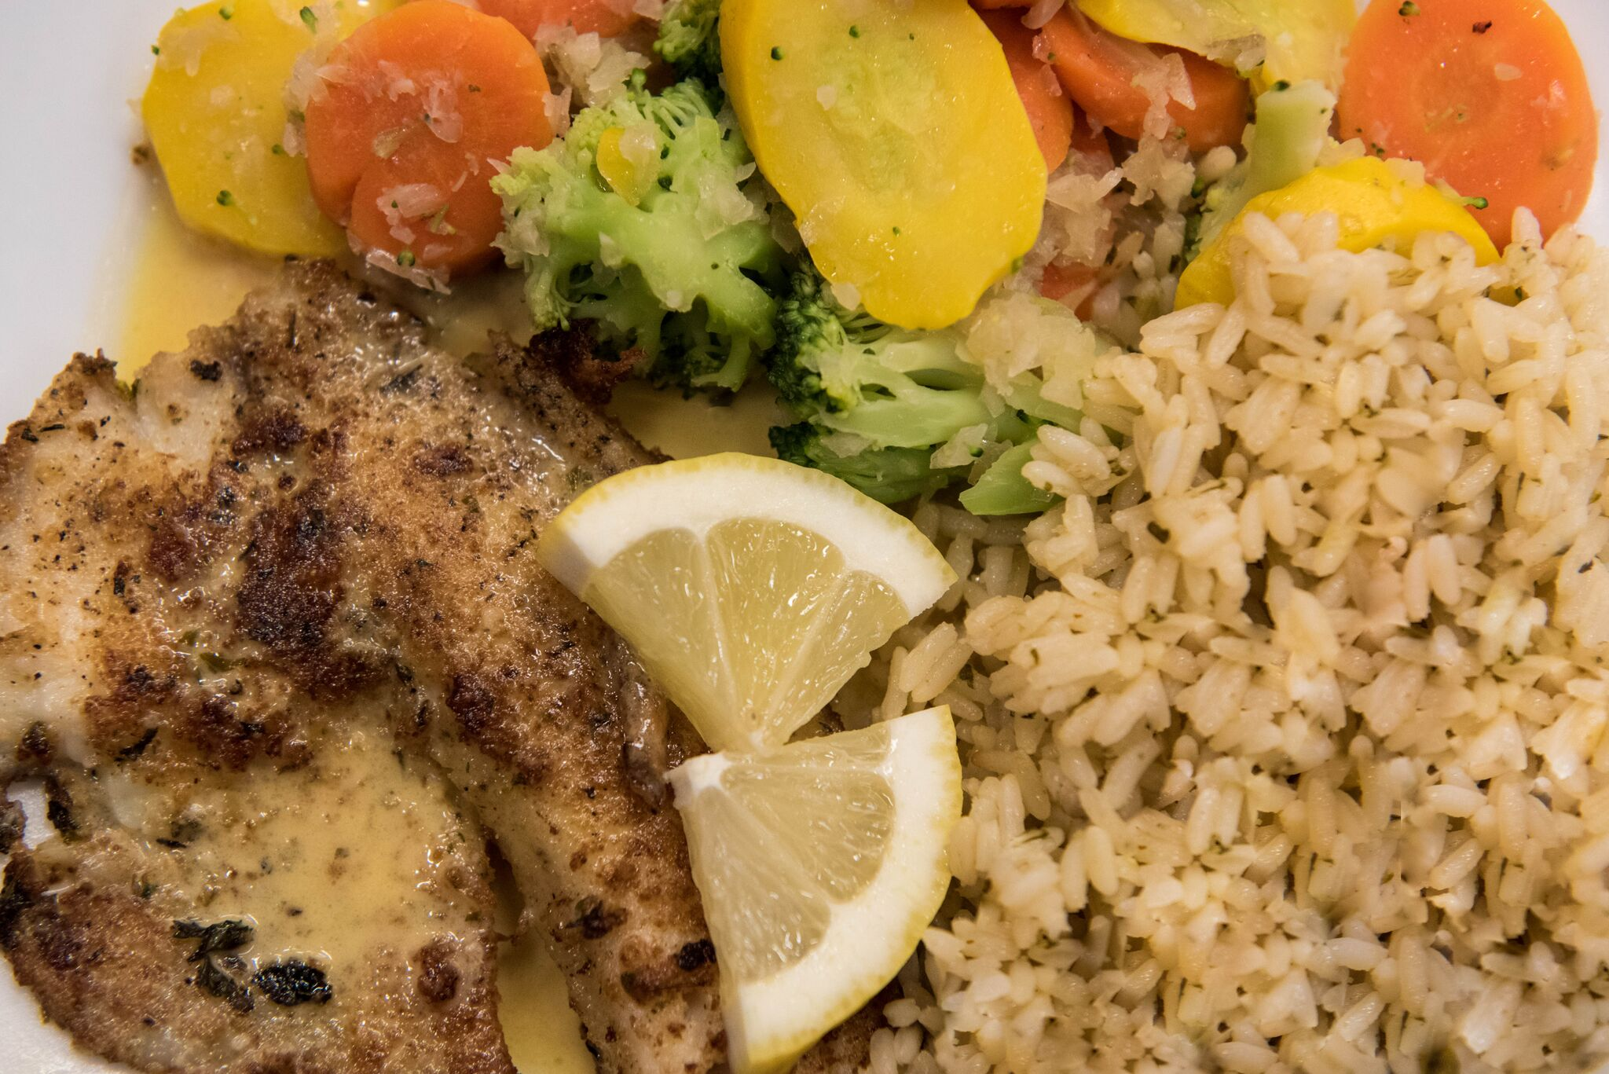
Knights of Columbus
Lenten Fish Dinner
Friday, February 16th
Drop photo here
Dimensions (4x6)
5:00pm-7:00pm in the Social Hall
Tickets Sold at the Door
$9 for Tilapia with Rice Pilaf and Vegetables
$4 for Macaroni and Cheese with Fries and Fruit

Slide 28

Title or Event
Drop photo Here:
Dimension: 8.5 x 11
Details, additional info, contact info, anything that might not be on the image, or that you want to highlight.
Contact info, or an invitation to a specific group

Slide 29
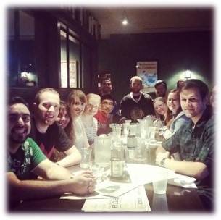
Young Adult Sunday Dinner
Sunday, September 24th
Meet in Church Narthex after 5:00 p.m. Mass
We’ll carpool to Milagro in Kirkland
Please see bulletin for contact information

Slide 30



Encounter Lent
Build a culture of encounter that saves lives through:
- Daily Prayer - Weekly Fasting - Almsgiving
Visit www.crsricebowl.org to see how
CRS Rice Bowl is changing lives.
Thank you for including Rice Bowl as a part of your families faith life!
Consider online giving through our parish website,
Or donate through the Archdiocese of Seattle website.

Slide 31


Slide 32

MINISTRY OR GROUP NAME
SPECIFIC GROUP NAME
MEMBER DRIVE
Drop photo here
Dimensions (4x4)
Use this space for details about your group
Meeting dates and time
Purpose of the group
Who can join
Contact information for ministry lead

Slide 33
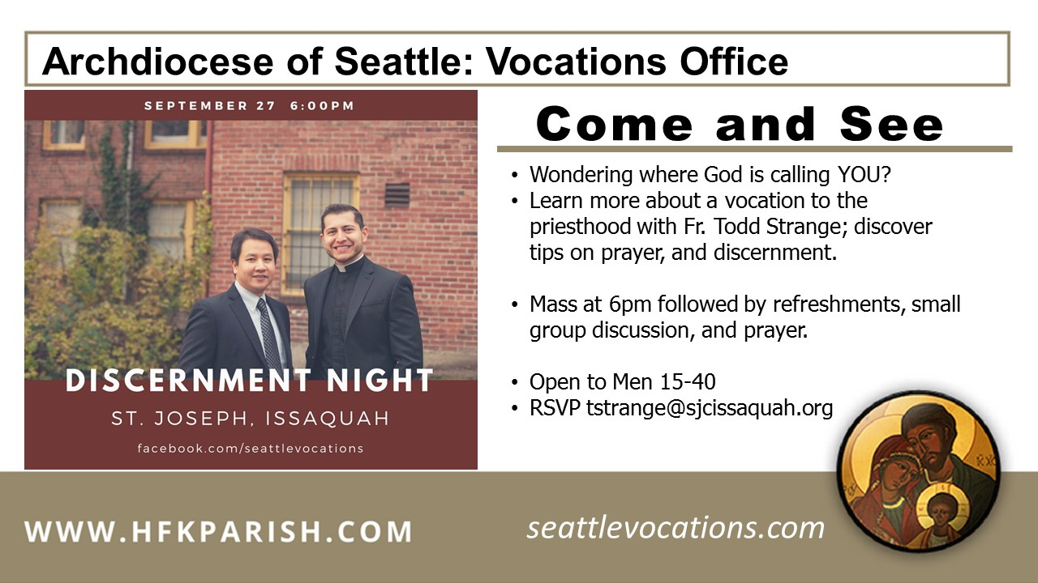
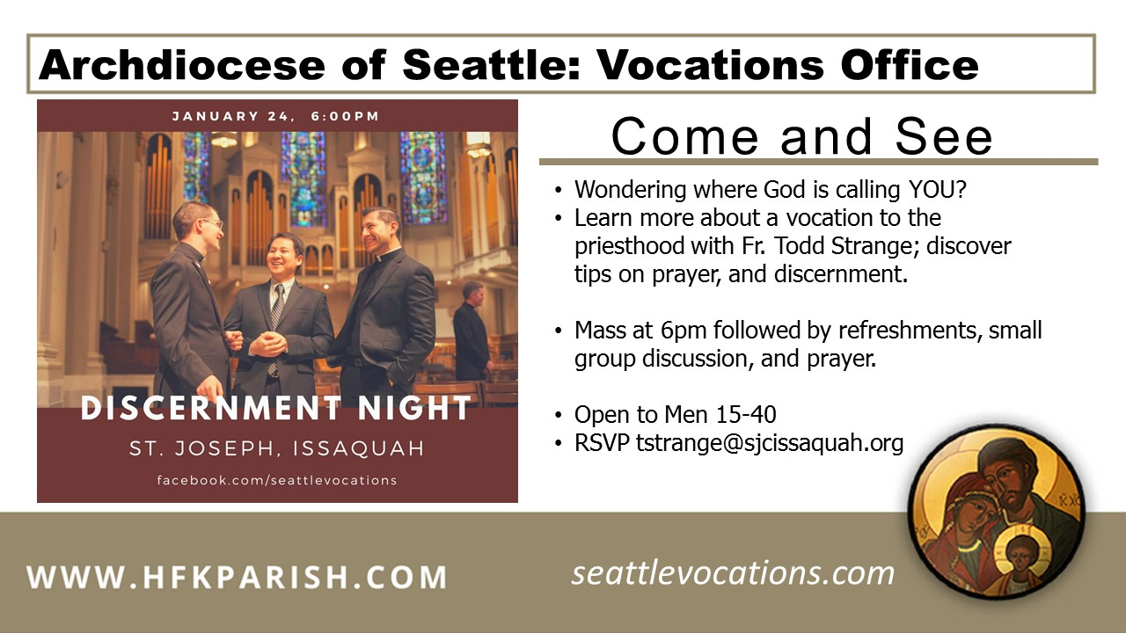

Slide 34

TITLE TEXT, NAME OF MINISTRY, OR EVENT
Name of Event
Details, Contact info, or something you want to HIGHLIGHT!
Details to explain event:
- Bullet points, a list, or a short sentance
MORE INFORMATION HERE
CONTACT
Name and email for the person in charge here

Slide 35


Slide 36

EVENT NAME
HERE
USE THIS SPACE TO PROVIDE A DESCRIPTION OF YOUR EVENT SUCH AS WHO IT IS FOR, WHAT WILL BE HAPPENING, ETC.
THIS SPACE IS FOR THE DETAILS OF THE EVENT – DATE, TIME, LOCATION, COST, REGISTRATION DETAILS, CONTACT INFORMATION, DEADLINES, ETC.

Slide 37
HOLY WEEK 2018
HOLY THURSDAY 3/29: 7pm mass
GOOD FRIDAY 3/30:
  9am: Stations of the Cross (lead by the Parish School)
  12 noon: Ecumenical stations (meet at St. John Episcopal)
  3pm: Stations of the Cross (Spanish)
  7pm: The Lord’s Passion, Service
HOLY SATURDAY 3/31:
  8pm: Easter Vigil Mass – Church
EASTER SUNDAY 4/1:
  Masses: 7am, 9am, 11am (No 5pm YYA mass)

