Slide 1
Education
101
What is Special Needs?
A look into their world
How can we as a church help?

Slide 2
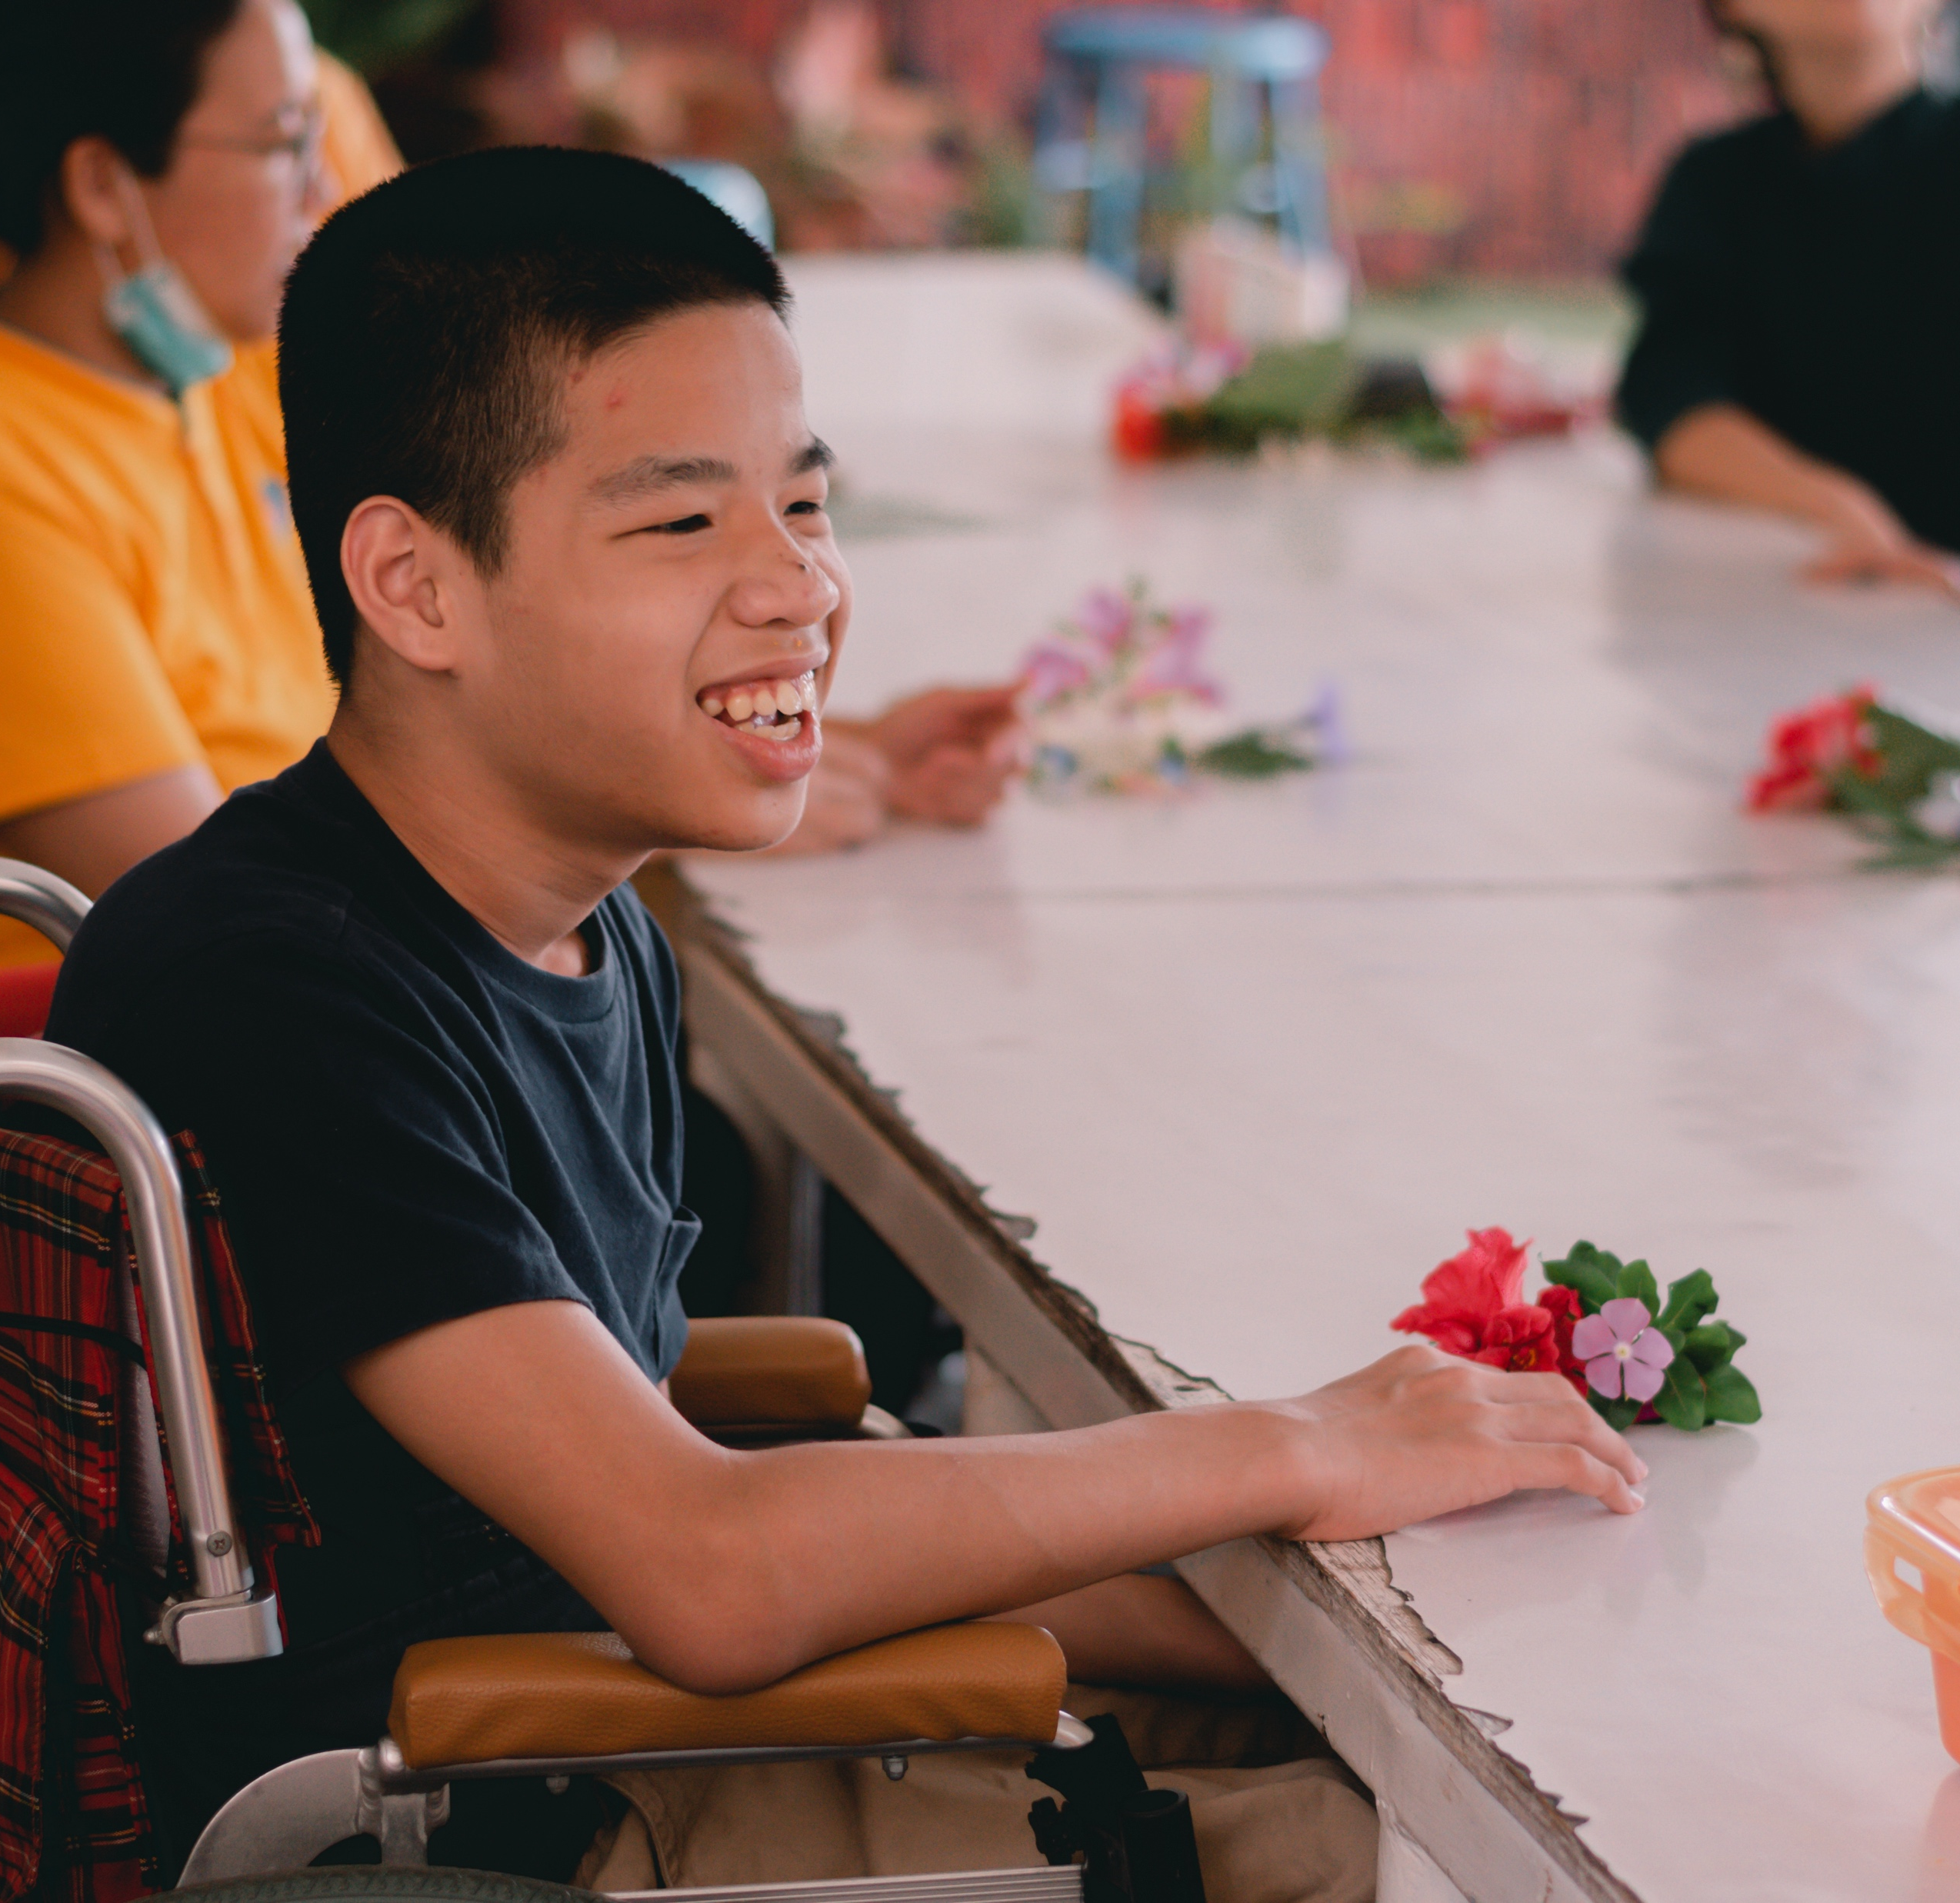

What is
Special Needs?

Slide 3
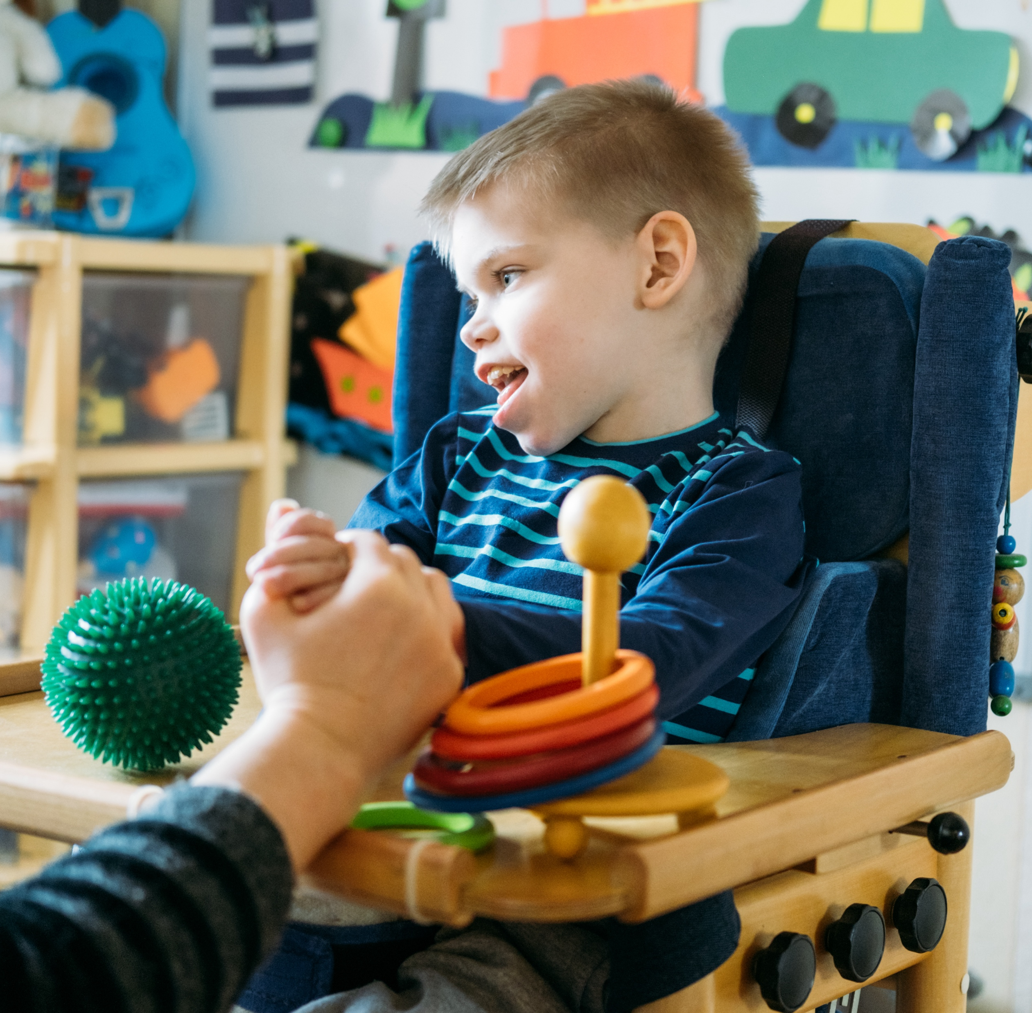
Definition of Special Needs
Special Needs, any of various difficulties (such as a physical, emotional, behavioral, or learning disability or impairment) that causes an individual to require additional or specialized services or accommodations.
Merriam-Webster

Slide 4

We are all unique.

Slide 5
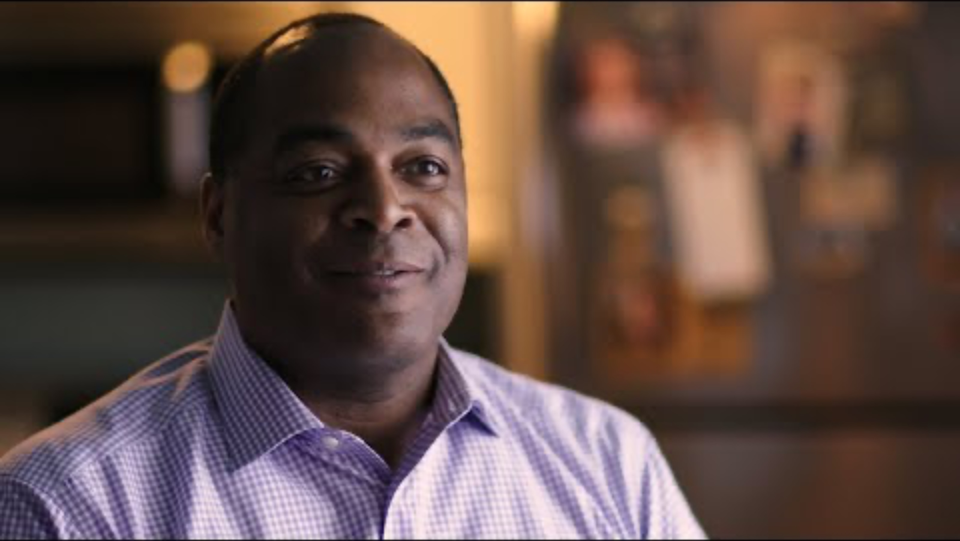
Life Changing Events
(That may cause someone to have a special need)
Heart attacks, accidents, surgeries
Nervous breakdown
Developing Alzheimers

Slide 6
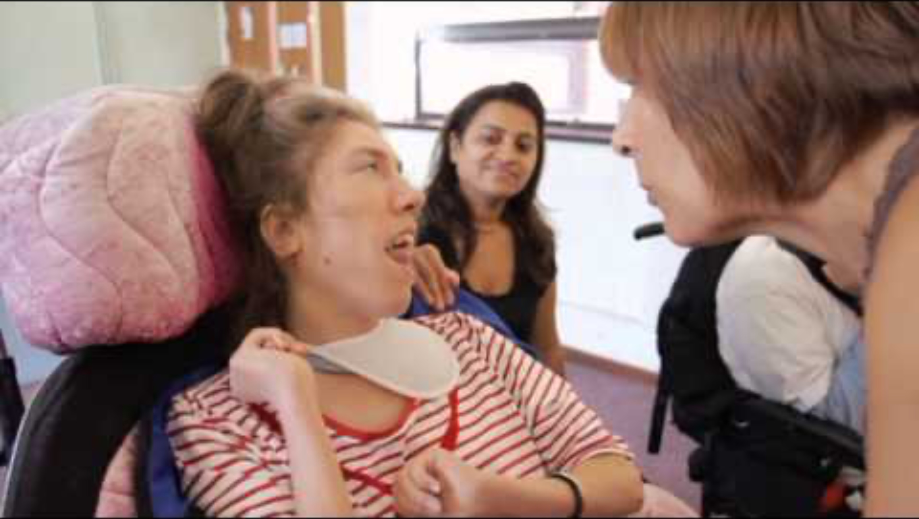
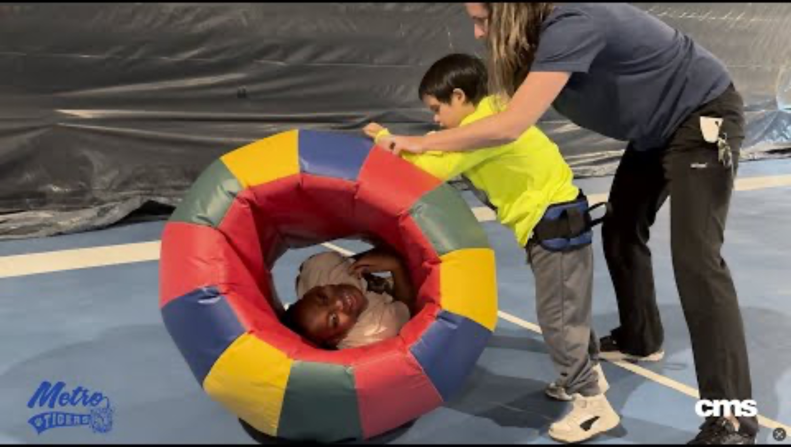
Meeting the needs of children with severe disabilities

Slide 7


A look into
their world

Slide 8


Job Opportunities

Slide 9

People say the most unusual things

Slide 10
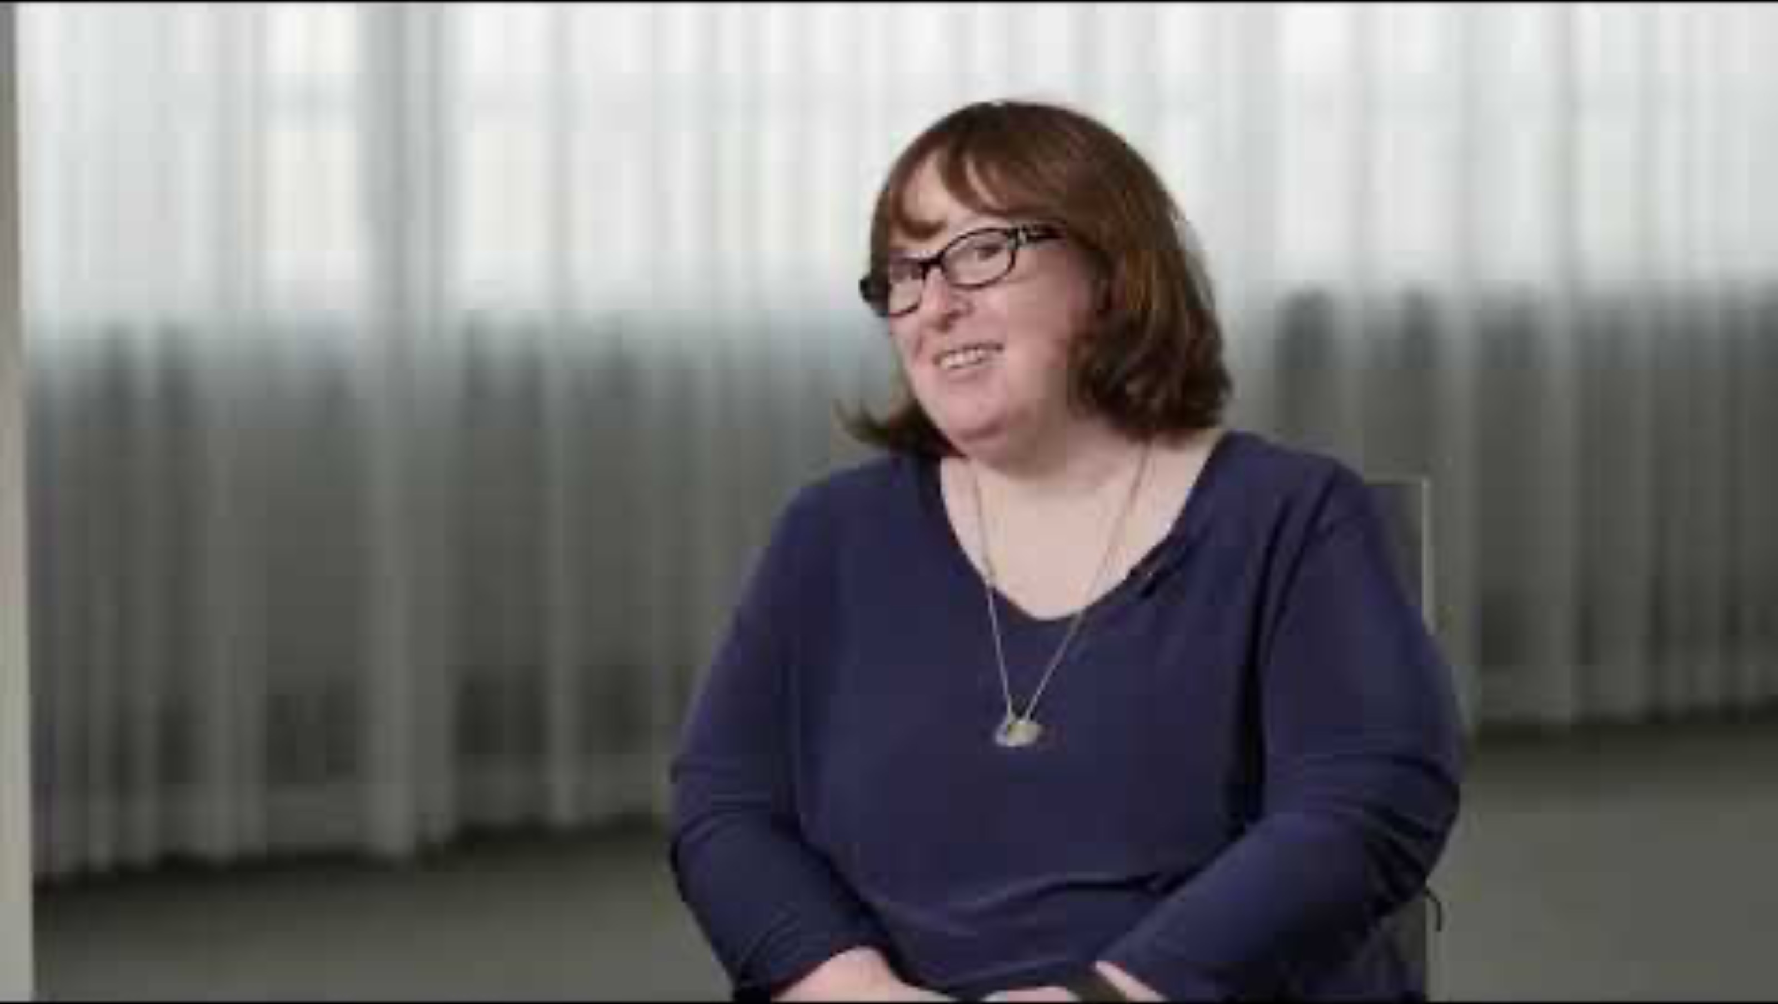
Building bridges

Slide 11
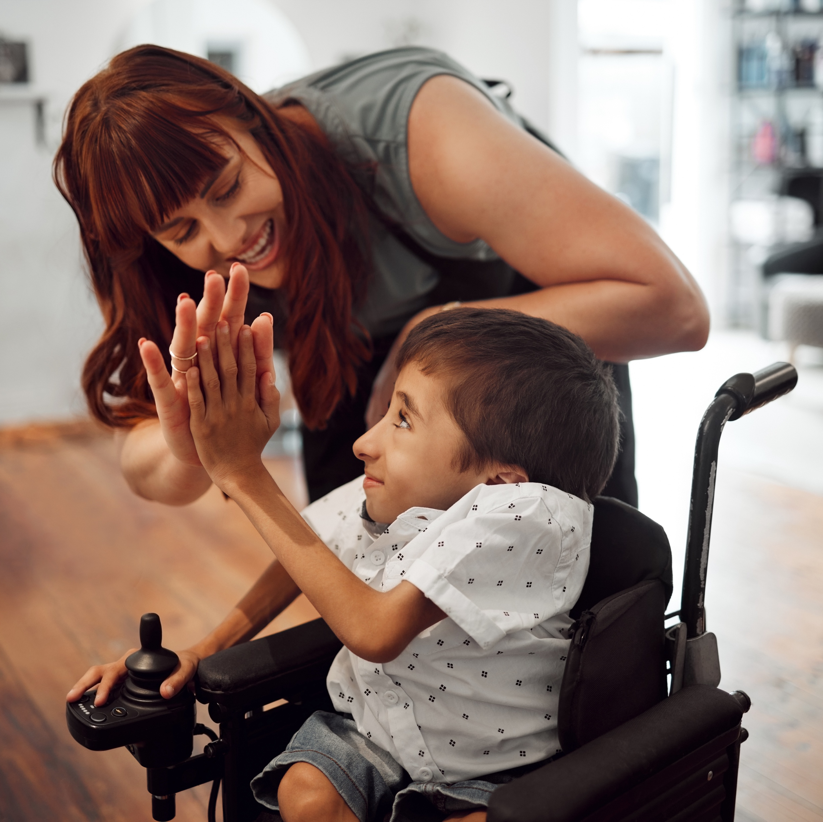
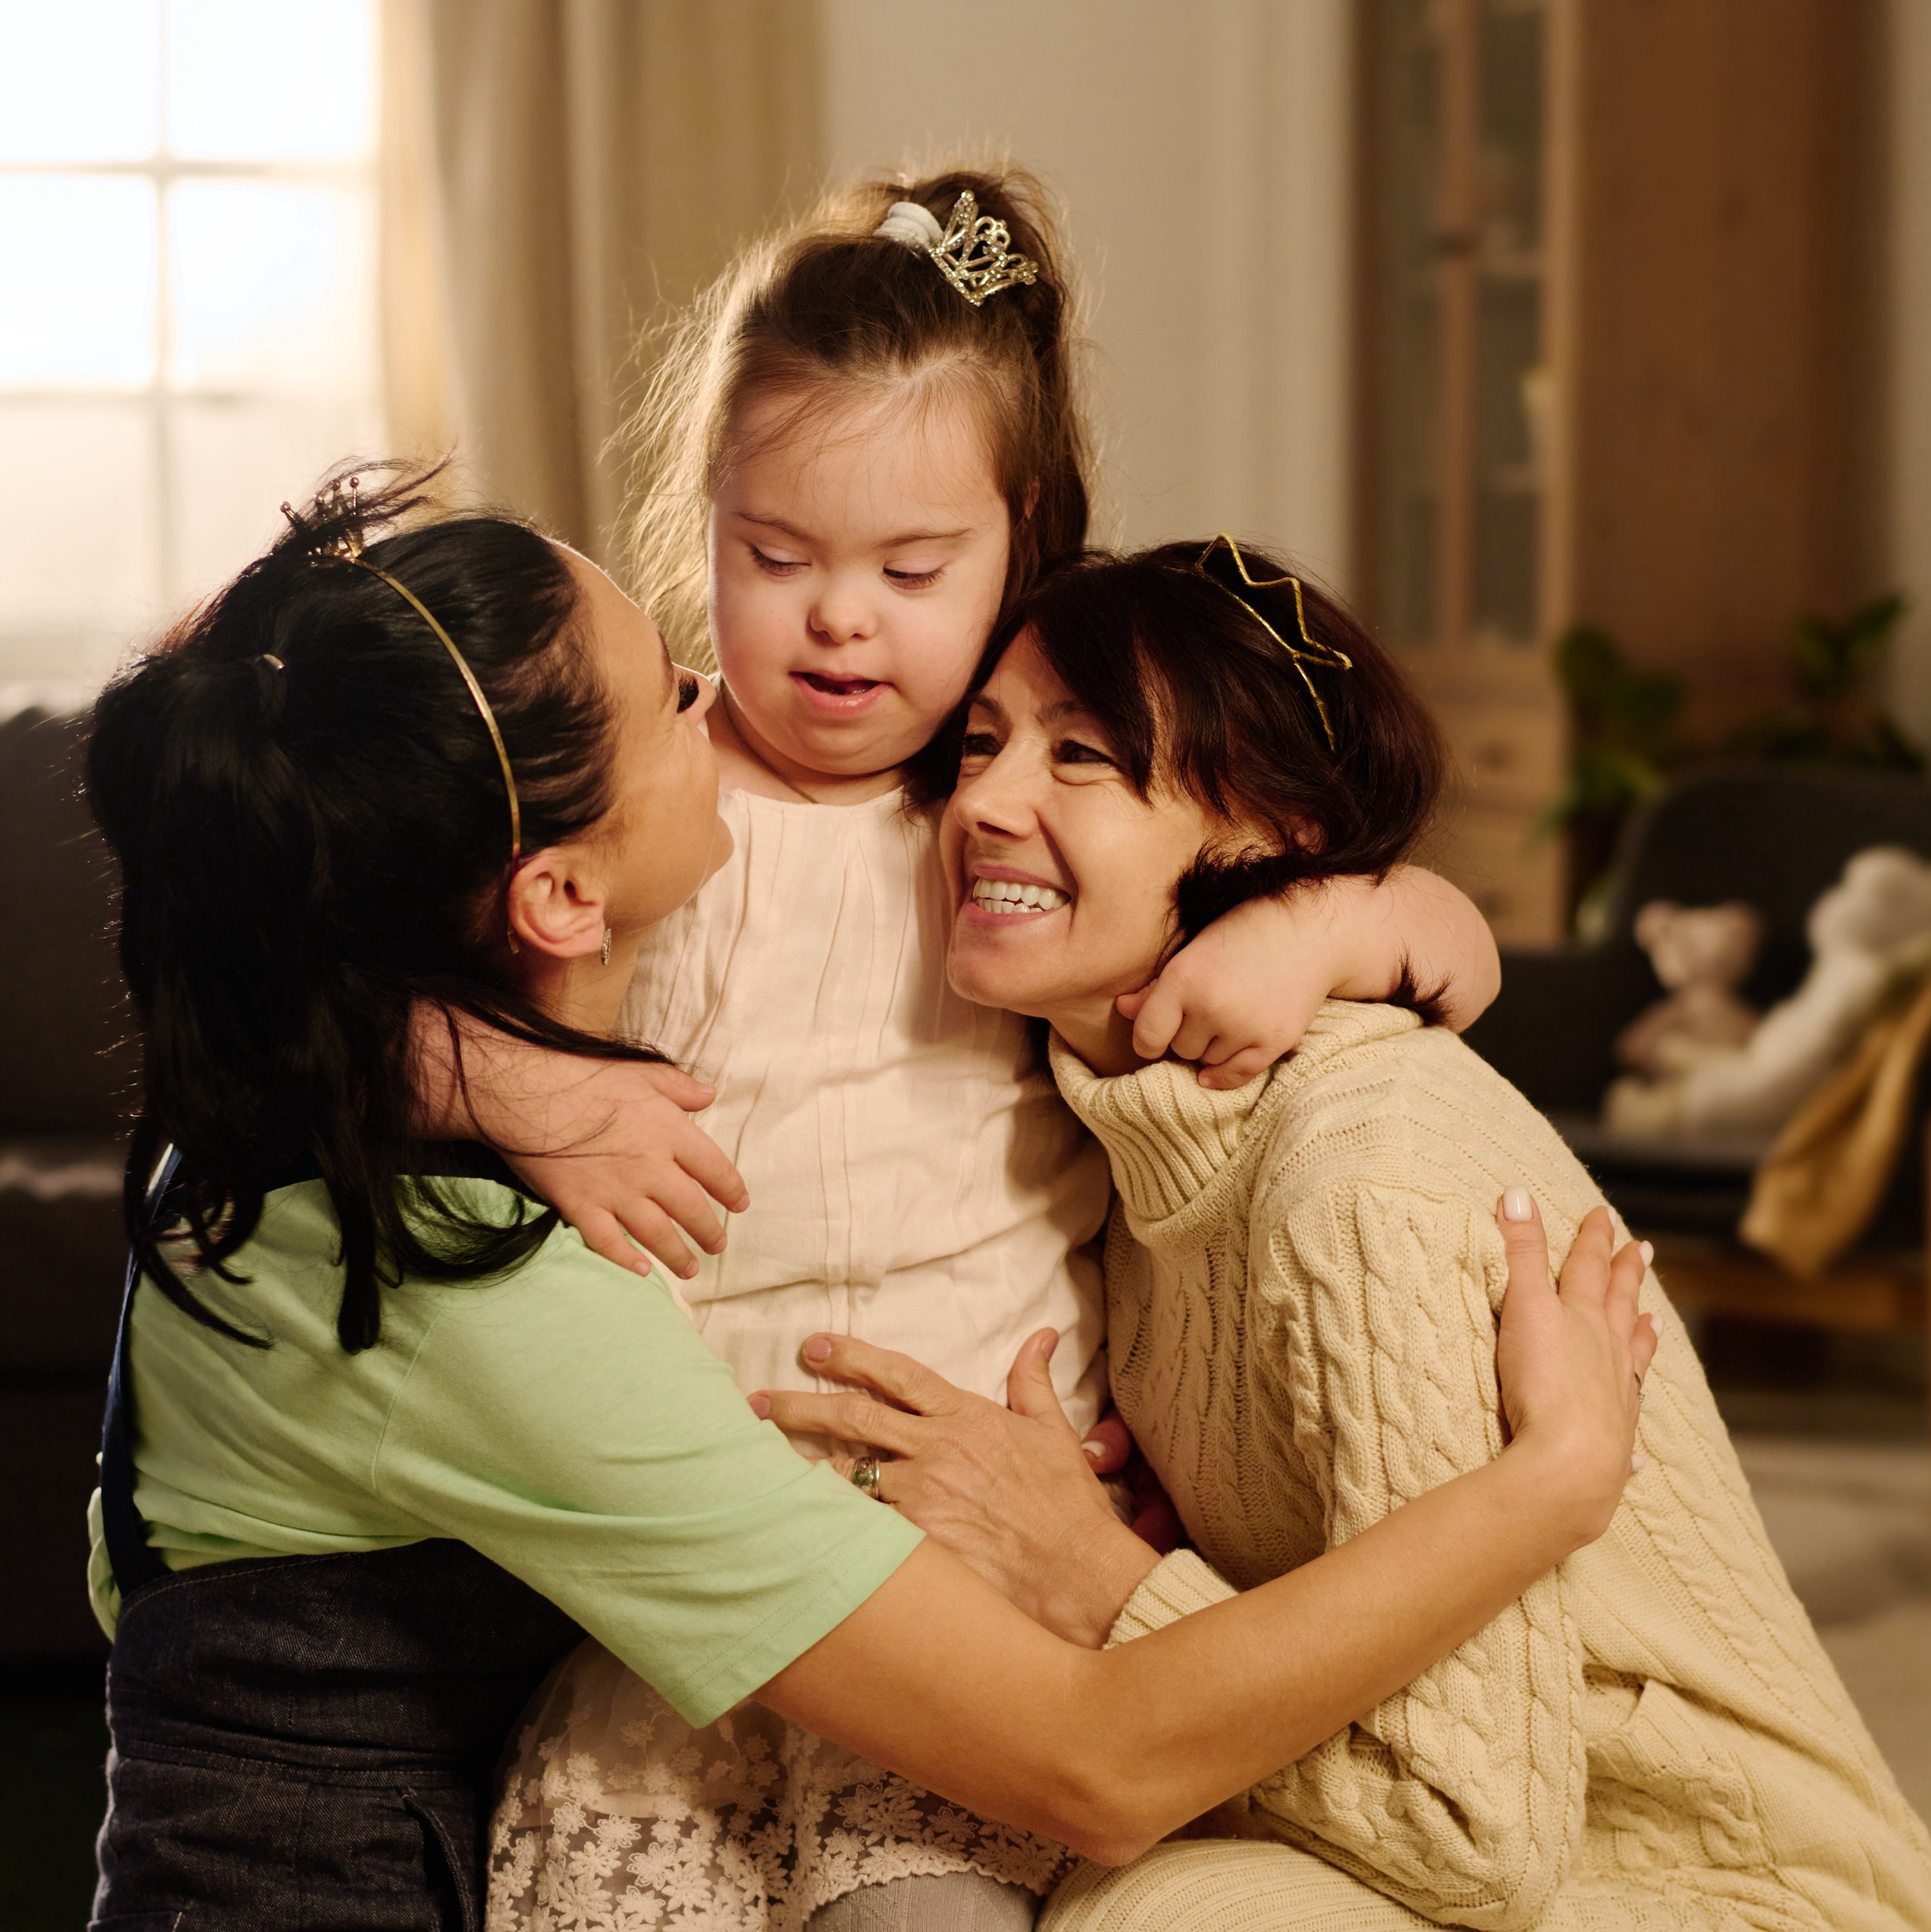
America’s Broken System
Adults with development or intellectual disabilities in the U.S. are legally entitled government-funded assistance. But hundreds of thousands of them are getting no help, or not the kind they need. Vice News investigates how the lack of funding and political will, combined with limited number of care options or diversity of needs, has led to a crisis in care for one of the country’s most vulnerable populations.
2021 Report

Slide 12
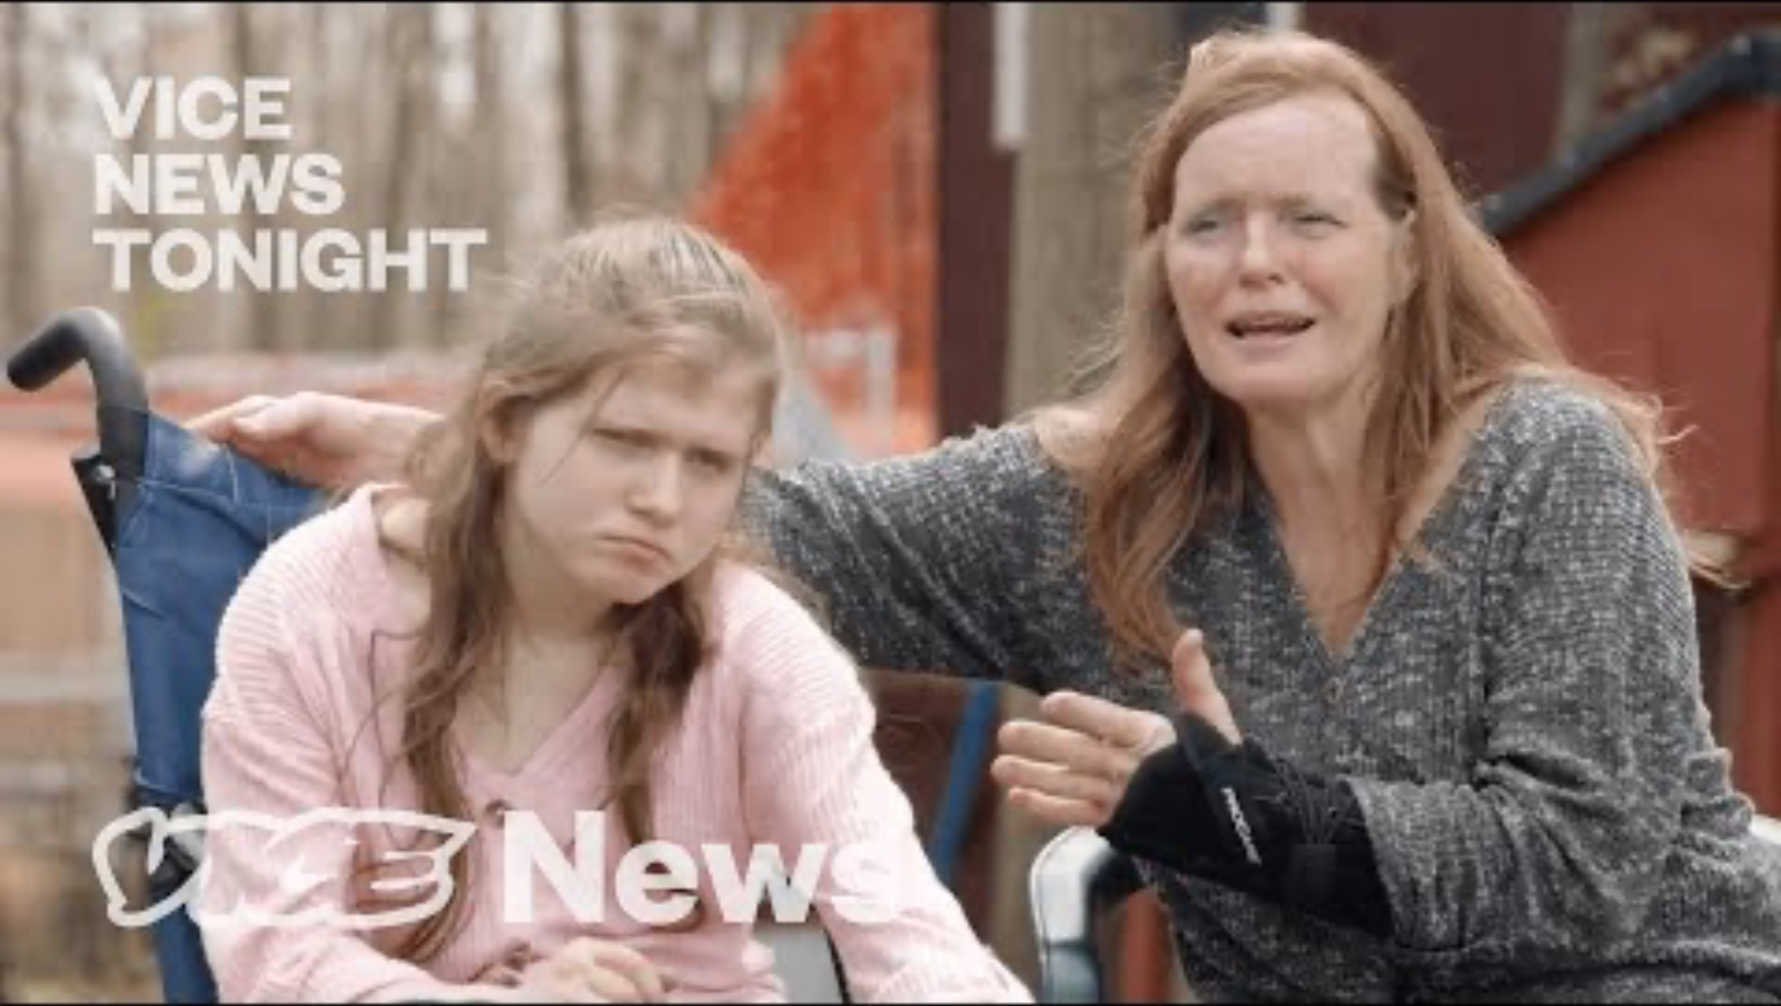
America’s Broken System

Slide 13

The accident that changed her life

Slide 14

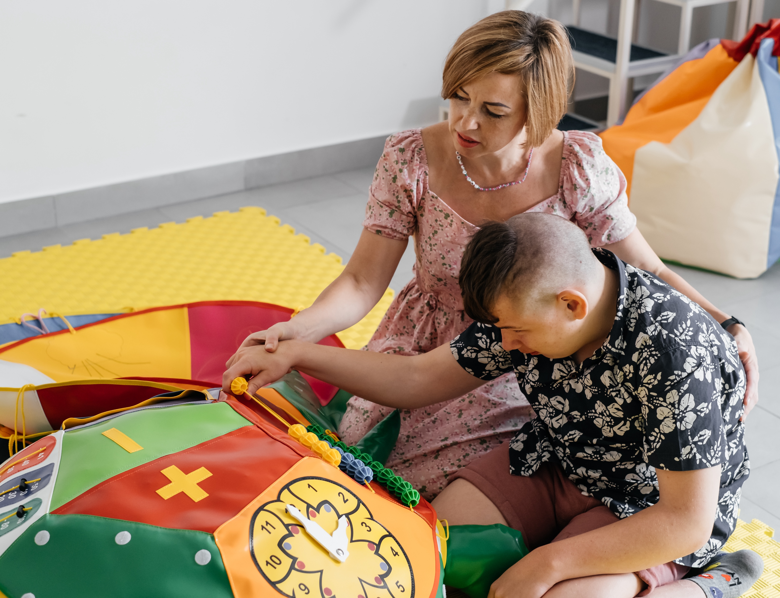
The Church
How can we help?

Slide 15
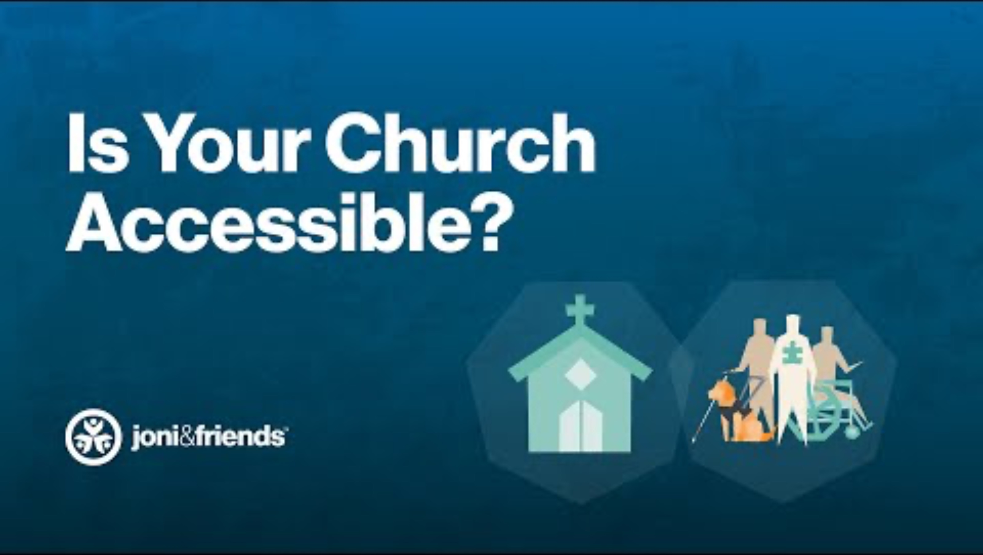
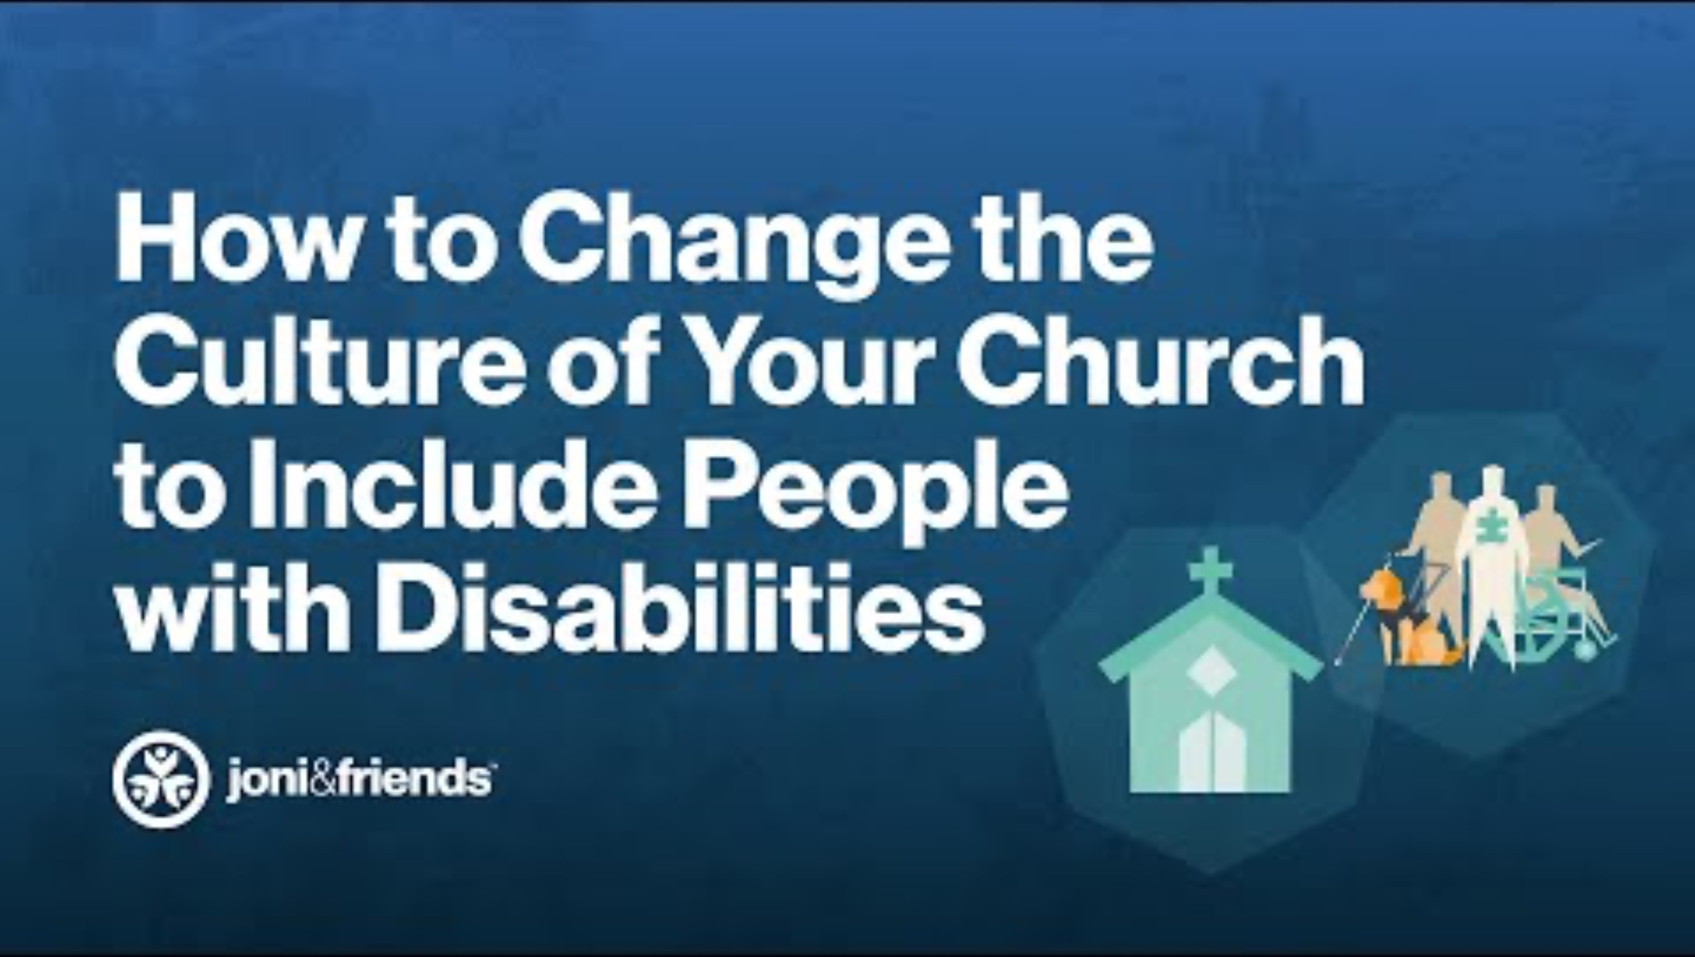
Your church

Slide 16

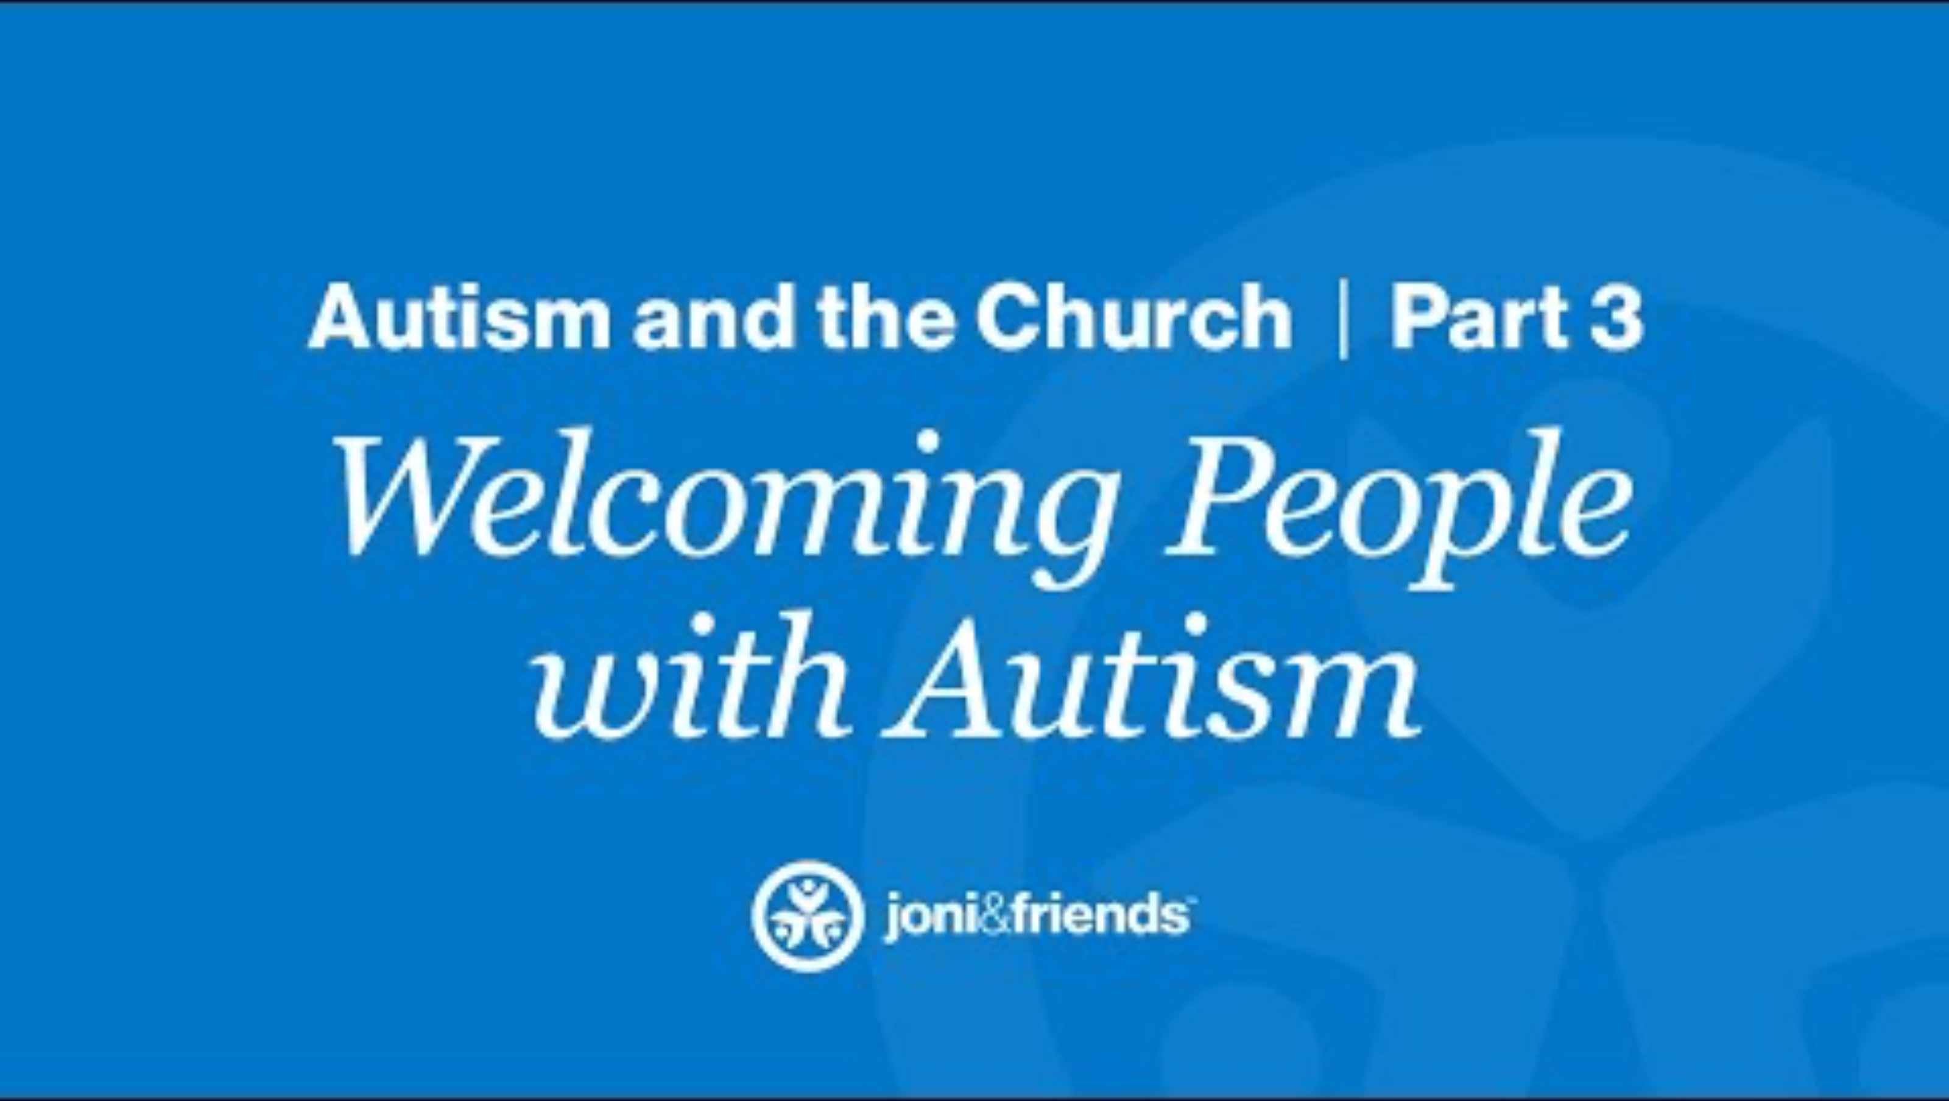
How can we help?

Slide 17
Discussion
Time

