Slide 1
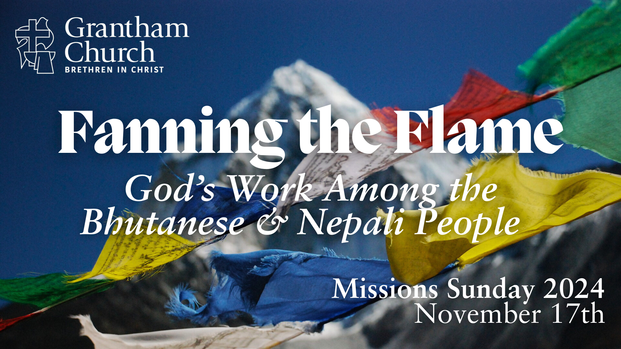

Slide 2
The Faithfulness of God through the generations—
The story of Bhutanese Refugees
Pastor Royal Rai

Slide 3
Scripture Reading:
Why should we declare the mighty acts of God?
“Great is the Lord, and greatly to be praised; And His greatness is unsearchable. One generation shall praise Your works to another, And shall declare Your mighty acts. I will meditate on the glorious splendor of Your majesty, And on Your wondrous works.”
Psalm 145:3-5 NKJV
“And all that generation also were gathered to their fathers. And there arose another generation after them who did not know the Lord or the work that he had done for Israel.”
Judges 2:10 ESV

Slide 4
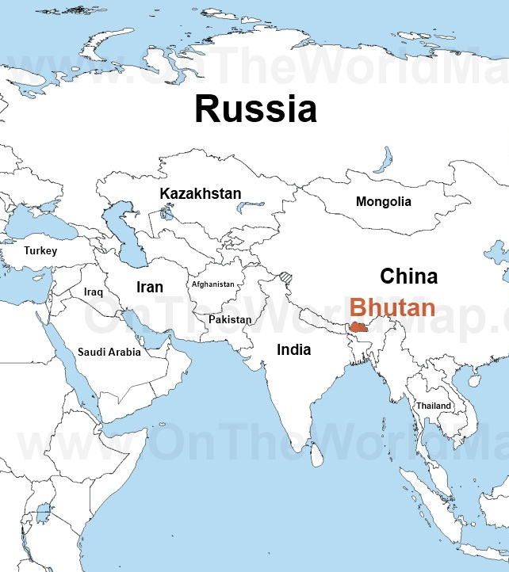
Bhutan, officially the Kingdom of Bhutan, is a landlocked country in South Asia situated in the Eastern Himalayas between China in the north and India in the south, with the Indian state of Sikkim separating it from neighboring Nepal.

Slide 5
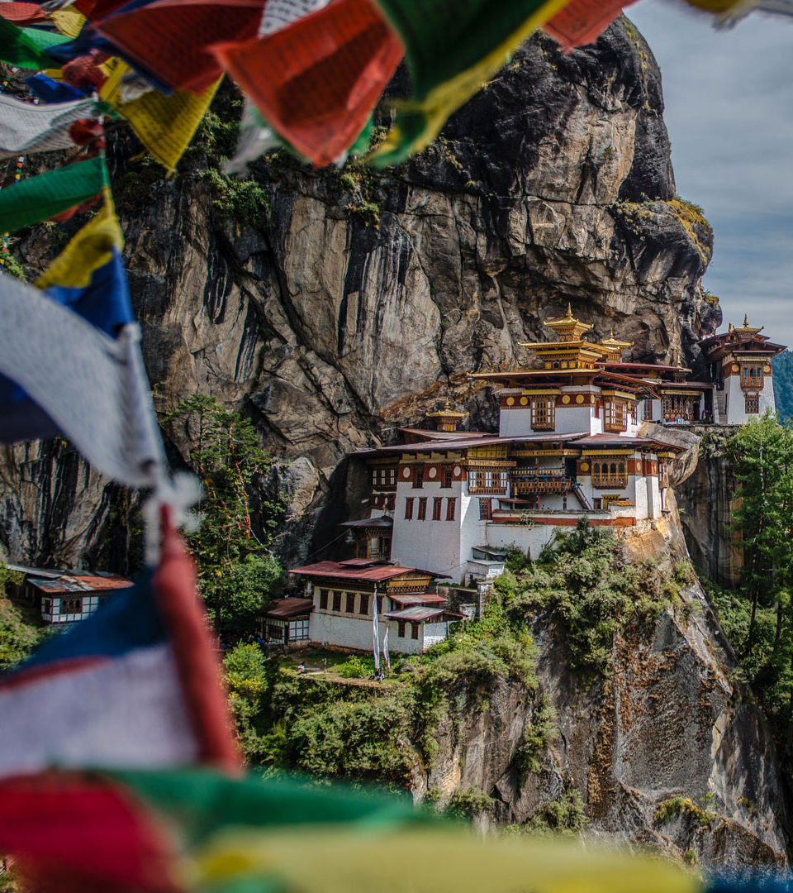
Some Fun Facts about Bhutan
Carbon Negative country in the world- Produce more Oxygen than Carbon dioxide.
- 70% of land covered w forest
- Constitution mandates to protect minimum
60% of land with forest all the time.
One of the happiest countries in the world- Nation is known by its Gross National Happiness (GNH) rather than Gross Domestic Product (GDP)- debatable*
Monarchy- Current King, 5th king from Wangchuck Dynasty

Slide 6
Three ethnic groups in Bhutan:
Ngalongs: Resides mainly Western Bhutan, King is from this Ethnicity, Elite group of Bhutan.
Sharchops: Easterners, believed to be the earliest settlers in Bhutan
Lhotshampas: Southern/ mainly Nepalese, migrated from Nepal

Slide 7
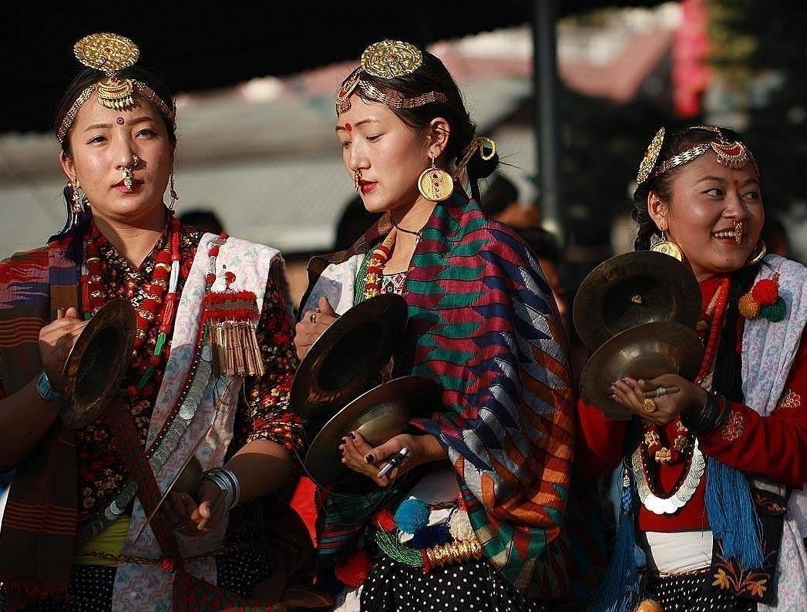
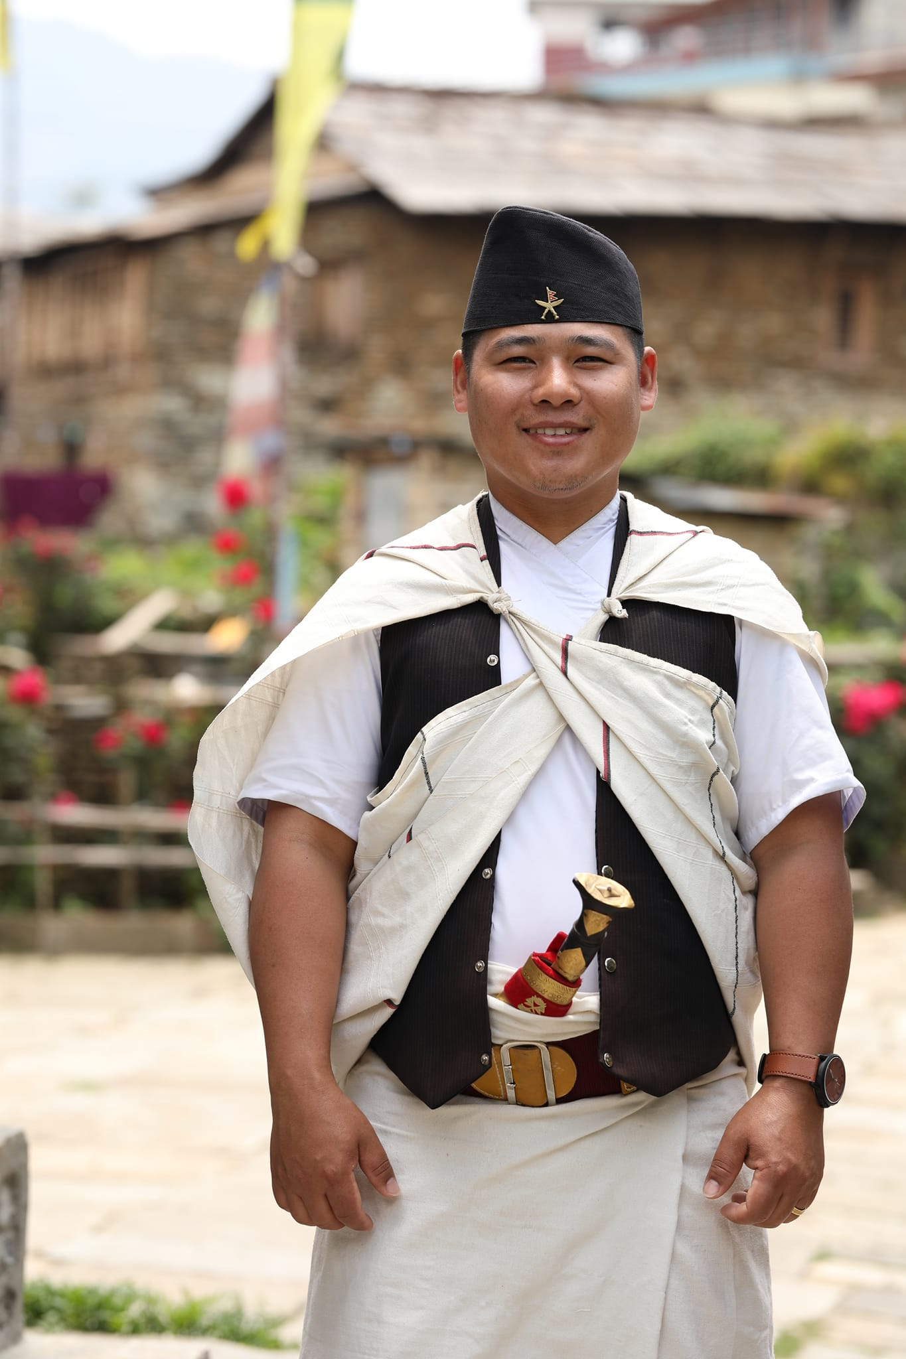
Origin of Lhotshampas (Nepalese) in Bhutan?

Slide 8
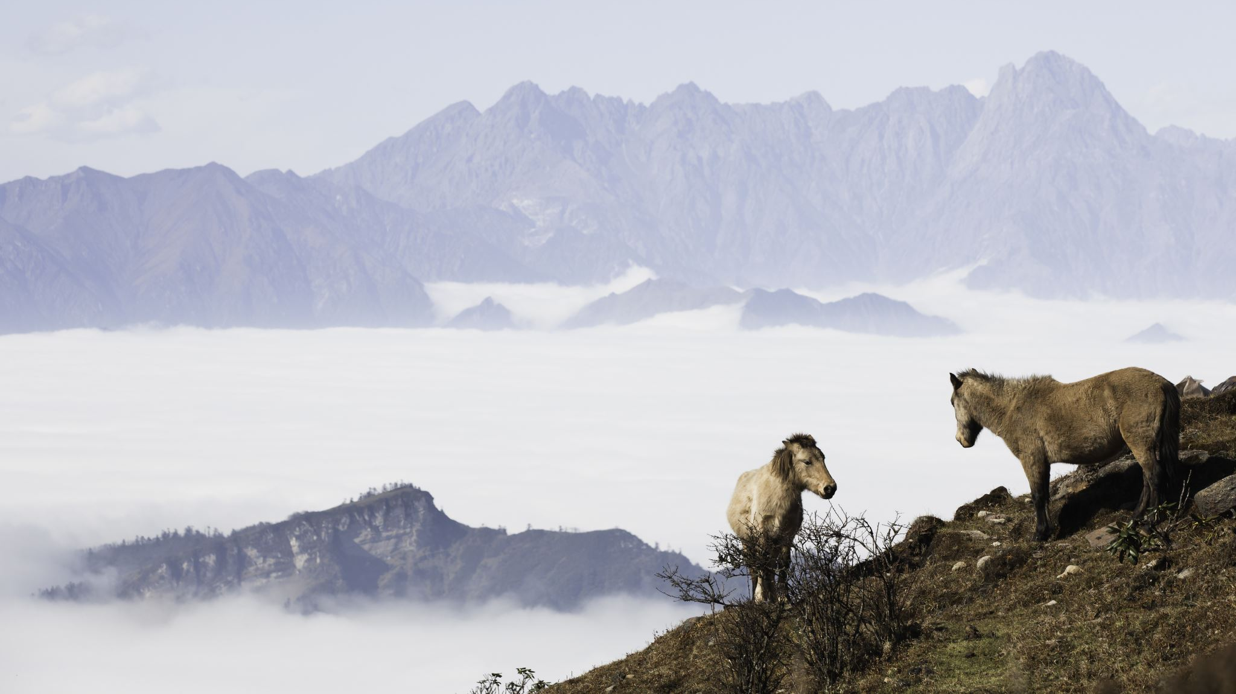
History of Nepalese Migration to Bhutan
8th Century, Bhrikuti Devi’s reign in Nepal, Crafts men migrated Bhutan for development work
16th Century, Ram Saha’s reign in Nepal, Architecture, Sculpturer Migrated to build Bhutanese infrastructure
In 1930, Nepalese were roughly 60,000 in the different part of southern Bhutan.

Slide 9
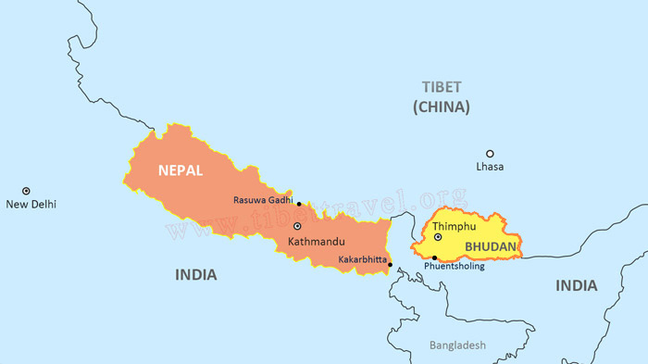
Nepalese Diaspora (Scattered) in Southern Bhutan.
Nepalese in southern Bhutan became main sources of food supplies in Bhutan.

Slide 10
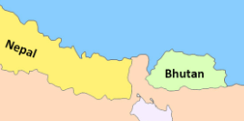
1990-1996, Government of Bhutan forced out Nepalese; In 1996, roughly 105,000 became refugees in East Nepal.
They gathered in Refugee Camp.

Slide 11
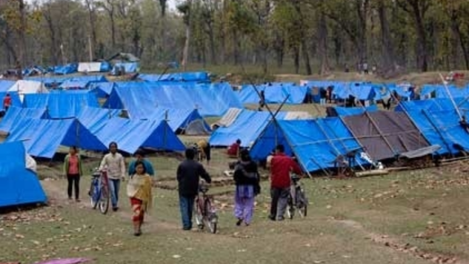
Initial Refugee Camp in East Nepal, Jhapa.
I was just three months old when our family resettled in 1993.

Slide 12
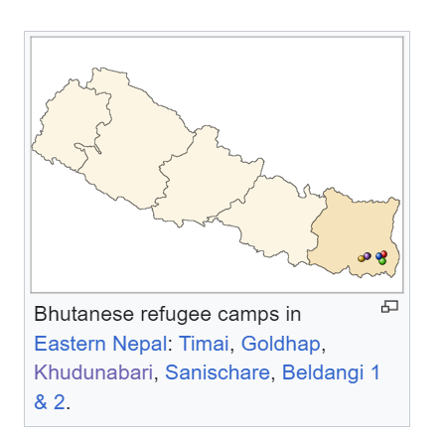
7 Bhutanese Refugee Camps- in Jhapa, Nepal

Slide 13
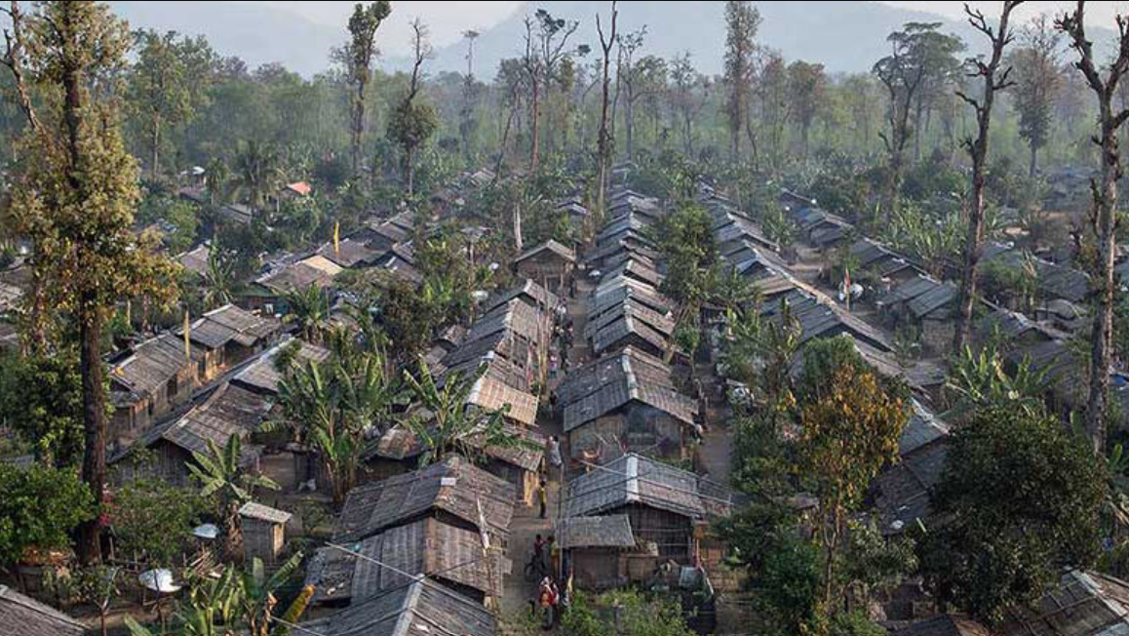
two decades OF Bhutanese Refugee Camp

Slide 14
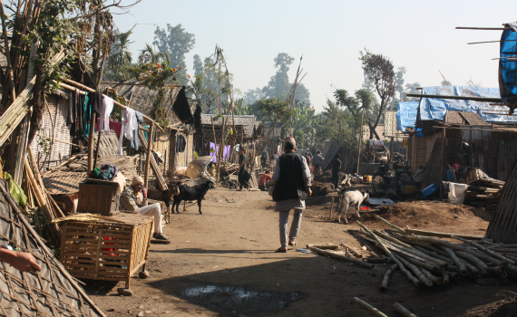
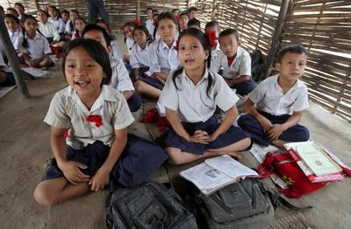
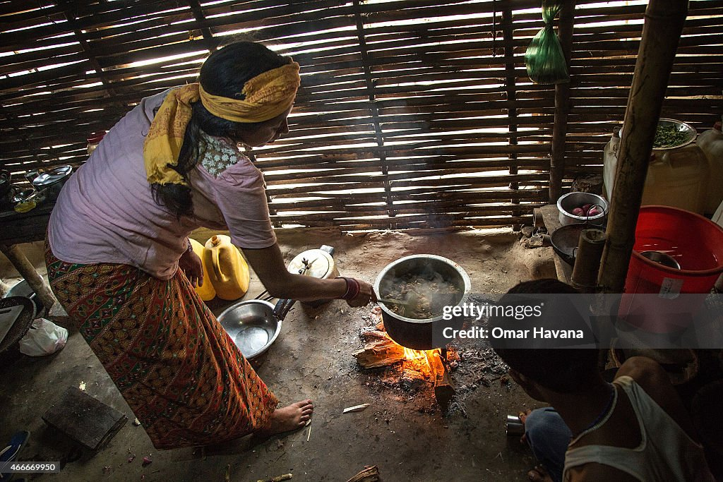
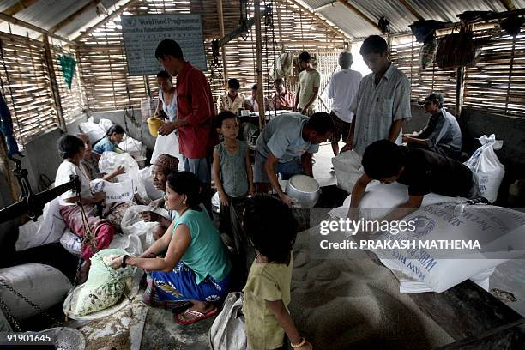
Glimpse of Bhutanese Refugee Camp
Street from below
School
Kitchen in the Hut
Ration food distribution Center

Slide 15
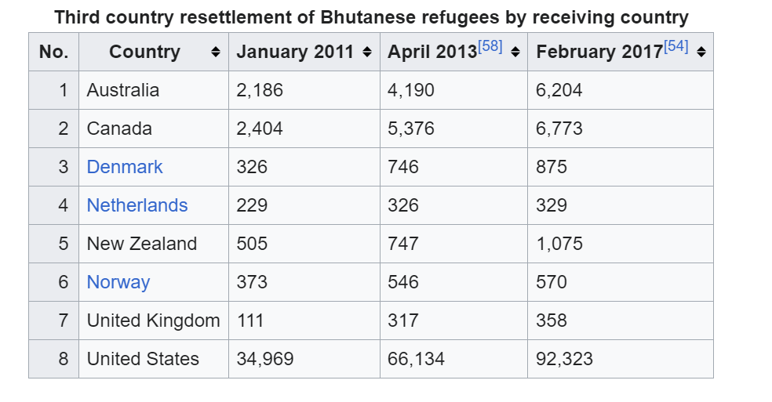
3rd Country Resettlement, Bhutanese Refugees scattered over the world.
2008- 2017
Source: Third-Counry-resettlement-of-Bhutanese-refugees.jpg (880×513)

Slide 16

United States hosted the highest number of Bhutanese Refugees, 85% of resettlement delivered in THE USA, 41 different States hosted Bhutanese refugees.

Slide 17
Bhutanese immigrants GATHERED in greater Harrisburg.
AN Estimated, 40,000+ Bhutanese immigrants reside in the greater Harrisburg AREA.
Dauphin, Cumberland, York counties

Slide 18

Seeing the Faithfulness of God when Zoomed out of our timeline!
Our spiritual ancestors had a similar theme in their generations.
Gathering and scattering
Garden of Eden, gathered
Tower of Babel, Scattered
Gathered through Abraham,
Joseph and Moses, called! a nation
Exile, Scattered!
Jesus, gathered church,
Persecution scattered the church
Jesus Coming back to gather

Slide 19
God’s faithfulness is constant throughout the generations even if we don’t clearly see it now. He was/is/will remain faithful.
“God accomplishes His mission through migration (movement of people).”
-Greg Okession (Asbury Seminary)

Slide 20

How Ignite Church play the roles in Greater Harrisburg?
Ignite Church
is 1.5 generation.

Slide 21

The Role of 1.5 Generation
The 1.5 generation serves as a bridge between the first and second generations.
The 1.5 generation can mobilize the first generation to help reach the second generation.
The 1.5 generation individual is someone who can mentor the second generation.
The 1.5 generation individual can serve as a storyteller for the second generation.
Source: Rai, Samuel, BNCA Youth Retreat

Slide 22

Struggles of Bhutanese Immigrants in the Greater Harrisburg Area?
Identity Crisis
Our identity comes from the source—Christ!

Slide 23

Struggles of Bhutanese Immigrants in the Greater Harrisburg Area?
2. Isolation
Language Barrier, Cultural Shock, Transportation & Technology.

Slide 24
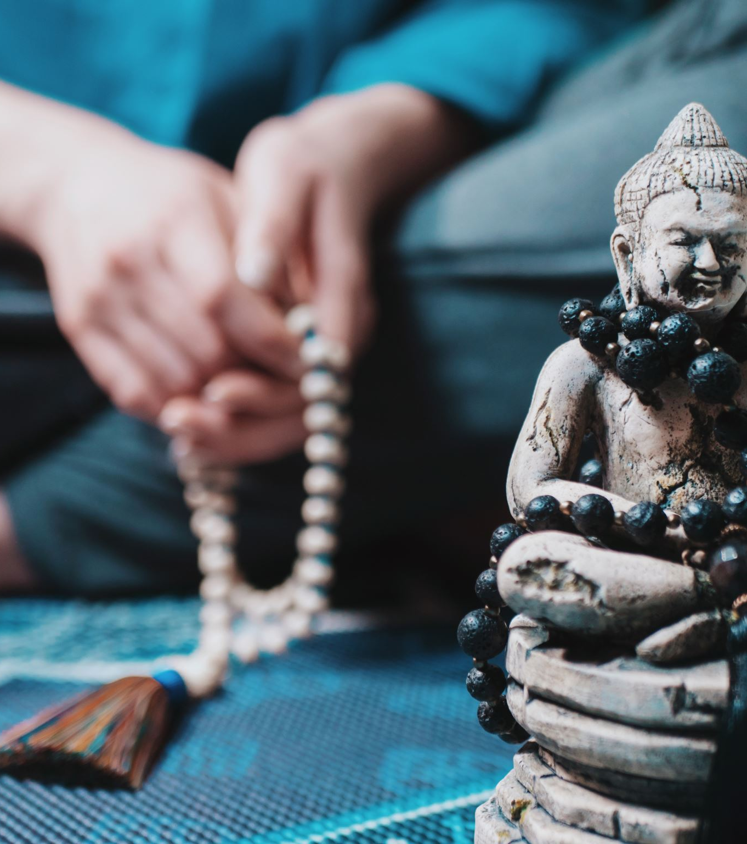
Struggles of Bhutanese Immigrants in the Greater Harrisburg Area?
3. Idolatry
Abundance, Busy Life, Independency

Slide 25
Calling for partners:

Slide 26
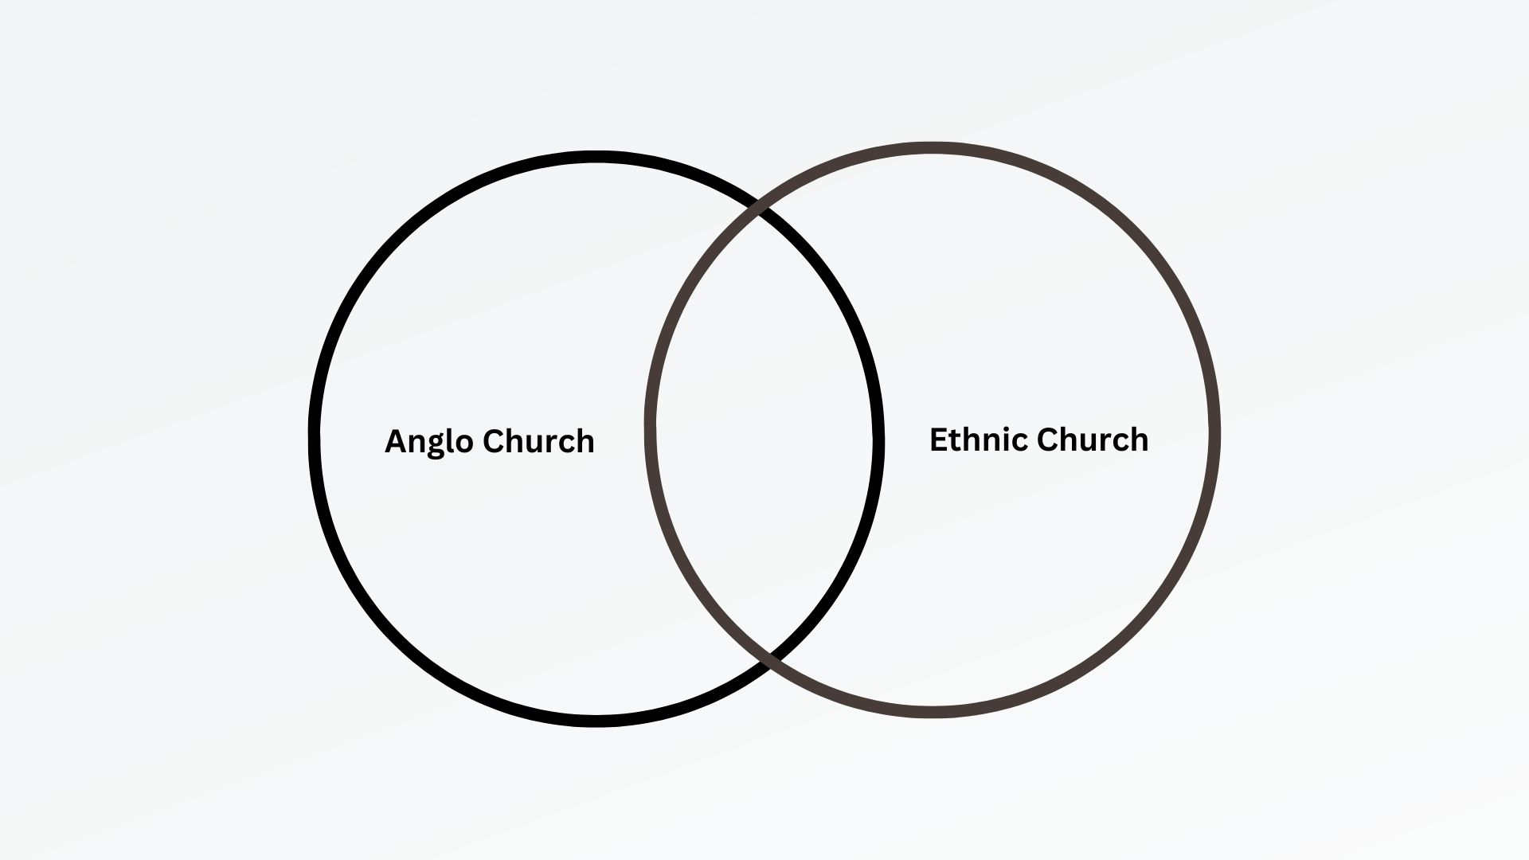
Diversity and partnership not just for the sake of diversity
and partnership, but for the Missio Dei—the Mission of God.

Slide 27

Missio Dei- Mission of God
All ethnicities
All languages
All of the world
Math: 28: 18-20
Rev: 7:9-10
Missio Dei- demands us to go beyond our own.

Slide 28
