Slide 1

Notes:
[INTRO]
I’ll never forget how hurtful it was. I had known the man since I was a little kid growing up in the church. He was a deacon. He was a faithful giver. He was thought of as a God-fearing person. People looked up to him and respected him as a “man of God” who was a pillar of the congregation. And so, when I went to work for him at his tree farm one summer in college, I wasn’t prepared to see a different side to this man I viewed as quiet but kind. I quickly learned that his love for God was merely a vertical thing; a private, one-to-one matter. His relationship with God and his so-called love for his law and liturgy was totally disconnected from the people that worked for him.
It was only for a couple of months, but it was a demeaning and demoralizing experience as I was on the receiving end of patronizing behavior and just plumb meanness. As a 19-year-old kid who was going into ministry, loved Jesus and the church, and thought the world of this guy, I was devastated to learn who he really was; to learn that this reputable man who said he loved God… treated people like trash.
I wish I could say that was the only time I’ve experienced that. But I’ve grown up in the church and been in pastoral ministry for over 20 years. I’ve seen it many times and continue to see it. And folks, I still feel the painful sting when I learn that a person isn’t what that seem to be; when their love of God and their work for the church does not include treating people with dignity, respect, or extending grace and kindness to others; when they worship faithfully on Sunday but are gossips and slanderers; when they cheat on their spouse or their taxes; when they embitter and provoke their children, when they are often rude to their leaders, to receptionists, to cashiers and waiters, and are repeatedly ugly and mean to their co-workers or employees; when they come to church for years, lead ministries, hold their hands up in praise and worship as if to touch God, but can’t even touch folks in their church with a forgiving hug, a simple smile, or a kind word.
And that, my friends, has much to do with why many people don’t want anything to do with the church. And that’s why many of our churches today aren’t making a greater impact on the world around us. Why? Because we’ve not taken seriously the greatest commandment given to us by Christ.
And that’s what I’d like to address today. If you missed the message last week, we’re in this two-part series on love. Last week we talked about what it looks like to love God with all of your heart, soul, and mind. And today we’re going to see what it looks like to love your neighbor as yourself. Our main Scripture text is found in Matthew 22:36-40.
You’ll recall that an expert in the Law of Moses comes to Jesus trying to trap him by asking our Master a series of questions, but he’s only able to ask one before Jesus shuts him down and shocks his listeners: [NEXT SLIDE]

Slide 2
Matthew 22:36-40 NIV
³⁶ “Teacher, which is the most important commandment in the law of Moses?” Jesus replied,
³⁷ “‘Love the Lord your God with all your heart and with all your soul and with all your mind.’ ³⁸ This is the first and greatest commandment. ³⁹ And the second is like it: ‘Love your neighbor as yourself.’ ⁴⁰ All the Law and the Prophets hang on these two commandments..”
Notes:
[BRIEF COMMENTS ON PASSAGE]
Jesus quotes from the ”Shema” in Deut. 6:4-5 – the Sunday school answer
Jesus then references Leviticus 19:17-18, pairing it with Deut. 6—something which had never been done before!
The two commands are intimately connected; love of God is vertical and horizontal
v.40 – What does Jesus mean?
[NEXT SLIDE]

Slide 3
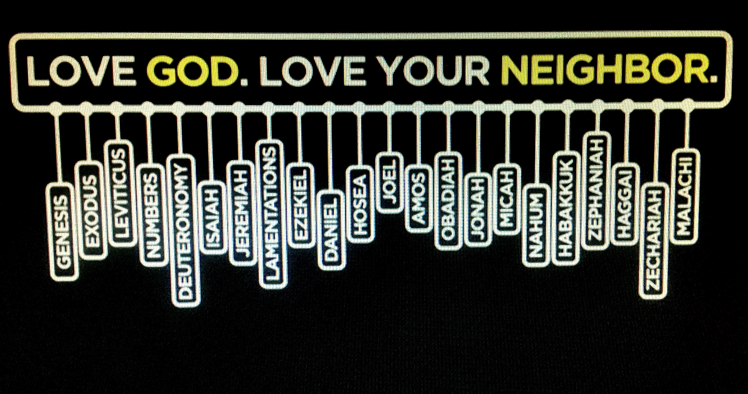
Notes:
He is saying that all of your Holy Scriptures hang (like a door on its hinges or a hanger in your closet) on this: Love of God and love neighbor. Everything else is simply history, explanation, and commentary.
Don’t miss this, church. Jesus doesn’t mean that the Scriptures aren’t important, aren’t helpful, or even sacred and inspired. Not at all. Jesus had a high view of Scripture (a “progressive” hermeneutic in some ways, but a high view nonetheless) and he believed it to be the story of God’s salvation and good news for Israel. But he also believed that in him God was fulfilling the Law and the Prophets; in him God the Father was revealing his perfect will—good news for the entire world; that in him God had become flesh to sum it up for us and make it plain.
Therefore, Jesus says, love your maker… love your neighbor. If you’re ever confused as to how to interpret something Isaiah said or what is written in the seemingly bizarre book of Leviticus… it’s simple: Love God. Love your neighbor. That is God’s will for you and for me. Period.
But what does it mean to actually love our neighbor? Well, first let’s look at the passage and the context thatJesus was referencing in Leviticus 19:17-18. [NEXT SLIDE]

Slide 4
Leviticus 19:17-18 NIV
¹⁷ “‘Do not hate a fellow Israelite in your heart. Rebuke your neighbor frankly so you will not share in their guilt.
¹⁸ “‘Do not seek revenge or bear a grudge against anyone among your people, but love your neighbor as yourself. I am the Lord.
Notes:
[BRIEF COMMENT]
So, you can understand why Jesus (in Luke 10) gets this question: “And who is my neighbor [NEXT SLIDE]

Slide 5
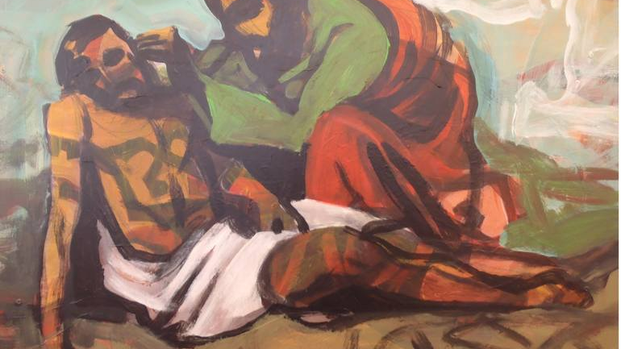
Luke 10:30-37 – The “Good” Samaritan
“And who is my neighbor?”
Notes:
On this occasion, Jesus is asked how a person can receive eternal life. Jesus tells his audience to love God and love your neighbor. And an expert in the Law, who has likely heard Jesus’ broadening definition of love (to mean more than other Jews), gets his second question in this time and says, “Oh, and who is my neighbor, Jesus?” And to answer that question, Jesus tells what we know as The Parable of the Good Samaritan.
In this parable, Jesus picks someone who to the Jewish people would have been despised and certainly unloved—a mixed-race, syncretistic Samaritan, whom the OT says was considered unclean and enemies of Israel—to be the hero of the story, the one who shows love to his neighbor. In this parable, it wasn’t the priest or the holy Levite who stopped to help the man attacked by robbers, it was the neighbor-loving Samaritan. Which is why Jesus says, ”Of these three men, who was a neighbor to the man who fell into the hands of robbers?” The expert in the Law replied, “The one who had mercy on him.” And Jesus told him, “Go and do likewise.”
Because as Jesus teaches us in the Sermon on the Mount, loving our neighbor also includes loving those we consider to be our enemies. In fact, Jesus goes so far as to update or “fulfill” what was written in Leviticus by saying… [NEXT SLIDE]

Slide 6
Matthew 5:43-45 NIV
⁴³ “You have heard that it was said, ‘Love your neighbor and hate your enemy.’ ⁴⁴ But I tell you, love your enemies and pray for those who persecute you, ⁴⁵ that you may be children of your Father in heaven.
Notes:
[BRIEF COMMENT]
“and hate your enemy”? – this is likely a popular sentiment deduced from Lev 19:18; if I’m to love my Jewish neighbor (those like me), well then surely I have the room and the right to hate those not like me; those outside my group, my family, my clan.
But Jesus says ”love your enemies” and pray for them!
And then Jesus ties our status as “children of the Father” to our obedience of this command.
That’s heavy stuff, folks! And if we consider ourselves followers of Jesus, then we do not get to opt out of this for whatever reason or excuse. This is serious business. And the first disciples knew this. That’s why the apostle John used such strong language in his epistle, as he hoped to communicate the gravity and urgency of believing that God is love and that he has called us to love as he loves.
Listen to these inspired words about love in 1 John 4, beginning with verse 7. [NEXT SLIDE]

Slide 7
1 John 4:7-12, 20-21 NLT
⁷ Dear friends, let us continue to love one another, for love comes from God. Anyone who loves is a child of God and knows God. ⁸ But anyone who does not love does not know God, for God is love. ⁹ God showed how much he loved us by sending his one and only Son into the world so that we might have eternal life through him. ¹⁰ This is real love—not that we loved God, but that he loved us and sent his Son as a sacrifice to take away our sins. ¹¹ Dear friends, since God loved us that much, we surely ought to love each other. ¹² No one has ever seen God. But if we love each other, God lives in us, and his love is brought to full expression in us.
Notes:
[BRIEF COMMENT]
Verse 20 and 21… John writes… [NEXT SLIDE]

Slide 8
1 John 4:7-12, 20-21 NLT
²⁰ Whoever claims to love God yet hates a brother or sister is a liar. For whoever does not love their brother and sister, whom they have seen, cannot love God, whom they have not seen.²¹ And he has given us this command: Anyone who loves God must also love their brother and sister.
Notes:
[BRIEF COMMENTS]
Well, I love them… but…
“You don’t know what they’ve done to me.” No, but Jesus does. Do you trust him to sort it out?
“But forgiveness is a process. I can’t just forget.” True. No, you can’t. However, it starts by letting Jesus soften your heart.
“What do you want me to do, keep letting them hurt me.” No, not if you’re in real danger. Get out of there, BUT still love them. Folks, for most of us, we’re not in any real danger. We just want an excuse not to deal with our own junk and do what Christ calls us to do.
”But I can’t stand them.” Yeah, well, God loved you when you were at your worst. And you can still act pretty rotten sometimes.
[NEXT SLIDE]

Slide 9
Matthew 22:37-39 NIV
³⁷ “‘Love the Lord your God with all your heart and with all your soul and with all your mind.’ ³⁸ This is the first and greatest commandment. ³⁹ And the second is like it: ‘Love your neighbor as yourself.’.”
Notes:
Church, Jesus said, ”love your neighbor as yourself.” As yourself… what does that mean?
I think this can easily be misunderstood in an age when our individualistic culture breeds narcissistic personalities and destructive behaviors all in the name of ”self-love”… when in reality our inability to know the love of God for ourselves and experience it (even allow it) from others leads to so-called “safe” ways of shutting ourselves off from the truth that we are made in God’s image but broken and not as we should be. Instead, we must see ourselves for who we really are (the good, the bad, and the ugly), sometimes with help from others, and then know that even then we’re loved beyond comprehension.
In his commentary on Matthew, Stanley Hauerwas writes: “To learn to love our neighbor as ourselves means we must learn to love ourselves as God has loved us. To learn to love ourselves truthfully is not easy because we most often desire to love ourselves on our own terms. The challenge that Jesus presents by joining these commandments is to learn that one is loved by God so that one is thus able to love God and others. Such a love requires a lifetime of training in which we are given the opportunity to have our self-centeredness discovered and overwhelmed.”
Brothers and sisters, I pray that you will experience the God who receives us as we are but loves us too much to leave us that way. For the more we know his love and the Spirit enables us to love ourselves rightly, we will make great advances in how we love others. Because the truth is… a person can only give away the love that they themselves have received.
Never forget this. If you see someone withholding love or failing to love, it is because they themselves have that much more to go in knowing and experiencing just how much God loves them, has forgiven them, and has freed them from guilt, shame, and those things that have enslaved them to sins like anger, bitterness, impatience, judgementalism, gossip, prejudice, and projecting their own brokenness, hurts, and pains onto you.
OK, so we’re called to love. But what does it really look like? Because it seems these days that a person can do just about anything they feel justified doing, or is socially acceptable to do, or have mutual consent to do and call it love. So once again, listen to these words from Jesus: [NEXT SLIDE]

Slide 10
“So now I am giving you a new commandment: Love each other. Just as I have loved you, you should love each other. Your love for one another will prove to the world that you are my disciples.”
Jesus, John 13:34-35 NLT
Notes:
[BRIEF COMMENT ON PASSAGE]
Jesus reduces two commandments into one. 1. Love God 2. Love Neighbor… into one – “Just as I have loved you…”
There is no wiggle room or loopholes!
What his disciples would have heard / Jesus might have said to them
And of course, Jesus then goes on to show them how he loves them on the cross
“Just as I have loved you…” You see, a lot of people miss this. But you know who didn’t miss it? The apostle Paul. That ex-Pharisee who once hunted down Christians, overseeing their deaths, but Christ changed his heart and gave him a new life and a new law: the law of love. And so, we hear Paul, having heard the words of Jesus from the 11 disciples, say things like this: [NEXT SLIDE]

Slide 11
Be kind and compassionate to one another, forgiving each other…
just as in Christ God forgave you.
Paul, Ephesians 4:32 NIV
Notes:
Why do I need to be kind, compassionate, and forgiving? Because Christ has done and is doing this for you.
And in then in the next chapter, Ephesians 5: [NEXT SLIDE]

Slide 12
Follow God’s example, therefore, as dearly loved children and walk in the way of love, just as Christ loved us and gave himself up for us.
Paul, Ephesians 5:1-2 NIV
Notes:
Sure, it’s important to ask, what does the Bible say?
But folks, the better question for followers of Jesus is: What does love require?
Jesus said, love as I have loved you. And Christ shows us that this love is sacrificial, welcoming, accepting, forgiving, and seeks to reconcile us to God and each other. It doesn’t quit, it doesn’t walk away, it doesn’t refuse to acknowledge wrongdoing, or to speak the truth in love and work for justice. This love runs into the storm, into the fire, and into the darkness. It’s fierce, relentless, and sometimes reckless.
For when you do this, when you love like this, Jesus says, the whole world will know that you belong to me. You see, church, when we get this right, people will want to work for you even if they don’t believe what you believe. When we get this right, even our enemies will start thinking about how they’re living. When we get this right, people will believe in redemption again. And when we get this right, people will flock to Grantham Church to discover the God who looks like Jesus.
So, let us heed these words from Paul to the Philippians: [NEXT SLIDE]

Slide 13
In your relationships with one another, have the same mindset as Christ Jesus.
Paul, Philippians 2:5 NIV
Notes:
Cause here’s the thing, you don’t need a sermon series or a book or a webinar or a learning community on how to respond to your husband, or respond to your wife, or respond to your children, or respond to your boss, or respond to your pastors, or your church board, or our political leaders, or anyone you’re having issues with. You just need to get this… God’s will for you is to adopt the same mindset as Christ Jesus.
It’s not that hard. Oh, the hard part can be doing it, I know. But it gets a lot easier when we stop making excuses for why we’re not loving God and loving our neighbor as ourselves. And we can make some major progress if we will believe that the greatest heresy, the greatest offense, the greatest scandal, the greatest injustice of all… is when you refuse to love others the way Christ has loved you.
And finally, a passage I’m sure you’re familiar with, 1 Cor 13. What does love look like? Paul writes: [NEXT SLIDE]

Slide 14
Paul, 1 Corinthians 13:4-7 NIV
⁴ Love is patient, love is kind. It does not envy, it does not boast, it is not proud. ⁵ It does not dishonor others, it is not self-seeking, it is not easily angered, it keeps no record of wrongs. ⁶ Love does not delight in evil but rejoices with the truth. ⁷ It always protects, always trusts, always hopes, always perseveres.
Notes:
Friends, this wasn’t written for weddings. This was written for the church in Corinth who had major problems with authority, with sexual immorality, with accusations and lawsuits made against other Christians, with some thinking of themselves more highly than they ought, and a general lack of order, respect, trust, and discipline in the church.
It’s true. The “love chapter” (as we refer to it in the church) is for the congregation who wants to survive the sabotage, emerge from her trauma and troubles, and make a difference in their community for the sake of the gospel and the glory of Christ in the world. It’s for those who want to take the call of Christ seriously and put his own love into action. The only question is, will we? [NEXT SLIDE]

Slide 15

What Does Loving Your Neighbor Look Like?

Slide 16
What Does Loving Your Neighbor Look Like?
Loving God.

Slide 17
What Does Loving Your Neighbor Look Like?
Loving God.
Doing unto others…

Slide 18
What Does Loving Your Neighbor Look Like?
Loving God.
Doing unto others…
Loving them as Jesus loves you.
Notes:
Finally, let’s sum up and conclude this message (and our series) this way: What does loving your neighbor look like?
[BRIEF COMMENTS]
1. Loving God.
Remember, you can’t love your neighbor properly if it’s not hitched to love of God, i.e., loving the God who looks like Jesus. We are what we love. We become like that which we worship.
2. Doing unto others as you’d have them do unto you.
The “Golden Rule” - Jesus said in Matthew 7:12, “So in everything, do to others what you would have them do to you.” Would you like people to be kind to you? Then be kind to them. Would you like people to show you mercy and grace? Then you show mercy and grace. Would you like people to smile at you, say thank you, good job, and I’m sorry? Then you do the same. Because that’s what love of neighbor looks like.
3. Loving them as Jesus loves you.
My fellow disciples, how has Jesus loved you? When you were far from him, living in sin, running from his grace, what did he do? He found you, forgave you, and accepted you back, didn’t he? How many times does he do this on a daily basis? And isn’t it God’s kindness that leads you to repentance? Isn’t it his love that overwhelms you, restores you, lifts you up out of the mud and the mire and puts your feet on the rock of his salvation? Sure it is. So then, let’s mimic the God who loves us and embody that love that gives birth to resurrection and renewal.
[NEXT SLIDE]

Slide 19
Notes:
Before we close in prayer, I want to do what we did last week and let the Lord peer into our hearts this morning, and this time let him speak a word about your neighbors and your enemies. If you’re willing to do that, would you close your eyes and join me in this spiritual exercise?
LEAD PEOPLE INTO A ROOM (their heart)
INVITE THEM TO SEE THEIR NEIGHBORS/ENEMIES
NOW SEE JESUS WALK INTO THE ROOM
AND HEAR JESUS SAY TO YOU, “My child, just as I have loved you, you must love each other.”
NOW SEE JESUS BRING YOU TOGETHER, & HEAR HIM SAY THESE WORDS, “What does love require?”
[CLOSING PRAYER]

