Slide 1


Slide 2
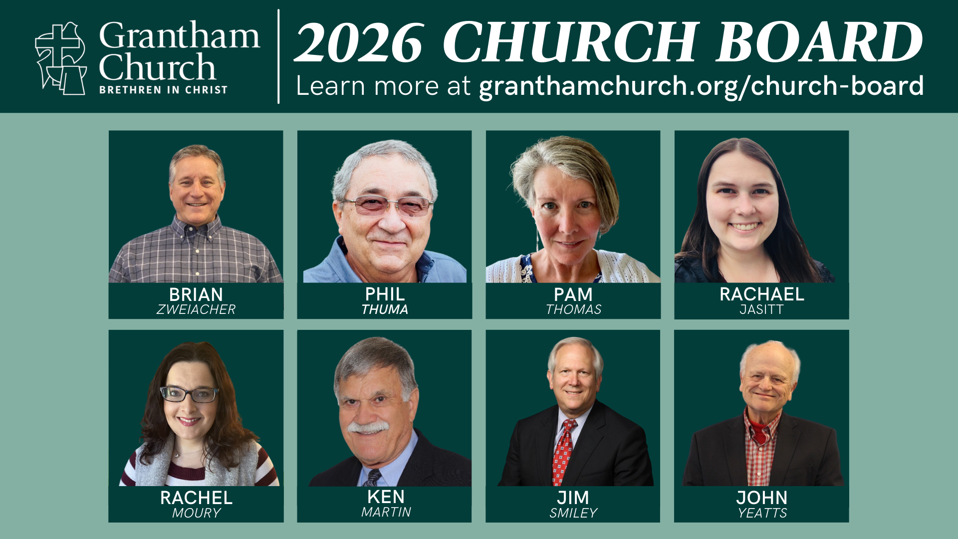

Slide 4


Slide 5


Slide 7


Slide 8

Lilly Endowment, Inc.
Thriving Congregations Initiative
$1.25 million for 5 years
Focus Areas:
Fostering ministries that are relevant to the lives of congregants and, at the same time, connect congregants more deeply to God.
Developing or strengthening outwardly focused ministries that serve those in their communities.
Notes:
[READ & COMMENT]

Slide 9
Thriving Congregations: Purpose
The Thriving Congregations program enables local congregations to explore and better understand their place among rapid social and cultural changes in their local context. This program penetrates all levels of congregational life, from senior pastoral leadership to the church board and covenant members to reach the community they seek to serve.
The programming recognizes that as congregations re-frame ministry based on social and cultural shifts, they must look both internally to their congregants and externally to their community, affirming that “We are not adapting to merely survive but to thrive! We are called to adapt to a changing world because we are called to reach that changing world.” (Bolsinger, Canoeing the Mountains)
Notes:
[READ & COMMENT]

Slide 10
Thriving Congregations: Characteristics
Developing a clear sense of congregational values and mission by engaging the 10 BIC U.S. core values, assessing internal congregational health, integrating principles of neighboring, and developing outward-facing community ministries that are unique for their assets and needs.
Assessing congregational health has implications for both the internal working and external ministry of a congregation. Congregations will dialogue honestly about the health of the congregation, establishing baseline data about the group and its effective ministries.
Integrating principles of neighboring helps congregations live out the Great Commandment (Matt. 22:34-40) and recognizes diversity within our communities. When congregations participate in activities with neighbors, the community is strengthened, affirming that “The church as the body of Christ thrives when it dwells deeply within its surrounding communities, joining neighbors there.” (Zscheile. Who is My Neighbor? The Church’s Vocation in an Era of Shifting Community)
Implementing outward-facing community ministries can be done well when congregations have a clear sense of identity and mission. Community ministries both build on assets of the congregation and meet community need(s).
Notes:
[READ & COMMENT]

Slide 11
Learning Process
Congregational Learning Community (CLC) or ”Thriving Core Team”
  Staff/board/member (3-5)
  Link between the program and the congregation
  “community of discernment”
Cohort-style
  Work within cohort for 3 years
In-person gatherings
  Mutual learning with other congregations
  Expert-led training with our grant partners
Monthly Newsletter
  Started in May 2025
  Updates, stories, resources
Growing Healthy Congregations cluster
  Led by Ryan Showalter
Coaching
  Assigned BIC coach to facilitate sessions – Joshua Nolt
Community Coffee Hour
  (Optional) Zoom calls
  Resourcing and “how-to” guides
Notes:
[READ & COMMENT]
Thriving Core Team Members – myself, Pastor Melissa, Dan Alonso, Sarah Becking, Rebekah Basinger, and Ken Martin
Here is what this 3-year. 3-phase prorgam looks like… [NEXT SLIDE]

Slide 12
Thriving Congregations: Program
3 year, 3-phase program
Who are we?
  As BIC church (identity)
  As a congregation with a mission and vision
Where are we?
  Neighborhoods and community connections
What is our impact?
  Implement outward-facing ministry
Notes:
[READ & COMMENT]
We have just finished the first year of formal meetings focused on Who Are We?, which included the PEAK survey; clarifying our definitions of mission, discipleship, and leadership; considering the unique impact and gifts of our congregation; discerning our Critical Gospel Impact; reflecting on our church story; and bringing it all together into a Ministry Action Plan (MAP).
Recently, we created this Critical Gospel Impact Statement… [NEXT SLIDE]

Slide 13
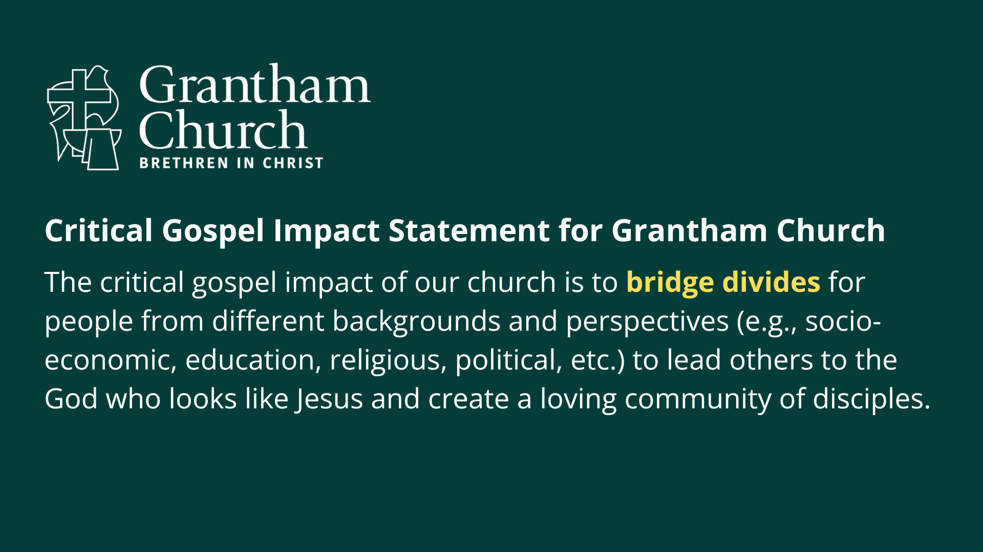
Notes:
[READ & COMMENT]
Intergenerational
Convergent
Third Way
Centered-Set Community
We have a real opportunity to be a unique congregation!
Finally, here are couple of pictures of our core team in action… [NEXT SLIDE]

Slide 14
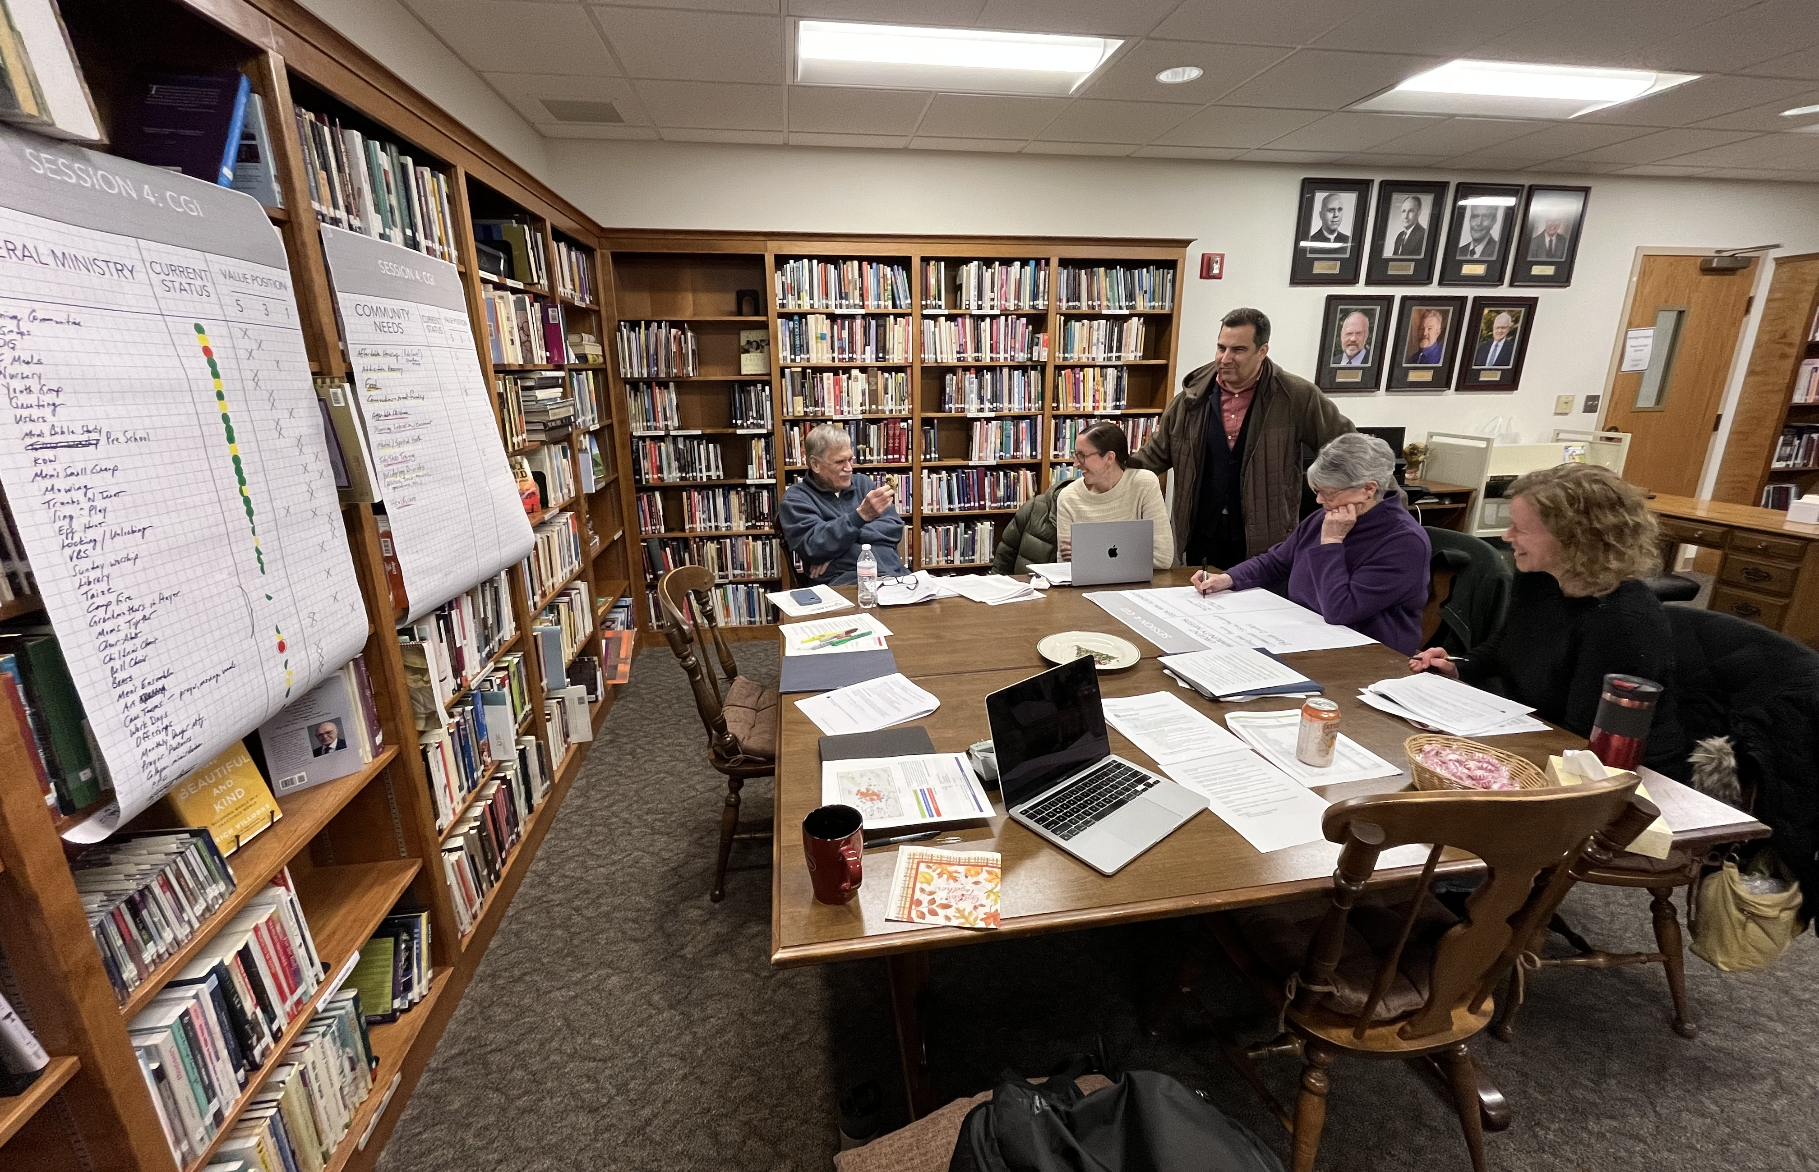
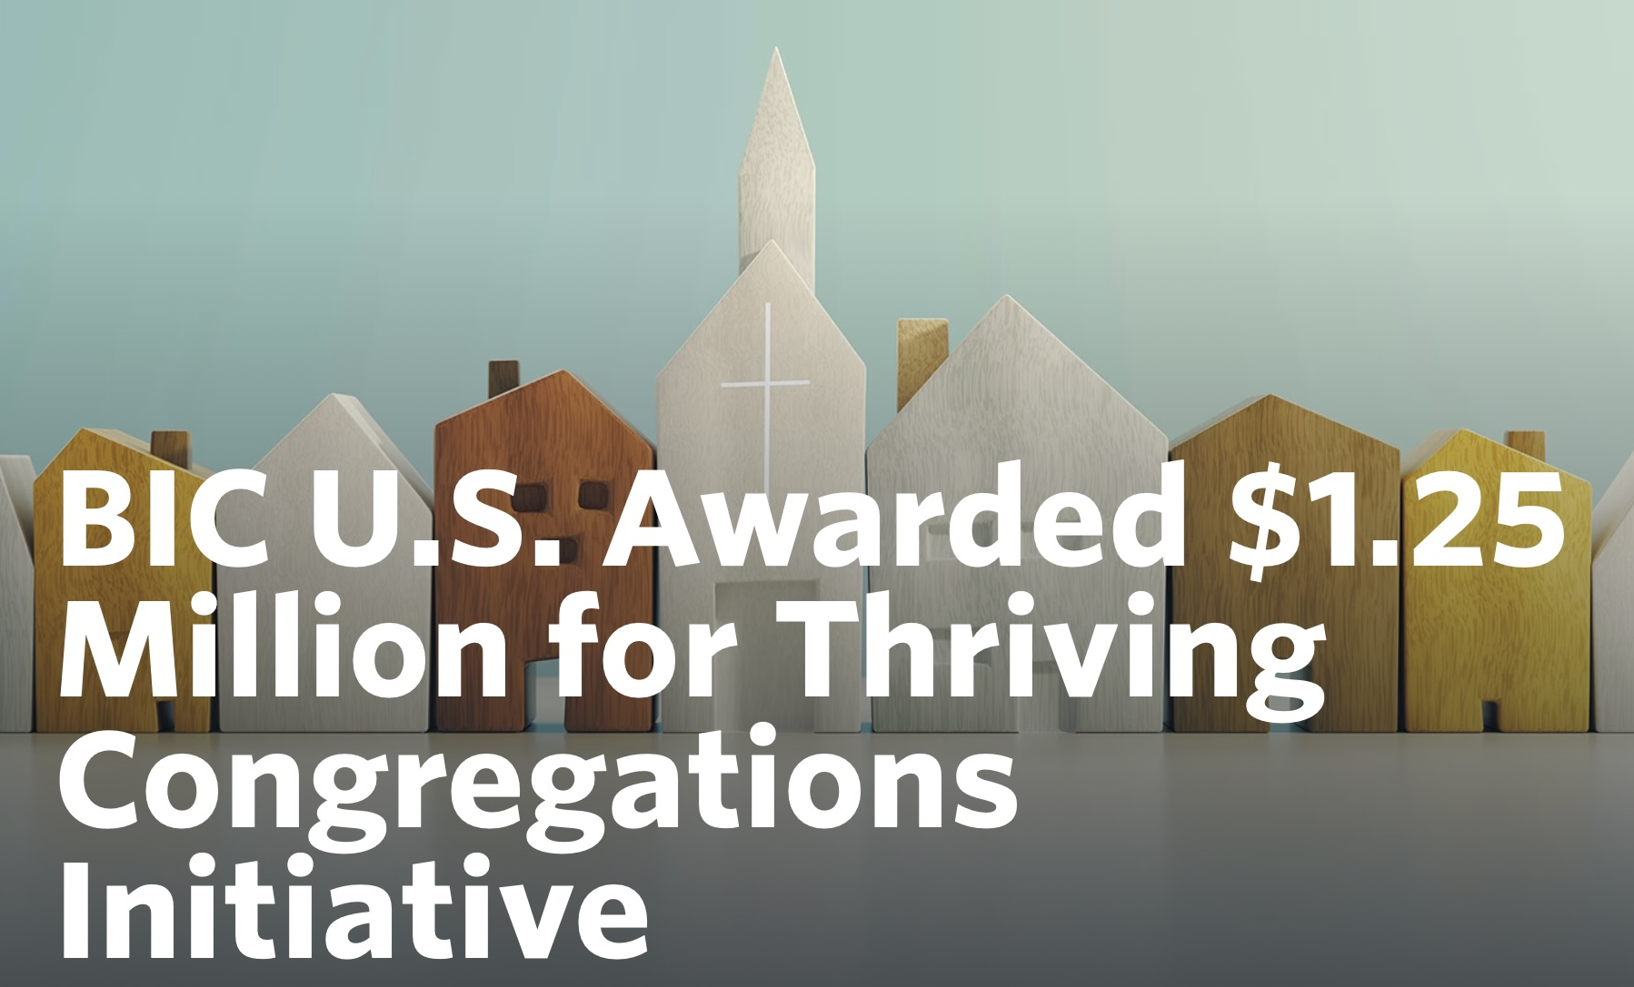
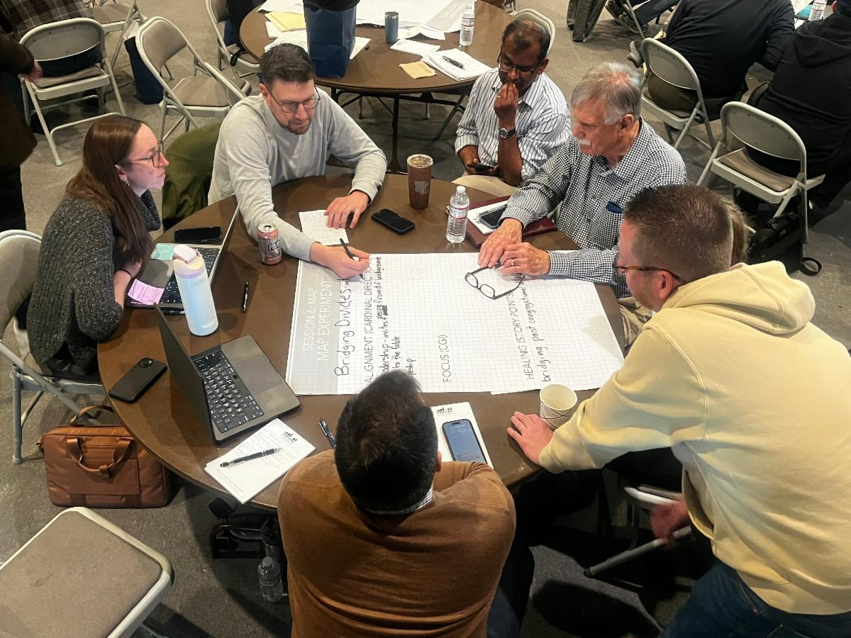

Notes:
It’s now up to us to execute the plans (our Ministry Action Plan) that we discussed at the last training. In the next 2-3 months we want to have conversation with church leadership about our vision of building bridges and what that means. Then in the next 9-12 months we hope to engage in a ministry inventory to discern alignment with vision.
In parallel to us working out the Ministry Action Plan from year 1, we will enter year 2 of training, again, guided by the question “Where Are We?”, as we engage in more discovery about our local community and the needs around us.
Then, as I said earlier, year 3 is guided by the question “What is Our Impact?”—or what new ways is God calling us to bless our community and reach our neighbors with the gospel through proclamation and service. And we suspect that this process will end in a capital campaign designed to help us carry out the unique calling that God has given us as a congregation.
We want to thank you for your prayers as we continue this process. We plan to share more updates in the future.

Slide 16


FINANCE COMMITTEE AND TREASURER’S REPORT
April 23rd, 2023

Slide 17
SPRING REPORTING COUNCIL 2026
2025 Income/Expense Report
2026 Income/Expenses - 1st qtr vs budget

Slide 18
Thanks
Thanks to weekly “counting team” (Lynn Brown, Patty Beardsley and Roger Johnson) for reliable and accurate help every Monday
Thanks to generous congregational giving which kept the church financially sound throughout 2025
Thanks to Finance Comm for reviewing reports and Linda Worman for keeping accurate financial records

Slide 19
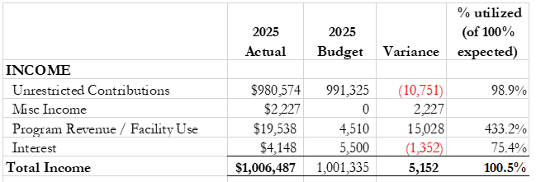

General Fund Report for 2025
Recall that the 2025 budget was a 15% increase over 2024
(Page 6)

Slide 20
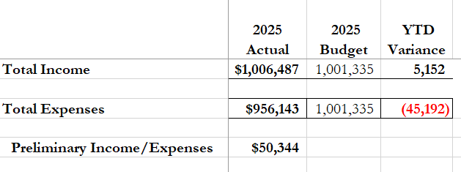

Income/Expense Report for 2025
NOTE: The Church Board allocated $50,000 from the 2025 year-end income/expenses balance to the Capital Fund

Slide 21
Income/Expense Report for 2025 - Summary
Although congregational giving fell behind budget early in the year, it was steady and generous throughout most of 2025, and especially in the last quarter of the year
More than 11% of undesignated income was given to external Ministry Partners, including the Brethren in Christ Church denominational ‘Common Fund’. This was in addition to special offerings of over $50,000.

Slide 22
Income Report for 2026 – as of Mar 31st
(Updated from Page 7)

Slide 23
Income/Expense Report for 2026 – as of March 31st

Slide 24
Income/Expense Report for 2026 to date
Summary
Total General Fund approved budget for undesignated giving in 2026 remained flat as compared to 2025
Undesignated (General Fund) weekly income year to date has been above budget expectations
BIC Common fund continues to receive 10% of all undesignated income

Slide 25
THANK YOU FOR YOUR GENEROUS GIVING

Slide 27
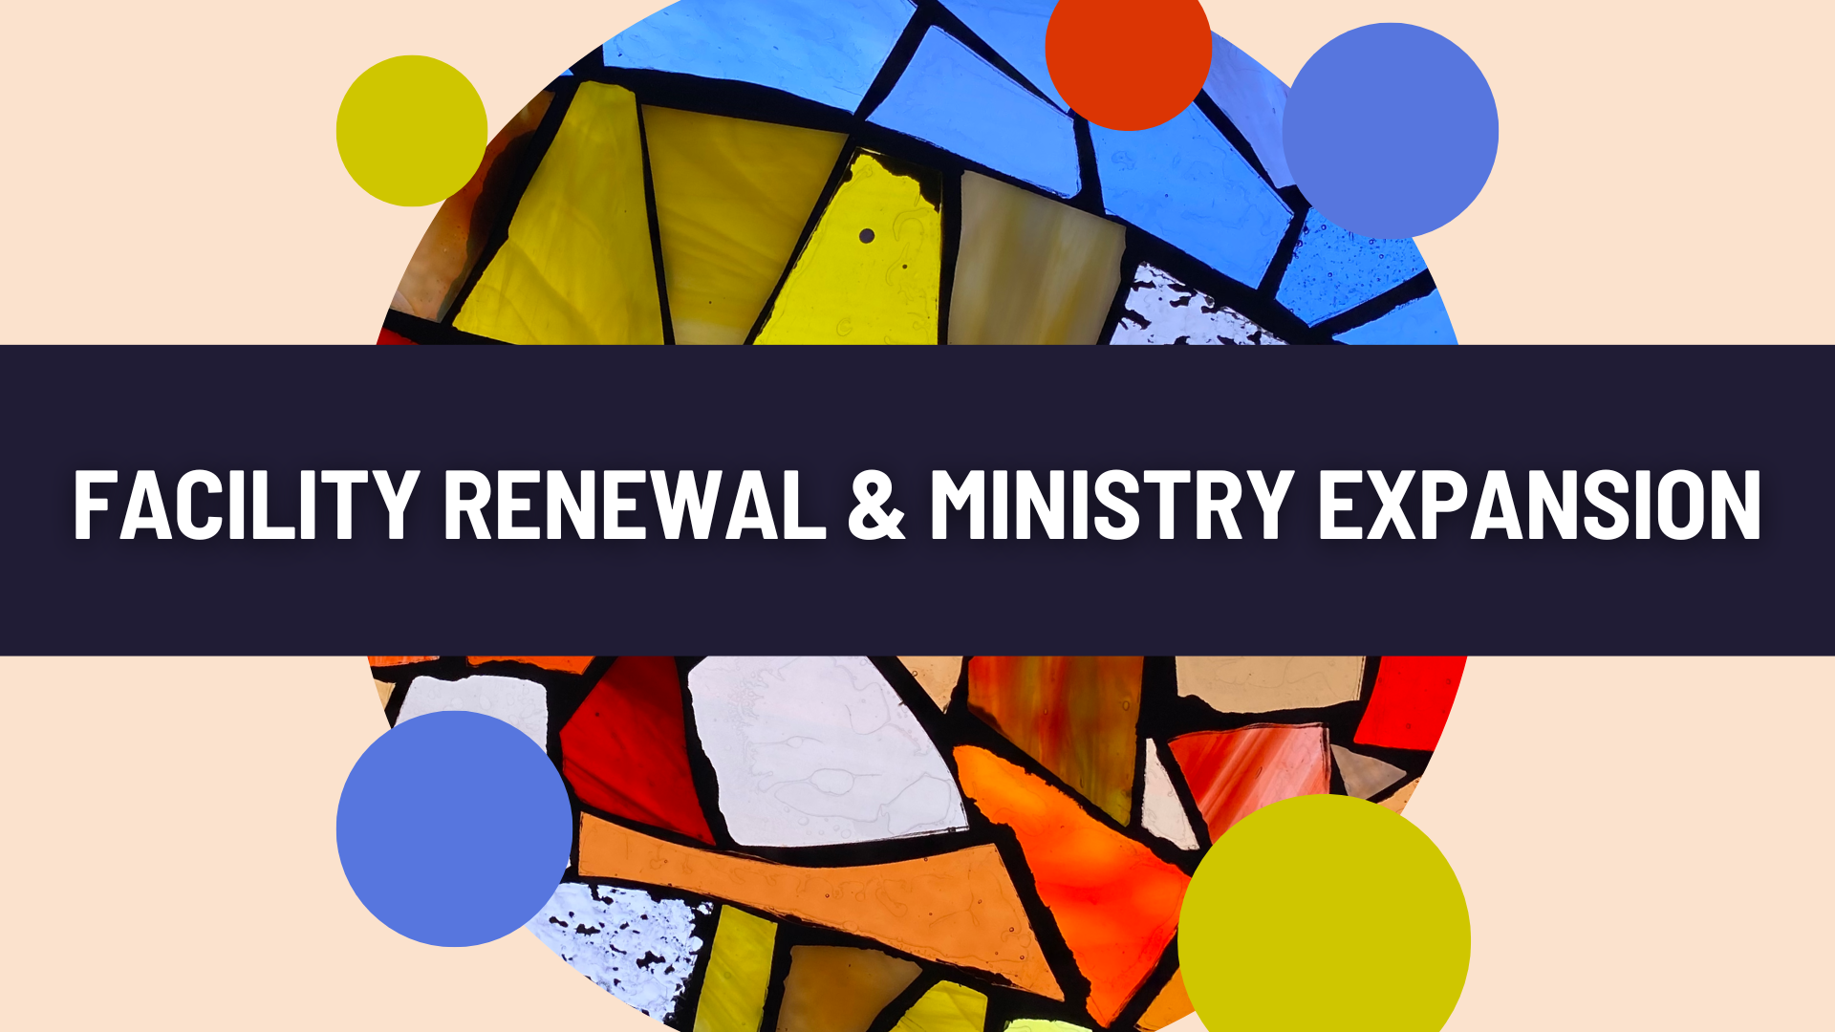

Slide 28
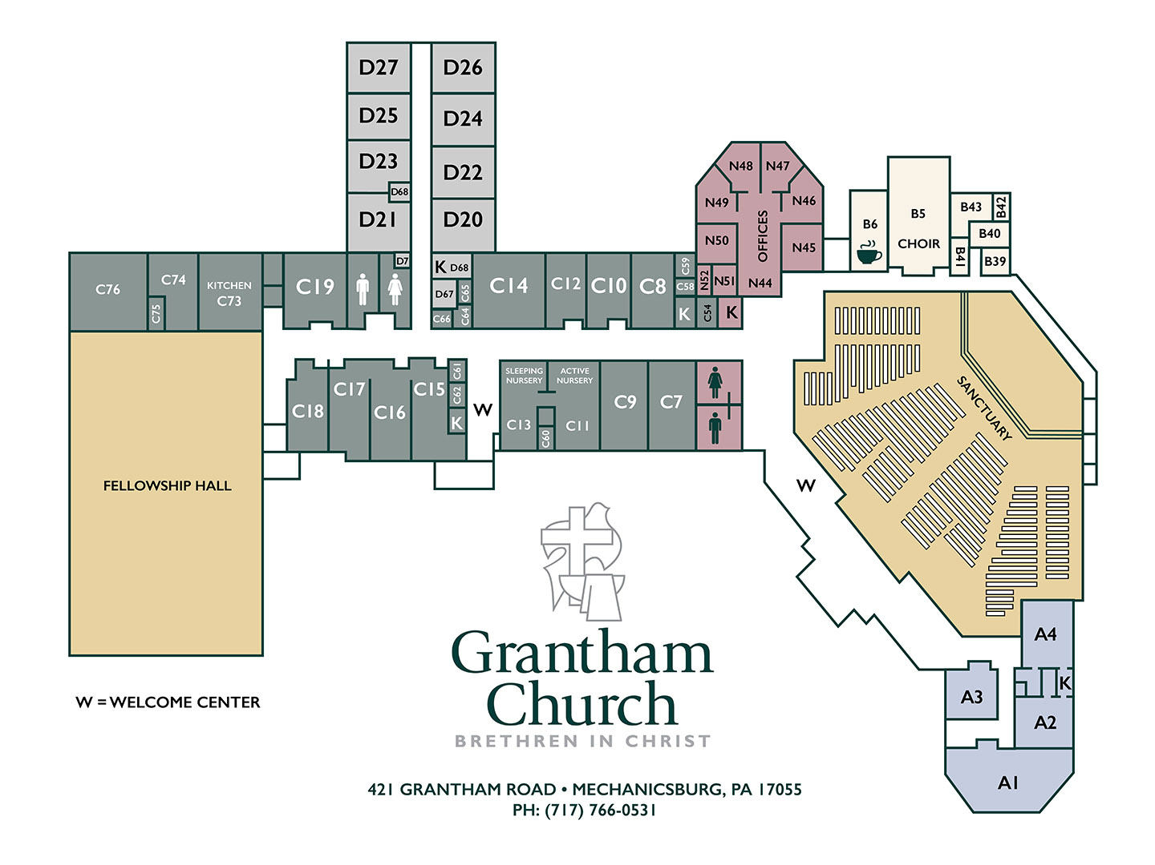

Slide 29
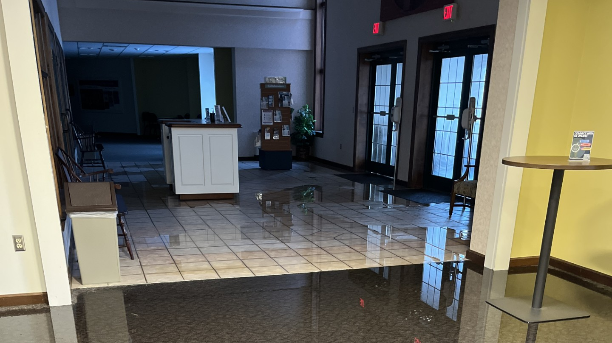

Slide 30



Slide 31



Slide 32
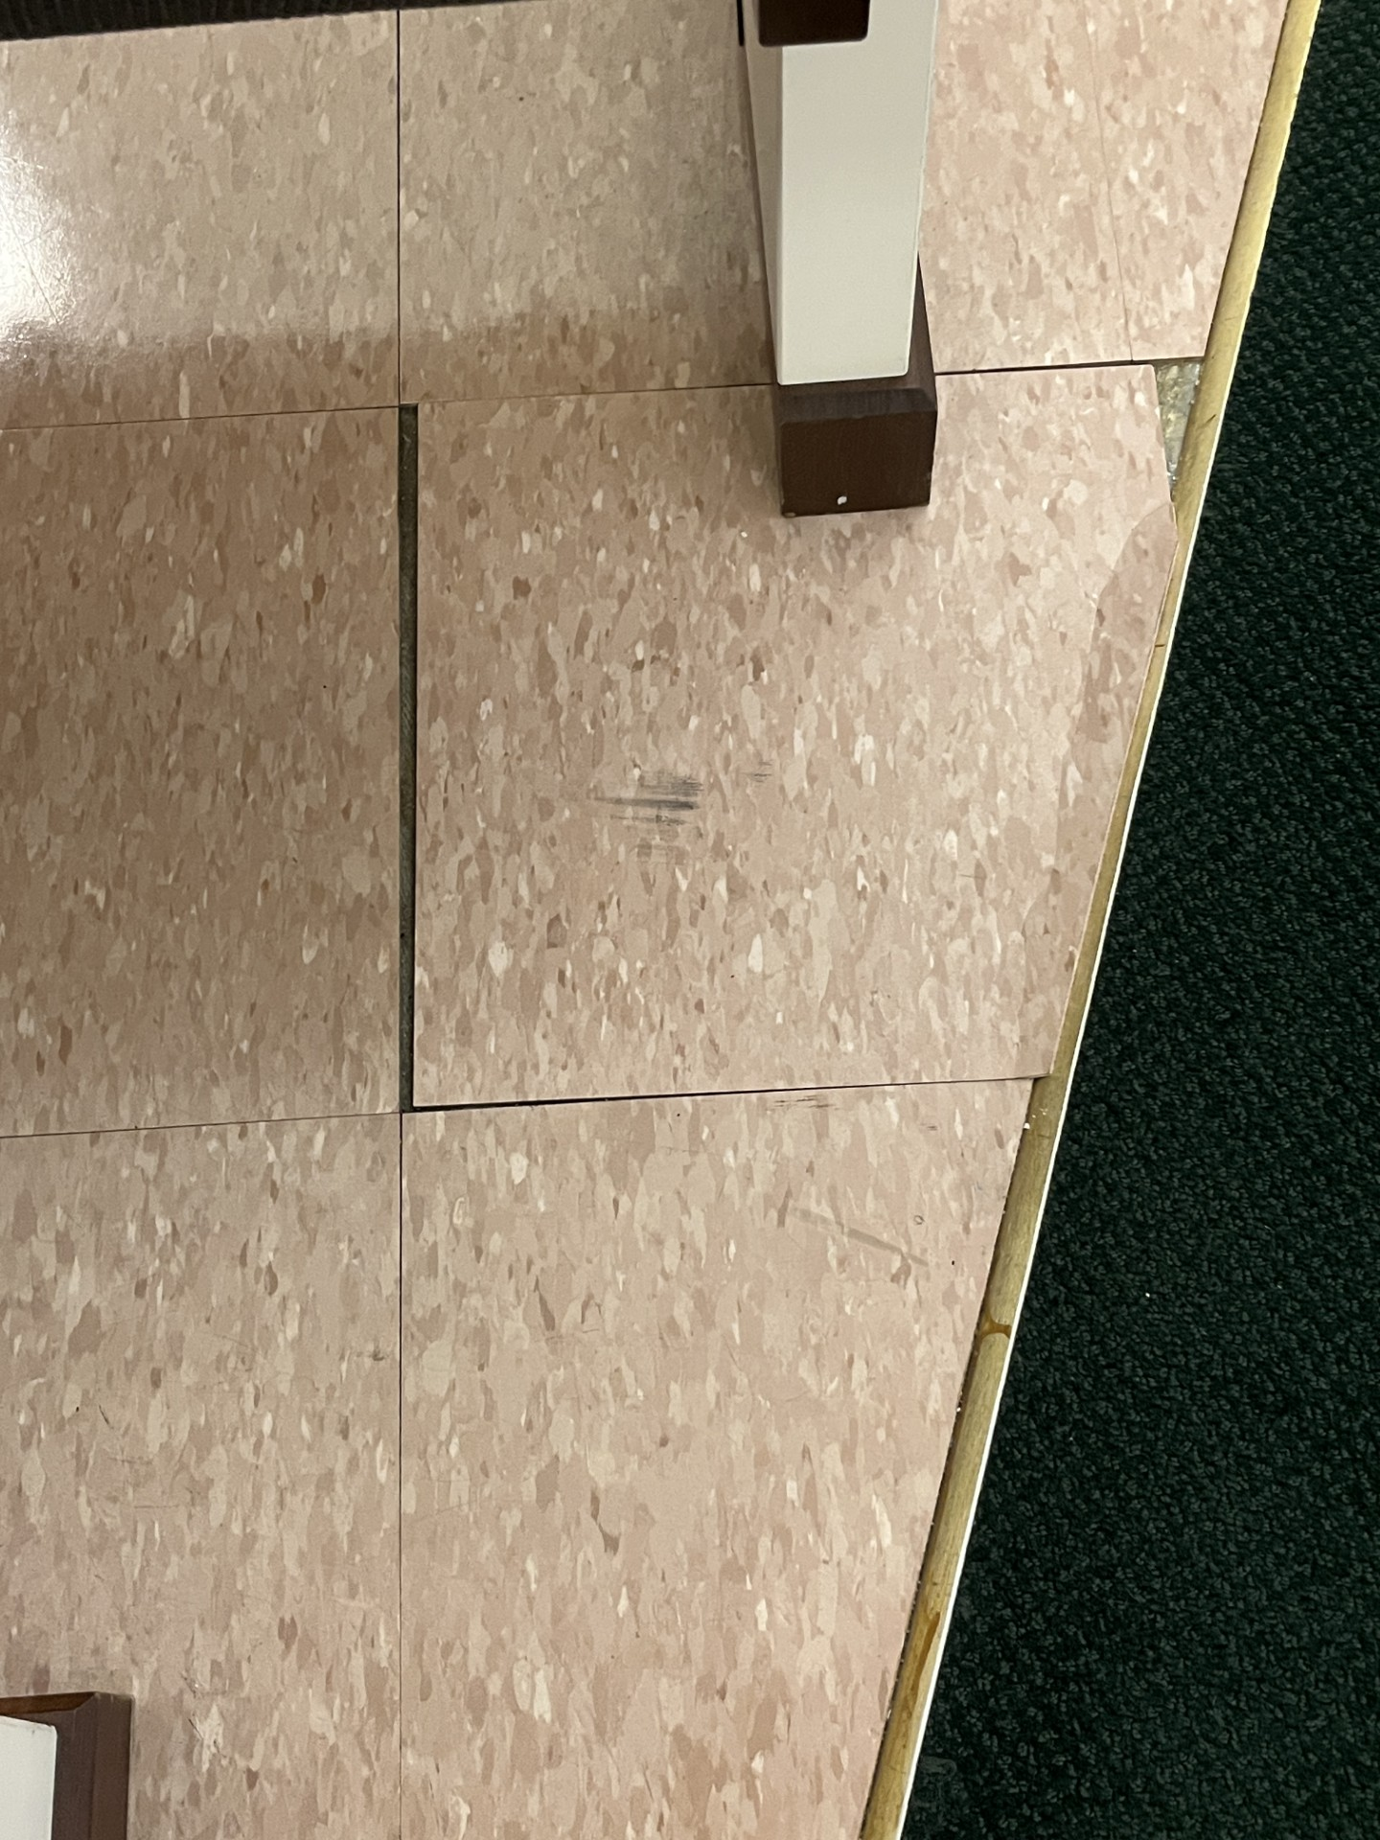

Slide 33
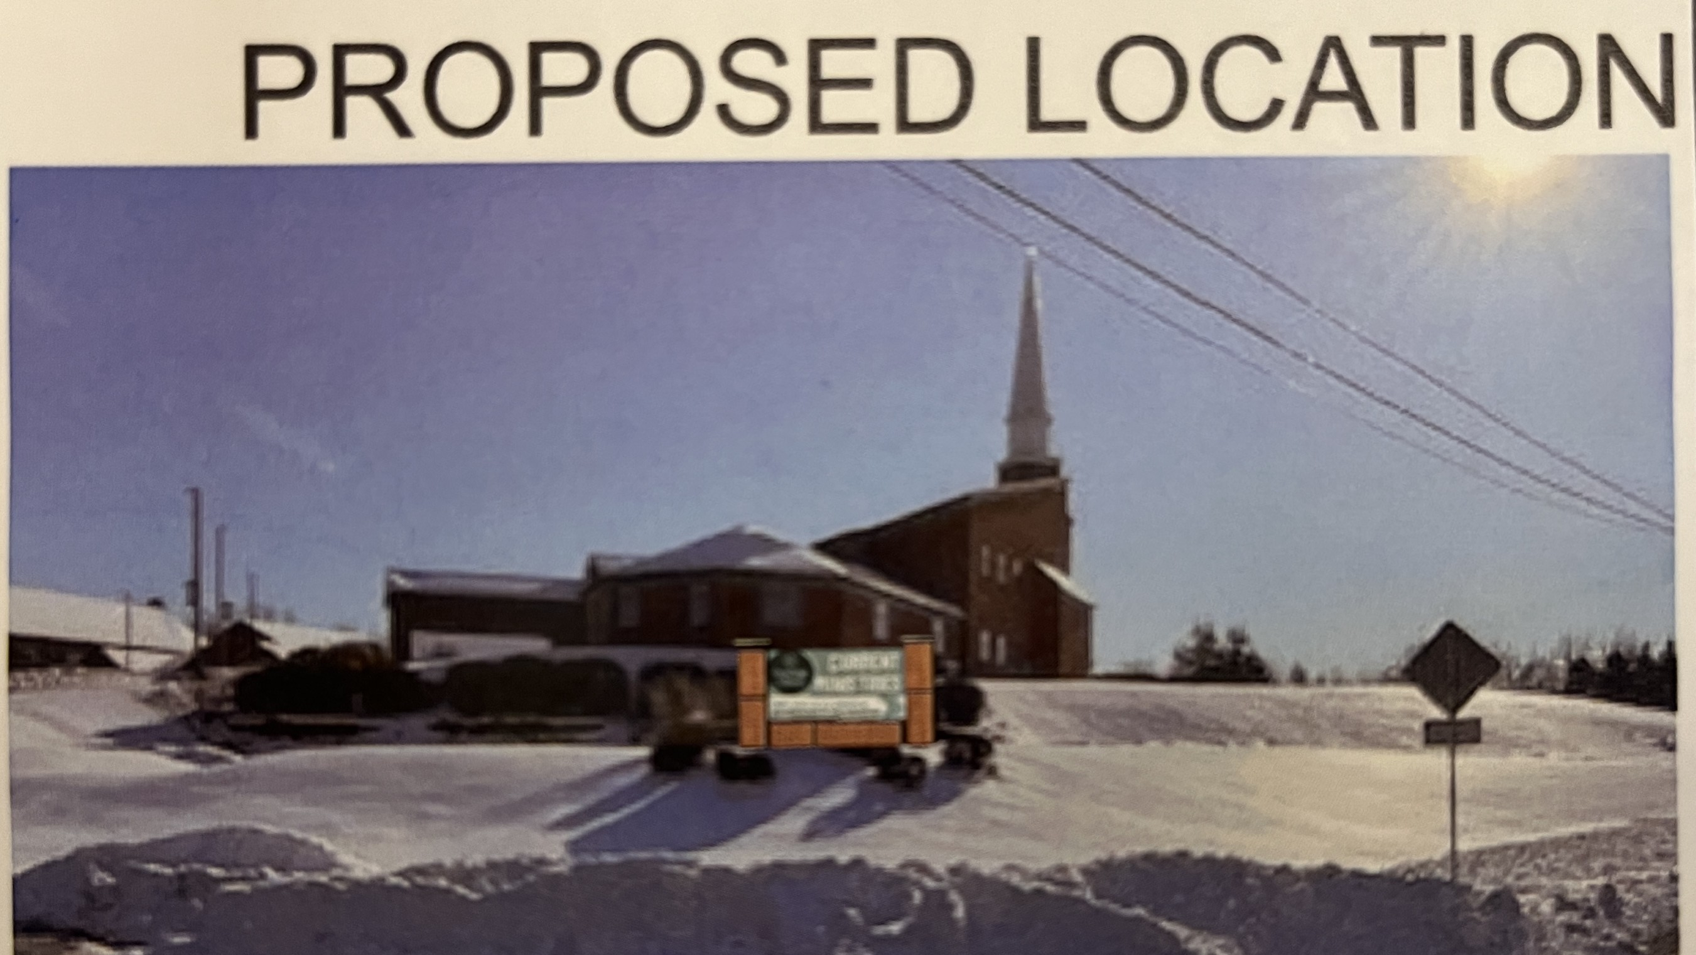

Slide 34
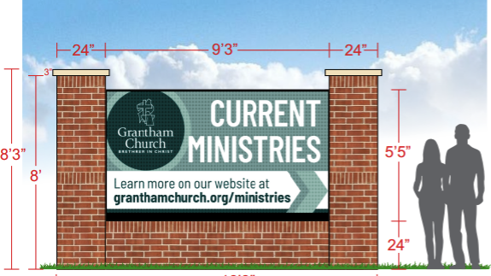

Slide 36


