Slide 1
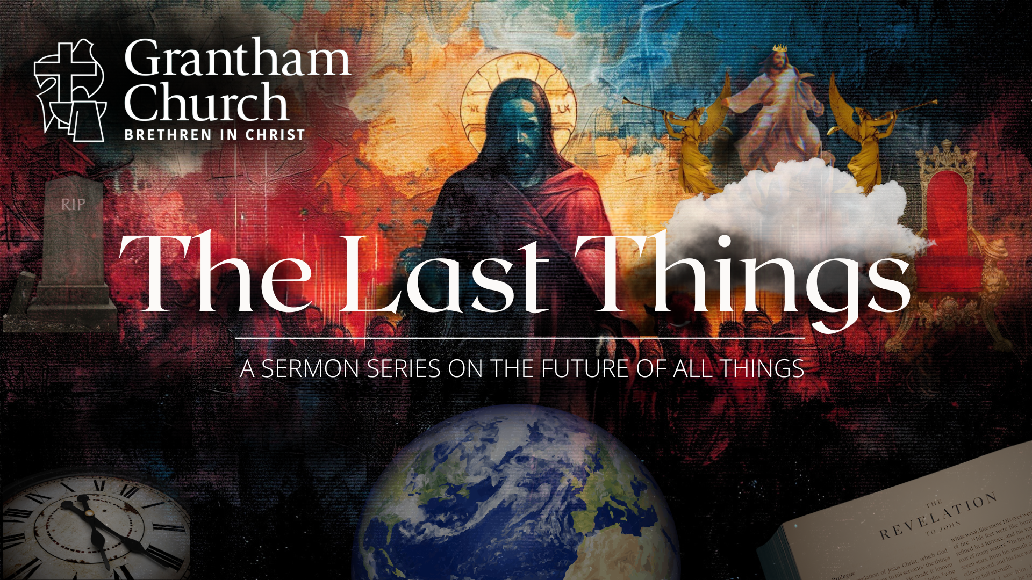
Notes:
[BRIEF WELCOME & INTRO]
As I said in the weekly email this past week, and as you can see in your bulletin this morning, today we begin a new sermon series, The Last Things – a 7-week sermon series on the future of all things.
If you’re new to the Christian faith, or you’ve been following Jesus for a while now but you don’t know, the ”last things” comes from… [NEXT SLIDE]

Slide 2
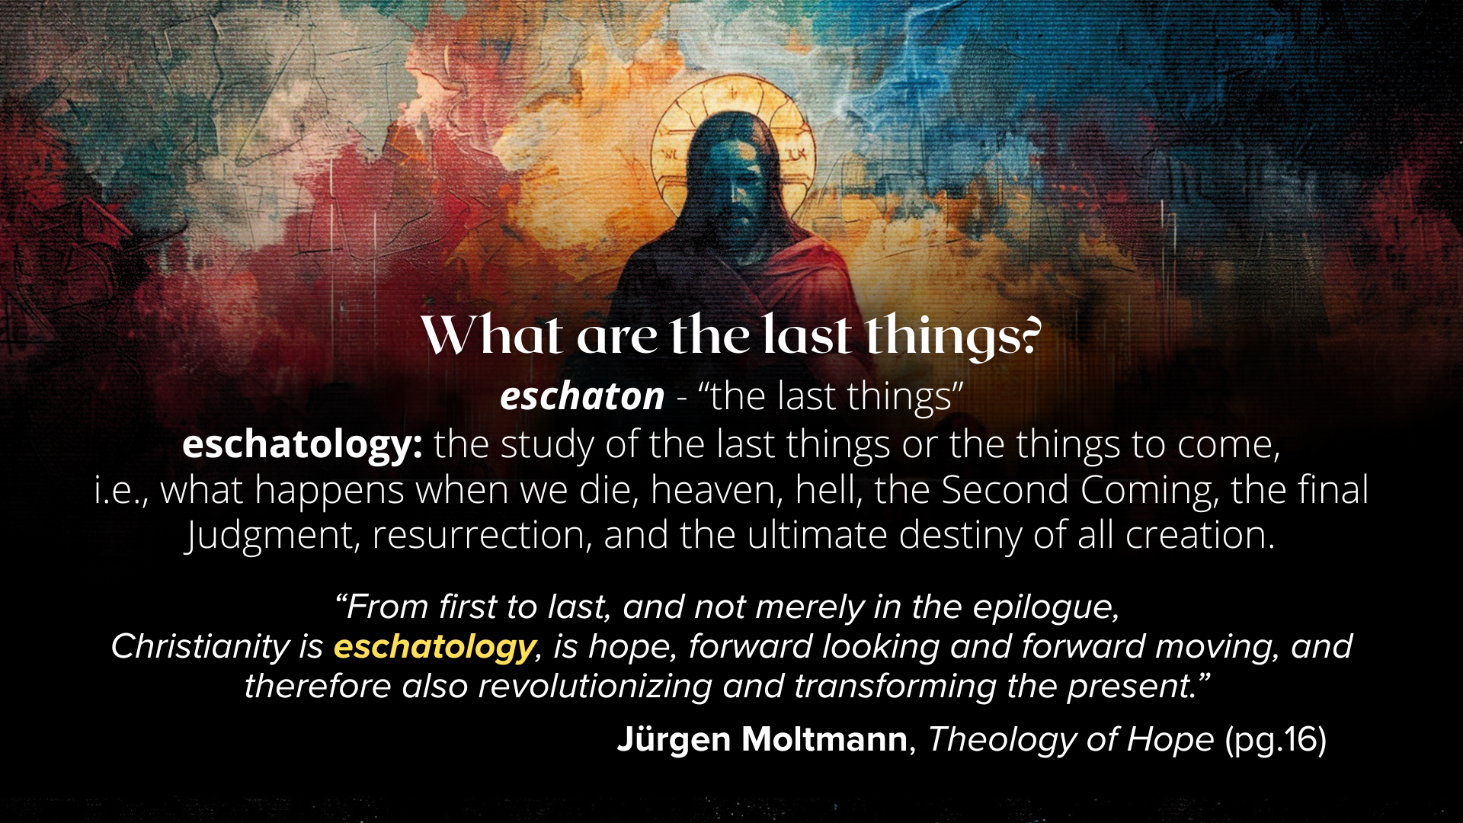
Notes:
[READ SLIDE & COMMENT]
You can hear in Moltmann’s words that a knowledge of “the last things” has meaning, purpose, and implications for our present lives. And as we will see throughout this series, knowing the end—i.e., knowing where everything is going, according to the Scriptures—ought to inform the way we live in the present; ultimately, that we would live with hope in Christ and trust in God’s good future.
But allow me to elaborate and expound a bit on why Christian eschatology matters and why we are doing this series. Here are some reasons to consider… [NEXT SLIDE]

Slide 3
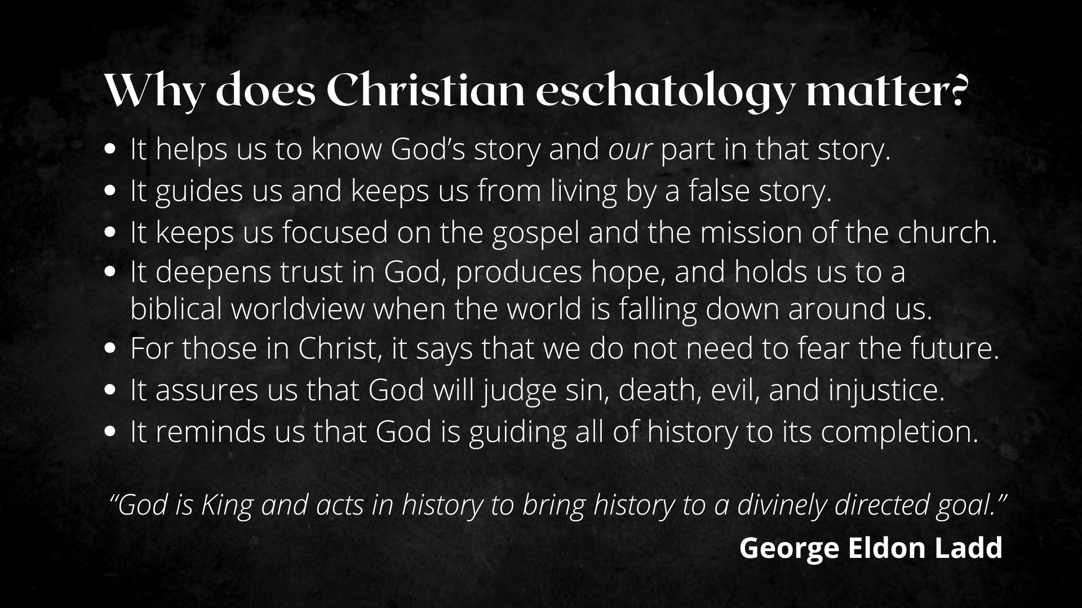
Notes:
It matters because…
It helps us to know God’s story and our part in that story.
It guides us and keeps us from living by a false story.
It keeps us focused on the gospel and the mission of the church.
It deepens trust in God, produces hope, and holds us to a biblical worldview when the world is falling down around us.
For those in Christ, it says that we do not need to fear the future.
It assures us that God will judge sin, death, evil, and injustice.
It reminds us that God is guiding all of history to its completion.
And as the theologian George Eldon Ladd said, “God is King and acts in history to bring history to a divinely directed goal.” And what is that telos… that aim and goal?
Here is how we’ve been presenting that divinely directed goal in a single image… [NEXT SLIDE]

Slide 4
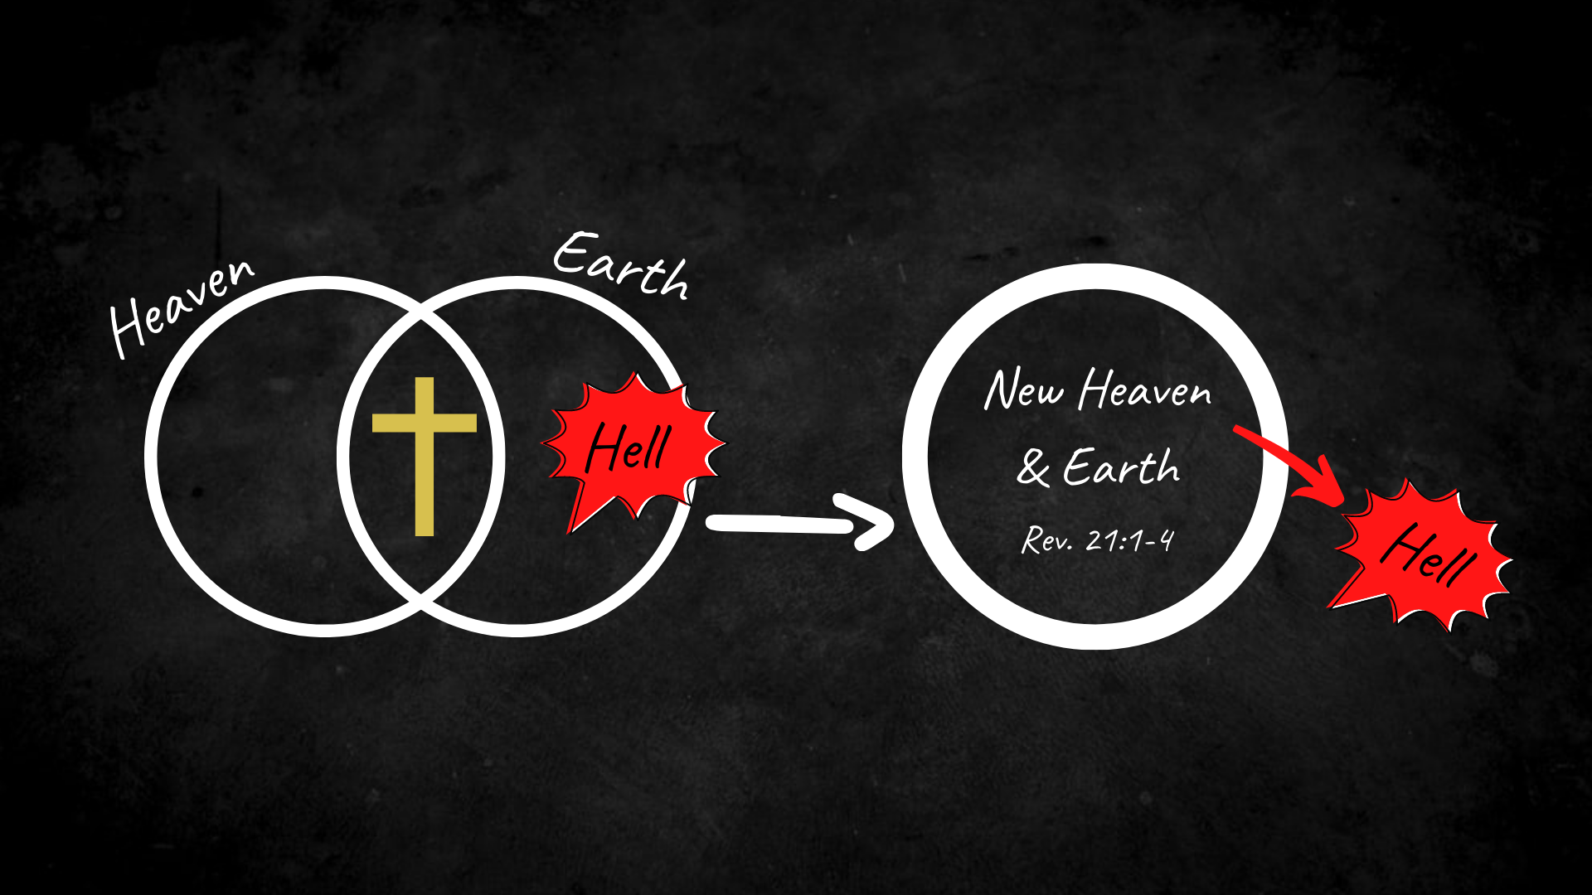
Notes:
[EXPLAIN GRAPHIC]
Heaven and earth: two spheres or dimensions; God’s space and our space overlapping and interlocking; in the OT we see this reflected in the Temple; in the NT we see this in Jesus (the true Temple)—his life, his miracles, healings, and most clearly in his death and resurrection
In his resurrection body, we see heaven and earth coming together; and we heard from Jesus and his first disciples that he has defeated sin and death, and is driving it out of God’s good creation
And so, God will eventually (upon the return of Christ) fully consummate and bring together heaven and earth, resurrect and renew the cosmos, and cast out sin, death, and hell forever.
And so, while this series will address the details and the various aspects of the last things, it will also expound upon this image which captures God’s goal, the gospel of the Kingdom, and a NT eschatology that is forward moving and has transformative power for the present and the future.
And here is where we’re going each week in this series… [NEXT SLIDE]

Slide 5
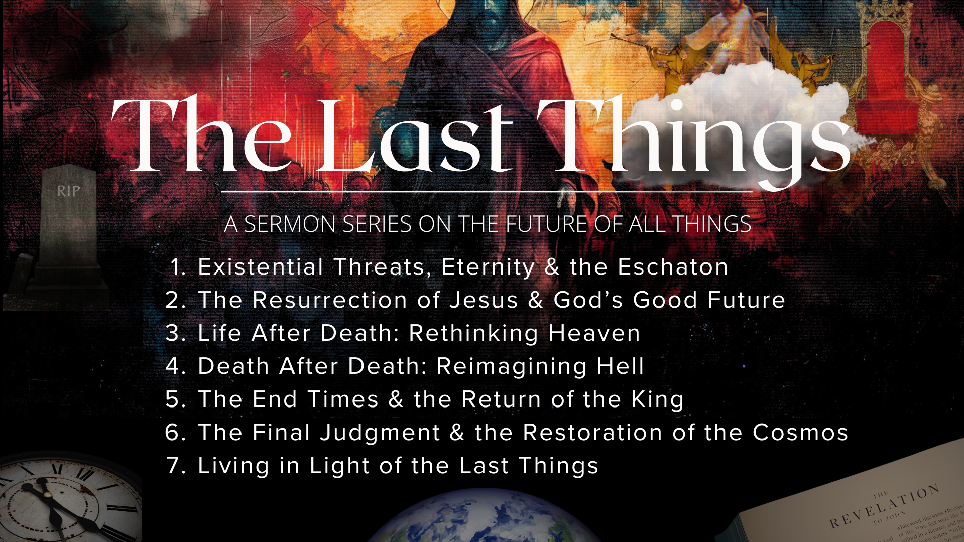
Notes:
Existential Threats, Eternity & the Eschaton In the intro this morning, I’ll be inviting us to adopt an eternal perspective, build our lives upon God’s story, and deepen our trust in his power to guide history to its divinely intended goal.
The Resurrection of Jesus & God’s Good Future We will look at how the resurrection of Jesus changed everything, what it means for us in the present, and why it’s essential for understanding where everything is going.
Life After Death: Rethinking Heaven What happens when we die? We will look at what the Bible says; we’ll consider neuroscience, testimonies of NDE’s, and clarify some misunderstandings and confusion about heaven.
Death After Death: Reimagining Hell Jesus warned us about a destruction of spirit, soul, and body in hell. What does he mean? The book of Revelation says there is a second-death for the lost; so, what may have we gotten wrong about hell, and how do we square an eternal hell with the God who looks like Jesus?
The End Times & the Return of the King Are we living in the end times? If so, what does it mean? And what about the return of Christ? I’ll challenge the popular conception of the rapture and unpack what the Bible actually says about Jesus coming back and what that will be like according to the Scriptures.
The Final Judgment & the Restoration of the Cosmos How do we understand God’s wrath on the wicked? What is the final judgment and why is it necessary? And we’ll look at how God plans to redeem and restore the entire universe.
Living in Light of the Last Things In the conclusion of the series, we will take everything we’ve covered and ask, “How then shall we live?” We will consider its implications on evangelism, the urgency of the gospel and the mission of the church, and why we can stand firm in our faith, no matter what may come.
And don’t forget, you can jam out to The Last Things Music Playlist at our YouTube channel! We also have books out in the lobby. And I will be following up each message with resources to go deeper. You can look for those in the weekly email and posted with the sermon at our website.
Before we move into today’s focus… [NEXT SLIDE]

Slide 6
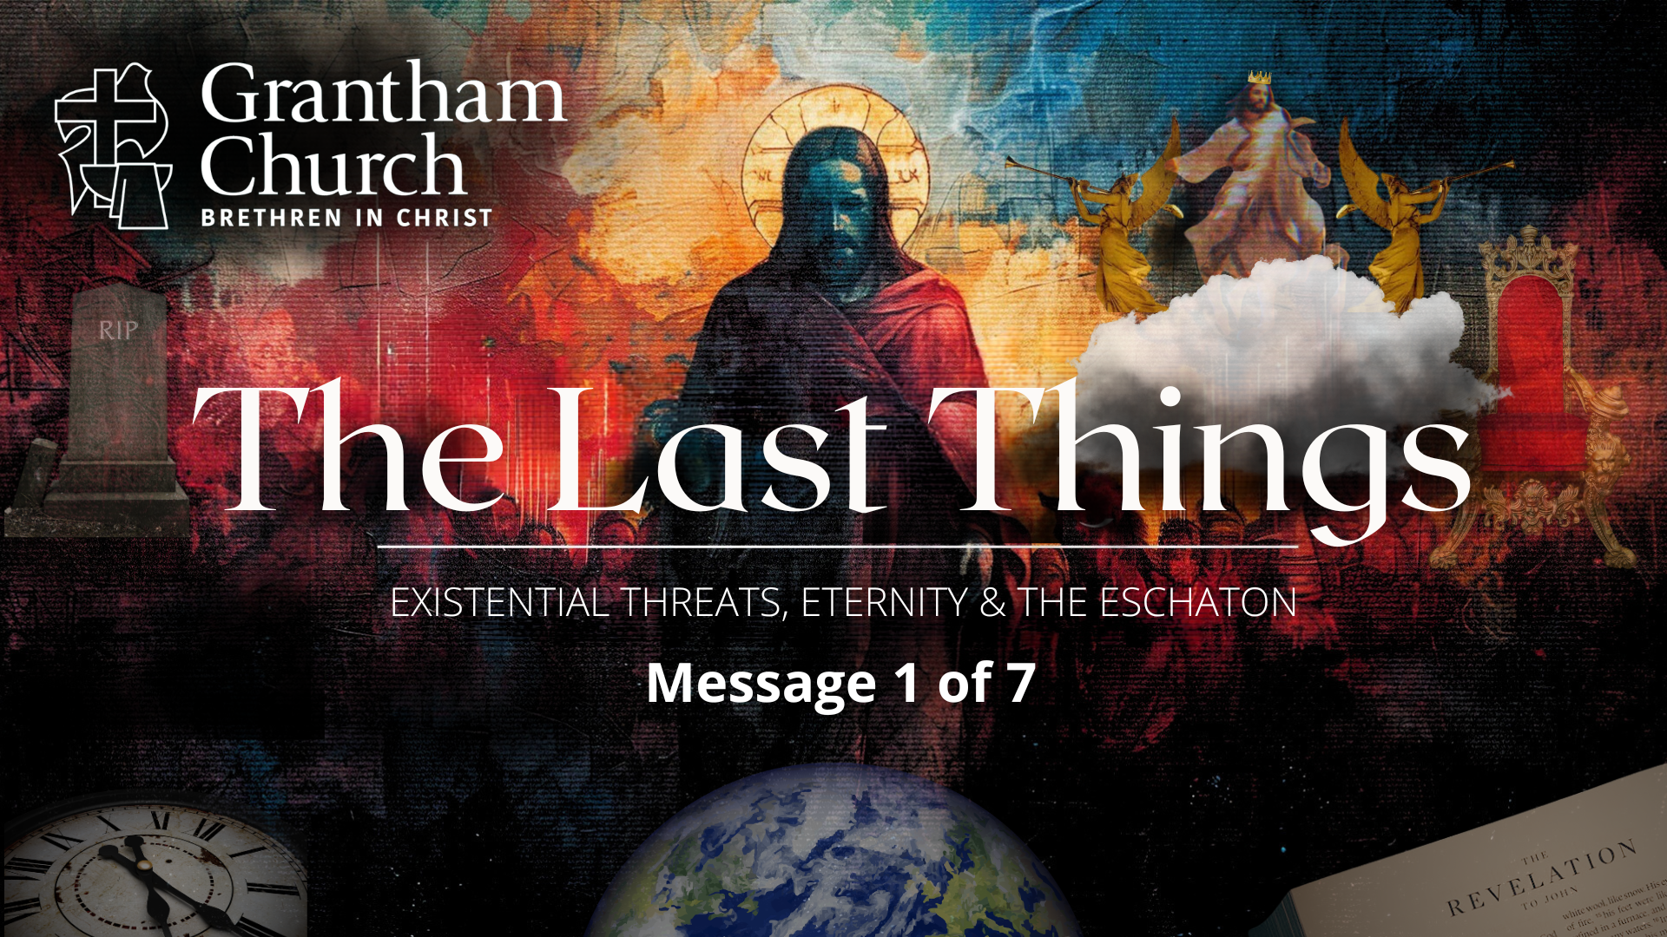
Notes:
Let’s ready our hearts and minds in prayer, as we prepare ourselves to receive a word from the Lord. [BRIEF PRAYER]
Existential Threats, Eternity & the Eschaton.
If you Google “existential threat” it will give you a definition like this: “An existential threat is a danger to something's very existence, or the continued well-being of something. It can refer to threats to living things, or even non-living things like ideologies or countries. Essentially, it's a threat that could lead to the end of something, or a significant and irreversible negative change in its nature.
In preparation for this series, and because I take personal interest in these things, I did some reading and video watching as it relates to these existential risks and threats that a growing number of leading thinkers are concerned about. And these concerns aren’t just from liberal politicians, godless scientists, or conspiracy theorists. Many people from across the political spectrum are engaging in these conversations. These concerns and threats range from artificial intelligence, to nuclear war, to climate collapse, to infectious disease, to super volcanoes, all the way to extra terrestrials.
And I’m aware of other pastors and theologians who are paying attention and trying to process these things through the lens of Christian eschatology.
In his book, The Precipice… [NEXT SLIDE]

Slide 7
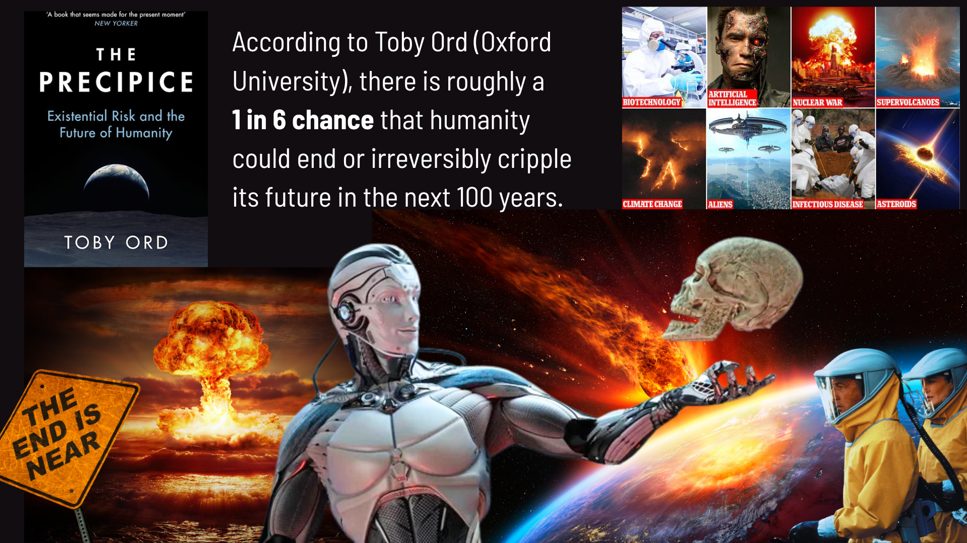
Notes:
Existential Risk and the Future of Humanity, Toby Ord, a respected philosopher at Oxford University, made a calculated and educated claim that there is roughly a 1 in 6 chance that humanity could end or irreversibly cripple its future in the next 100 years. To be clear, these are not predictions, but, rather, subjective, expert-informed estimates that Ord hopes will spur action and awareness. Ord emphasizes that these risks are preventable, and that humanity is at a critical point—"the precipice"—where our decisions this century could determine our long-term future.
Is that concerning? Sure it is. And as a people who want to hold together a belief in God’s sovereignty alongside human free will (and that we live in some sense a “choose-your-own-adventure” sort of world), we should know that our actions, or lack thereof, matter… even though God is still in charge and promises to redeem and restore creation. But he calls us to be stewards and caretakers of this groaning creation, so that our lives would be signposts pointing to the new world that is coming.
So, what do we make of all this “end of the world” talk and fascination with the demise of humanity? From books, movies, to streaming shows that are “apocalyptic” and dystopian in nature, to political speeches and news headlines, this stuff is everywhere. And so, as Christians, what are we to think about it? How should we respond? Well, I submit to you that whatever your fears or concerns about the future may be, we need to look to Christ and the Scriptures before we draw any conclusions.
If you have your Bibles, turn with me to… [NEXT SLIDE]

Slide 8
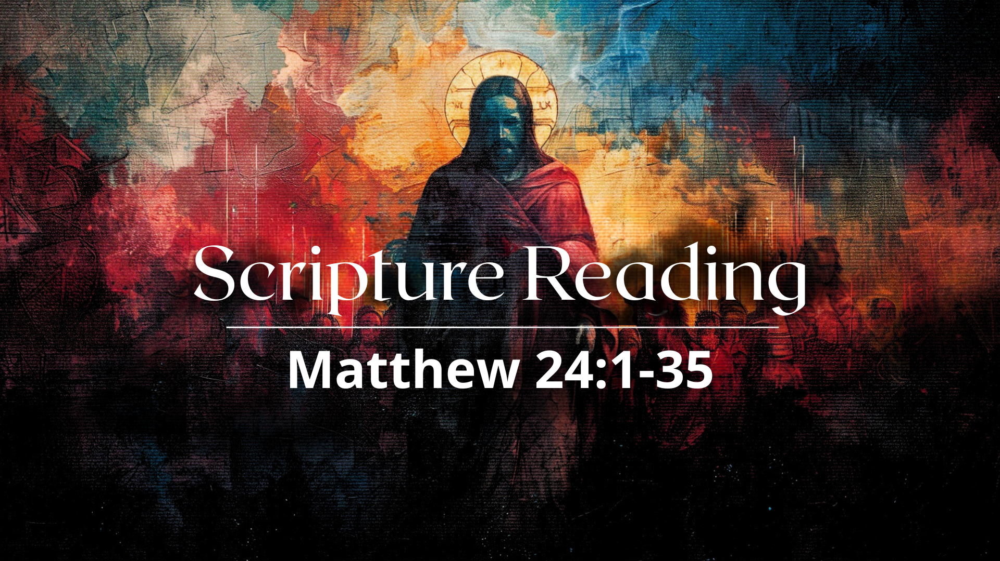
Notes:
[READ MATT. 24:1-35 & COMMENT ON PASSAGE]
[SUMMARY]
In the immediate context, Jesus is predicting the fall of Jerusalem (e.g., Matt. 24-25)
While he wasn’t talking about the end of the world, it would have seemed that way to them
Does the Bible talk about the end of the world? Well, not the way we often talk about or envision it. And that will become clear as we move along in this series.
Still, these sobering words of Jesus can apply to us, specifically his call to be awake, alert, and ready for hard times; And when they come, we should not panic, join in on the hate and violence, or lose our heads, or our faith. Rather, we need to remember the goodness and the power our God.
Listen to what the Lord says through the prophet Isaiah… [NEXT SLIDE]

Slide 9
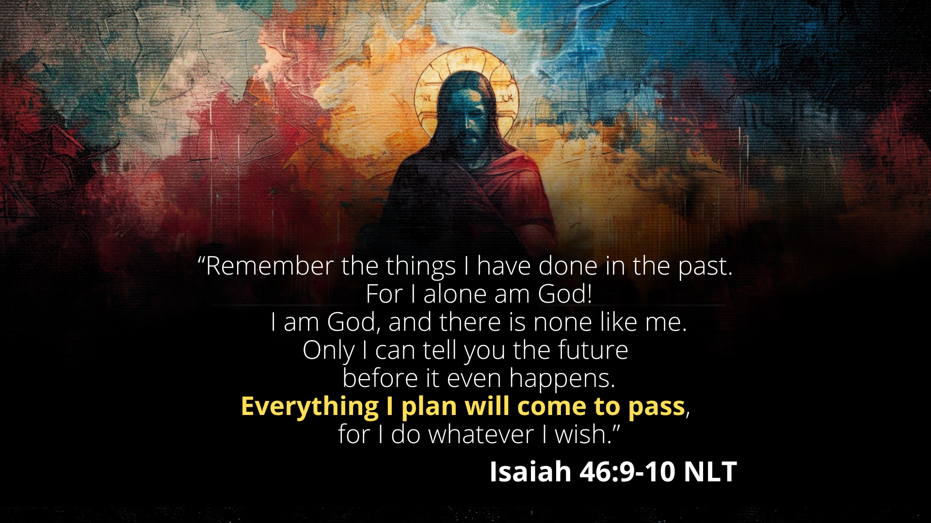
Notes:
[READ & COMMENT]
“Everything I plan will come to pass…” And what has God planned? Where is everything going?
Let’s look at what God has revealed in the New Testament… [NEXT SLIDE]

Slide 10
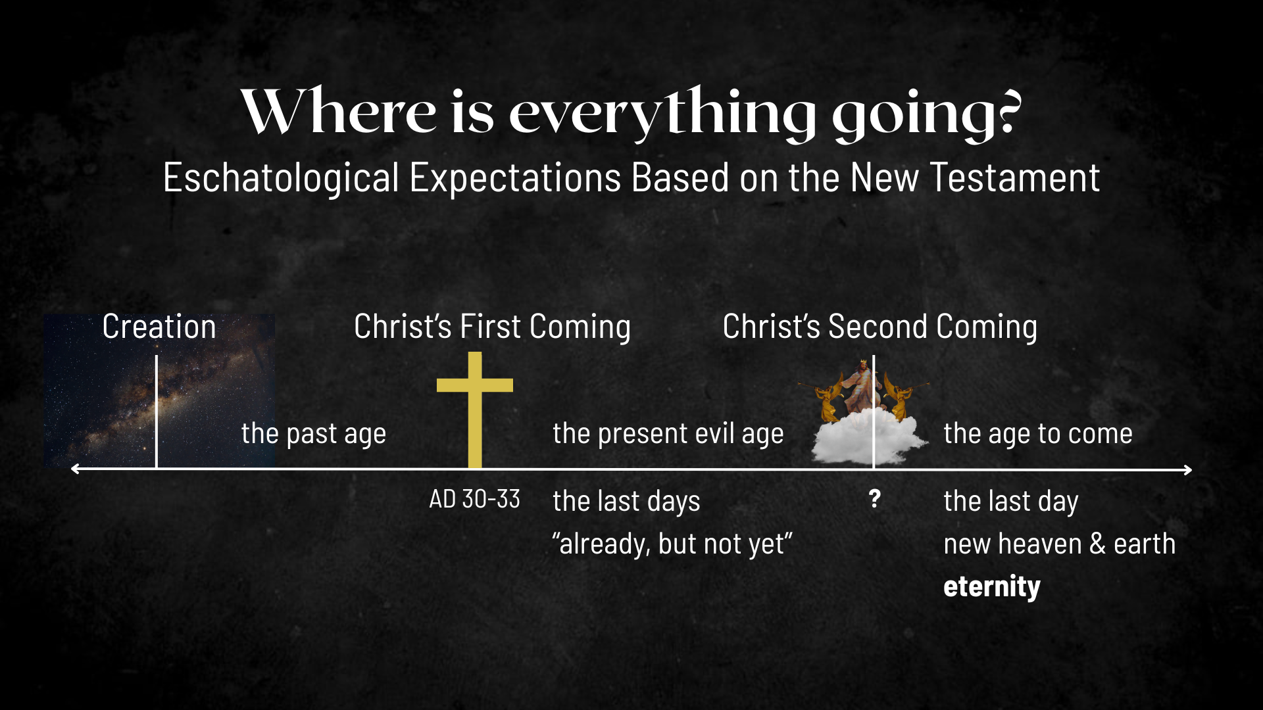
Notes:
[EXPLAIN IMAGE – CREATION TO ETERNITY]
Jesus’ first coming split our historical timeline (the ages)
An Inaugurated and Future (already, but not yet) Kingdom eschatology
The French theologian Oscar Cullman used a helpful illustration to understand the effect of the first and second comings of Christ: D-Day (June 6, 1944) vs. VE-Day (May 8, 1945); the decisive battle has been won on the cross and the victory is certain, it’s only a matter of time.
According to the NT, since the life, death, and resurrection of Christ, we are living in the “last days” of the present evil age; we live in the ”already, but not yet” of the Kingdom of God;
And when Christ returns a second time, the new age or “age to come” will be realized; this is when God brings heaven to earth and we enter the eternal (aionios), the age to come life, and this ”eternal” life or “eternity” isn’t just about never-ending existence, it’s about a quality of life.
And if we will listen and pay attention to our inner most being, we will discover that God has put longings for the eternal and eternity in us. In Ecclesiastes 3:11, the Bible says… [NEXT SLIDE]

Slide 11
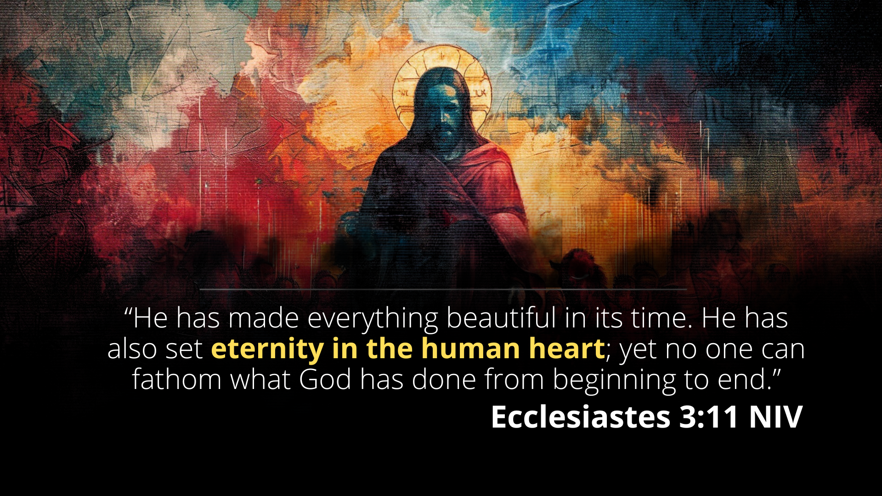
Notes:
[READ & COMMENT]
The awareness that death is an assault on life; it’s a thief and a robber; it’s an evil that interrupts and destroys; it feels to us (if we will pay attention to it) that it doesn’t belong.
Also, we have this innate desire to go on and never be separated from loved ones; the desire to just sit in a beautiful, inspiring, glorious, loving moment forever… my friends, that’s “eternity in the human heart.” And that is reflective of what God has placed within us and wants for us.
And so, we must adopt an eternal perspective of this present evil age. And that’s what this sermon series is about; that we would have an eternal perspective that impacts and transforms us in the present to live with the knowledge that God will save and deliver those who want to be.
Let’s look now at some takeaways and seek to make application based on this first message in our series… [NEXT SLIDE]

Slide 12
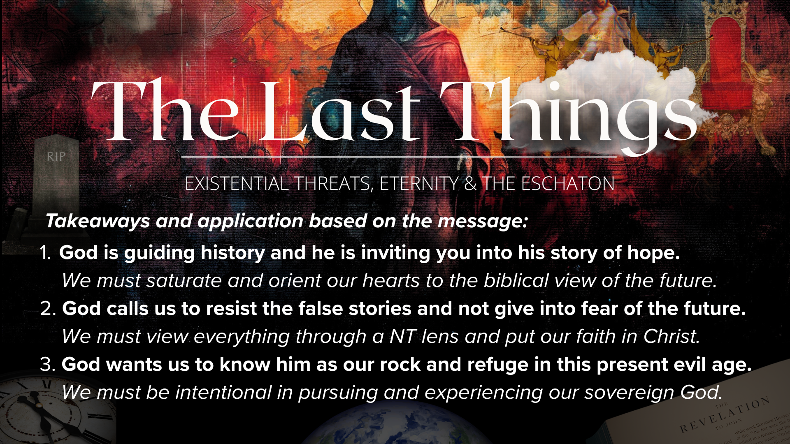
Notes:
[READ & COMMENT ON EACH TAKEAWAY]
1. God is guiding history and he is inviting you into his story of hope.
We must saturate and orient our hearts to the biblical view of the future.
2. God calls us to resist the false stories and not give into fear of the future.
We must view everything through a NT lens and put our faith in Christ.
3. God wants us to know him as our rock and refuge in this present evil age.
We must be intentional in pursuing and experiencing our sovereign God.
Finally, I’d like us to read one more passage together… [NEXT SLIDE]

Slide 13
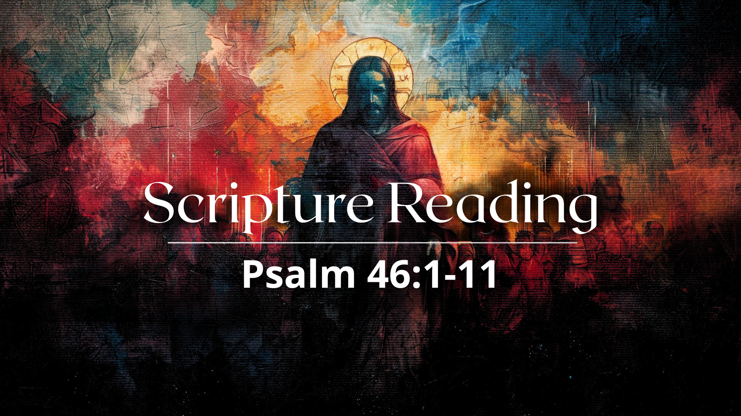
Notes:
[READ PSALM 46:1-11 NIV]
“Be still… and know that I am God” (v.10).
Church, it is critical that we find times to be still, to log off social media, to turn off the news, to get away from the noise, and sit with our thoughts. And then invite the Lord to meet us there in our questions, concerns, worries, and fears of the future; to speak to us; and to remind us by the power of the Holy Spirit who he is, that he is with us, and that he will do what he has promised.
[BRIEF COMMENTS] – This series is for you.
Here are some questions to help us reflect and respond to what we’ve heard this morning… [NEXT SLIDE]

Slide 14
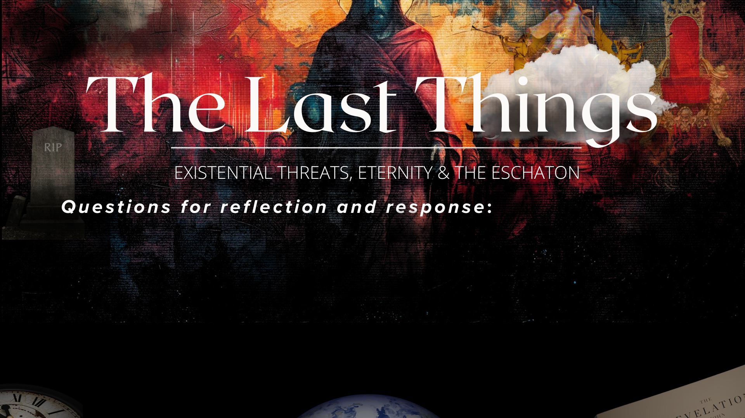

Slide 15
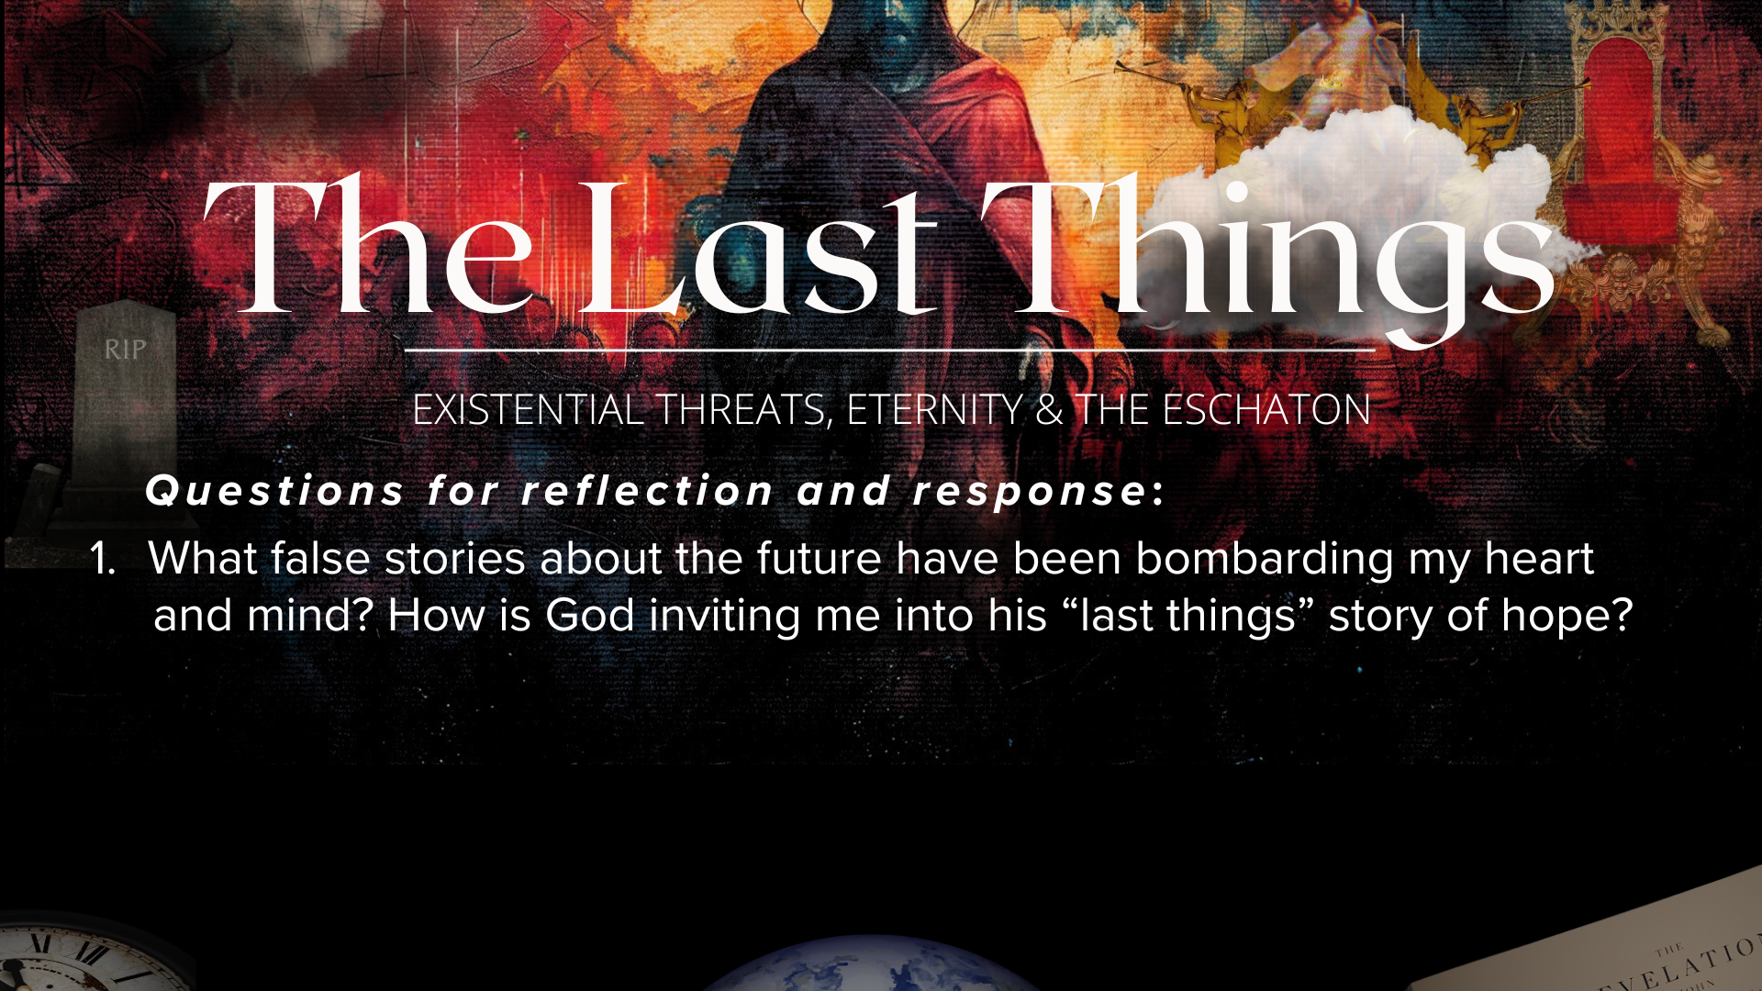

Slide 16
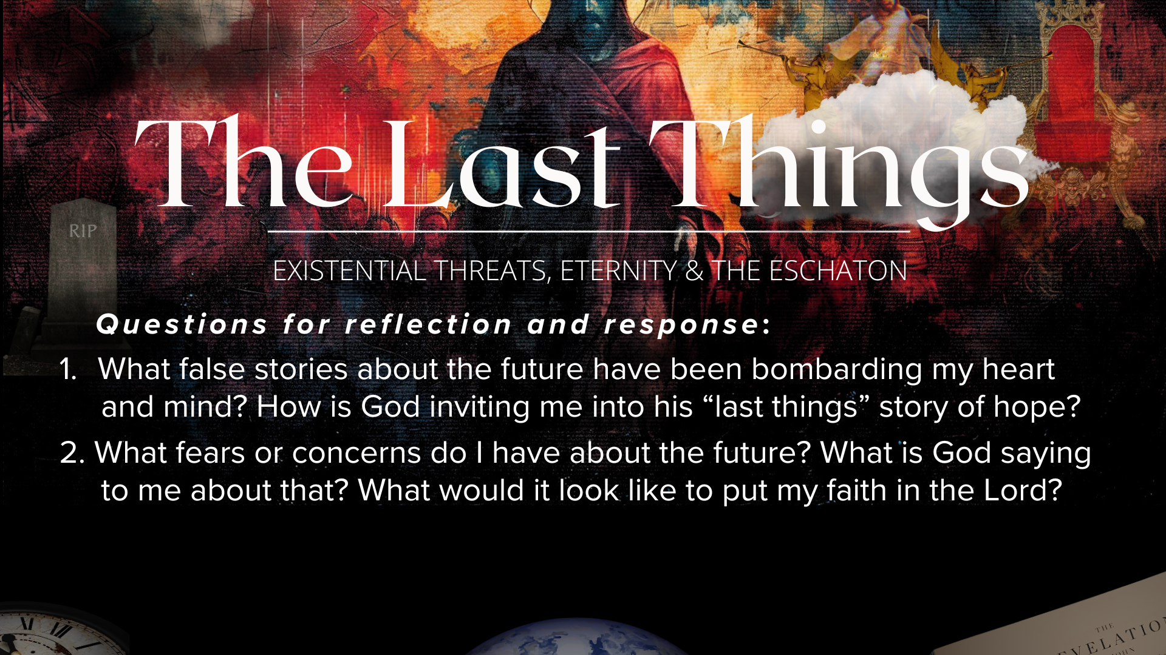

Slide 17
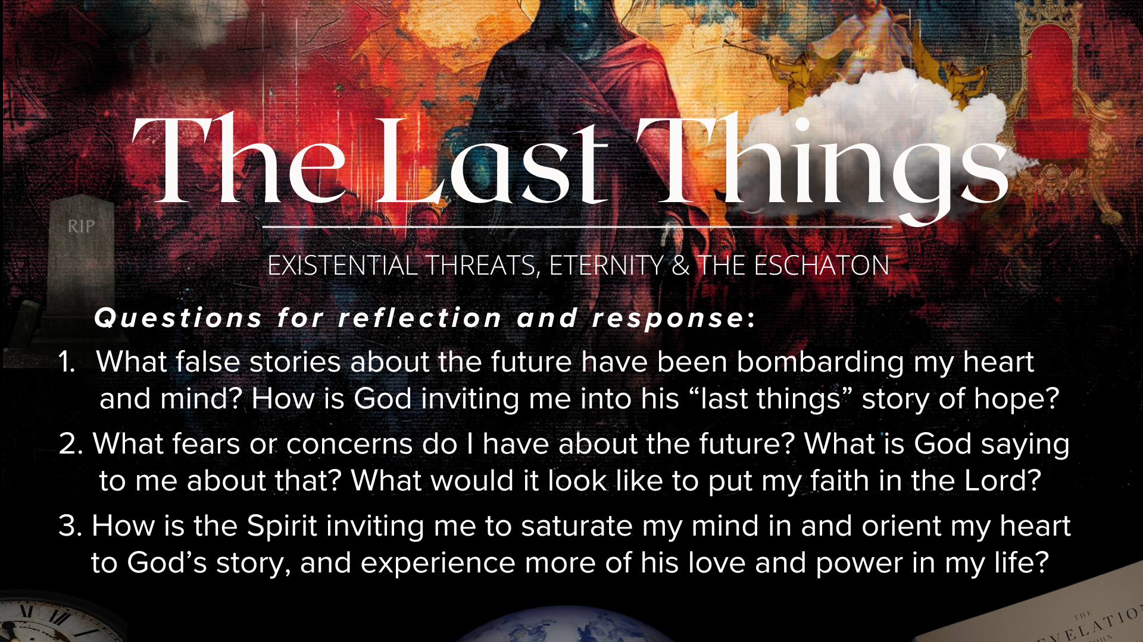
Notes:
[READ & BRIEF COMMENT ON EACH QUESTION]
What false stories about the future have been bombarding my heart and mind? How is God inviting me into his “last things” story of hope?
What fears or concerns do I have about the future? What is God saying to me about that? What would it look like to put my faith in the Lord?
How is the Spirit inviting me to saturate my mind in and orient my heart to God’s story, and experience more of his love and power in my life?
[CLOSING WORDS]
Let’s pray… [NEXT SLIDE FOR CLOSING PRAYER]

Slide 18
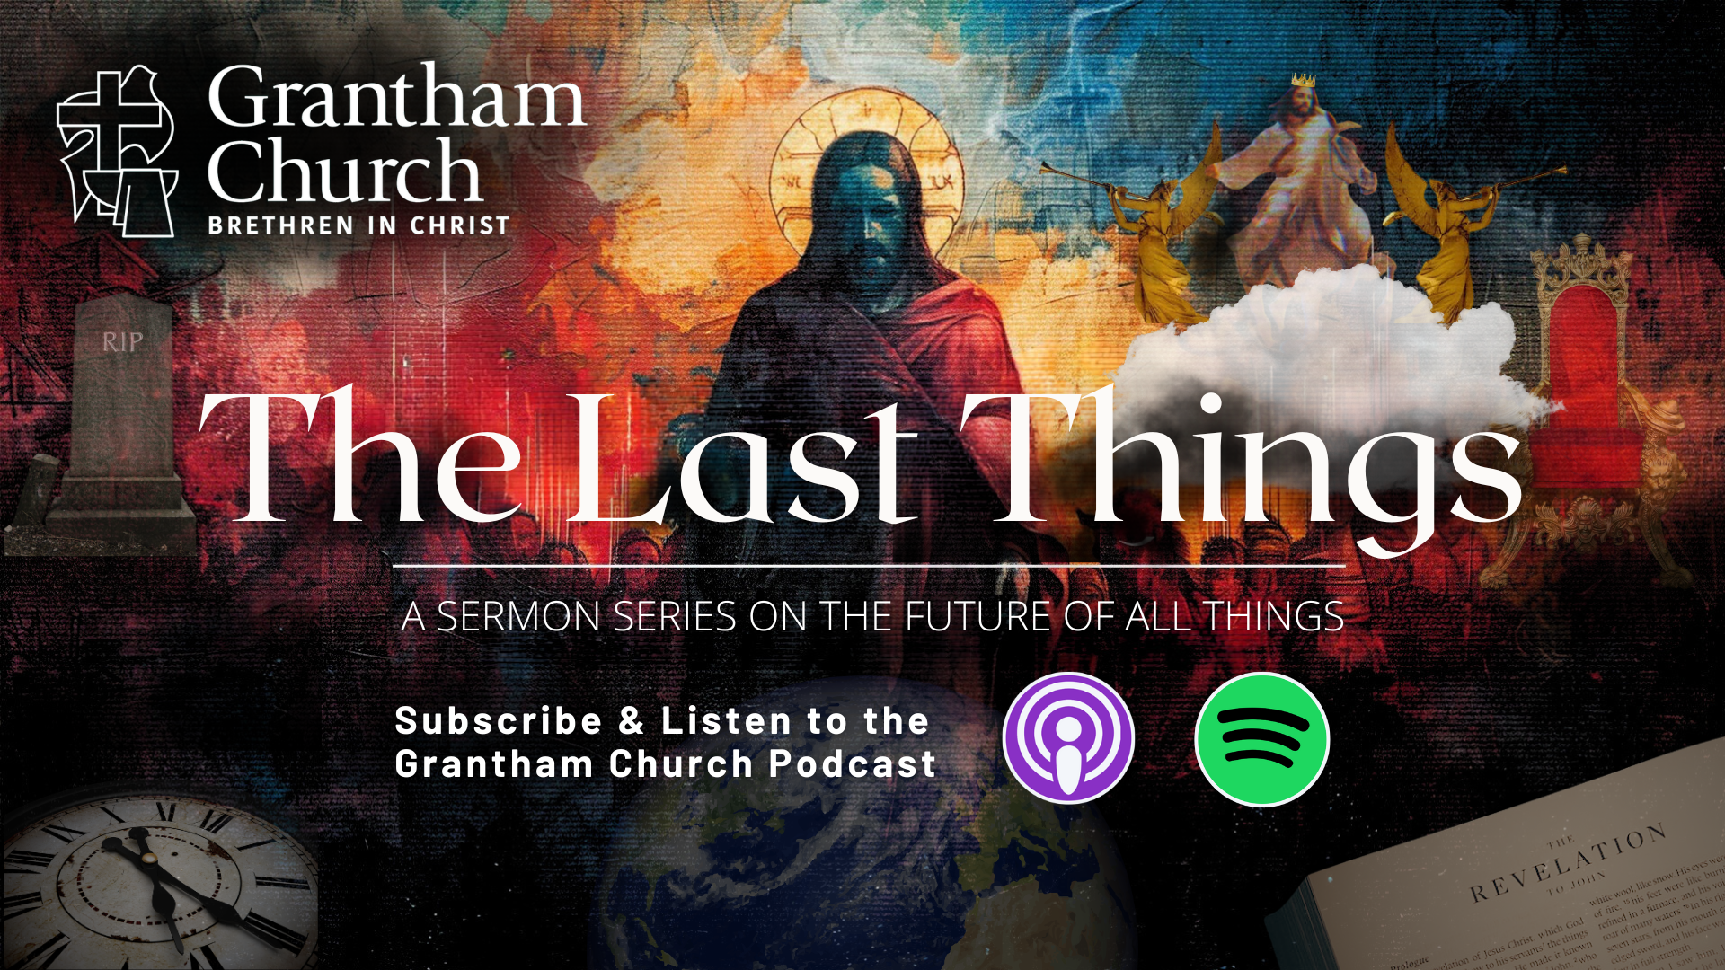
Notes:
[CLOSING PRAYER]
[APOSTLES’ CREED]
[COMMUNION]
Benediction
Church, may our sovereign God fill you with peace as you look to the future with faith, not fear. May the promise of resurrection and eternal life anchor your soul in times of uncertainty and give you hope. And may you live in light of the last things with confidence that Christ will return and bring heaven to earth. Until we gather again, go in peace to love and serve the Lord. Amen.

