Slide 1
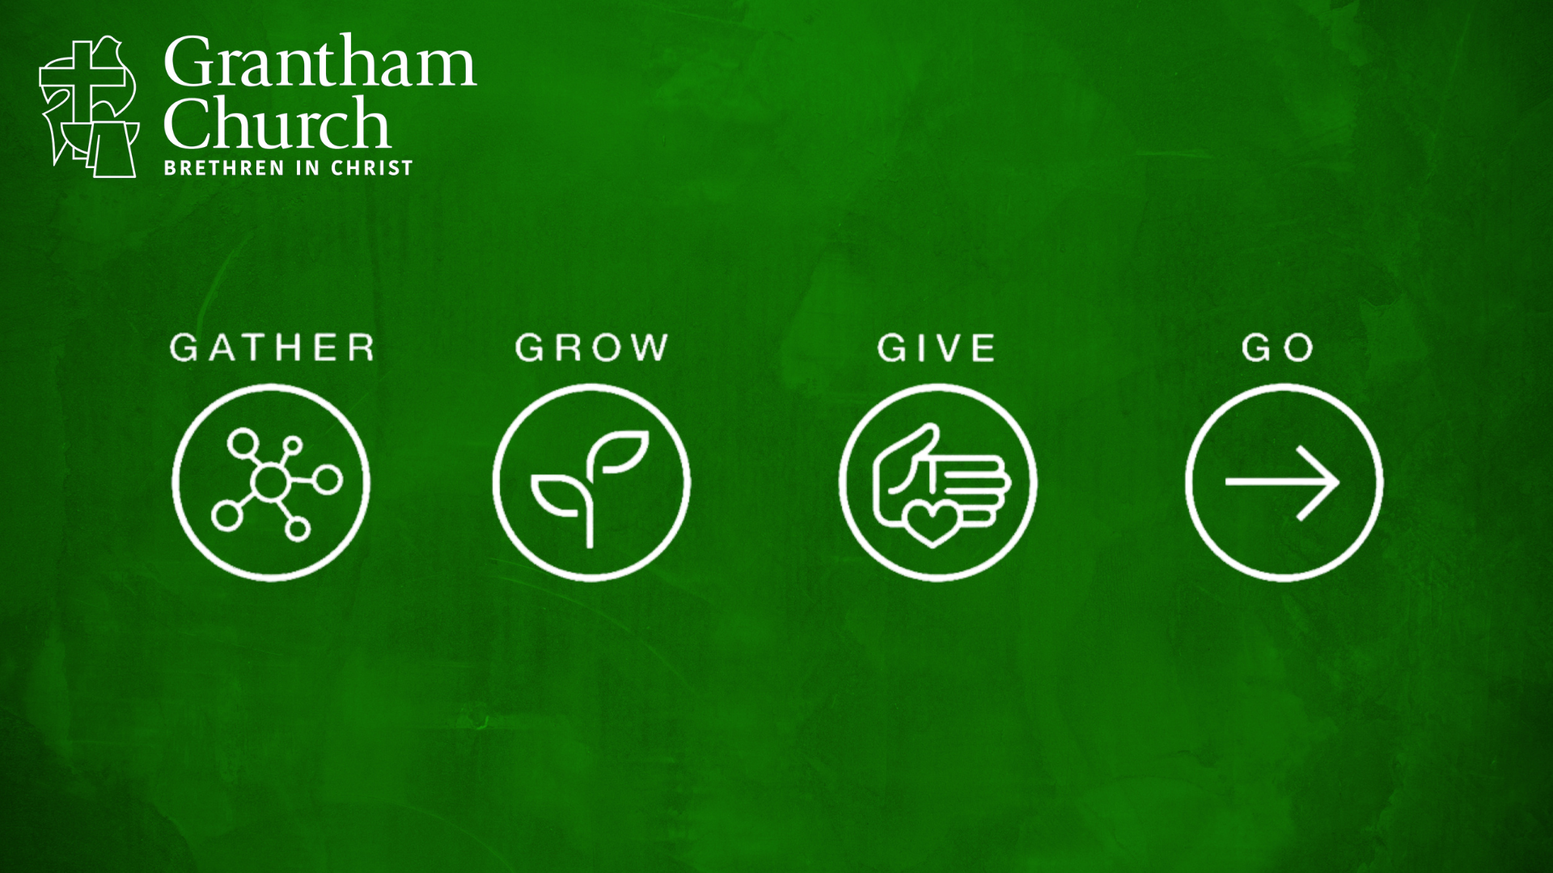
Notes:
Gather-Grow-Give-Go.
Stand-a-lone messages through the summer.
A flow and connection to each sermon this month.
Jesus & the Selfless Life
Created for Community
The church (ekklesia) is God’s idea -- Jesus said, “I will build my church” (Matt 16:18). And he also said that we are to “make disciples” and proclaim the good news. So, what does that look like? As a Christ-following community at Grantham Church, what does Jesus want our church (his disciples) to be doing? What should our family-life look like week in and week out? Think about this.
Every family needs routines and rhythms. We set priorities, we have beliefs and values, we have a calendar that we live by, and we have a weekly routine that we follow. And of course, there are different seasons in the year (and different seasons in life), so things do eb and flow, but still some routine and rhythms exist. Because human beings, families, and communities all need to utilize these things to give us meaning, purpose, peace, stability, and a way of orienting our lives to what is most important to us—what we love and value the most; what is at the heart of who we are and who we want to become.
And it’s important to stop and think about this because we don’t become disciples without intentionality, nor does the church fulfill its purpose without checking to see if we have the tools and resources we need to be faithful to Christ and can follow some basic steps in living out the mission of God. It works this way with any task or project, we’re just not always thinking about it. We just do it. But some things require more thought and planning. For example… [NEXT SLIDE]

Slide 2
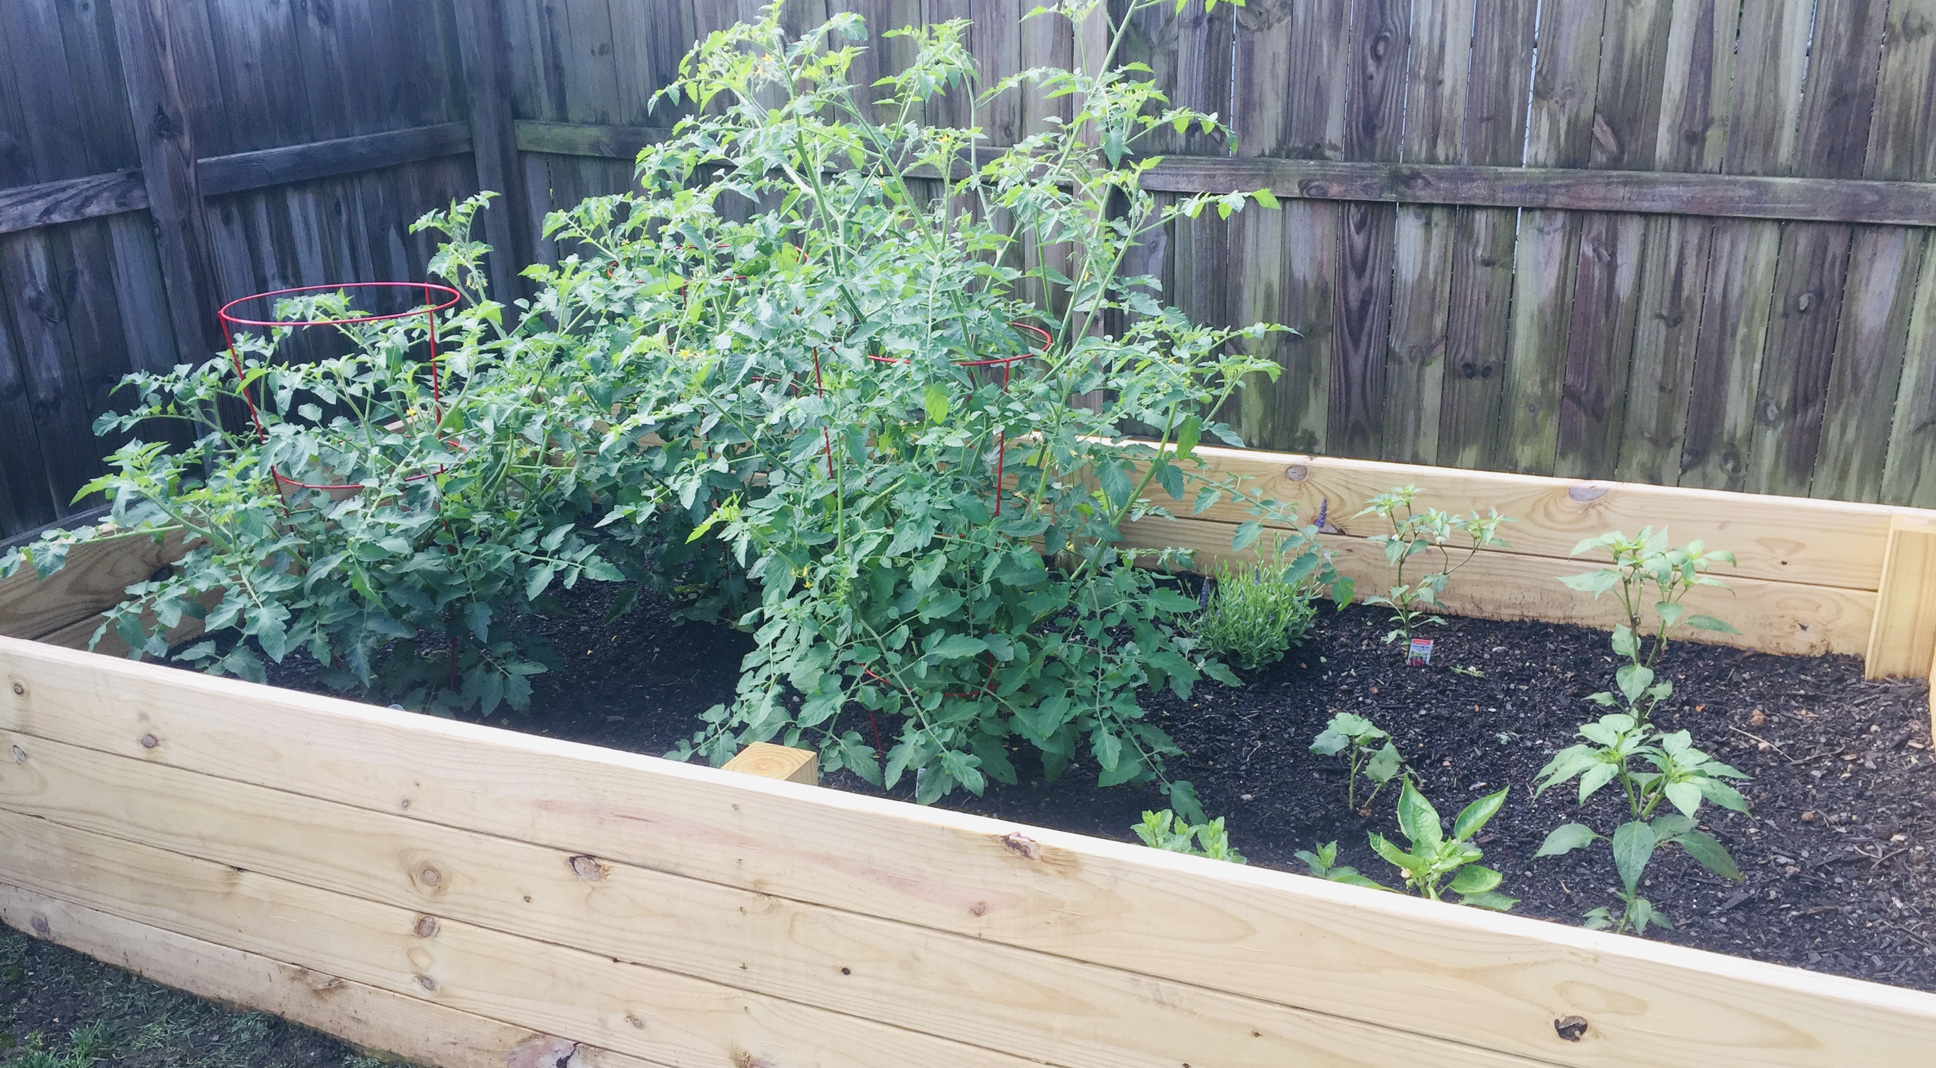
Notes:
[BRIEF COMMENT ON RAISED GARDEN]
And so thinking through the steps and the rhythm to carrying out the task is helpful. That’s why I’d like us to do that today with the steps (or the circular rhythm and routine) of the church—God’s garden, if you will.
Again, we can sum it up this way… [NEXT SLIDE]

Slide 3

Notes:
Let’s look briefly at each one of these and listen for how the Spirit is inviting us to live into this rhythm at Grantham.
So, let’s start with Gather. [NEXT SLIDE]

Slide 4

Notes:
[BRIEF COMMENTS]
Created for community (last week)
1 Peter 2:4-5 – we are like “living stones” being built into a spiritual house
Jesus was religious and committed to gathering
And he taught his disciples to do the same
In Acts 2 we read about how the church gathered daily and shared life together
Gathering is critical. That is why the author of Hebrews said this… [NEXT SLIDE]

Slide 5
Hebrews 10:24-25 (VOICE)
²⁴ Let us consider how to inspire [spur] each other to greater love and to righteous deeds [good works],
²⁵ not forgetting to gather as a community, as some have forgotten, but encouraging each other, especially as the day of His return approaches.
Notes:
[BRIEF COMMENTS]
What is the purpose of gathering? To inspire and encourage discipleship.
Now why might disciples ”forget” or “give up” (NIV) meeting together? Could be lots of reasons.
Folks, we have an enemy that seeks to scatter us and keep us from gathering. Did you know that the name diablos (devil) comes from the root which means “to scatter” abroad? Think about that for a moment.
As we saw last week, here is what gathering looks like… [NEXT SLIDE]

Slide 6
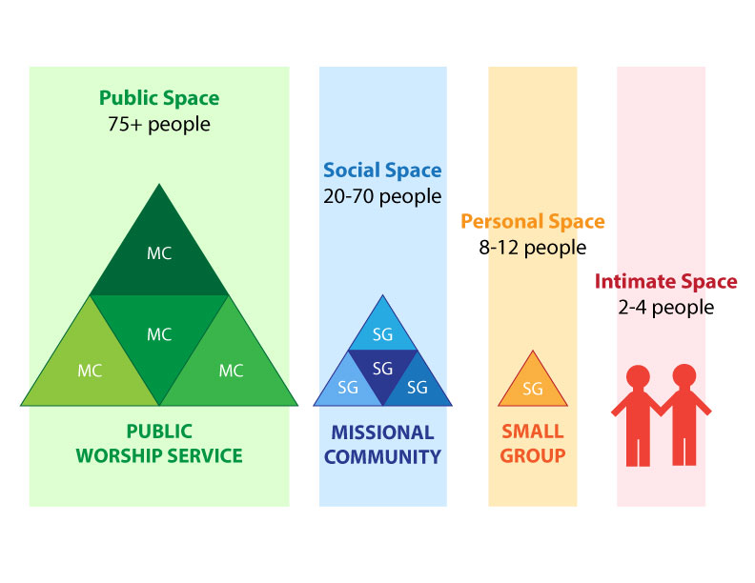
Notes:
[BRIEF COMMENTS]
We’re called to ”work the spaces” of the church because they’re all different.
Also, we gather in these spaces with other believers in and outside the building.
What happens when we gather and work the spaces? Why do we do this? To grow… [NEXT SLIDE]

Slide 7

Notes:
As disciples, we are called to grow in Christ (our knowledge and our living), so that we can become like him. In Colossians 2:19, Paul said that individual disciples make up the members of a local church, and that we are all like parts of a human body. We are all connected with the head who is Christ. And he says, ”from whom the whole body, supported and held together by its joints and ligaments, grows as God causes it to grow.”
So, ultimately, the Spirit is the one who is responsible for the growth that occurs, but we are certainly called to participate in that spiritual growth as we set up the proper conditions for that growth to happen. Remember, there is an order to these things… like growing a garden or (to use Paul’s metaphor) how a body functions. Listen to what the apostle Paul said in Ephesians 4:11-16. [NEXT SLIDE]

Slide 8
Paul, Ephesians 4:11-16 NIV
¹¹ So Christ himself gave the apostles, the prophets,
the evangelists, the pastors [shepherds] and teachers,
¹² to equip his people for works of service, so that the body of Christ may be built up ¹³ until we all reach unity in the faith and in the knowledge of the Son of God and become mature, attaining to the whole measure of the fullness of Christ.
Notes:
[BRIEF COMMENTS ON PASSAGE]
Things to notice about this passage:
The leaders don’t do all of the ministry; their primary task is to equip and empower the church to do ministry.
The goal is for each individual disciple to reach his/her fullest potential, so that the congregation does the same.
Verse 14… [NEXT SLIDE]

Slide 9
¹⁴ Then we will no longer be infants, tossed back and forth by the waves, and blown here and there by every wind of teaching and by the cunning and craftiness of people in their deceitful scheming.
Notes:
[BRIEF COMMENT]
Verse 15… [NEXT SLIDE]

Slide 10
¹⁵ Instead, speaking the truth in love, we will grow to become in every respect the mature body of him who is the head, that is, Christ. ¹⁶ From him the whole body, joined and held together by every supporting ligament, grows and builds itself up in love, as each part does its work.
Notes:
[BRIEF COMMENTS]
Get this picture. See the interconnectedness and the dependency we have on each other for the church to be a healthy and whole. For the church to grow in Christ and carry out his mission to the world, Paul said each part must do its work. We all have a role to play in the church. Don’t miss this, friends. Because American consumerism and hyper-individualism has conditioned us to see the church like any other service provider.
We do not gather with the church to consume religious services and good. That is not a New Testament view of the church, and it doesn’t reflect the self-giving love and servant leadership of Christ. The church isn’t your doctor’s office, your insurance company, or your local grocery store. The church is me and you. We are the church. We are a family. And healthy families own what is working and not working. And then we grow together and press on together in love.
As I’ve thought about this consumeristic mentality that many have when they come to church, I keep thinking about what JFK said in his inaugural address: “Ask not what your country can do for you, but what you can do for your country.” That’s the right idea. So, let’s put it this way: [NEXT SLIDE]

Slide 11

Notes:
Why? Because that’s reflective of the mindset of Christ, and it’s the one that leads to church health and growth. Amen?
So, we gather, we grow, and next… [NEXT SLIDE]

Slide 12

Notes:
[BRIEF COMMENT]
There are lots of ways to give and serve the Body. As you’ve heard me say… God calls us to give of our time, our talents (our gifts and skills), and our treasure (i.e., sharing our financial resources) for the ministry of the church—to bless those who are a part of our family as well as those who are within our sphere of influence beyond our walls. How is God calling you to give and serve? No matter how large or small you think the gift is, it’s vital to the life of the church.
Again, listen to what Paul wrote, this time to the church in Corinth: [NEXT SLIDE]

Slide 13
Paul, 1 Corinthians 12:4-6, 12-14 NIV
⁴ There are different kinds of gifts, but the same Spirit distributes them. ⁵ There are different kinds of service, but the same Lord. ⁶ There are different kinds of working, but in all of them and in everyone it is the same God at work.
Notes:
[BRIEF COMMENTS]
Verse 12… [NEXT SLIDE]

Slide 14
¹² Just as a body, though one, has many parts, but all its many parts form one body, so it is with Christ. ¹³ For we were all baptized by one Spirit so as to form one body—whether Jews or Gentiles, slave or free—and we were all given the one Spirit to drink. ¹⁴ Even so the body is not made up of one part but of many.
Notes:
[BRIEF COMMENTS ON PASSAGE]
I’ve talked to several people recently who have expressed a desire to serve here at Grantham:
“I like to teach. I’m interested in teaching a learning community in the fall.”
“Pastor David, I’m listening for how God wants me to use my gifts at Grantham. What might be some avenues I can do that?”
“I want to help. What can I do? Is there some way I can volunteer here at the church?”
Friends, as Jesus said, it is more blessed to give than to receive. That’s because it’s in self-giving, sacrifice, and service that we: (1) discover the healing power in living for others and not ourselves; and (2) that collectively through the work of the church we can do far more together than we can living scattered lives. Teamwork makes the dream work. That is why we give. And that’s why it must be a part of our rhythm: Gather-Grow-Give and lastly… [NEXT SLIDE]

Slide 15

Notes:
[BRIEF COMMENT]
We do all of this… we gather, grow, and give… not just so we can have a nice Grantham church family, but so that we can go with Jesus into the world, so that others might know the hope of the gospel and the salvation that Christ offers a lost world.
Remember what Jesus said… [NEXT SLIDE]

Slide 16
Matthew 28:18-20 NIV
¹⁸ Then Jesus came to them and said, “All authority in heaven and on earth has been given to me. ¹⁹ Therefore go and make disciples of all nations, baptizing them in the name of the Father and of the Son and of the Holy Spirit,
²⁰ and teaching them to obey everything I have commanded you. And surely I am with you always, to the very end of the age.”
Notes:
[BRIEF COMMENTS ON PASSAGE]
v.19 – “as you are going” into the world
We gather and go… to be a “missional” church that sees herself sent by Christ to live out our faith in the world.
It can be summarized it this way… [NEXT SLIDE]

Slide 17
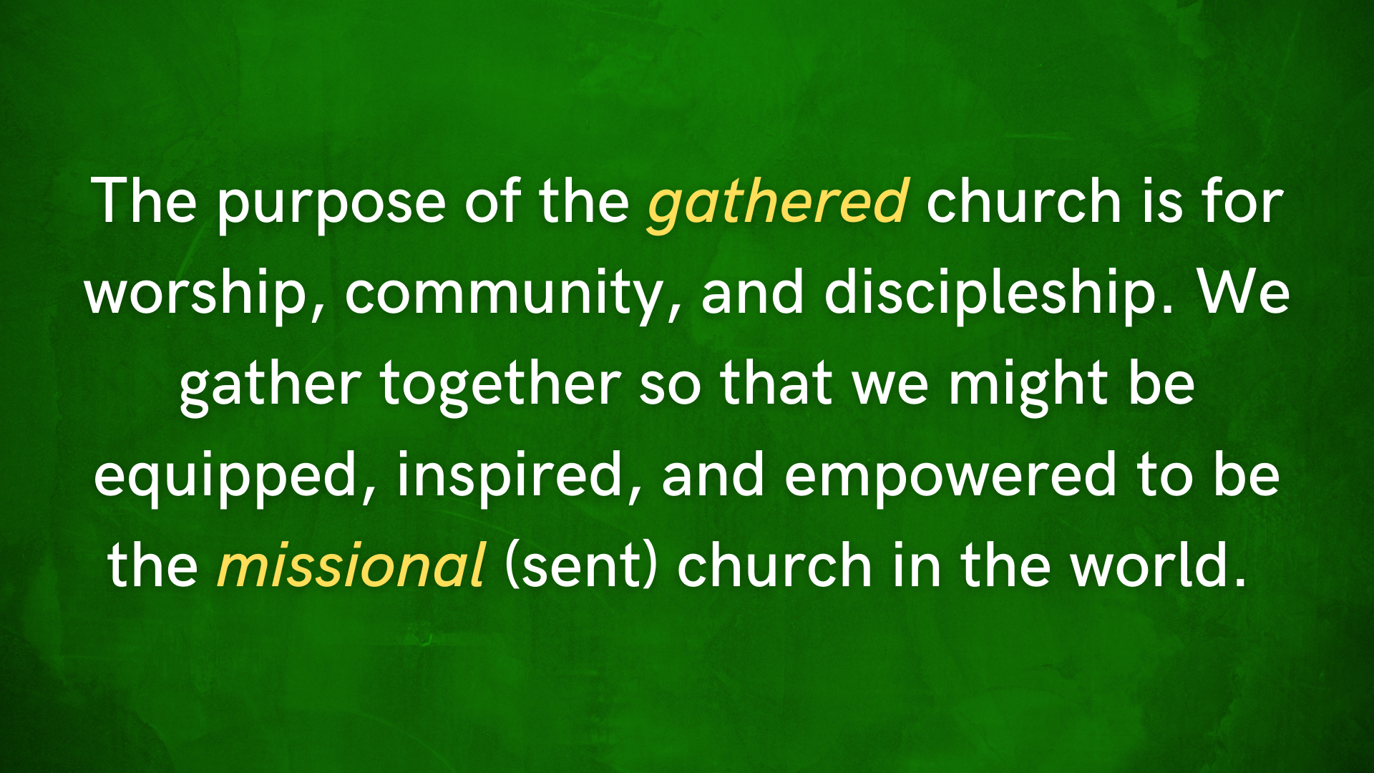
Notes:
[BRIEF COMMENT]
Do you see the church this way?
Do you see that what we’re doing at Grantham is ultimately for those outside of our fellowship who don’t know Jesus?
Do you see your job, your neighborhood, your hobbies, and your trip to the store as an opportunity to live out the gospel?
As Teresa of Avila said, Christ has no body now but yours. No hands and no feet now but yours.
Robert Webber said it this way… [NEXT SLIDE]

Slide 18

“The church is a kind of continuation of the presence of Jesus in the world. Jesus is not only seated at the right hand of the Father, but is visibly and tangibly present in and to the world through the church. This is an incarnational understanding of the church. It is a unique community of people in the world, a community like no other community because it is the presence of the divine in and to the world.”
Robert Webber
Notes:
[BRIEF COMMENT]
Finally, here are some questions for reflection and response:

Slide 19
Questions for reflection and response:

Slide 20
Questions for reflection and response:
Of the four G’s, which of these is the Spirit inviting you to engage and live into more fully, or experience in a new way?

Slide 21
Questions for reflection and response:
Of the four G’s, which of these is the Spirit inviting you to engage and live into more fully, or experience in a new way?
What might it look like to respond to the Spirit’s leading from a place of gratitude and grace instead of duty or obligation?

Slide 22
Questions for reflection and response:
Of the four G’s, which of these is the Spirit inviting you to engage and live into more fully, or experience in a new way?
What might it look like to respond to the Spirit’s leading from a place of gratitude and grace instead of duty or obligation?
Will you gather, grow, give, and go with us at Grantham Church?
Notes:
[READ QUESTIONS & COMMENT ON EACH]
[CLOSING WORDS & PRAYER]

