Slide 1

Notes:
[BRIEF INTRO]
This is week 4 of our 8-week study of the book of Philippians; if you’ve missed any of the messages, each sermon builds upon the other, so it would be helpful to listen at our podcast or watch online at Grantham’s YouTube channel
Remember, the Apostle Paul, a former Pharisee and persecutor of the church, planted the church in Philippi in 52 AD, which you can read about in Acts chapter 16... [NEXT SLIDE]

Slide 2
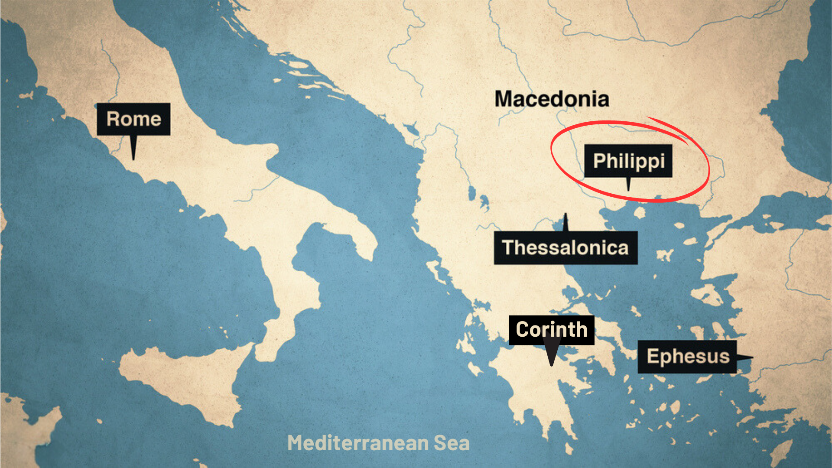
Notes:
About 10 years later, Paul writes to the Philippian believers from Rome, where he has been detained under house arrest, awaiting his trial before the emperor Nero. The Philippians are concerned for Paul. So, they sent a brother from Philippi to Paul to help him and hear how he is doing. The letter to the Philippians is his response to those concerns, as well as his reminders of what the gospel means for how they are to follow Jesus in an idolatrous city that is loyal to the Roman empire and view the Christian faith as a threat to law and order.
Each week I’ve been keeping the cultural context of Philippi before us so that we can hear Paul’s words the way the Philippians would have heard him. [NEXT SLIDE]

Slide 3
Notes:
[BRIEF COMMENTS]
Philippi was an affluent Roman colony of 10,000 people; it’s full of retired veterans and patriotic nationalists. And in many ways, it’s like a miniature version of Rome
From its architecture, to its roads, to its cults and religions, Philippi was proud of its status and the favor bestowed upon them by Caesar, and they wanted to keep it that way
This not only meant that there were strong cultural forces that pressured the city’s inhabitants to express their patriotism through the imperial cult and glorifying Rome, but there was also an expectation that all Philippians would uphold Roman values and virtues, which reinforced their way of life and the glory of Rome
And today we will see how Christ and the gospel challenged their values and virtues by furthering a belief and practice that was viewed as weakness to Roman citizens
Here is what we’ve covered so far in the letter to the Philippians… [NEXT SLIDE]

Slide 4
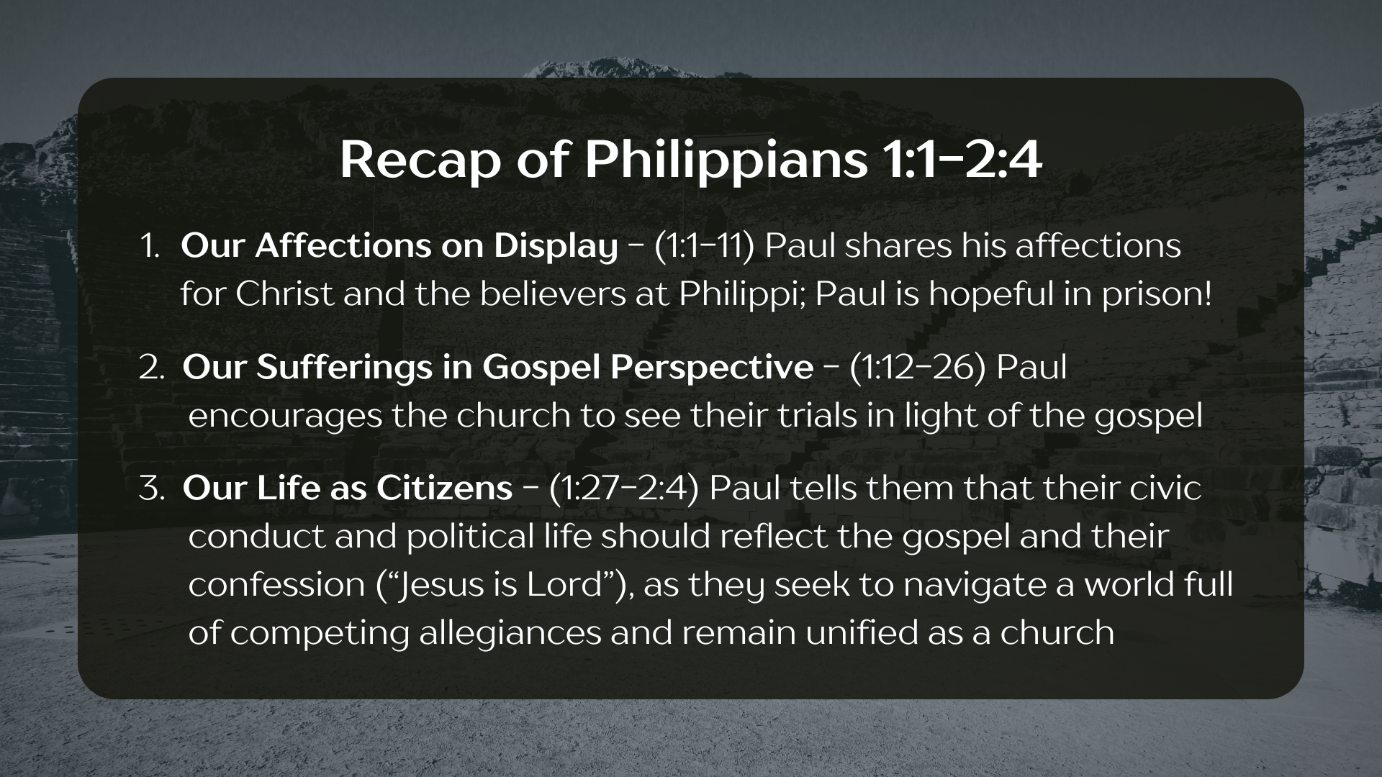
Notes:
[READ SLIDE & COMMENT]
We began our series by giving attention to the opening of Paul’s letter (1:1-11); right away we read of Paul’s love for Christ and his affection for the church in Philippi; we also picked up on themes and concepts that Paul will address in the rest of his letter
In the second message, we looked at chapter 1, verses 12-26, where Paul encouraged the Philippian Christians to see their own sufferings in light of the gospel and the Kingdom that is coming in Christ, in the same way Paul sees his own sufferings and the possibility that he might be executed in Rome; he said, “To live is Christ; to die is gain.”
And then last Sunday, we finished chapter one and read a few verses into chapter 2; we heard Paul tell the Philippian believers that their civic conduct and political life should reflect the gospel and their confession that “Jesus is Lord” (not Caesar), as they seek to navigate a world full of competing allegiances and remain unified as a church
And last week we unpacked a key verse for this entire letter… [NEXT SLIDE]

Slide 5
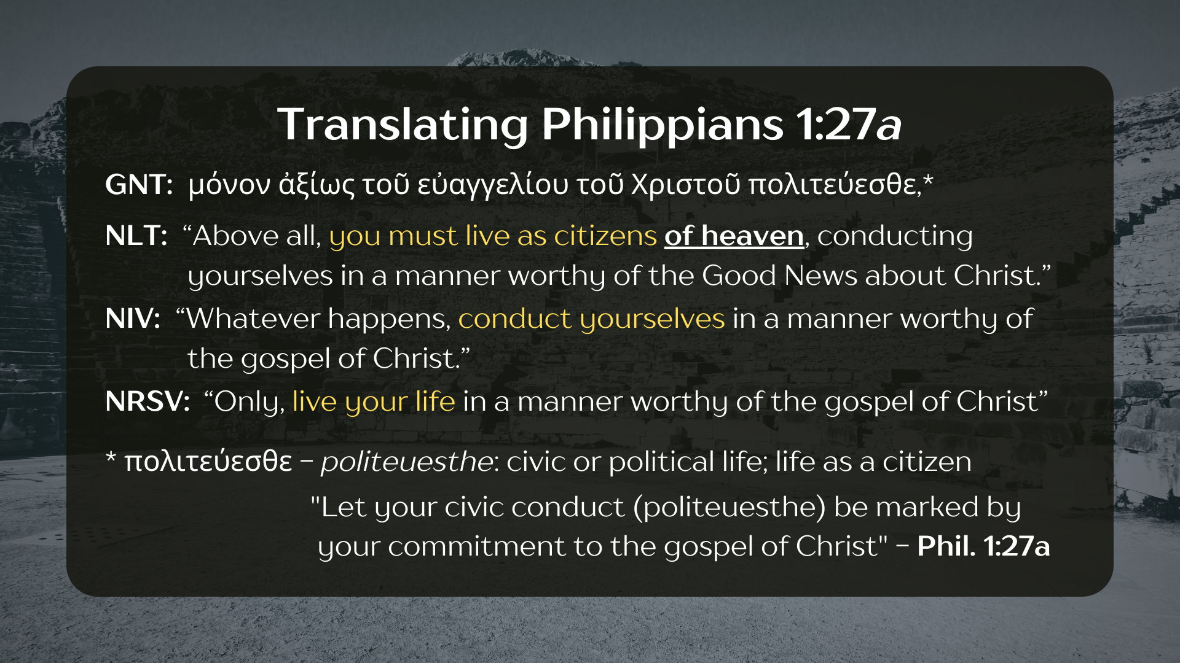
Notes:
[COMMENT ON VERSE]
Keep in mind that Phil.1:27-3:21 is one literary unit; it’s bookended with language of citizenship; I don’t want us to lose sight that Paul is writing to them about their civic conduct, or the way they live as citizens and inhabitants of a city that is loyal to empire
And as Paul gets to the end of chapter 1 and the beginning of chapter 2, he encourages the believers in Philippi to stand firm with each other; not to let their trials, their fear, the threats from the outside, and their differences divide them. Rather, stay loyal and true to Christ and the gospel. And then Paul tells them to remain united in the gospel mission by having the same mindset that Jesus had in his life and ministry.
Let’s pick up on his thought in our main reading this morning, as we continue to go verse-by-verse… [NEXT SLIDE]

Slide 6

Notes:
[READ & COMMENT ON PASSAGE VERSE-BY-VERSE]
v. 5 – “attitude” (NLT) or “mindset” (NIV); GNT: “your way of thinking”
v. 6 – “to seize” for “his own advantage” (NIV)
v. 7 – “gave up his divine privileges” (NLT) or “he made himself nothing” (NIV); GNT: “emptied himself” so that he could be a servant to others; the God of the universe becoming human and lowering himself to serve others; Is there a greater picture of humility? And this humbling, of course, led to his humiliation. But let’s be clear, they are not the same.
You may recall Jesus saying these words in Matt. 5:38-42:
“You have heard the law that says the punishment must match the injury: ‘An eye for an eye, and a tooth for a tooth.’ But I say, do not resist an evil person! If someone slaps you on the right cheek, offer the other cheek also. If you are sued in court and your shirt is taken from you, give your coat, too. If a soldier demands that you carry his gear for a mile, carry it two miles. Give to those who ask, and don’t turn away from those who want to borrow.”
The other day I was watching the latest season of the tv series, The Chosen… [NEXT SLIDE]

Slide 7
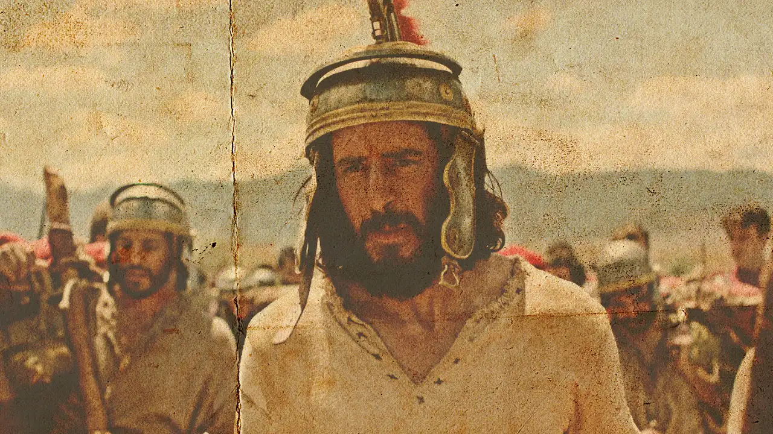
The Chosen (season 4, episode 5)
Notes:
[THE CHOSEN (S4;E5) -- BRIEF COMMENTS]
The disciples are walking along, and they encounter Roman soldiers
Jesus uses the opportunity to practice what he has preached
The disciples are upset (Judas says, “This is humiliating!”)
At the end of one mile, Jesus insists on carrying their gear one more mile to their fort
The Roman soldiers dumbfounded, allow it; their mockery turns to inquisitive looks
Because of Christ’s example, the early church held up humility as one of the highest virtues of Christian character. In fact, it was an identity marker that set disciples apart from unbelievers in the Greco-Roman world. This was scandalous because they live in an honor and shame culture where there is no difference between humility and humiliation. And so, in the first century, humility was seen as weakness and denigrated by those who believed that things like boasting, self-sufficiency, wealth and status, and political power were ways of achieving the good life. It was how you proved your worth and preserved your honor.
Therefore, in this cultural context, for Paul to write to the Philippians and call them to adopt Christ’s mindset… increases the likelihood that the church will invite further revulsion and mockery from fellow citizens of Philippi. But so be it. This is the way of the cross. It’s the way of the Kingdom. And it’s the way to reflect the God who looks like Jesus.
So, what about our own cultural context? How do we hear a call to humility today in America? In the brand-new multi-ethnic Bible commentary, The NT in Color... [NEXT SLIDE]

Slide 8

Notes:
[READ QUOTE & COMMENT]
Park goes on to say, “The solution to the diminished self must be anchored to salvation in both the benefits and the obligations.” In other words, we can’t accept Christ for all the good things (things like love, joy, forgiveness, etc.), and then avoid or outright deny hardships and living out a cross-centered faith in our narcissistic, idolatrous culture. When we accept Christ as Lord, we not only receive the benefits of the cross, but we also agree to its demands. As Jesus said, “If you want to be my disciple, you must deny yourself and take up your cross and follow me.” And we can’t help but notice those who have no interest in this today.
Back to verse 8… [READ VERSE 8]
The cross was the icon of humiliation in the Roman world. The Roman empire used it to completely horrify, disarm, and subjugate those they conquered. They would often nail their victims to the cross along roadways to remind those passing by what happens when you forget who is in charge. Here is a depiction… [NEXT SLIDE]

Slide 9
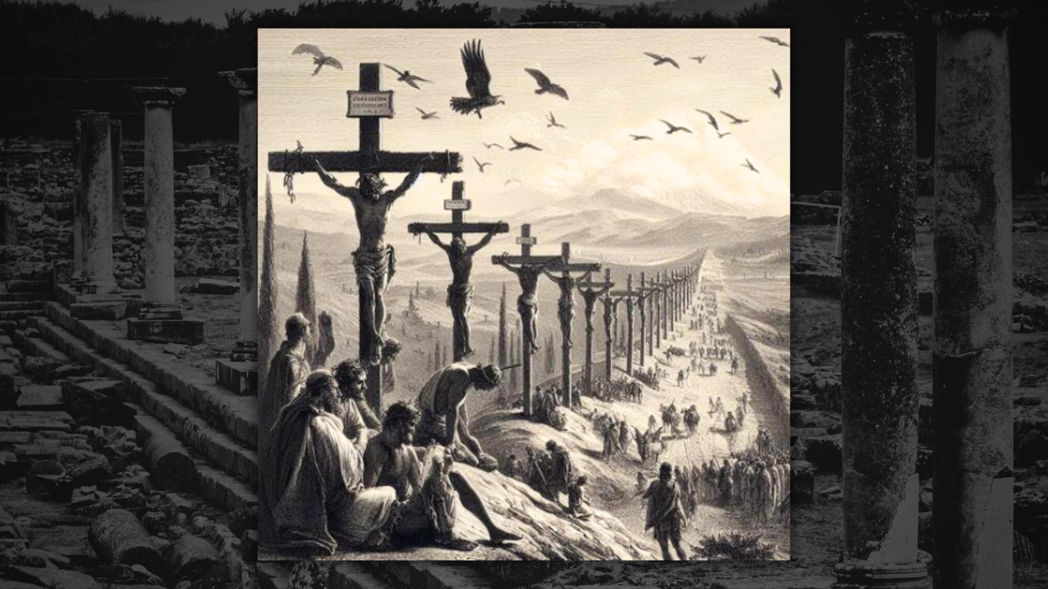
The Appian Way
Notes:
[BRIEF COMMENTS]
The crucified along the Appian Way, the first Roman road
A known slogan in the first century: “It’s Rome’s way or the Appian Way!”
So, Rome used it to humiliate, but for the early Christians… [NEXT SLIDE]

Slide 10
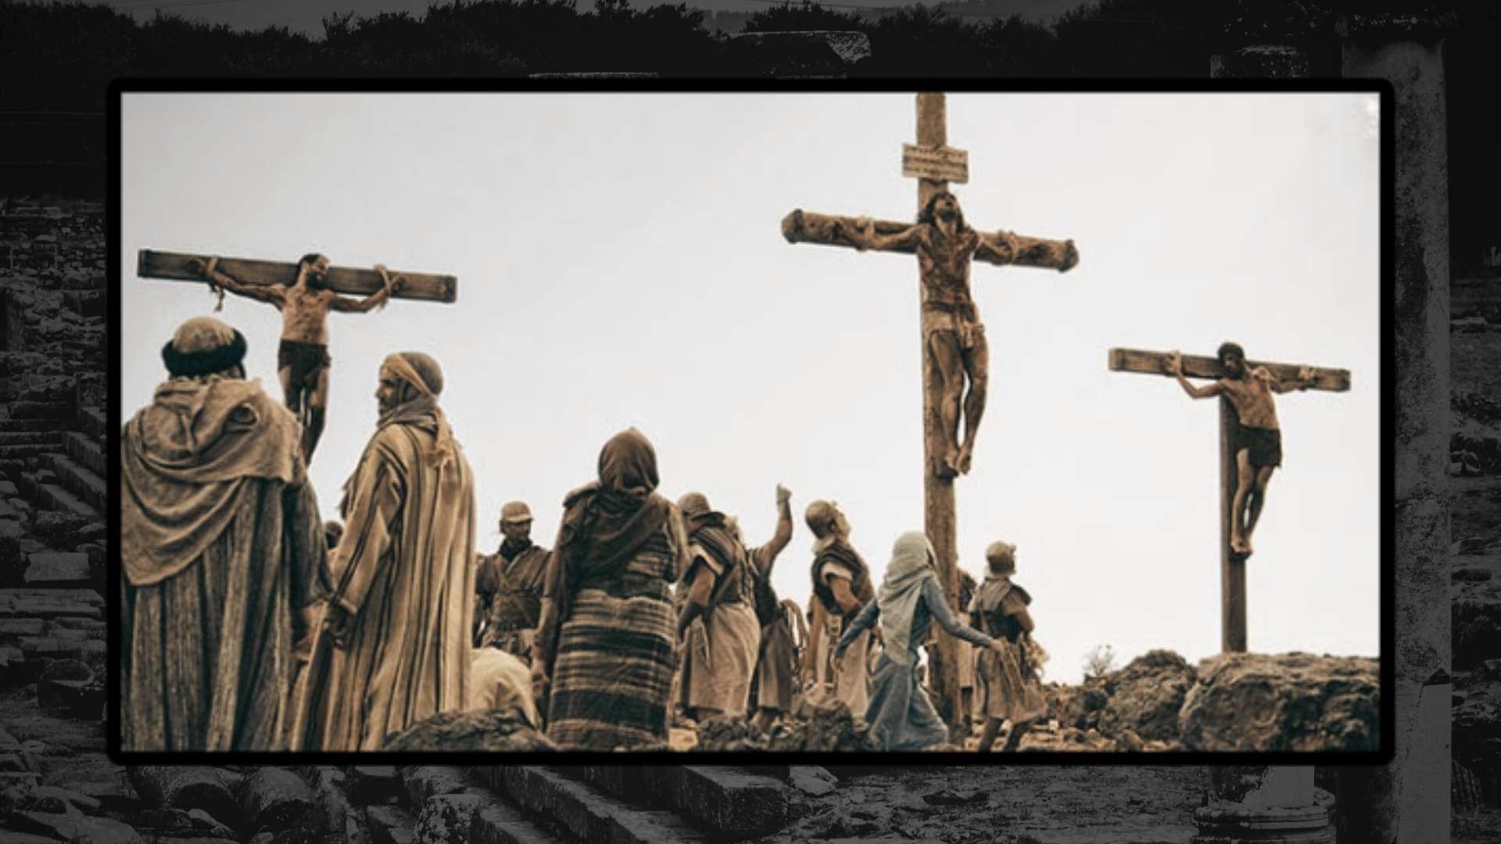
Notes:
They saw the crucifixion of Jesus as a divine act of humility and love. By the cross of Christ, God disarmed the principalities and powers and exposed the evil and depravity of humankind; taking a weapon of humiliation and using it to secure victory over sin and death.
Therefore… verse 9… [NEXT SLIDE]

Slide 11
Notes:
[READ VERSES 9-11 & COMMENT]
As Jesus said in Matthew 23:11-12: "The greatest among you must be a servant. But those who exalt themselves will be humbled, and those who humble themselves will be exalted.”
In his book, Humilitas, John Dickson defines humility… [NEXT SLIDE]

Slide 12

Notes:
[READ DEFINITION & COMMENT]
Here is a glimpse of humility in action… [NEXT SLIDE]

Slide 13
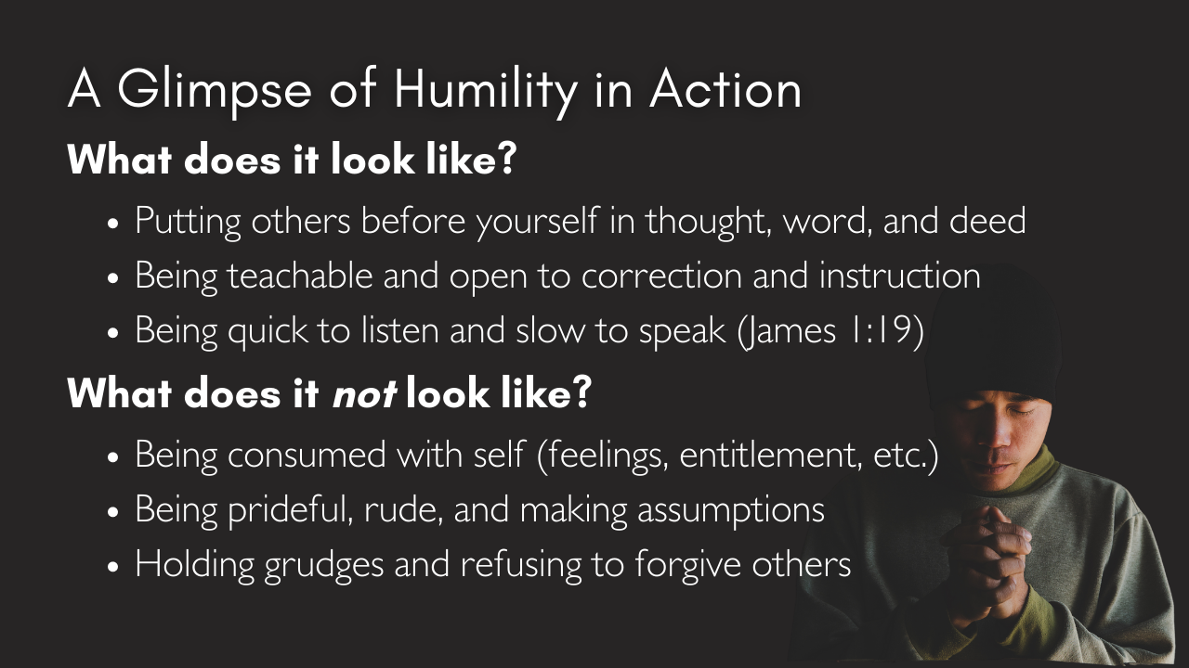
Notes:
Remember… let’s think about our civic conduct and political life!
[READ & BRIEF COMMENTS ON EACH]
Back to Paul’s letter. Let’s finish with verses 12-18… [NEXT SLIDE]

Slide 14
Notes:
[READ & COMMENT ON EACH VERSE]
There was a study done a few years ago by mostly non-Christian historians at Macquarie University in Sidney, Australia who were looking at the role humility plays in leadership. And they found that (historically) the Christian faith is solely responsible for the massive shift in the world’s view of humility. One of the lead researchers said that we in the West are attracted toward humility (and often have a contempt for false humility) because of one person and one movement: Jesus of Nazareth and the Christian church.
And Jesus said, “Blessed are the meek (NLT: “humble”), for they will inherit the earth.”
Brothers and sisters, let us rediscover the Christian virtue of humility, and invite us to embody this way of Christ by renewing our commitment to the God who looks like Jesus, over and against all other carnality, extreme ideologies, and competing allegiances, which corrupt individuals and the entire nation. This goes to the very heart of our faith and of our civic witness. May God helps us as Christians to adopt the mindset of our Lord.
Finally, here are some questions to help us reflect and respond to the Spirit… [NEXT SLIDE]

Slide 15


Slide 16


Slide 17


Slide 18

Notes:
[READ & BRIEF COMMENT ON EACH QUESTION]
Does my civic conduct and political life reveal a willingness to give up my own privileges and humble myself to serve others?
Have I been prideful, rude, unforgiving, etc.? How do I need to humble myself so that God can exalt me in his way and time?
How do I see the church in America not reflecting the attitude of Christ and trusting in the way of the cross? How is the Spirit inviting me to pray and be the change we need to see today?
Let’s pray… [NEXT SLIDE]

Slide 19

Notes:
[CLOSING PRAYER]
[APOSTLES’ CREED]
[COMMUNION]
Benediction
May the God who looks like Jesus lead you to faithfully follow him in a world that needs to hear and see the Gospel of Jesus Christ. And may the grace and peace of the Lord Jesus comfort and sustain you as a witness of his coming Kingdom. Amen.

