Slide 1

Notes:
This is the final week of our 5-week sermon series, We the Church. If you’re visiting and just joining us for this last message in our series, we’ve been sharing that the purpose of the WE THE CHURCH initiative is to mobilize us as God’s people to see that our primary calling is to testify and embody the good news of Jesus to our neighbors, which requires that we partner with other churches in this gospel mission to those who live in our community and region. But if we’re doing to do that, we need to have a clear understanding of the gospel.
At Grantham, we explain and describe the gospel like this… [NEXT SLIDE]

Slide 2
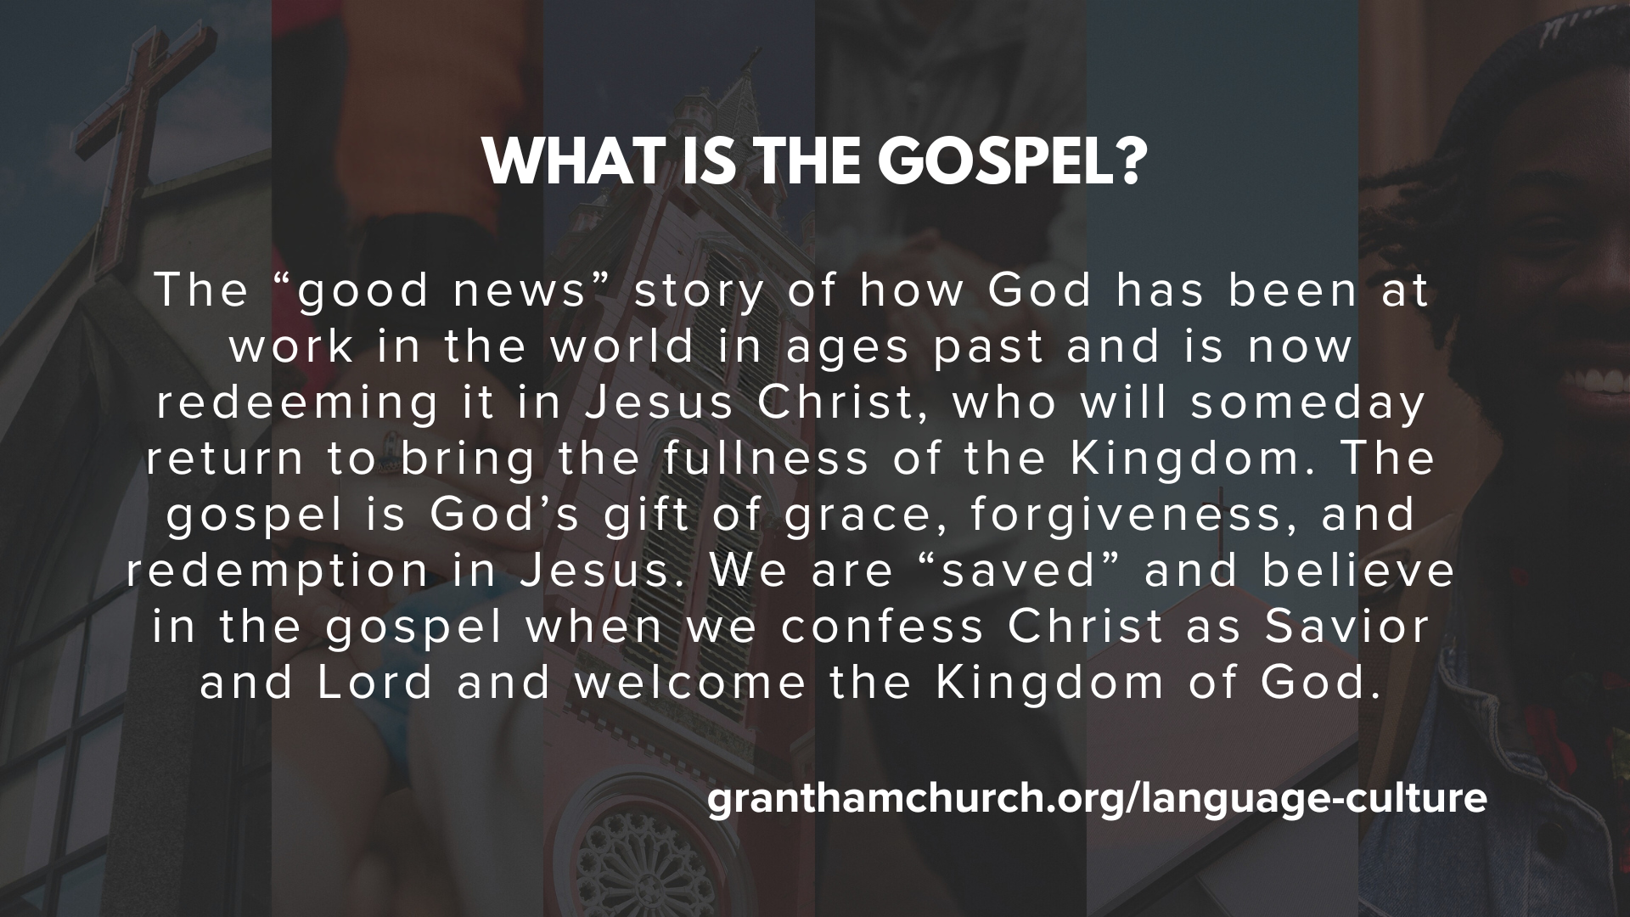
Notes:
[READ DEFINITION & COMMENT]
The gospel is for you; to bring forgiveness, healing, and transformation
But the gospel is also for others (e.g., our family, friends, neighbors, enemies)
Also, the gospel is about the renewal of all creation when Christ returns; Jesus doesn’t just save souls, he is interested in saving bodies, nations, and redeeming the world.
And once again, here is the image we use to communicate this… … [NEXT SLIDE]

Slide 3
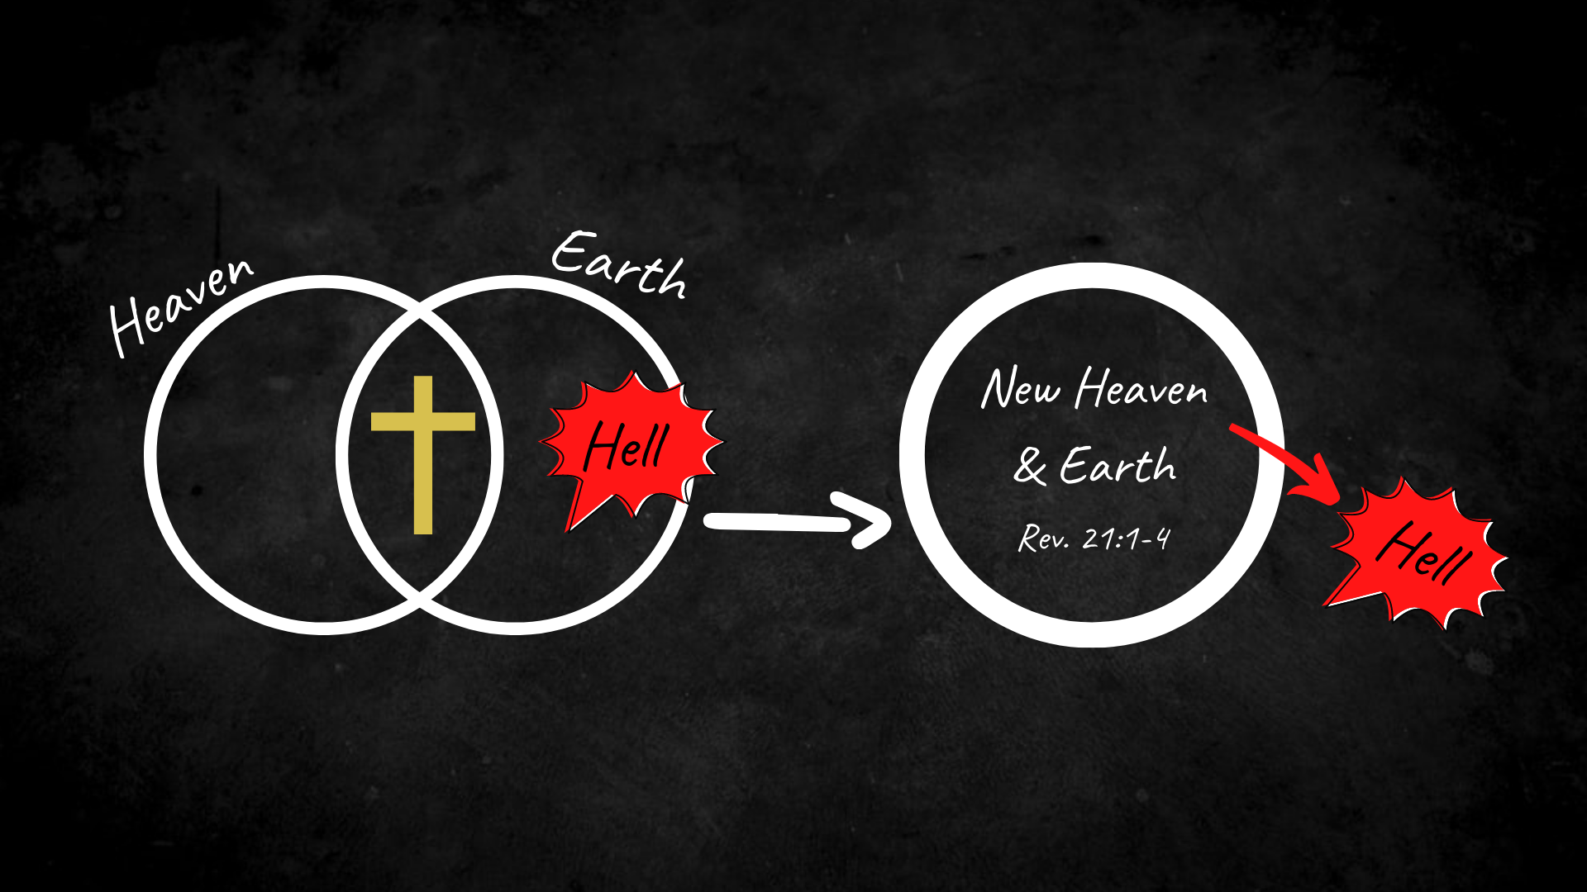
Notes:
[EXPLAIN IMAGE]
Heaven and earth are two interlocking planes of existence; heaven (spiritual dimension) is God’s space, and earth is our space; they are coming together in Jesus; Jesus’s death and resurrection are uniting heaven and earth; his resurrected body is the proof!
In that process, Jesus has declared that death and hell have lost its power and is coming to an end; and Jesus promises to cast the hell out of earth and out of you and me
And the gospel proclaims that Christ will someday return and bring about a new glorious reality; a resurrected cosmos; a new heaven and earth; where God’s perfect reign and rule will be known in us and death and hell will be cast out forever; they will be no more.
In the meantime, we are seeking to become like Jesus as his disciples, and we’re called by Jesus to tell others about him, because he is the only one who can change us, our communities, our country, and save our world from death and destruction. And so, we want to adopt a “gospel saturation” mindset about where God has placed us in this world.
What is gospel saturation? [NEXT SLIDE]

Slide 4
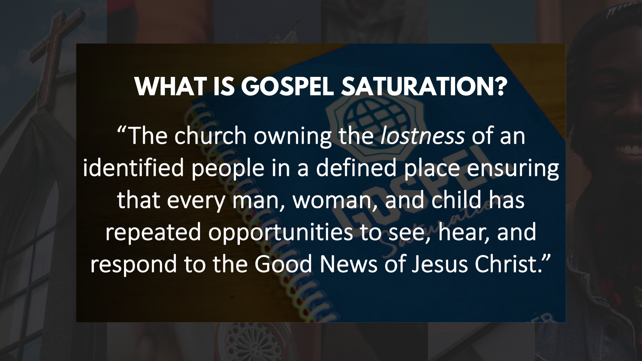
Notes:
It’s the process of helping each disciple understand our role as ambassadors of the good news where we live, learn, work, and play so that every person has repeated opportunities to see, hear, and respond to the good news of Jesus Christ. And we want to partner with other churches who recognize Jesus’ call to unity within the Body of Christ for the sake of the gospel and his mission of love to a broken humanity.
That is why we began our series with a focus on unity… [NEXT SLIDE]

Slide 5
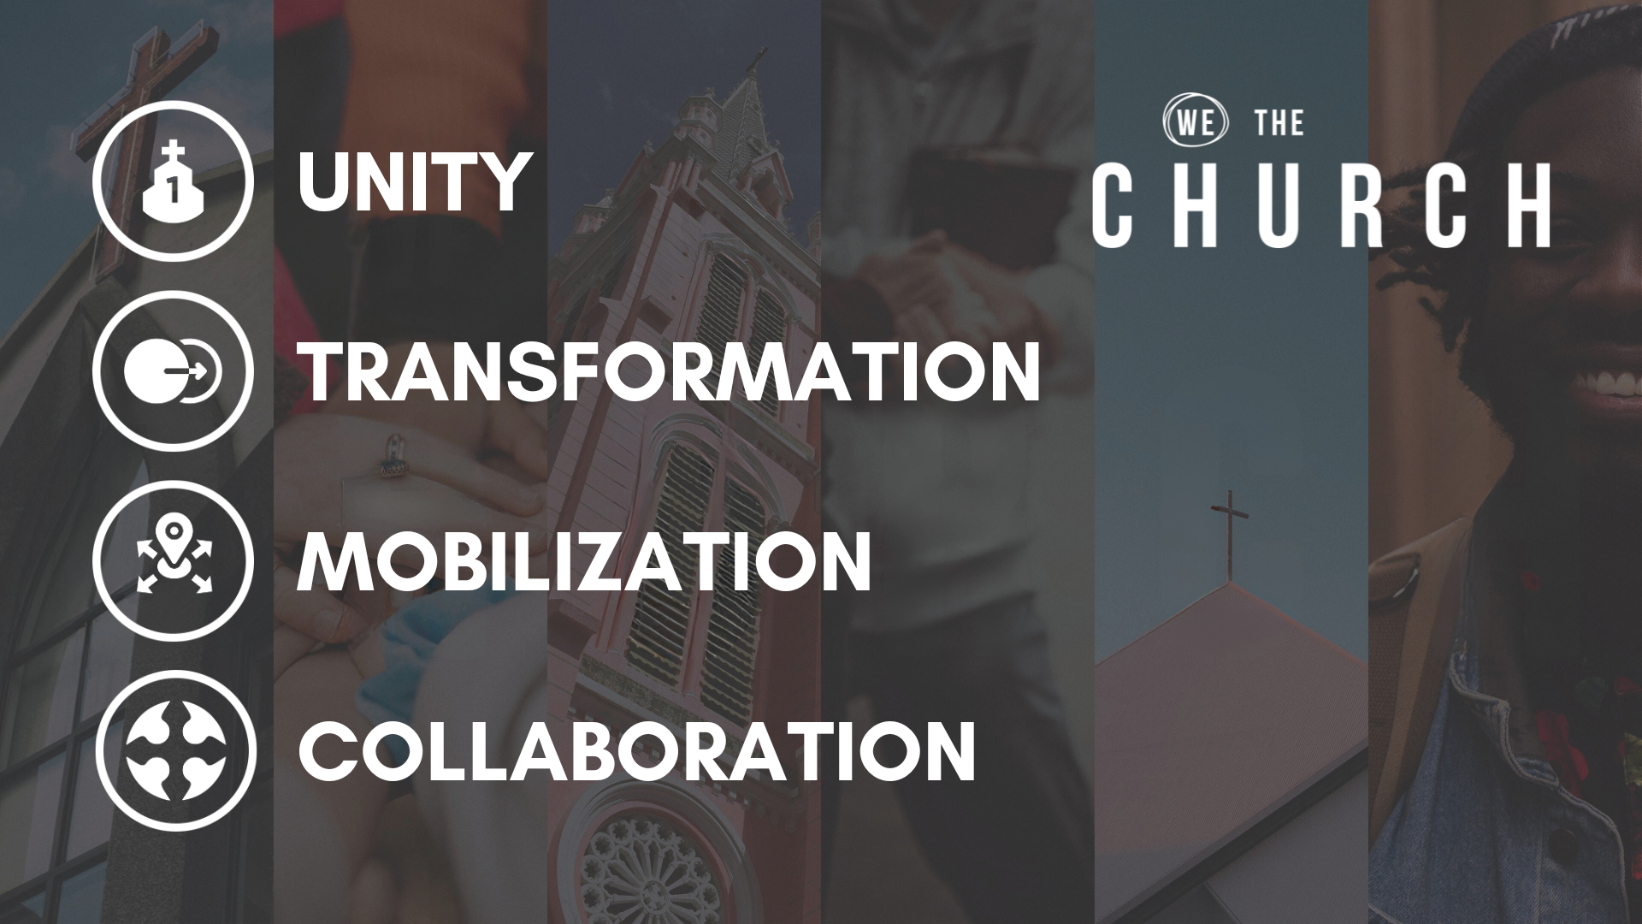
Notes:
In that first message, we read Jesus’ prayer in John 17 that the world will know that the Son was sent by the Father through our union with him and our shared calling in his mission. And so, Jesus calls us all to recognize his Lordship and for the Church in our community to take responsibility for those who don’t know him that live around us.
In the second message, we looked at how the purpose of the gospel is to transform individuals who embody the character and competencies of Jesus. The inevitable result of our own transformation will be the transformation of our community. Because as we are being changed by Jesus, we will want others to know the same kind of life-giving change. So, transformation motivates us to act and mobilize.
In week 3, Pastor Melissa shared how we need to shift from a “Sunday-centric” church mission to an “every day-centric” mission, where every disciple accepts the responsibility to share and embody the gospel wherever we live and work in community with others. This means that we are all ministers of the gospel in our homes, workplace, neighborhoods, etc.
And then last week, we looked at collaboration. I said that we shouldn’t view other churches as competition but rather see collaboration among local churches as a necessity for faithful disciples of Jesus. While our churches won’t agree on everything, we want to (and we believe we can) partner with other churches who can agree on the heart of the gospel and Christ’s call to make disciples who make disciples.
Which brings us to our focus for this final sermon on… [NEXT SLIDE]

Slide 6

Notes:
Multiplication. In this concluding message of our series, we’re going see how Christ isn’t just inviting us to bring individuals to him (a simple 1 to 1 addition), but that we are called as disciples to make disciples who also make disciples and multiply the Kingdom harvest. What does that mean? What does that look like? And how do we do it? [BRIEF PRAYER]
Why did John have trouble memorizing multiplication tables? Because times were difficult. The minus sign tried to explain to the plus sign how multiplication works, but he only understood sum of it. I can do this all day. OK… one more… What are three types of people in the world? Those who can count, and those who can’t.
Since 8th grade Algebra, I’ve not been great at math. In college, I put off my math credits until my last year just so I’d be determined enough to pass. And still to this day the thought of doing math makes me anxious. And so, if you’re like me, you may not want to think about math in worship, but this is the sort that I think makes a lot of sense and should interest all followers of Jesus, because we’re talking about the math of the Kingdom.
My friends, God intends for us to participate with him in expanding his Kingdom through multiplying disciples. And if you’re thinking, “Oh, we’re about numbers now?” I want to say, no, we’re about people coming to know the God who loves them. Remember what Jesus said in Mark 1:17… [NEXT SLIDE]

Slide 7
“Come, follow me,” Jesus said,
“and I will send you out to fish for people.”
Mark 1:17 NIV
Notes:
[READ SCRIPTURE & COMMENT]
And they fished with nets (many fish), not with a rod and reel (a single fish)
And so, the Lord intends for multiplication (at least the capability and capacity for it) to be built into the DNA of every disciple and every church.
Of course, you’ll recall the last words to his first disciples at the end of Matthew’s Gospel, Jesus gives us what is known as The Great Commission… [NEXT SLIDE]

Slide 8
Matthew 28:18-20 NIV – The Great Commission
¹⁸ Jesus came and told his disciples, “I have been given all authority in heaven and on earth. ¹⁹ Therefore, go and make disciples of all the nations, baptizing them in the name of the Father and the Son and the Holy Spirit. ²⁰ Teach these new disciples to obey all the commands I have given you. And be sure of this: I am with you always, even to the end of the age.”
Notes:
[READ SCRIPTURE & COMMENT]
v. 18 – Jesus is the ultimate authority (e.g., ”By the power invested in me…”)
v. 19 - “go” indicates an intentional setting out to do something; “go and make disciples” – Q: What do they know about making disciples? How did Jesus “make” his own disciples? He shared life with them, taught them, walked with them in a small group and one-on-one;
“of all nations” – everyone (not just white people, not just Americans, or republicans or democrats, etc.) and “baptize” them in the name of the Triune God
v. 20 – How did Jesus teach? In a variety of ways that included showing, doing, and sending his disciples out to practice and embody the lessons; and fear not, because we have a living Jesus with us; we are not alone; we have the Lord’s power with us.
And after Jesus gave them the Holy Spirit in the Upper Room on Pentecost, his disciples were empowered to share the gospel, make disciples, and multiply the Kingdom. Take a look at this summary of the growth of the church in those first days… [NEXT SLIDE]

Slide 9
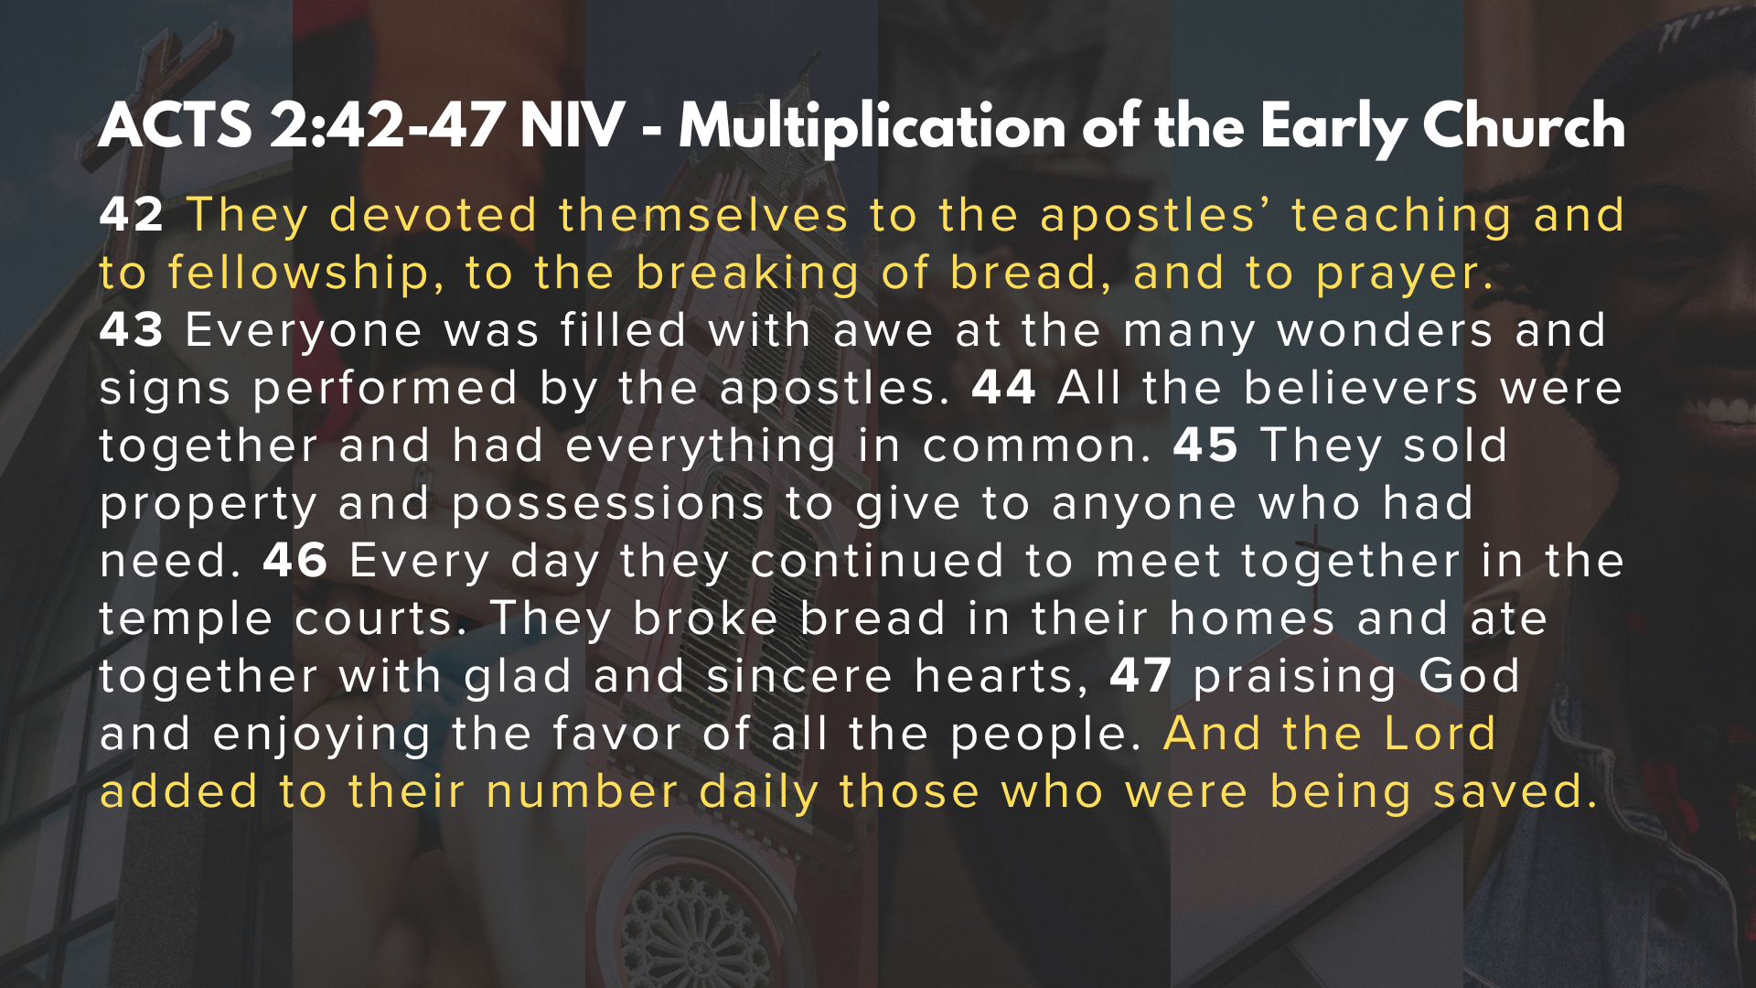
Notes:
[READ SCRIPTURE & COMMENT]
v. 42 – They were committed to what Jesus had said and done; they were committed to the koinonia (fellowship) or community of disciples, to eating together and communion, and to praying. This made up the very heart of their worshipping community.
And as a result of this discipleship… [READ & COMMENT ON VERSES 43-47]
We can see that multiplication and growth of the early church came through them following Jesus in their own individuals lives, but also in submitting to the disciple-making process with other Christians by working the spaces… [NEXT SLIDE]

Slide 10
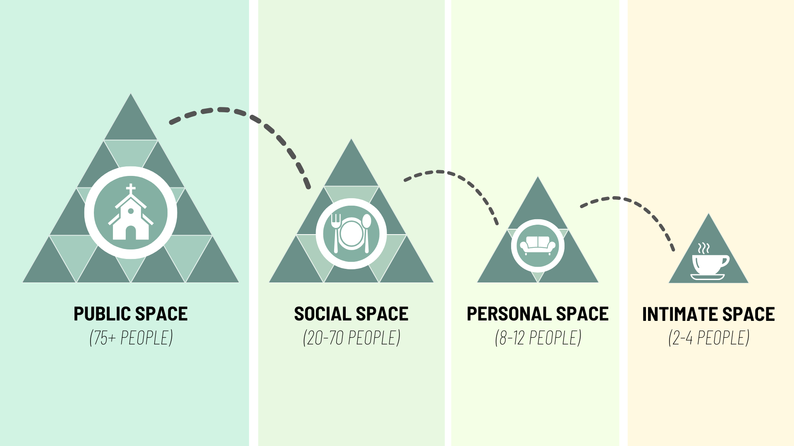
Notes:
[COMMENT ON SPACES GRAPHIC]
The spaces represent the various ways we can engage in the life of the church and grow in our faith, but notice that Jesus calls his disciples to go deeper in our relationships
And it’s in the personal and intimate spaces that we have opportunities to engage in conversation with other disciples about where we are in our walk with Christ; to ask questions, to confess sins, to hold each other accountable, to pray for one another, to share each other’s burdens, and to experience Jesus in close-knit community
Whether it’s a small group, a bible study, an intentional discipleship group, or an intimate meeting among friends, it’s a space where we can be real with each other and invite the Holy Spirit to transform us into the image of Christ, as we share the journey together; a space where we can be honest, authentic, and vulnerable with each other.
Because the whole aim in the disciple-making process is that we would become more and more like Jesus. Listen to what Paul wrote in Colossians… [NEXT SLIDE]

Slide 11
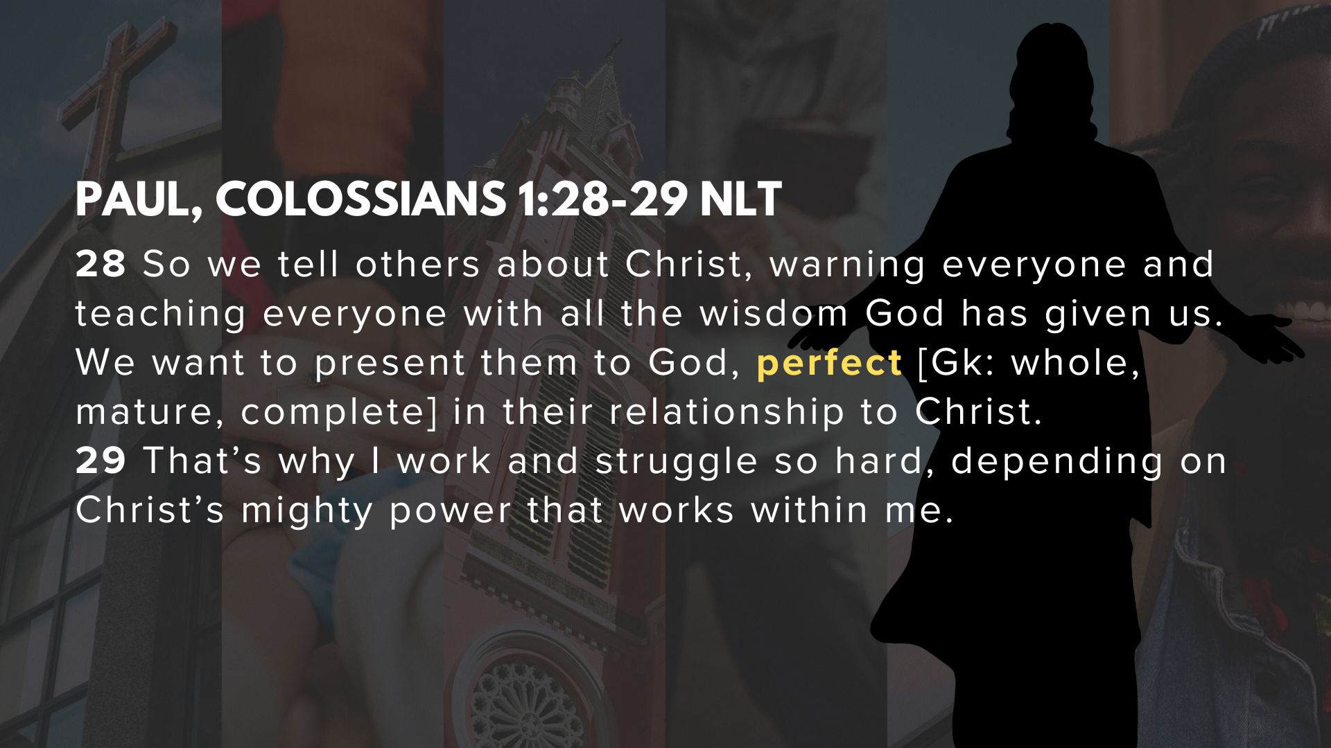
Notes:
[READ & COMMENT ON PASSAGE]
So, what does making disciples look like for you and our church? Or as some of you may be asking, How do we do this? How do we make disciples who make disciples?
Here is what we’re being invited to do… [NEXT SLIDE]

Slide 12
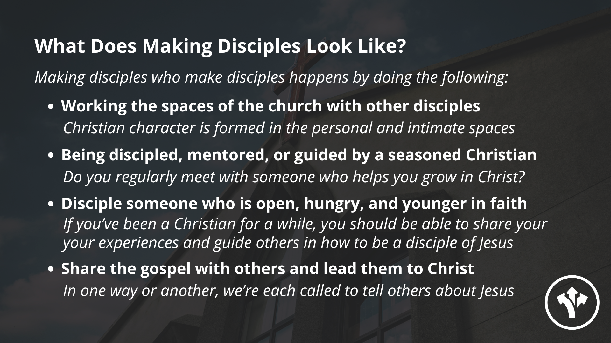
Notes:
[READ & COMMENT ON EACH POINT]
And what does that look like? How can we share the gospel in word and deed? Here are some practical things we can do… [NEXT SLIDE]

Slide 13
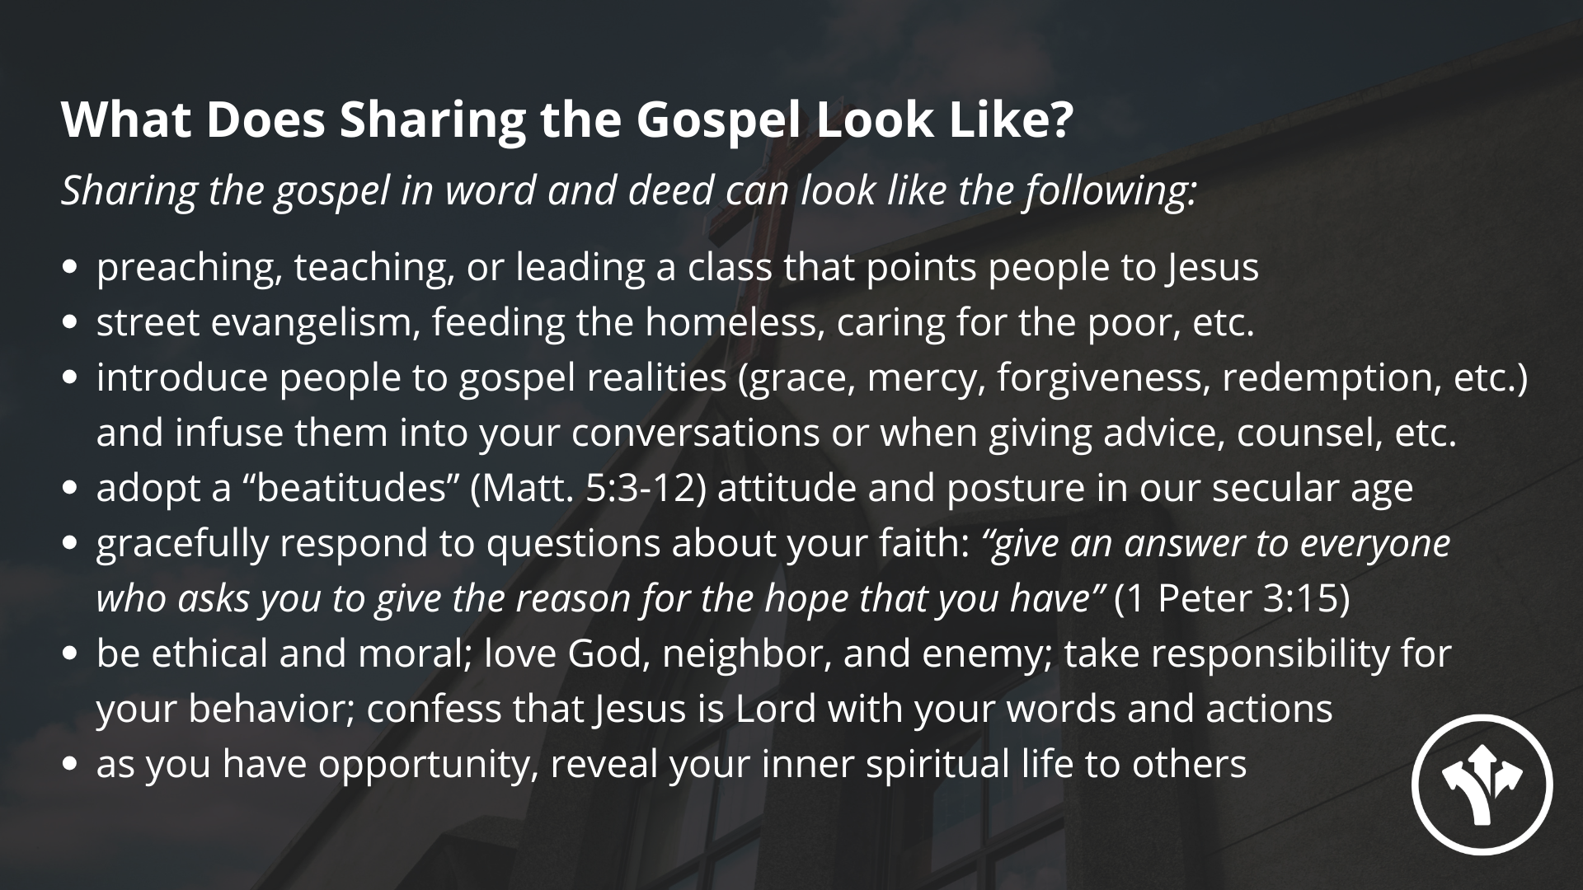
Notes:
[READ & COMMENT ON EACH POINT]
This past week Pastor Melissa and I spoke with an older woman in our church who was checking out at a store and had changed purses and couldn’t remember where she had put her credit card. She was searching in her purse and couldn’t find it and was feeling anxious. She apologized to the clerk and the people behind her in line. Then, she paused, took a deep breath, and said a prayer like “Lord, help me.” When she opened her eyes, she looked in her purse and knew where the card was and found it. She gave it to the clerk who said, “I’m glad you found the card.” Now, this congregant could have moved on and just said “yes, me too” but she took a moment to say, “you know what I did?” The clerk said, “You took a deep breath?” And she said, “Yes, and then I said a prayer and God helped me to know where it was.” What a simple way to reveal your faith! She didn’t have a relationship with the cashier or the person behind her, so it wasn’t appropriate for her to sit down with them and give them a full gospel presentation or steps to becoming a Christian. But she made a connection between her actions and beliefs and helped those around her to get a glimpse of the gospel: God meeting her in a difficult place and providing for her needs. In a simple but meaningful way, she demonstrated and proclaimed the good news in everyday life.
May God give us all a Kingdom imagination for how we can be fishers of people and proclaim the good news where we live, learn, work, and play… so that every person has repeated opportunities to see, hear, and respond to the good news of Jesus Christ. Amen? Finally, here are some questions to help us reflect and respond together… [NEXT SLIDE]

Slide 14

Notes:
Questions

Slide 15


Slide 16
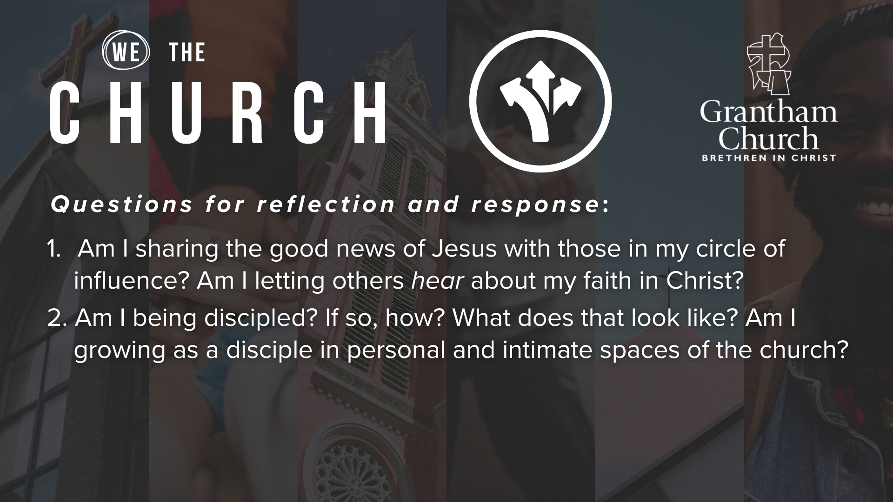

Slide 17
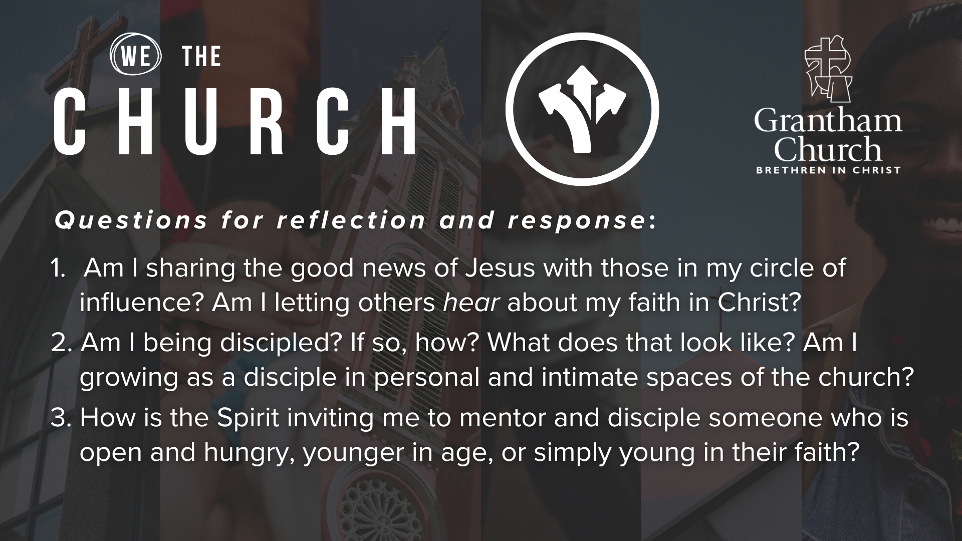
Notes:
[READ & BRIEF COMMENT ON EACH QUESTION]
Am I sharing the good news of Jesus with those in my circle of influence? Am I letting others hear about my faith in Christ?
Am I being discipled? If so, how? What does that look like? Am I growing as a disciple in personal and intimate spaces of the church?
How is the Spirit inviting me to mentor and disciple someone who is open and hungry, younger in age, or simply young in their faith?
[CLOSING WORDS]
Brothers and sisters, this series is merely the beginning of our efforts to develop a gospel saturation mindset, to cultivate a culture of discipleship, faith-sharing, and collaboration, and to equip our congregation to be about the Great Commission. We hope that you will join us in praying for continued growth in these areas as we seek to be faithful to Jesus.
[NEXT SLIDE FOR CLOSING PRAYER]

Slide 18

Notes:
[CLOSING PRAYER]
[APOSTLES’ CREED]
[COMMUNION]
[RESPONSE SONG]
ANNOUNCEMENTS – College Lunch & Fellowship Meal after the service
Benediction
Brothers and sisters, God wants us to share his heart by embodying and sharing the good news of Jesus with every person we encounter in life. Therefore, let us go into the world and make disciples who make disciples. May the Holy Spirit empower you to carry out the mission we’ve been give to lead others to the God who looks like Jesus. In the name of the Father, and the Son, and the Holy Spirit. Amen.

