Slide 1

Notes:
[INTRO]
There were many times in Jesus’ ministry when the religious leaders challenged Jesus (i.e., stump him, trap him, get him in trouble).
We can read about a few of those instances in Matthew 22
First, the Pharisees asked, “Should we pay taxes, participate in idolatry, and fuel the empire?”
Then the Sadducees challenged him on the idea of resurrection
Once again, the Pharisees attempt to get Jesus to slip up on matters of the Law
[NEXT SLIDE]

Slide 2
Matthew 22:36-40 NIV
³⁶ “Teacher, which is the most important commandment in the law of Moses?” Jesus replied,
³⁷ “‘Love the Lord your God with all your heart and with all your soul and with all your mind.’ ³⁸ This is the first and greatest commandment. ³⁹ And the second is like it: ‘Love your neighbor as yourself.’ ⁴⁰ All the Law and the Prophets hang on these two commandments.”
Notes:
v.36 - The question is setting Jesus up, likely followed by another question to back Jesus into a corner
v.37-38 - Jesus’ response would have been the expected “Sunday school answer” to the question – He is referencing Deut. 6:4-5 – the Shema
But Jesus doesn’t stop there. Before this expert in the Law can jump to his next question, Jesus does something none of them were expecting.
v.39-40 – Jesus references Leviticus 19:17, pairing it with Deut. 6—doing something which had never been done before. While this Pharisee is trying to use this as an opportunity to make Jesus look foolish, the Lord uses it to teach them (us) something. Your faith isn’t just a vertical thing, it’s also a horizontal thing. In other words, true love of God looks like love of neighbor; it looks like loving others. And with that, Jesus sums up all of Scripture.
[NEXT SLIDE]

Slide 3
Notes:
And that’s what I want us to explore over the next couple of Sundays in a two-part series simply called, Love. Today we’re going to look at loving God. And next Sunday we will look at loving your neighbor. What does this mean? What does it look like? And why does Jesus sum up our faith this way?
So, I hope you’ll join us as we lean in and listen to the voice of the Spirit and apply these two messages to our lives in this unique place in time.
[BRIEF PRAYER]

Slide 4

Notes:
If you’ve attended Grantham for any length of time, you probably know that I’m a fan of Star Wars.
But I’m also a fan of Star Trek.
Spock – a Vulcan (a race of humanoids who are strictly logical and unemotional), but Spock has a human mother; yet he has chosen to fully embrace his Vulcan side; for most of the original series, he suppresses his emotions and operates by reason and logic alone, like a human computer); he is the first officer to Captain James T. Kirk and the science officer on the starship Enterprise.
For many of us, we find this more than amusing. Some actually prefer to think of themselves simply as thinking machines—computers encased in flesh. [NEXT SLIDE]

Slide 5
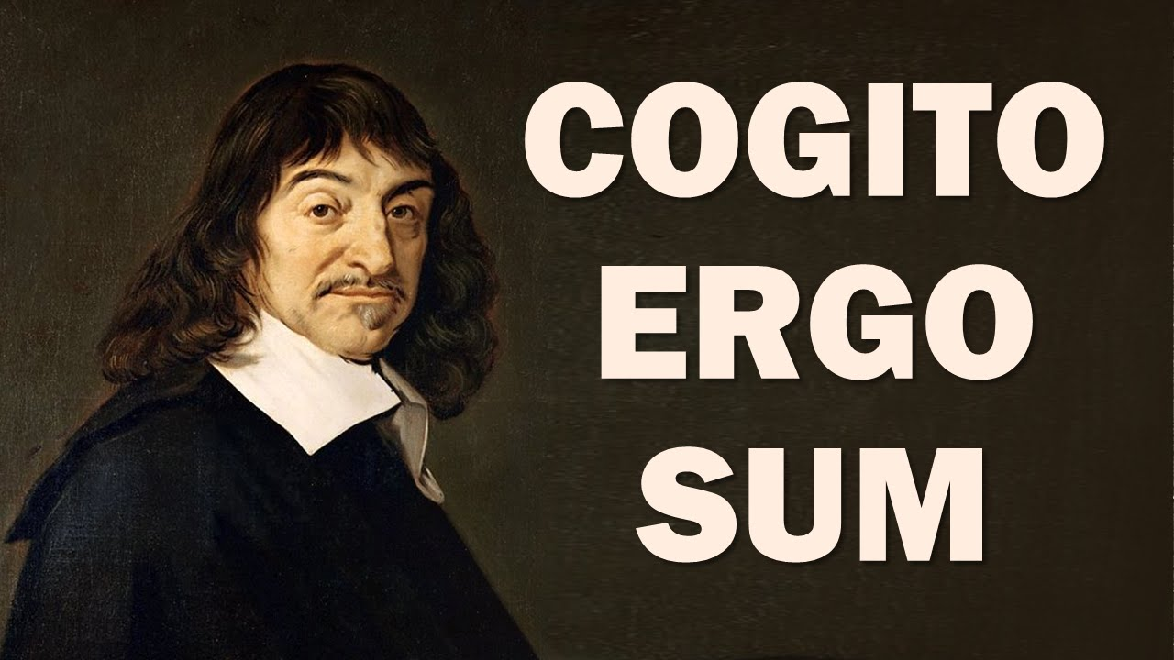
Notes:
That’s kind of how the French philosopher Rene Descartes viewed humans. He said I’m a thinking person: Cogito Ergo Sum (I think, therefore, I am). And of course, it’s this perspective that shaped the Enlightenment and still shapes much of Western thought today. And while we certainly affirm and encourage thinking at Grantham (we’re not anti-intellectual here) for some, we want to be careful not to imagine that we’re just brains on a stick. As the Scriptures teach us (which were inspired by God through eastern lenses), we’re more than our prefrontal cortex.
It’s true. Did you know that the Bible says the heart (not the mind) is the center and seat of the human person. Your heart. No, not the organ pumping blood in your chest right now, but your soul, the inner sanctum—what the Scripture describes as the center of your will, emotions, and deepest longings—your gut—the place where you love your loves. The Bible says that’s where real “spiritual” change is unlocked and let loose.
Which is why we can’t think our way to holiness. We can’t become better discipleships just by learning more information and educating ourselves about things we don’t know. It can certainly help. But you see, ideas aren’t fully responsible for pushing out holiness, for making disciples, and producing the actions we desire. No, our loves are what pull action out of us. Our loves pull action out. So, it’s the heart that we should pay more close attention to. That’s why Proverbs tells us this: [NEXT SLIDE]

Slide 6
Above all else, guard your heart,
for everything you do flows from it.
Proverbs 4:23 NIV
Notes:
[BRIEF COMMENT]
Knowing that the heart is this important, how might that change things?
Listen to these questions asked by Jamie Smith in his book, You Are What You Love: The Spiritual Power of Habit. [NEXT SLIDE]

Slide 7

“What if, instead of starting from the assumption that human beings are thinking things, we started from the conviction that human beings are first and foremost lovers? What if you are defined not by what you know but by what you desire? What if the center and seat of the human person is found not in the heady regions of the intellect but in the gut-level regions of the heart? How would that change our approach to discipleship and Christian formation?
James K.A. Smith, You Are What You Love: The Spiritual Power of Habit
Notes:
So instead of saying you are what you think, it may be more accurate to say that you are what you love. Another way to say that is: you are what you worship. It’s not a question of whether we love and worship, but what we will love and worship—what will we love with such passion and obsession that we orient our lives around that love?
I submit to you that Jesus knew that’s how it works. He knew (and knows) that human beings are very religious in that way. Which is why his very first words (the very first red letters) in the Gospel of John, chapter 1, verse 38, are these: [NEXT SLIDE]

Slide 8
John 1:36-38 NIV
³⁶ When he [John the Baptist] saw Jesus passing by, he said, “Look, the Lamb of God!” ³⁷ When the two disciples heard him say this, they followed Jesus. ³⁸ Turning around, Jesus saw them following and asked, “What do you want?”
Notes:
“What do you want?” Two disciples of John the Baptist are directed to follow Jesus, the Lamb of God who has come into the world. Jesus turns and sees them following and says, “What do you want?” Not, how can I help you? Do you have a question? Or what do you need? But instead, Jesus asks them, “What do you want?”
Listen, folks. Jesus knows they want to follow him. This isn’t a question to help Jesus understand their intentions. This is the first question of anyone who thinks they want to follow him. Jesus says, “What do you want?” The Greek word there for “want” is zeteo, which refers to desire and worship. What do you desire? What do you worship? What do you love?
Again, Jamie Smith writes: “To be human is to have a heart. You can’t not love. So the question isn’t whether you will love something as ultimate; the question is what you will love as ultimate.” Because you are what you love. O brothers and sisters, we so need to hear this today. Because so many Christians think they’re loving God (loving Jesus), but don’t realize that their lives say something much different. Just consider the many loves (what the Bible calls “idols” that are at work in American society today: [NEXT SLIDE]

Slide 9

Our American Loves (Idols) & Liturgies
Career
Hobbies
Sports
Sex
Entertainment
24/7 News
Food
Parenting
Technology
Consumerism
War & Violence
Nationalism
Partisan Politics
Social Activism
Notes:
[BRIEF COMMENTS ON EACH]
Folks, we live in a culture that contests our most sacred beliefs and practices through its own loves and liturgies. Even good things can become idols. Secular American society says, you want some loves? You looking for life and purpose? Want to feel good about yourself? Try these things! Tired of the Christian religion? Looking for something new and not so boring? We got ya covered! We have alternative systems of beliefs, values, and spirituality. And if you let it (if you’ve got no Christian liturgies and formative practices of the church in place – if the love of God is not your ultimate) these pagan forces will rush in to fill the void of organized religion. As Aristotle once said, “Nature abhors a vacuum.”
And so think about this truth: if inward and outward practices of our faith are not there shaping you, if you’ve not incorporated holy habits, rituals, routine, religious commitment and religious community into your life to shape you (even during a pandemic), then something else will. None of us can opt out of worship and formation. It’s happening whether you like it or not, even more so as the pandemic has sped up this country’s slide into post-Christendom.
This is why, now more than ever, we need to say that we’re not only spiritual, we’re religious. As I said in our Fall 2019 series (Spiritual and Religious), we need to embrace the power that comes from owning and living into the Christian religion. I defined religion this way: [NEXT SLIDE]

Slide 10
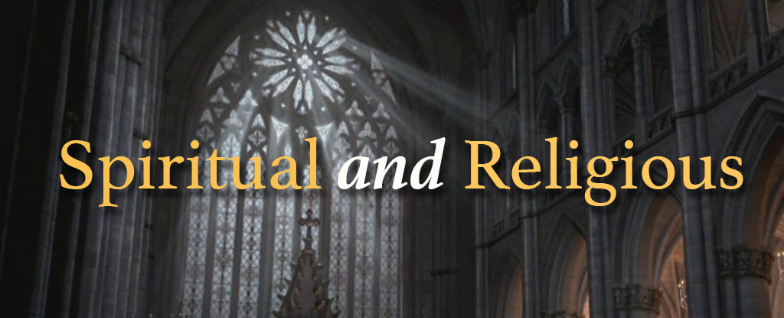
What is religion?
religio – “to bind” to something
Religion is a socio-cultural system of designated beliefs, values, behaviors, and practices that provide meaning, purpose, and direction to a person’s life and to the world around them.
A functional definition of “religion” for Christians:
Practices of prayer, Scripture, sacrament, liturgy, etc. handed down to us so that we would be properly formed in worship.
Notes:
Some have used “religion” as a pejorative. But remember, the word “religion” appears 5x in the NT, and it is by itself a neutral term. Religion can be helpful, or it can be harmful. It’s up to you and how you use it. I’m calling us to accept it as a way of shaping us and forming us into disciples who love God with all of their heart, soul, and mind; and who love their neighbors as themselves.
Again, Jamie Smith writes: “In short, if you are what you love, and love is a habit, then discipleship is a rehabituation of your loves. This means that discipleship is more a matter of reformation than of acquiring information. The learning that is fundamental to Christian formation is affective and erotic, a matter of “aiming” our loves, of orienting our desires to God and what God desires for his creation.”
As I’ve said before, church, God doesn’t need our religion, we do! Why? Because we are liturgical beings. We are a product of ritual formation. Our habits are what shape us, for better or for worse. And we need to wake up to the idols and the many competing liturgies that vie for our attention; for our passions, for your loves, for our hearts. And we need to resist the excuses that are so easy to make when we can’t gather for public worship. The church is not just he public space, it’s also the social, personal, and intimate spaces of the church. It’s all the early church knew, and we can know its power too if we will be honest about our loves and do what is required of us to be spiritually formed into the image of Christ. Amen?
That is the purpose of the Christian religion: [NEXT SLIDE]

Slide 11

The Purpose of the Christian Religion
to properly form disciples to be like Christ
to preserve and pass on faith in Jesus Christ
Notes:
[BRIEF COMMENT ON EACH]
Even for early Judaism and the Hebrew faith, which was Jesus’ religion, proper religious formation and preserving and passing on the faith was not only important, it was commanded by God in Deuteronomy 6:4-8. That’s the passage Jesus was quoting from. The text in its entirety reads: [NEXT SLIDE]

Slide 12
Deuteronomy 6:4-9 NIV
⁴ Hear, O Israel: The Lord our God, the Lord is one. ⁵ Love the Lord your God with all your heart and with all your soul and with all your strength. ⁶ These commandments that I give you today are to be on your hearts. ⁷ Impress them on your children. Talk about them when you sit at home and when you walk along the road, when you lie down and when you get up. ⁸ Tie them as symbols on your hands and bind them on your foreheads. ⁹ Write them on the doorframes of your houses and on your gates.
Notes:
And some of us may be thinking… uh, that’s hard… seems a little extreme… feels like a lot of work. [BRIEF COMMENT]
OK, so we need to be intentional about our faith, and make religious routines and rituals second nature. But, pastor, c’mon, we’re commanded to love God? And I say, sure. If you understand that the loves and liturgies of the world are always at work seeking to shape your soul, conform your mind, and lead you away from real life, then a command is quite appropriate, don’t you think? It’s urgent. You see, church, a command to love may seem ridiculous at first. But it’s really all about who or what gets your heart, and where you’ve aimed your loves. That’s why Jesus himself calls us to be intentional wiith our aim.
And if you’re still wondering why should love God, hear this… it’s because he created you for love and loved you first. [NEXT SLIDE]

Slide 13
1 John 4:9-10, 16, 19 NIV
⁹ This is how God showed his love among us:
He sent his one and only Son [Jesus] into the world that we might live through him. ¹⁰ This is love: not that we loved God, but that he loved us and sent his Son as an atoning sacrifice for our sins.
¹⁶ God is love… ¹⁹ We love because he first loved us.
Notes:
[BRIEF COMMENT]
God is love – He doesn’t just love, he is love (Trinity)
We love because he first loved us – this love of God (while we were yet sinners) ought to move us to love him
Because here’s the thing… the yearnings you have to love, to be loved, to experience life, peace, purpose, and fulfilment… it’s the mark of the Creator on your soul. As the psalmist identified, it’s a longing to know, to worship, and to love God. [NEXT SLIDE]

Slide 14
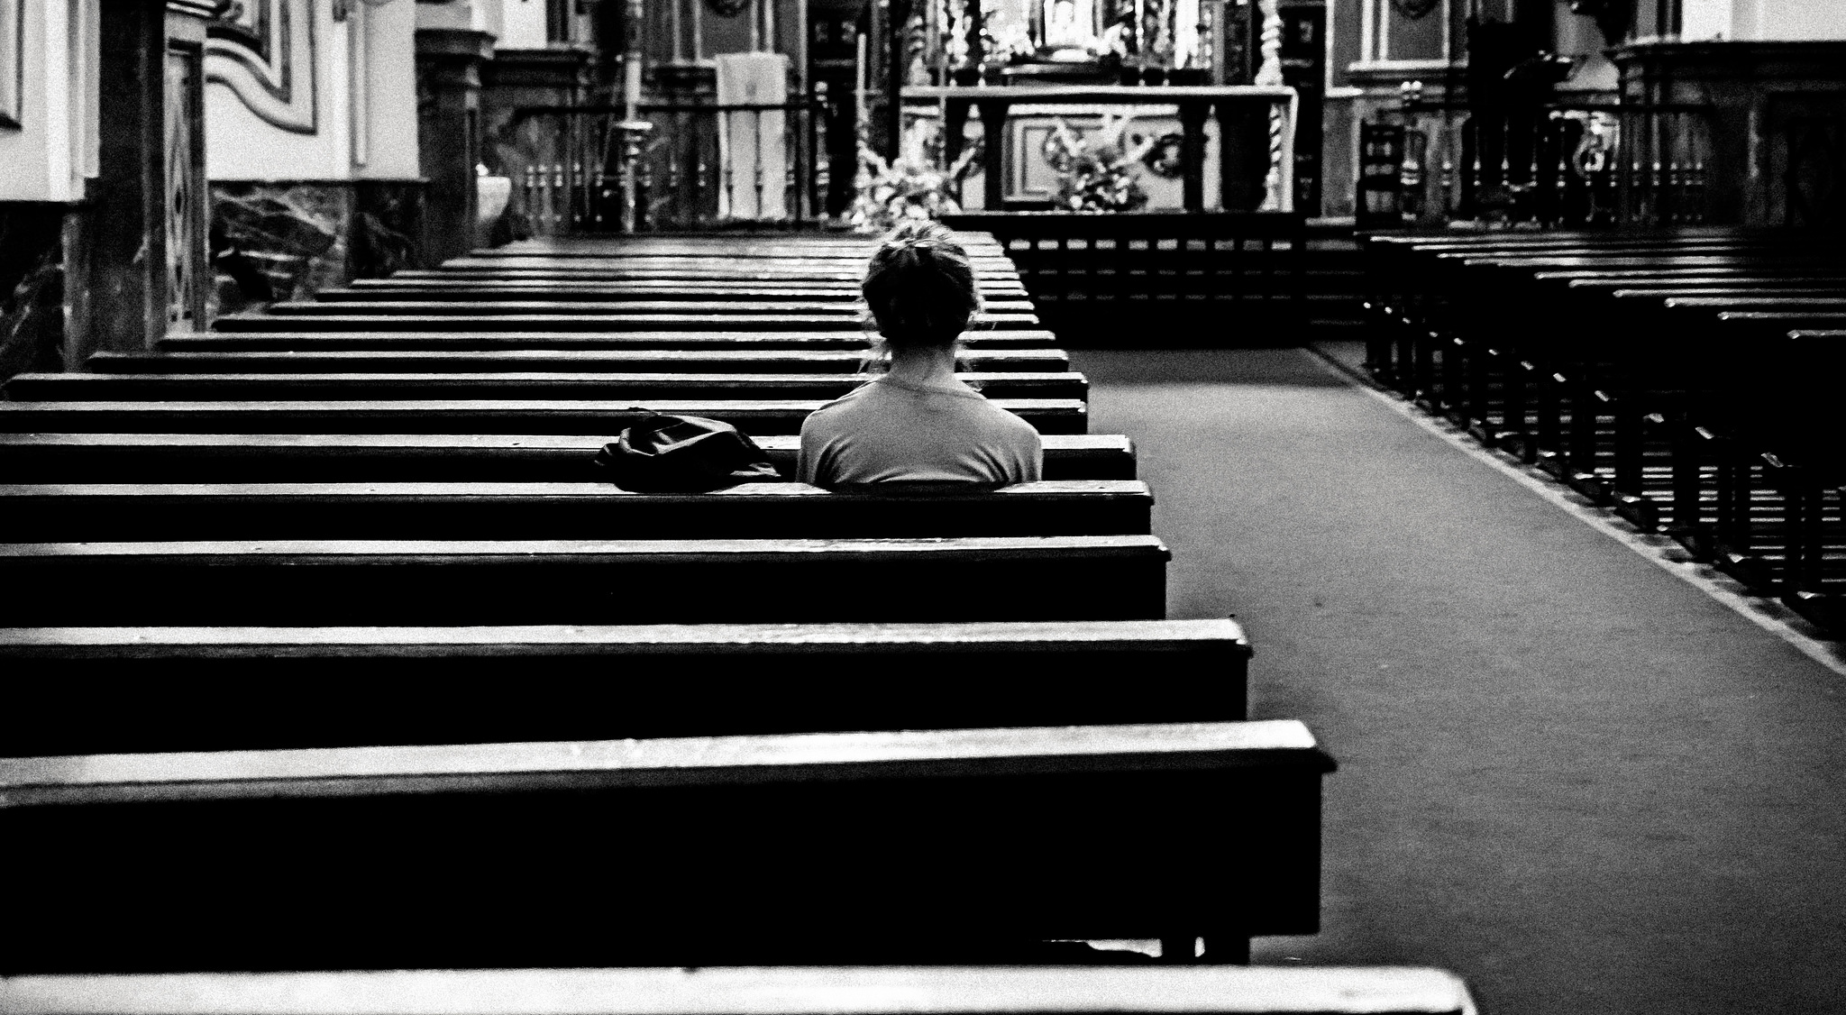
“As the deer pants for streams of water,
so my soul pants for you, my God.
My soul thirsts for God, for the living God.
When can I go and meet with God?”
Psalm 42:1-2 NIV
Notes:
My fellow disciples, Jesus invites us to love God with our whole being. So, how do we do that?
What does loving God look like?
Let’s sum up it up like this: [NEXT SLIDE]

Slide 15

What Does Loving Your God Look Like?

Slide 16
What Does Loving Your God Look Like?
Holy Habits, Rhythms & Routines

Slide 17
What Does Loving Your God Look Like?
Holy Habits, Rhythms & Routines
Following Jesus with the Church

Slide 18
What Does Loving Your God Look Like?
Holy Habits, Rhythms & Routines
Following Jesus with the Church
Loving Others
Notes:
1. Holy Habits, Rhythms & Routines
What ways can you express your devotion, worship, and obedience to Christ? What formative practices do you need to put into place in your daily life, with your family, or with your small group that is meant to focus your love, deepen your faith, and empower you to live as citizens of the Kingdom?
2. Following Jesus with the Church
As I’ve said many times, we’re not closed as a church, we’re just doing church differently during the pandemic. Are you engaging in the social, personal, and intimate spaces of the church – learning communities (Zoom), small groups, Bible studies, prayer meetings, etc.?
3. Loving Others
But that will have to wait until next week in part 2 of our Love series. I hope you’ll tune in for that. [NEXT SLIDE]

Slide 19
Notes:
Finally, do you want to grow in your faith, fend off idols, and see knowledge become action? Then you have to first start by tending to the heart, the place where your loves reside. Will you let the Lord peer into your heart this morning, so the two of you can be honest about what loves are there? If you’re willing to do that, would you close your eyes for a moment before I close us in prayer.
LEAD PEOPLE INTO A ROOM (their heart)
INVITE THEM TO SEE ALL OF THEIR LOVES
NOW SEE JESUS WALK INTO THE ROOM
HEAR JESUS SAY “WHAT DO YOU WANT?” – What did you say?
WHAT NEEDS TO CHANGE FOR YOU TO ORIENT & AIM YOUR LIFE TOWARD HIM?
[CLOSING PRAYER]
As St. Augustine prayed, we pray O Lord, “You have made us for yourself, and our heart is restless until it rests in you.”
Help us to follow you with the church, to love you, and to do whatever is necessary to experience your peace, freedom, and joy
Make us more religious, not less.

