Slide 1

Notes:
[BRIEF INTRO]
I’m addressing the most repeated responses we received from a congregational exercise at the end of last year: “With God’s help in 2024, I will stop… I will start…”
So far, we’ve looked at worry and anxiety, work & rest, and today I’m addressing another response that was listed more than others -- “I want to stop being so critical and judgmental.”
As the sermon summary reads in your bulletin… It’s not just our upbringing and experiences that make us critical and judgmental of others. The inclination to accuse and assume the worst about others, and to judge them in your heart, is rooted in our fallen human nature. And so, as disciples of Jesus, we’re called to resist those evil impulses and choose love over judgment. Because, as we will see this morning, you can’t love people and judge them at the same time. Therefore, with the Lord’s help, I’m going to invite us this morning to overcome a critical and judgmental spirit with the love of Jesus. But before we go any further, let’s go to God in prayer.
[BRIEF PRAYER]
If you have a Bible, please open up to our main Scripture reading… [NEXT SLIDE]

Slide 2

Notes:
[INVITE CONGREGATION TO STAND FOR SCRIPTURE READING]
[READ PASSAGE]
“This is the Word of the Lord…. You may be seated.”
Several years ago, in a similar message on today’s topic, I referenced this character… [NEXT SLIDE]

Slide 3
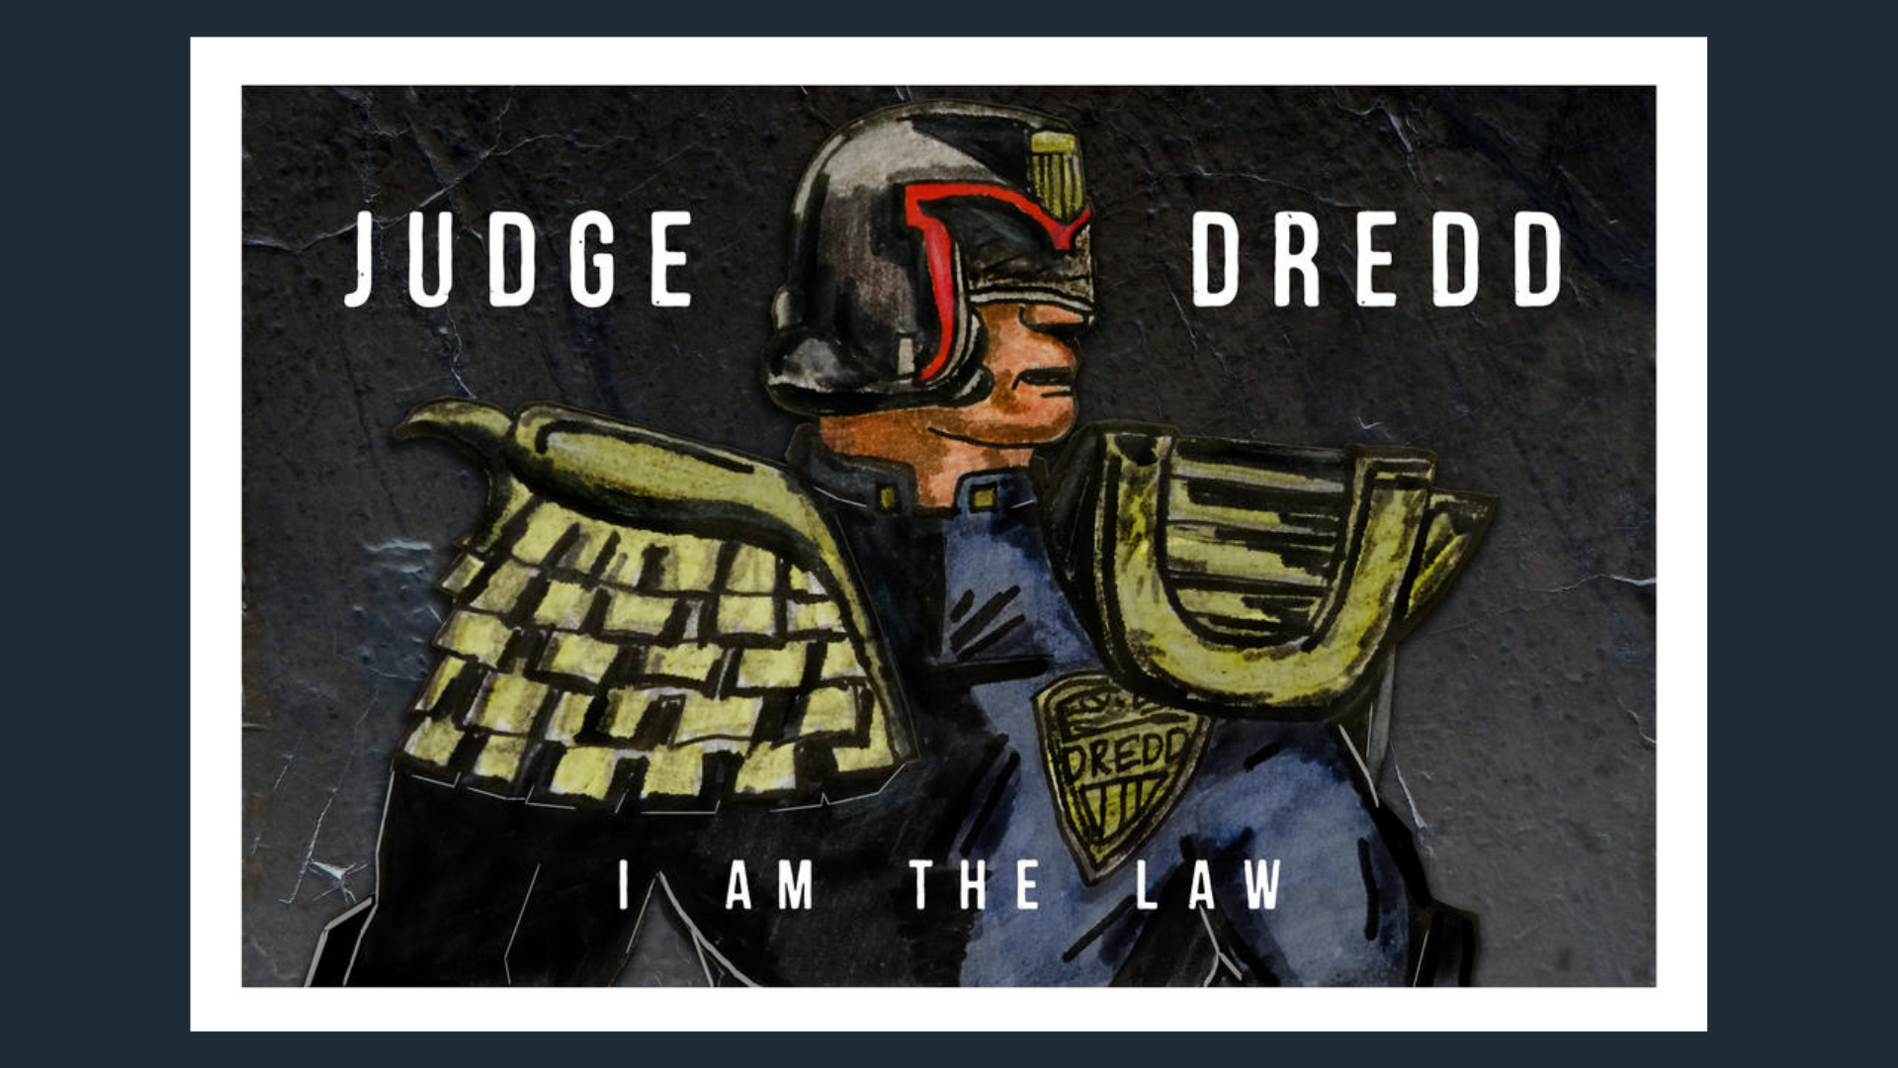
Notes:
Judge Dredd – Who is he? He is a comic book character (American comics in early 80s)
dystopian future (22nd century) – after global nuclear war – no more lawyers
Dredd is judge, jury & executioner -- “I AM THE LAW”
Judge Dredd represents the sort of behavior that Jesus is prohibiting in Matthew 7:1-5; you could say that he is calling out the Judge Dredd in each of us!
[THE CONTEXT OF MATT. 7:1-5]
The passage we just read is found in Jesus’ Sermon on the Mount
While it might seem that many of Jesus’ teachings in Matt. 5-7 is a hodgepodge of disconnected material, it’s actually quite sophisticated in its flow and structure (which I won’t go into today)
Just keep in mind that the whole of Jesus’ teaching in the Sermon on the Mount is about what it looks like for his disciples to be in right relationship to God and to others—which is what he means in Matt. 6:33 when he says, “seek first his Kingdom and his righteousness…”
And so, being in right relationship with God and others means that we don’t criticize and judge others while looking down on them with a superior attitude. Let’s listen again as we read the passage from the Message… [NEXT SLIDE]

Slide 4
Matthew 7:1-5 The Message (MSG)
“Don’t pick on people, jump on their failures, criticize their faults—unless, of course, you want the same treatment. That critical spirit has a way of boomeranging. It’s easy to see a smudge on your neighbor’s face and be oblivious to the ugly sneer on your own. Do you have the nerve to say, ‘Let me wash your face for you,’ when your own face is distorted by contempt? It’s this whole traveling road-show mentality all over again, playing a holier-than-thou part instead of just living your part. Wipe that ugly sneer off your own face, and you might be fit to offer a washcloth to your neighbor.
Notes:
[READ & COMMENT ON PASSAGE]
One commentator says the key component here is the absence of love, because clearly Jesus says you can remove the speck in your own eye (or the ugly sneer on your face) first and then help them. So, there is a way to help others without judging or criticizing them.
But this admonition has a humility that says, “I love you enough to want to help you, and tomorrow you will need to correct me.” There is no sense of superiority, no desire to make yourself look good at the expense of another (Osborne, Matthew-Exegetical Commentary, pg. 258).
That’s why James, the half-brother of Jesus, writes this in his wisdom epistle… [NEXT SLIDE]

Slide 5
James 4:11-12 NLT
¹¹ Don’t speak evil against each other, dear brothers and sisters. If you criticize and judge each other, then you are criticizing and judging God’s law. But your job is to obey the law, not to judge whether it applies to you. ¹² God alone, who gave the law, is the Judge. He alone has the power to save or to destroy. So, what right do you have to judge your neighbor?
Notes:
[READ & BRIEF COMMENTS]
And what are the things we think and say that qualifies as “judging” others?
Things that devalue them or condemn them
Things that make them look bad and you look good
Things that make others think less of them after hearing your criticism
Things that tear people down instead of building them up
Things that are based on your feelings instead of the real facts
Things that are just downright petty and not helpful
Have you ever noticed how our minds can constantly judge others (e.g., just sit on a bench in the mall or at Wal-Mart or in a restaurant)? What thoughts run through your head?
So, where does this propensity to judge come from? The Bible tells us that this is actually a result of what we call: the Fall. Look at Genesis chapter 3, verse 15… NEXT SLIDE]

Slide 6

Notes:
[READ & BRIEF COMMENTS]
What’s going on here? Well, remember that Genesis 2 already said we have been made in God’s image, but notice that the serpent accuses and casts doubt on God’s character, his intentions, his motives, and seeks to entice God’s image bearers to take upon themselves the role of creator and judge as only God can do.
This narrative is showing us there is a way to be like God and a way we’re not called to be like God. The way we’re to be like God is in bearing his loving image into the world and caring for creation. That is the way of the tree of life. But we’re not called to be like God in terms of our knowing all that he knows. We are not omniscient and all-knowing. That is the Tree of the Knowledge of Good and Evil. And taking from that tree is what led to a broken world.
We call this ”sin” in Christianity. Listen to what Greg Boyd wrote in his book, Repenting of Religion. He says… [NEXT SLIDE]

Slide 7
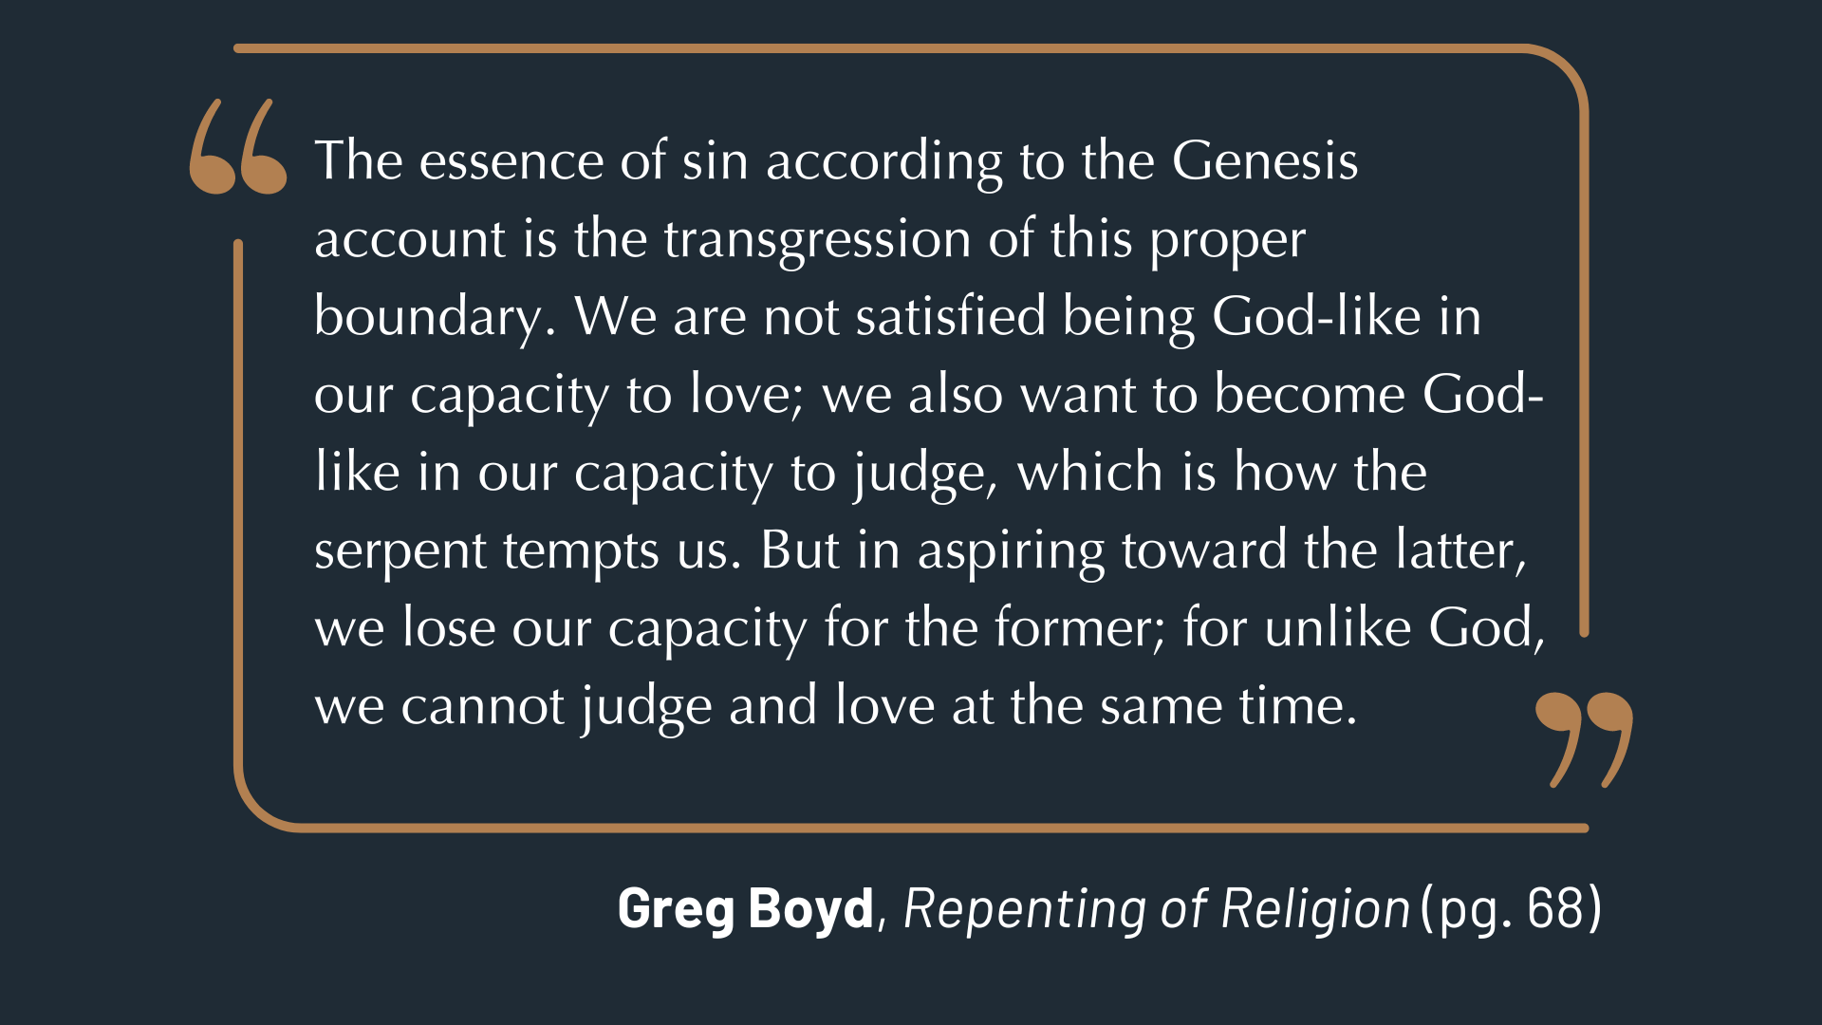
Notes:
[READ QUOTE & COMMENT]
And what is love? More specifically, what does the love of God look like? “Love is about ascribing unsurpassable and unconditional worth to another at cost to yourself.” But instead, when we judge people, we’re robbing people of their worth to ascribe worth and value to ourselves.
When we base our opinion on what we think and see (which is often contrary to what God has declared about people because of the cross of Christ), we are in essence rejecting what God has declared about them for our own fallen perceptions. And this isn’t what love looks like.
Instead, look at what John says about what love really looks like… [NEXT SLIDE]

Slide 8
“We know what true love looks like because of Jesus. He gave His life for us, and He calls us to give our lives for our brothers and sisters.”
1 John 3:16 VOICE
Notes:
[READ & BRIEF COMMENTS]
And remember what Jesus said in the Gospel of John 13:34-35 – “the whole world will know that you are my disciples by the way you love one another.” So, love is clearly the distinguishing mark of a disciple – it is the all or nothing of the Kingdom. Again, we can’t judge people and love them at the same time.
Listen to how the Apostle Paul thought about judging himself and others in 1 Corinthians chapter 4, verses 3-5… [NEXT SLIDE]

Slide 9
Paul, 1 Corinthians 4:3-5 NIV
³ I care very little if I am judged by you or by any human court; indeed, I do not even judge myself.
⁴ My conscience is clear, but that does not make me innocent. It is the Lord who judges me. ⁵ Therefore judge nothing before the appointed time; wait until the Lord comes. He will bring to light what is hidden in darkness and will expose the motives of the heart. At that time each will receive their praise from God.
Notes:
[READ & COMMENT]
But wait a minute… all this talk about not judging… doesn’t Jesus and the NT tell us to make right judgments? Is it always wrong to judge or make a judgment? Good question.
What does the Bible say about it in context? Real quick, let’s consider this… [NEXT SLIDE]

Slide 10
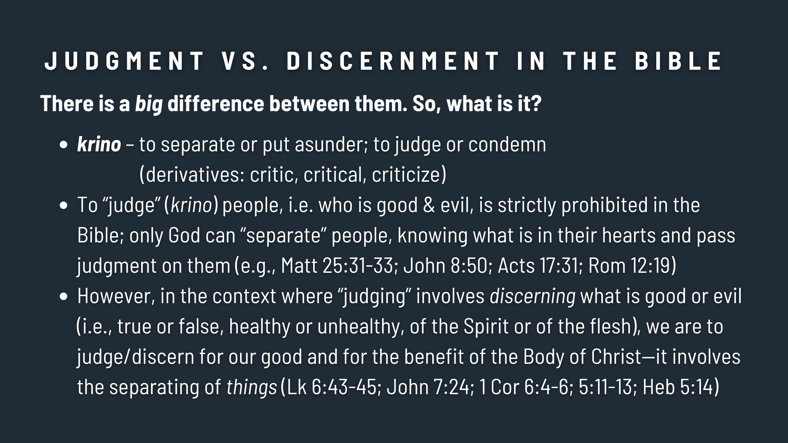
Notes:
[READ & COMMENT ON EACH POINT]
So, judging or condemning people is wrong. But judging or “discerning” good and evil things is right. A prime example of that is found in Matthew 7:17-20 (in the same chapter!) when Jesus says, “Likewise, every good tree bears good fruit, but a bad tree bears bad fruit. A good tree cannot bear bad fruit, and a bad tree cannot bear good fruit. Every tree that does not bear good fruit is cut down and thrown into the fire. Thus, by their fruit you will recognize them.”
Jesus is saying that we can judge a tree by its fruit, but judgment of the tree itself is for God alone to do. In other words, we can discern what is good and evil without cursing or condemning others.
Furthermore, listen to what Paul writes to the Christians in Rome… [NEXT SLIDE]

Slide 11
Paul, Romans 2:1-3 NIV
¹ You, therefore, have no excuse, you who pass judgment on someone else, for at whatever point you judge another, you are condemning yourself, because you who pass judgment do the same things. ² Now we know that God’s judgment against those who do such things is based on truth. ³ So when you, a mere human being, pass judgment on them and yet do the same things, do you think you will escape God’s judgment?
Notes:
[READ & COMMENT]
So, how can we pump the brakes, or stop completely, before running someone over with our thoughts and words? Well, the Apostle Paul said it begins with the way you see yourself.
To his young padawan learner, Timothy, Paul wrote this… [NEXT SLIDE]

Slide 12
“This is a trustworthy saying, and everyone should accept it: “Christ Jesus came into the world to save sinners”—and I am the worst of them all.”
Paul, 1 Timothy 1:15 NLT
Notes:
[READ & COMMENT]
And how would having this view of yourself be helpful? Afterall, if you haven’t noticed, we’re living in a narcistic, self-centered, hyper individualistic culture that likely hears this verse promoting self-loathing, self-hatred, or something worse. And we should acknowledge, this view of oneself that Paul is espousing, and encouraging us to espouse, is radically counter-cultural in American society and culture today. No doubt. And so, let’s get this right.
Because this is how we begin to overcome a critical and judgmental spirit… [NEXT SLIDE]

Slide 13
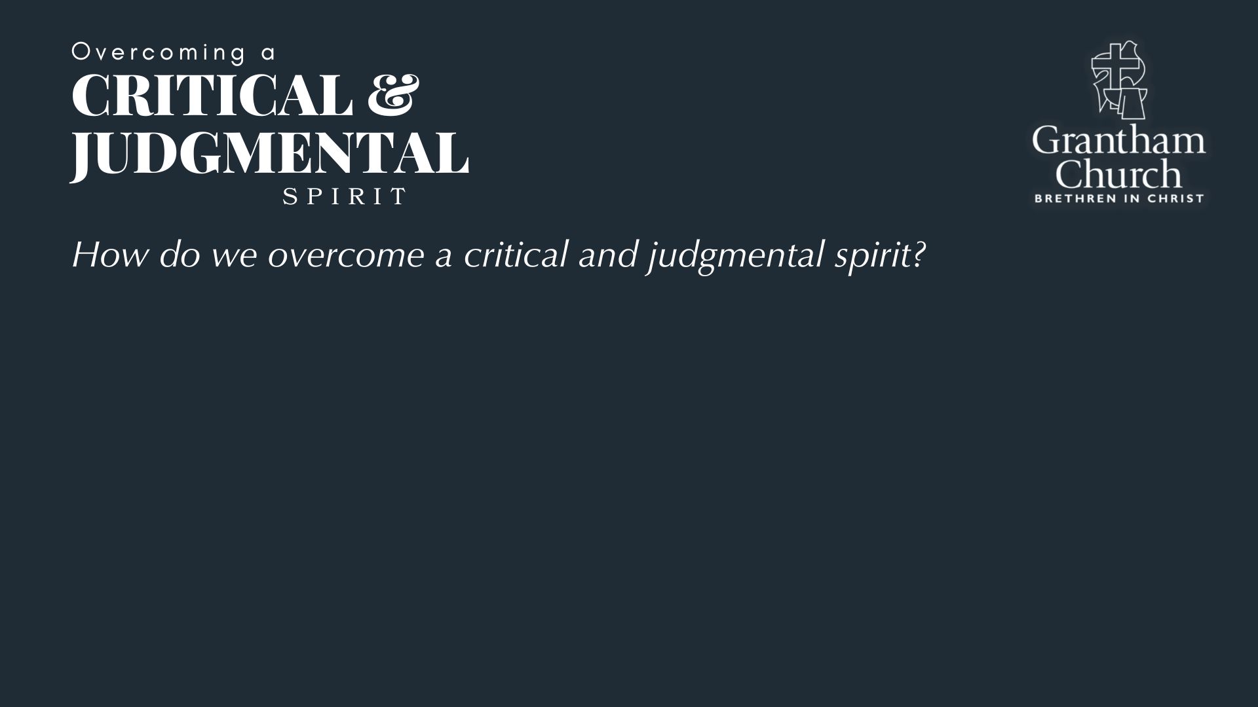

Slide 14
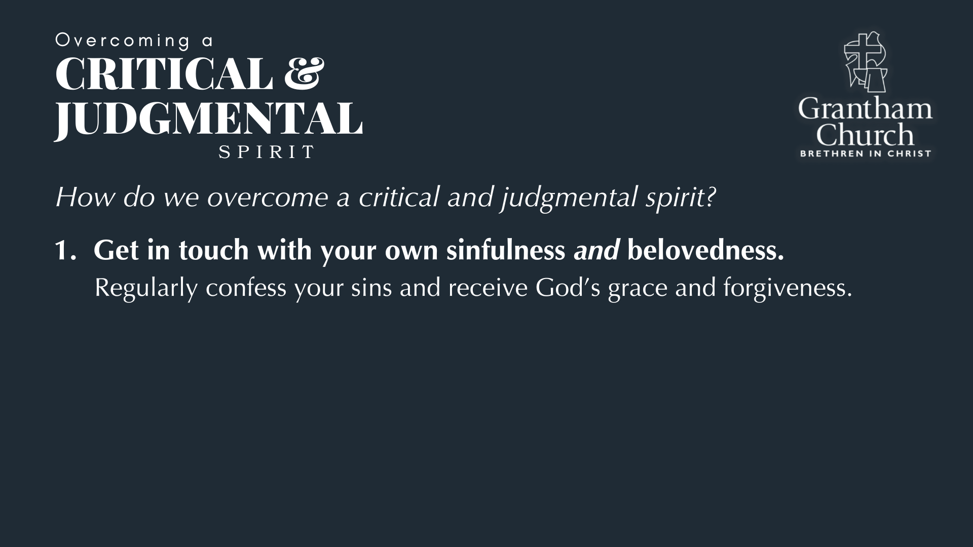

Slide 15
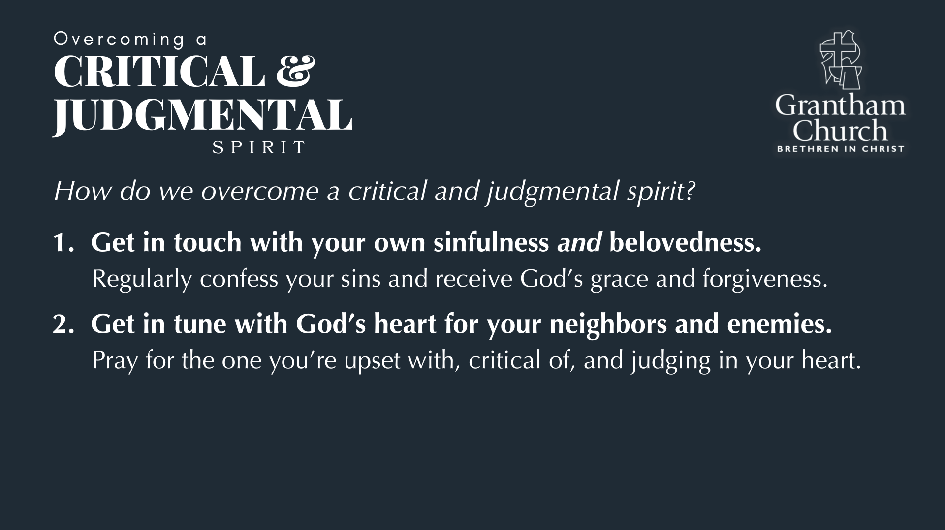

Slide 16
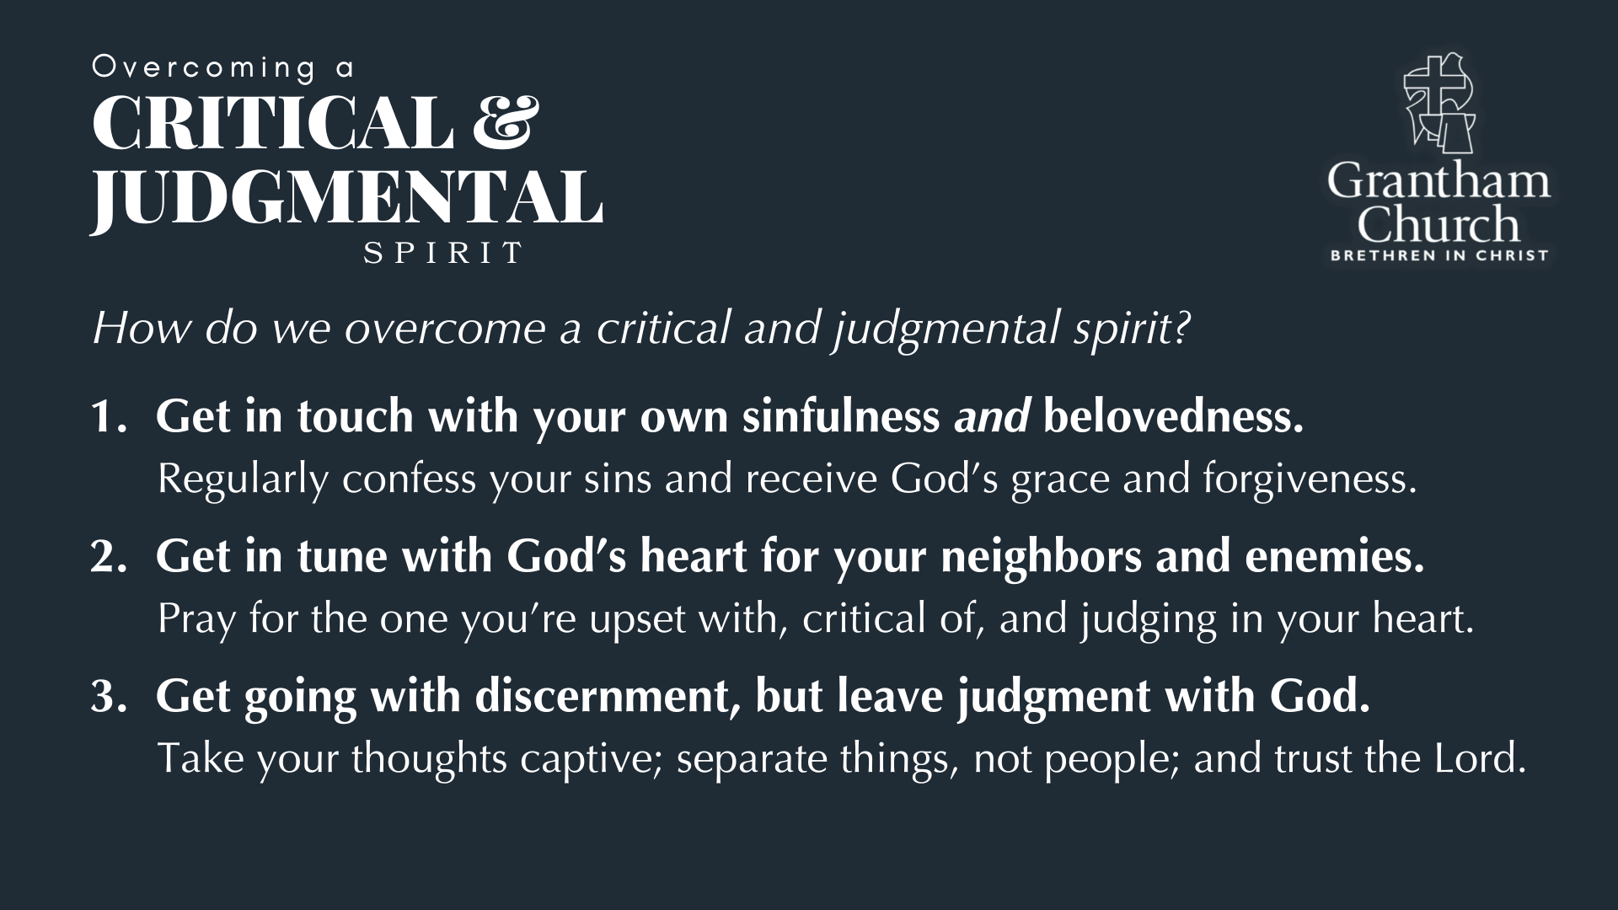
Notes:
[BRIEF COMMENT ON EACH POINT]
Get in touch with your own sinfulness and belovedness.
Regularly confess your sins and receive God’s grace and forgiveness.
Get in tune with God’s heart for your neighbors and enemies.
Pray for the one you’re upset with, critical of, and judging in your heart.
Get going with discernment, but leave judgment with God.
Take your thoughts captive; separate things, not people; and trust the Lord.
Finally, here are some questions for reflection and to help us respond… [NEXT SLIDE]

Slide 17
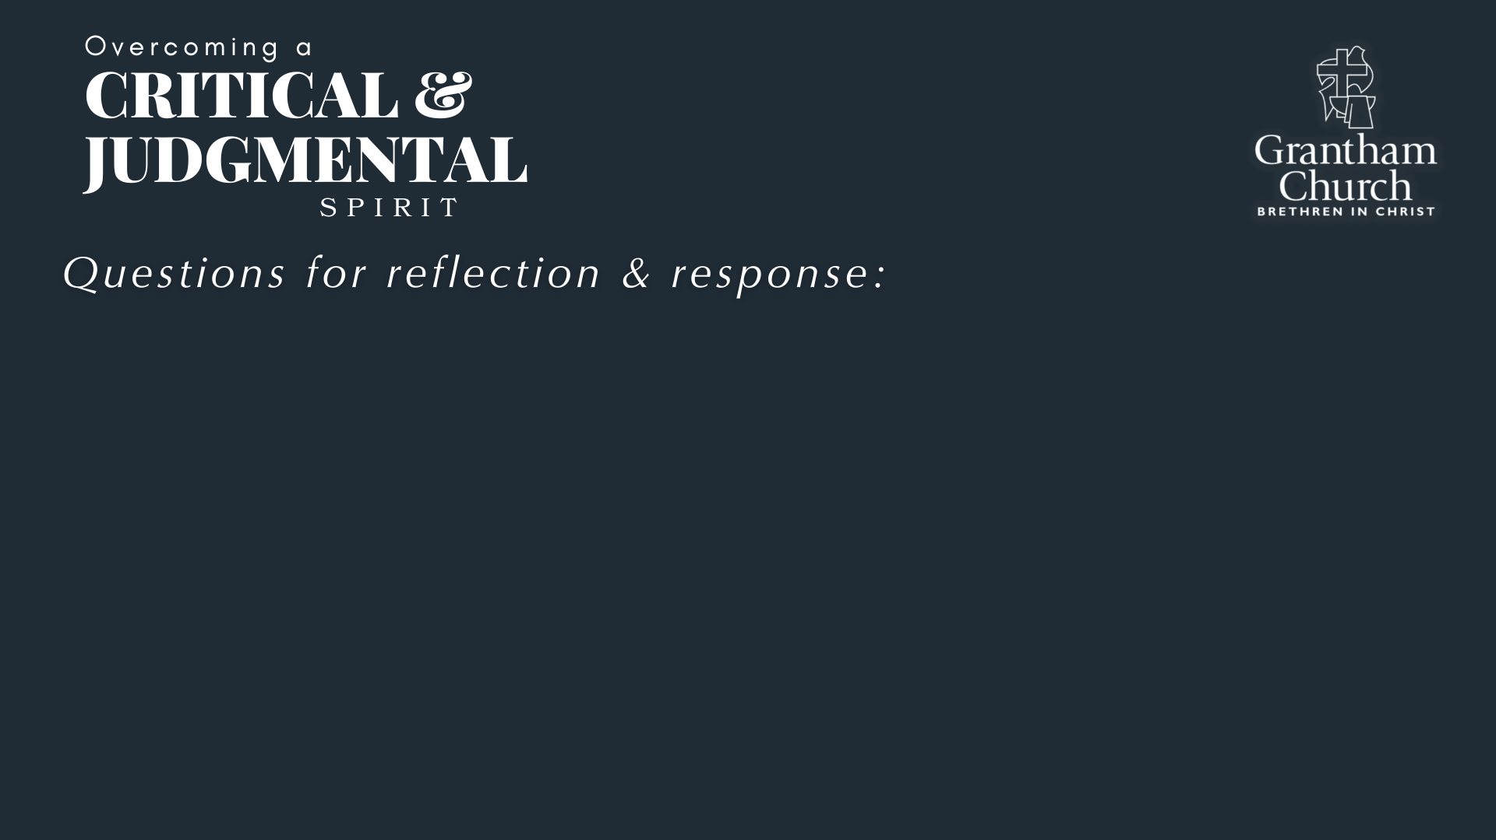

Slide 18
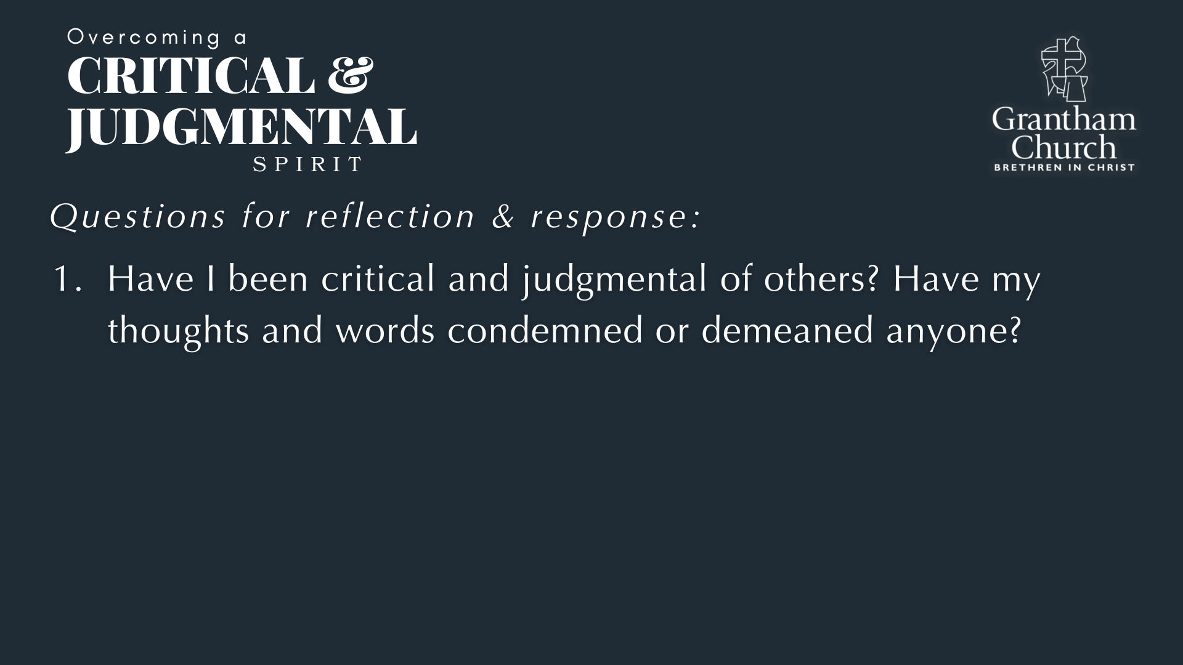

Slide 19
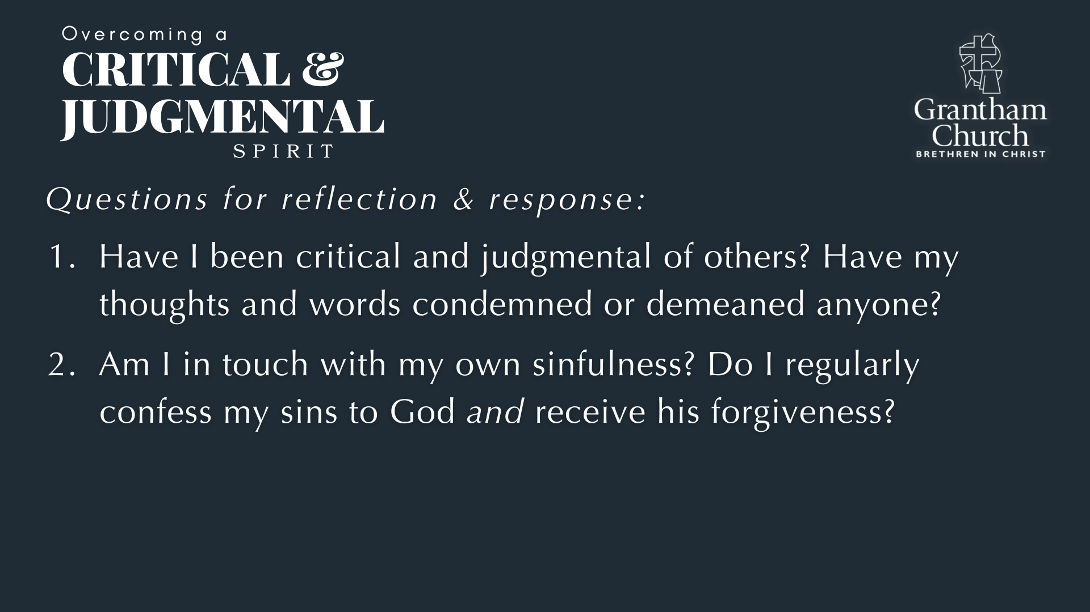

Slide 20
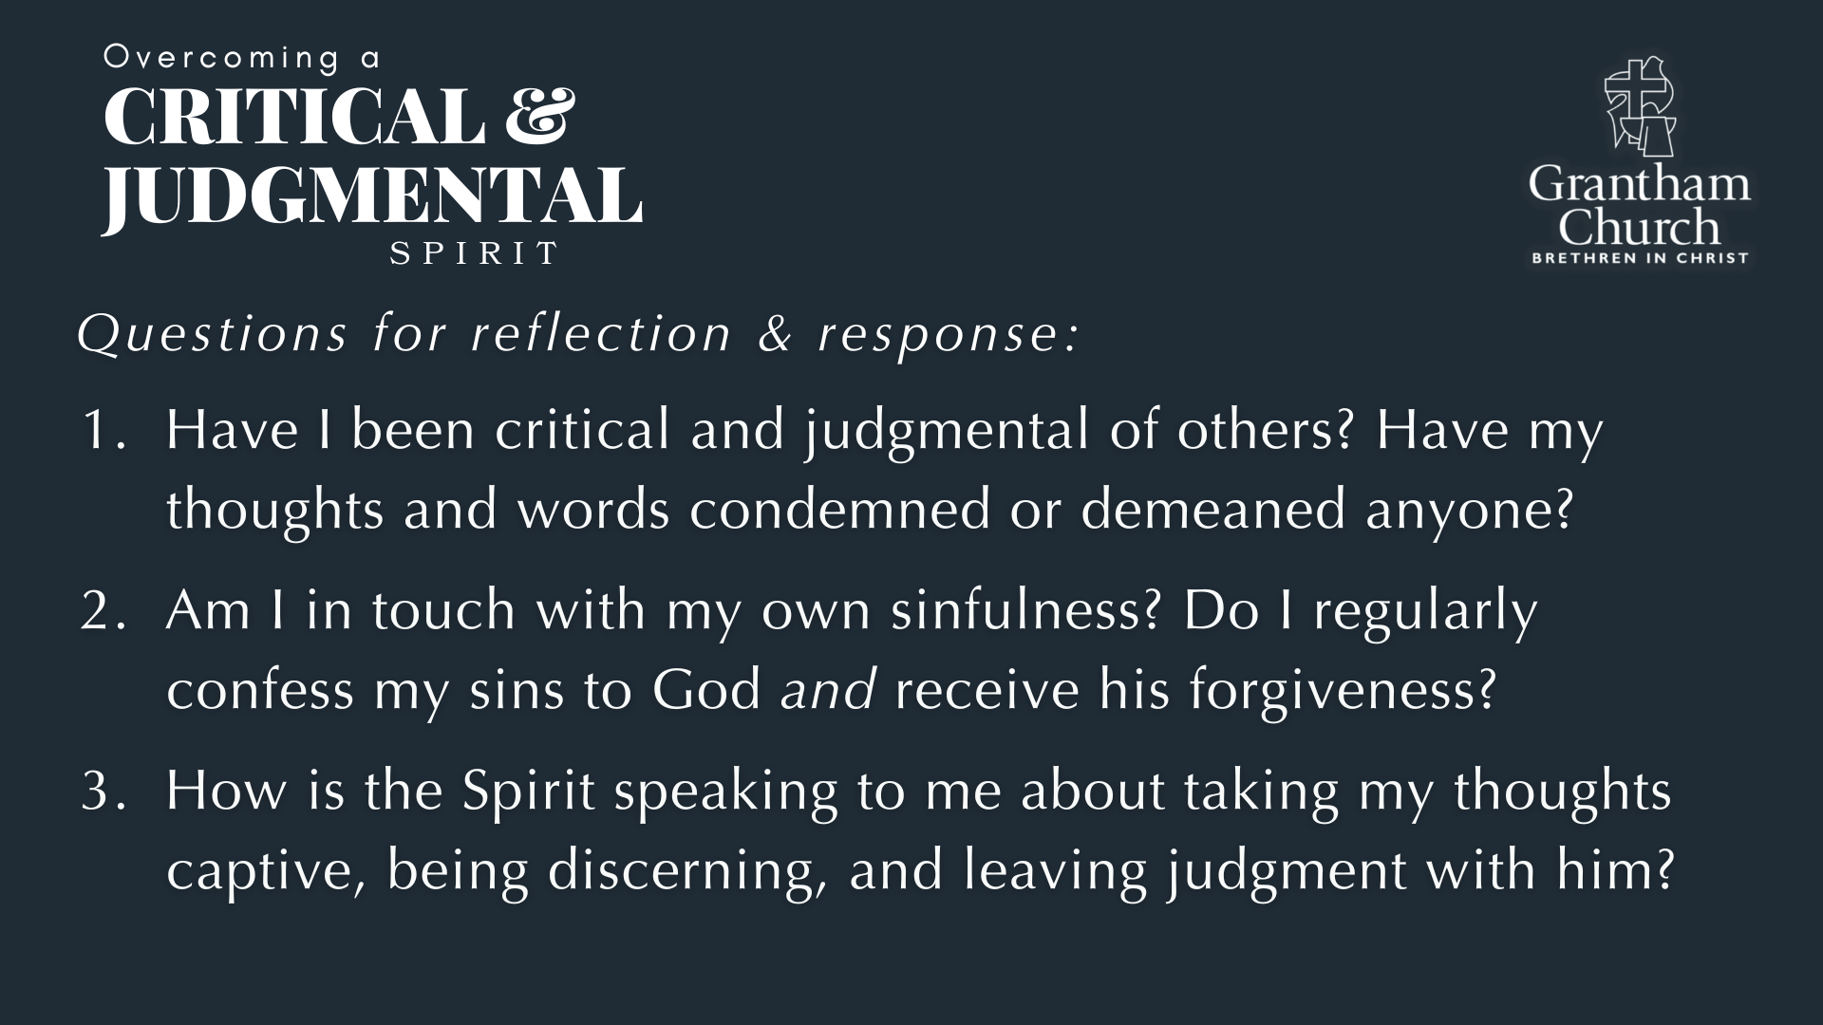
Notes:
[READ & COMMENT ON EACH QUESTION]
Have I been critical and judgmental of others? Have my thoughts and words condemned or demeaned anyone?
Am I in touch with my own sinfulness? Do I regularly confess my sins to God and receive his forgiveness?
How is the Spirit speaking to me about taking my thoughts captive, being discerning, and leaving judgment with him?
Let’s pray… [NEXT SLIDE FOR CLOSING PRAYER]

Slide 21
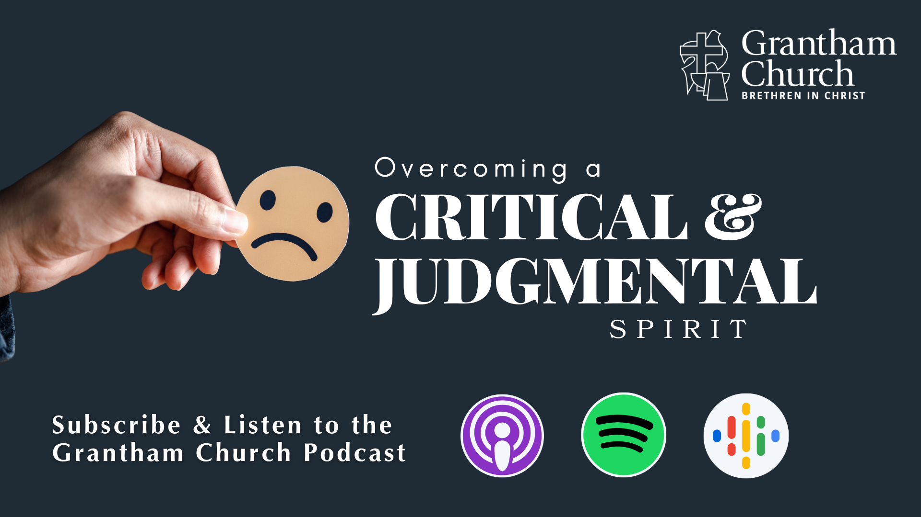
Notes:
[INVITE SERVERS & WELCOME CHILDREN BACK]
Email From the Pastor
We aspire to be intergenerational
Communion is for baptized disciples of Jesus (vows and renewal)
However, we do not police the table
Parents, please discern and guide your children
[CONFESS APOSTLES’ CREED] & [COMMUNION LITURGY]
Benediction
In anxiety may you find peace
In sadness may you find comfort
In sickness may you find healing
In loneliness may you find community
In busyness may you find stillness
In listening may you find wisdom
In following may you find hope
And in the One who meets all our needs
May you find rest.

