Slide 1
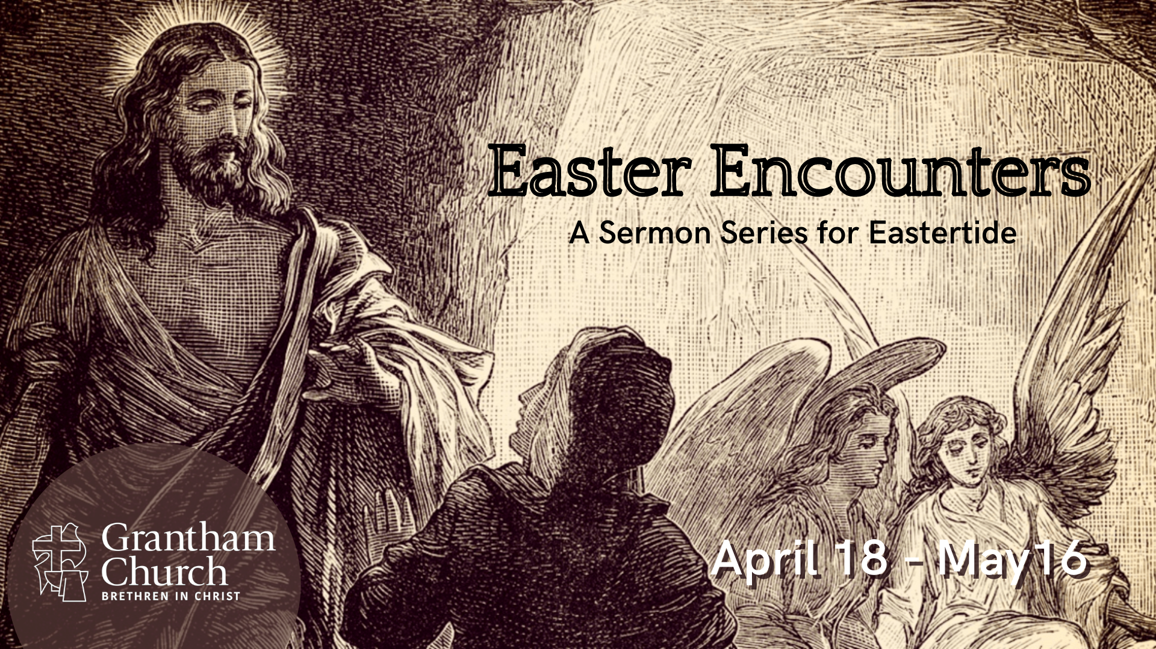
Notes:
This is week 2 of our sermon series, Easter Encounters—A sermon series for Eastertide, which is again what we call the time between Easter Sunday (when Jesus rose from the dead) and Pentecost Sunday (when the Holy Spirit comes upon the disciples in the upper room). So, this series will end on Ascension Sunday, when Jesus gives us the Great Commission and leaves the earth in bodily form until his return at some point in the future, when he will bring the fullness of the Kingdom.
If you’re just joining us, in this series we are looking at some of the experiences that the first disciples had with the risen Jesus. Last Sunday we began by looking at Mary Magdalene’s Easter encounter at the empty tomb (and why it seems that Jesus appeared to her first). And this morning we are looking at Luke 24:13-35, when Jesus catches up with two disciples on the road to Emmaus. There are several lessons to learn and theological truths to glean from this story. Therefore, I want to invite us to open up our hearts to what the Spirit wants to say to us through this message, so we can then apply it to our lives.
[BRIEF PRAYER] and then [NEXT SLIDE]

Slide 2
Luke 24:13-35 NIV – On the Road to Emmaus
¹³ Now that same day two of them were going to a village called Emmaus, about seven miles from Jerusalem. ¹⁴ They were talking with each other about everything that had happened. ¹⁵ As they talked and discussed these things with each other, Jesus himself came up and walked along with them; ¹⁶ but they were kept from recognizing him.
Notes:
[BRIEF COMMENTS]
v.13 – this episode follows the empty tomb scene on Easter morning; this is later that day in the afternoon. These two disciples were on their way home to a village called Emmaus, since it seemed to them that the show was over, and all of their hopes and aspirations had died with Jesus on the cross.
v. 14 – “everything that had happened”? Maybe Jesus’ arrest, his trial, his crucifixion, the empty tomb?
v. 15 – there were likely other travelers on the road.
v. 16 – Luke wants to communicate to us that God kept them from recognizing Jesus. Why is that? We’ll come back to that.
Verse 17… [NEXT SLIDE]

Slide 3
¹⁷ He asked them, “What are you discussing together as you walk along?”
They stood still, their faces downcast. ¹⁸ One of them, named Cleopas, asked him, “Are you the only one visiting Jerusalem who does not know the things that have happened there in these days?”
¹⁹ “What things?” he asked.
Notes:
[BRIEF COMMENTS]
v. 17 – Obviously Jesus pretends not to know what they’re talking about.
v.18 – Who is Cleopas? John 19:25 says “Mary the wife of Clopas” was at the cross. Scholars believe “Clopas” is a slight variation of the name “Cleopas.” If that’s the case, then this is Cleopas and his wife, Mary. And some also believe that this could be the same Mary who is the “mother of James,” which Luke mentions in the previous episode along with the other women who went to the tomb that morning and found it empty. And some have even speculated that this could be Jesus’ own aunt and uncle. But it’s not entirely clear. Between the differences in the synoptic gospel accounts, and so many people being named Mary and James in that day (because they were common names), it’s hard to say. Of course, it could be that Luke purposely doesn’t name the other disciple so that we could insert ourselves into this story. That’s a possibility.
But if the unnamed disciple is Mary, Cleopas’ wife, then we can at least say that she was at the cross and watched Jesus die. And in that case, it’s likely that they were discussing the crucifixion and the so-called claims that Jesus had risen from the dead. But nonetheless, those claims must not have seemed credible or believable to them since these two disciples are headed home to Emmaus. Which is why, when Jesus asks them what they’re talking about, they are visibly upset, and it stops them in their tracks when he surprises them with his question.
v. 19 – Again, Jesus pretends not to know. He’s interested in what they’re going to say about it all.
And they respond… [NEXT SLIDE]

Slide 4
“About Jesus of Nazareth,” they replied. “He was a prophet, powerful in word and deed before God and all the people. ²⁰ The chief priests and our rulers
handed him over to be sentenced to death, and they crucified him; ²¹ but we had hoped that he was the one who was going to redeem Israel. And what is more, it is the third day since all this took place.
Notes:
[BRIEF COMMENTS]
v. 19 – Notice what they don’t say about Jesus. They said he was a prophet, that he said and did some great things, but no mention of him being the Messiah. Because in their minds, Messiahs don’t die. But Jesus did die.
v. 20-21 – “we had hoped” meaning, their hopes were dashed (the Jesus movement was over for them) because Jesus did not ”redeem Israel” (i.e., make himself king, restore the line of David, throw off Roman rule and oppression, fulfill Messianic expectations and prophecies, and bring the Kingdom of God on the earth). And they point out that it’s “the third day”—possibly recalling that Jesus had said something would happen on the third day. But instead, from what they can tell, nothing.
And they go on… verse 22… [NEXT SLIDE]

Slide 5
²² In addition, some of our women amazed us.
They went to the tomb early this morning ²³ but didn’t find his body. They came and told us that they had seen a vision of angels, who said he was alive. ²⁴ Then some of our companions went to the tomb and found it just as the women had said, but they did not see Jesus.”
Notes:
[BRIEF COMMENTS]
v. 22a – The NIV translates the Gk word (existēmi) as “amazed” us. But I don’t think that’s the best translation. Here’s why. For us, when we English speakers think of being “amazed” we think of “Woah! That’s amazing! That’s so good!” But I don’t think that best conveys the idea here, nor does it fit with the next two verses. So, consider how other translations handle this verse: NRSV – “astounded” us; NASB – “bewildered” us; (VOICE) – “shocked” us; JB Phillips NT – “disturbed us profoundly!"
And that makes sense. Back to verse 22…
v. 22b-24 – empty tomb, no body, a “vision” of angels, the men double-checked, but still no body—they did not see Jesus! And consider this, if this is Cleopas and his wife, and if she was at the empty tomb that morning, that makes it even more interesting. You could then read this whole encounter as a husband who doesn’t believe his wife’s report. Regardless, Jesus isn’t all that happy that these two are walking away disbelieving, not more curious, not more intrigued, and now failing to understand that this is exactly what he had prepared his disciples for, and what was written in the Hebrew Scriptures about these things. Look at Jesus’ response… [NEXT SLIDE]

Slide 6
²⁵ He said to them, “How foolish you are, and how slow to believe all that the prophets have spoken!
²⁶ Did not the Messiah have to suffer these things and then enter his glory?” ²⁷ And beginning with Moses
and all the Prophets, he explained to them what was said in all the Scriptures concerning himself.
Notes:
[BRIEF COMMENTS]
v. 25 - ”foolish” and “slow to believe” - literally, how slow to understand you are, and how slow to act; Jesus says, all of this was foretold by the Hebrew prophets in your Scriptures (what we call the Old Testament).
v. 26 – “Was this not what was supposed to happen?” Jesus says. “First the suffering of the Messiah and then the glory of his Kingdom, then him taking the throne, then him reigning and ruling as kings do.”
v. 27 – For seven miles Jesus gives these two disciples (and ultimately the entire early church), a Christo-centric or cruciformed reading of the entire Law and the Prophets; showing them how the Old Testament Scripture pointed to Jesus of Nazareth!
And we can only imagine that what Jesus says to these two disciples is reflected in various places in Matthew’s gospel (as Matthew quotes the OT as prophecies about Jesus), in the preaching recorded in the book of Acts, in Paul’s letters, in the NT book of Hebrews, and then passed down through 2 millennia of Christian teaching and preaching.
Maybe Jesus started with the very first prophecy in Genesis 3:15 – that the Messiah would “crush the head” of the serpent through a saving act. And maybe he talked about how Moses and the Exodus was a foreshadowing of what the Christ would do (which Jesus showed his disciples by changing the meaning of Passover at the Last Supper), or how the whole temple system was fulfilled in Jesus’ death; or maybe he explained how the Law was never enough and it only paved the way for the grace of Christ, or how Jesus when he was on the cross quoted from Psalm 22 (which goes on to eerily describe a crucifixion long before it even existed).
And it’s likely that he shared how the suffering servant in Isaiah 53 (prophesied 800 years before) was uniquely fulfilled in Jesus, just three days before at Golgotha. And then maybe he explained to them that since the tomb was empty, and that Jesus said he would rise (remember his words, "destroy this temple and in three days I will rebuild it), that means new creation and the age of the Kingdom had really begun in Jesus after all. And if that’s the case, this changes everything. Everything must be rethought, relearned, as everyone must be reborn to see it. Maybe Jesus said something like that. We can only imagine.
Verse 28… [NEXT SLIDE]

Slide 7
²⁸ As they approached the village to which they were going, Jesus continued on as if he were going farther. ²⁹ But they urged him strongly, “Stay with us, for it is nearly evening; the day is almost over.” So he went in to stay with them.
Notes:
While it was customary for good Jews to offer this sort of hospitality, Luke wants us to know that they “urged him strongly” to stay with them. Clearly, the presence of Jesus and his words had captured the full attention of these disciples.
And don’t forget, they still don’t know that this great expositor of the Scriptures is Jesus, until…
Verse 30… [NEXT SLIDE]

Slide 8
³⁰ When he was at the table with them, he took bread, gave thanks, broke it and began to give it to them. ³¹ Then their eyes were opened and they recognized him, and he disappeared from their sight. ³² They asked each other, “Were not our hearts burning within us while he talked with us on the road and opened the Scriptures to us?”
Notes:
[BRIEF COMMENT]
v. 30 – notice, Jesus was invited as a guest, but he is here playing the role of the host.
v. 31 – Why now? Why are their eyes opened when he breaks the bread?
It could be for a few reasons, and maybe all of them: (1) it could be that these disciples had been present in the room when Jesus did this with his 12 disciples on Maundy Thursday in the upper room; (2) it could be that at this point his nail-scarred hands are visible; and (3) because at this very moment (at the table, after the hearing of the word, that Jesus is made visible in the breaking of bread—in communion. Though he is not seen bodily, he can be seen and touched in the Table.
Back to verse 31. Just as soon as their eyes were opened to recognize Jesus, he vanishes from their sight. Which isn’t the only time that the risen Jesus appears and disappears during Eastertide. More on that next week. And then verse 32. “They asked each other, “Were not our hearts burning within us while he talked with us on the road and opened the Scriptures to us?” The word for “opened” the Scriptures to us is the same word used when Jesus opened the eyes of the blind. And it’s the opening of our spiritual eyes that is front and center in this story. Finally, verse 33-35… [NEXT SLIDE]

Slide 9
³³ They got up and returned at once to Jerusalem. There they found the Eleven and those with them, assembled together ³⁴ and saying, “It is true! The Lord has risen and has appeared to Simon.” ³⁵ Then the two told what had happened on the way, and how Jesus was recognized by them when he broke the bread.
Notes:
[BRIEF COMMENT]
Which brings us back to the question at the beginning of the message, “Why did God keep these two disciples from recognizing Jesus in the first place?” Let’s give that some thought, as well as other lessons and truths that Luke wants us to know so that we can faithfully follow Jesus and recognize him in our own Easter encounters. [NEXT SLIDE]

Slide 10

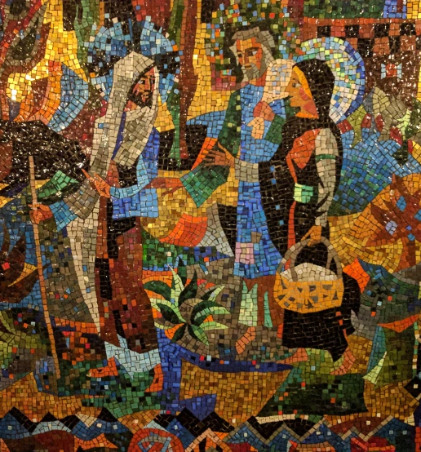
Encountering Jesus on the Road to Emmaus
Why were the two disciples kept from recognizing Jesus?

Slide 11
Encountering Jesus on the Road to Emmaus
Why were the two disciples kept from recognizing Jesus?
He wanted their honesty and to see how they’d respond.
Notes:
[BRIEF COMMENT]
Like in Luke 9:20, “Who do you say that I am?” and what are you going to do now?
Earlier in Luke 10:9, Jesus said the “Kingdom has come near” – that same language is used when Jesus comes near the two disciples walking on the road. Luke wants us to ask, ”when Jesus comes to us, will we recognize him?”
Secondly… [NEXT SLIDE]

Slide 12
Encountering Jesus on the Road to Emmaus
Why were the two disciples kept from recognizing Jesus?
He wanted their honesty and to see how they’d respond.
He wanted them to see him in the Scripture & the Table.
Notes:
[BRIEF COMMENT]
The Lord doesn’t want his disciples to recognize him by sight anymore, but rather get used to encountering him in:
(1) the Scriptures – as the Apostle Paul says in Romans 10:17 “faith comes from hearing the message, and the message is heard through the word about Christ” – which is why it’s important that we regularly read our Bibles (to encounter the Lord there) and why we preach Christ from the Scriptures, so that the Spirit might reveal Jesus to us and change us through it.
(2) the Table of communion – where the Lord meets us in a memorial meal that is both a symbol and a sacrament—meaning that there is a deep spiritual impact on us as we partake together in receiving the elements that represent his body & blood.
And thirdly… [NEXT SLIDE]

Slide 13
Encountering Jesus on the Road to Emmaus
Why were the two disciples kept from recognizing Jesus?
He wanted their honesty and to see how they’d respond.
He wanted them to see him in the Scripture & the Table.
He wanted them to see the need for a spiritual revelation, i.e., It’s God who opens eyes!
Notes:
[BRIEF COMMENT]
In John 3:3, Jesus told Nicodemus, “you must be born again” to see the Kingdom
Unless the Lord opens our eyes to understand the Scriptures, to see him in the Table, and to encounter him as we walk along the road and seek to make sense of this world, then we are but blind followers and blind guides.
Folks, you can’t be a true follower of Jesus by simply using your own intellect and power. That is why the Apostle Paul wrote this to the church at Ephesus (Ephesians 1:17-20 NIV): ¹⁷ I keep asking that the God of our Lord Jesus Christ, the glorious Father, may give you the Spirit of wisdom and revelation, so that you may know him better. ¹⁸ I pray that the eyes of your heart may be enlightened in order that you may know the hope to which he has called you, the riches of his glorious inheritance in his holy people, ¹⁹ and his incomparably great power for us who believe. That power is the same as the mighty strength ²⁰ he exerted when he raised Christ from the dead and seated him at his right hand in the heavenly realms…
Therefore, we must humble ourselves and ask the Lord for the Spirit of wisdom and revelation—to know him better so that we might follow him better. O that God would open the eyes of our heart, not just our mind, so that we might experience his transforming power and unleash more of his life in us and through us as we follow him on the road.
As we round the corner for the final stretch of this message, let’s think about other lessons that we can learn from the Emmaus Road. Consider what the Spirit might be saying to you through these: [NEXT SLIDE]

Slide 14
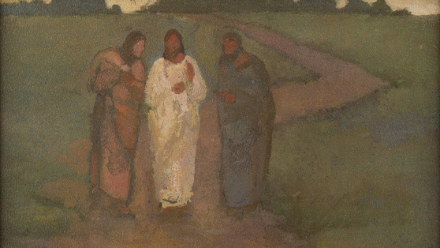
Other Lessons from the Emmaus Road

Slide 15
Other Lessons from the Emmaus Road
We can be in the presence of the Lord and not recognize him because the eyes of our heart haven’t been opened.

Slide 16
Other Lessons from the Emmaus Road
We can be in the presence of the Lord and not recognize him because the eyes of our heart haven’t been opened.
We can quit and walk away too soon and miss the Lord; in his grace he may catch up with us, but we will have missed things.

Slide 17
Other Lessons from the Emmaus Road
We can be in the presence of the Lord and not recognize him because the eyes of our heart haven’t been opened.
We can quit and walk away too soon and miss the Lord; in his grace he may catch up with us, but we will have missed things.
Like the two disciples on the road, Jesus can restore our soul, revive our dead aspirations, and renew our calling.

Slide 18
Other Lessons from the Emmaus Road
We can be in the presence of the Lord and not recognize him because the eyes of our heart haven’t been opened.
We can quit and walk away too soon and miss the Lord; in his grace he may catch up with us, but we will have missed things.
Like the two disciples on the road, Jesus can restore our soul, revive our dead aspirations, and renew our calling.
We must invite Jesus to abide with us. Otherwise, he may move on to those who desire a fresh Easter encounter.
Notes:
[BRIEF COMMENTS ON EACH POINT]
Brothers and sisters, how is the Lord speaking to you through this Easter encounter on the road to Emmaus? How is the Spirit at work now in your heart? Whatever the Lord is saying, however you’re being invited to respond, I want to encourage you to do that this morning, so that you can have a fresh encounter of your own and be changed by abiding in the risen Jesus.
[CLOSING PRAYER]

Slide 19


