Slide 1
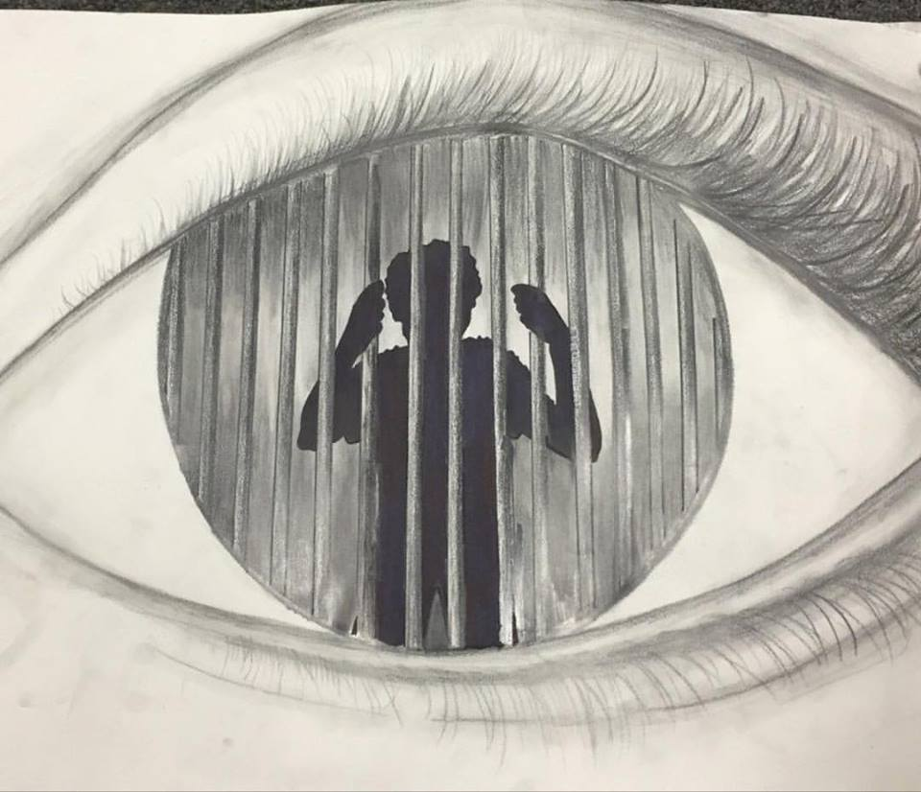
Acts 16: 16-40
Dominique
DuBois
Gilliard

Slide 2
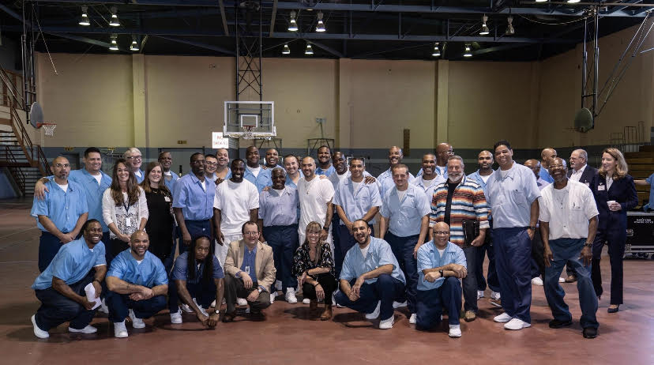

Slide 3
But God demonstrates his own love for us in this: While we were still sinners, Christ died for us.
Paul, Romans 5:8 NIV
Notes:
[BRIEF COMMENT]
Jesus proclaimed the gospel that is good news for the poor, the prisoners, to the blind, and to those who are oppressed. He made it clear for us, as we can see in his life, teachings, and in the faith and practices of the early church, that treating others the way we want to be treated is God’s will; that lifting people up from their despair, becoming their allies, even using our power and privilege as we’re able, to free them from their bondage, is what it means to embody the good news and proclaim the coming Kingdom. And he not only calls us to do this, but also to sit, listen, and learn from the marginalized. As Dennis Edwards told last year, the marginalized are often the best teachers when it comes to knowing what it means to follow Jesus in the world today.
Therefore, as we embark on this journey through our Pursuing Racial Justice series, may we open to listening, learning, and living out what the Spirit is calling us to do, for such a time as this. [CLOSING PRAYER]

Slide 4
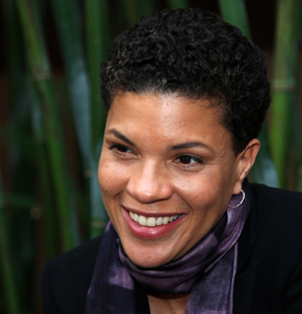
Mass Incarceration
Mass incarceration is a massive system of racial and social control. It is the process by which people are swept into the criminal justice system, branded criminals and felons, locked up for longer periods of time than most other countries in the world who incarcerate people who have been convicted of crimes, and then released into a permanent second-class status in which they are stripped of basic civil and human rights, like the right to vote, the right to serve on juries, and the right to be free of legal discrimination in employment, housing, access to public benefits.

Slide 5

Collateral Consequences
The term "collateral consequences" refers to restrictions that follow the completion of a criminal sentence.
The American Bar Association has identified over 44,000 legal collateral consequences in existence today.
More than 70 million Americans, one in three, have arrest records.

Slide 6
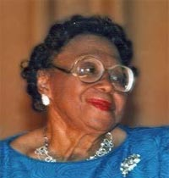
Kathryn Johnston, 92, murdered in a botched drug raid (2006).

Slide 7
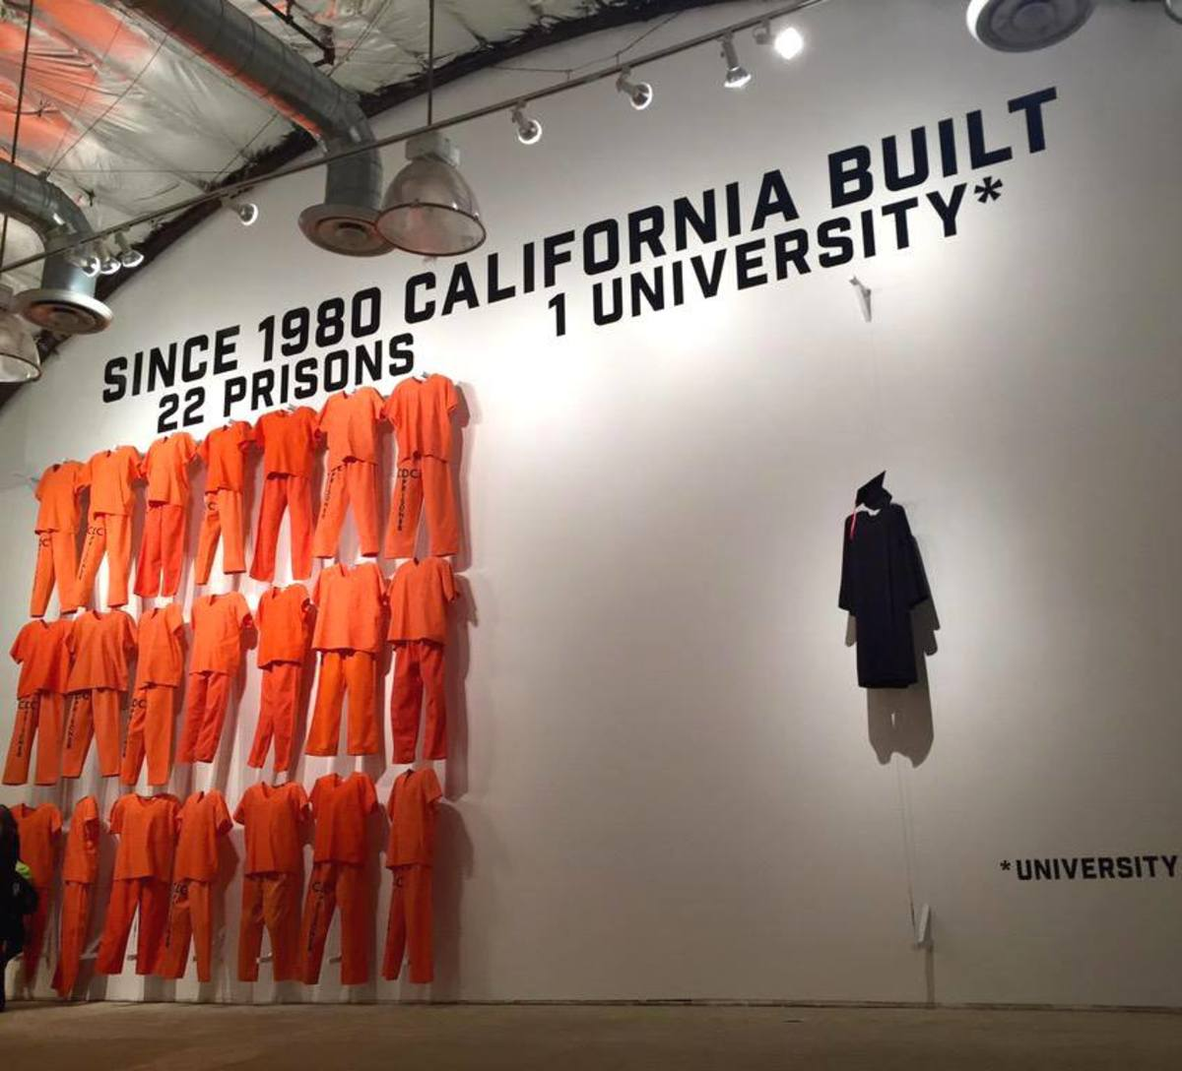
There are more jails and prisons than degree-granting colleges and universities

Slide 8
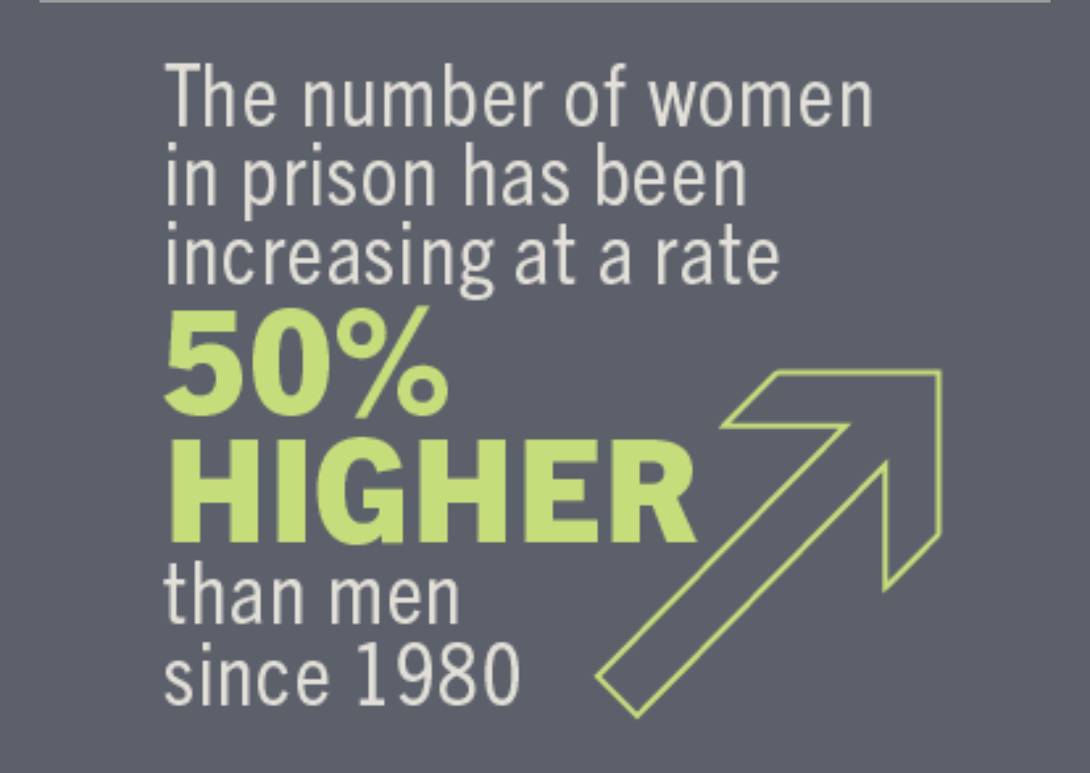
The incarceration of women

Slide 9
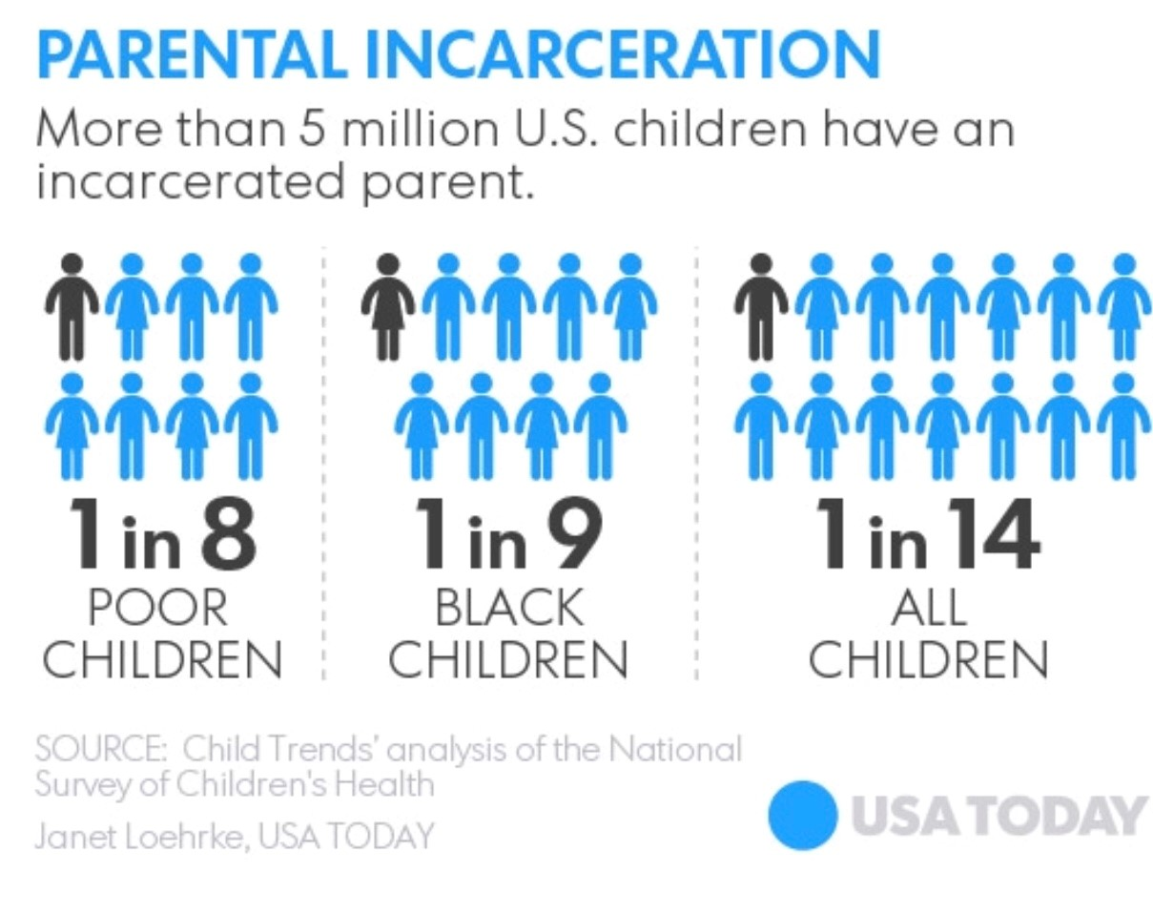
7.3 Million kids have an incarcerated parent

Slide 10
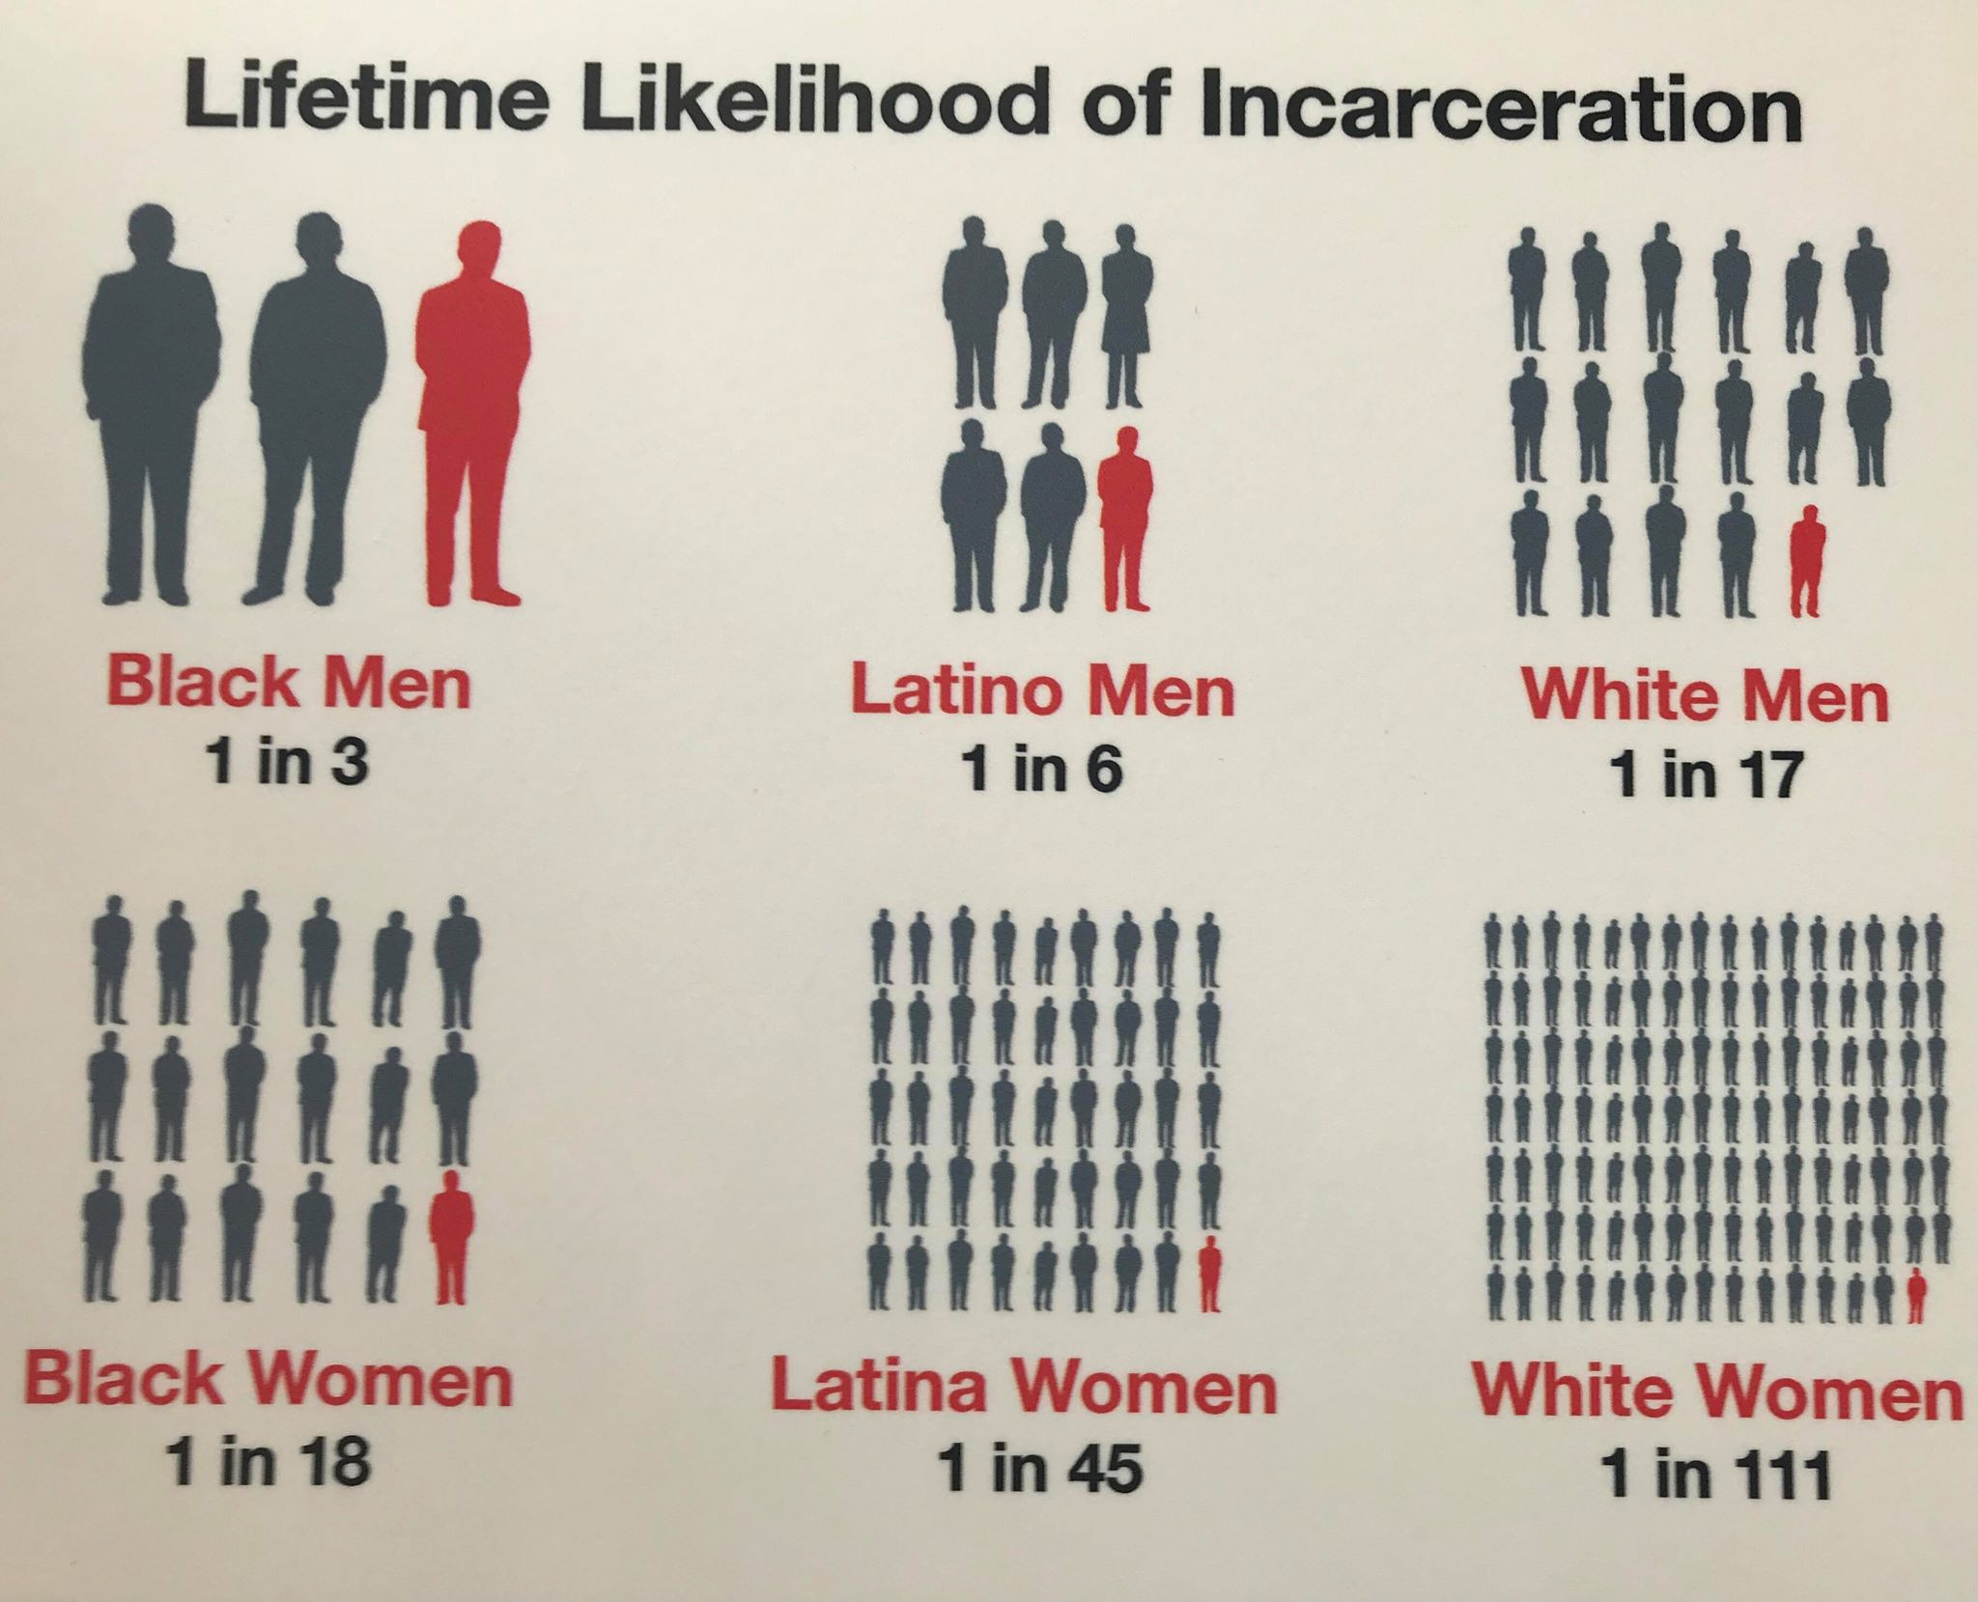
Race, Gender, & Incarceration

Slide 11
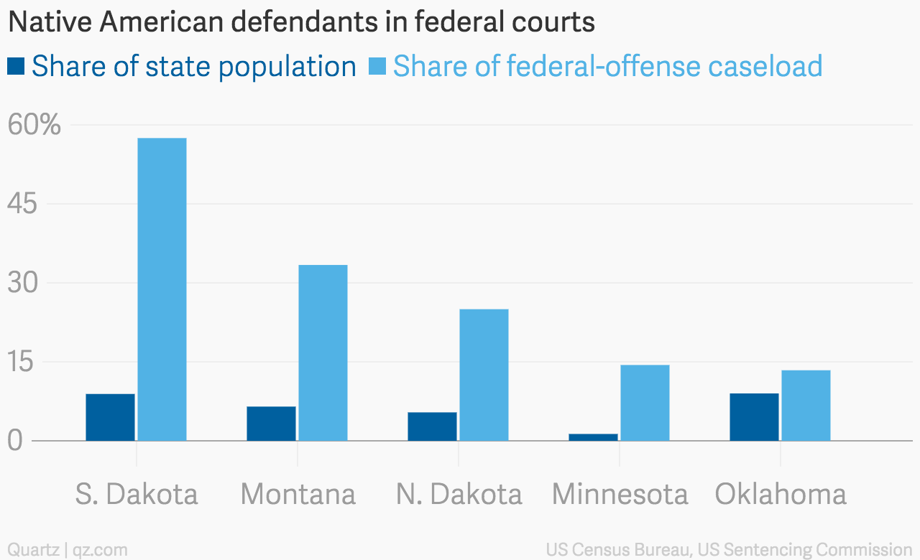
Native American incarceration rates
38% of Alaska’s incarcerated are Native Americans, while only 15% of Alaska's population in Native American.
Montana’s prison population is 22% Native American, North Dakota’s and South Dakota’s at 29%, while in all of these states Native Americans constitute just 5-9% of these states populations.
In Minnesota, Native American women represent 22% of the female incarcerated populace, although Native Americans only represent 1.3% of the states population.

Slide 12
Bail & Jail
“75 percent of people in American local jails are there because they cannot pay bail.” Robin Steinberg
We spend 14 billion $ annually holding people in jail cells who haven’t been convicted of a crime. That’s 40 million $ a day!
A 2017 report, by Philadelphia City Controller Alan Butkovitz, found that “the city could save more than $75 million a year by eliminating the cash bail system.”
Research has shown that 99% of jail growth, in America over the last 20 years, has been the result of pretrial incarceration.

Slide 13
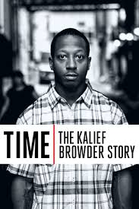
The impact of cash bail
Was arrested at 16-years-old
He was charged with a $3,000 bail his family couldn’t afford
During his time behind bars, he spent 14 months in solitary confinement
He was ultimately detained at Rikers Island for 3 years without a trail
Two years after his release, Browder committed suicide at his mother's home.
After his death became highly publicized because of celebrities like Jay Z, the city decided to pay his family $3.3 million

Slide 14
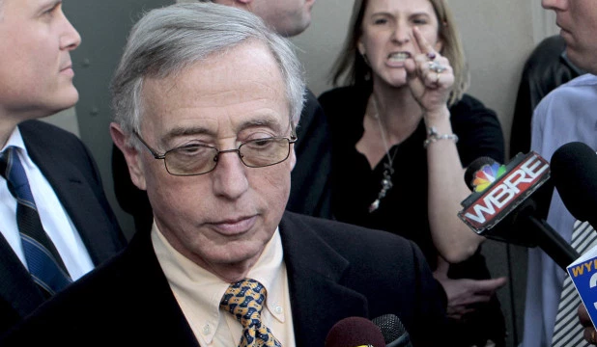
Kids for Cash Scandal
Mark Ciavarella Jr., Lauded for his strictness, and tough-on-crime approach.
In 2009, “the Pennsylvania Supreme Court vacated the adjudications of all youth who appeared before Ciavarella between 2003–2008, dismissed their cases with prejudice and ordered all of their records expunged.” In the end, 4,000 of Ciavarella’s convictions were nullified

Slide 15
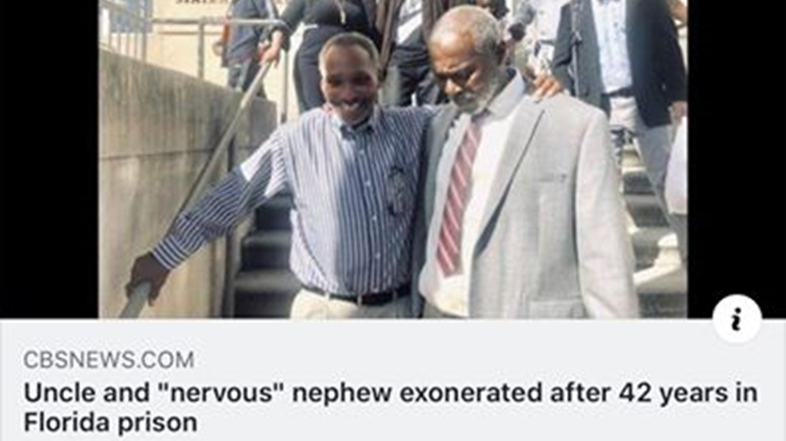
Falsely Incarcerated or sentenced
In 2018 alone, wrongly convicted people lost more than 1,600 years of their life behind bars.
Many exonerated individuals never receive any form of reparations for their false incarcerations.

Slide 16
Incarcerated Christian Leaders in Scripture
Jesus—the author and perfecter of our faith
John the Baptist—who was called to pave the way for Jesus
Paul—who wrote the majority of the NT
Peter—who Jesus told “upon this rock I will build my church”
Samson
Hanani the Seer
Joseph
Micaiah
Stephen
Jeremiah
Shadrach
Meshach
Abednego
Silas
Junia
Andronicus

Slide 17

5 books of the Bible were written in prison:
Colossians
Philemon
Ephesians
Philippians
Revelations

Slide 18
Churches should be involved in at least 1 of 4 ways
1. Prevention
2. Ministry to the incarcerated
3. Walking alongside of families with incarcerated loved ones
4. Reentry

