Slide 1


Slide 2
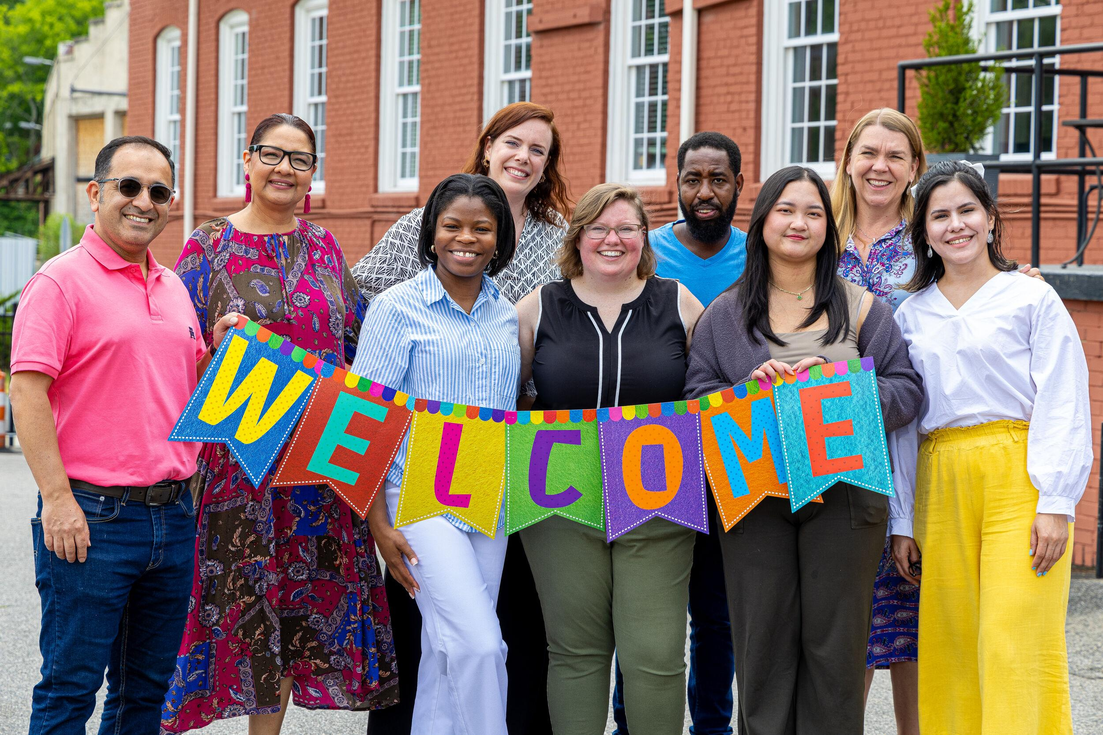

Welcoming the Stranger:
Thinking Biblically about Refugees & Immigration
Matthew Soerens

Slide 3
A Troubling Statistic
Just 23% of evangelical Christians say their views on the arrival of immigrants are primarily informed by the Bible (LifeWay Research, 2025)
  Only 38% listed the Bible as among the top three influences on their views

Slide 4
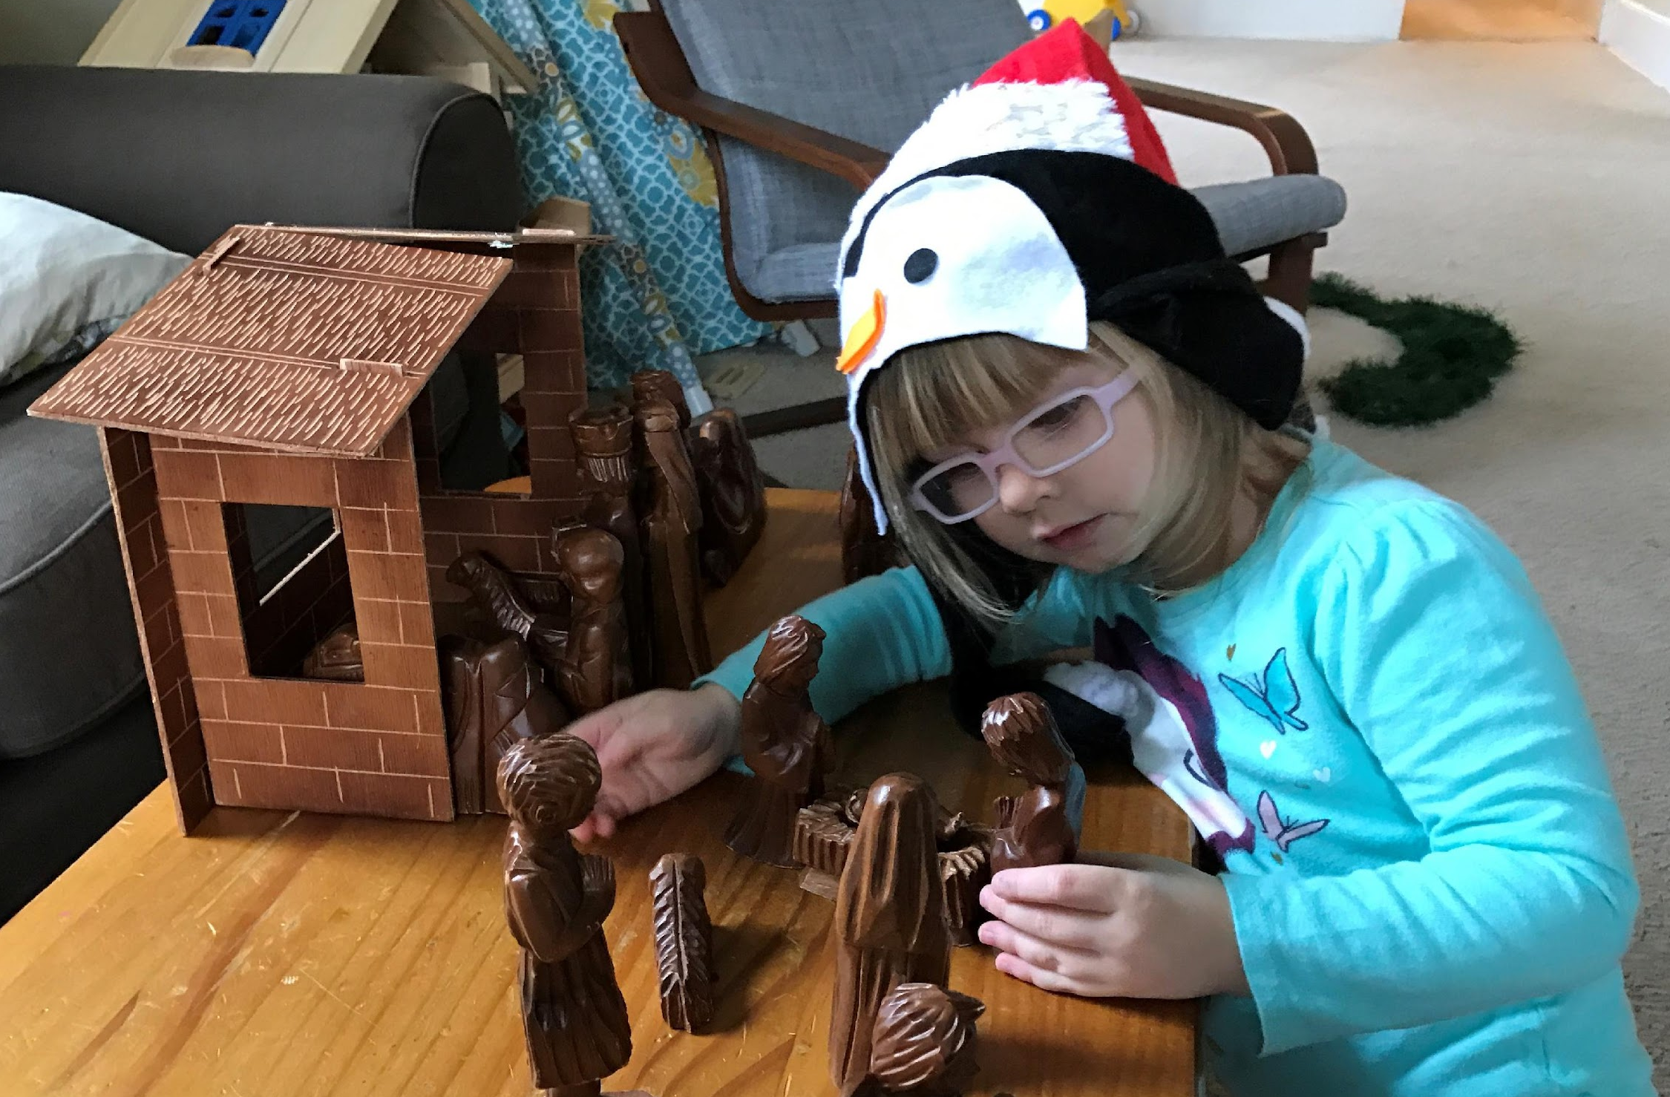
Jesus Himself Was an Immigrant
Matthew 2:13-18

Slide 5
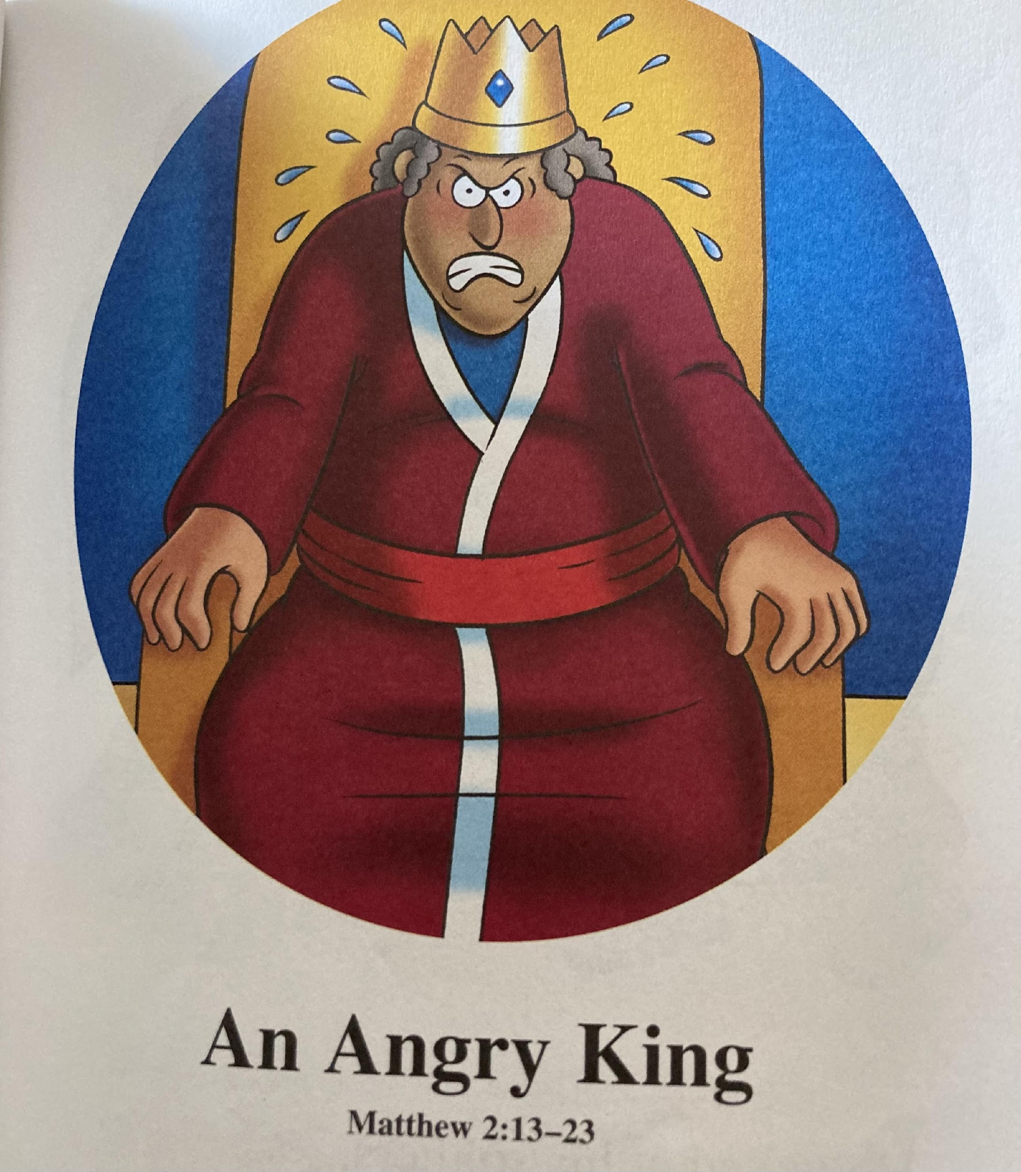
Illustration by Kelly Pulley, from The Beginner’s Bible

Slide 6
Legal Definitions
A refugee is a person who has fled their country because of a well-founded fear of persecution on account of their:
  Race
  Religion
  Political Opinion
  National Origin
  Particular Social Group
An asylum seeker is an individual who professes to meet this legal definition of a refugee upon arrival in the country where they wish to stay, but whose case has not yet been adjudicated by an appropriate authority

Slide 7

All immigrants are made in the Image of God and possess inherent dignity and potential (Genesis 1:26-27)

Slide 8
Economics of Refugees & Immigration
46% of Fortune 500 Companies were founded or cofounded by an immigrant or their children (American Immigration Council)
20 years after arrival, the average refugee adult has contributed approximately $21,000 more in taxes than they have received in governmental assistance and services at all levels (University of Notre Dame study)
Immigrants overall have contributed more in taxes than they have cost in governmental expenditures on their behalf every year since at least 1994, reducing US deficits by $14.5 trillion since that time (Cato Institute)

Slide 9
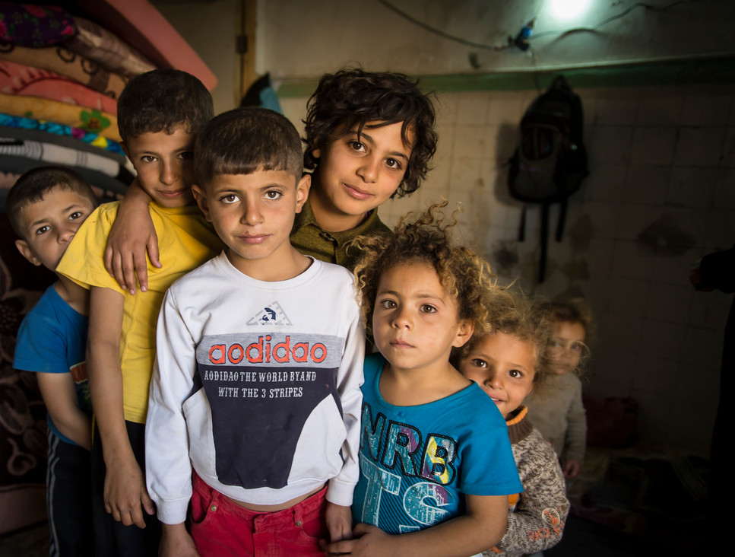
God commands His people to care for the vulnerable – the orphan, the widow, and the foreigner – both to emulate His character & because of their own history as foreigners
(Ex. 23:9, Deut. 10:17-19; Deut. 24:19-22; Ps. 146:9; Zech. 7:9-10; Jer. 22:3; Mal. 3:5)

Slide 10
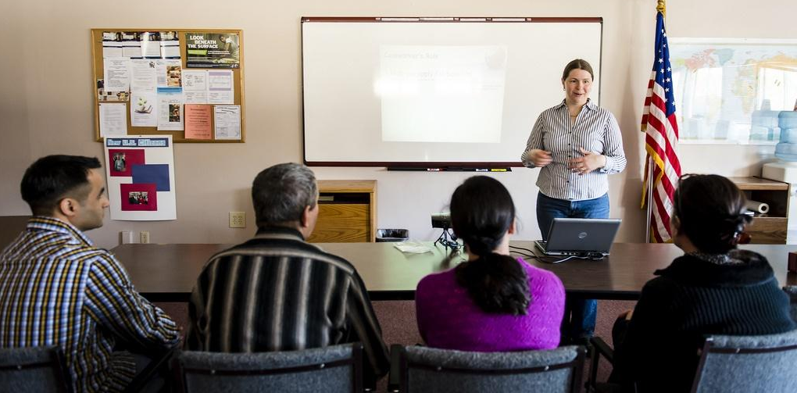
We are commanded to love our neighbors – without caveats (Leviticus 19:18, 33-34; Luke 10:25-37)

Slide 11
Refugees & Terrorism
Refugees admitted through the U.S. Refugee Admissions program already are subjected to the most thorough vetting of any category of visitor or immigrant to the US (Heritage Foundation)
Since the Refugee Act of 1980, 0 Americans have lost their life in an Islamist terrorist attack perpetrated by an individual admitted as a refugee (Cato Institute)

Slide 12
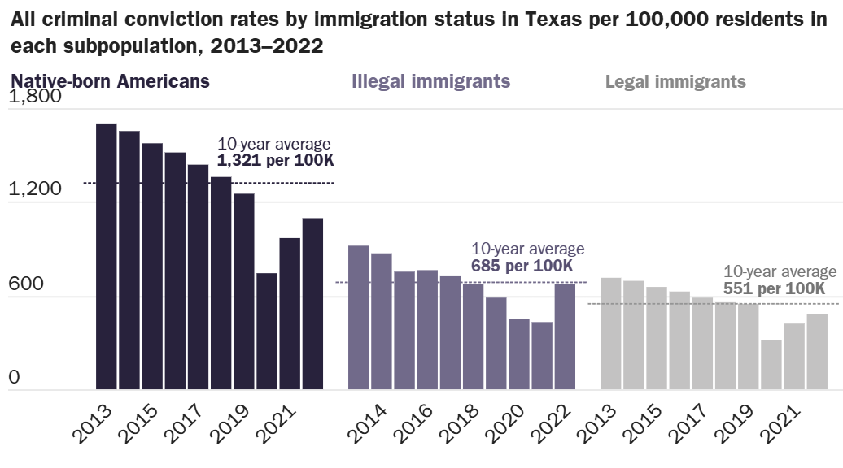
Immigrants & Crime (in Texas)
Source: Cato Institute analysis of Texas Department of Public Safety data and the American Community Survey, 2024; see also Michael Light, Jingying He & Jason P. Robey, “Comparing Crime Rates between Undocumented Immigrants, Legal Immigrants, and Native-Born US Citizens in Texas,” Proceedings of the National Academy of Sciences, 2020

Slide 13
Immigrant Detention
Despite rhetoric that immigration enforcement focuses on the “worst of the worst” criminals…
  Most (70.8%) of those currently detained have not been convicted of any crime (US Dept of Homeland Security, as of April 4, 2026)
  Only 5% of those detained have been convicted of, and less than 14% of those arrested had been charged with, a violent crime (Cato Institute, as of November 2025; CBS News, as of January 2026)
  But most (80%) of those vulnerable to detention & deportation are Christians of one tradition or another – and 1 in 12 Christian households in the US is at risk of having at least one family member removed (Center for the Study of Global Christianity at Gordon-Conwell Theological Seminary)

Slide 14
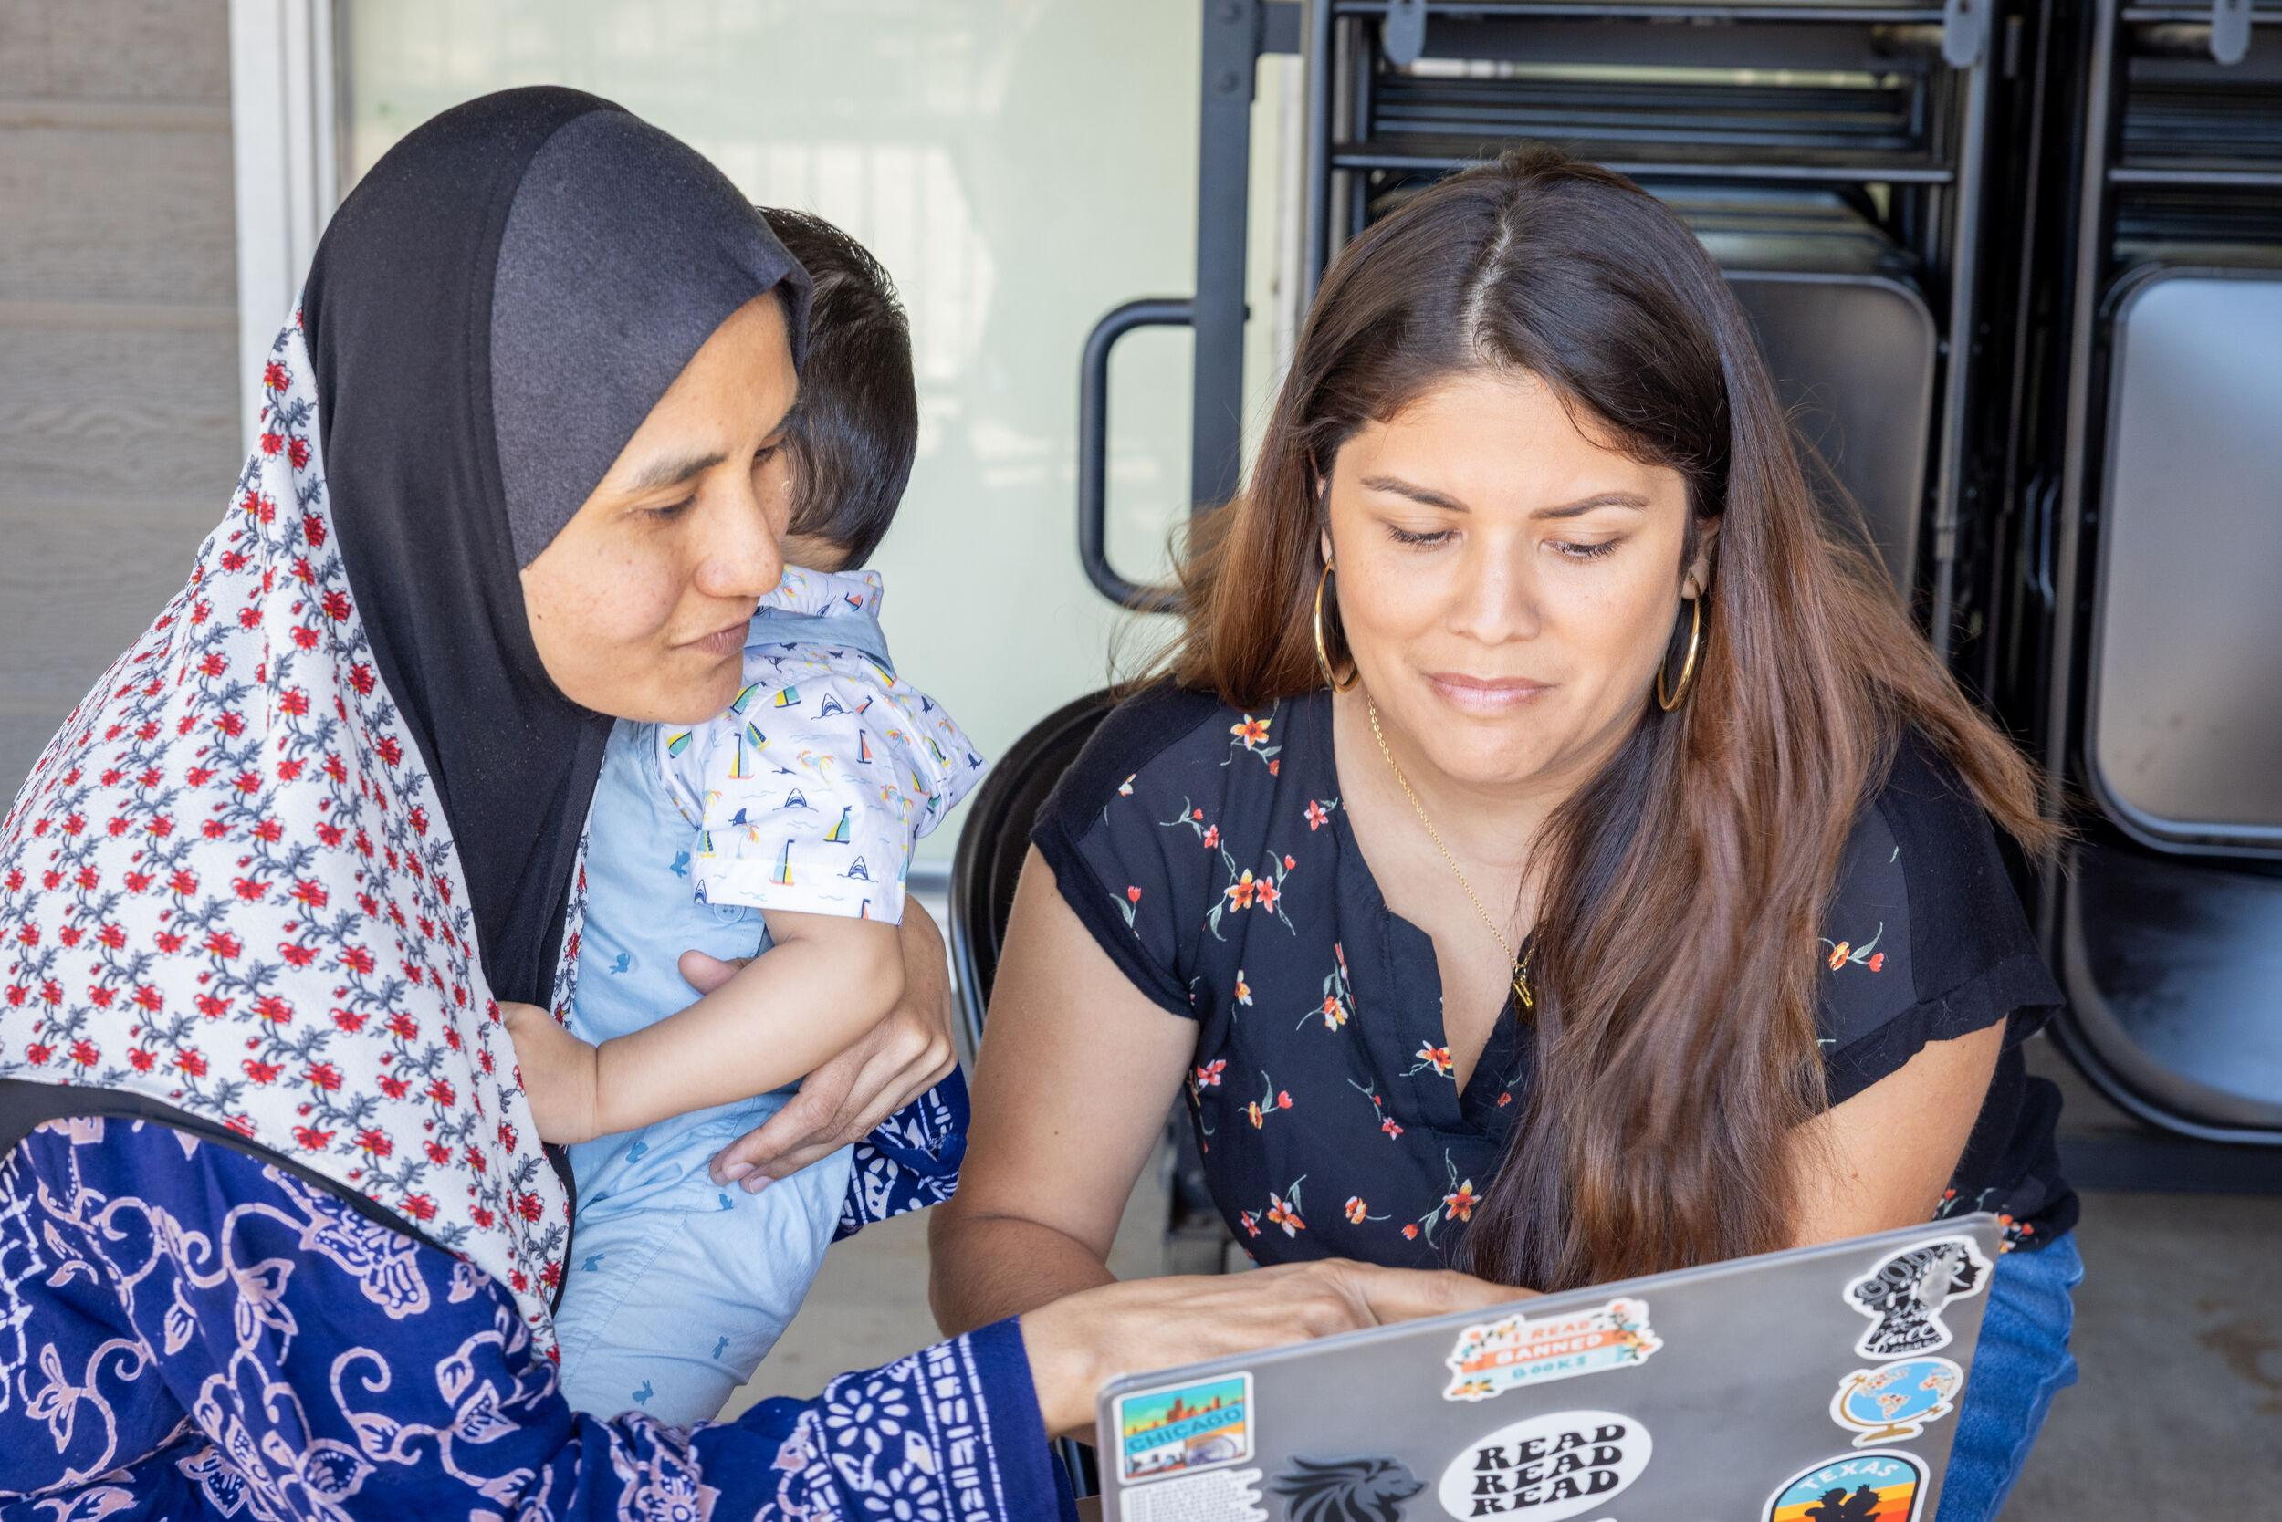
By welcoming those of other faiths, we have opportunities to “make disciples of all nations” (Matthew 28:19) and to “give an answer to everyone who asks” for the reason for the hope within us (1 Peter 3:15)

Slide 15
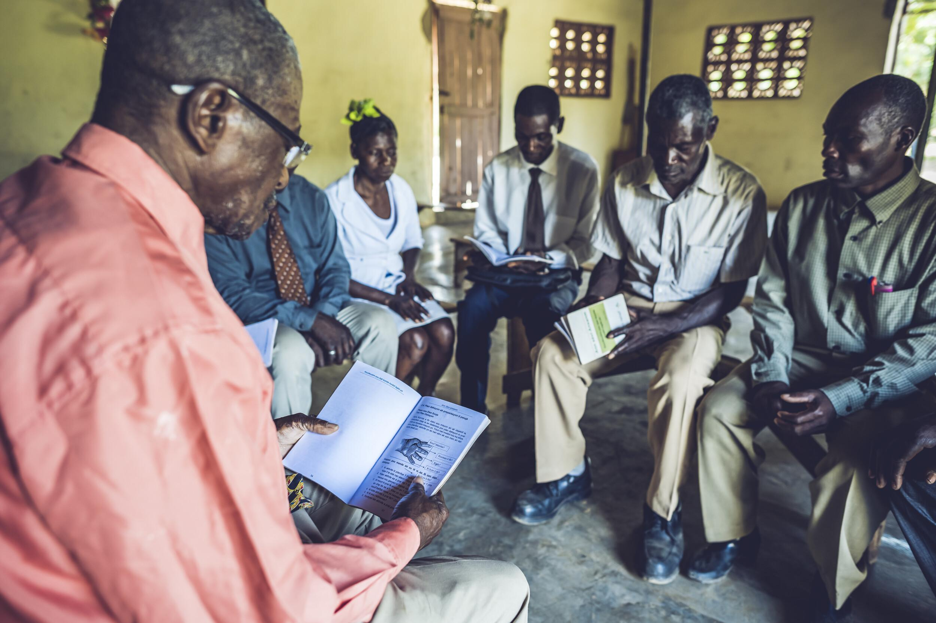
Many refugees and asylum seekers are fleeing persecution on account of their Christian faith – and as we welcome them, we welcome Jesus (Matthew 25:35)

Slide 16
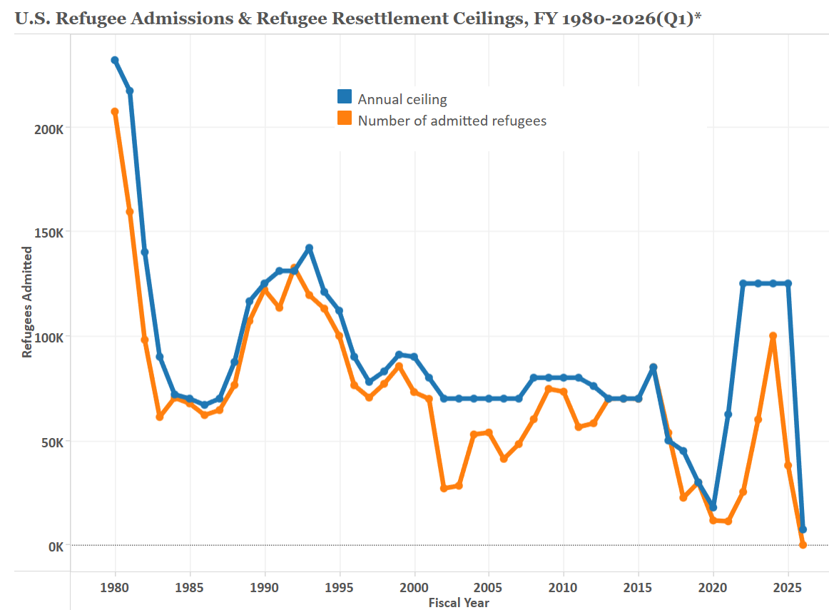
U.S. Refugee Resettlement
Source: Migration Policy Institute

Slide 17
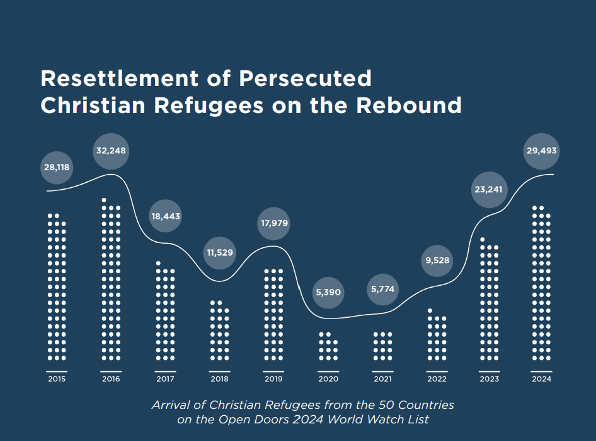

Source: Open Doors US & World Relief
Source: State of the Golden Door Report 2024, Open Doors US & World Relief, adapted

Slide 18
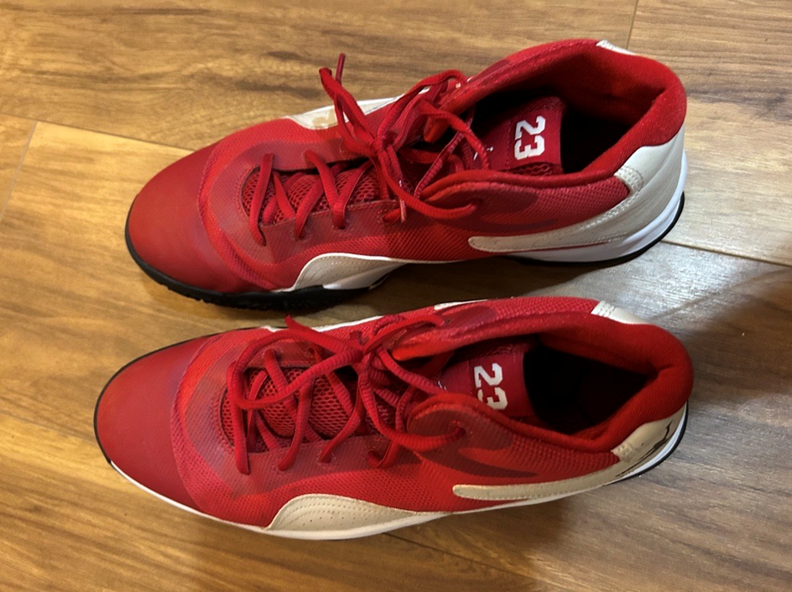
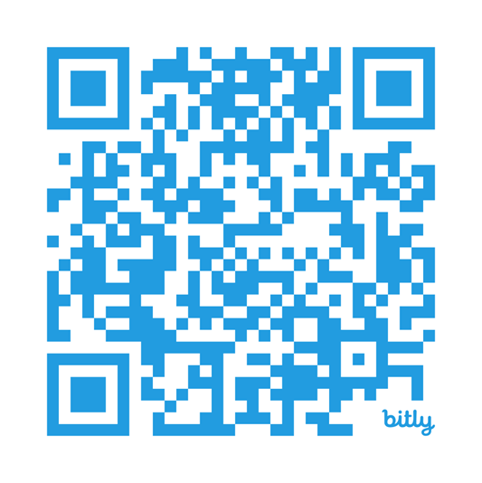
Walking in Another’s Shoes
Scan for access to slides & to receive occasional World Relief advocacy updates

Slide 19


