Slide 1

Notes:
He is Risen! [BRIEF COMMENTS – Risen (2016) Movie Clip]
This is the seventh and final week of our Lent to Easter Sunday series – Waging Peace: A Journey with Jesus Through Holy Week
Our series began… [NEXT SLIDE]

Slide 2
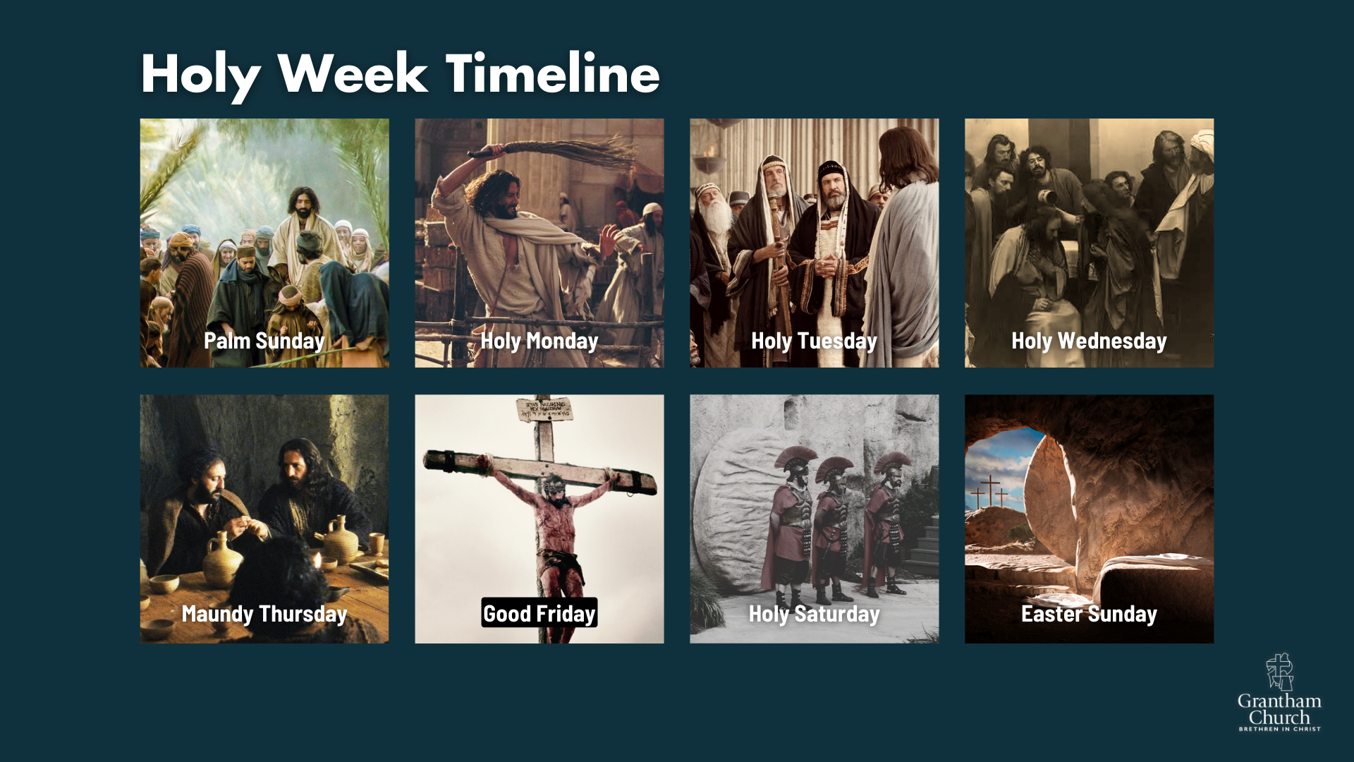
Notes:
…with Jesus looking out over Jerusalem on Palm Sunday and crying aloud, “If only you knew the things that make for peace.” And Jesus spends each day of the week confronting injustice, calling out oppressors, and contending for peace.
Monday – as an act of prophetic theater, Jesus clears the temple
Tuesday – returns to confront the hypocrisy of the religious leaders
Wednesday – the calm before the storm: Judas betrays; Mary anoints
Thursday – the Last Supper, washes feet, new command & arrested
Friday – goes before Sanhedrin, Herod & Pilate; Jesus is crucified
Which brings us to today’s message where we will look briefly at Holy Saturday and then at Easter Sunday, when Jesus rose from the dead and appeared to his disciples. In a message entitled… [NEXT SLIDE]

Slide 3
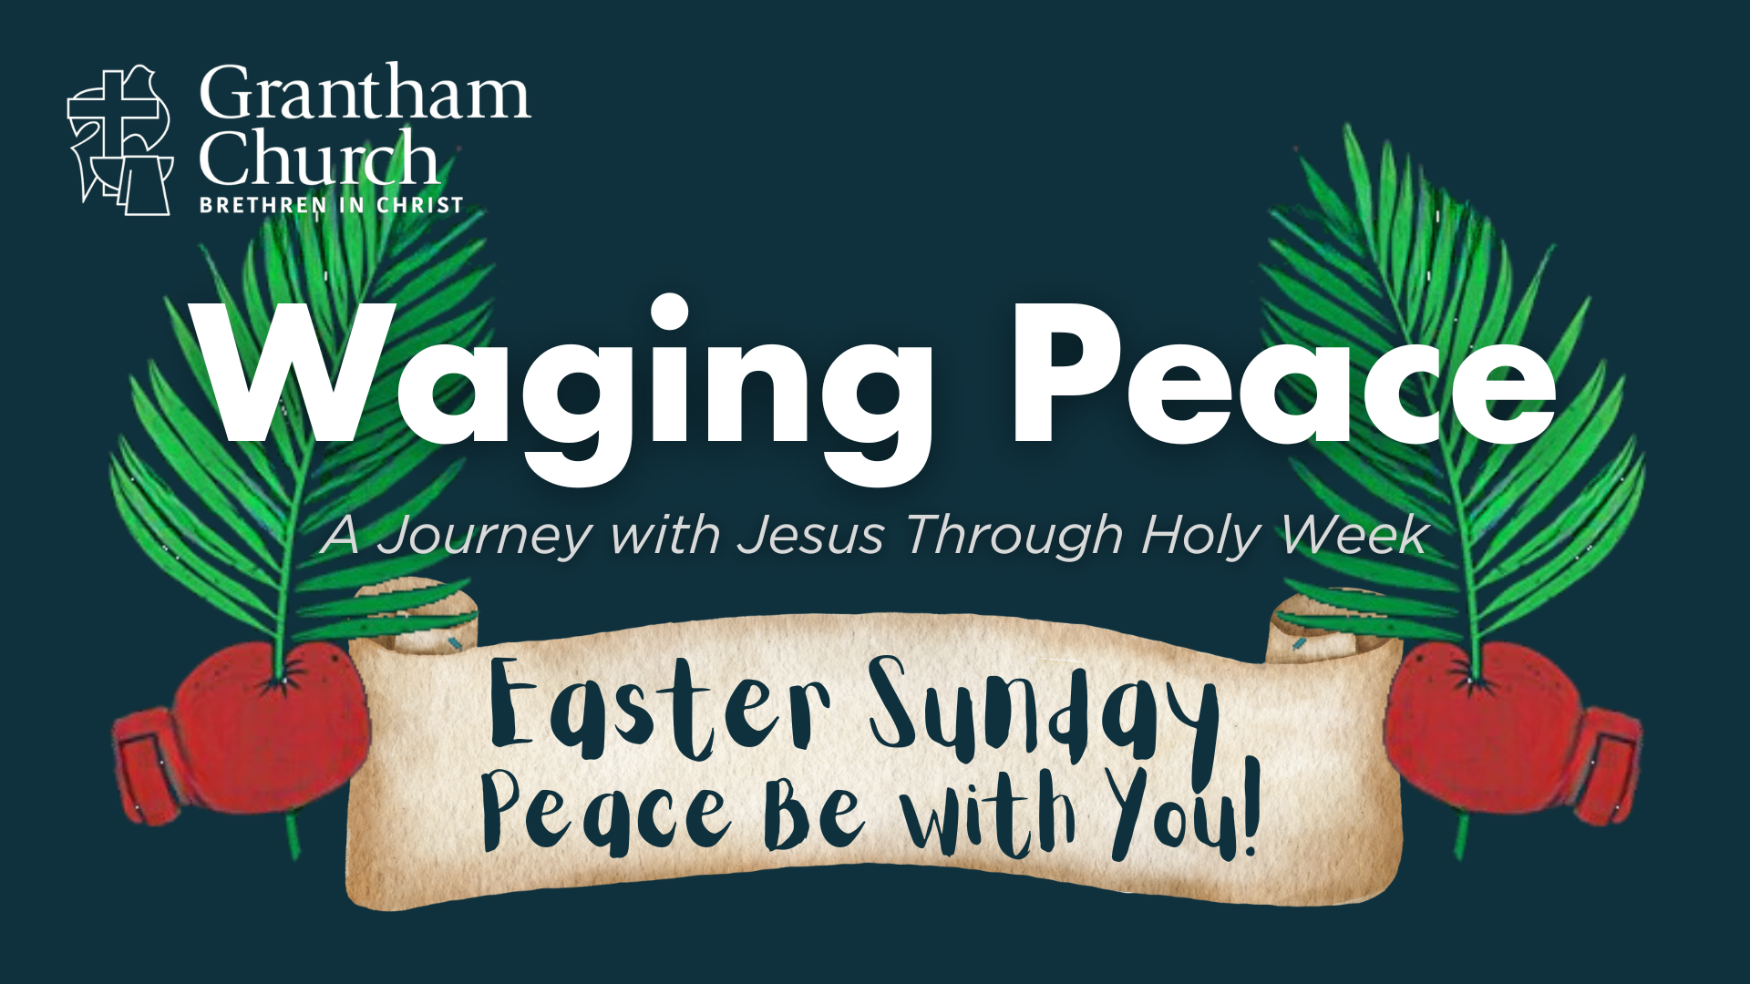
Notes:
Peace Be With You!
[BRIEF PRAYER]
Jesus was crucified and hung on the cross on Friday morning from 9:00 am to 3:00 pm. And after Jesus was confirmed dead by the Roman soldier who pierced him with a spear, rupturing his pericardial sack and causing blood and water to flow from his side, the Gospels tell us that Joseph of Arimathea (a rich Pharisee who followed Jesus), made a request that Pilate allow him to take the body of Jesus, prepare it for burial, and place it in his own tomb. [NEXT SLIDE]

Slide 4
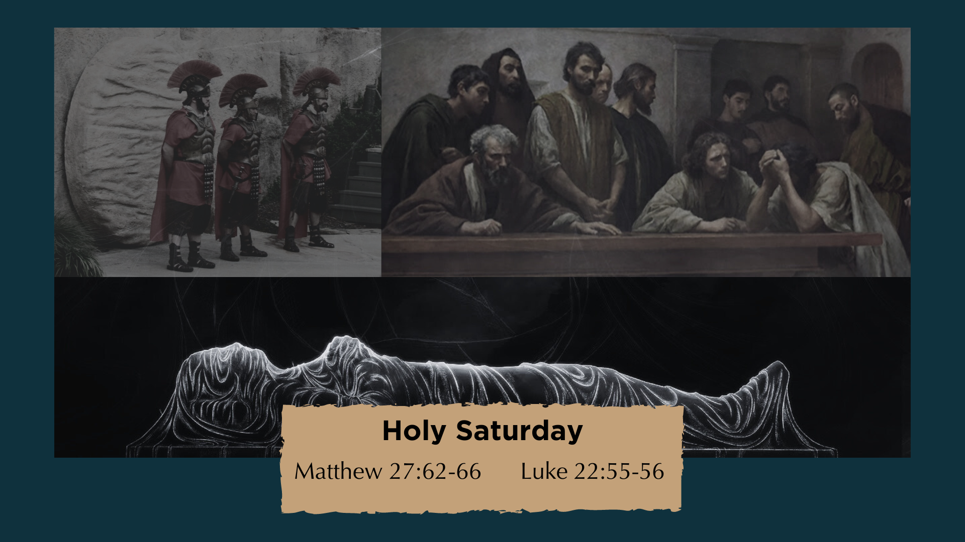
Notes:
And then Matthew 27:62-66 says: “The next day, on the Sabbath, the leading priests and Pharisees went to see Pilate. They told him, “Sir, we remember what that deceiver once said while he was still alive: ‘After three days I will rise from the dead.’ So, we request that you seal the tomb until the third day. This will prevent his disciples from coming and stealing his body and then telling everyone he was raised from the dead! If that happens, we’ll be worse off than we were at first.” Pilate replied, “Take guards and secure it the best you can.” So, they sealed the tomb and posted guards to protect it.”
Meanwhile, we know the disciples were in hiding. It’s the Sabbath (so they’re not traveling anywhere), but more than that… they’re afraid, they’re devastated, and they’re in shock. Many so-called Messiahs had come before Jesus, but they were certain that Yeshua was the One. How did this happen? Why did we abandon him? Just imagine the grief, the trauma, the pain, and confusion. It had to be the longest day of their lives. Sitting there alone with their thoughts.
There isn’t much said about what happened on Saturday. We can certainly imagine what the disciples were experiencing. But what about Jesus? Where was he? What was he doing as his body lay dead on a cold hard slab of rock? Well, let’s reflect on that a moment… [NEXT SLIDE]

Slide 5
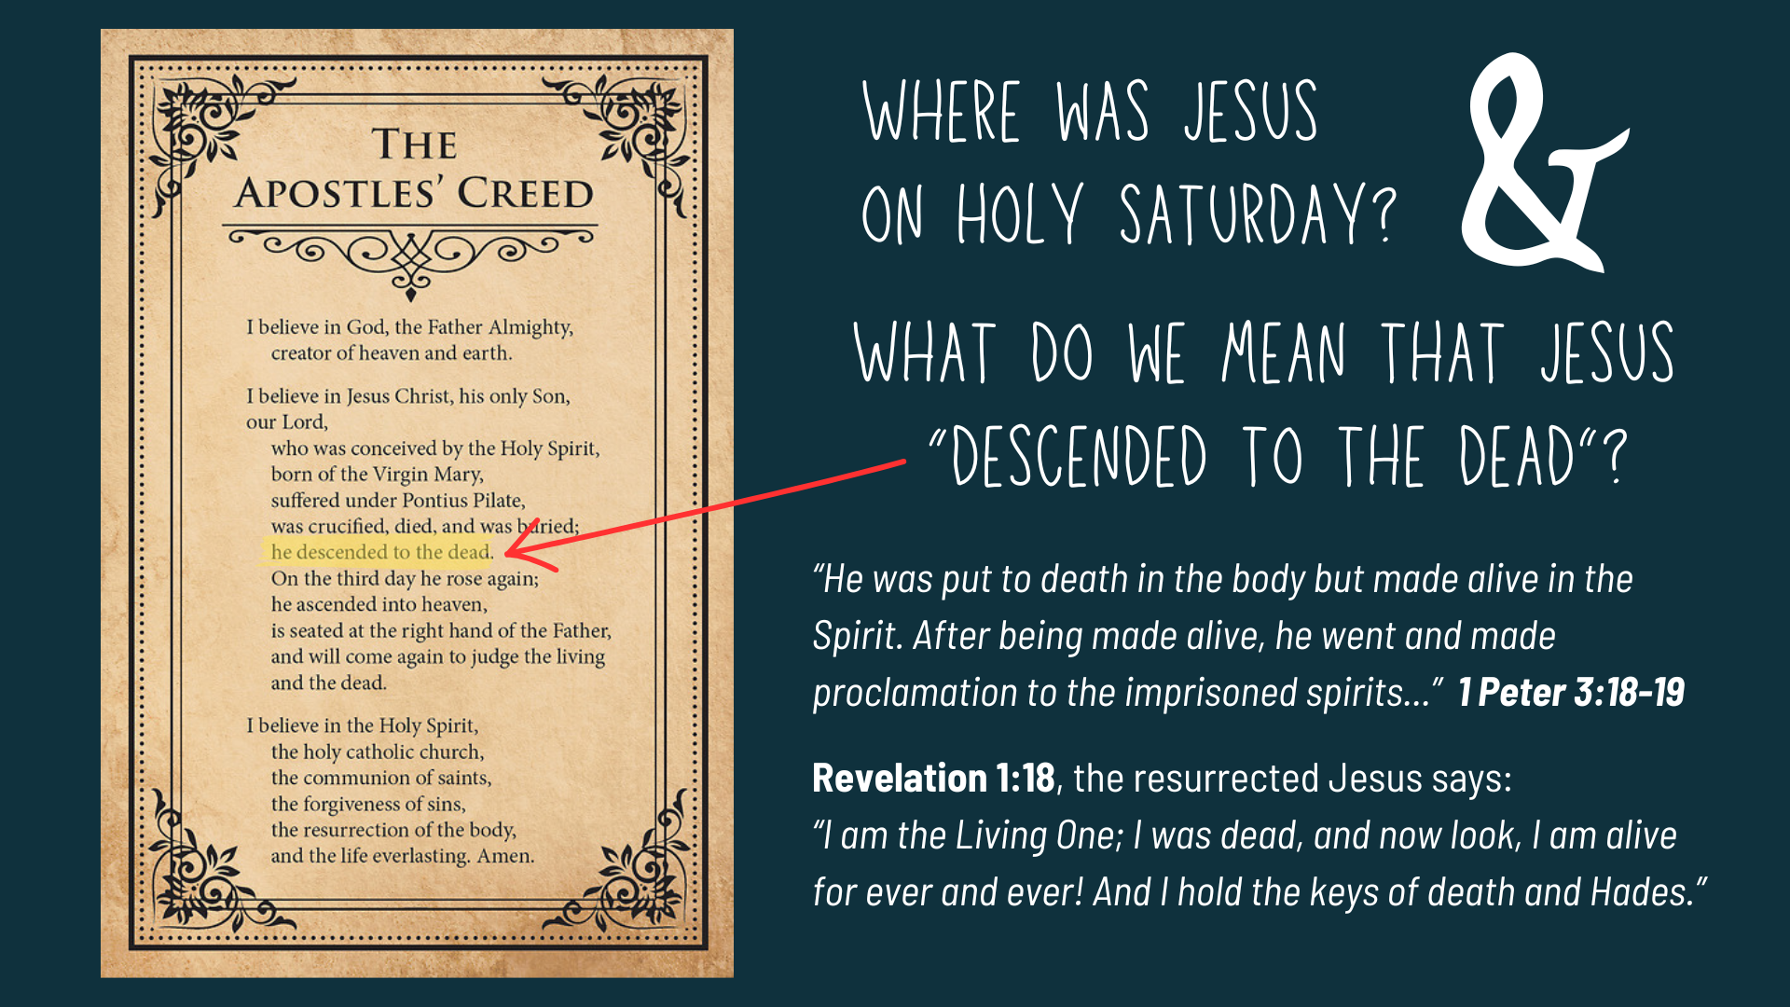
Notes:
The Apostles’ Creed, which we confess before communion here at Grantham, says that Jesus “descended to the dead” or to “hell” or “Hades” depending upon the version. And the reason there are variations is because of differing views on what is meant, and what actually happened on Holy Saturday. There are often two points in the Creed where folks want clarity.
As for “he descended to the dead”… there are several Scriptures that refer to this, and the one hotly debated in theological circles is 1 Peter 3:18-19. What does Peter mean? Are we talking about the general realm of the dead (Heb: sheol; Gk: hades or the underworld)? Or do we mean that Jesus went to a literal place of torment called “hell” like Dante imagined in his Inferno? Personally, I believe the idea here is that Jesus went and proclaimed his victory over death to all who had ever died before him, going all the way back to the beginning of the biblical story.
But what we all should be able to agree upon is that Jesus, who was/is body, soul, and spirit, left his crucified, dead, and buried body in the Spirit, and announced his defeat over the powers of Satan, death, and hell to all who have died. He proclaimed his victory, and that the great exodus has begun—the ultimate liberation from our bondage to the principalities and powers.
As Christ said in Revelation 1:18, “I am the Living One; I was dead, and now look, I am alive for ever and ever! And I hold the keys of death and Hades.” And so, on Holy Saturday we see our first lesson in peacemaking for today’s message… [NEXT SLIDE]

Slide 6
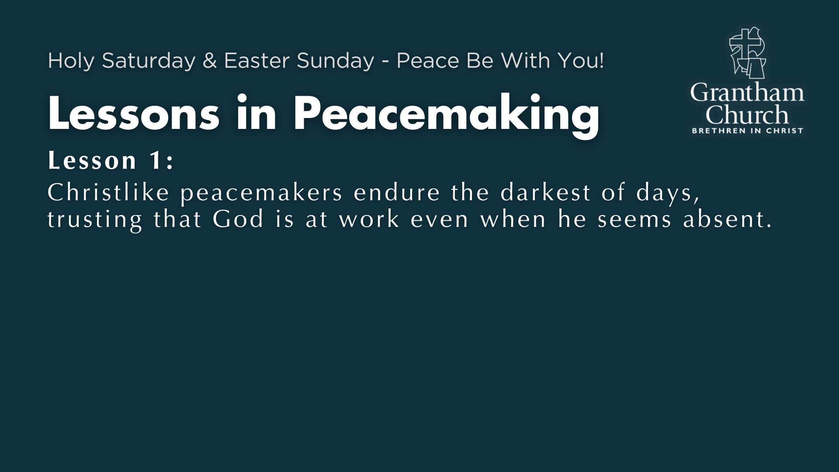
Notes:
Lesson 1: Christlike peacemakers endure the darkest of days, trusting that God is at work even when he seems absent.
Just think… when the disciples were at their lowest, and God’s peace and presence seemed impossible to access, the Lord was at work, and he is still at work even when we can’t see it.
Listen to what Jason Porterfield writes in his book, Fight Like Jesus… [NEXT SLIDE]

Slide 7
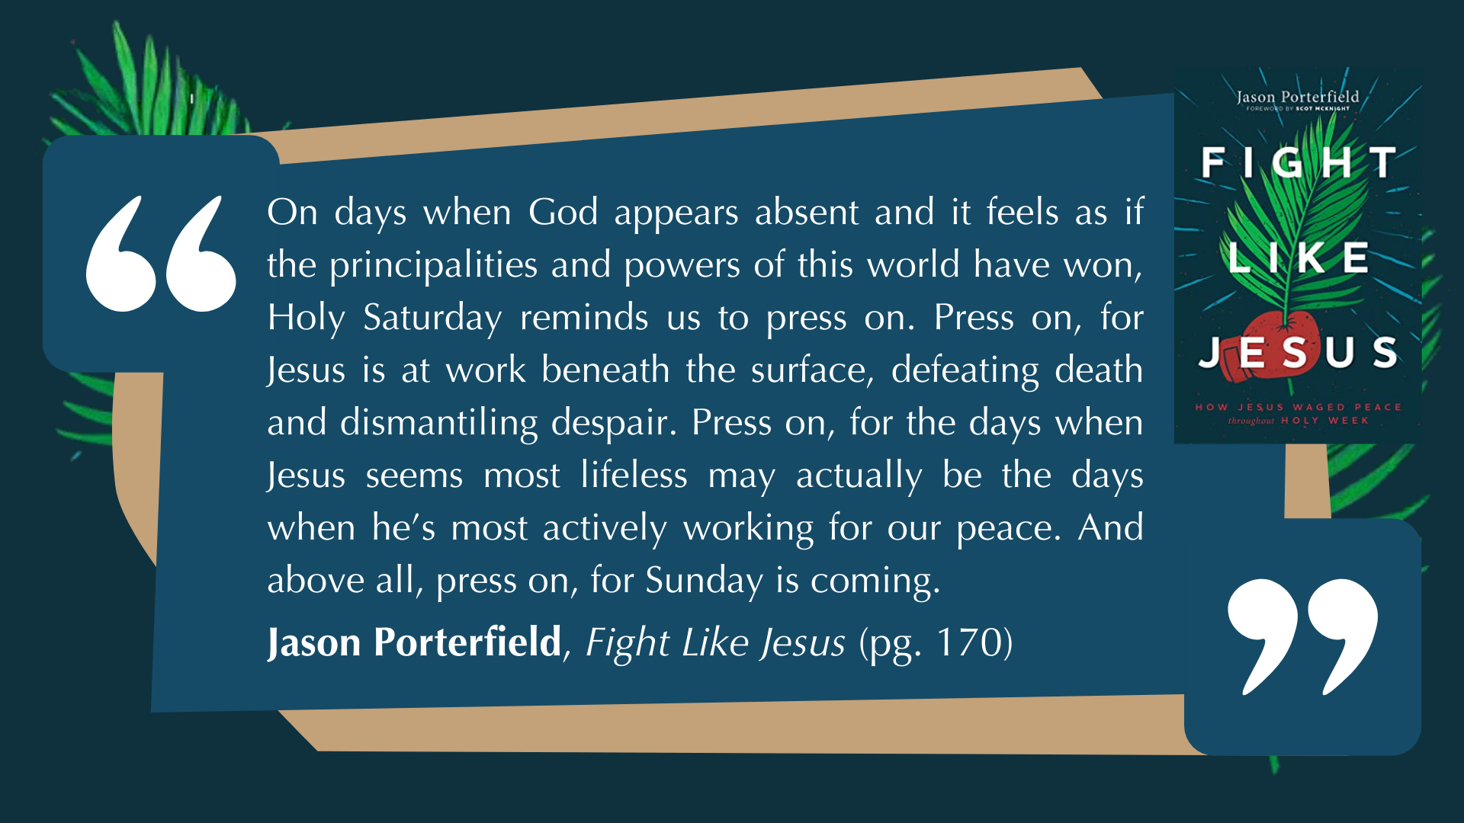
Notes:
[READ QUOTE & BRIEF COMMENTS]
Do you feel like you’re hiding in a locked room, full of grief, fear, and hopelessness? Have you forgotten that even the darkness is light to him? Friends, he may be silent, but he is not uncaring. He may seem distant, but we can trust that is working behind the scenes.
How is the Spirit speaking to you about this?
Friday, before the sun goes down, Jesus is laid in a borrowed tomb. He was there Friday, Saturday, and on the third day, Sunday, the unexpected happens… [NEXT SLIDE]

Slide 8
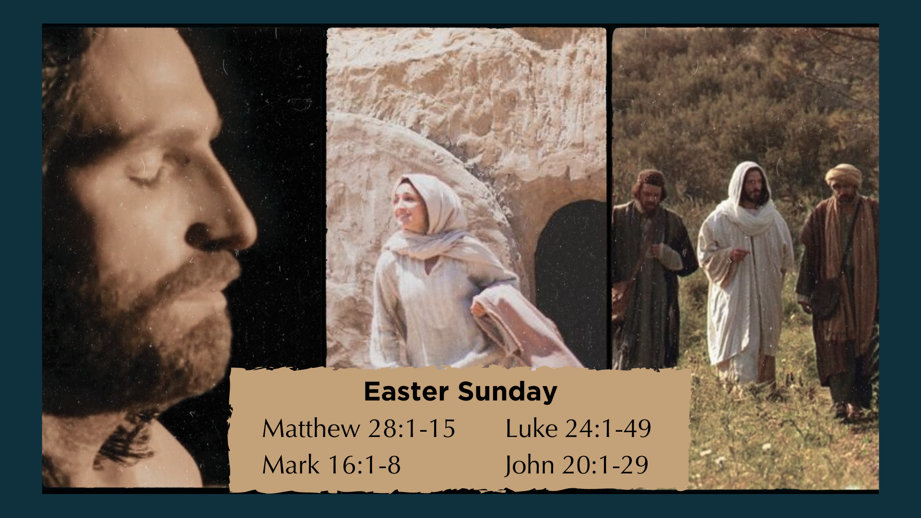
Notes:
All four Gospels record what happens on Sunday morning. The spirit of Jesus returns to his body and the radiating power of the Holy Spirit heals, restores, and transforms the crucified Jesus—giving him a glorified, incorruptible, imperishable, immortal, and resurrected body. His resurrected body was in some ways like his old one, but the risen Jesus is metaphysically different.
As we soon see in the story, the risen Jesus eats and can be touched, but he can appear in locked rooms and then disappear. And John says that Mary Magdalene doesn’t recognize him at first. And so, when Mary comes to the tomb that morning hoping to anoint Jesus’ body with spices, she thinks the tomb has been robbed and that the risen Jesus is a gardener.
And then he says her name, “Mary”… and it’s as if her eyes are opened to see him. She is beyond excited. Naturally, she wants to grab ahold of him. But the risen Jesus tells her that he is on a mission, and that she has a job to do. She must tell the other disciples that he is alive. And she does. But it wasn’t until Sunday evening that they all became true believers.
Let’s go there now in John chapter 20… [NEXT SLIDE]

Slide 9

Notes:
[READ & COMMENT ON PASSAGE]
“Peace be with you!” It seems the first blessing of “peace” is so that the disciples wouldn’t be afraid at what they were literally seeing: Jesus was dead and is now alive! So, he shows them his wounds from the crucifixion—the scars that remain in his resurrected body.
The second “Peace be with you” appears to be a blessing of good will before he commissions his disciples to be carriers of his peace as peace-makers. First, the blessing of good will. Why a blessing of good will? Because this is the first time they are seeing Jesus since Peter denied him and they all abandoned him during his arrest in the Garden of Gethsemane.
Why is this blessing of peace significant? It reveals Jesus’ heart toward them and his intentions, despite their abandonment, and what his enemies did to him. Notice, there is no argument, no condemnation, no “I told you so”, or any signs of vengeance.
This reminds me of a skit that Saturday Night Live did in a few years back… [NEXT SLIDE]

Slide 10
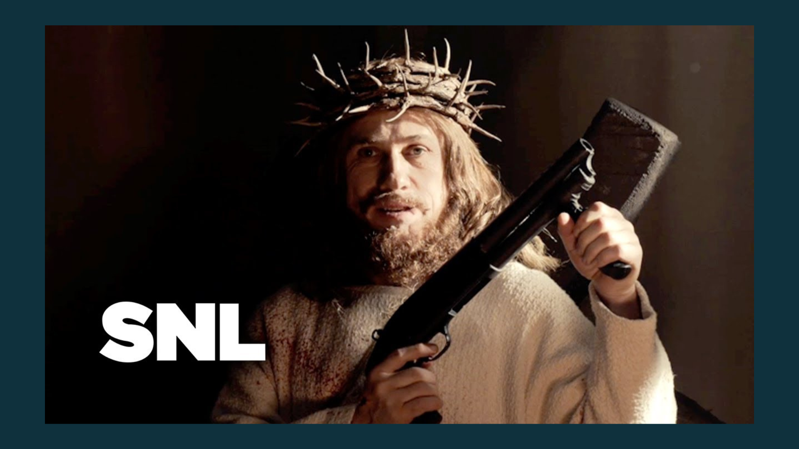
Notes:
Djesus Uncrossed. Meant to be a gruesome, comedic, spoof on Quentin Tarantino’s, Django Unchained. In this skit, which plays like a movie trailer, Jesus comes back from the dead only to unleash his wrath upon his enemies. It shows him unleashing violence upon the Romans and training his disciples to do the same. One-by-one, Jesus gets payback for what was done to him. And the trailer ends with him saying, “No more Mr. Nice Jesus.” As he cocks his weapon, and a loud gunshot echoes out.”
And while this SNL skit might offend some of us, I find that it’s actually quite effective in using humor to show how ridiculous the whole idea is contrasted with the portrait of Jesus in the Gospels. We can all see that this isn’t what Jesus is like, no matter how much we’d like to justify our own violence and vengeful feelings, as we have clearly seen throughout this sermon series, and we can see and hear from Jesus in John 20 when he says, “Peace be with you!”
Herein lies the second lesson in peacemaking… [NEXT SLIDE]

Slide 11
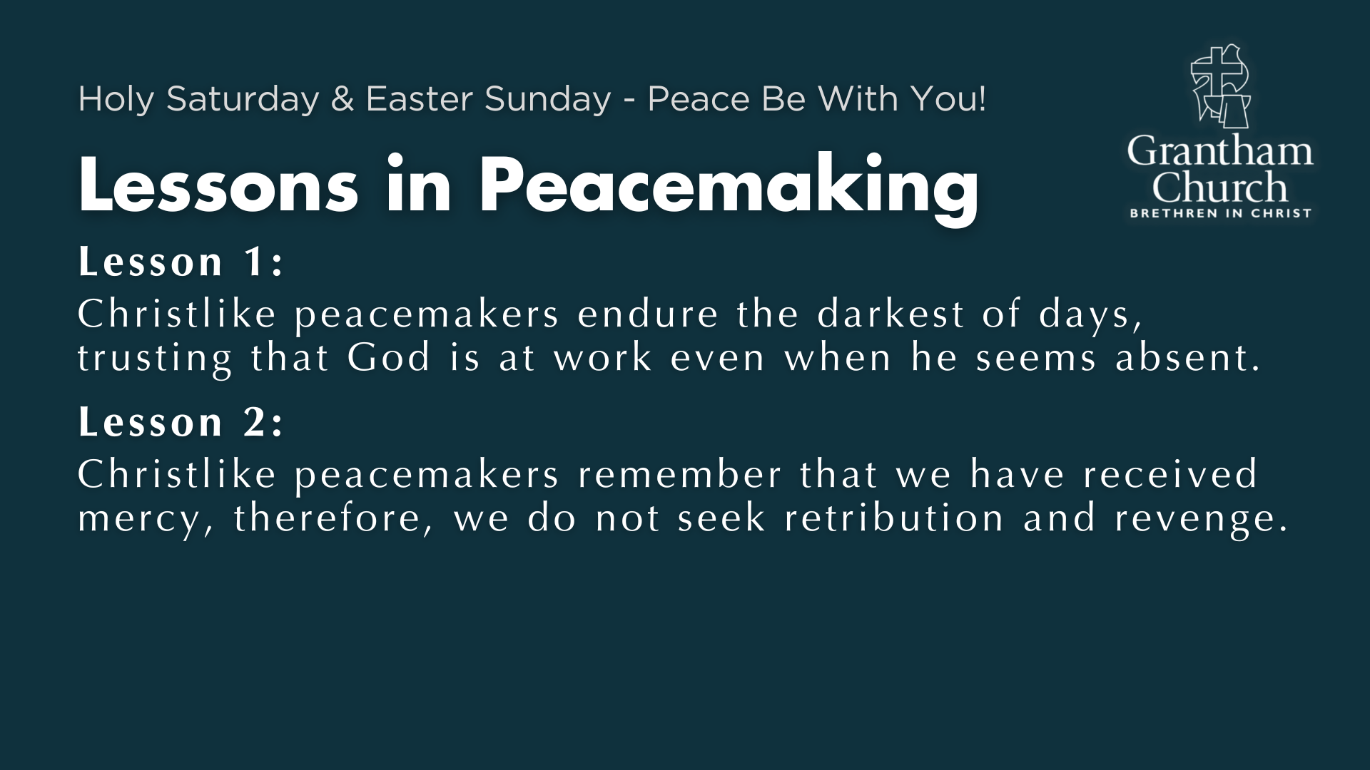
Notes:
Lesson 2: Christlike peacemakers remember that we have received mercy, therefore, we do not seek retribution and revenge.
So, remember when we asked the question, “How has Jesus loved me?” we also should ask, “How has Christ shown me mercy?” Have I denied him by my words or actions? Have I ever abandoned him? Have I ever cursed him? Have I ever sinned against him or someone else willfully or in my ignorance? Have I done anything for which I’m ashamed? Sure we have! And how has Christ been merciful to you and me? Right. So then, we ought to be merciful to others. ”Blessed are the merciful for they shall be shown mercy,” Jesus said.
Also, notice in the closing moments of Easter Sunday, Jesus’ second blessing of “Peace be with you” function not as a greeting but as a fulfillment of the promise he made on Thursday evening in the upper room. Remember what he said… [NEXT SLIDE]

Slide 12
“I am leaving you with a gift—peace of mind and heart. And the peace I give is a gift the world cannot give. So don’t be troubled or afraid.”
“I have told you all this so that you may have peace in me. Here on earth you will have many trials and sorrows. But take heart, because I have overcome the world.”
John 14:27; 16:33 NLT
Notes:
[READ PASSAGE & BRIEFLY COMMENT]
“peace” – (eirene) Gk: tranguil state of the soul, harmony and accord between individuals, exemption from rage and warring with others; the Gk equivalent of the Hb “shalom”
For the Lord’s disciples, who have just seen the risen Jesus and touched his wounds, it was now quite clear how Jesus overcame and is overcoming the world of sin, hate, and violence. He did not respond in like kind; he did not use threats and force; he did not overcome evil with evil, but through self-giving love. And here he is giving us the gift of his own peace/shalom.
And why do we need to receive this peace of Jesus? Don’t miss this. Because you cannot give away to others what you do not possess yourself. So, once again, let’s listen to these words of Jesus… [NEXT SLIDE]

Slide 13
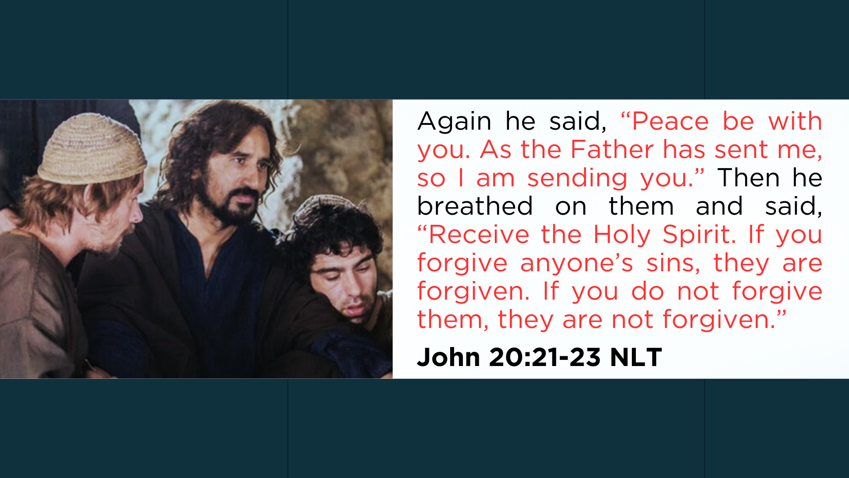
Notes:
[READ & COMMENT]
What does Jesus mean by these words?
He is in effect saying, “This is how I make peace. And now this peace is yours. You can now experience it personally and extend it to others who also need it. My mission has become your mission. I want you to identify yourself with me, my way, my truth, and my life; I want you to carry on my work. And through the power of the Holy Spirit, you can bless others with my peace and forgiveness. I’m giving you this authority. So, go and be peacemakers.”
Church, those first disciples understood that the resurrection of Jesus changed everything. Listen to this final quote from Fight Like Jesus… [NEXT SLIDE]

Slide 14
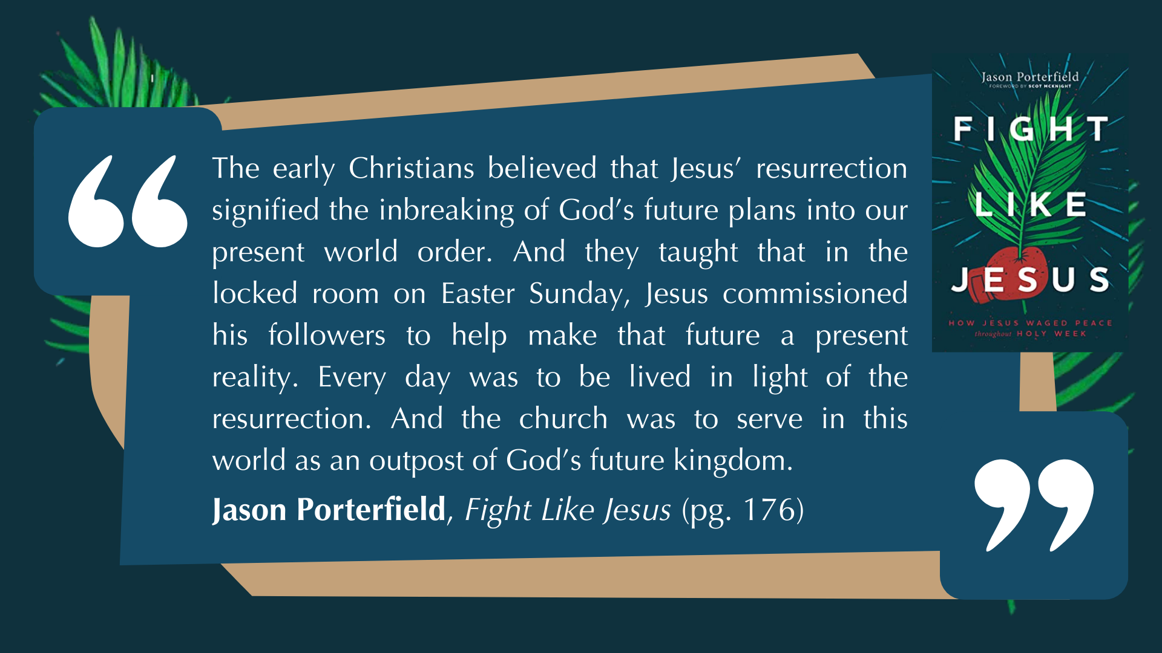
Notes:
[READ QUOTE & COMMENT]
In other words, someday Christ will return and fully establish his Kingdom on the earth. As the Lord says in the book of Revelation, “Behold, I am making all things new.”
My friends, please don’t miss the significance of Jesus’ resurrection. Remember what the Apostle Paul wrote in 1 Corinthians 15. He said that if Jesus was not physically raised from the dead then our faith is meaningless; we are wasting our time; we are ultimately doomed. That’s because the resurrection of Jesus means that sin, evil, and death do not get the final word. It means that what happened to Jesus will someday happen to all who believe. And then we will be transformed as he was on Easter Sunday, with bodies fit for living in a resurrected world.
And that brings us to our final lesson in peacemaking… [NEXT SLIDE]

Slide 15
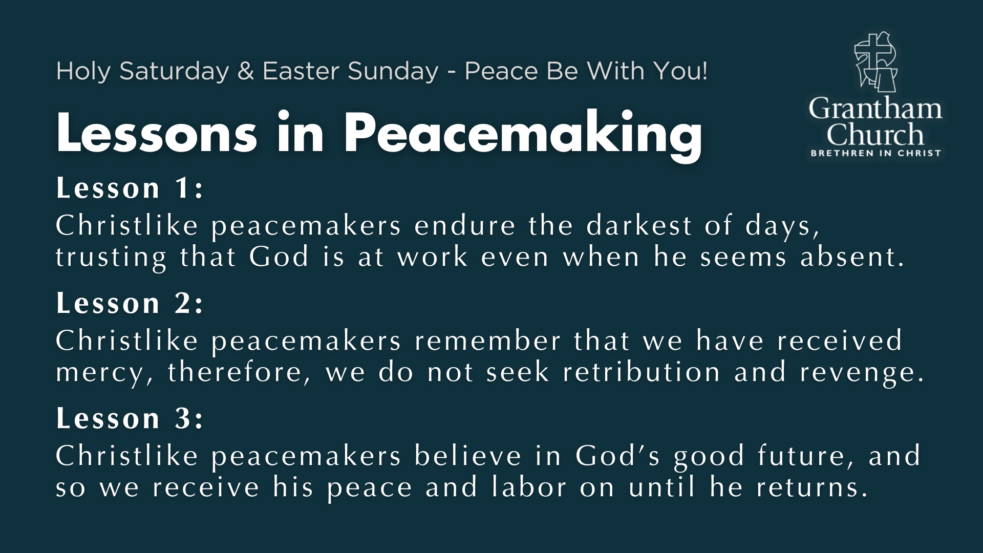
Notes:
Lesson 3: Christlike peacemakers believe in God’s good future, and so we receive his peace and labor on until he returns.
The New Testament is quite clear where things are headed. Jesus said so himself. There will be wars and rumors of wars, there will be an increase in wickedness, hate, and violence, there will be difficult days ahead as the world looks for salvation apart from Christ and turns in upon itself; as Jesus said, when the love of most will grow cold. But we do not have to fear. Our crucified and risen Lord has secured God’s good future. Therefore, let us receive his peace and live our lives as signposts to the coming Kingdom of God as we witness to the hope we have in Christ.
Finally, listen to these concluding words at the end of Paul’s chapter on the resurrection of Jesus and its meaning for our lives and the race we are running… [NEXT SLIDE]

Slide 16
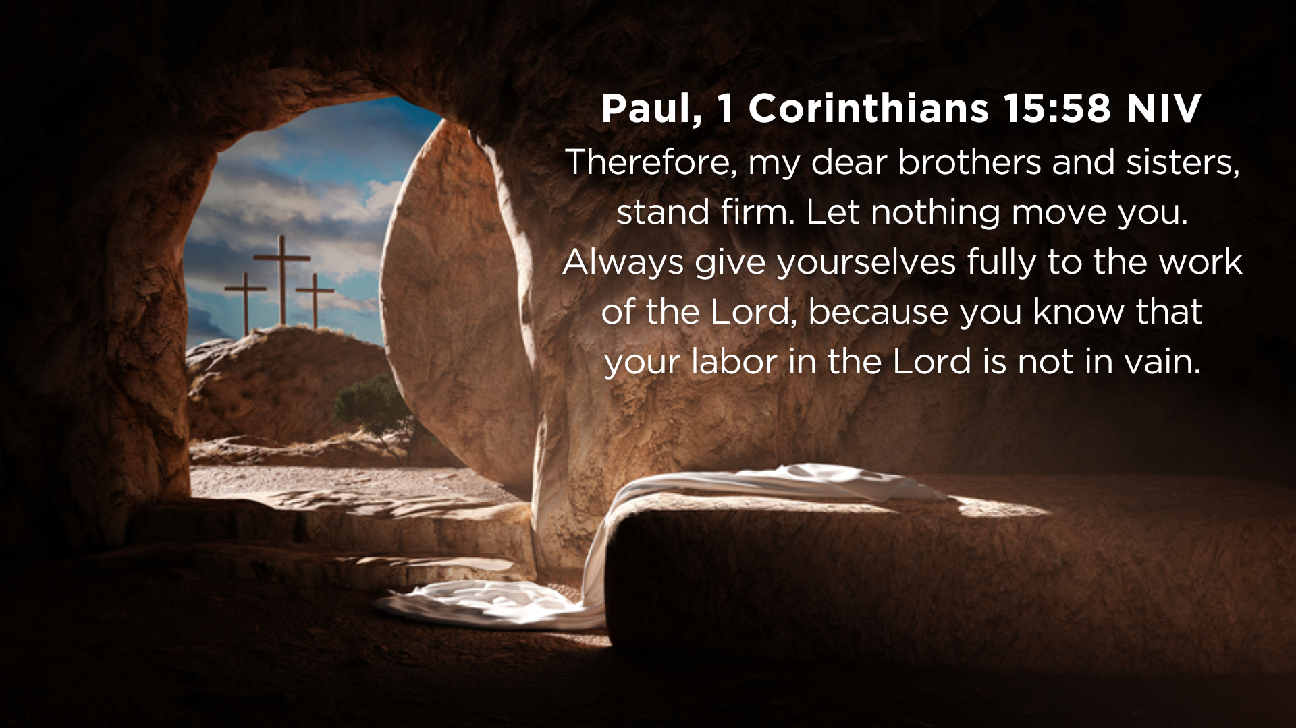
Notes:
[READ & BRIEF COMMENTS]
Why is our labor in the Lord not for nothing? It’s because Jesus of Nazareth, the Messiah, was raised from the dead. Why do we press on in our faith with our good deeds, our works of service, our ministries of mercy, and sharing the gospel? It’s because the grave couldn’t hold him. Why do we labor on in the fight against injustice? Why do we press on against our flesh day in and day out? Why do we continue to battle with spiritual armor against the forces of darkness in unseen places? It’s because the risen Jesus holds the keys of death and hell.
Peace be with you, Grantham Church! For we know where things are going. We know how it all ends. But until that time comes—when Christ makes all things new—let us faithfully run our race as the Lord’s peacemakers and take comfort in knowing that the Spirit who raised Jesus from the dead lives in us. And so, as far as it depends upon you, live at peace with everyone.
He is Risen! (He is Risen Indeed) Let us pray… [NEXT SLIDE]

Slide 17
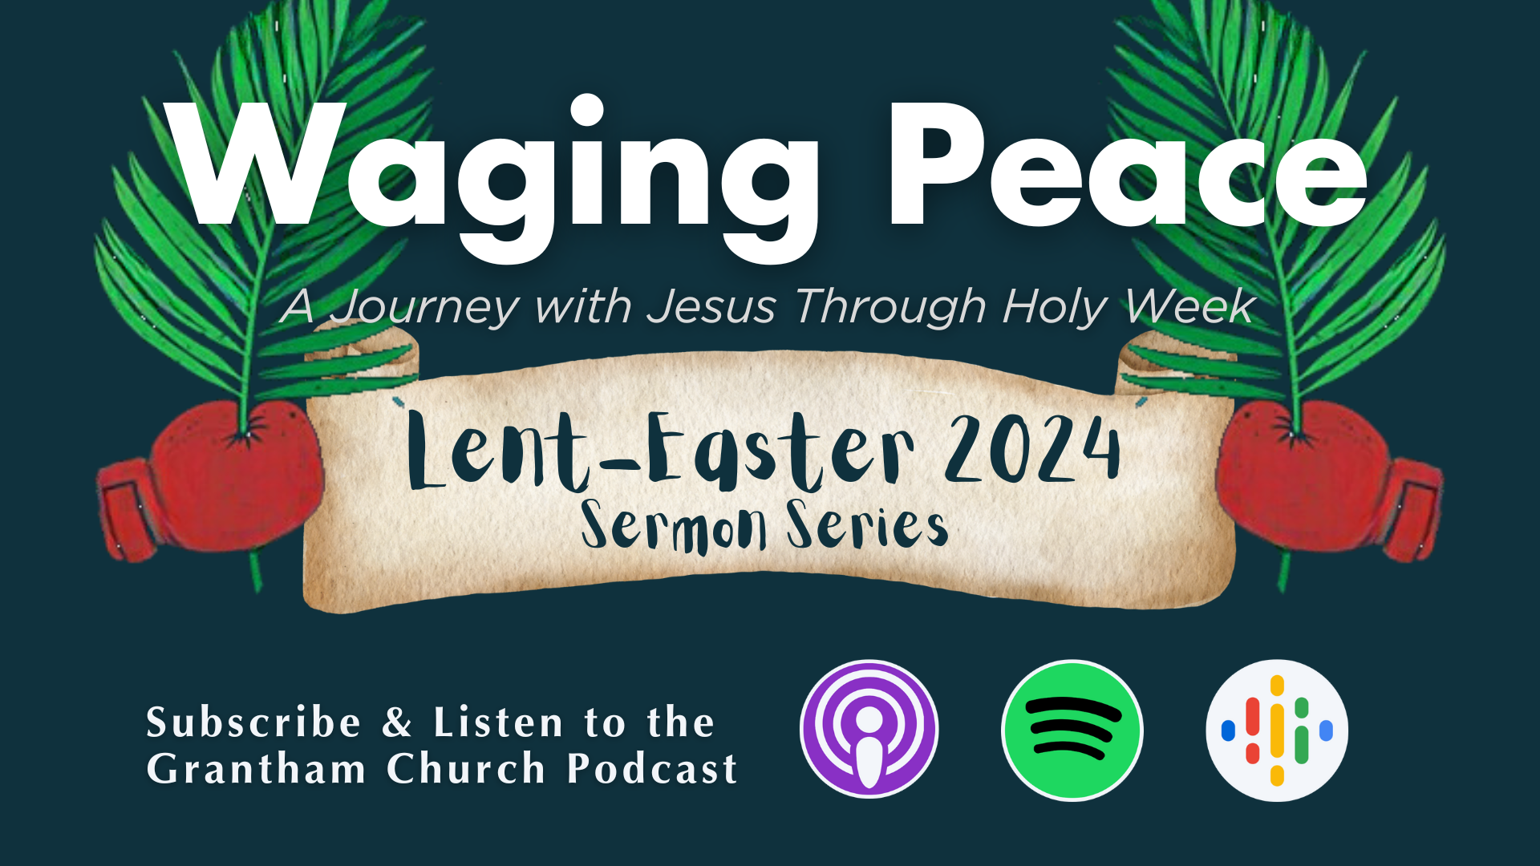
Notes:
[CLOSING PRAYER]

