Slide 1

Notes:
This is the fourth week of our sermon series, Easter Encounters—A sermon series for Eastertide. If you’re just joining us, we have been looking at some of the experiences that the first disciples had with the risen Jesus. And if you missed any of the previous messages, you can always find those at our website or listen on the go via the Grantham Church Podcast.
As many of you know, we began with Mary Magdalene’s Easter encounter at the empty tomb, two weeks ago we saw where Jesus catches up with two disciples on the road to Emmaus, and then last Sunday we looked at Thomas’ Easter encounter with the risen Jesus, as the Lord accommodated his doubt, and then how Thomas is the first to confess that Jesus is God. Which brings us to the very next episode in John’s gospel, where Jesus has breakfast with his disciples and restores Peter.
So, please turn in your Bibles… [NEXT SLIDE] to John 21 and stand with me as we read from our inspired Scriptures together. If you don’t have your Bible with you, you can simply listen as I read.

Slide 2
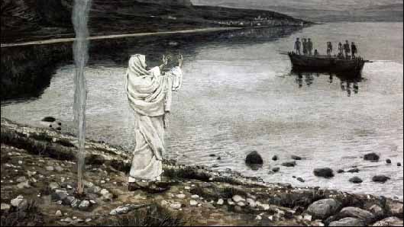
Scripture Reading
John 21:1-19 NIV
Notes:
[READ JOHN 21:1-19 NIV] – This is the Word of the Lord. Thanks be to God. You may be seated.
Cancel culture. Maybe you’ve heard of it. If you look it up on Wikipedia it says:
“Cancel culture is a modern form of ostracism in which someone is thrust out of social or professional circles – whether it be online, on social media, or in person. Those who are subject to this ostracism are said to have been "cancelled.” The expression "cancel culture" has mostly negative connotations and is commonly used in debates on free speech and censorship. The notion of cancel culture is a variant on the term “call-out” culture and constitutes a form of boycotting or shunning involving an individual who is deemed to have acted or spoken in a questionable or controversial manner.”
We’ve seen this sort of thing on both the political right and the left. We’ve seen it aimed at celebrities, as well as those who are unknown but said the wrong thing, used the wrong word, or made a really dumb mistake when they were being watched by a culture that quickly gets whipped into a self-righteous frenzy and is ready to pounce with merciless judgment.
I could give some examples of this, but I honestly worry that by doing so someone listening (depending on your political affiliation) might prove my point and shut me out this morning. Or worse yet, cancel me. So, I’ll just trust you know what I’m talking about and that you can imagine what it’s like to be on the receiving end of the cancel culture mob. And I think it’s accurate to describe it that way. It’s as Rowan Atkinson (the British comedian known for playing “Mr. Bean”) recently said, “What we have now is the digital equivalent of the medieval mob roaming the streets looking for someone to burn.”
OK, I’ll use one political reference. Back in October of 2019, former President Barack Obama challenged call-out and cancel culture in a speech he gave at the Obama Foundation Summit. He said, "I do get a sense now among certain young people, and this is accelerated by social media, that the way of me making change is to be as judgmental as possible about other people and that's enough, Like if I tweet or hashtag about how you didn’t do something right or used the wrong verb, then I can sit back and feel pretty good about myself cause, “Man, you see how woke I was? I called you out.”"
Obama said. "That is not activism, that is not bringing about change," he said. ”This idea of purity and you’re never compromised, and you’re always politically woke and stuff. You should get over that quickly.” He said, “The world is messy. There are ambiguities. People who do really good stuff have flaws. And if all you’re doing is casting stones, you’re probably not going to get very far. That’s easy to do.”
And whatever you may think about Obama and his presidency, I hope we can all see that he’s on to something with his comments about how we pounce on people in the wrong and think we’ve made the world a better place. Now, don’t misunderstand me, I think we should be discerning about what is right and wrong, speak truth to power, and even refuse to support those who continue to commit crimes, perpetuate hate, sexism, racism, violence, and exploit the weak and vulnerable. That’s not what I’m talking about, or what Obama was talking about.
But I mention this because many folks (even in the church) don’t recognize that we’re being drawn into these toxic extremes, which often looks more like the work of Satan, the accuser, than that of Jesus, the healer, the redeemer, and the one who reconciles and restores us to God and human community.
Furthermore, you may have noticed, that we are increasingly becoming a society deprived of mercy and forgiveness, and one that is incapable of offering confessing, repentant sinners any grace or means of reconciliation and restoration.
And as a pastor, teacher, and believer in the good news of Christ, I say to us this morning that this simply will not do for disciples of Jesus. I submit to you that we should have nothing to do with this sort of satanic behavior, as we remember who we would be without Christ, but also who we are by the grace of God through the cross and resurrection of Jesus. Instead, we are called to believe in God’s reconciling love, his restorative power, and his merciful call on our lives. Amen?
And that is what we see today in our Scripture reading as Jesus forgives and reinstates Peter after his blunder as the leader and spokesperson of the 12 disciples.
So, now that I’ve got your attention, let’s now go verse-by-verse through the passage we read earlier. [NEXT SLIDE]

Slide 3
John 21:1-19 NIV
¹ Afterward Jesus appeared again to his disciples, by the Sea of Galilee. It happened this way: ² Simon Peter, Thomas (also known as Didymus), Nathanael from Cana in Galilee, the sons of Zebedee, and two other disciples were together. ³ “I’m going out to fish,” Simon Peter told them, and they said, “We’ll go with you.” So they went out and got into the boat, but that night they caught nothing.
Notes:
v. 1 – ”afterward” – you’ll notice that this follows Thomas’ Easter encounter in the previous episode; this time his disciples have traveled northward into Galilee. Much of Jesus’ ministry took place around the Sea of Galilee (also known as the Sea of Tiberius or Lake of Gennesaret), and several of the disciples are fishermen, so they are there waiting there for the next appearing of Jesus.
v. 2 – 7 disciples in all. At least three of them were fisherman by trade.
v. 3a – a couple things to note: (1) Why does Peter go fishing? (2) Peter still has disciples taking his lead.
v. 3b - night fishing is said to be very good on the Sea of Galilee; also, some folks fished at night so they could take their fresh catch to market first thing in the morning. But unfortunately, the fish aren’t biting that evening.
Verse 4… [NEXT SLIDE]

Slide 4
⁴ Early in the morning, Jesus stood on the shore, but the disciples did not realize that it was Jesus.
⁵ He called out to them, “Friends, haven’t you any fish?”
“No,” they answered.
⁶ He said, “Throw your net on the right side of the boat and you will find some.” When they did, they were unable to haul the net in because of the large number of fish.
Notes:
v. 4 – Why didn’t they know that it was Jesus? We’re not sure, but possibly for a few reasons: (1) it was too dark; (2) it was too far, v.8 says they were 100 yards from shore; (3) they were too tired; (4) Jesus looked different in his resurrected state; or (5) God kept them from recognizing him (e.g., the road to Emmaus).
v. 5 – Gk (paidia) – “children” or “little ones”; Jesus addresses them as he had many times before, not as an insult, but as an affectionate way of relating to them. And in this case, Jesus uses a standard Greek idiom for anyone inquiring as to whether the fishermen or the hunters had experienced success, while anticipating a negative response. “No” they said.
v. 6a – We know that Galilean boats were about 27 feet long and 7 ½ feet wide. And we also know that fishermen would use the left side of the boat for casting their nets because the right side held the oars. Therefore, Jesus’ command (which is what it was; this is an imperative, not a suggestion) would have seemed unusual and downright ridiculous.
Folks, get this picture. Jesus told them to cast their nets 7 ½ feet in the other direction. And at this point the disciples must have thought this stranger on the shore could see something they couldn’t, or that as crazy as it sounded, this guy sure sounded like he knew what he was talking about. Whatever it was that compelled these exhausted fisherman to do as they were told, they did cast their net and the catch was so large that they couldn’t get it in the boat. And where have we seen that before?
Immediately, it clicked something for one of the disciples. It was like deja vu for him. This had happened before. Jesus had given them a miraculous catch when he first called them. Verse 7… [NEXT SLIDE]

Slide 5
⁷ Then the disciple whom Jesus loved said to Peter, “It is the Lord!” As soon as Simon Peter heard him say, “It is the Lord,” he wrapped his outer garment around him (for he had taken it off) and jumped into the water. ⁸ The other disciples followed in the boat, towing the net full of fish, for they were not far from shore, about a hundred yards. ⁹ When they landed, they saw a fire of burning coals there with fish on it, and some bread.
Notes:
v. 7a – many scholars believe “the disciples whom Jesus loved” is the author, John. Again, as I’ve said before, this was the way John expressed his own experience of Christ’s deep love, which he understood before all the others.
v. 7b – Peter had been working in his loincloth and now puts his clothes back on so as it be presentable once he reaches the shore and then he dives in and swims 100 yards toward Jesus! He figures he can get there quicker by swimming than by rowing (even in wet clothes), plus the other disciples have to deal with the fish. Notice how we can see Peter’s love and devotion to Jesus. John may have beat Peter to the empty tomb, but he wasn’t going to beat Peter to the seashore.
v. 8 – we should, like other fish stories in the Gospels, begin to see that this scene is a metaphor; there is a spiritual meaning here; there is a deeper meaning than just, “Oh good! They get to make some money at the market and have some breakfast.”
v. 9 – “burning coals” (NRSV-”charcoal” fire) – Don’t miss this, church. John seems to be resetting the scene because something else happened around a fire—Peter denied Jesus 3 times while warming himself by a fire in John 18:18. And once again, Jesus continues to play the host. It’s his fire and his table; he provides for his disciples. He feeds his sheep.
Verse 10… [NEXT SLIDE]

Slide 6
¹⁰ Jesus said to them, “Bring some of the fish you have just caught.” ¹¹ So Simon Peter climbed back into the boat and dragged the net ashore. It was full of large fish, 153, but even with so many the net was not torn. ¹² Jesus said to them, “Come and have breakfast.” None of the disciples dared ask him, “Who are you?” They knew it was the Lord. ¹³ Jesus came, took the bread and gave it to them, and did the same with the fish. ¹⁴ This was now the third time Jesus appeared to his disciples after he was raised from the dead.
Notes:
v. 10-11 – I think Peter is excited as a child on Christmas morning. But make no mistake, while he may be a child of the King, he has the strength of a man. In his enthusiasm and his determination to sit with the risen Jesus, Peter lugs all the fish closer to where they’re sitting, just as Jesus asked. Of course, Jesus said, “bring some” but Peter brings them all.
v. 12 – why is this significant? [THE RESURRECTED JESUS]
v. 13-14 – John means that this is the “third” post-resurrection story he includes in his gospel, because we know that Jesus made 10 appearances in all of the gospels combined – he appears to Mary Magdalene, the other women at the tomb, the two disciples on the road to Emmaus, he appears to Peter, to the disciples in the locked room, then again with Thomas present, here with these 7 disciples, also on a mountain in Galilee, and then at the ascension (as we will see next week).
Of course, the apostle Paul tells us in 1 Corinthians 15 that Jesus also appeared to over five hundred disciples at once, as well James, the half-brother of Jesus, and to himself on the road to Damascus—a total of 12 appearances. And according to Acts 1:3, all these things happened over a period of 40 days. It’s no wonder that the Jesus movement was unstoppable against all odds and in the face of opposition, and eventually persecution. These Easter encounters fueled the birth of the church. And then the story turns back to Peter. Verse 15… [NEXT SLIDE]

Slide 7
John 21:15-19 NIV
¹⁵ When they had finished eating, Jesus said to Simon Peter, “Simon son of John, do you love me more than these?”
“Yes, Lord,” he said, “you know that I love you.”
Jesus said, “Feed my lambs.”
Notes:
Read before verse 15 Now, there is something we should note as the story turns back to Peter, because I think this is often overlooked. We need to remember that this is not Peter’s first Easter encounter with the risen Jesus. You’ll recall that when the two disciples from Emmaus arrived back in Jerusalem after their experience of the risen Jesus, the disciples tell them that they know that Jesus has been raised from the dead because they say (in Luke 24:34) that the Lord had appeared to Simon Peter.
Interesting. What do you think that conversation was like? Well, it was a private conversation, so we can only imagine. Which is why we need to recognize that what is happening here is a public conversation. All of the disciples are listening in to what Jesus is saying to Peter. In other words, what Jesus is saying isn’t just for Peter’s sake, it’s also for those who are hearing it.
[BRIEF COMMENTS ON VERSES 15-17]
Jesus is going to ask Peter three times if he loves him. Why?
Notice, Jesus addresses him as Simon (not Peter). Why?
In the Gk, there is variety in the words that Jesus and Peter uses here. Let’s look at that.
v. 15 – Jesus says, “do you love me more than these?” (1) love – agape; (2) “more than these”? – a. occupation – fishing; b. other apostles – friends; c. comparison – love him more than his friends. Jesus is most likely referring to Peter’s old occupation. Peter’s response is very telling – “you know that I love (phileo) you.” Why?
And then Jesus commissions Peter. Verse 16… [NEXT SLIDE]

Slide 8
¹⁶ Again Jesus said, “Simon son of John, do you love me?”
He answered, “Yes, Lord, you know that I love you.”
Jesus said, “Take care of my sheep.”
Notes:
v. 16 – once again, Jesus uses the word agape, and Peter uses phileo. And a second time, Jesus commissions him in front of the other disciples to lead and shepherd the church.
Verse 17… [NEXT SLIDE]

Slide 9
¹⁷ The third time he said to him, “Simon son of John, do you love me?”
Peter was hurt because Jesus asked him the third time, “Do you love me?” He said, “Lord, you know all things; you know that I love you.”
Jesus said, “Feed my sheep.”
Notes:
v. 17a – This time Jesus uses the word Peter was using in response: “do you phileo me?”
And Peter was hurt. Why was he hurt? I think it’s because (1) Jesus used phileo, and; (2) Peter understands what Jesus is doing third time—three times Peter had denied him; three times Jesus questions him.
Can you see what is happening here, church? Look at how recent events have changed Peter. We can’t help but notice how Peter’s responses reveal that he has been humbled by all that has happened, and that he has also lost his confidence. And so, Jesus wants to restore him, as well as restore the rest of the disciples’ confidence in Peter as a pastoral leader of the church.
v. 17b – Peter says, I don’t know what to say. You know everything. And despite my failure, you know that I truly love you. And then for the third and final time, Jesus completes his reinstatement of Peter and commissions him to lead and feed the church.
And Jesus goes on. Verse 18… [NEXT SLIDE]

Slide 10
¹⁸ Very truly I tell you, when you were younger you dressed yourself and went where you wanted; but when you are old you will stretch out your hands, and someone else will dress you and lead you where you do not want to go.” ¹⁹ Jesus said this to indicate the kind of death by which Peter would glorify God. Then he said to him, “Follow me!”
Notes:
v. 18-19 – ”stretch out your hands” is a clear allusion to crucifixion. Jesus is telling Peter how he is going to die. Why would he do this? And how is this supposed to be encouraging, re-build his confidence, and restore him publicly?
First, remember that Peter failed before. He swore he would die for Jesus, but he denied him instead. Nevertheless, Jesus is assuring Peter that he has what it takes. In fact, he says that Peter will ultimately die for him. Secondly, Jesus tells Peter that he has a vocation to lead and feed the church. So, in the eyes of Jesus, Peter is the “rock” after all. Yes, Peter failed, but his failure has humbled him and positioned him for greater use in the Kingdom. Therefore, Peter can live knowing he has a long ministry ahead of him. Yes, he will die a martyr, but he’ll be a pillar of the early church first.
And with the very words that Jesus first used as an invitation to discipleship, the Lord says to Peter, ”Follow me!” Literally, Jesus says ”keep following me” Peter. Keep following me and you will live into all that I’ve called you to be, and you will be able to prove your love and devotion, as you vowed to do in the beginning. Keep following me, and you will receive your heart’s desire—to be a bold but humble leader; to be the one that shows others the faith it takes to walk on water, to be an example of what it looks like when someone has made Christ central and supreme, forsaking all other loves.
And brothers and sisters, Peter is able to become everything we read about him in the book of Acts because Jesus forgave him and restored him. Days before the Spirit comes at Pentecost, Jesus saw in Peter what he couldn’t see in himself, and he called it out. And that same grace is available to all of us today. No matter who you are, or what you’ve done. Jesus can restore you and give you a purpose in the Kingdom of God. May we open our ears to hear his voice and our hearts to receive it.
Finally, let’s reflect briefly on a few takeaways: [NEXT SLIDE]

Slide 11
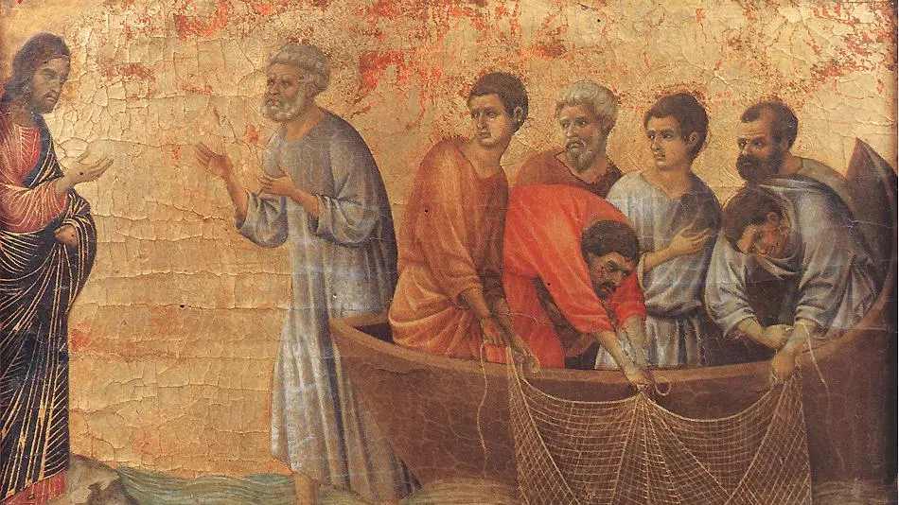
The Risen Jesus Forgives Peter
What are some takeaways from Peter’s encounter with Jesus?

Slide 12
The Risen Jesus Forgives Peter
What are some takeaways from Peter’s encounter with Jesus?
Jesus wants us to see our need and be willing to obey, so that we might know his power.

Slide 13
The Risen Jesus Forgives Peter
What are some takeaways from Peter’s encounter with Jesus?
Jesus wants us to see our need and be willing to obey, so that we might know his power.
Jesus wants us to practice forgiveness and believe in his ability to redeem & restore.

Slide 14
The Risen Jesus Forgives Peter
What are some takeaways from Peter’s encounter with Jesus?
Jesus wants us to see our need and be willing to obey, so that we might know his power.
Jesus wants us to practice forgiveness and believe in his ability to redeem & restore.
Jesus commissions us all.
Notes:
[BRIEF COMMENTS ABOUT EACH POINT]
Jesus wants us to see our need and be willing to obey, so that we might know his power. “Haven’t caught anything, have you?” – “Cast your net on the other side!” What does this look like in your life? What is the Spirit saying to you?
Jesus wants us to practice forgiveness and believe in his ability to redeem & restore. Peter denied Jesus. Left him to die alone. But Jesus forgave him, and his kindness changed everything. Aren’t you glad that Jesus doesn’t cancel us? How do you need to believe in this for yourself? Do you need an encounter with the Lord’s forgiveness? What about for others? How do you need to extend mercy and grace so that others can change?
Jesus commissions us all. How are you serving Christ where you are? If Jesus said, “Do you love me more than these?” What would the “these” be? Is God calling you into vocational ministry, or to a ministry? How is he commissioning you?
[CLOSING PRAYER]

Slide 15


