Slide 1


Slide 2
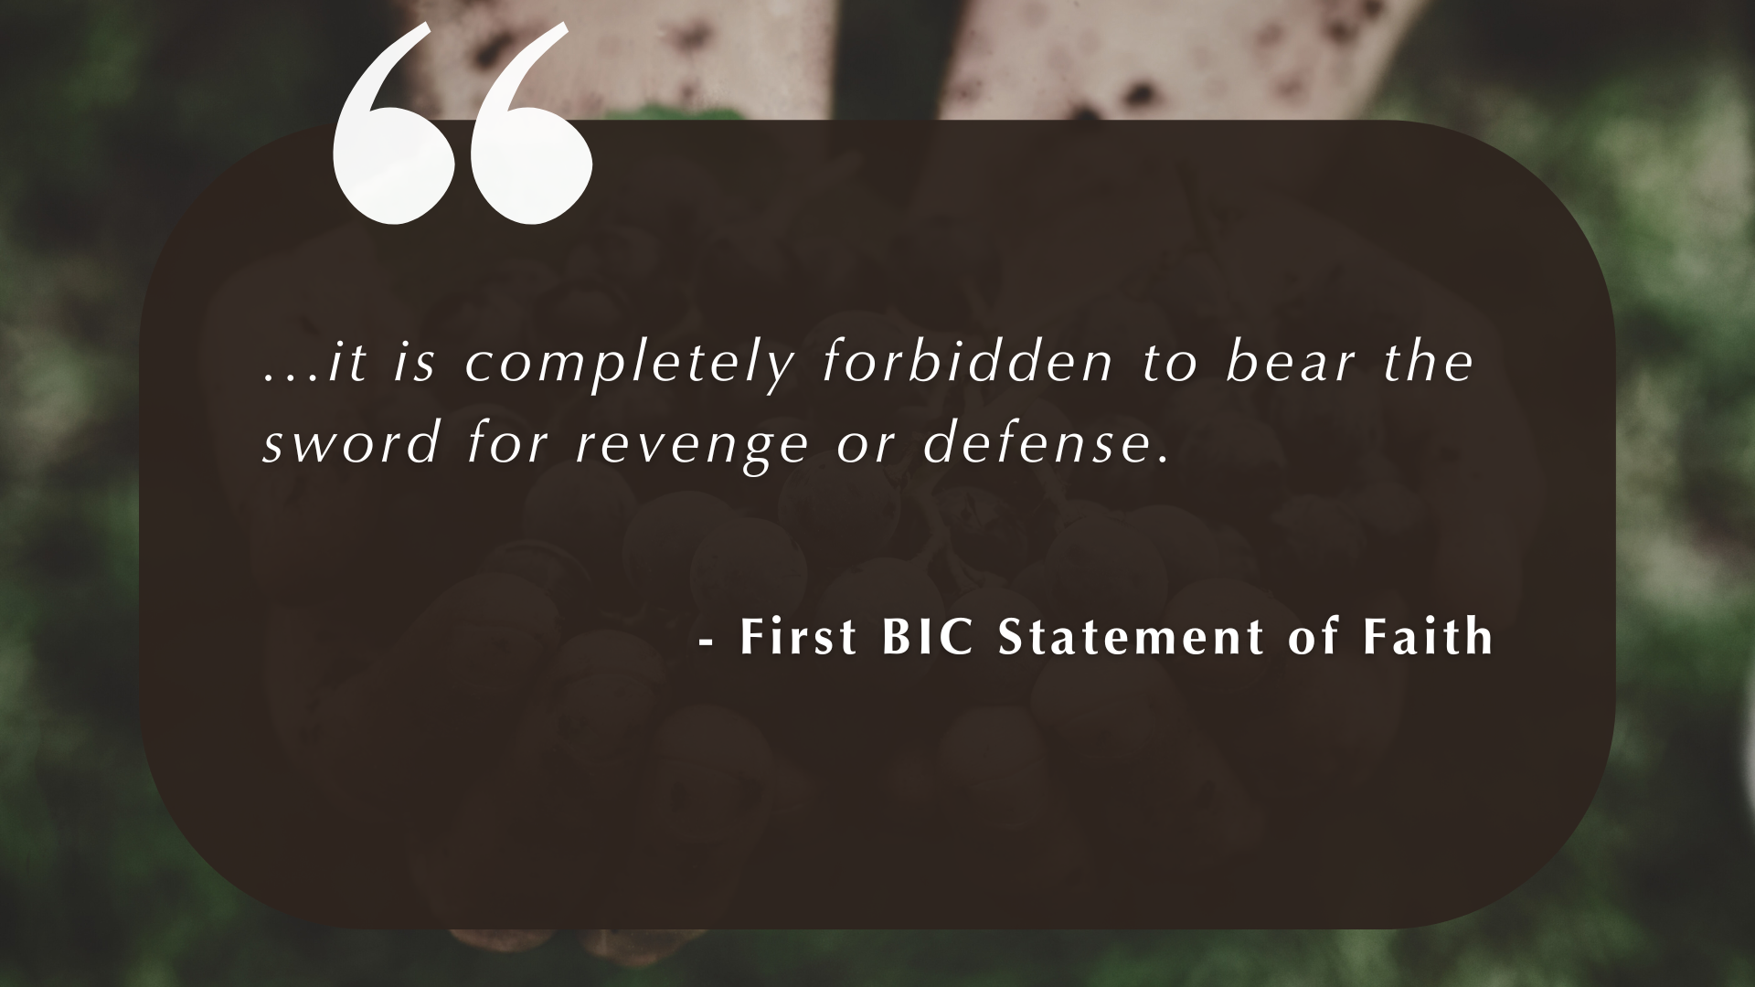

Slide 3
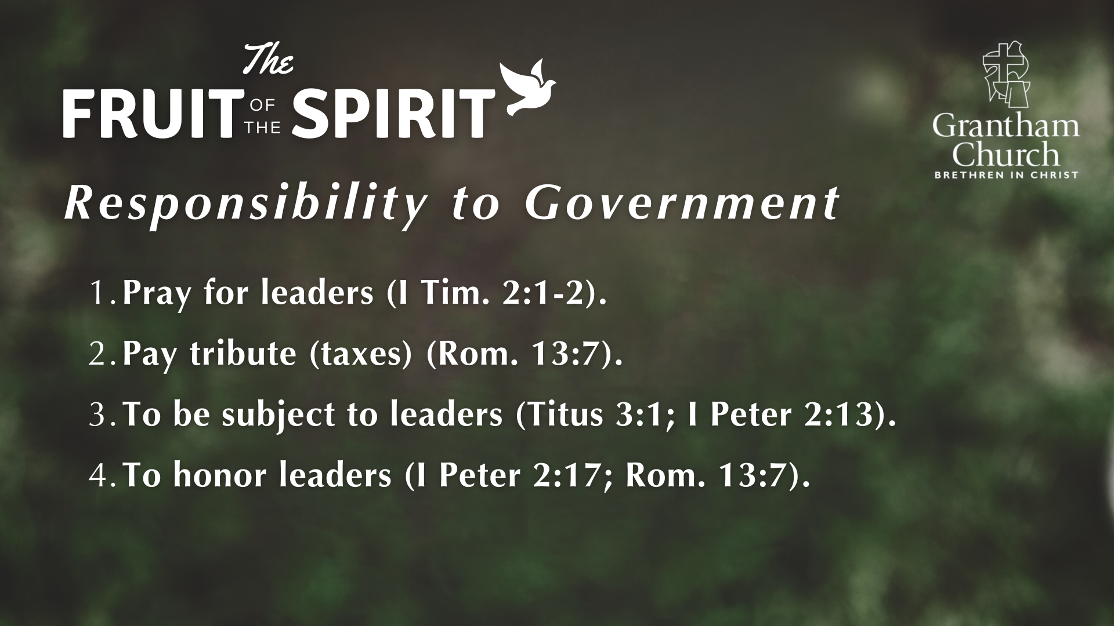

Slide 4


Slide 5
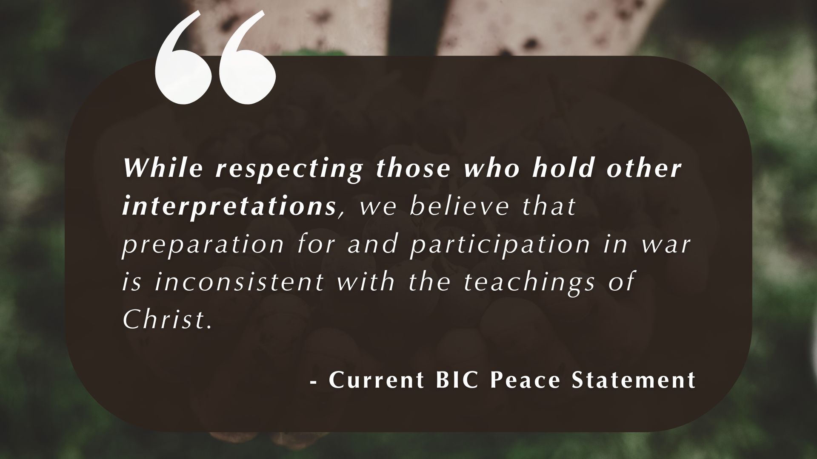

Slide 6
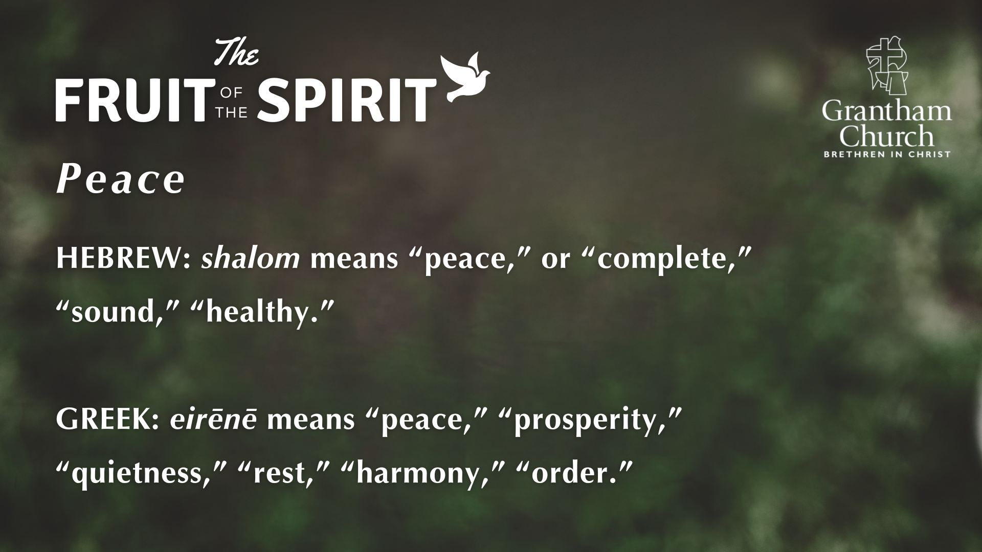

Slide 8


Slide 9

The wolf will live with the Lamb, the leopard will lie down with the goat. The calf, lion, and yearling together; and a little child will lead them. The cow will feed with the bear, their young will lie down together, and the lion will eat straw like the ox. The infant will play near the cobra’s den; and the young child will put its hand into the viper’s nest.
They will neither harm nor destroy on all my holy mountain, for the earth will be filled with the knowledge of the LORD as the waters cover the sea.
ISAIAH 11:6-9

Slide 10
Then I saw a new heaven and a new earth; for the first heaven and the first earth had passed away, and the sea was no more…. And I heard a loud voice from the throne saying, "See, the home of God is among mortals. He will dwell with them; they will be his peoples, and God himself will be with them; he will wipe every tear from their eyes. Death will be no more; mourning and crying and pain will be no more, for the first things have passed away.
REVELATION 21:1-4

Slide 11
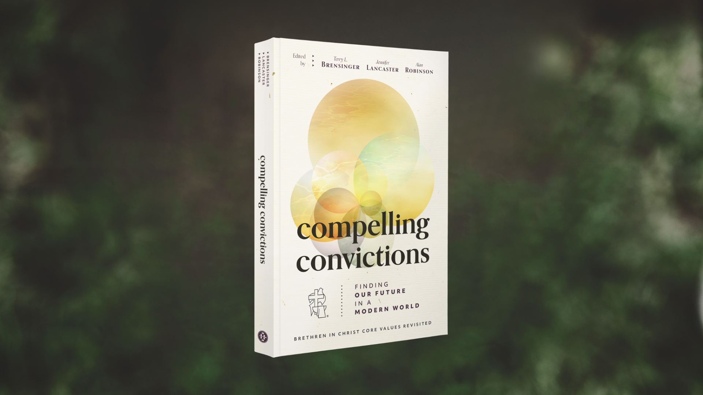

Slide 12
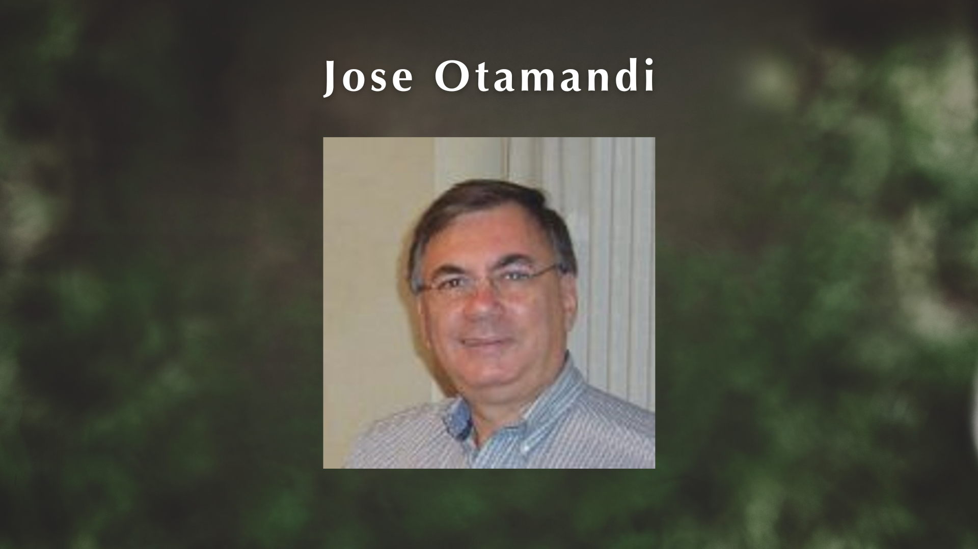

Slide 13
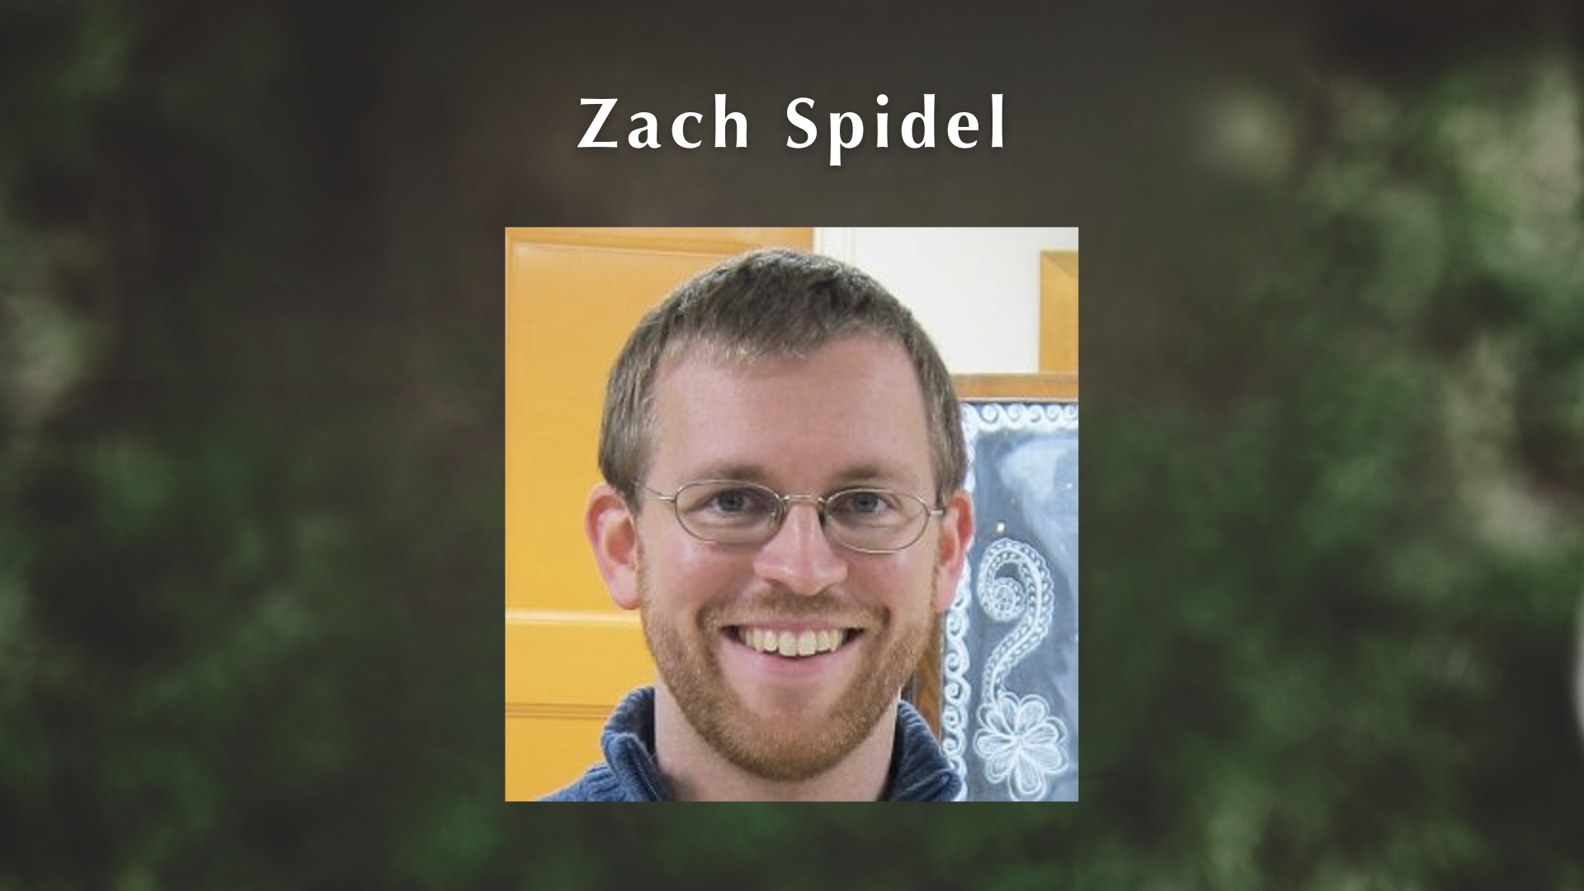

Slide 14
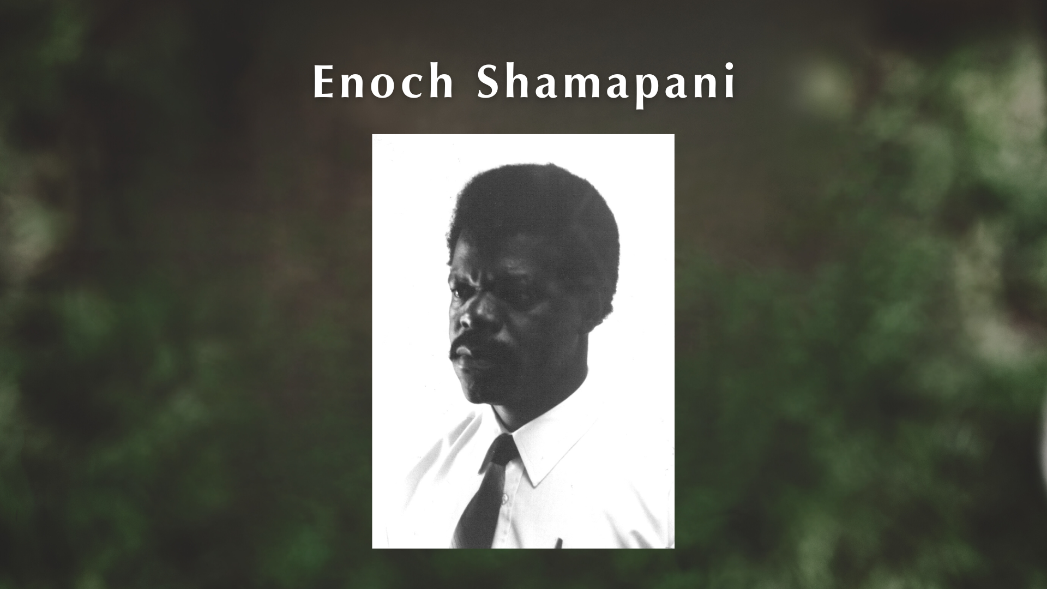

Slide 16
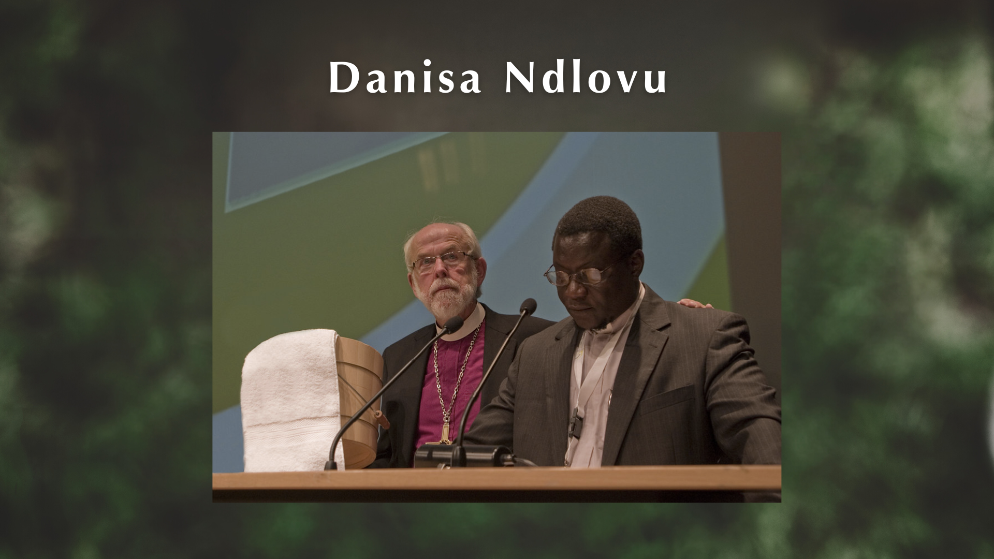

Slide 18


Slide 19


Slide 20


Slide 21


Slide 22


Slide 23


