Slide 1

Notes:
They were engaged, but not married. And then Mary was visited by an angel with an announcement. Joseph had a dream to confirm it. They were told they would be the parents to the Son of God, the Messiah. It’s obvious that this news and the events that followed were… unexpected.
And that’s what we’ve been looking at in our Advent 2020 series. We have reflected on a handful of biblical characters and their stories of unexpected events, and how God met them in the waiting when their plans fell apart. As we’ve seen, God meets us where we are and surprises us with his mercy, grace, and love. He did not abandon Abraham and Sarah, Joseph, and Job, but he kept his promises, which he will do for us as well if we too will live by faith.
And once again, that’s what we will see in this final message of our series, the Sunday before Christmas. We’re going to look at the story of Mary and Joseph, and then reflect on what their story teaches us about God, about ourselves, and about how we should live. And I think it’s appropriate that we end our series here, not just because Christmas is just a few days away, but also because it’s my final sermon of the year—a year that has been full of trials, challenges, disappointments… and for some… despair.
Our focus this morning is perfect because Mary and Joseph’s story invites us into what they experienced leading up to the first Christmas. As we will see, they experienced hope amid despair, light in the midst of darkness, and faith in the face of doubt. For the coming birth of Jesus was a time filled with great joy… right alongside fear, struggle, and uncertainty about the future. Which is why we need to hear this message this morning. And why I’m happy to preach it.
Our story begins in Luke chapter 1, verse 26. Follow along as I read and unpack the passage. [NEXT SLIDE]

Slide 2
Luke 1:26-38 NIV
²⁶ In the sixth month of Elizabeth’s pregnancy, God sent the angel Gabriel to Nazareth, a town in Galilee, ²⁷ to a virgin pledged to be married to a man named Joseph, a descendant of David. The virgin’s name was Mary. ²⁸ The angel went to her and said, “Greetings, you who are highly favored! The Lord is with you.”
Notes:
[BRIEF COMMENTS]
v. 26 – In the sixth month of Elizabeth’s pregnancy, God sent the angel Gabriel to Nazareth, a town in Galilee
Elizabeth is the wife of Zechariah, a priest in the temple
Earlier in chapter 1 the angel Gabriel appeared to Zechariah in the temple
There are echoes of Abraham and Sarah, as well as the story of Hanna
After 400 years of silence, God is now speaking and acting in Israel
v. 27 – to a virgin pledged to be married to a man named Joseph, a descendant of David. The virgin’s name was Mary.
Mary and Joseph are betrothed to each other
Mary would have been 12 or 13 when betrothal began; Joseph is around 18
Joseph is in the royal line of King David, the greatest king of Israel
v. 28 – The angel went to her and said, “Greetings, you who are highly favored! The Lord is with you.”
Verse 29. [NEXT SLIDE]

Slide 3
²⁹ Mary was greatly troubled at his words and wondered what kind of greeting this might be. ³⁰ But the angel said to her, “Do not be afraid, Mary; you have found favor with God. ³¹ You will conceive and give birth to a son, and you are to call him Jesus. ³² He will be great and will be called the Son of the Most High. The Lord God will give him the throne of his father David, ³³ and he will reign over Jacob’s descendants forever; his kingdom will never end.” ³⁴ “How will this be,” Mary asked the angel, “since I am a virgin?”
Notes:
[BRIEF COMMENTS]
v. 29 – Mary was greatly troubled at his words and wondered what kind of greeting this might be.
Mary was simultaneously experiencing amazement, confusion, and fear.
v. 30 – But the angel said to her, “Do not be afraid, Mary; you have found favor with God.
Again, the angel points out that she has God’s favor, i.e. blessings come to those who are favored.
v. 31 – You will conceive and give birth to a son, and you are to call him Jesus.
Jesus is the Greek form of Joshua (or Yeshua), which means “Yahweh saves”; it’s a common name, so an epithet would be added to distinguish him from others-–Jesus of Nazareth.
vs. 32-33 – He will be great and will be called the Son of the Most High. The Lord God will give him the throne of his father David, and he will reign over Jacob’s descendants forever; his kingdom will never end.”
“Son of the Most High” is a clear indication of his divinity and unique relationship to God; God will “give him the throne of his father David” and “his kingdom will never end” are all allusions to OT prophecies
v. 34 – “How will this be since I am a virgin?” Mary doesn’t ask for proof as Zechariah did earlier in the chapter. Instead, she simply wants understanding. And it’s obvious that Mary understood that this was something divine and immediate. Gabriel wasn’t talking about a natural pregnancy. You can see why she’s troubled.
And the angel responds in verse 35. [NEXT SLIDE]

Slide 4
³⁵ The angel answered, “The Holy Spirit will come on you, and the power of the Most High will overshadow you. So the holy one to be born will be called the Son of God. ³⁶ Even Elizabeth your relative is going to have a child in her old age, and she who was said to be unable to conceive is in her sixth month. ³⁷ For no word from God will ever fail.” ³⁸ “I am the Lord’s servant,” Mary answered. “May your word to me be fulfilled.” Then the angel left her.
Notes:
[BRIEF COMMENTS]
v. 35 – The angel answered, “The Holy Spirit will come on you, and the power of the Most High will overshadow you. So the holy one to be born will be called the Son of God.
The angel’s words conjure up images of the Spirit’s work in the Genesis creation accounts. This is not the crude pagan idea of a god coupling with a human woman; this is a divine mystery—outside the pattern of human generation. Luke wants to make this clear to his readers. God is making this possible.
OK. C’mon, pastor. You really believe in the “virgin” birth? Uh, yes. Real quick… I’ll give you three reasons why: (1) I believe in Genesis 1:1 (that God created the universe), and so a virgin birth is nothing for God; (2) I recognize, as ANE people would, that claiming a virgin birth is scandalous, yet Matthew and Luke still tell this story, which I believe adds to its credibility (much like the early disciples claiming that Jesus was raised from the dead); also (3) Scientists will tell you that a virgin birth is theoretically possible (as it’s happened with fish and reptiles), although highly unlikely with humans. And so, I choose to believe that the Holy Spirit made it possible for Mary to conceive without Joseph’s help by providing the necessary proteins and chromosomes that are needed from male sperm to create a male child.
Therefore, for those of us in the Church who confess that Jesus was ”conceived by the Holy Spirit, born of the Virgin Mary” from the Apostle’s Creed, we can say with confidence (lit., with faith) that this belief does not contradict science or reason, it simply goes beyond it. For those who accept the mysterious work of the Spirit in the cosmos, this isn’t a problem. So, let’s not worry about what people think of us for believing this sort of thing… because Mary doesn’t.
vs. 36-37 – Even Elizabeth your relative is going to have a child in her old age, and she who was said to be unable to conceive is in her sixth month. For no word from God will ever fail.”
Again, we can hear an allusion to what God did in the Abraham and Sarah story, showing that all things are possible with God. The angel wants Mary to be encouraged by God’s work in Elizabeth, a relative of Mary.
v. 38 – “I am the Lord’s servant,” Mary answered. “May your word to me be fulfilled.” Then the angel left her.
Folks, this is what a faith response looks like. It’s amazing really. Mary says, I’m a servant of God. And her simple acceptance not only embraces the “impossibility” of what the angel has promised, but she also embraces whatever cost might come to her for being a pregnant teen who has yet to tie the knot with Joseph.
And of course, she could not have known the cost that would come later in life as her son would be unjustly condemned and crucified as the “King of the Jews” and who appeared to be a failed Messiah. That’s because, as we know, the Messiah would not be like what they expected. Jesus would not be a Messiah like David, a fallible king on an earthly throne. Instead, God’s vision was much bigger, much better. And his plan for Messiah more… cosmic.
But back to Mary. Think about these words from the angel. Many in Israel longed for the Messiah, for their deliverer to come. And many young Jewish girls must have wondered, could I be the one who might give birth to the Messiah? Will he come from my womb, from my generation? You know, not every teenage girl would be able to handle this news with such poise, humility, and faith. Yet, Mary, an ordinary yet faithful young woman has found favor with God. Her heart is prepared for God to do the impossible through her.
Think about it. Based on her song (the Magnificat), which follows this announcement, she knows the Scripture. She keeps God’s commands. She is righteous and faithful, a person of integrity and respect. She is not puffed up. She is not a narcissist. You won’t find her posting selfies of herself to attract attention. She won’t be tweeting out how faithful she was and how special she must be for God to pick her. No, Mary is a virtuous young woman who is clearly secure in her identity and needs no approval from others. She doesn’t need anyone to “like” her stuff. That’s because she is grounded in her faith and only lives for the Lord. And that’s why the Lord chooses her.
Needless to say, it takes a special person to be able to hear this unexpected news and trust God with whatever comes next, which is what Mary did. And I’d like us to see this played out in a scene from the movie, The Nativity Story. The clip you’re about to watch is of Mary coming back home to Nazareth after spending time with Elizabeth. Joseph has been waiting for Mary to return so they can be joined as husband and wife. And it doesn’t take long for Joseph, Mary’s parents, and the small village of Nazareth to see that Mary has returned with a baby bump.
Let’s watch this together. [NEXT SLIDE]

Slide 5
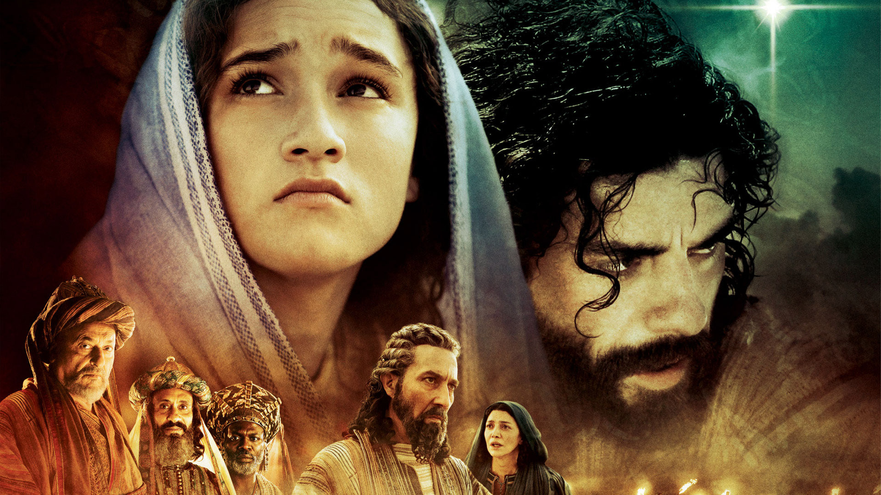
Notes:
[SHOW MOVIE CLIP]

Slide 6
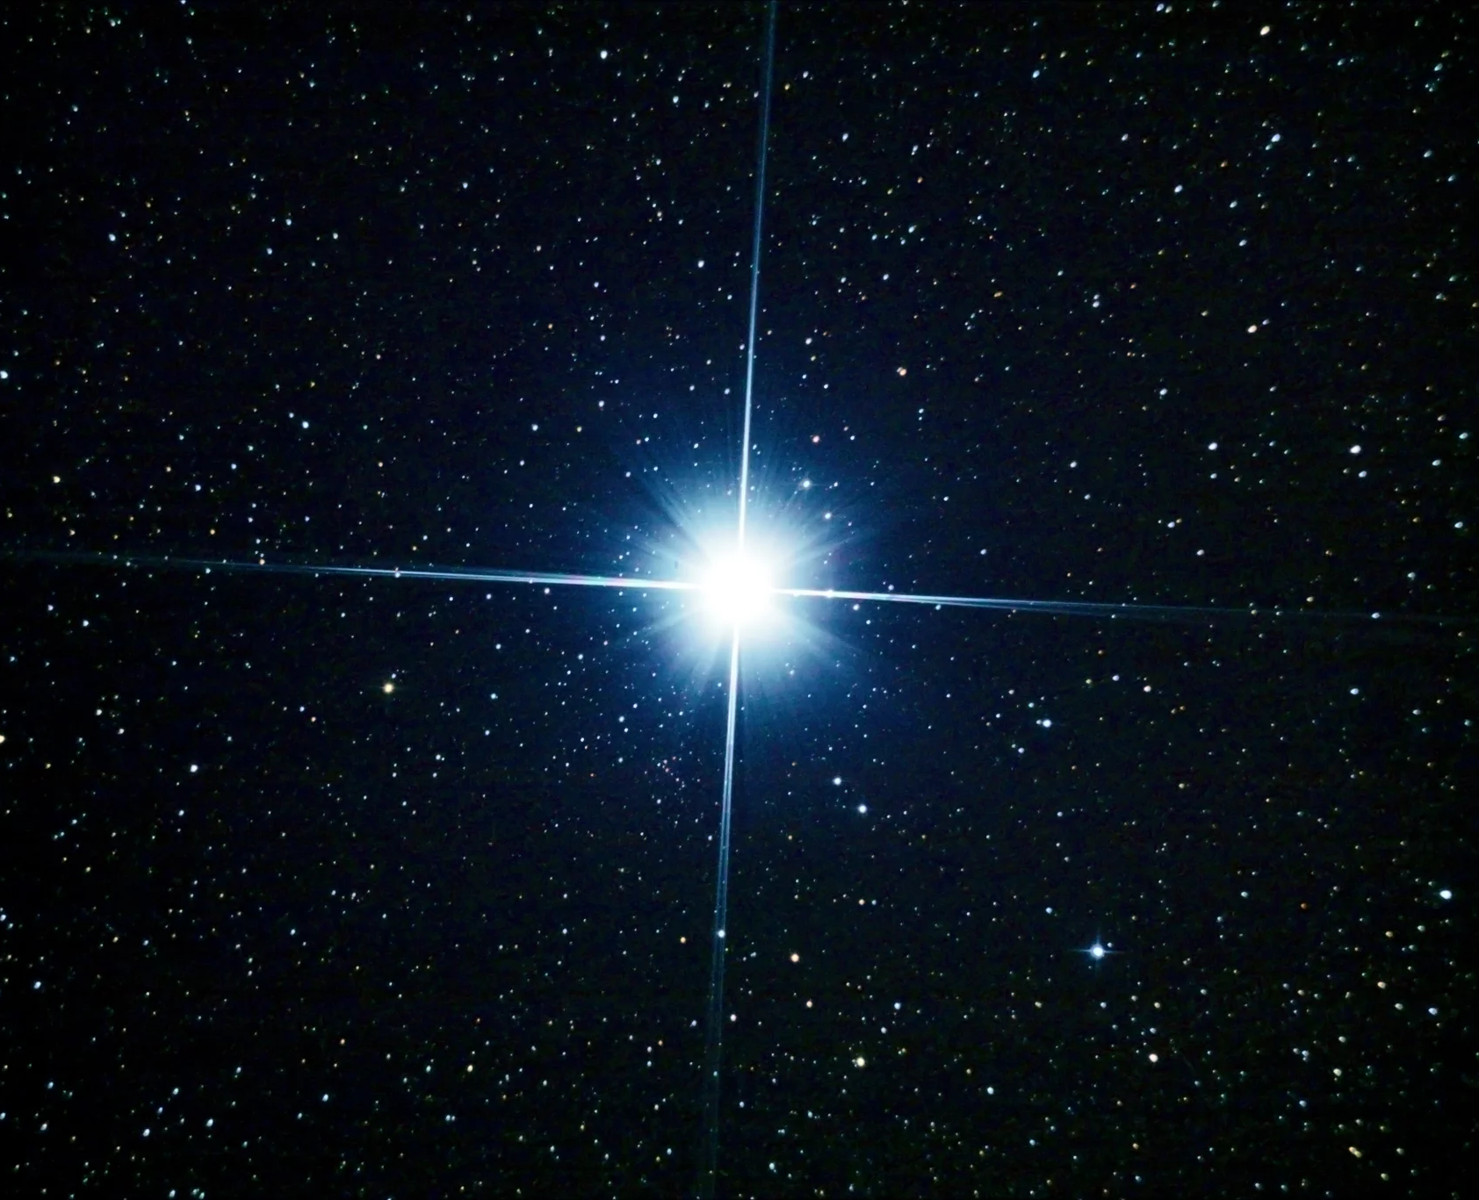
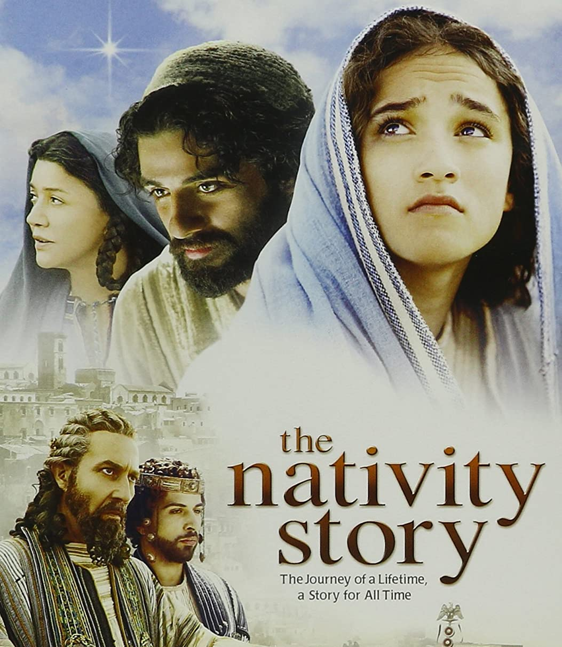

Rent or buy at Amazon.com
Notes:
What did you think? I believe that really helps us to imagine how that scene might have played out, and what must have gone through their minds. Imagine what Joseph was thinking when he hears Mary’s explanation that an angel told her it was because of the Holy Spirit, and that the baby would be the Messiah. In Joseph’s mind, he must be thinking that Mary is lying (maybe even crazy), and she has either been unfaithful with another man or she has been sexually assaulted (maybe by one of Herod’s soldiers, as Mary’s father asked her about in the clip we just saw).
But regardless of what actually happened, and how he must have been flooded with all kinds of thoughts and emotions, Joseph (like Mary) is a righteous, good-hearted person. In breaking from his own culture and desire for retribution, Joseph isn’t concerned about his own honor, or invoking Deuteronomy 22:13-21, which calls for stoning someone who has committed adultery. Instead, he chooses what is known as the “escape clause” in Deut. 24 and decides to divorce her without drawing further attention to the situation.
Let’s take a look at what happened next in Matthew 1:19-25. [NEXT SLIDE]

Slide 7
Matthew 1:19-25 NIV
¹⁹ Because Joseph her husband was faithful to the law, and yet did not want to expose her to public disgrace, he had in mind to divorce her quietly. ²⁰ But after he had considered this, an angel of the Lord appeared to him in a dream and said, “Joseph son of David, do not be afraid to take Mary home as your wife, because what is conceived in her is from the Holy Spirit. ²¹ She will give birth to a son, and you are to give him the name Jesus, because he will save his people from their sins.”
Notes:
[BRIEF COMMENT ON PASSAGE]
As we’ve already seen in this series, God works through dreams. God will use a dream three separate times with Joseph in the birth and childhood narrative of Jesus. And it’s worth pointing out that God still speaks through dreams today, particularly with individuals or cultures that are open to this way of God communicating to them, and who almost expect it if God has something to say and wants to get their attention. And this definitely gets Joseph’s attention!
Verse 22… [NEXT SLIDE]

Slide 8
²² All this took place to fulfill what the Lord had said through the prophet: ²³ “The virgin will conceive and give birth to a son, and they will call him Immanuel” (which means “God with us”).
²⁴ When Joseph woke up, he did what the angel of the Lord had commanded him and took Mary home as his wife.²⁵ But he did not consummate their marriage until she gave birth to a son. And he gave him the name Jesus.
Notes:
[BRIEF COMMENT ON PASSAGE]
Look at that. Again, like Mary, we see the righteous character and quick submission and obedience of Joseph. Is it any wonder why God chose this couple? As soon as Joseph wakes, he instantly does the Lord’s bidding. Let there be no doubt, Jesus had God-fearing parents who were serious about their faith and modeled it in their living.
Don’t miss this, folks. If you want to know what’s really inside a person, pay attention to how they respond when the unexpected happens and their faith is put to the test. Do they buckle under the pressure? Do they quit when things get hard? Do they slide back into apathy, self-pity, anger, and the flesh? Or do they stick to the narrow path and allow the events to strengthen their faith and trust in God, and make them a better person? For Mary and Joseph, they overcome whatever obstacles they encounter, they accept that some people will not understand (even accuse or slander them), and they believe that God’s will is greater than anything the enemy may throw at them.
And the enemy does come after them. [NEXT SLIDE]

Slide 9
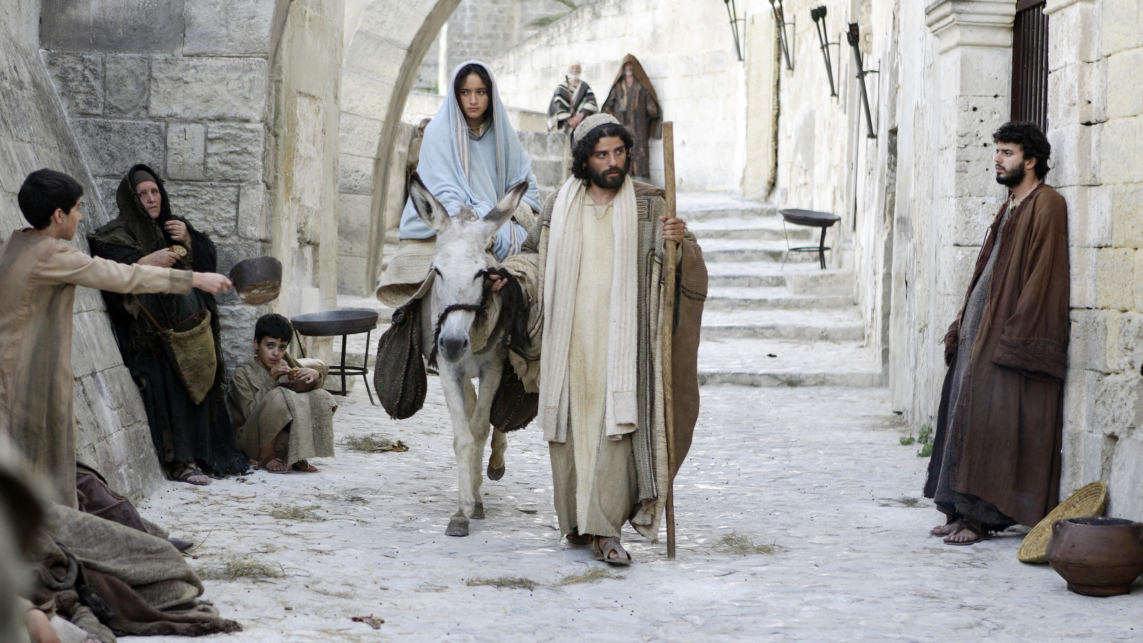
Notes:
You’ll recall that in Luke 2, Caesar Augustus issues a decree for a census to be taken throughout the Roman world, forcing people back to their place of birth to register. Another reminder of the oppressive powers of the empire. And so, Joseph and Mary set off for Bethlehem, where Joseph was born, about 100 miles to the south. [NEXT SLIDE]

Slide 10
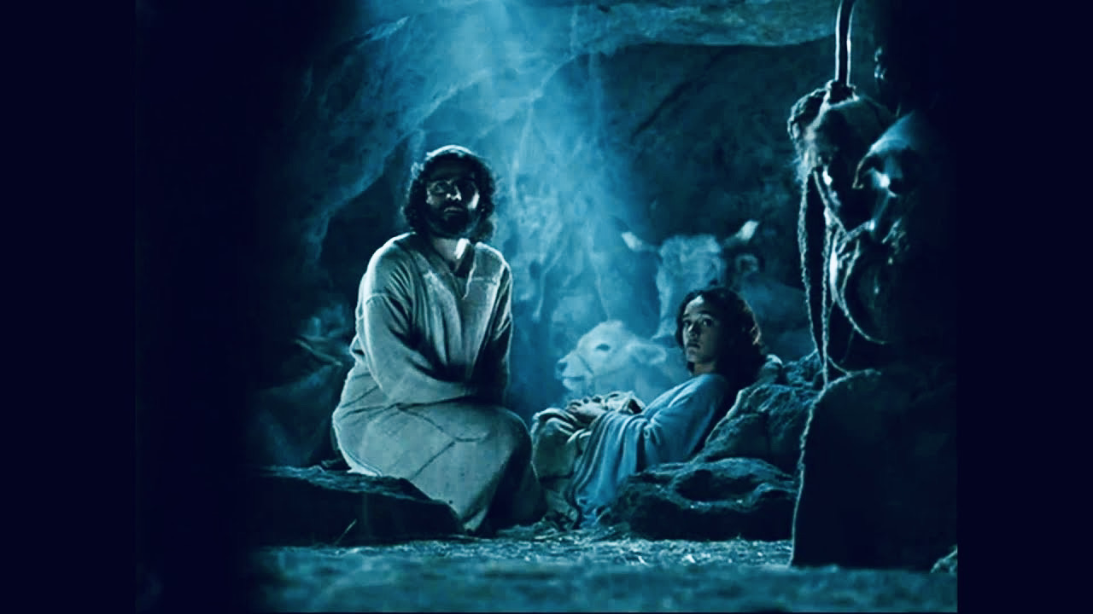
Notes:
It’s there that Mary will give birth, but not in a hospital. They didn’t have those. And not in a family home, because there were no rooms available with any of Joseph’s relatives, likely due to the moving about and returns home brought on by the census. So, the only space they could find was a manger, where a family member or a local villager kept the animals for the night. Not quite where you’d expect the God of the universe to be born in human flesh.
And as a sign of God’s grace and a gift of affirmation to Mary and Joseph, as well as the inclusion of the lowly, the poor, and the anxious, shepherds to come by invitation of angels to see what God has done. Heaven and earth rejoices at how God has done the unexpected and entered into his own creation through the birth of Christ. [NEXT SLIDE]

Slide 11
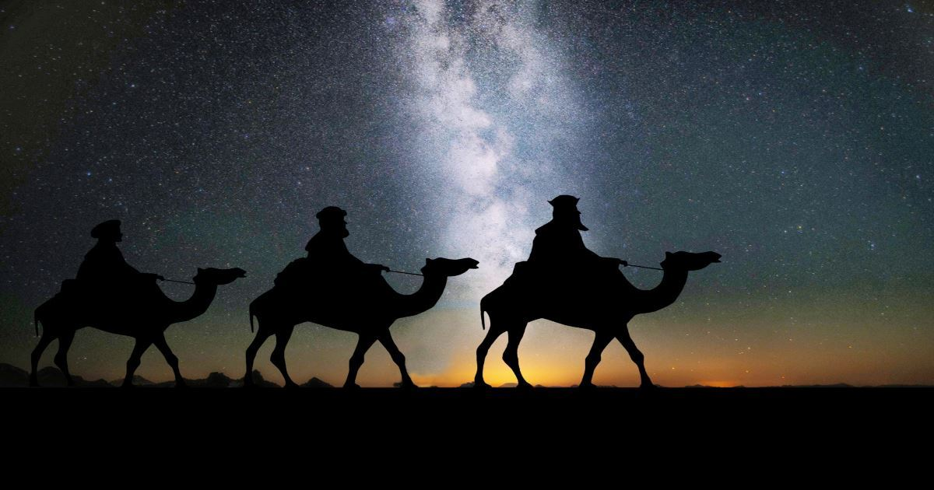
Notes:
But as I said, the enemy comes up against them seeking to stop God’s redemptive plan. Some time later, after Jesus was born, while Mary and Joseph were still in Bethlehem, Magi, who were Gentile astrologers from the east that watched the skies for signs so that they might discern present and future events (often referred to as “wise men”) followed a star, which they believed was an indication that a king was born.
It’s most likely what they witnessed was the aligning of two planets, much like what is happening tomorrow with Jupiter and Saturn. So, the Magi connect this celestial event to the prophecies in the Hebrew Scriptures. We’re not sure why exactly, but they do. And so, they head to Jerusalem in Judea. [NEXT SLIDE]

Slide 12
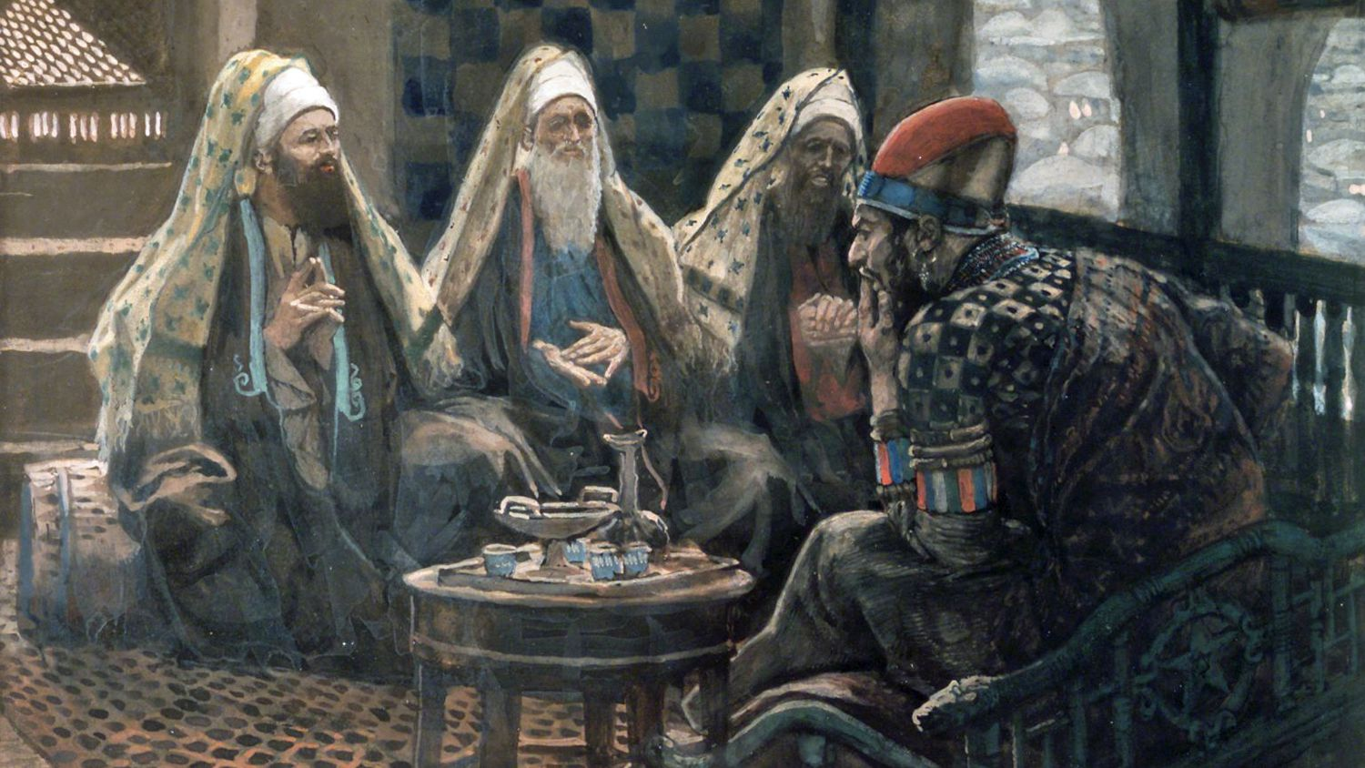
Notes:
Once they arrive, they go straight to Herod’s palace looking for this newborn King. But they soon realize that not only has there not been a royal birth there, but they have also just alerted a really paranoid and brutal king that he may have a viable threat to his throne. An infant a threat? Well, remember that this guy had his own mother and sons killed because he felt they threatened his rule. In fact, it was recorded that Caesar Augustus once quipped that he “would rather be Herod’s pig than his son.” You don’t want to mess around with this guy. He’s bad news.
But you know this, because you know what happens next. [NEXT SLIDE]

Slide 13
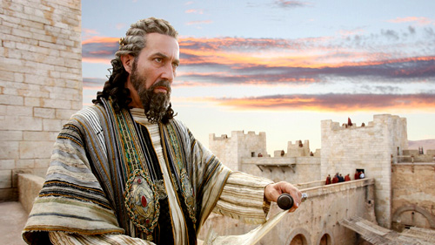
Notes:
Herod gets wind that the Magi found the child just south of the city in Bethlehem, but that they’re not coming back to give him any information. They of course didn’t believe him when he said, “Come back and tell me where he is so that I can worship him too.” So, he does the unthinkable. He orders that all the first-born boys of Bethlehem, 2-years and younger, be killed. In Herod’s dark, twisted mind, this will ensure that the prophecies will never come true.
But before he can issue the decree, an angel tells Joseph in a dream to wake up and flee with his family to Egypt. And I know, this is the part of the story that we don’t want to talk about. We don’t even want to think about it. [NEXT SLIDE]

Slide 14
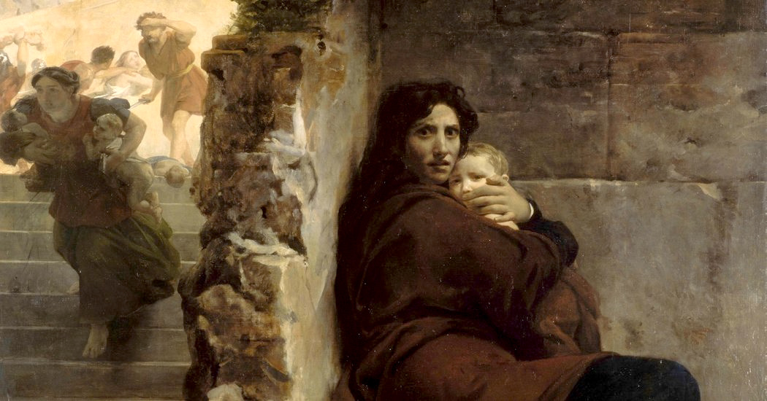
Notes:
As he writes in his commentary on Matthew, Rodney Reeves says: “This is the Christmas story? Matthew’s version of our favorite holiday is hardly recognizable except for the star and the wise men. Joseph nearly divorcing Mary, Herod’s diabolical ploy, the slaughter of the innocents, the flight to Egypt, waiting for the king to die—none of these things make the cover of Christmas cards… Yet there it is in Matthew’s story. In all of its glory. And we turn our eyes away from the tragedy because everyone knows Christmas is about warm feelings, nostalgic recollections, and finding serenity in the midst of our chaotic lives.” [NEXT SLIDE]

Slide 15
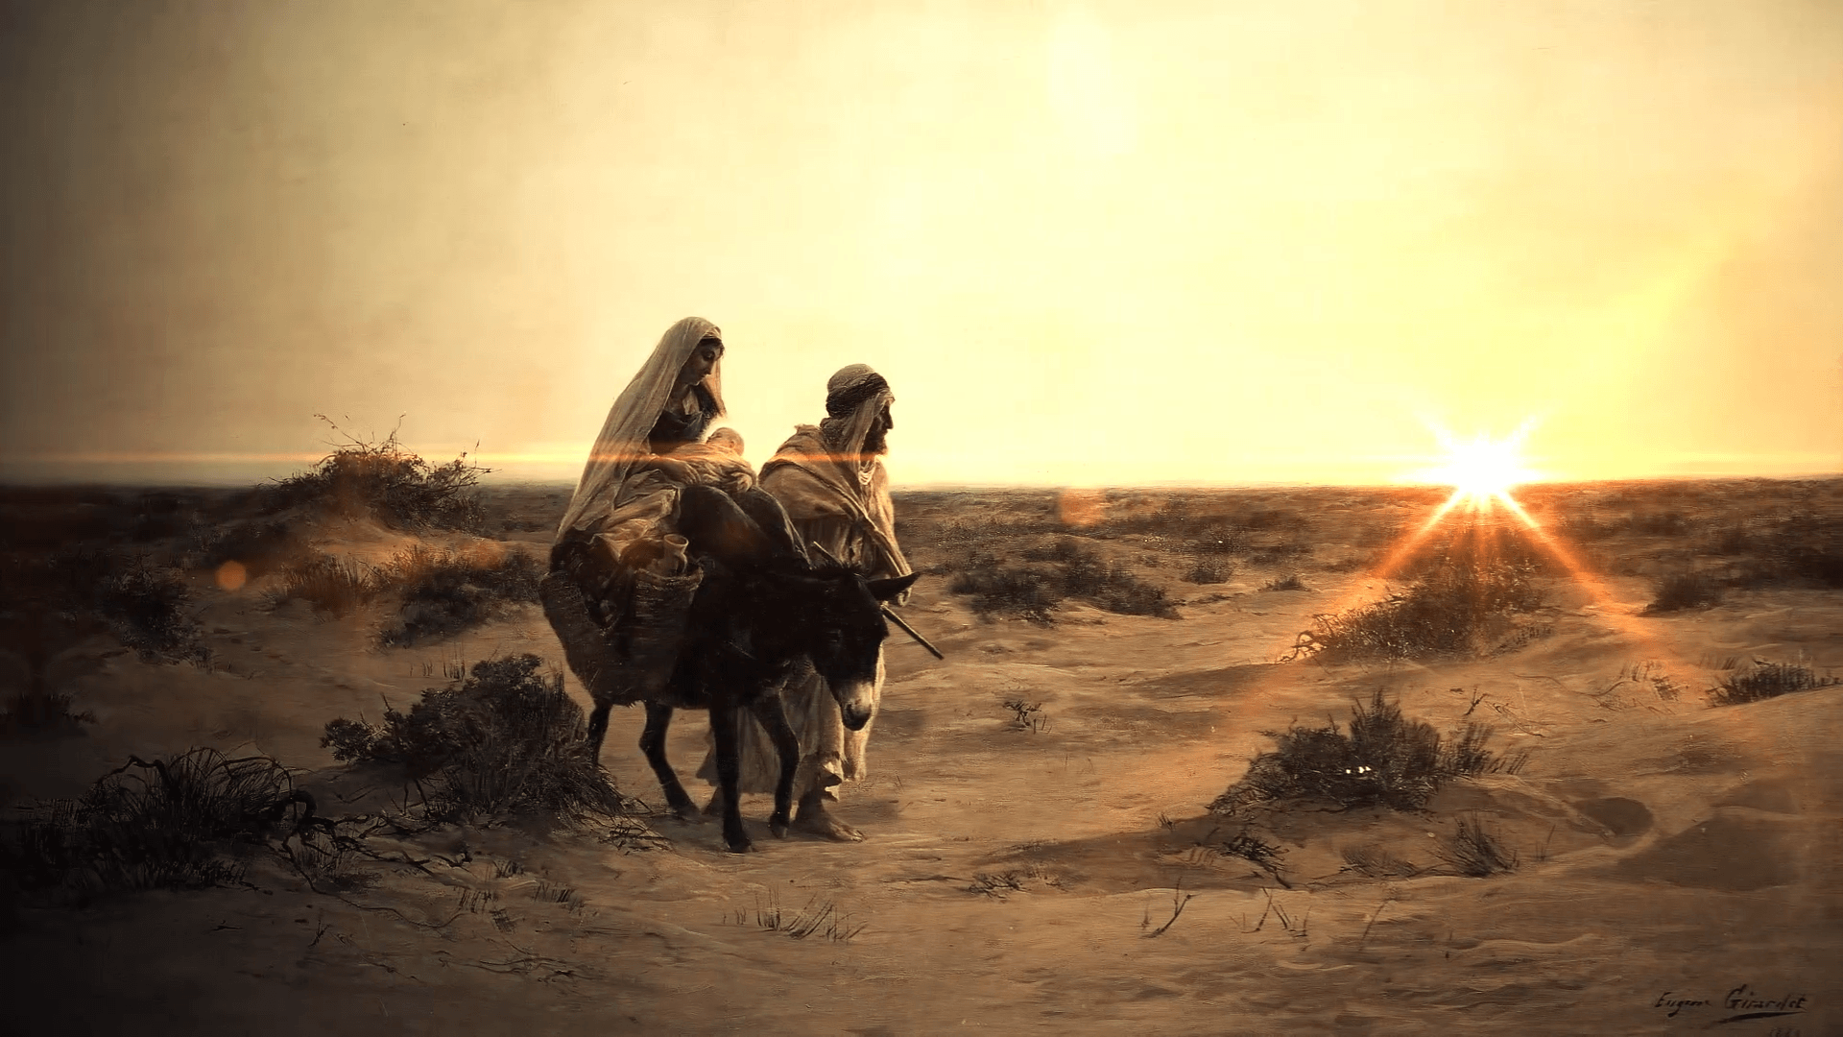
Notes:
But Matthew shares these details to help us see that this is the real Christmas story—it’s the story about God breaking in to the blackest darkness of our world and experiencing it with us, and proclaiming to that darkness that the light has come. Reeves writes, “I find hope knowing that even when Jesus was born, there were outsiders bearing gifts, politicians trying to hold onto power, and people in Bethlehem screaming, “Where is God?”
(Rodney Reeves, The Story of God Bible Commentary - Matthew, pgs. 61-63)
It is strangely comforting, because it’s true. For us to experience the real hope and joy of Christmas, we must be willing to see the contrast between light and darkness, between good and evil, between hope and despair, between a righteous couple and an evil king. And then we can go and celebrate what God has done in Christ. Amen?
Finally, in closing, as we prepare our hearts for Christmas, let’s consider what this story teaches us. [NEXT SLIDE]

Slide 16
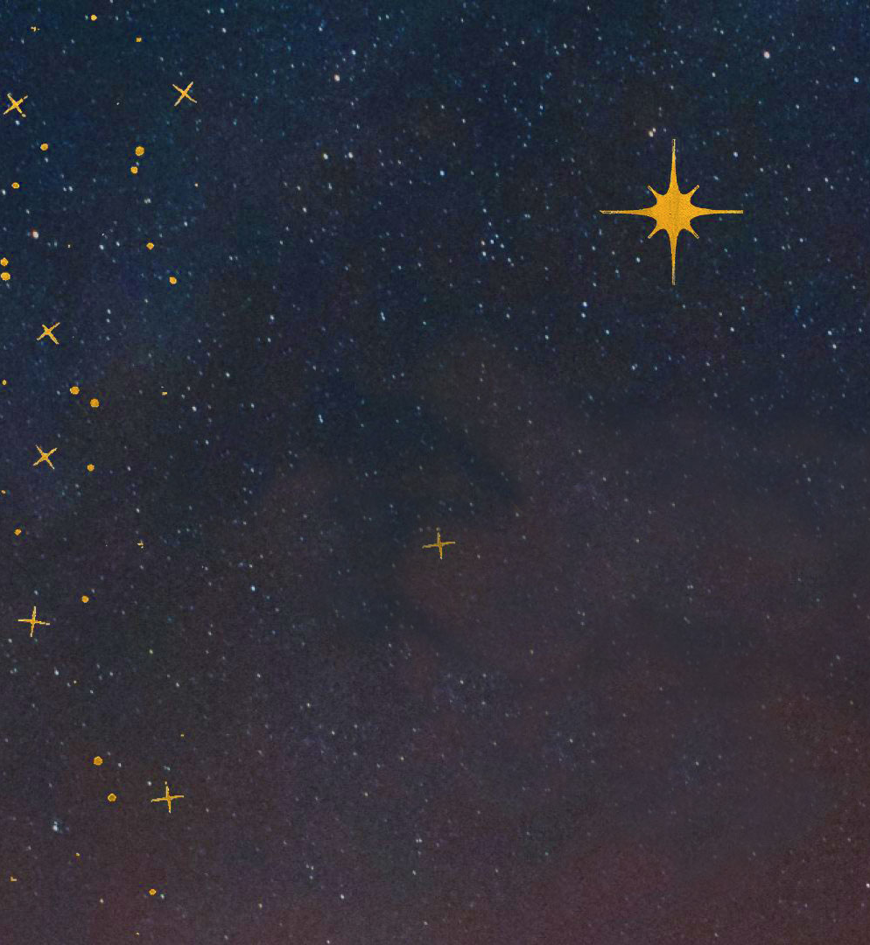
unexpected Advent 4 Reflection – What does this story teach us?
About God?
About ourselves?
About how we should live?

Slide 17
unexpected Advent 4 Reflection – What does this story teach us?
About God? God comes to those who are meek, humble, and righteous.
About ourselves?
About how we should live?

Slide 18
unexpected Advent 4 Reflection – What does this story teach us?
About God? God comes to those who are meek, humble, and righteous.
About ourselves? We are limited in our power, but God can do all things by his Spirit.
About how we should live?

Slide 19
unexpected Advent 4 Reflection – What does this story teach us?
About God? God comes to those who are meek, humble, and righteous.
About ourselves? We are limited in our power, but God can do all things by his Spirit.
About how we should live? We must not live as defeated victims, but press on as righteous people of faith.
Notes:
[BRIEF COMMENTS ON EACH]
About God? God comes to those who are meek, humble, and righteous. Do you want to experience more of God, and know his will for your life? We can see this truth in all four stories we’ve looked at in Advent.
About ourselves? We are limited in our power, but God can do all things by his Spirit. Mary said: “How can this be? How will this happen?” In Mark 10:27, Jesus acknowledged that while some things might be impossible for us, it isn’t for God. He said, “all things are possible with God.”
About how we should live? We must not live as defeated victims but press on as righteous people of faith. We have a choice everyday: will we live as victims or grow up in our faith and stand firm in our identity?
What will you do in response to this year? As the wise Dr. Seuss once said, “When something bad happens you have three choices: You can either let it define you, let it destroy you, or you can let it strengthen you.” Brothers and sisters, let’s be like all of the characters that we’ve seen in our Advent series (and all of the people of faith whose lives are recorded in Scripture), and allow the Lord to use our trials this year to strengthen us and build our faith in him. Because as the author of Hebrews has written, “we do not belong to those who shrink back and are destroyed, but to those who have faith and are saved.” May it be so.
And may God increase our faith as we wait on him to do the unexpected.

