Slide 1
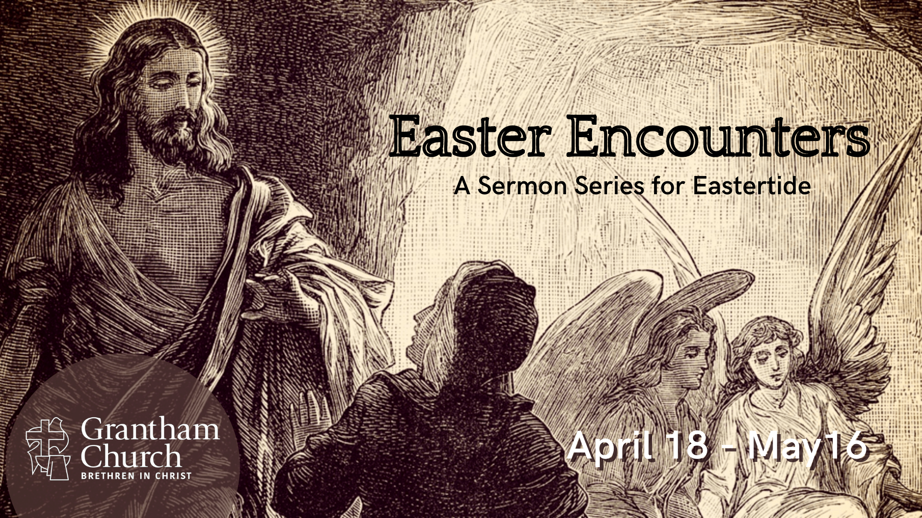
Notes:
This is the final week of our 5-week sermon series, Easter Encounters. That’s because this is the last Sunday of Eastertide when we reflect on the resurrection of Jesus from the dead. That means that next Sunday is Pentecost Sunday, when we remember how the Holy Spirit came to the church after the Ascension of Jesus, which is what today is all about.
It is Ascension Sunday on the church calendar. And the Easter Encounter we will see today is the last time the risen Jesus was seen in the 40-day period between Easter morning and the Ascension when Jesus was taken into heaven. And then about 10 days later, the disciples will receive the Spirit in the upper room where and when the church is officially born. You can read all about that in the book of Acts, Luke’s second volume to his gospel.
So, if you just happen to be joining us for the final sermon in this series, or if it helps to be reminded of what we’ve covered, we began our series with Mary Magdalene’s Easter encounter at the empty tomb, then we saw where Jesus catches up with two disappointed disciples on the road to Emmaus (reviving their dead aspirations), and then we looked at Thomas’ Easter encounter with the risen Jesus, and the lessons we can learn from his doubt and confession. And then last week we looked at the scene where Jesus had breakfast by the seashore with 7 of his disciples and reinstates Peter as the leader of the Eleven. Which brings us to the last of the Easter encounters. We will be looking at two scenes: when Jesus gives his disciples “The Great Commission” and when Jesus offers parting words before ascending to heaven.
So, please turn in your Bibles… [NEXT SLIDE] to Acts chapter 1 (our main Scripture reading today) and stand with me as we read from our sacred text. If you don’t have your Bible with you, you can simply listen as I read.

Slide 2
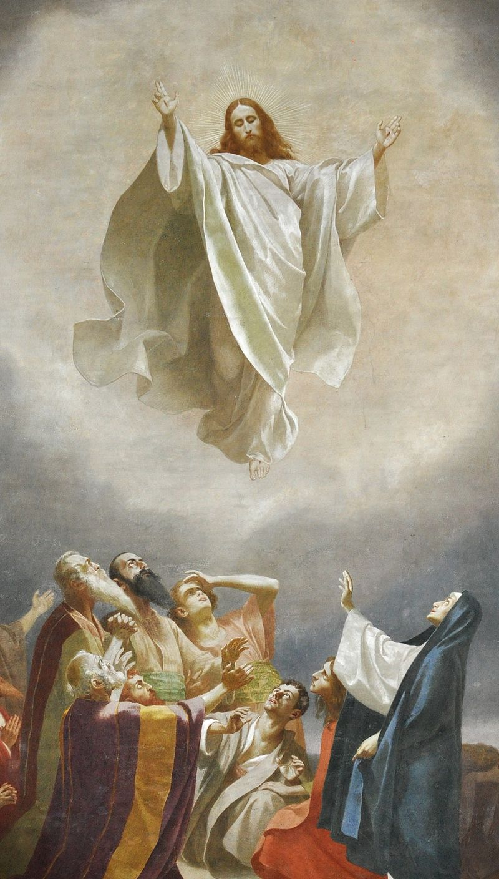
Scripture Reading
Acts 1:1-11 NIV
Notes:
[READ ACTS 1:1-11 NIV] – This is the Word of the Lord. Thanks be to God. You may be seated.
The evidence for the resurrection really is astounding if you can approach it all with both an open mind and an open heart, and be honest about your own preconceived ideas and your historical, social, and cultural location, which shapes your view of the world in the present. Because as I’ve said before, the reasons for putting your faith in the risen Jesus are pretty good.
To begin with, just consider all of the resurrection appearances recorded in the New Testament. [NEXT SLIDE]

Slide 3
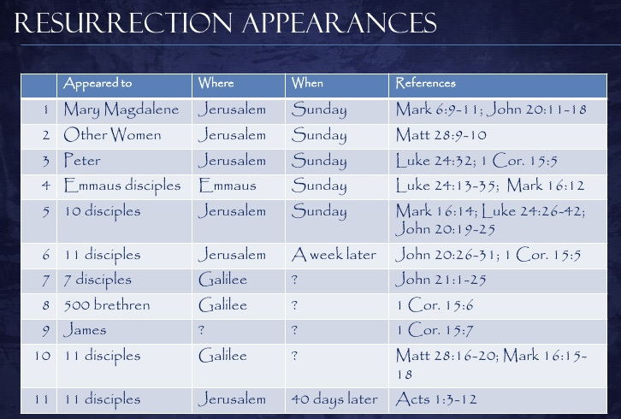
Notes:
[BRIEF COMMENT ON CHART]
And you may recall last week I said that there is one more appearance that we need to count, that being the experience that Saul of Tarsus (known to us as the Apostle Paul) had on the road to Damascus. His encounter with the risen and ascended Jesus would make the twelfth resurrection appearance of Jesus in the New Testament.
While some skeptics want to say that Paul simply had a vision of some kind, not an encounter with the risen Jesus, I think we should push back on that and say that Paul did in fact experience the risen Christ, even if it was a voice coming from a bright light, and say that Jesus appeared to him this way for at least two reasons: (1) Jesus had already ascended to heaven (he doesn’t leave heaven to reveal himself); and (2) Jesus intended to stop Saul of Tarsus dead in his tracks, and a blinding light was just what Paul needed.
But despite these Easter encounters, many are skeptical and say that there isn’t enough evidence to believe the resurrection was a historical event. Besides, how can we trust the New Testament. It’s ancient, biased, and unreliable. Well, that’s actually where I begin my own list of reasons for believing in the resurrection of Jesus. And I’d like to touch on those reasons very briefly before returning to Acts 1, because I do think it’s important (someone may need to hear it this morning) and as disciples of Jesus we should, as Peter said, have an answer ready for the hope that we have. Amen?
Here are 7 reasons for believing in the resurrection of Jesus: [NEXT SLIDE]

Slide 4
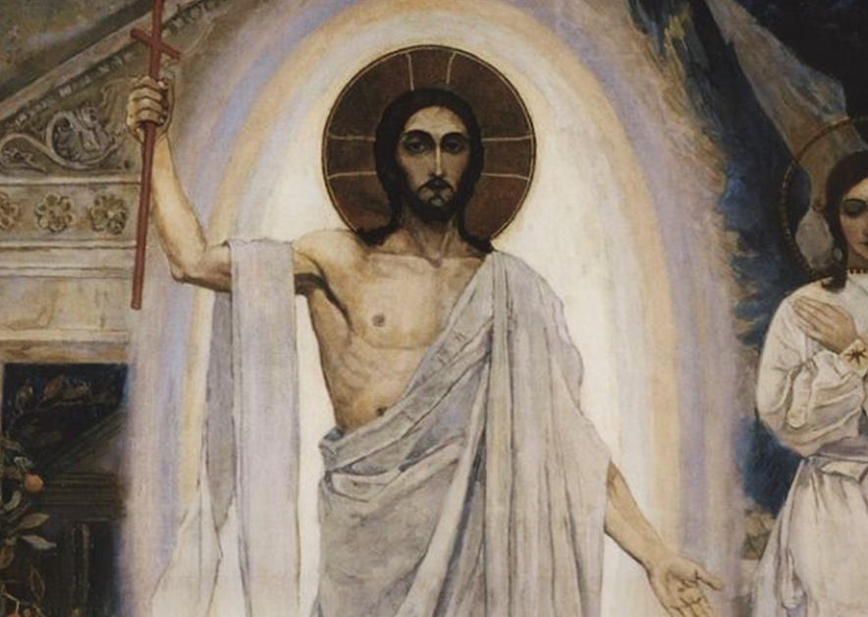
The Resurrection of Jesus—
Reasons for Believing

Slide 5
The Resurrection of Jesus—
Reasons for Believing
Reliability of the NT

Slide 6
The Resurrection of Jesus—
Reasons for Believing
Reliability of the NT
Testimony of Eyewitnesses

Slide 7
The Resurrection of Jesus—
Reasons for Believing
Reliability of the NT
Testimony of Eyewitnesses
Multiple Attestation

Slide 8
The Resurrection of Jesus—
Reasons for Believing
Reliability of the NT
Testimony of Eyewitnesses
Multiple Attestation
The Empty Tomb

Slide 9
The Resurrection of Jesus—
Reasons for Believing
Reliability of the NT
Testimony of Eyewitnesses
Multiple Attestation
The Empty Tomb
Resurrection Appearances

Slide 10
The Resurrection of Jesus—
Reasons for Believing
Reliability of the NT
Testimony of Eyewitnesses
Multiple Attestation
The Empty Tomb
Resurrection Appearances
Growth of the Early Church

Slide 11
The Resurrection of Jesus—
Reasons for Believing
Reliability of the NT
Testimony of Eyewitnesses
Multiple Attestation
The Empty Tomb
Resurrection Appearances
Growth of the Early Church
The Credibility of Miracles
Notes:
[BRIEF COMMENTS ON EACH POINT]
Reliability of the New Testament – Over 5,600 early Greek manuscripts; over 20,000 manuscripts in various languages. And there are no major differences in those manuscripts and the copies of the copies. No other ancient document compares! And yes the gospel writers want you to believe, but they are also recording historical events.
The Testimony of Many Eyewitnesses – As we saw earlier, we have well over 500 witnesses to the resurrection of Jesus; in 1 Cor 15:6, the Apostle Paul indicated that most of those folks were still alive at the time he wrote his epistle.
Multiple Attestation – This means that we don’t just have one history of the life, death, and resurrection of Jesus, we have 4 ancient biographies and the rest of the 23 books of the New Testament that all attest in some way to Jesus.
The Empty Tomb – Every classical or biblical scholar of this historical period (Christian & non-Christian) agrees that the tomb of Jesus was empty. But why was it empty? Justin Martyr recorded that people in the second century were still saying that someone stole the body. And just to drive home that the empty tomb is believed to be a historical fact, in the realm of historical Jesus studies, they have come up with all kinds of alternative theories for why the tomb was empty and people claimed to see Jesus alive (e.g. the swoon theory, group hallucination, Jesus had a twin brother, etc.).
Resurrection Appearances – Of all the claims that people saw the risen Jesus, there are two that stick out above the rest because they were not followers of Jesus until he appeared to them: James and Paul.
Growth of the Early Church – Renowned NT scholar N.T. Wright says that he knows nothing else that could explain the initial birth and rapid expansion of the early church, except that Jesus was really raised from the dead.
Wright states that there are two things “historically secure” about the first Easter: the empty tomb and the meeting with the resurrected Jesus. Nothing in Second-Temple Judaism would have produced such a radical claim that someone would be raised to life in the middle of human history. Wright says, “It is therefore historically highly probable that Jesus’ tomb was indeed empty on the third day after his execution, and that the disciples did indeed encounter him giving every appearance of being well and truly alive.”
And lastly… 7. The Credibility of Miracles – As Christians, we do not believe that faith goes against reason or science, but rather that faith goes beyond it. It really is about your worldview. Does your worldview allow for the unexplained and the supernatural, or not? For us, we believe that the God who created the universe revealed himself in Jesus of Nazareth and has no problem bending or transcending the laws of physics as we know them, which, after all, he created.
If you’d like to dig deeper into this one, NT scholar Craig Keener has written a two-volume work called, Miracles: The Credibility of the New Testament Accounts. Keener presents a monumental case for miraculous phenomena from late antiquity up to contemporary times. He even includes first-hand experience of miracles.
Finally, to wrap up these reasons for believing, listen to this very telling quote from Paula Fredriksen (a non-Christian historian of Boston University), who said this in an ABC tv interview many years ago. She said, “I know in their own terms what they saw was the raised Jesus. That’s what they say and then all the historic evidence we have afterwards attest to their conviction that that’s what they saw. I’m not saying that they really did see the raised Jesus. I wasn’t there. I don’t know what they saw. But I do know that as a historian that they must have seen something.”
Let’s now return to our main Scripture reading and walk through that verse-by-verse together. [NEXT SLIDE]

Slide 12
Acts 1:1-11 NIV
¹ In my former book, Theophilus, I wrote about all that Jesus began to do and to teach ² until the day he was taken up to heaven, after giving instructions
through the Holy Spirit to the apostles he had chosen. ³ After his suffering, he presented himself to them and gave many convincing proofs that he was alive. He appeared to them over a period of forty days and spoke about the kingdom of God.
Notes:
[BRIEF COMMENT ON EACH VERSE]
v. 1 – “former book” – “Theophilus” – “began to do and to teach”
v. 2 – “”taken up to heaven” – “after giving instructions” - “apostles”
v. 3 – “many convincing proofs” – “the kingdom of God”
Verse 4… [NEXT SLIDE]

Slide 13
⁴ On one occasion, while he was eating with them, he gave them this command: “Do not leave Jerusalem, but wait for the gift my Father promised, which you have heard me speak about. ⁵ For John baptized with water, but in a few days you will be baptized with the Holy Spirit.”
Notes:
[BRIEF COMMENT ON EACH VERSE]
v. 4 – “On one occasion” - Luke 24:49 records the risen Jesus in the locked room, giving them the command to stay in Jerusalem until they have been given power from above. Jesus had also promised them the Spirt before his death.
v. 5 – “baptized with the Holy Spirit”
Verse 6… [NEXT SLIDE]

Slide 14
⁶ Then they gathered around him and asked him, “Lord, are you at this time going to restore the kingdom to Israel?”
Notes:
v. 6 – Since the disciples hear Jesus talking about the coming of the Spirit, they are wondering, “Will this now be the time when Israel will get her national independence?”
Two things: (1) the disciples are still not getting it (i.e. the nature of the Kingdom and it being for all nations); and (2) they think the Kingdom will come all at once. They still haven’t understood the slow, patient work of the Spirit.
Verse 7… [NEXT SLIDE]

Slide 15
⁷ He said to them: “It is not for you to know the times or dates the Father has set by his own authority. ⁸ But you will receive power when the Holy Spirit comes on you; and you will be my witnesses in Jerusalem, and in all Judea and Samaria, and to the ends of the earth.”
Notes:
v. 7 - You’ll notice that Jesus doesn’t say “No” and chide them for continuing to get this wrong. But he instead tells them that the timing of God’s plans shouldn’t be their concern, and he will just let them experience the sort of power the Spirit brings 10 days later. And in verse 8 he corrects their nationalistic thinking.
v. 8 – “power” (dunamis – e.g. dynamite) - “witnesses” for him; and for Luke this becomes the geographical outline of the book of Acts (Jerusalem ch.1-7; Judea & Samaria ch.8-12; all boundaries to Rome ch.13-28)
This image can help us visualize what Jesus is saying: [NEXT SLIDE]

Slide 16
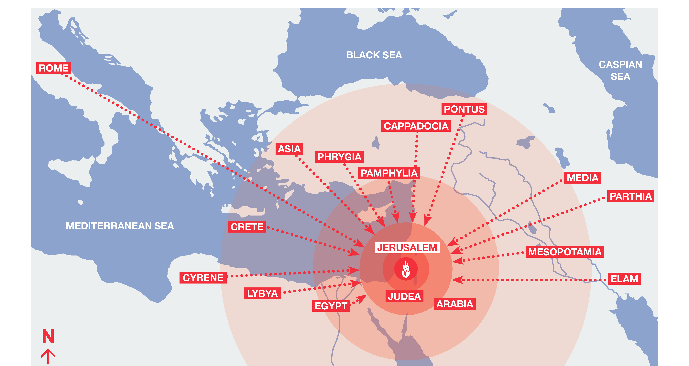
Notes:
[BRIEF COMMENT ON IMAGE]
And this is what Jesus had in mind when he gave what is known as “the Great Commission” in Matthew’s gospel.
What is the Great Commission?
In my study, I found this 2018 statistic from the Barna Group rather alarming:
[NEXT SLIDE]

Slide 17
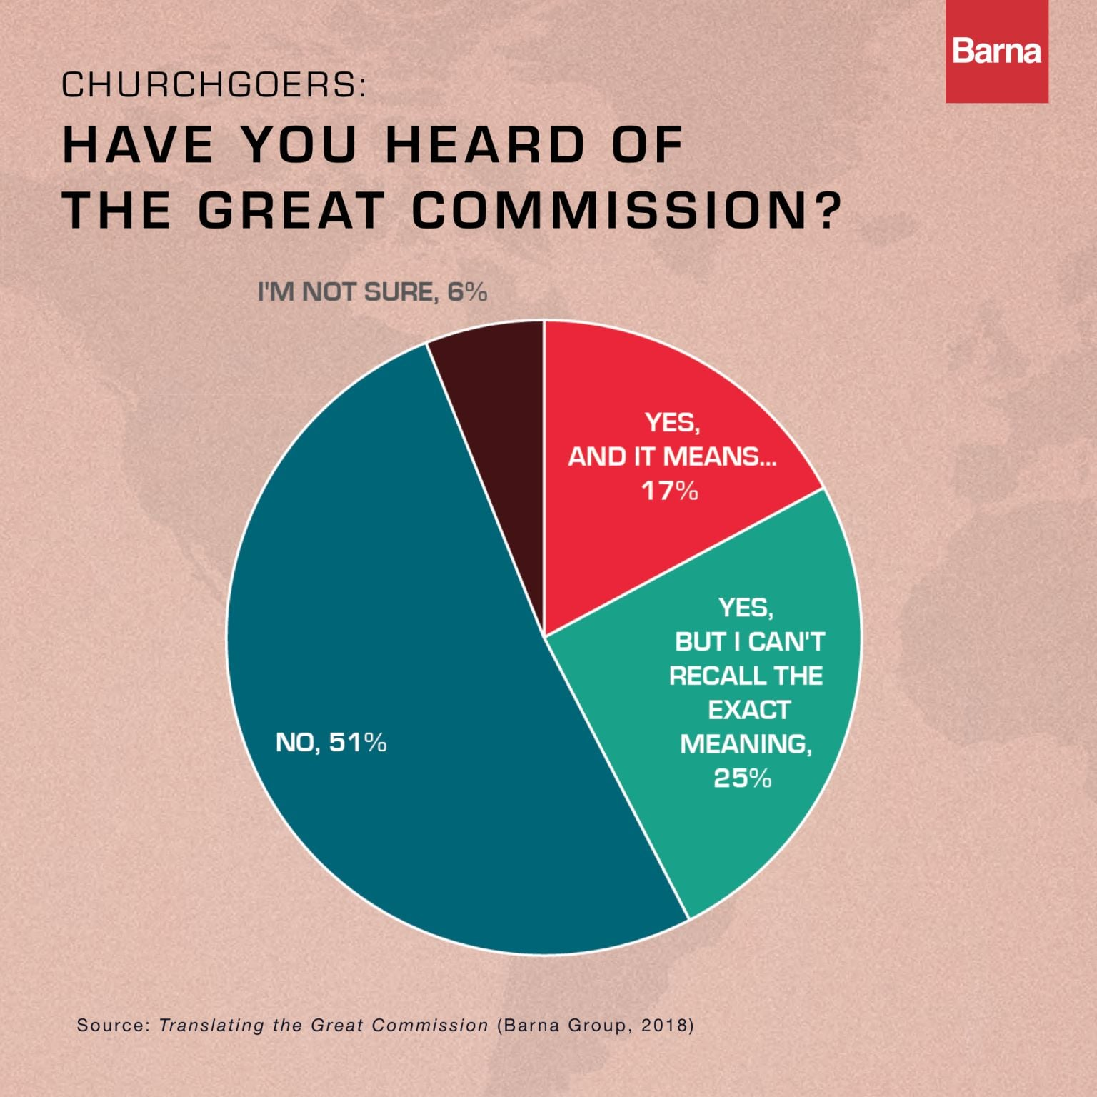
Notes:
[BRIEF COMMENT ON GRAPH]
What does this tell us? A few things: (1) churches in America don’t have the Great Commission at the heart of their mission (so it begs the question, “what is their mission?”); (2) it reveals that the church isn’t properly teaching and shaping disciples, or that people aren’t with the church enough to be spiritually formed; and (3) our post-Christian society is affecting our congregations.
And if this wasn’t convincing enough that we had a problem in 2018, the pandemic has certainly exposed our lack of depth and commitment to discipleship, as researchers and leaders predicted would happen (e.g. the perfect storm—politics, racism, and COVID—people have left for another church or for good!).
So, what is the Great Commission? It’s the last words of the risen Jesus given to his disciples, as recorded by Matthew. And it’s the last three verses of his gospel.
[NEXT SLIDE]

Slide 18
Matthew 28:18-20 NIV
¹⁸ Then Jesus came to them and said, “All authority in heaven and on earth has been given to me. ¹⁹ Therefore go and make disciples of all nations, baptizing them in the name of the Father and of the Son and of the Holy Spirit, ²⁰ and teaching them to obey everything I have commanded you. And surely I am with you always, to the very end of the age.”
Notes:
[READ ENTIRE PASSAGE]
v. 18 – “All authority” – why does Jesus have all authority? He was obedient unto death and God exalted him!
v. 19 – Matthew uses an aorist passive participle to begin the sentence, which literally reads: “Therefore, after you go, makes disciples of all nations.” Meaning, as you leave and go about your lives, be my witnesses and see to it that more disciples are made. And not just of Jews, not just of your tribe and people, but of all groups of people. Baptize them in the name of the God who is three in one and (verse 20) teach them to obey everything that Jesus taught.
And I can hear someone say this in our pluralistic, post-modern, politically correct culture:
“Now, wait a minute Jesus. You just mean those who are discontented with their life, right? I mean, surely you don’t mean you want us to make disciples of folks who are seemingly happy with their life, or with their inherited religion, or with their “spiritual-but-not religious” lives? I mean, c’mon, “go tell everyone, make everyone a disciple?” that sounds a bit presumptuous-–like your way is better or your way is the only way. Don’t you know how exclusive and intolerant that sounds today? And besides, who are we to tell others that they need the gospel? And who are you to make such a command of us?”
And Jesus says, “I am the Way, the Truth, and the Life. No one can come to the Father (can know God) apart from me.” Jesus says, “I am the resurrection and the life. He who believes in me will never die.” Jesus says, “For God so loved the world that he gave his one and only Son that whoever believes in him shall not perish but have eternal life.”
Jesus says, “Narrow is the road that leads to life (and only a few find it), but broad is the road that leads to destruction (and many enter through it).” Jesus says, “I am the Living One; I was dead, and now look, I am alive for ever and ever! And I hold the keys of death and hell.” Jesus says, “All authority in heaven and on earth has been given to me.” That is why he can give us the Great Commission and that is why it ought to be at the center of our lives and the mission of the church—to become like Jesus and do the things that Jesus did.
This is the call of Christ on all of our lives. To be a disciple, and to make disciples who make disciples. Friends, if we’re not doing that in some shape or form, if we’re not living into that in whatever job we have and whatever we’re doing with our life, then we’re no different than the 51% who don’t have a clue what the Great Commission is because practically and functionally, we might as well be ignorant of the Lord’s last words.
Back to Acts 1, verse 9… [NEXT SLIDE]

Slide 19
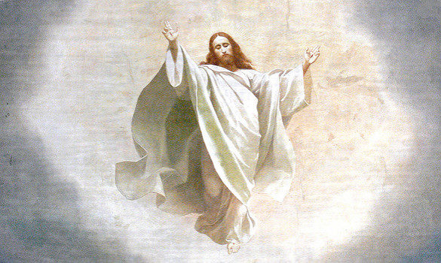
⁹ After he said this, he was taken up before their very eyes, and a cloud hid him from their sight.
Notes:
v. 9 – “taken up” and a “cloud hid him” What’s this about? – cloud of God’s glory and enthronement; Jesus disappears into heaven—where is that exactly?—well, it’s another dimension!
This makes me think of “String Theory”—which is a scientific theory that seeks to unite quantum mechanics and gravity and so unify all of physics into one glorious theory, i.e. a so-called ”theory for everything.” Some physicists would say that since there isn’t enough room in three dimensions (which we live in) to put all the laws of physics (to make sense of everything), that there appears to be so much more going on in the universe, therefore there must be multiple dimensions (up to 10-11) that we don’t see and can’t currently access, but they’re there and just as real as the first three.
And actually, this is fitting with ancient Hebraic concept of the interlocking nature of heaven and earth. And it’s consistent with what has happened with the resurrected body of Jesus-–heaven and earth (multiple dimensions) coming together in Christ.
Verse 10… [NEXT SLIDE]

Slide 20
¹⁰ They were looking intently up into the sky as he was going, when suddenly two men dressed in white stood beside them. ¹¹ “Men of Galilee,” they said, “why do you stand here looking into the sky? This same Jesus, who has been taken from you into heaven, will come back in the same way you have seen him go into heaven.”
Notes:
v. 10 – “looking intently into the sky” – stunned, pondering, maybe confused, etc.; they experience what is called a theophany, and maybe they thought that Jesus would reappear like the transfiguration. But he doesn’t. Obviously, the disciples don’t quite get it yet.
What is happening here? What’s this all about? What does it mean? Church, Jesus is ascending to the Oval office of the universe (to sit at the “right hand of the Father”), so that the Spirit can descend and be his presence and power magnified; so that Jesus can reign and rule through his Easter people.
Therefore, the ascension is not the absence of the presence of Christ, it will be the increased and heightened presence of Christ. It’s not the loss of his leadership, intimacy, provision, and protection, it is the magnification of it. Jesus ascended, which means we have a job to do—to be witnesses of the gospel for the glory of his Kingdom, testifying to our own Easter encounters, and to make disciples who make disciples; baptizing, teaching, and showing folks how to follow Jesus.
And finally, verse 11, listen to what the angels say… [Read Verse 11]
v. 11 – In other words, don’t just stand there. For whatever reason they were gazing, Luke may be saying to us, don’t just stand there, get going. Get on with it. There is more to come. He might also say that it’s not time to grieve your loss anymore, or look back and be sad, or be stuck in the past. The Lord is moving on. And it’s time for you to move on and get ready for the next thing God is planning through the giving of the Holy Spirit.
And be encouraged, the angels told them (and they say to us), for Christ will return at some point in the future to bring the fullness of the Kingdom and bring heaven and earth together once and for all. Which is why we confess together, ”Christ has died, Christ is risen, and Christ will come again.”
As we bring this message and our series to a close…. [NEXT SLIDE]

Slide 21

Notes:
I want to ask you the two questions I frequently ask of Grantham Church:
What is God saying to you? and What are you going to do about it?
INVITATION
Is the risen Jesus and his Great Commission at the center of your life?
Are you living like Christ has ascended and sits at the right hand of the Father?
How will you respond to these Easter encounters?
And how is the Lord inviting you to have a fresh encounter with him?
Maybe it’s time for new beginning. Maybe it’s time to believe again.
CLOSING PRAYER
Father, it is a holy and pleasing thing to you that we are all together, in person and in spirit, encouraging and consoling, provoking and inspiring, and edifying one another. And while we are not all physically together as a congregation, we want to still be about your Kingdom work and not grow comfortable being apart. So, help us to be intentional about discipleship and furthering your mission in a world that’s in need of healing and renewal.
And Lord as we continue to navigate our way through what seems to be the end of the pandemic, help us hear the words of the angels to the disciples staring into the sky: “Why do you stand there looking up toward heaven?” Oh, Jesus, we know what you’ve called us to do. Forgive us for making excuses and putting off what is eternal and will last forever, so that you can then empower us to live as your disciples and make disciples who follow you. For we know that while you went up to heaven, your Spirit came down to us to help us. You have not left us alone, nor are we lacking in purpose and hope. Therefore, bless us now as we wait, pray, and act on what you’ve called us to do.
In the name of the Father, the Son, and the Holy Spirit we pray, Amen.

