Slide 1
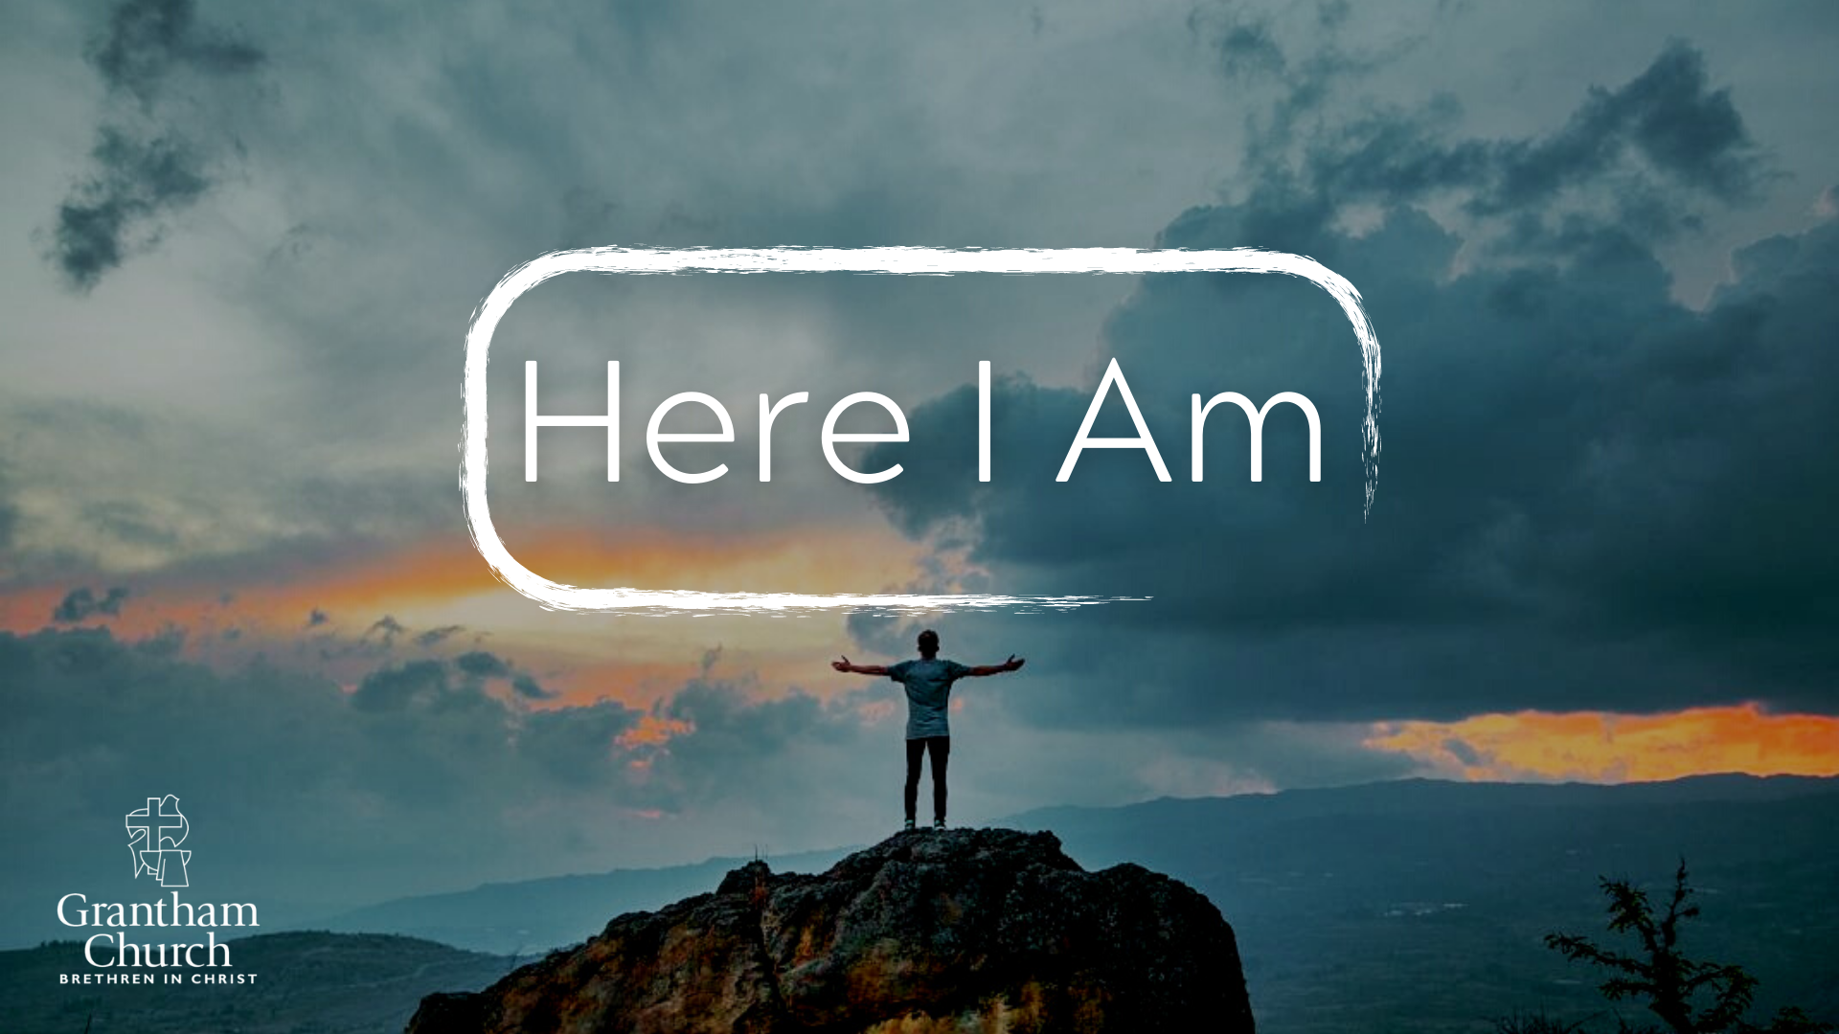
Notes:
[BRIEF INTRO]
Greetings
Please take your Bible and turn to… [NEXT SLIDE]

Slide 2
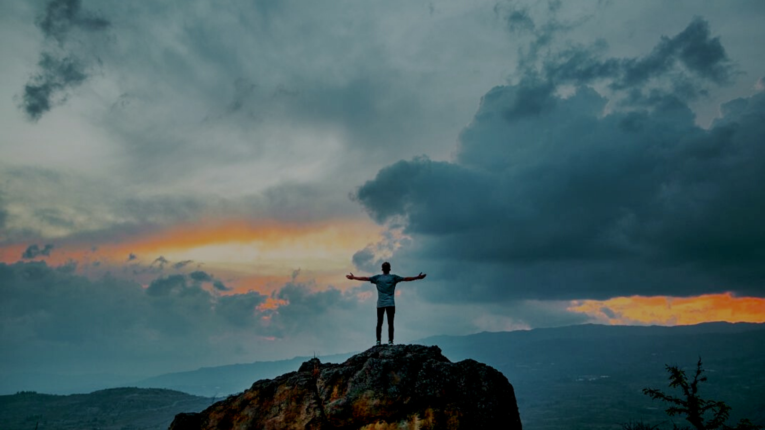
Scripture Reading
Isaiah 6:1-8 NLT
Notes:
[INVITATION TO STAND FOR SCRIPTURE READING]
[READ ISAIAH 6:1-8 NLT]
This is the word of the Lord. Thanks be to God
You may be seated. [NEXT SLIDE]

Slide 3
Notes:
[BRIEF COMMENTS]
If I said the word “submit” or “submission”… what feelings bubble up within you?
Negative associations and connotations
However, it’s a biblical concept (e.g., children are to submit and obey their parents, we’re called to submit and obey governing authorities, to submit to the elders of the church, husbands and wives are to submit to one another, and of course, we’re told to submit to God)
Submit – to come and under; to yield instead of resist
Due to misuse and abuse, we tend to ignore or disregard the concept – react to extremes
Also, let’s he honest: submission and surrender isn’t very American
A perfect picture of this can be seen with the character… [NEXT SLIDE]

Slide 4
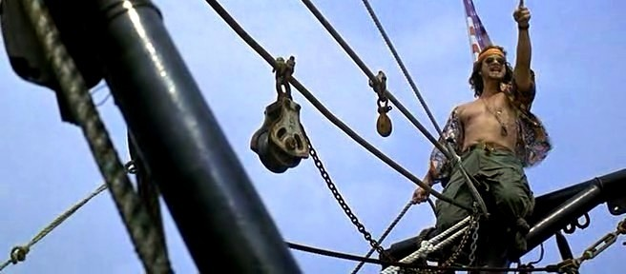
Lieutenant Dan from Forrest Gump (1994)
Notes:
[BRIEF COMMENTS]
The storm comes and Lt. Dan screams at God in defiance, fueled by all his pent-up anger “It’s time for a showdown! You and me!”
Obviously, Lt. Dan is not a picture of humble submission to God in the storms and challenges of life
Note: this sort of arrogance, lack of humility, failure to reflect on one’s own sinfulness, refusal to yield to a higher power with infinite wisdom, not only exacerbates our pain, but it also cuts us off from experiencing the true love, majesty, and holiness of God that changes us for the better
You can probably think of a few biblical characters like this… [NEXT SLIDE]

Slide 5
Notes:
[BRIEF COMMENTS] – Biblical figures who were reluctant or flat-out didn’t say ”yes” and submit to God—to his will, wisdom, and ways.
For example, people like Cain, Esau, King Saul, Jonah, the rich young ruler, and Judas)
But the prophet Isaiah, like many other men and women in the Bible, said yes to the Lord. And we should recognize that he did this in a time of impending doom, as the wicked Assyrian empire was bearing down on the northern kingdom of Israel (sure to move on to Judah after that), who had all given themselves over to idolatry and oppression.
And so, Yahweh needed someone to call them to repentance, to speak the truth of the coming judgment, but also to share the hope that God would one day restore Jerusalem and fulfill his covenant promises. That’s the reason for God revealing himself to Isaiah in the Temple and the context of Isaiah 6, verse 8. [NEXT SLIDE]

Slide 6
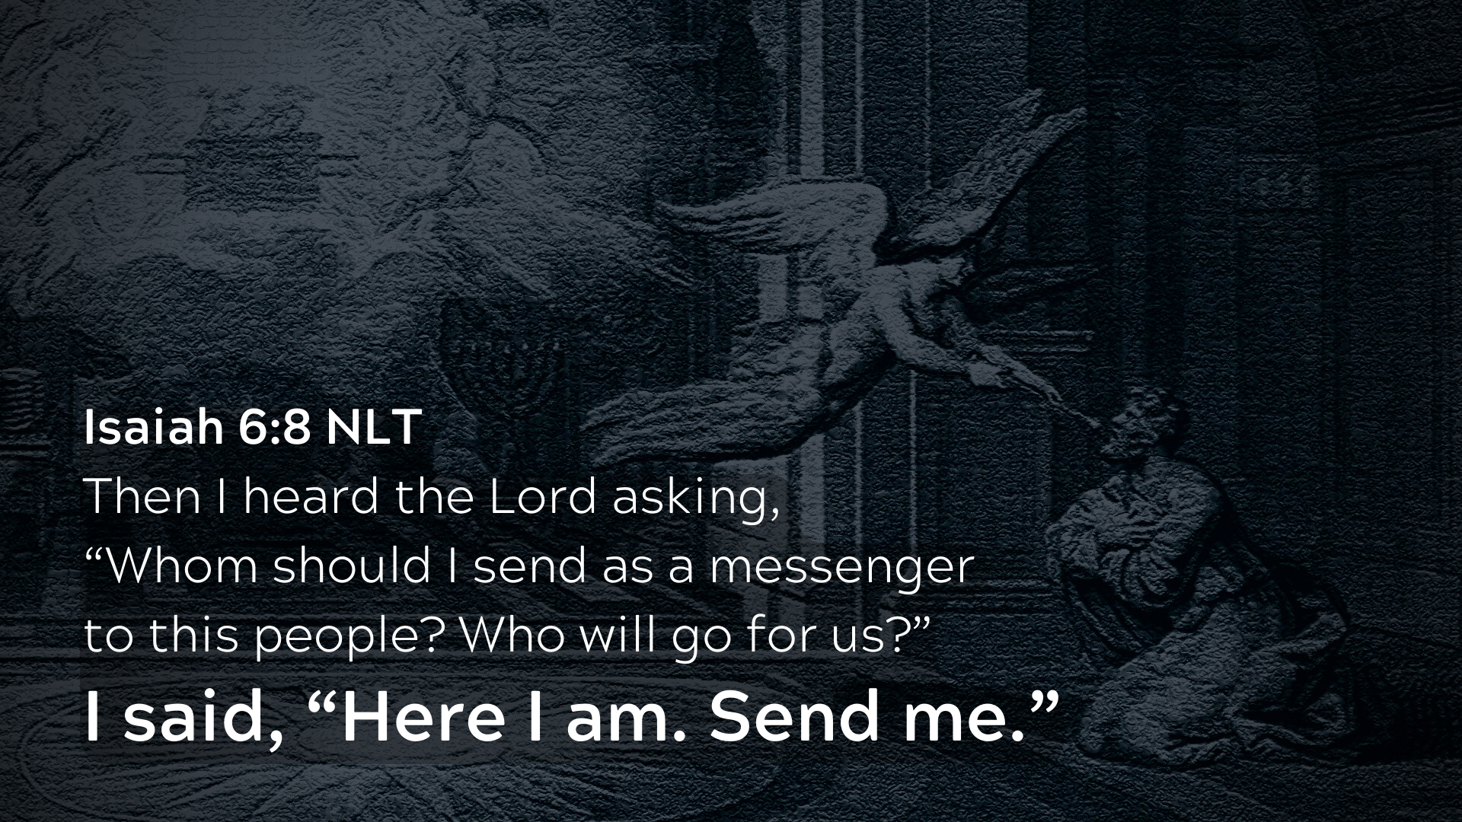
Notes:
[BRIEF COMMENTS]
Notice, Isaiah’s experience of God’s holiness awakens him to his own sin and the sins of his people
The angelic messenger cleanses and anoints Isaiah’s mouth – as represented by the burning coal
Thus, Isaiah is set apart to do a God-sized task among a rebellious, hard-hearted, faithless people in a dark time
[READ ISAIAH 6:8 & COMMENT]
Of course, Isaiah wasn’t the first to utter the words, “Here I am.” [NEXT SLIDE]

Slide 7
Biblical characters who said, “Here I Am”
Abraham (Genesis 22:1, 11)
Jacob (Genesis 31:11; 46:2)
Moses (Exodus 3:4)
Samuel (1 Samuel 3:4)
David (Psalm 40:6-8)
Isaiah (Isaiah 6:8)
Ananias (Acts 9:10)
Notes:
[BRIEF COMMENT ON EACH]
Abraham – twice when he is tested in Genesis 22
Jacob – once in a dream when he was young and then in a vision late in life
Moses – his response to God at the burning bush
Samuel – his child-like response to God before he even understood prayer
David – “Here I am… I desire to do your will.”
Isaiah – his response to God’s holiness, his own sin, and God’s calling on his life
Ananias – his immediate submissive reply to the Lord’s voice
And while he never actually used the phrase, “Here I am”… Jesus perfectly revealed a submissive and surrendered heart, believing that his Father would deliver him from death and ultimately vindicate him. We heard these words last week from Matthew 26:42… NEXT SLIDE]

Slide 8
““My Father, if it is not possible for this cup to be taken away unless I drink it, may your will be done.”
Matthew 26:42 NIV
Notes:
[BRIEF COMMENT ON PASSAGE]
And the apostle Paul wanted the Philippian Christians to seriously consider the example of Jesus’ own surrender…
[NEXT SLIDE]

Slide 9
Paul, Philippians 2:5-11 NLT
⁵ You must have the same attitude that Christ Jesus had.
⁶ Though he was God, he did not think of equality with God as something to cling to. ⁷ Instead, he gave up his divine privileges; he took the humble position of a slave and was born as a human being.
Notes:
[READ & COMMENT ON PASSAGE]
Verse 7 continues… [NEXT SLIDE]

Slide 10
When he appeared in human form, ⁸ he humbled himself in obedience to God and died a criminal’s death on a cross.
⁹ Therefore, God elevated him to the place of highest honor and gave him the name above all other names, ¹⁰ that at the name of Jesus every knee should bow, in heaven and on earth and under the earth, ¹¹ and every tongue declare that Jesus Christ is Lord, to the glory of God the Father.
Notes:
[BRIEF COMMENT ON PASSAGE]
The Kingdom of God is upside down to the world. Think about it. The first shall be last, the last first. God uses the weak to put those who think they are strong in their place. He wins by dying, not killing. Jesus comes to us and reveals God not as conquering king on a warhorse, but a condemned criminal on a cross. And so it’s in keeping with his Kingdom that he would raise up those who humble themselves and submit their lives to his loving care; that he would reveal himself and bless those who follow on his footsteps and adopt his attitude.
My friends, God’s ways are higher and better: (1) because the Lord knows every possible future as if it were a certainty; he can see things that we can’t see; and (2) he is motivated purely and solely out of love for us; to give us his very best and help us to deepen our faith within a broken world.
That is why we must heed the wisdom being communicated in Proverbs… [NEXT SLIDE]

Slide 11
Trust in the Lord with all your heart and lean not on your own understanding; in all your ways submit to him, and he will make your paths straight.
Proverbs 3:5-6 NIV
Notes:
IT’S TIME FOR THE CHURCH TO SUBMIT AND SURRENDER TO GOD…
No more trusting in our own intellect and education; it’s time to humble ourselves; no more putting our faith in horses and chariots, trusting in parties and politicians with their extreme ideologies, or doing whatever makes the most economic sense without any concern for what God wants and how he can provide; no more playing it safe; rather, it’s time to acknowledge that God can provide everything we need if we will ask, trust him, and seek to live holy lives as carriers of the gospel
And with that sort of faith in God, it’s time to look around, see the needs that exist, and say “Here I Am” (e.g., where there is anger in our homes, schools, and workplace; where there is inequity and injustice in the marketplace; where there is broken relationships and marriages; where there is a young person who doesn’t want to waste their life; where there is an elderly widow who thinks they have nothing left to give; where there is addiction and hopelessness; fear-mongering and name-calling; where there is greed, consumerism, and exploitation of creation; where there is war and rumors of war; where there is domestic abuse and violence; where there is sexual immorality and idolatry; and where there is an untapped well of potential Kingdom impact, let us say, ”Here I Am"
Church, it’s time for us to hear the God say, ”Who will go for us?” And we reply with, “Here I am, Lord. Send me.”
Finally, here are some questions to help us reflect and respond to God this morning... [NEXT SLIDE]

Slide 12

Questions for reflection and response:

Slide 13
Questions for reflection and response:
What challenges are you experiencing right now? Are you being intentional with letting God meet you in them and speak to you?

Slide 14
Questions for reflection and response:
What challenges are you experiencing right now? Are you being intentional with letting God meet you in them and speak to you?
How do you need to humble yourself before God? What would it look like for you to submit and surrender to him in your situation or calling?

Slide 15
Questions for reflection and response:
What challenges are you experiencing right now? Are you being intentional with letting God meet you in them and speak to you?
How do you need to humble yourself before God? What would it look like for you to submit and surrender to him in your situation or calling?
Despite your fears, the risks, and costs… will you say, “Here I Am, Lord”?
Notes:
[BRIEF COMMENT ON EACH]
In bringing this message to a close, and to help us respond as humble disciples of Jesus, I’d like us to close with an embodied prayer and a moment of silence… [NEXT SLIDE]

Slide 16
Notes:
[INVITE CONGREGATION TO STAND FOR PRAYER]
[READ PRAYER]
[CLOSE WITH MOMENT OF SILENCE]

