Slide 1

Notes:
Has God ever revealed to you something about his will for your life, but it came to pass in a way that was totally unexpected? Have you ever felt like you were being treated unfairly (even violently) by others, or by your circumstances in life, when all you were trying to do was trust in God, live for him, and do what was right? What do we do when that happens? How should we respond?
That’s what I’d like us to give attention to today in the second installment of our Advent 2020 series, Unexpected: Waiting on God When Our Plans Fall Apart. In this 4-part series, we’re looking at biblical characters who experienced God through unexpected events—biblical characters whose ideas about God and their plans for the future were challenged and disrupted, yet they were surprised by God’s faithfulness, mercy, and love after a period of waiting on him.
Last week we kicked off our series with Abraham and Sarah—way back where the redemptive narrative began. And through their story, we saw how God meets us where we are and blesses our messy lives. We said that God isn’t looking for perfect people, but faithful people—people who want to grow in their trust and reliance upon him and experience the blessings of heaven, despite how many times we fail. Because, as we’ll continue to see in this series, we will never mature in our faith and be used by God if we don’t learn to let him use our circumstances to grow us.
And today’s biblical character knows all about that. For this guy went from being daddy’s favorite to being left for dead in a pit by his brothers, only then to be sold into slavery, falsely accused, and then thrown into prison for something he didn’t do… all before God would elevate him to Pharaoh's palace and he see his dreams fulfilled and his life vindicated. Who was this person? It was Joseph, the 11th son of Jacob, and the grandson of Isaac, who we were introduced to last week.
So, let’s jump into Joseph’s life starting in Genesis 37, and see what his story can teach us about God, ourselves, and how we too can live by faith, and how we should apply the message to our lives. Genesis 37, beginning with verse 3 and 4. [NEXT SLIDE]

Slide 2
Genesis 37:3-4 NIV
³ Now Israel loved Joseph more than any of his other sons, because he had been born to him in his old age; and he made an ornate robe* for him. ⁴ When his brothers saw that their father loved him more than any of them, they hated him and could not speak a kind word to him.
* ornate robe – multicolored tunic (NASB); a coat of many colors (KJV); a long robe with sleeves (NRSV); a “dress coat”
Notes:
[BRIEF COMMENT ABOUT PASSAGE]
Why did Jacob (Israel) love Joseph more? – his mother was Rachel
Why the special coat? – a sign of his favor
Jacob’s favoritism wasn’t the only reason why Joseph’s brothers hated him. Let’s pick back up with verse 5. [NEXT SLIDE]

Slide 3
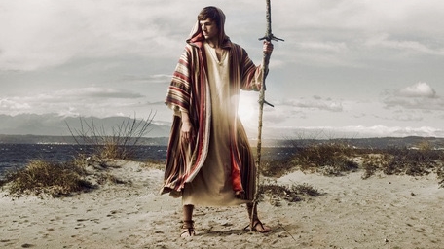
Notes:
[NEXT SLIDE]

Slide 4
Genesis 37:5-11 NIV
⁵ Joseph had a dream, and when he told it to his brothers, they hated him all the more. ⁶ He said to them, “Listen to this dream I had: ⁷ We were binding sheaves of grain out in the field when suddenly my sheaf rose and stood upright, while your sheaves gathered around mine and bowed down to it.” ⁸ His brothers said to him, “Do you intend to reign over us? Will you actually rule us?” And they hated him all the more because of his dream and what he had said.
Notes:
Joseph’s mistake wasn’t that he had the dream. It was that this 17-year-old dared to share his dream that indicated he would one day rule over his brothers. Now, dreams in the Ancient Near East are one way that people hear from their gods. And in this case, Joseph believes the one true God has used this same method of communication and is trying to tell him something about his future.
But in his youth, he naively thinks that his brothers will be just as excited to hear about his dream as he was to have it. And I suspect that his brothers are thinking that Joseph’s so-called dreams are merely the result of dad’s favoritism gone to his head.
And the dreams don’t stop there. Verse 9. [NEXT SLIDE]

Slide 5
⁹ Then he had another dream, and he told it to his brothers. “Listen,” he said, “I had another dream, and this time the sun and moon and eleven stars were bowing down to me.”¹⁰ When he told his father as well as his brothers, his father rebuked him and said, “What is this dream you had? Will your mother and I and your brothers actually come and bow down to the ground before you?” ¹¹ His brothers were jealous of him, but his father kept the matter in mind.
Notes:
[BRIEF COMMENT ON PASSAGE]
Joseph’s dream will come true, but not as he expected. And he will have to wait a long time before he sees their fulfillment.
A few verses later, the Bible tells us that one day Joseph is going out to meet his brothers who are shepherding in the fields:
¹⁸ They saw him from a distance, and before he came near to them, they conspired to kill him. ¹⁹ They said to one another, “Here comes this dreamer. ²⁰ Come now, let us kill him and throw him into one of the pits; then we shall say that a wild animal has devoured him, and we shall see what will become of his dreams.”
They decide to strip Joseph of his ornate robe and throw him in a cistern. But two of his brothers want mercy for Joseph. And one of them (Judah) suggests that they sell him to a caravan of Ishmaelites who are on their way to trade in Egypt. [NEXT SLIDE]

Slide 6
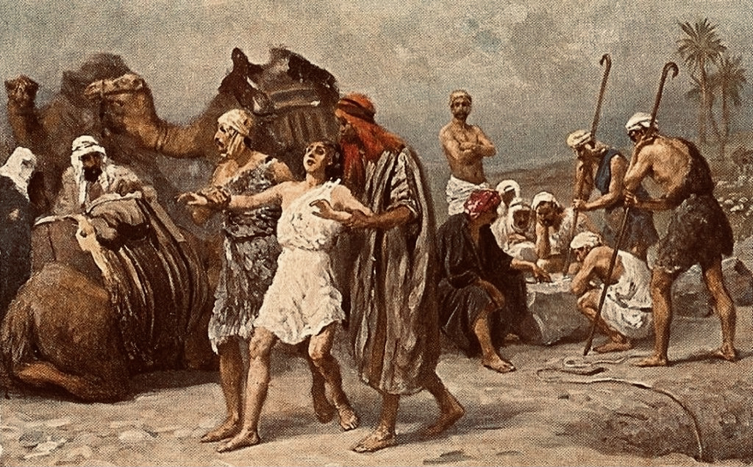
Notes:
And that’s exactly what they do. Joseph’s brothers sell him for 20 shekels of silver, dip his robe in goat’s blood, and then tell their father Jacob that Joseph had been devoured by a wild animal. Jacob was devastated and said he would mourn Joseph until he died.
This is the first of three major injustices in Joseph’s life.
Then were told in Genesis chapter 39 that the Midianite merchants go down to Egypt and sell Joseph to Potiphar, one of Pharaoh’s officials, the captain of the guard. Despite this terrible turn of events in Joseph’s life—his own brothers selling him into slavery and now separated from his parents, the only people who really love him—the text says that “the LORD was with Joseph so he prospered” as he lived in the house of his Egyptian master. Potiphar takes notice of Joseph’s character and skills, and so he puts him in charge of his entire household and all that he owned. And Potiphar noticed how blessed he was because the blessing of Joseph’s God was on him. Things were looking up.
That is until Potiphar’s wife took an interest in Joseph, who we’re told was well-built and good-looking. You’re likely familiar with this part of the story. [NEXT SLIDE]

Slide 7
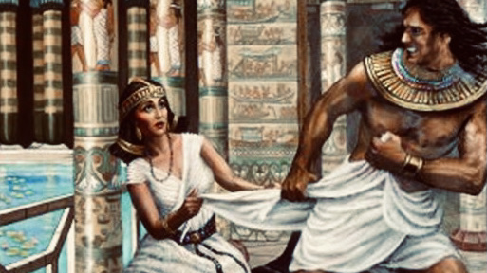
Notes:
Potiphar’s wife eventually tries to get Joseph to sleep with her. He refuses. She grasps ahold of his garment and Joseph flees, leaving his clothes behind. She then accuses him of attempting to take advantage of her and convinces her husband of her lie. Who doesn’t want to believe and take sides with their wife, right? So, she demands something be done. Potiphar is furious and then throws Joseph into prison.
²⁰ And Joseph’s master took him and put him into the prison, the place where the king’s prisoners were confined; he remained there in prison.
This was the second great injustice in Joseph’s life.
²¹ But the Lord was with Joseph and showed him steadfast love; he gave him favor in the sight of the chief jailer. ²² The chief jailer committed to Joseph’s care all the prisoners who were in the prison, and whatever was done there, he was the one who did it. ²³ The chief jailer paid no heed to anything that was in Joseph’s care, because the Lord was with him; and whatever he did, the Lord made it prosper.
Don’t miss this, folks. Whatever his situation, Joseph seeks to be a person of integrity and the best at whatever he is doing, whatever position he is put in. He doesn’t blame and complain, and as we will see, he makes no effort to defend himself, nor does he try and get even. I have to believe that’s why the Lord continues to make him prosper. It’s certainly not that Joseph didn’t have his own internal struggles—it’s safe to say he did—but he is self-controlled and trusting in God to give him justice, but in his time and in his way. [NEXT SLIDE]

Slide 8
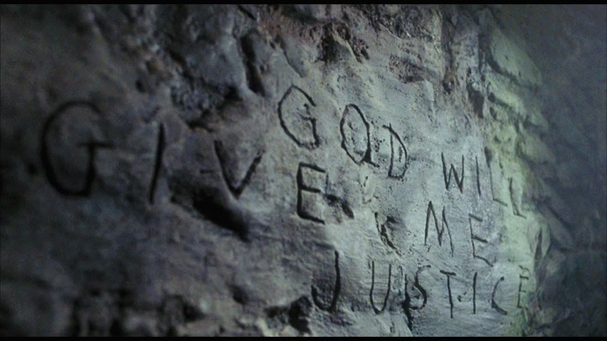
Notes:
That reminds me of the Count of Monte Cristo when Edmund Dantes is wrongly accused and sent to prison. And Instead of trusting in God to sort it out, Edmund sits, stews in bitterness, and plots his revenge after his escape from prison. This is what he has in mind when he runs a sharp rock over the stone walls of his cell, God Will Give Me Justice. But we see no evidence of this in Joseph’s speech or behavior.
Then some time later, we’re told in chapter 40, that two of Pharaoh’s staff were thrown into prison with Joseph—a cupbearer and a baker. We’re not told what they did to end up in prison with Joseph. Whatever it was, Pharaoh jailed these guys until he could figure out what to do with them. And Joseph sees these men the next morning. They seem unusually vexed. He asks why they are so sad.
Notice that Joseph isn't self-absorbed and consumed with his own problems. We know this because he sees the disturbed countenance of his fellow prisoners and cares enough to ask what’s wrong. They then tell him about dreams they both had the night before, but they don’t know what they mean. Joseph tells them that only God can interpret their dreams and asks them to tell him. Interesting. You’d think that Joseph would be done with dreams by now. Afterall, look where his dreams have gotten him. It appears that Joseph hasn’t let go of his own.
And so the cupbearer (who was like a secret service agent responsible for serving drinks at the royal table and making sure the king was protected from assassination attempts), tells Joseph his dream first. Joseph interprets the dream to mean that the cupbearer will be welcomed back into Pharaoh’s court—a favorable interpretation. Cheers the cupbearer right up. And after sharing his interpretation, Joseph immediately says… [NEXT SLIDE]

Slide 9
Genesis 40:14-15 NIV
¹⁴ But when all goes well with you, remember me and show me kindness; mention me to Pharaoh and get me out of this prison. ¹⁵ I was forcibly carried off from the land of the Hebrews, and even here I have done nothing to deserve being put in a dungeon.”
Notes:
Joseph is saying, please put in a good word for me. Tell Pharaoh about me, what I’ve done, and about my innocence. Tell him about the way I ended up in a foreign land and how it’s not fair and just that I’m in this place.
But did the cupbearer bring this to Pharaoh’s attention when he was released three days later? No, unfortunately, he did not.
This is the third major injustice in Joseph’s life, as Joseph would spend the next two years in the king’s prison. [NEXT SLIDE]

Slide 10
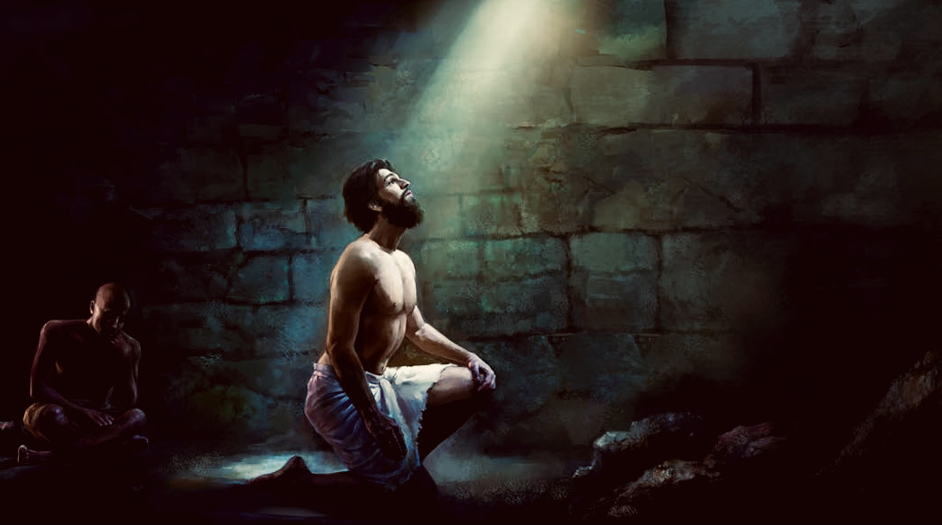
Notes:
Imagine how Joseph must have felt. Imagine the thoughts he must have wrestled with in his isolation. What did I do to deserve this? What about my dreams? I have only tried to do my best to be and do what God expects of me. I’m by no means perfect (so I shouldn’t have told my brothers about those dreams – I said too much), but how is it fair for me to suffer in this way? My best efforts have led to this? Is this my lot in life? And I imagine, like Jesus in the wilderness, thoughts sent from the Tempter entered Joseph’s mind.
But from what we can tell, Joseph resisted his base impulses and rejected the pathway of anger and a desire to get back at those who wronged him. Joseph chose not to become bitter and he didn’t quit. Instead, he actively waited on God in faith. He believed that God works in the darkness—that even after everything that had happened to him, and all of his plans had fallen apart, Joseph clung to his dreams and the belief in a God who is good and keeps his promises.
And then it happened. Finally, after two long years of waiting. Pharaoh has a dream that no one in his house could interpret. And when those closest to the king couldn’t help him, they begin to worry and fear for their own lives. Remember the cupbearer? In what would appear to be a last-ditch effort to save his own life, the cupbearer just so happens to remember how Joseph had interpreted his dream.
Genesis 41:14-16
¹⁴ Then Pharaoh sent for Joseph, and he was hurriedly brought out of the dungeon. When he had shaved himself and changed his clothes, he came in before Pharaoh. ¹⁵ And Pharaoh said to Joseph, “I have had a dream, and there is no one who can interpret it. I have heard it said of you that when you hear a dream you can interpret it.” ¹⁶ Joseph answered Pharaoh, “It is not I; God will give Pharaoh a favorable answer.”
Joseph interprets his dream to mean there will be 7 years of plenty before 7 years of famine. He tells the Pharaoh that he must prepare for the hard times that are coming, and that if he will do that, his people will survive.
³⁹ So Pharaoh said to Joseph, “Since God has shown you all this, there is no one so discerning and wise as you. ⁴⁰ You shall be over my house, and all my people shall order themselves as you command; only with regard to the throne will I be greater than you.” ⁴¹ And Pharaoh said to Joseph, “See, I have set you over all the land of Egypt.” ⁴² Removing his signet ring from his hand, Pharaoh put it on Joseph’s hand; he arrayed him in garments of fine linen, and put a gold chain around his neck. ⁴³ He had him ride in the chariot of his second-in-command; and they cried out in front of him, “Bow the knee!”
Joseph was 30 years old when he became Pharaoh’s grand vizier (va-zeer), the second most powerful man in Egypt. [NEXT SLIDE]

Slide 11
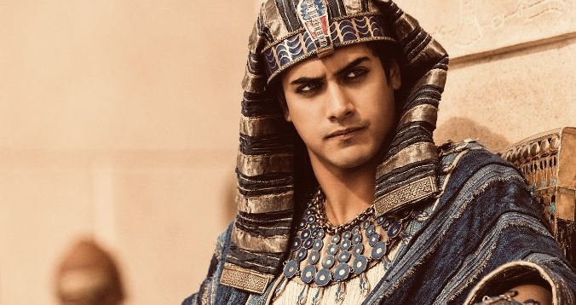
Notes:
And the Lord blessed Joseph and word not only spread of his rise, but also of the God who made it so. Over the next seven years, Joseph prepared Egypt and surrounding lands for the famine that was coming. And after those seven years were up, the famine came, just as God had revealed to him through Pharaoh’s dream. And the Bible says that he then opened up the storehouses and the whole world came to Joseph to buy grain. And that means that Joseph’s family also came, for the famine had reached the land of Canaan.
[NEXT SLIDE]

Slide 12
Genesis 42:3-6 NIV
³ Then ten of Joseph’s brothers went down to buy grain from Egypt. ⁴ But Jacob did not send Benjamin, Joseph’s brother, with the others, because he was afraid that harm might come to him. ⁵ So Israel’s sons were among those who went to buy grain, for there was famine in the land of Canaan also.⁶ Now Joseph was the governor of the land, the person who sold grain to all its people. So, when Joseph’s brothers arrived, they bowed down to him with their faces to the ground.
Notes:
Joseph’s dream (his vision from God) had come true. The stars are bowing down, but his brothers don’t recognize Joseph. And if you go on to read Genesis chapter 42-44, Joseph tests his brothers. First, he questions them, acting as if they are spies. They tell him about their family and where they are from. Joseph wants to know where their youngest brother is, and so he tells them to go get him. In his mind, he’s of course thinking of himself. Would they confess to what they had done to Joseph when he was only 17? Had they felt any remorse? Had they repented of their sins? Had they changed? Joseph must have wondered.
But instead, they say our youngest is still at home. Joseph thinks they must be lying, but he doesn’t know that he has a younger brother, born after Joseph had been sold into slavery; born by his own mother, Rachel, who had unfortunately died when giving birth to Benjamin. After some back and forth, and more testing, the brothers eventually retrieve Benjamin and bring him to Joseph. This is where Joseph finally begins to emotionally unravel and break down, revealing his true identity. [NEXT SLIDE]

Slide 13
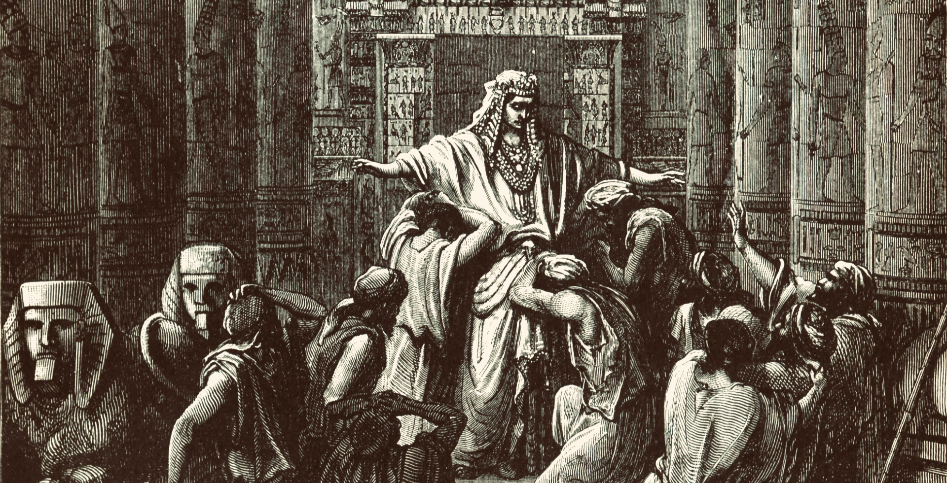
Notes:
Genesis 45:1-11
¹ Then Joseph could no longer control himself before all his attendants, and he cried out, “Have everyone leave my presence!” So there was no one with Joseph when he made himself known to his brothers. ² And he wept so loudly that the Egyptians heard him, and Pharaoh’s household heard about it.³ Joseph said to his brothers, “I am Joseph! Is my father still living?” But his brothers were not able to answer him, because they were terrified at his presence.
⁴ Then Joseph said to his brothers, “Come close to me.” When they had done so, he said, “I am your brother Joseph, the one you sold into Egypt! ⁵ And now, do not be distressed and do not be angry with yourselves for selling me here, because it was to save lives that God sent me ahead of you. ⁶ For two years now there has been famine in the land, and for the next five years there will be no plowing and reaping. ⁷ But God sent me ahead of you to preserve for you a remnant on earth and to save your lives by a great deliverance.
⁸ “So then, it was not you who sent me here, but God. He made me father to Pharaoh, lord of his entire household and ruler of all Egypt. ⁹ Now hurry back to my father and say to him, ‘This is what your son Joseph says: God has made me lord of all Egypt. Come down to me; don’t delay. ¹⁰ You shall live in the region of Goshen and be near me—you, your children and grandchildren, your flocks and herds, and all you have. ¹¹ I will provide for you there, because five years of famine are still to come. Otherwise, you and your household and all who belong to you will become destitute.’
What a moving story of dreams, injustice, of forgiveness, and of God’s sovereignty—a story that reveals God’s ability to bring good out of evil; to bring about his will despite the work of our enemies, and to fulfill his promises through unexpected events. It’s hard to get our heads and hearts around it, isn’t it? Not just how God was able to work his will through one injustice after the next, but also how Joseph was able to get better, not bitter; how Joseph was able to see God’s hand at work through all of his trials and forgive those who treated him so terribly.
Toward the very end of the story, after his entire family had settled in Goshen (from where Moses would someday lead the exodus), Jacob (Israel) dies and the brothers once again worry that now that their father is dead, Joseph may finally get his revenge. But listen to how Joseph responds, as you can hear the God who looks like Jesus coming through his words: [NEXT SLIDE]

Slide 14

“You intended to harm me, but God intended it for good to accomplish what is now being done, the saving of many lives.”
Joseph, grand vizier of Pharaoh (Genesis 50:20 NIV)
Notes:
In other words, what the enemy meant for evil, God used for my good.
Oh, Lord. Help us… so that we too might see the evil done to us in the same way.
Finally, let’s close with a time of reflection. [NEXT SLIDE]

Slide 15
unexpected Advent 2 Reflection – What does this story teach us?
About God?
About ourselves?
About how we should live?

Slide 16
unexpected Advent 2 Reflection – What does this story teach us?
About God? He is able to bring good out of evil and the harm meant for us.
About ourselves?
About how we should live?
Notes:
[BRIEF COMMENT]
Romans 8:28-29 ⁸ And we know that in all things God works for the good of those who love him, who^{[i]} have been called according to his purpose. ²⁹ For those God foreknew he also predestined to be conformed to the image of his Son, that he might be the firstborn among many brothers and sisters.
God elevates his favored servants through trials. Henri Nouwen called it the way of downward mobility.

Slide 17
unexpected Advent 2 Reflection – What does this story teach us?
About God? He is able to bring good out of evil and the harm meant for us.
About ourselves? If we will remain faithful to God and stay the course, we will be blessed and be a blessing to others.
About how we should live?
Notes:
[BRIEF COMMENT]
Joseph never gave up on his gift, his dreams, and his calling.
We limit God when we resist and make matters worse by our lack of faith and carnal behavior.
Let God right the wrongs. Let God deal with your brothers, your Potiphar’s wives, and your cupbearers.
He gave glory to God for his gifts, his power, and his position – God blessed him and other!

Slide 18
unexpected Advent 2 Reflection – What does this story teach us?
About God? He is able to bring good out of evil and the harm meant for us.
About ourselves? If we will remain faithful to God and stay the course, we will be blessed and be a blessing to others.
About how we should live? Live as if God will give your pain meaning.
Notes:
[BRIEF COMMENT]
Nothing is wasted with God.
God doesn’t cause the evil, but he will use it for your good and make your enemies his footstool
And he can use a famine, or even a pandemic, to do something great in you, your family, our church, and our world.
This is how we can give thanks in all things and circumstances (1 Thess 5:18) – we serve a God who uses it all.
What is God saying to you? And what are you going to do about it?
Let’s learn from Joseph this Advent and allow his story to teach us. As we wait on God after the unexpected has happen, may we have the faith and the courage to give him our unfulfilled plans and our broken dreams… and trust him to do what he does best: work all things together for the good for those who love him and are called according to his purpose.
Be blessed, church.

