Slide 1

Notes:
This is the fifth Sunday in Lent and week 5 of our sermon series, Galatians: Faith Formation in Centered-Set Community.
We’re continuing to go chapter-by-chapter through Galatians, the very first epistle written by Paul in the New Testament, and we’re seeking to better understand his passionate letter to the churches in Galatia by reading it through the lens of bounded, fuzzy, and centered-set community.
Remember what those are… NEXT SLIDE]

Slide 2
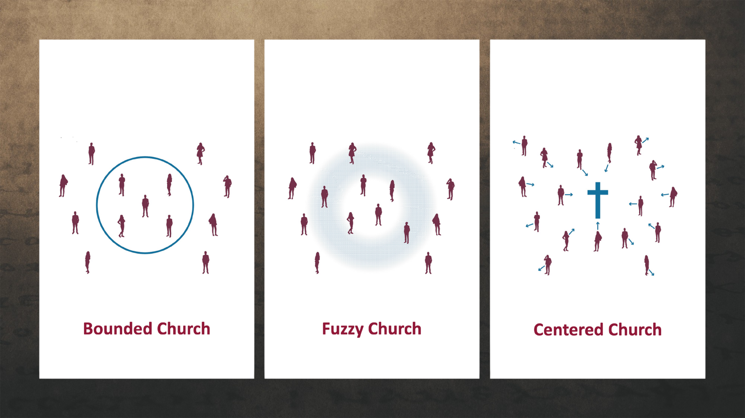
Notes:
A Bounded Church has a clear boundary line and separates who is in from who is out. The line generally consists of a list of correct beliefs and certain visible behaviors. While beliefs, boundaries, and behaviors are important, a bounded church uses these things to create a sense of superiority for its core members and exclude others. And it hinders transparency and utilizes shame to motivate conformity. Remember, this is the sort of thinking that was threatening the Galatians and at the heart of why Paul is so concerned for them.
A Fuzzy Church is the opposite extreme of the bounded church. It erases all lines and boundaries. Fuzzy folks might be more friendly, but the fuzziness about what they believe and who they are erodes the group’s sense of identity and mission. Therefore, it lacks a sense of call to follow Christ, and it disregards discipleship and spiritual formation. It has a tendency toward blandness, low expectations, and it creates a new set of problems in the church.
A Centered Church discerns who belongs to the group by observing people’s relationship with the center—Jesus Christ. Do they show that they want to follow Jesus and be formed into his image? Because the focus of a centered church is to know Jesus, meet people where they are, and encourage each other to move closer to the center, rather than focus on boundaries. In a centered church, we accept that everyone is in a different place in their journey. And so as long as our hearts are oriented toward Christ (which is made evident by our words and actions) then we should create and experience a sense of belonging to Christ in community.
And I’ve been saying that this centered-set community is what Paul wants for the Galatians. And they can have it if they will embrace the gospel of God’s grace, which makes centered church possible. If you’re just joining us, here is some background information on Galatians and a quick review of what we’ve looked at so far… [NEXT SLIDE]

Slide 3
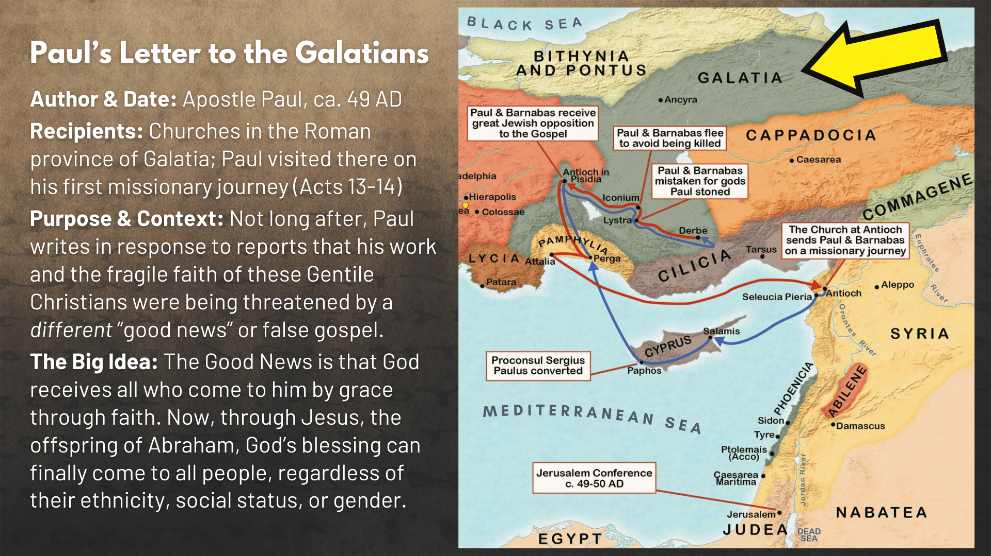
Notes:
On his first missionary journey, Paul and Barnabas planted churches in the southern part of the province of Galatia, which you can read about in Acts 13-14. And not long after that journey (around 49 AD), Paul writes to the Galatians in response to reports that his work and the fragile faith of these Gentile Christians were being undermined and threatened by the work of some “agitators” or false missionaries from Jerusalem leading them astray with a false gospel that required males to be circumcised and men and women to obey the Torah.
And these two gospels are very different… [NEXT SLIDE]

Slide 4
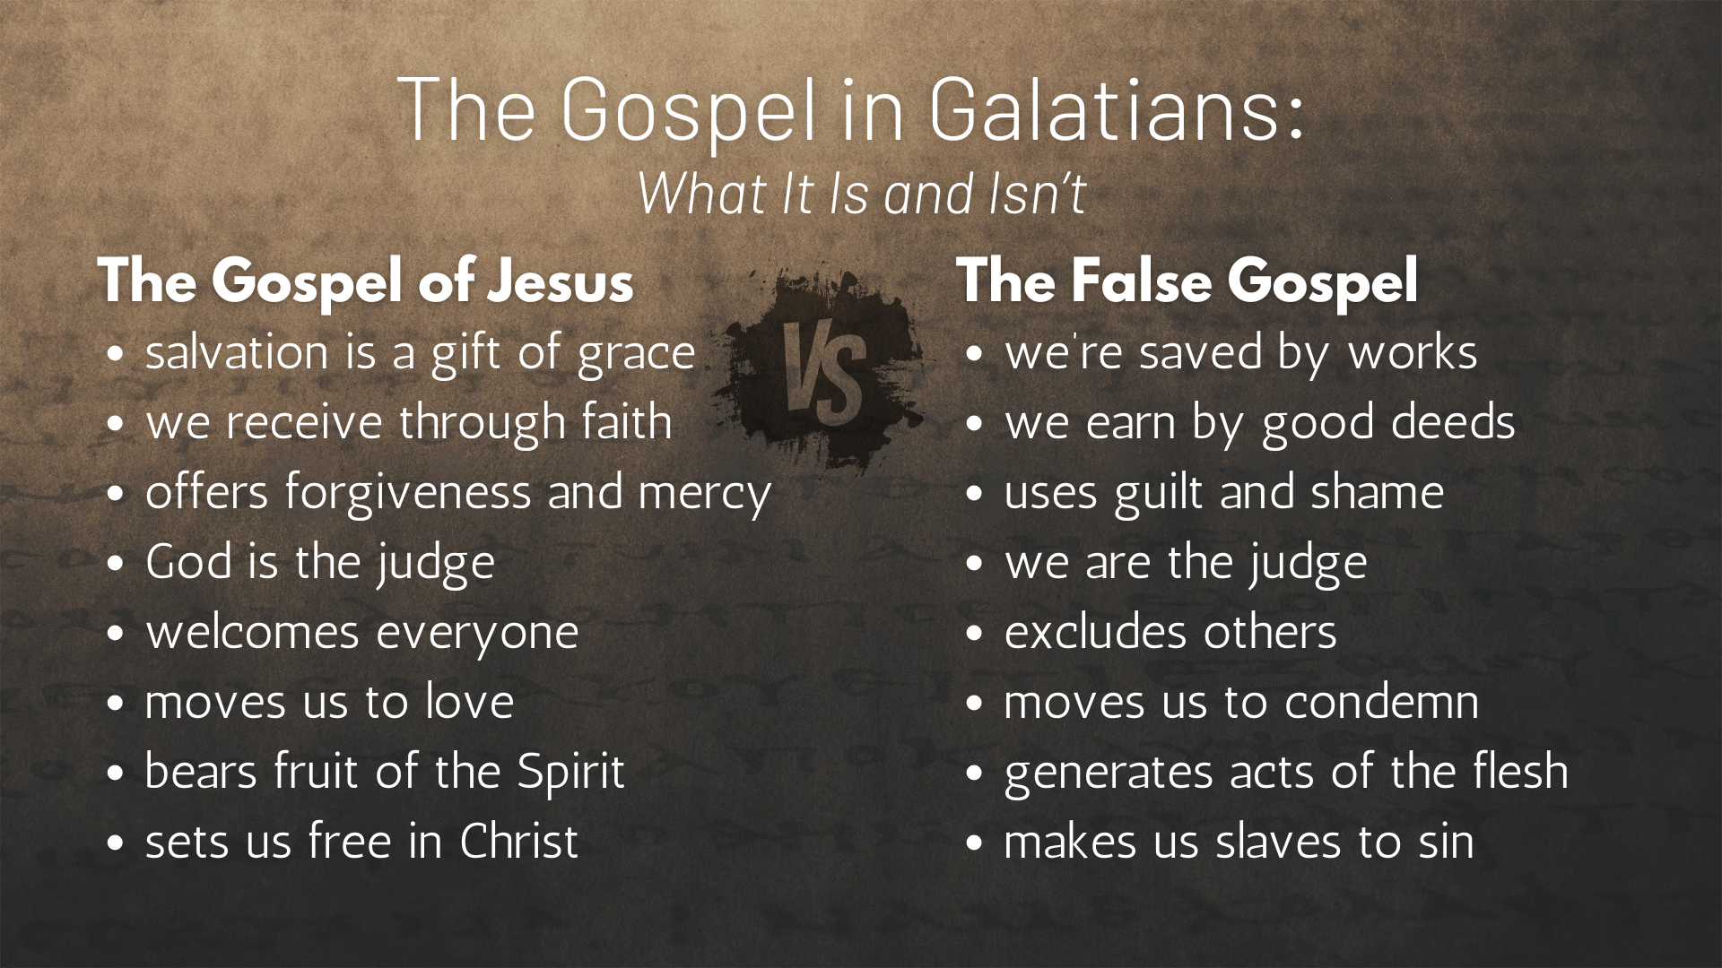
Notes:
[READ EACH POINT & COMMENT]
The Gospel of Jesus and then the False Gospel
And once again, Galatians can be divided into three major parts… [NEXT SLIDE]

Slide 5
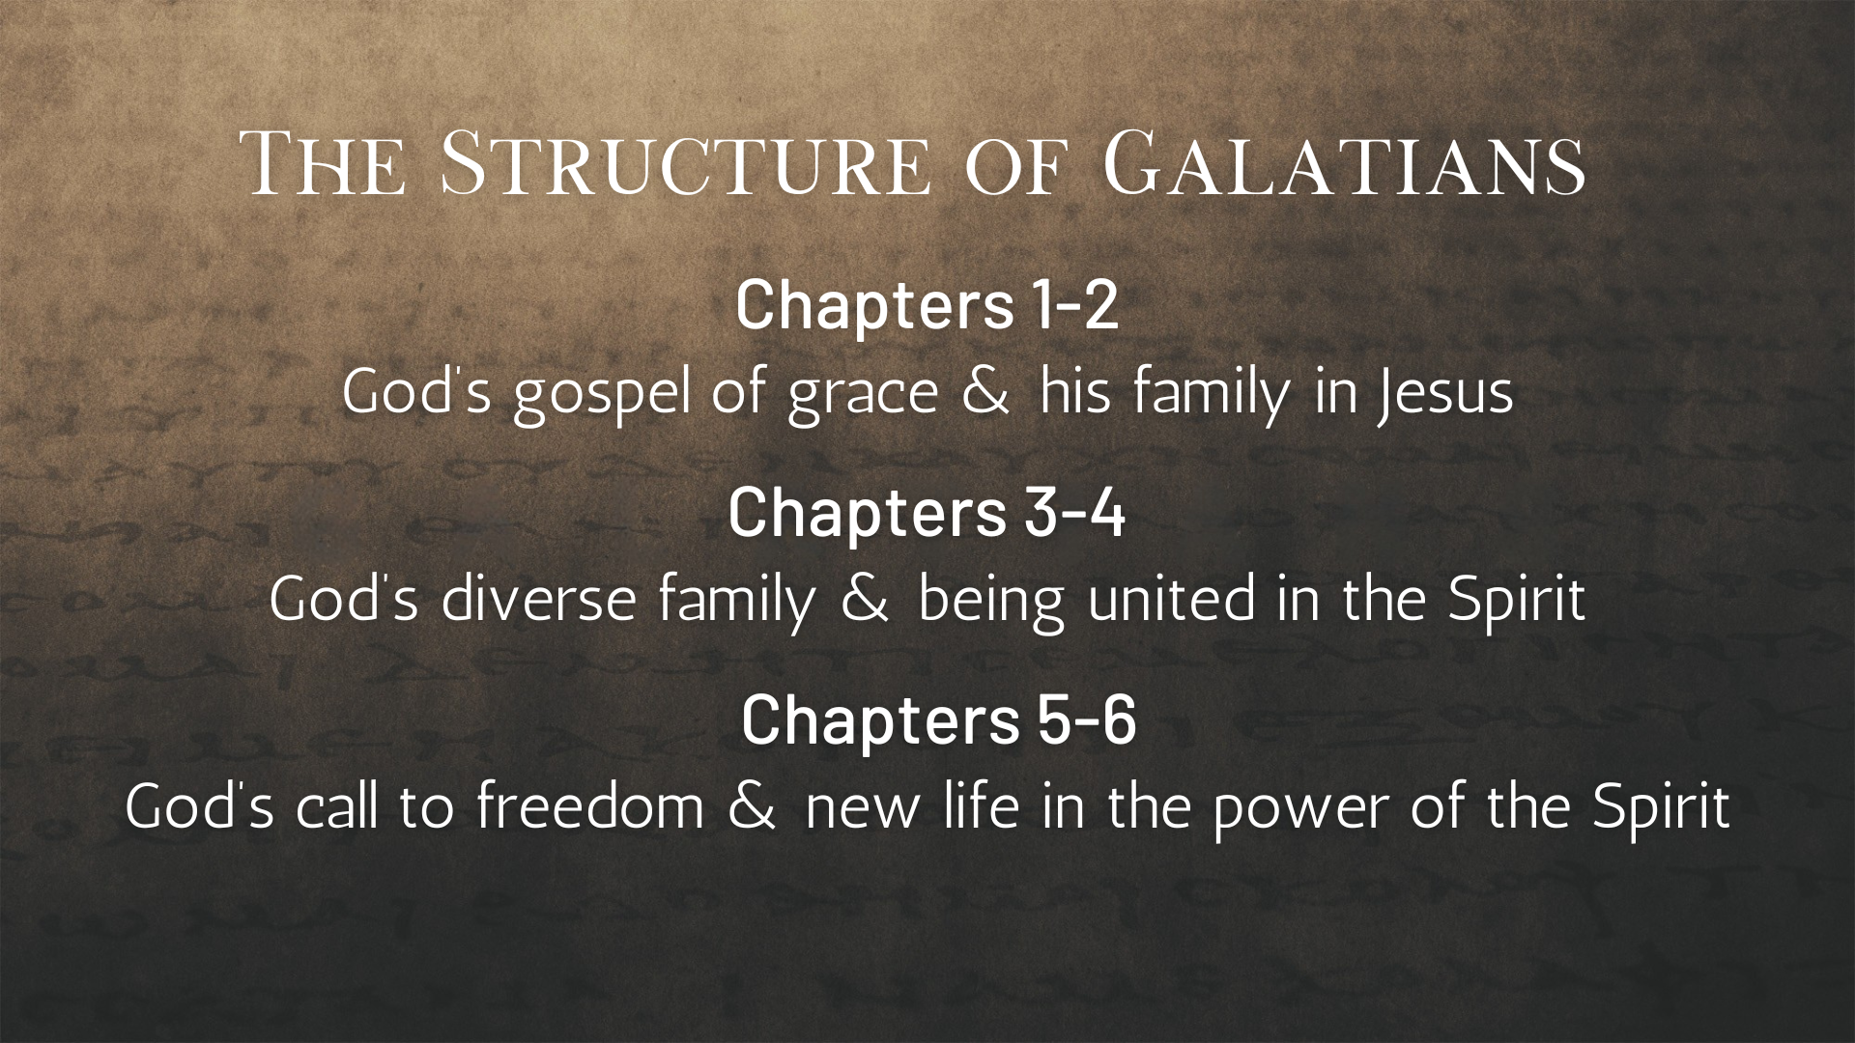
Notes:
In the first four chapters of Galatians, we have heard Paul challenge his readers to reject the false gospel, he has confronted opponents of the gospel of God’s grace and told the church not to become slaves again to sin and bounded-thinking. He has explained the purpose of the Mosaic law and how Christ is now forming a centered-set church through the gospel of God’s grace.
In today’s message, we’re going to look at Paul’s meaning of freedom, the flesh, and the fruit of the Spirit, as he says to the Galatians and to us that we’re all free to follow Christ in the new way of the Spirit. But before we enter the final unit in Galatians (ch.5 & 6), let’s remember this key verse in chapter 4 as we move forward this morning… [NEXT SLIDE]

Slide 6
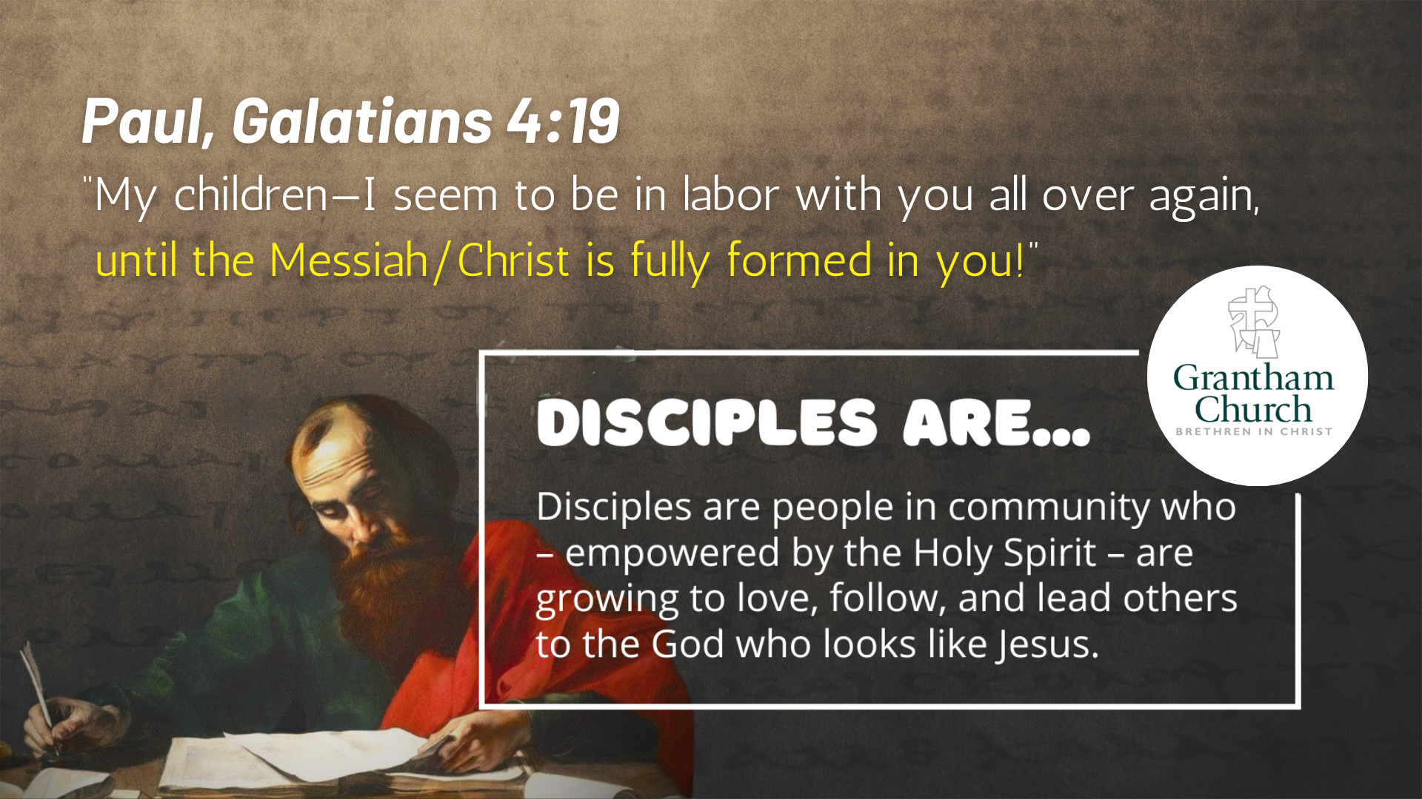
Notes:
[READ VERSE]
Paul’s ultimate aim and desire is for the Galatians to be fully formed disciples of Jesus; he doesn’t just want them “saved” or to take the name “Christian”; he wants them to be like Christ.
And at Grantham Church we say that: “Disciples are people in community who—empowered by the Holy Spirit—are growing to love, follow, and lead others to the God who looks like Jesus.”
So, as Paul is making a case for being a church centered on Jesus, and as we seek to live into that here at Grantham Church, we need to remember that worship, discipleship, and spiritual formation is why we are here, as I think will become clear in Galatians chapter 5… [NEXT SLIDE]

Slide 7
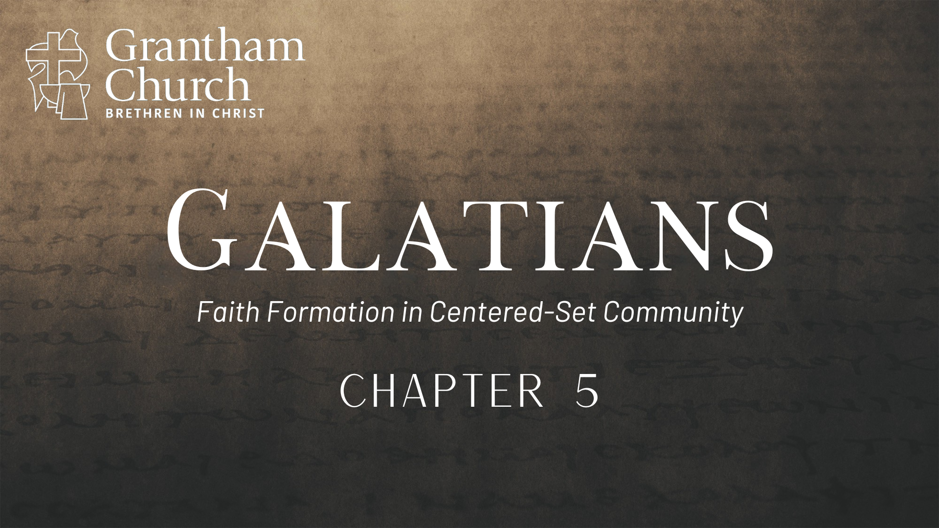
Notes:
[BRIEF PRAYER]
If you would, please open up your Bibles to Galatians chapter 5… [NEXT SLIDE]

Slide 8
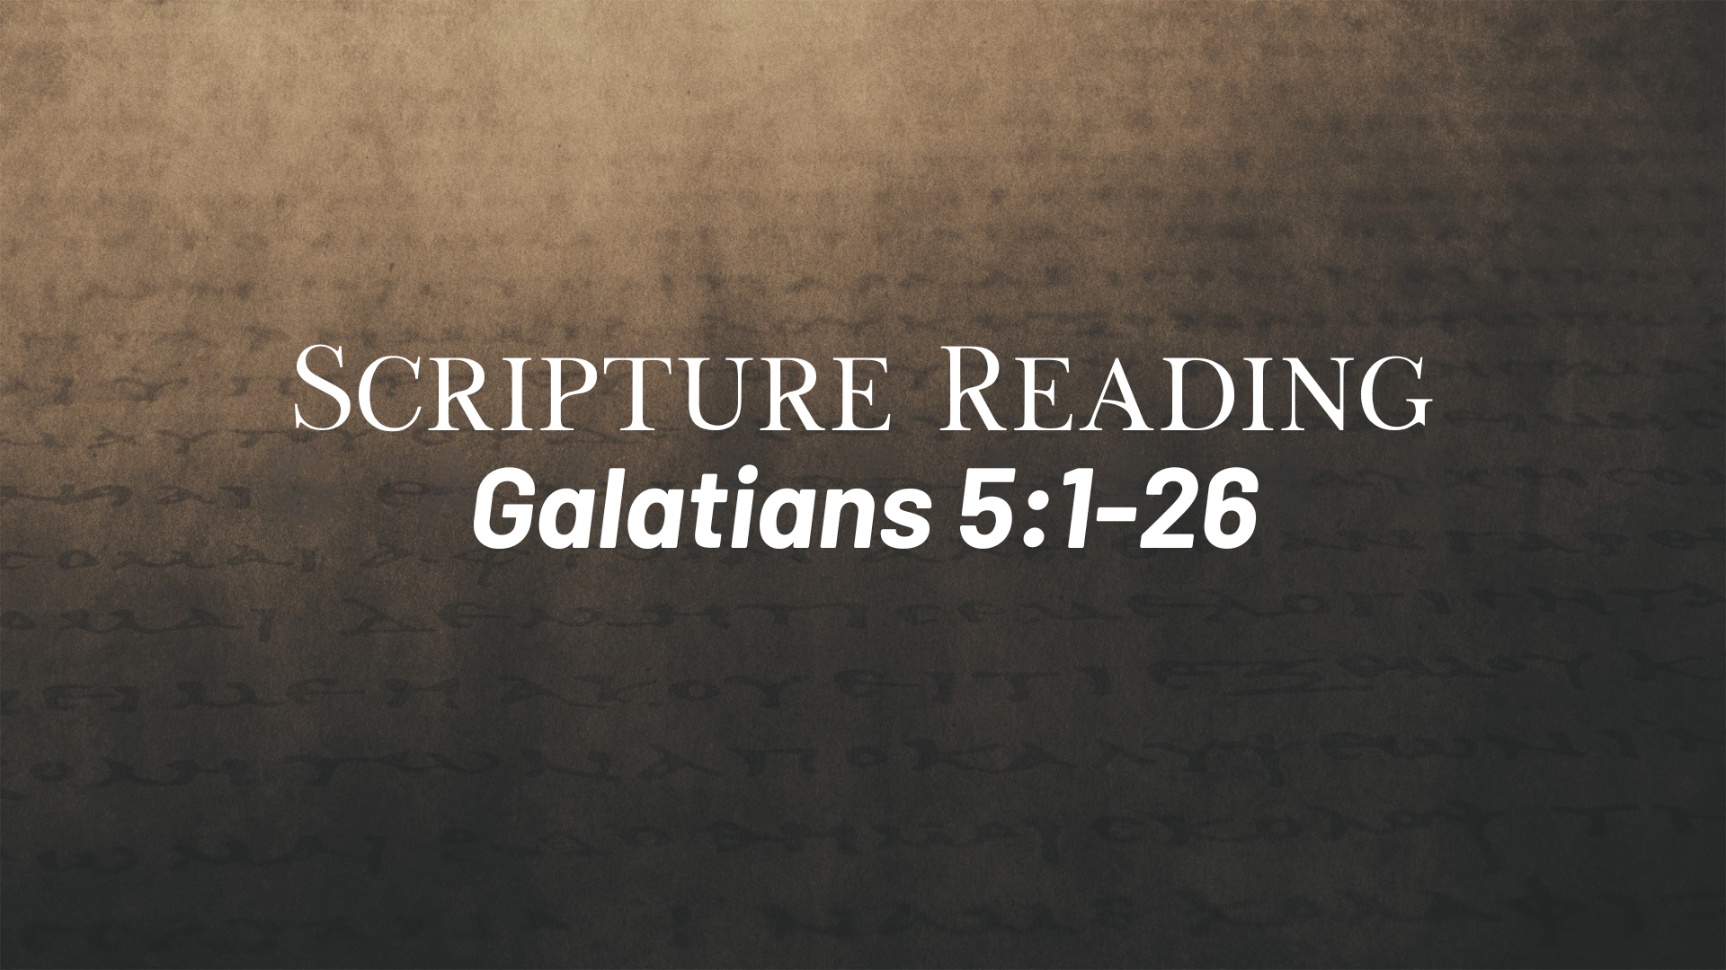
Notes:
vs.1-12 – Paul will finish his thoughts on “freedom” (which he began talking about in ch. 4), and he will offer a stern warning and challenge to the believers in Galatia.
[READ GALATIANS 5:1-12 VERSE-BY-VERSE & COMMENT]
v. 1 – “freedom” from the burden and slavery of the law of sin and death (in other words: “God has set you free! Don’t return to Egypt.)
v. 2-4 – if you start down that road, you gotta go all the way! Paul is saying, “Nothing that you can do will ever make you right with God. You have already been made right with God through Jesus.”
v. 5-6 – “live by the Spirit”, i.e., listen to Jesus in you and let his Spirit guide you; “faith expressing itself in love” means that true faith, and what honors God, is you working out your salvation, your discipleship, your spiritual formation in a loving response to God’s grace in your life
v. 7-8 – Paul uses a “racing” metaphor; Who held you up? Who slowed you down? How is it that you started off in grace now to be burdened down by the weight of bounded-thinking?
v. 9-10 – It only takes a little bounded thinking to affect you and the whole church! And God will deal with the person who introduces this bounded leaven that corrupts the community.
v. 11 – Look at how these agitators are treating me! That tells you all you need to know.
v. 12 – NIV: “As for those agitators, I wish they would go the whole way and emasculate themselves!” Now, why does Paul say this? This is very important, because we could easily just hear Paul venting his anger at this point. But I’m about to show you that isn’t the case.
Paul is likely referring to a pagan practice rooted in the worship of the goddess Cy-bele… [NEXT SLIDE]

Slide 9
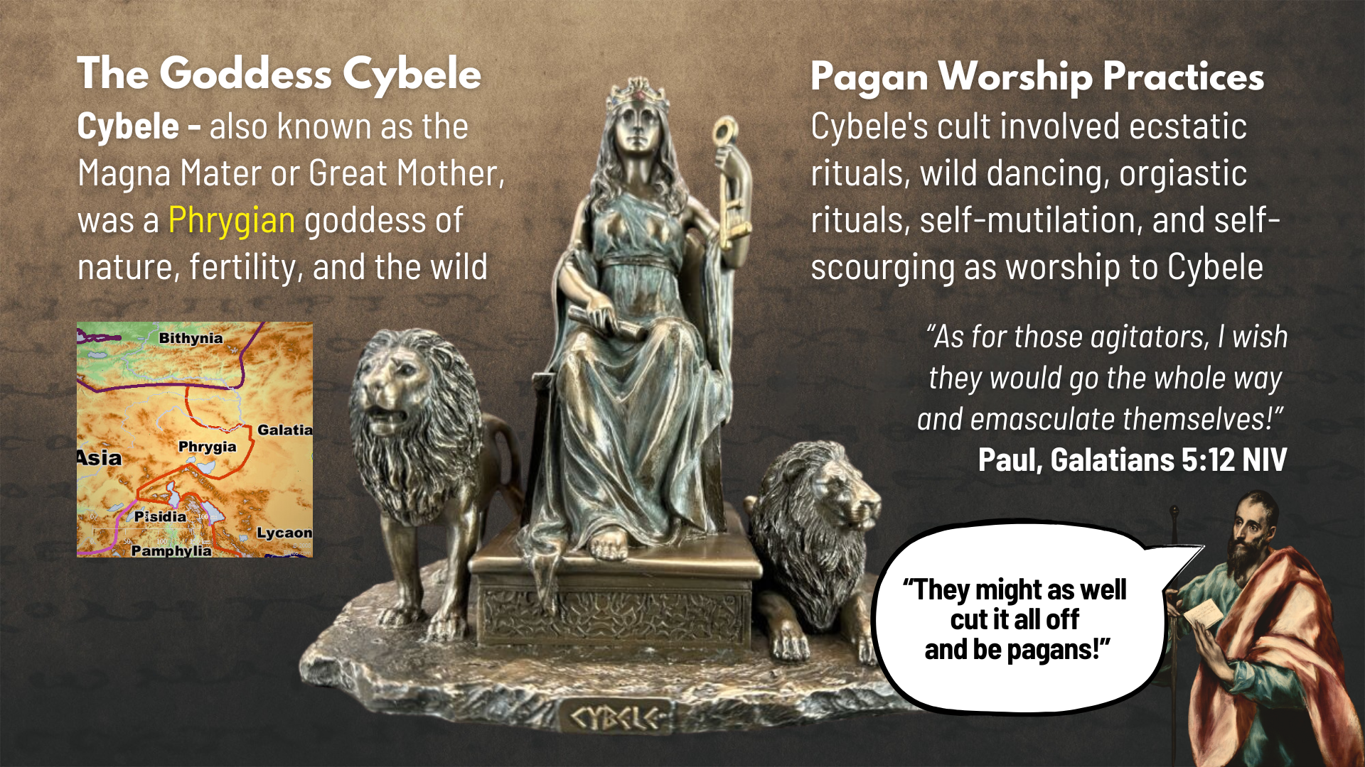
Notes:
Cybele was a goddess of nature, fertility, and the wild; she was known as the “Great Mother”; and worship of Cybele originated in Phrygia, which neighbored the Galatians.
And parts of Phrygia were incorporated into the province of Galatia by the Romans
So, the Galatians would have been well aware of this pagan cult; some may have once practiced Cybele worship before coming to Christ; which involved ecstatic rituals, wild dancing, orgiastic rituals, self-mutilation, and self-scourging.
Therefore, when Paul says, “As for those agitators, I wish they would go the whole way and emasculate themselves!” he is essentially saying, “They might as well cut it all off and be like the pagans down the street!” Why? Because the Judaizers have turned their backs on what Christ has revealed, and they’ve given up on the gospel of God’s grace. And now these so-called “mutilators of the flesh” are leading these former pagans astray with their bounded thinking.
Back to Galatians 5, verse 13, where Paul now turns his attention to how we are called to live by the Spirit, not the flesh… [NEXT SLIDE]

Slide 10
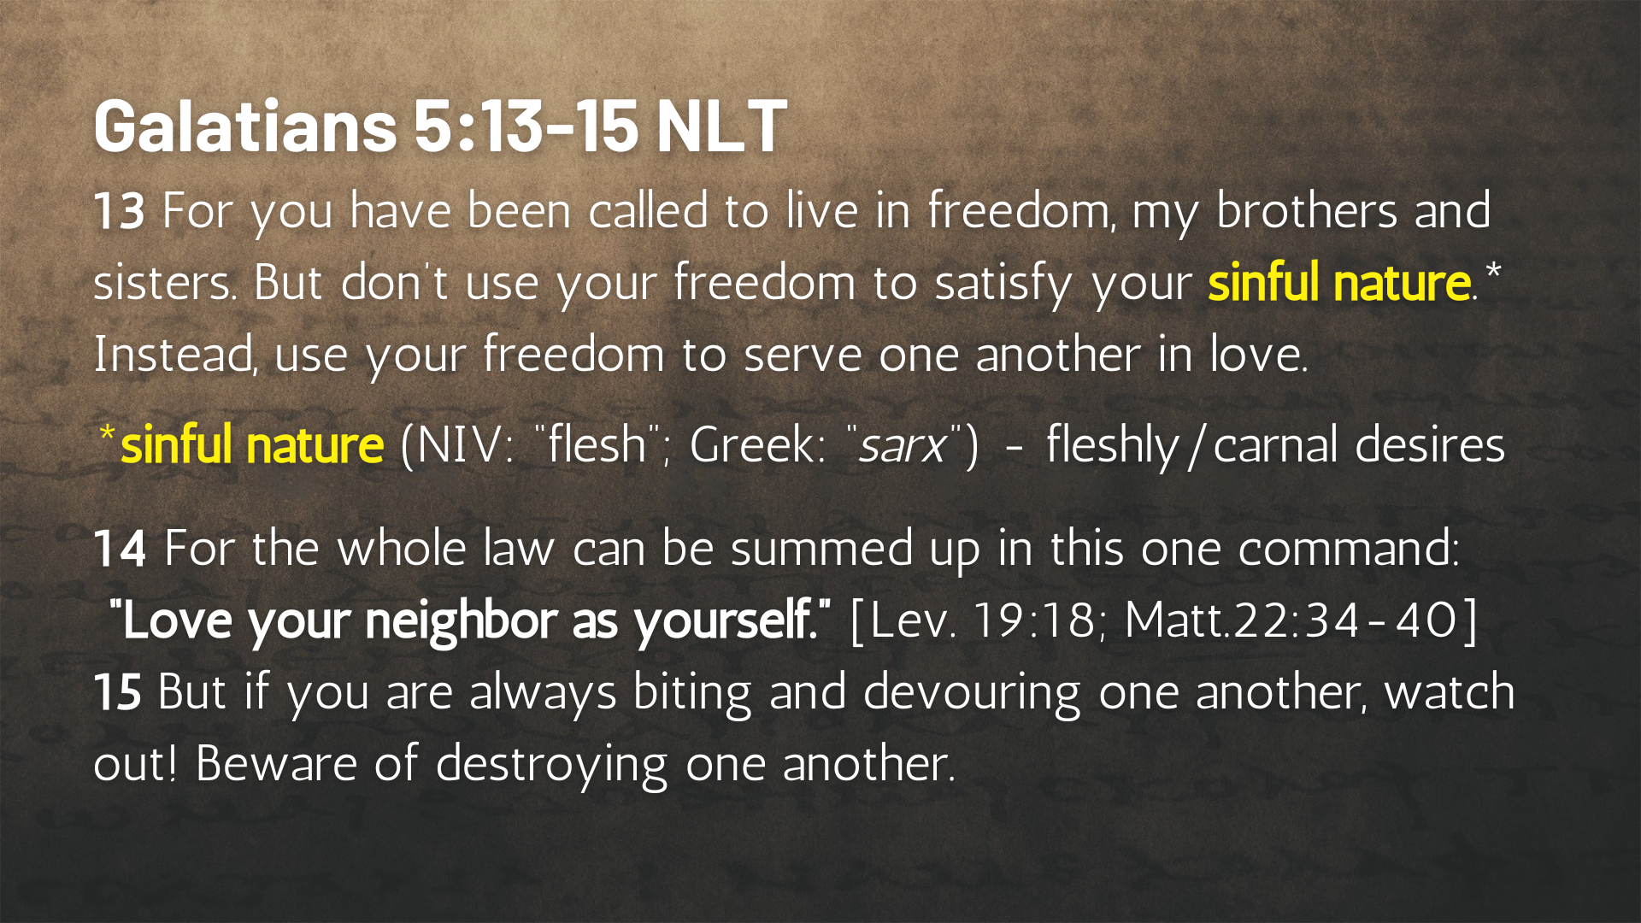
Notes:
[READ PASSAGE THROUGH & COMMENT]
v. 13 – “freedom” in the Lord is a freedom not to live however you want; it is a freedom from the chains of fleshly, carnal desires that seek to master and control you; and it is a freedom not to live for yourself, but to live and serve others in love.
vs. 14-15 – we’re called away from ego-centric living, because it impedes upon our ability to love God and our neighbor, and (as Paul says in verse 15) it leads to spiritual cannibalism.
NLT says “sinful nature” but the NIV says “flesh” – Why the difference?
Sinful “nature” is (in my opinion) not the preferred translation because it can be misleading. Because calling it a “nature” can lead us to believe it is a part of our identity, when it’s not. Listen to what Greg Boyd writes about this in his book Seeing is Believing… [NEXT SLIDE]

Slide 11
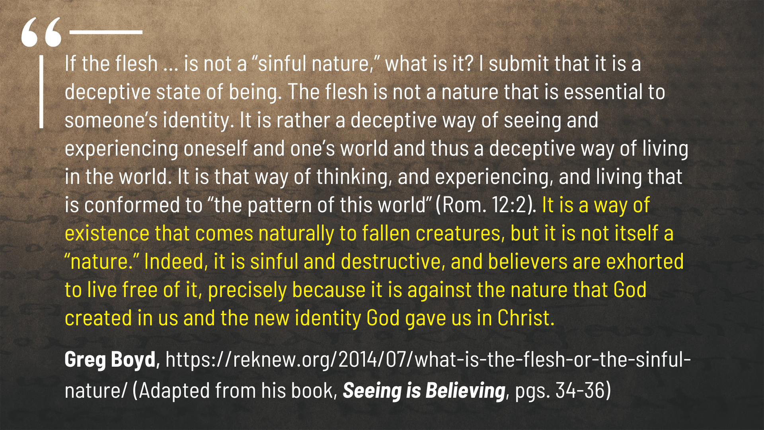
Notes:
[READ QUOTE & COMMENT]
it “comes naturally” to us (it feels like our default at times), but it is not our “nature” or who we are now that Christ has undone the powers of sin, death, and the fall; we have a new nature!
Remember what Paul wrote in 2 Corinthians 5, verse 17… [NEXT SLIDE]

Slide 12
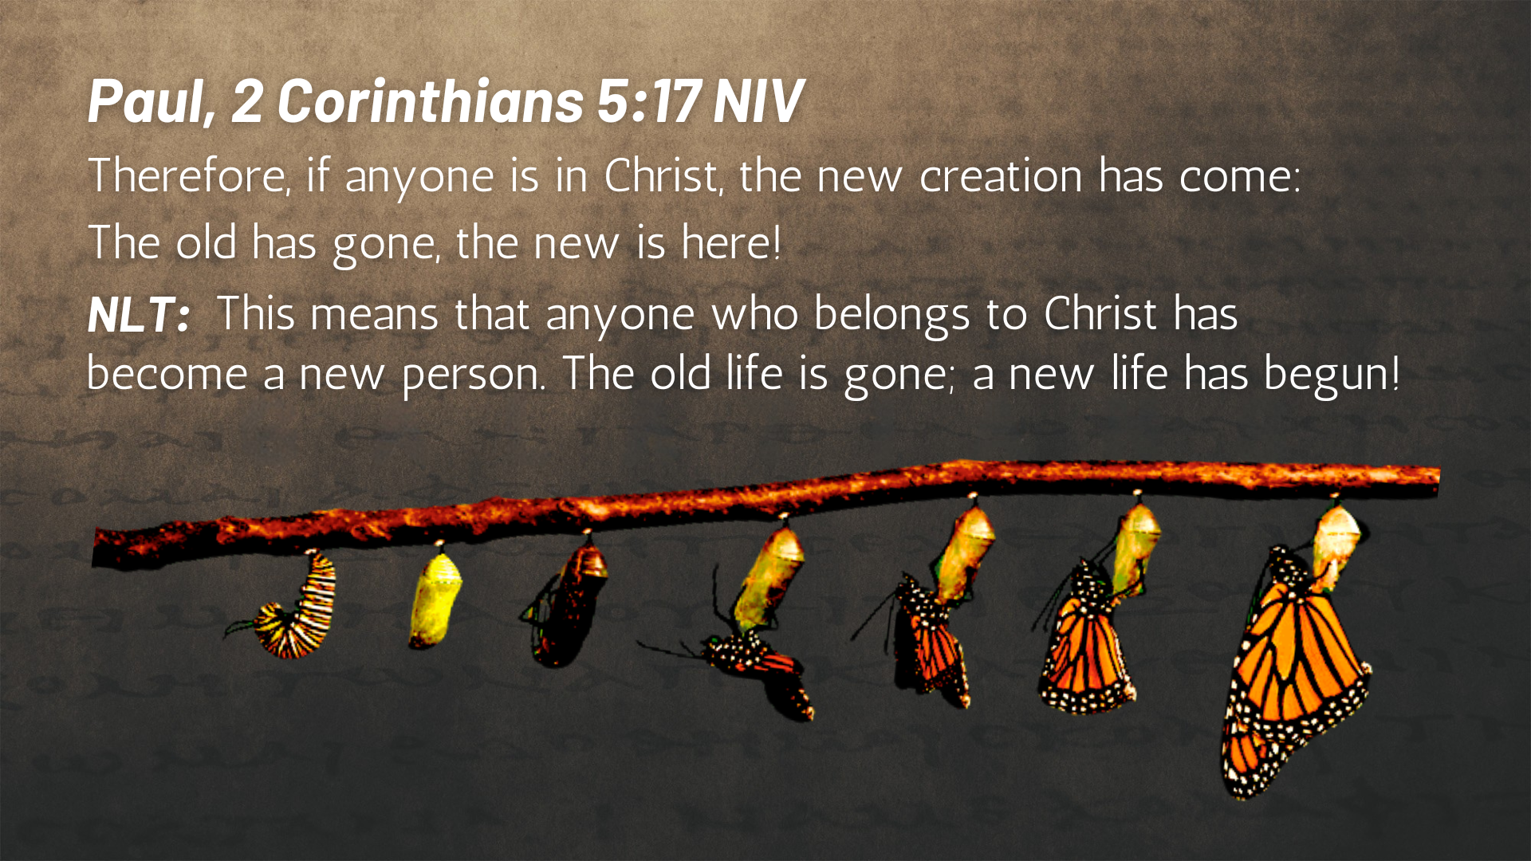
Notes:
[READ VERSE & COMMENT]
Will we take the red pill and live into our new reality and identity in Christ?
Our spiritual formation as Christians begins and ends with us embracing this new identity in Christ, where we say “No!” to the flesh and “Yes!” to the Spirit.
Back to Galatians 5, verse 16… [NEXT SLIDE]

Slide 13
Notes:
[READ & COMMENT ON VERSES 16-18]
v. 16 – NIV: “walk in the Spirit” and you won’t “gratify the desires of the flesh”; in other words, when you’re seeking to live out of your new identity and walking in the strength that Jesus gives us through the Spirit, you will discover the power to overcome your fleshly, carnal desires.
v. 17 – there is an internal struggle to do what our flesh wants or allow Christ in us to prevail (see Romans 7:14-25).
v. 18 – “directed by the Spirit” or ”led by the Spirit” Paul has the “exodus” in mind; the Spirit of God is able to lead us out of sin and bondage to freedom and a better way of life in Christ.
And now the remaining verses in chapter 5, verses 19-26… [NEXT SLIDE]

Slide 14
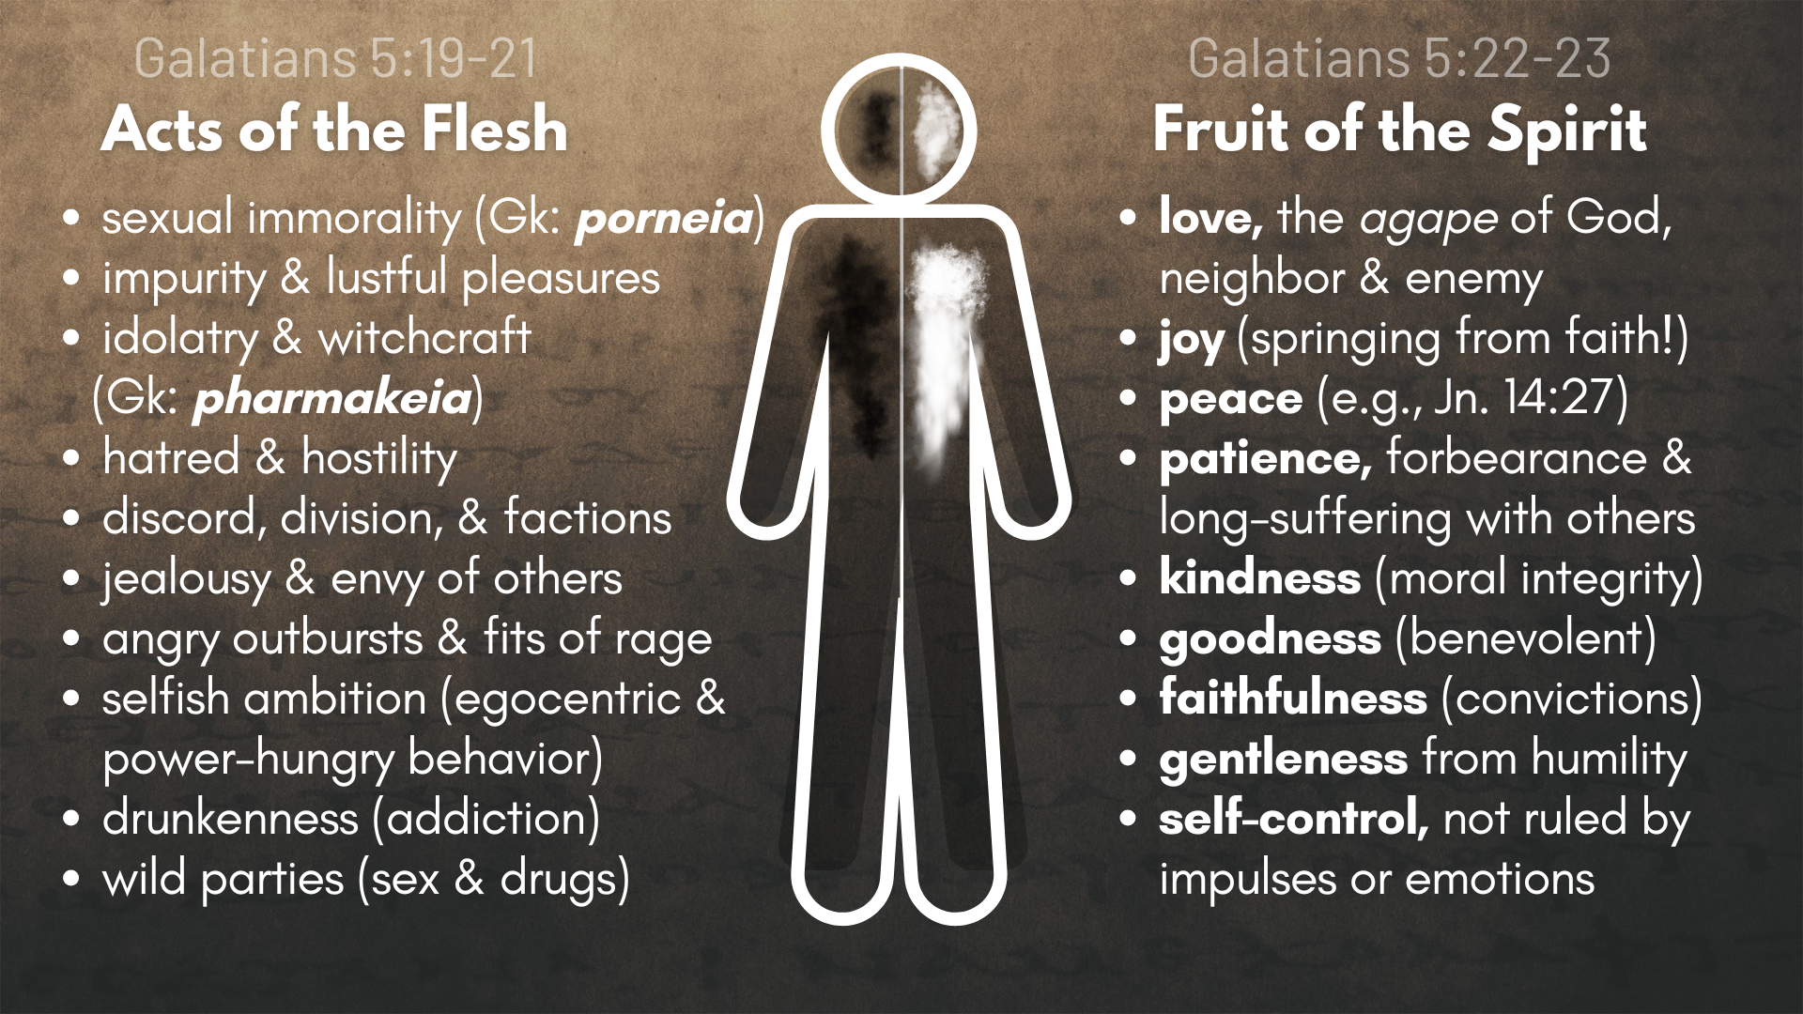
Notes:
[READ VERESES 19-23]
[READ SLIDE & COMMENT]
[READ FINAL VERSES 24-26]
Listen to how Paul describes how we’re to follow in the new way of the Spirit in his letter to the Romans, chapter 7:4-6… [NEXT SLIDE]

Slide 15
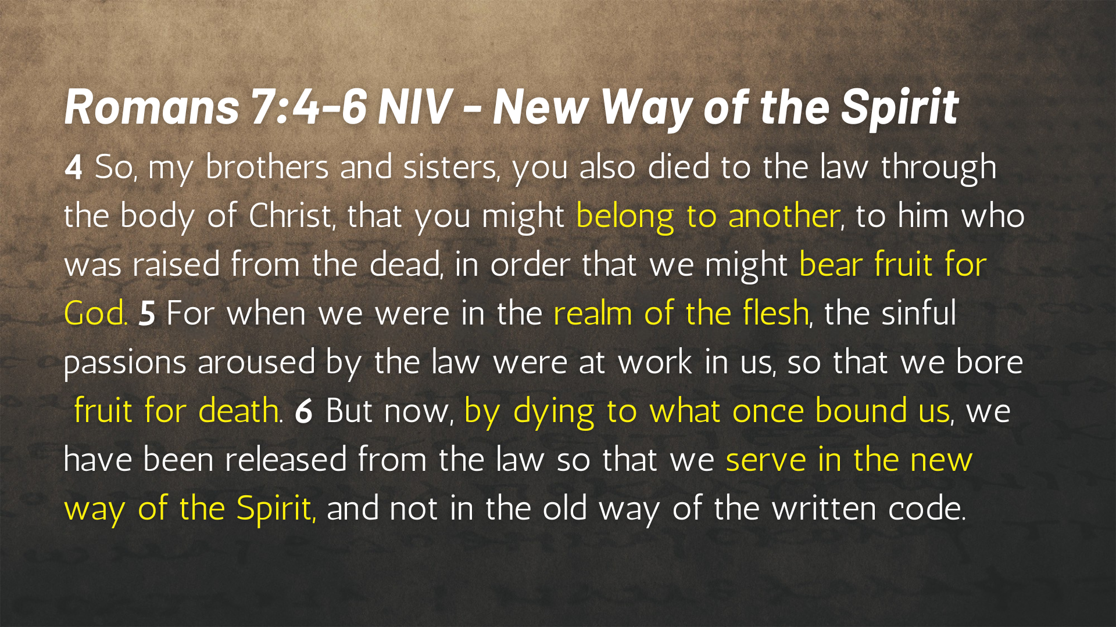
Notes:
[READ PASSAGE & COMMENT]
So… real quick… how might we apply what we’ve heard from Paul in Galatians chapter 5. Here are some suggested takeaways… [NEXT SLIDE]

Slide 16
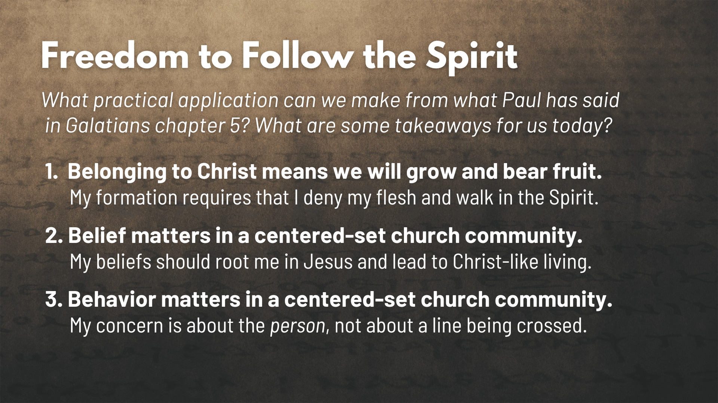
Notes:
[APPLICATION - READ EACH POINT & COMMENT]
Belonging to Christ means we will grow and bear fruit.
My faith formation requires that I’m intentional in denying my flesh and walking in the Spirit.
2. Belief matters in a centered-set church community.
My beliefs should root me in the Lord Jesus and lead to Christ-like living and actions.
3. Behavior matters in a centered-set church community.
Our concern is about the person becoming like Jesus, not about a line being crossed.
Now… let’s take all that we’ve heard and apply it to the centered-set community image. What does this mean and look like for us who desire to be a centered church? [NEXT SLIDE]

Slide 17
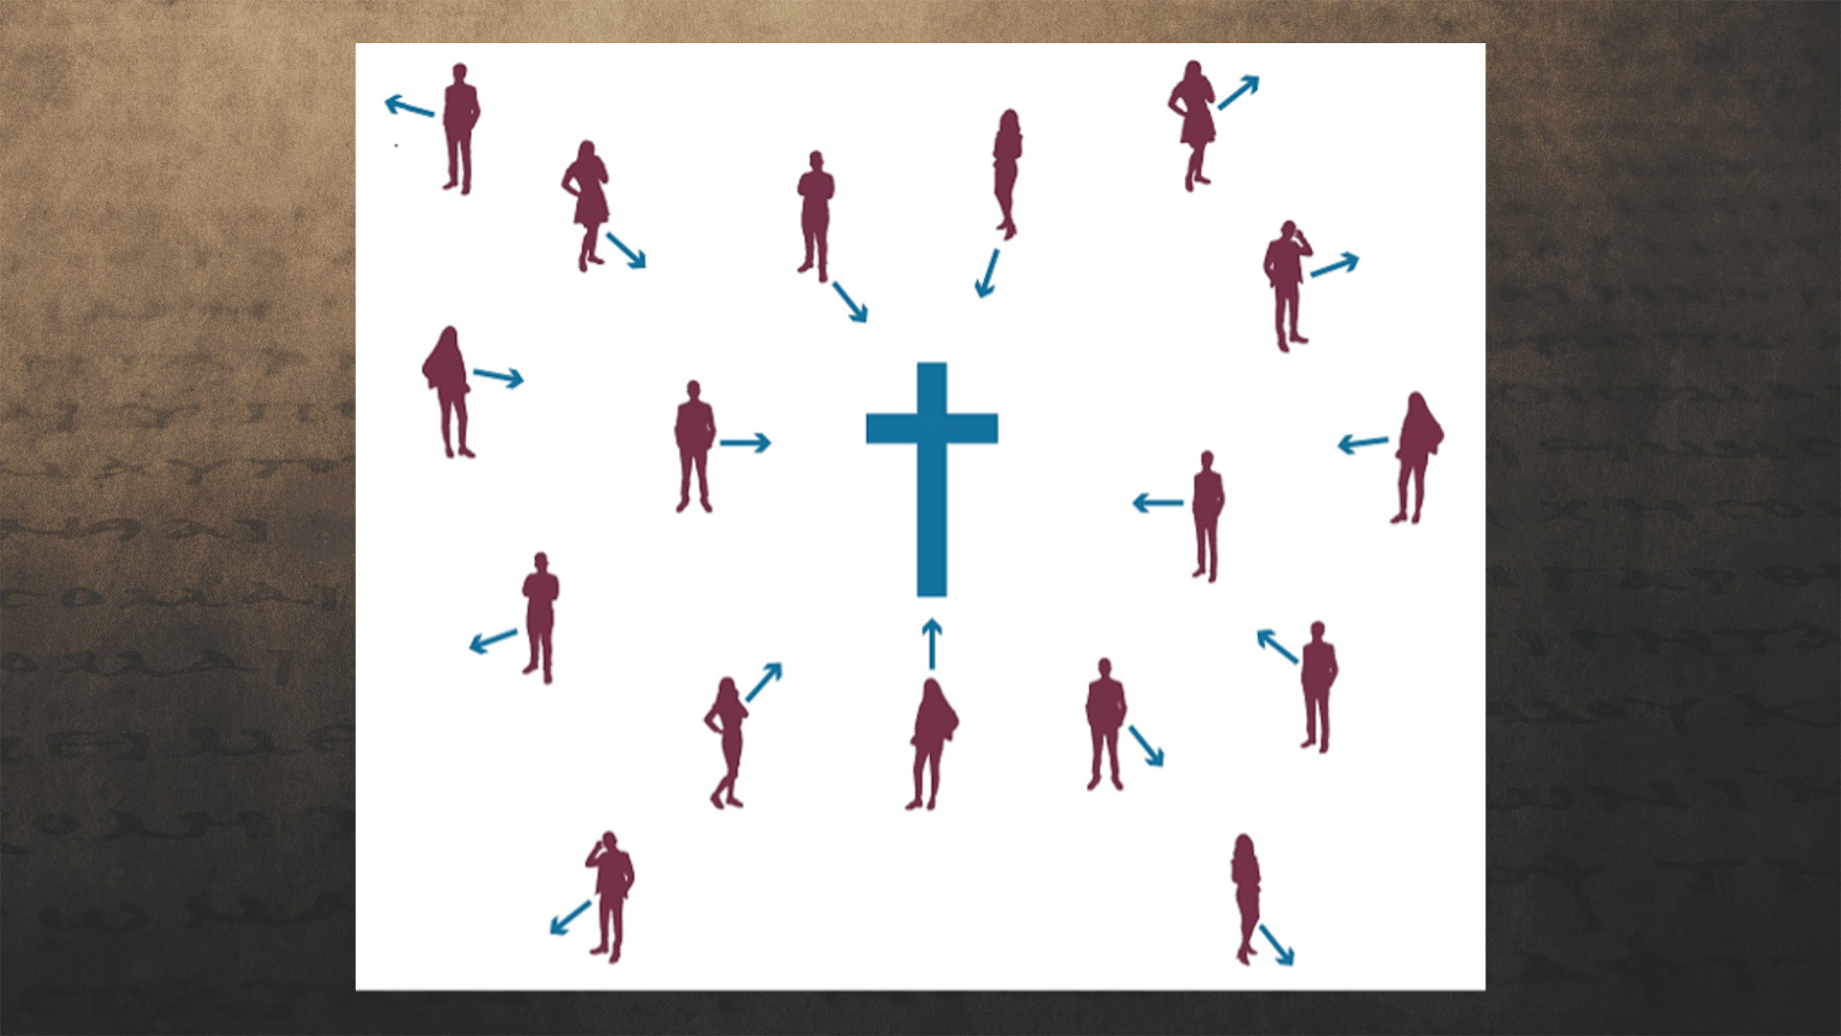
Notes:
A centered church invites and welcomes everyone, but not everyone is guaranteed to feel included. Why? How so? Because everyone who wants to be a part of a centered church must be interested in building a relationship with Jesus Christ—the center—who says, “Follow me.”
Brothers and sisters, it is those who want to learn how to “walk in the Spirit” (not the flesh), those who give themselves over fully to this kind of community, that experience the greatest reward and sense of belonging. But those who don’t—those who are only interested in the public spaces and sitting out on the fringes of Christian community—will either keep watching from a comfortable distance, as they try to make up their mind about what they want to do, and/or eventually leave because they’re not really interested in discipleship, growing in their faith, character formation, and spiritual transformation as we journey alongside other disciples in the Body of Christ.
Of course, the invitation is that we would all be intentional in how we’re seeing and engaging with the centered community which we aspire to be at Grantham Church. Because the welcome mat is laid down… for everyone. And it is my prayer that all of you (all of us) will enter the “house of the Lord” and experience the belonging and the freedom that is available for the children of God.
Finally, here are some questions to help us reflect and respond to the message… [NEXT SLIDE]

Slide 18
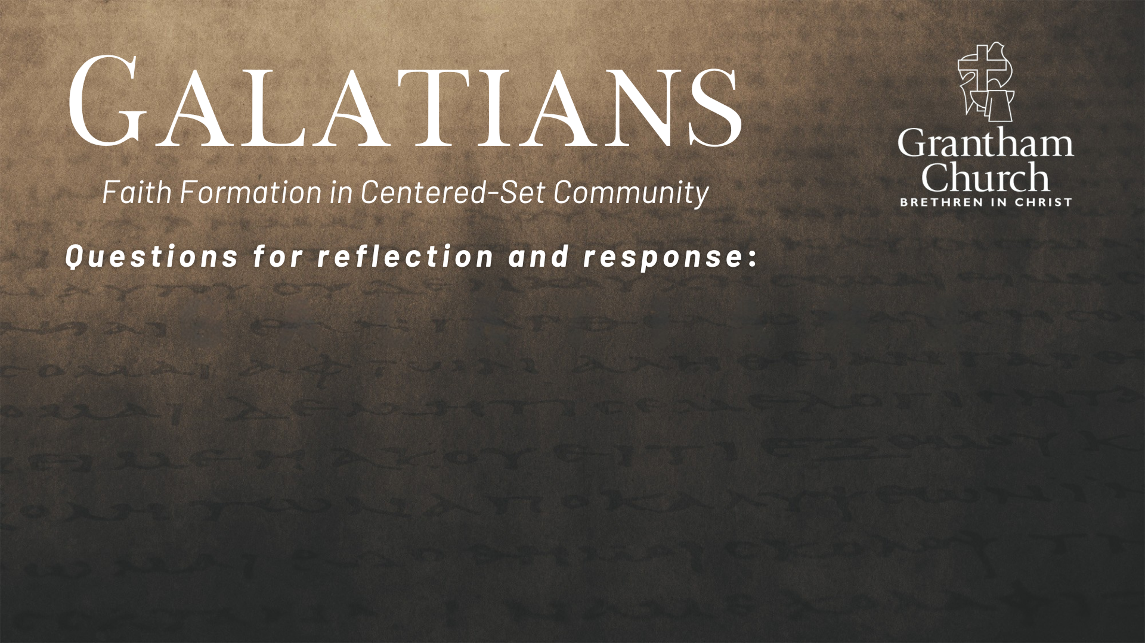
Notes:
Questions

Slide 19
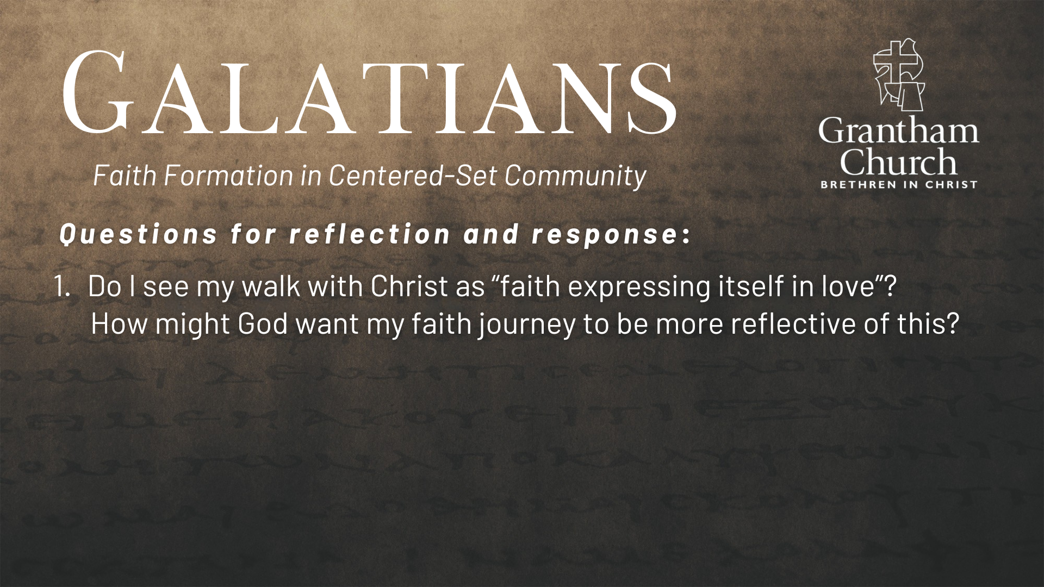

Slide 20
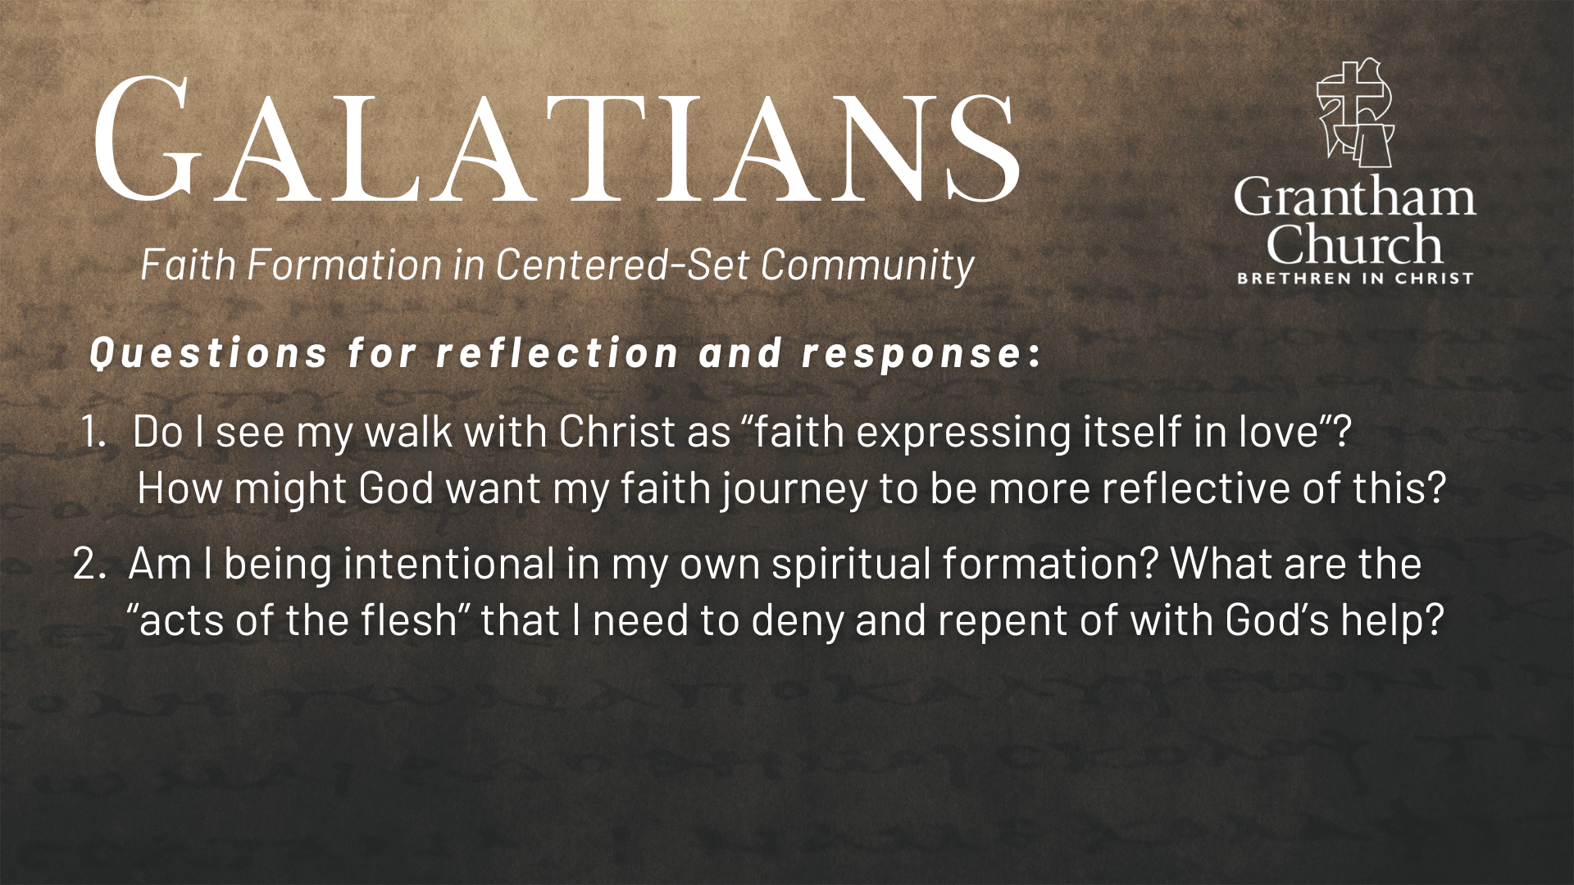

Slide 21
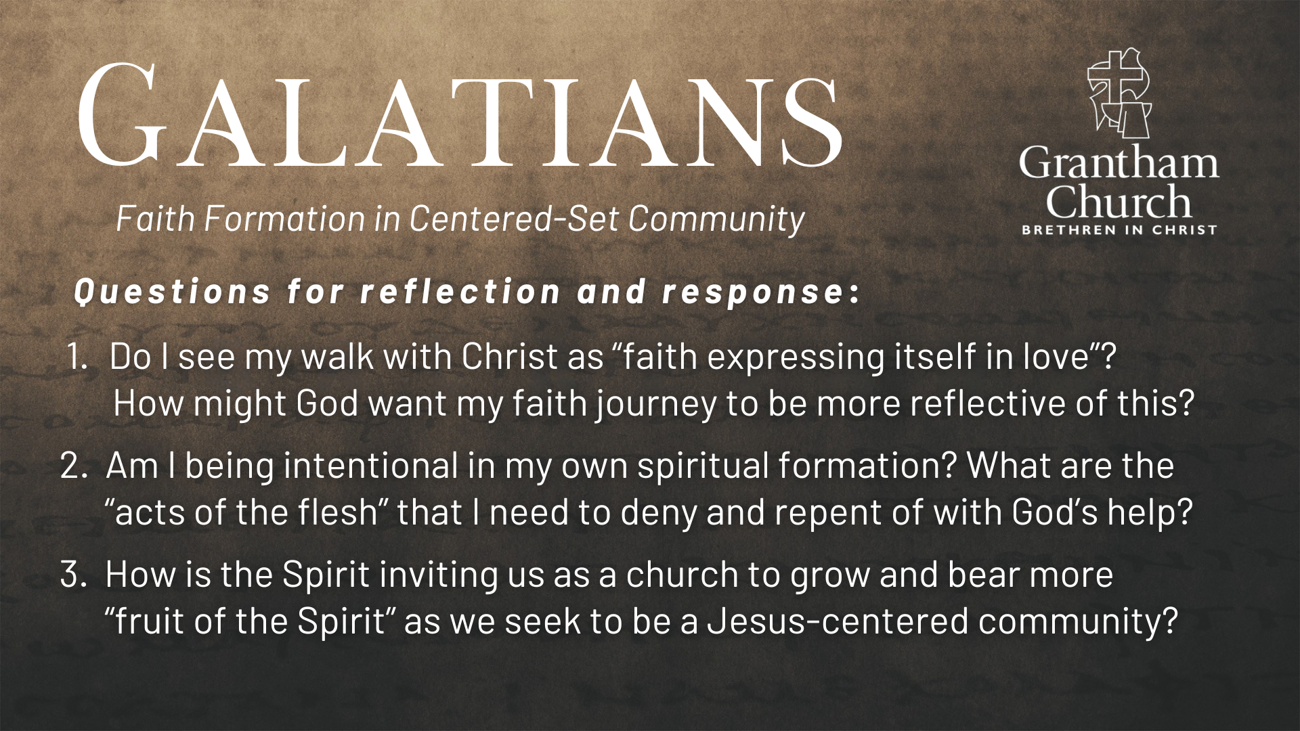
Notes:
[READ & BRIEF COMMENT ON EACH QUESTION]
Do I see my walk with Christ as “faith expressing itself in love”? How might God want my faith journey to be more reflective of this?
Am I being intentional in my own spiritual formation? What are the “acts of the flesh” that I need to deny and repent of with God’s help?
How is the Spirit inviting us as a church to grow and bear more “fruit of the Spirit” as we seek to be a Jesus-centered community?
[CLOSING WORDS]
Let’s pray… [NEXT SLIDE FOR CLOSING PRAYER]

Slide 22
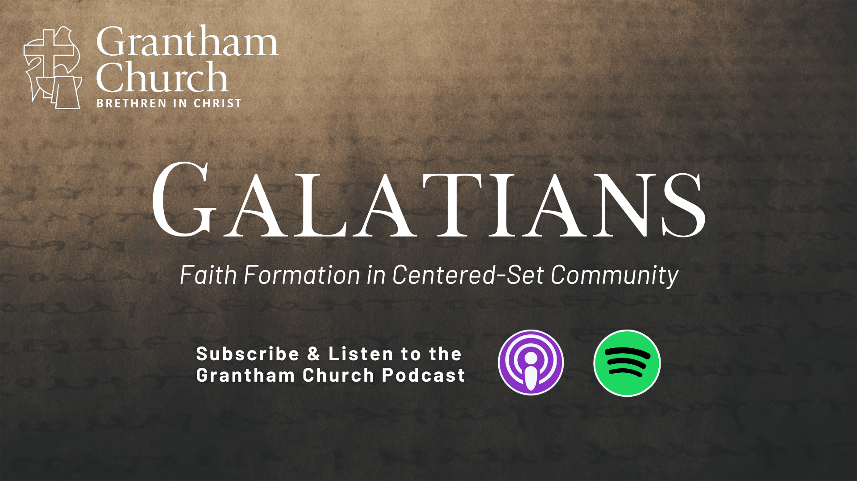
Notes:
[CLOSING PRAYER]
[APOSTLES’ CREED]
[COMMUNION]
Announcement: Fellowship Meal
Benediction
Brothers and sisters, we’ve been saved by grace through faith to be formed in Christ-centered community. May you only boast in the cross of our Lord Jesus Christ, for we have been freely given (not earned) Gods love and favor. Now let us go and extend that same gift of grace to others—in the church and in the world. In the name of the Father, and of the Son, and of the Holy Spirit. Amen.

