Slide 1

Notes:
INTRO
I hope you had a Merry Christmas and a restful holiday
I enjoyed some much-needed down time at home, a stay-cation!
It’s a New Year (2021) – a message to refocus and remember who we are and where we’re going; what God has called us to do.
But before we jump into the message this morning…

Slide 2
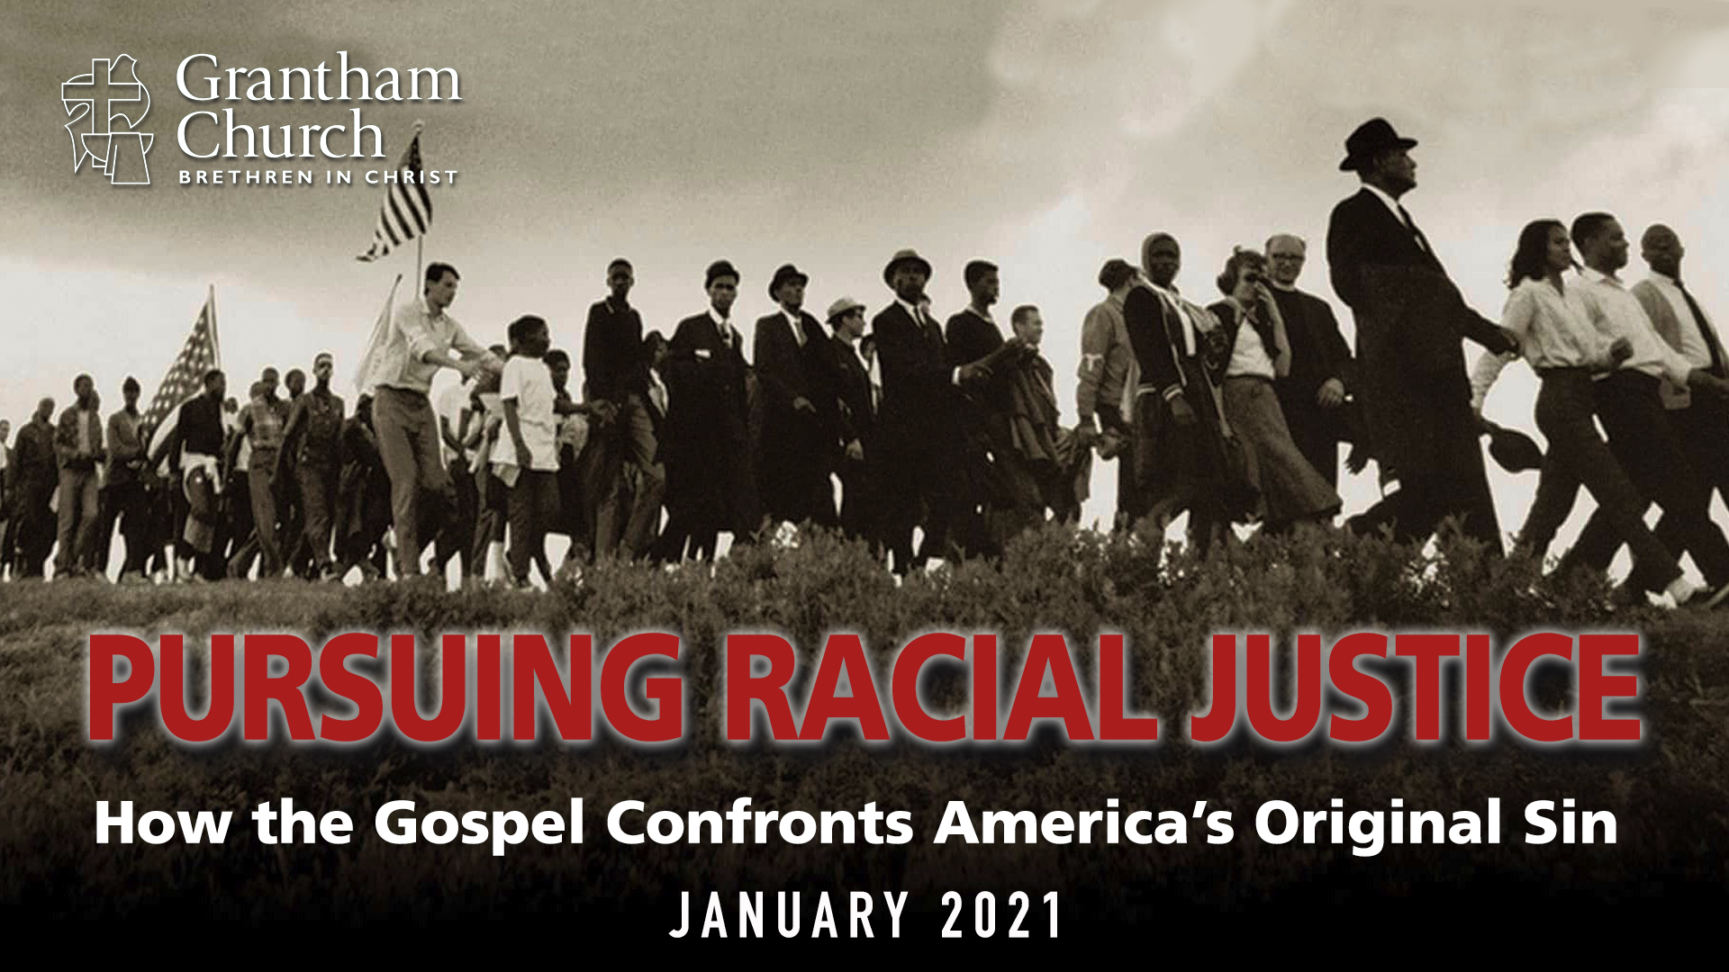
Notes:
I want to mention that our January 2021 series begins next Sunday. As you know, for the past several years our Peace and Social Justice Commission has helped to design a month-long series that focuses on a peace and justice related issue. Last year we focused on creation care. And this year we will be addressing racism and what we can do about it.
In a series called, Pursuing Racial Justice, we will be looking at how the Gospel confronts America’s Original Sin. As disciples, we want to ask questions like, “What does the Gospel have to say about this? What should Christians do in response to racial injustice?” It’s going to be an informative and practical series, so I hope you’ll plan to join us next Sunday as we learn how Jesus calls us to follow in solidarity with the vulnerable and testify to God’s reconciling love in the world.
Stay tuned this week to your inbox for the Email From the Pastor, as I’ll be sharing how you can join the church-wide learning community each Sunday morning via Zoom. In the meantime, you can see our series outline and the lineup of speakers at the Peace & Social Justice page on our website.
[BRIEF PRAYER]

Slide 3
Notes:
Why am I doing this? What’s the point? Where is this going? Having a purpose and a goal is often necessary to carry on or to complete a task.
There are other helpful boundary-markers, time markers, and seasons that help us reflect, assess, grieve, celebrate, etc. (e.g. the church calendar, holidays, the new year). The beginning of a new year is a good time to do that. Especially after the dizzying effects of 2020.
What is our shared purpose at Grantham Church? Who are we and what are we about?
The Apostle Paul helps us answer that question in his letter to the Philippians.
[SHARE CONTEXT OF LETTER/PASSAGE]

Slide 4
Philippians 3:10-11 NIV
¹⁰ I want to know Christ—yes, to know the power of his resurrection and participation in his sufferings,
becoming like him in his death, ¹¹ and so, somehow, attaining to the resurrection from the dead.
Notes:
v.10
“know Christ” – this is an intimate, relational knowing, a spiritual union; Paul finds Jesus inexhaustible
“the power of his resurrection” – those who are in union with Christ can know his power within them
If the love of God is seen most clearly in his death, then his power is most visible in his resurrection!
“participation in his sufferings” – sounds strange, but the NT is clear that suffering is one way we identify with Christ
The sufferings of Christ overflow into our lives” (2 Cor 1:5)
“like him in his death” – What was Christ like in his death? – surrendered to God’s will, forgiving, loving, etc.
v.11
“attaining to the resurrection” – NLT: “so that one way or another I will experience the resurrection”

Slide 5
Philippians 3:12-14 NIV
¹² Not that I have already obtained all this, or have already arrived at my goal, but I press on to take hold of that for which Christ Jesus took hold of me.
¹³ Brothers and sisters, I do not consider myself yet to have taken hold of it. But one thing I do: Forgetting what is behind and straining toward what is ahead,
¹⁴ I press on toward the goal to win the prize for which God has called me heavenward in Christ Jesus.
Notes:
v.12
“arrived at my goal”… “I press on” speaks of an athletic race
Paul alludes to his encounter with the risen Jesus on the road to Damascus
v.13
Paul is saying, if you’re going to run a race, you can’t keep looking over your shoulder. If you do, it’s going to slow you down. In other words, of all people, Paul knows there are things that we’re not proud of, even ashamed of; that there are things that have happened to us, things we’ve experienced that aren’t pleasant. But we must “forget it” and leave it in the past, so that we can move toward God’s good future. If we don’t it is going to hinder our race. So, do whatever you need to do to let it go: confess, forgive, grieve, repent, and heal. Otherwise, it’s going to negatively impact your faith.
v.14
Again, Paul envisions an athlete (like someone in the games in Rome) who wins and receives their prize from the emperor himself. But for Paul, it is Christ who reigns from heaven who will give him his reward for finishing the race. And Paul wants his readers to make his ambition their own.

Slide 6
Philippians 3:15-16 NIV
¹⁵ All of us, then, who are mature should take such a view of things. And if on some point you think differently, that too God will make clear to you.
¹⁶ Only let us live up to what we have already attained.
Notes:
v.15
Paul is confident that his view is right about his perspective on enduring faith, and that mature believers will agree.
v.16
Greek: literally says, “To what we arrived, by the same to walk.” – Meaning: strive for maturity, but be content with what you have and where you are.”
NLT: “But we must hold on to the progress we have already made.”
Therefore, pressing on for us who are his disciples means we continue to practice the fundamentals of our faith—spiritual disciplines.
And as a church it means that we remember who we are, who we aspire to be, and what God has called us to as we press on together with the basics of Christian discipleship and how we’re embodying that at Grantham Church—how we’re leading others to know the God who looks like Jesus.
[NEXT SLIDE]

Slide 7
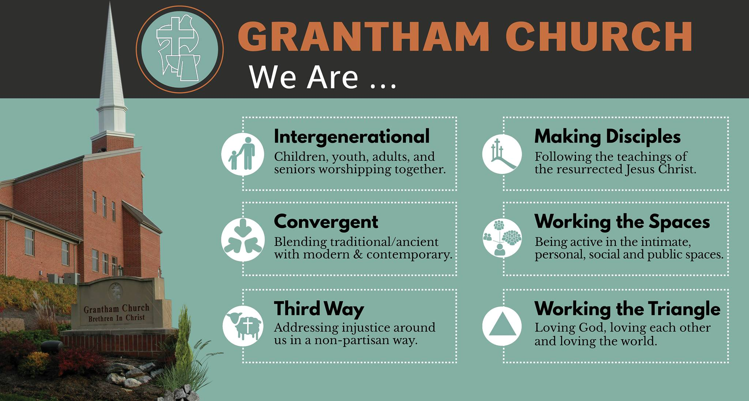
Notes:
[READ THE FIRST THREE & COMMENT]
So, our call is to: Bridge the divides in our world by beginning with our own church.
We want to promote and pursue diversity in our leadership and congregation, embrace convergent worship, and model third-way unity that bridges the divides of political and theological differences.
We also want to warmly welcome all who enter our doors, actively participate in meeting the needs of our local community, and generously support our ministry partners in the U.S. and around the world.
We also want to equip and empower our members to share their faith with those who are spiritually curious, invite people to join us in worship, and lead people to the God who looks like Jesus.
And we want to help our members understand their spiritual gifts, talents, and skills as followers of Jesus and identify corresponding service opportunities in the church and in the broader community.
We want to make disciples who are passionate about Jesus. Therefore, we are committed to spiritual formation and making disciples by “working the spaces” through public worship, learning communities, sermon-based small groups, and intimate accountability groups. [NEXT SLIDE]

Slide 8
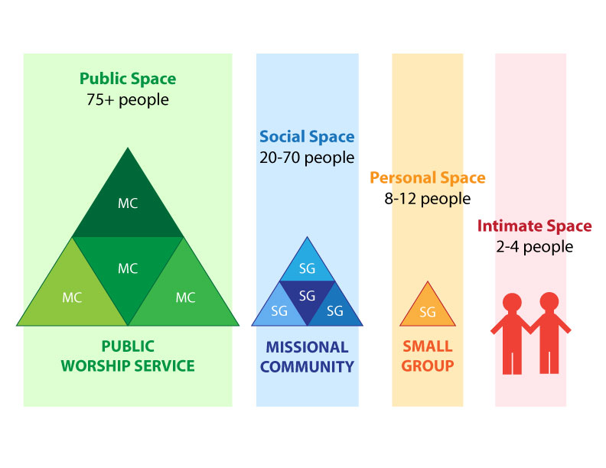
Notes:
[BRIEFLY EXPLAIN]
It’s critical that we work all of these spaces together!
While we can’t work the public space during the pandemic, we can the social, personal, and intimate spaces.
And remember, part of being a disciple and making disciples is to maintain spiritual balance and health. [NEXT SLIDE]

Slide 9
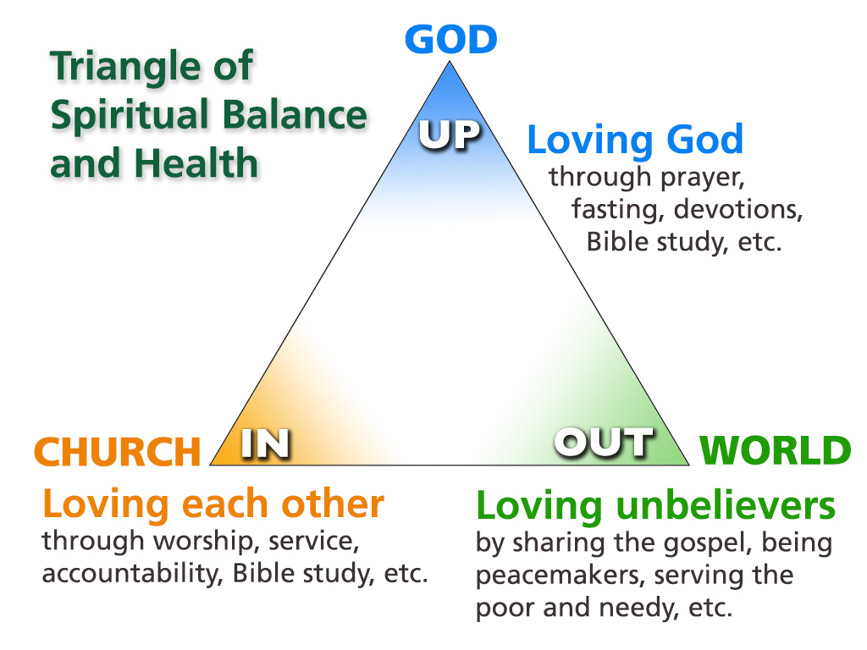
Notes:
[BRIEFLY EXPLAIN]
Notice what is at the top of the triangle: our direct connection to God in Christ.
We must stay connected to Jesus… [NEXT SLIDE]

Slide 10
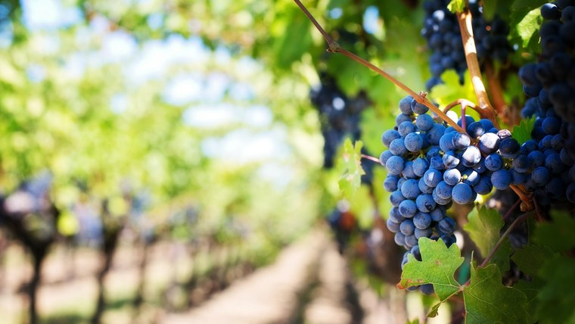
“Yes, I am the vine; you are the branches. Those who remain in me, and I in them, will produce much fruit. For apart from me you can do nothing.”
Jesus, John 15:5 NLT
Notes:
[BRIEF COMMENT]

Slide 11
John 15:6-8 NLT
⁶ Anyone who does not remain in me is thrown away like a useless branch and withers. Such branches are gathered into a pile to be burned. ⁷ But if you remain in me and my words remain in you, you may ask for anything you want, and it will be granted! ⁸ When you produce much fruit, you are my true disciples. This brings great glory to my Father.
Notes:
[BRIEF COMMENTS]
v. 7 – Since Jesus says we can ask him for anything that involves the bearing of fruit and he will grant it, I’d like to invite you to join me in praying for the following this year. [NEXT SLIDE]

Slide 12

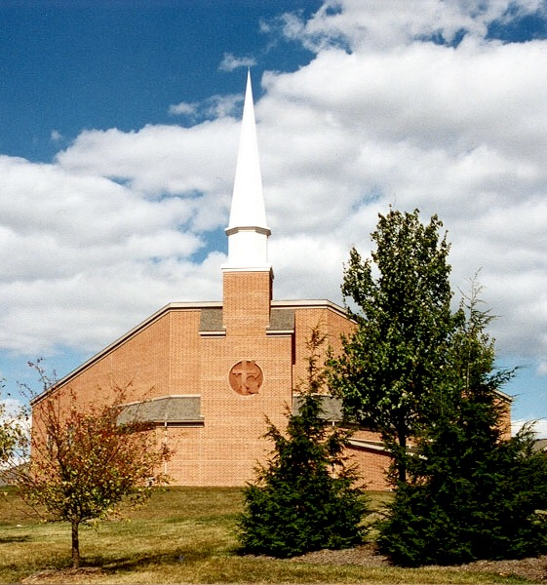
Pressing On With
Our Prayers in 2021
Please pray for the following:
Notes:
[BRIEF COMMENT ON EACH]
Why do these things matter? – the furtherance of Great Commission and the Kingdom
Why do we want to grow our church in these ways? – for the glory of God and the fame of his Son
We desire to be a thriving church so that we might lead others to the God who looks like Jesus.
[SHARE WHAT GOD DESIRES FOR GRANTHAM]
Ephesians 3:20-21 [NEXT SLIDE]

Slide 13
Pressing On With
Our Prayers in 2021
Please pray for the following:
Leadership at Grantham Church – pastoral team & church board
Notes:
[BRIEF COMMENT ON EACH]
Why do these things matter? – the furtherance of Great Commission and the Kingdom
Why do we want to grow our church in these ways? – for the glory of God and the fame of his Son
We desire to be a thriving church so that we might lead others to the God who looks like Jesus.
[SHARE WHAT GOD DESIRES FOR GRANTHAM]
Ephesians 3:20-21 [NEXT SLIDE]

Slide 14
Pressing On With
Our Prayers in 2021
Please pray for the following:
Leadership at Grantham Church – pastoral team & church board
Search/Hiring Process and the Rebuilding of Church Staff
Notes:
[BRIEF COMMENT ON EACH]
Why do these things matter? – the furtherance of Great Commission and the Kingdom
Why do we want to grow our church in these ways? – for the glory of God and the fame of his Son
We desire to be a thriving church so that we might lead others to the God who looks like Jesus.
[SHARE WHAT GOD DESIRES FOR GRANTHAM]
Ephesians 3:20-21 [NEXT SLIDE]

Slide 15
Pressing On With
Our Prayers in 2021
Please pray for the following:
Leadership at Grantham Church – pastoral team & church board
Search/Hiring Process and the Rebuilding of Church Staff
Development and Implementation of 5-year Mission & Vision
Notes:
[BRIEF COMMENT ON EACH]
Why do these things matter? – the furtherance of Great Commission and the Kingdom
Why do we want to grow our church in these ways? – for the glory of God and the fame of his Son
We desire to be a thriving church so that we might lead others to the God who looks like Jesus.
[SHARE WHAT GOD DESIRES FOR GRANTHAM]
Ephesians 3:20-21 [NEXT SLIDE]

Slide 16
Pressing On With
Our Prayers in 2021
Please pray for the following:
Leadership at Grantham Church – pastoral team & church board
Search/Hiring Process and the Rebuilding of Church Staff
Development and Implementation of 5-year Mission & Vision
Increased Connection, Discipleship and Spiritual Growth
Notes:
[BRIEF COMMENT ON EACH]
Why do these things matter? – the furtherance of Great Commission and the Kingdom
Why do we want to grow our church in these ways? – for the glory of God and the fame of his Son
We desire to be a thriving church so that we might lead others to the God who looks like Jesus.
[SHARE WHAT GOD DESIRES FOR GRANTHAM]
Ephesians 3:20-21 [NEXT SLIDE]

Slide 17
Pressing On With
Our Prayers in 2021
Please pray for the following:
Leadership at Grantham Church – pastoral team & church board
Search/Hiring Process and the Rebuilding of Church Staff
Development and Implementation of 5-year Mission & Vision
Increased Connection, Discipleship and Spiritual Growth
Increased Passion, Energy and Holy Momentum
Notes:
[BRIEF COMMENT ON EACH]
Why do these things matter? – the furtherance of Great Commission and the Kingdom
Why do we want to grow our church in these ways? – for the glory of God and the fame of his Son
We desire to be a thriving church so that we might lead others to the God who looks like Jesus.
[SHARE WHAT GOD DESIRES FOR GRANTHAM]
Ephesians 3:20-21 [NEXT SLIDE]

Slide 18

“Now all glory to God, who is able, through his mighty power at work within [Grantham Church], to accomplish infinitely more than we might ask or think. Glory to him in the church and in Christ Jesus through all generations forever and ever! Amen.”
Ephesians 3:20-21 NLT
Notes:
Will you believe in Jesus to do greater things in 2021?
Will you commit to praying, staying connected, giving, serving, and working the spaces as you’re able?
Will you join me in embracing a vision for a church that is consumed with knowing Jesus and making him known?
Church, remember that our goal is knowing Christ. And his desire is for more of God’s reign and rule to be known in our lives and in our community. Therefore, let us press on toward the goal, let us continue running the race, so that others may know the loving God we are coming to know.
Let’s make it a great year, church!

