Slide 1

Notes:
[BRIEF WELCOME]
Living Out Our Calling – that is the theme of this year’s Spring Celebration Service.
This morning, we are giving attention to how God is at work through the lives of people in our congregation, and how the Lord has called each of us to further the Kingdom in and outside the church.
The word “vocation” comes from the Latin, vocare, which means “to call.” Before I introduce our panel this morning, think with me for a minute about some key Scriptures related to calling and biblical characters that God has called… [NEXT SLIDE]

Slide 2
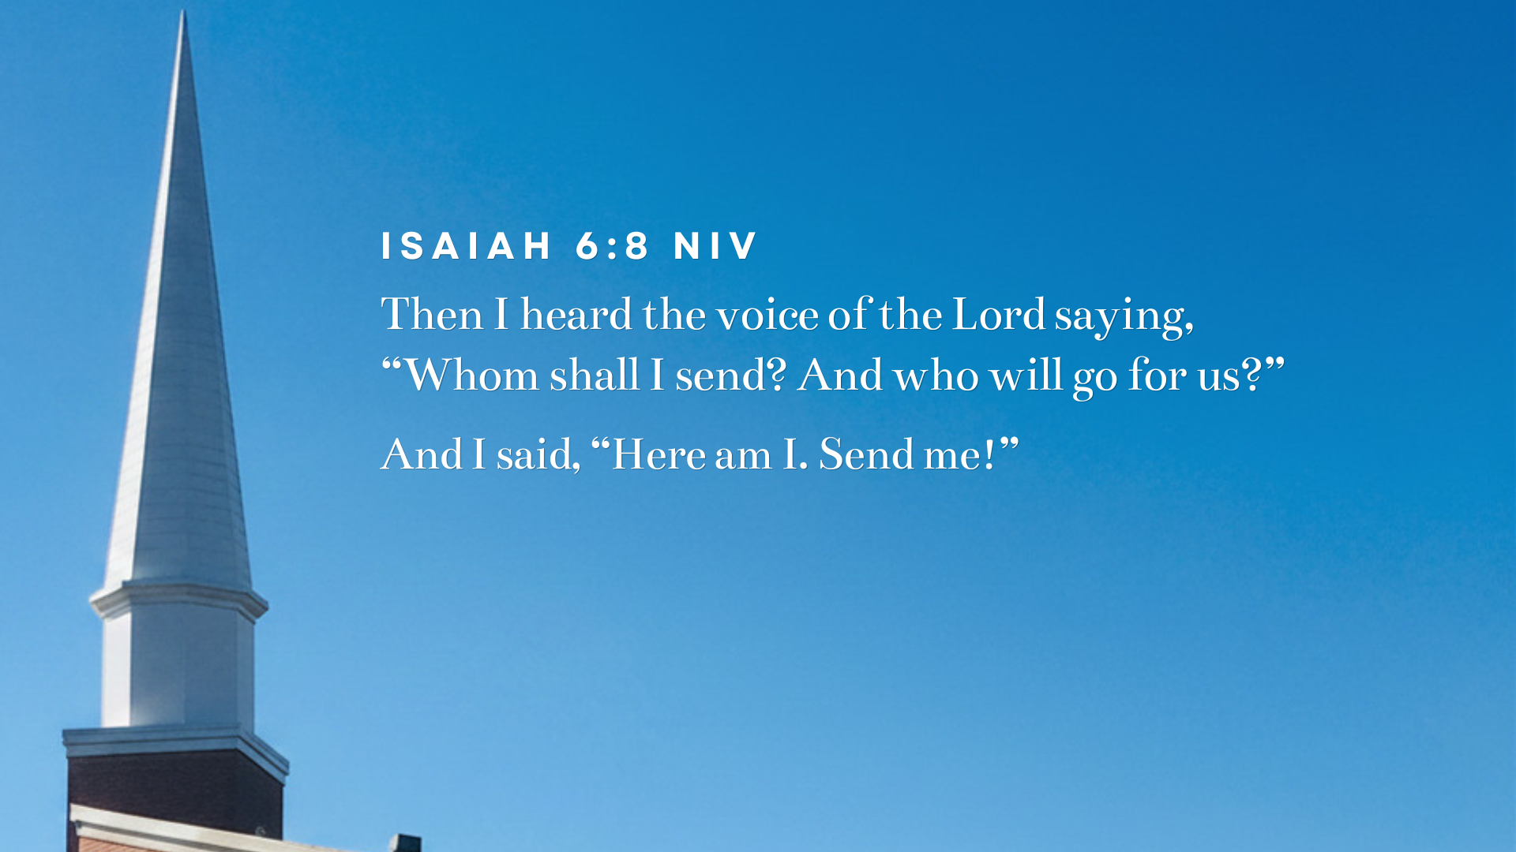
Notes:
[READ VERSE & COMMENT]
Isaiah was an 8th century prophet; hundreds of years before Jesus
He was called while worshipping in the Temple
His main message was that God is the holy and sovereign Ruler who brings judgment on sin and idolatry—particularly within Israel/Judah—but offers comfort, redemption, and restoration through a promised Messianic Servant.
Consider other biblical characters that God called to serve him in various ways… [NEXT SLIDE]

Slide 3
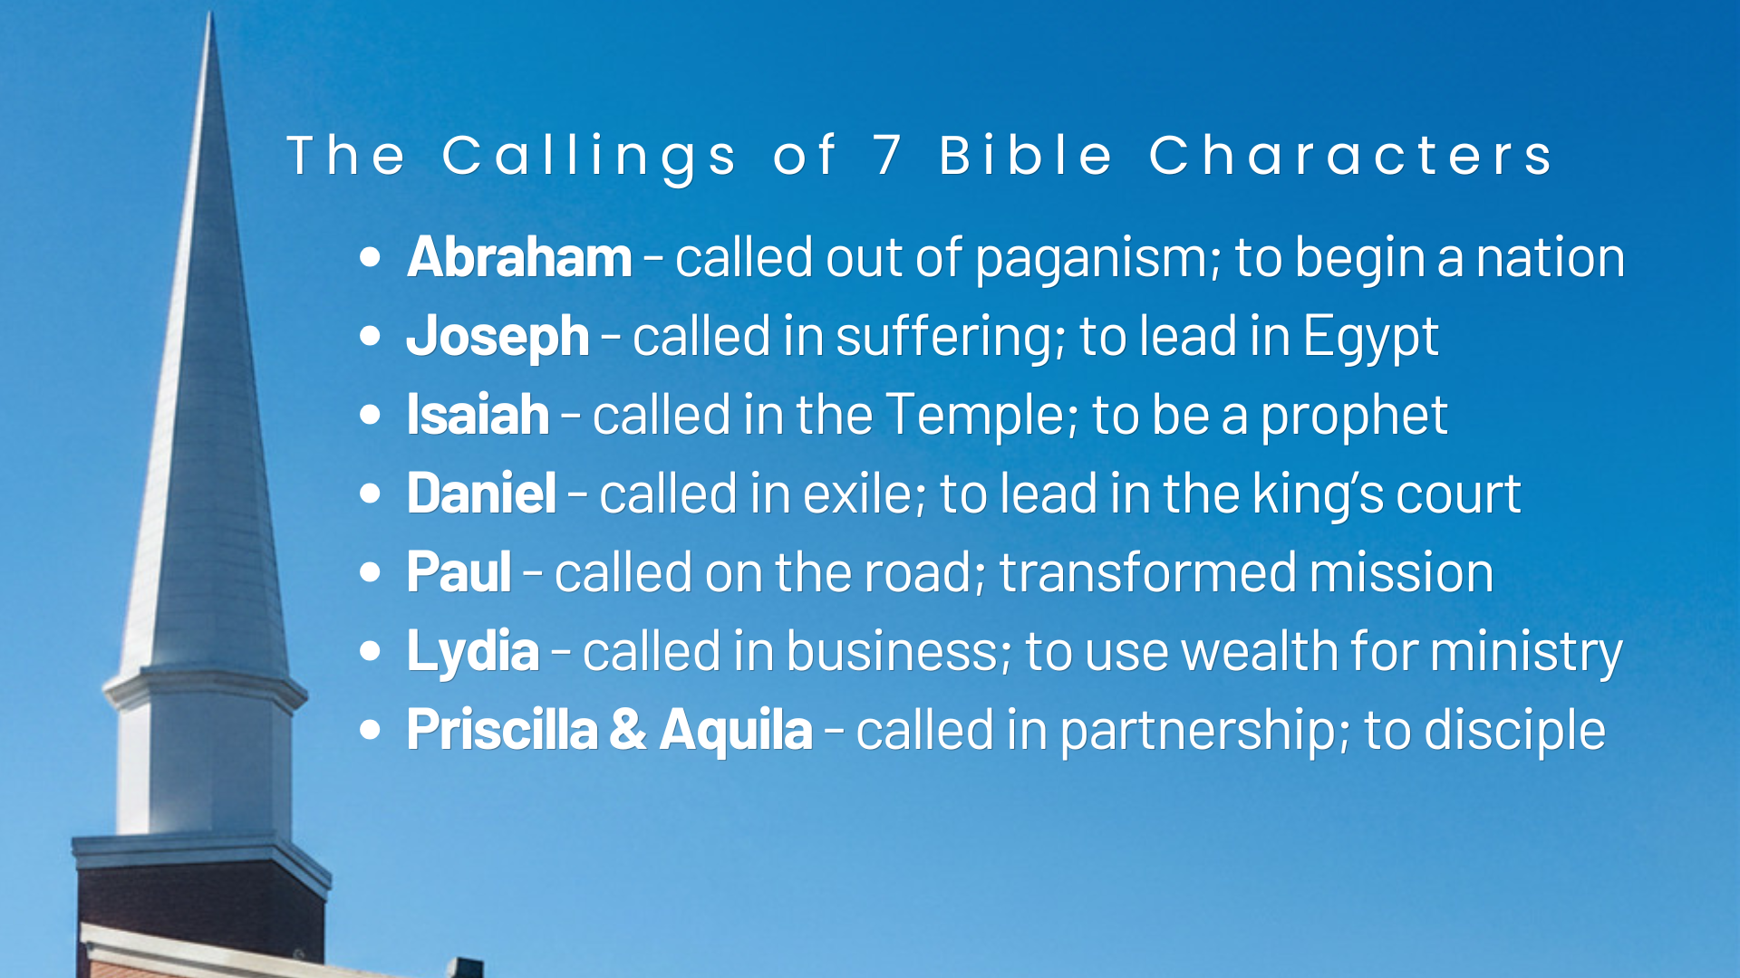
Notes:
[COMMENT ON BIBLE CHARACTERS]
Finally, listen to what the Apostle Paul writes to the church in Ephesus about calling… [NEXT SLIDE]

Slide 4
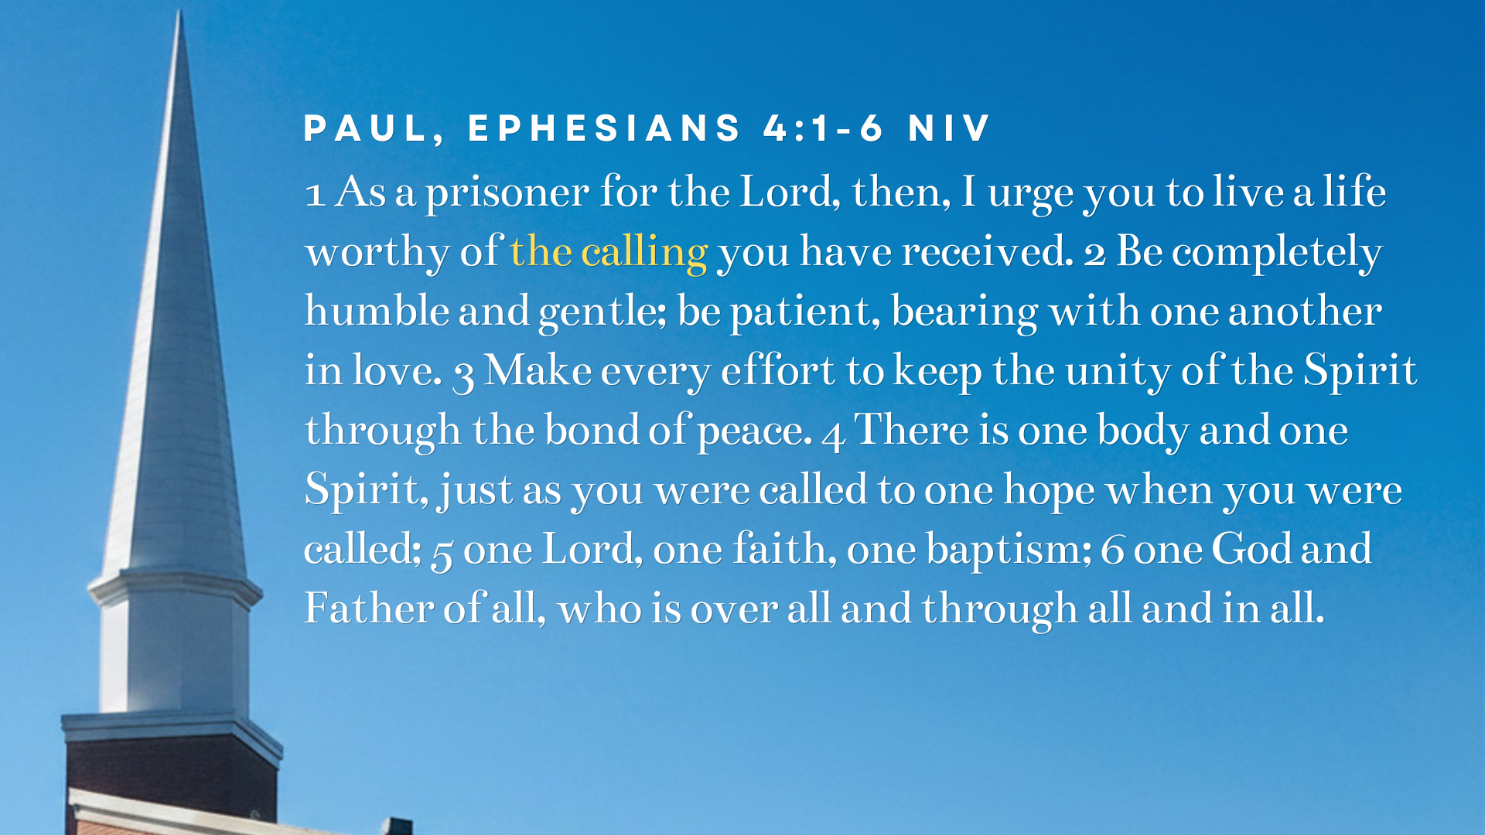
Notes:
[READ PASSAGE & COMMENT]
Today we’re going to hear from people responding to God’s call in their life; both inside and outside the church:
Dawn Isley – leads our Fellowship Meals
Sam Mummert – our new Children’s Team Coordinator
Chrissy Hoffner – our newly licensed youth pastor
Seth Derliunas – a congregant going into missions
Blaise Pepitone – who works for an energy company
Please give our participants a hand as they come to the stage… [NEXT SLIDE]

Slide 5
Notes:
[CONVERSATION WITH CONGREGANTS]
[REMAIN ON THIS SLIDE DURING CONVERSATION]
In closing… we’d like to invite the rest of you to consider some questions about your own calling… [NEXT SLIDE]

Slide 6
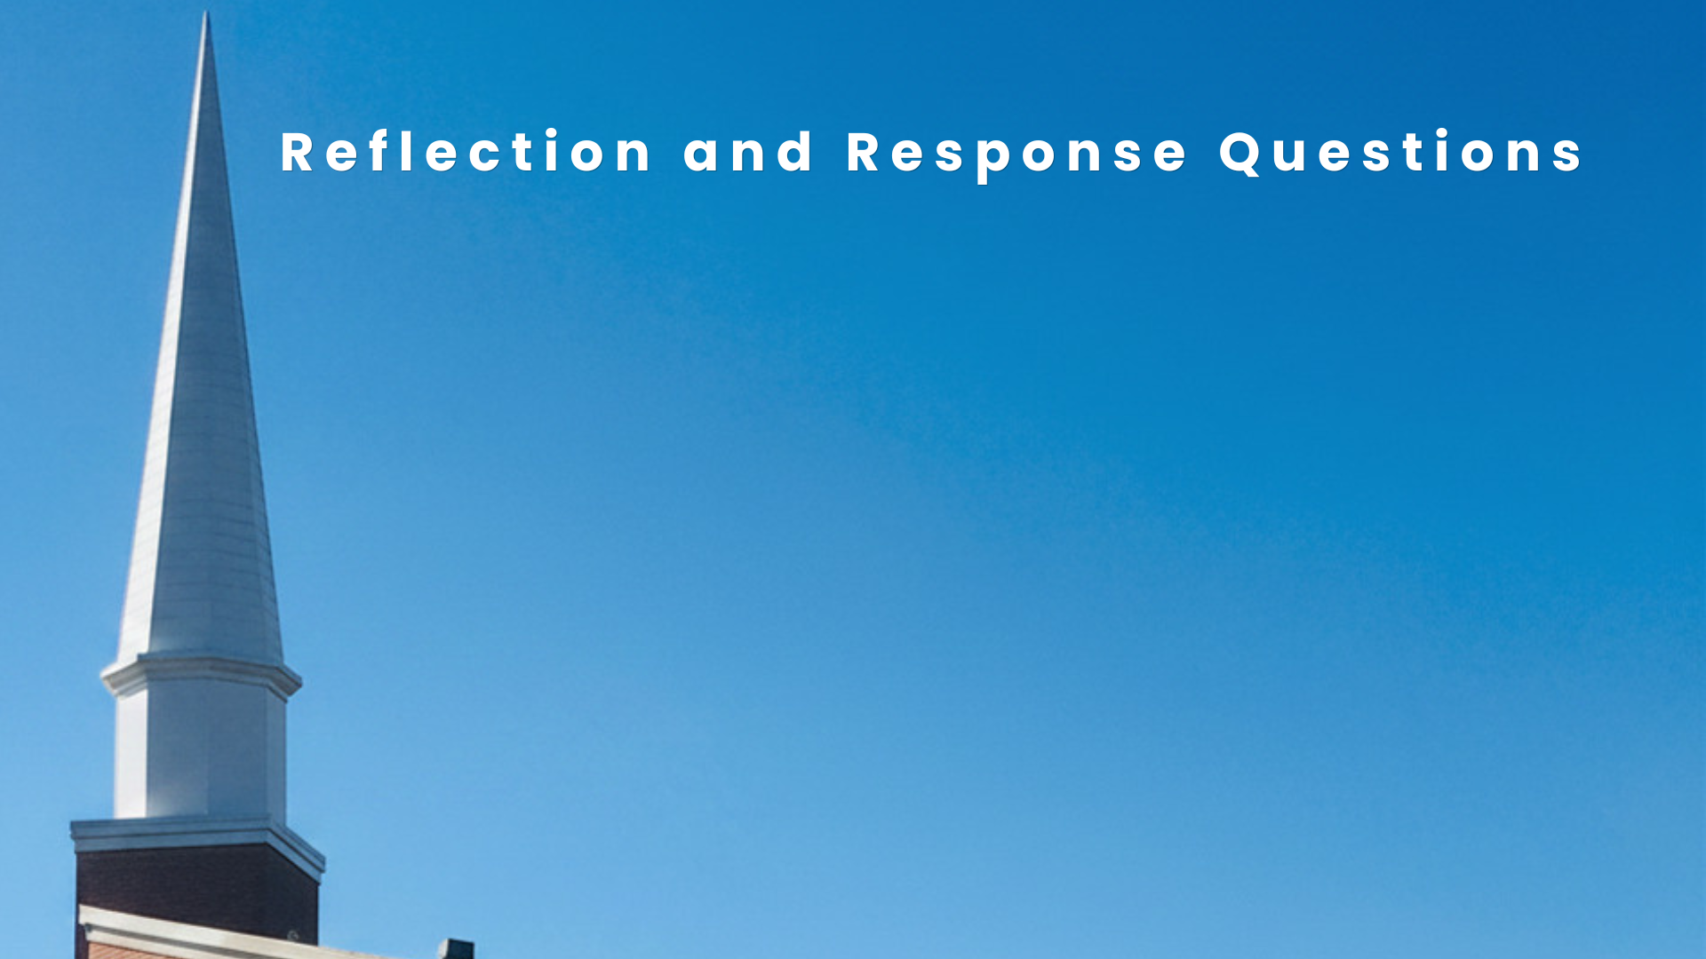

Slide 7
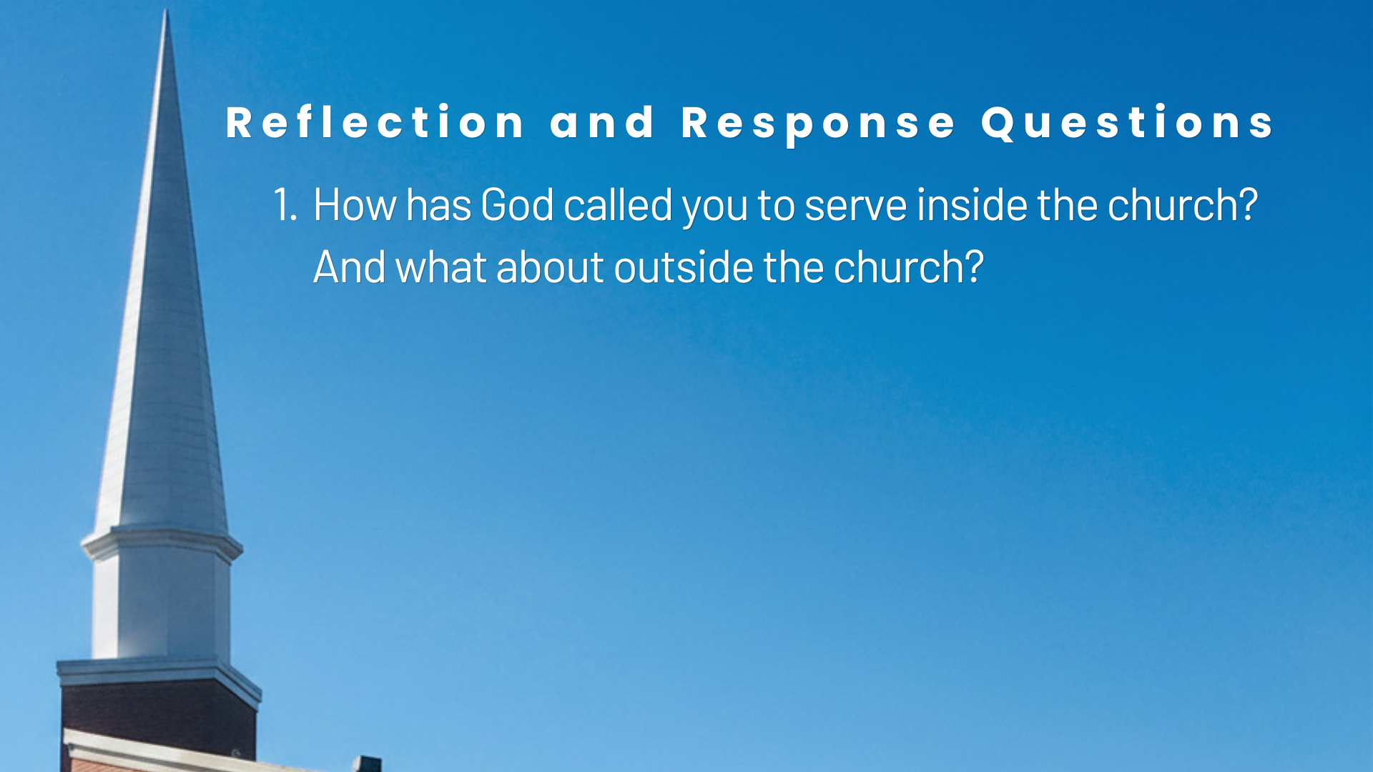

Slide 8
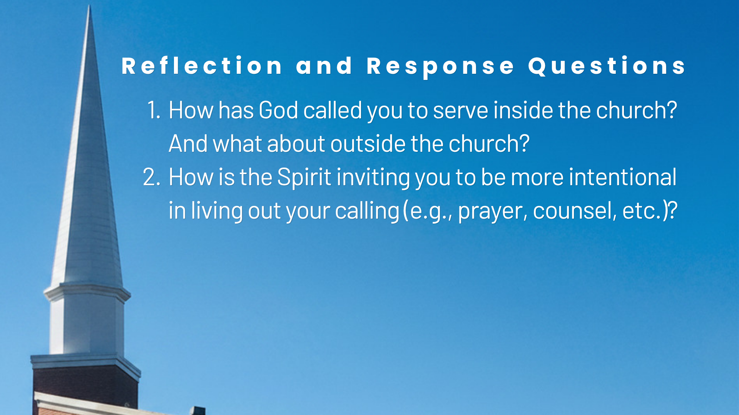

Slide 9
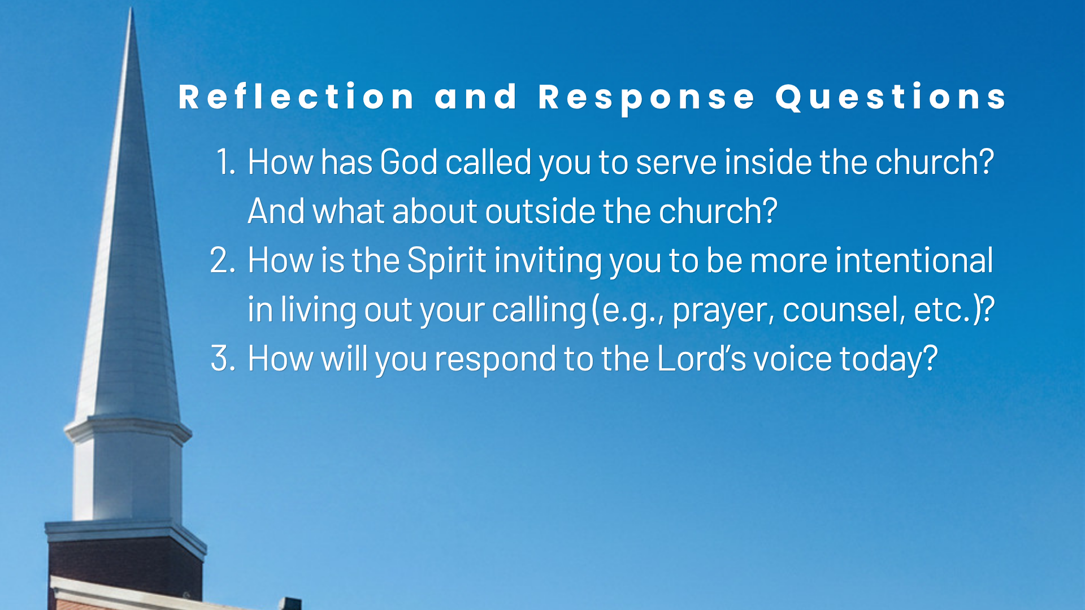
Notes:
[READ QUESTIONS & COMMENT]
How has God called you to serve inside the church? And what about outside the church?
How is the Spirit inviting you to be more intentional in living out your calling (e.g., prayer, counsel, etc.)?
How will you respond to the Lord’s voice today?
[INVITE MELISSA TO PRAY]
[GO TO NEXT SLIDE FOR CLOSING PRAYER]

Slide 10

Notes:
[CLOSING PRAYER]

