Slide 8
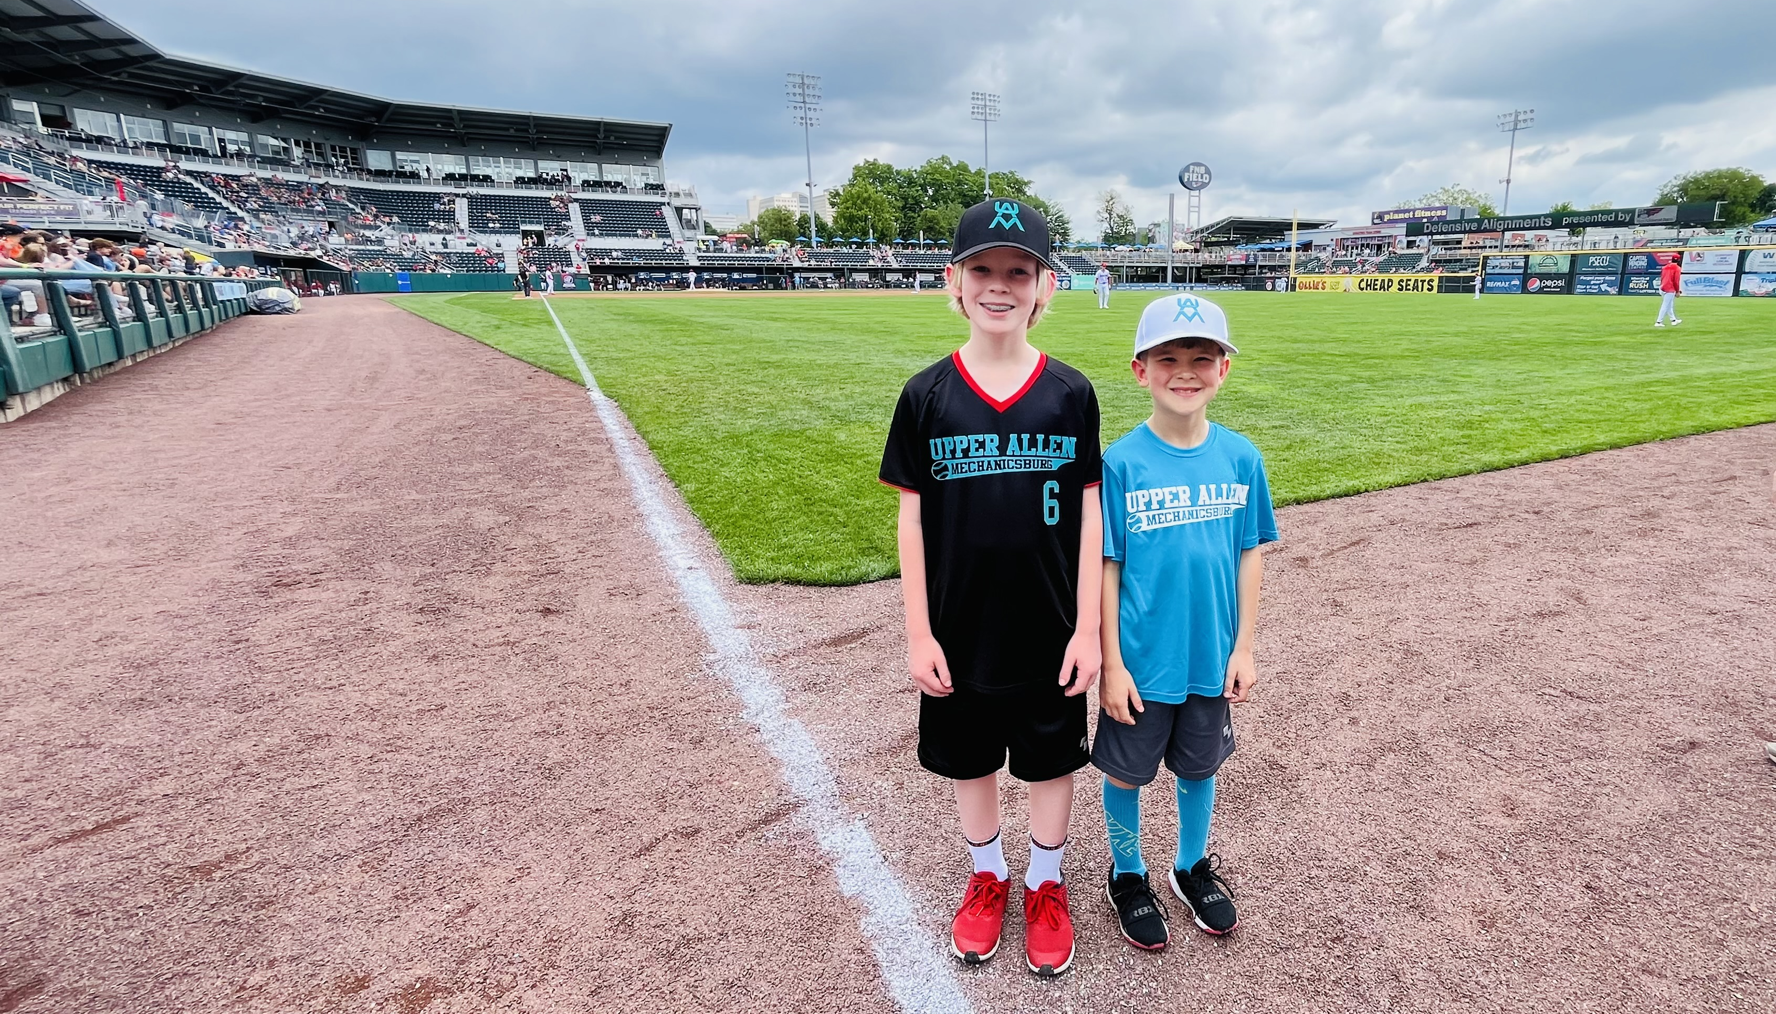
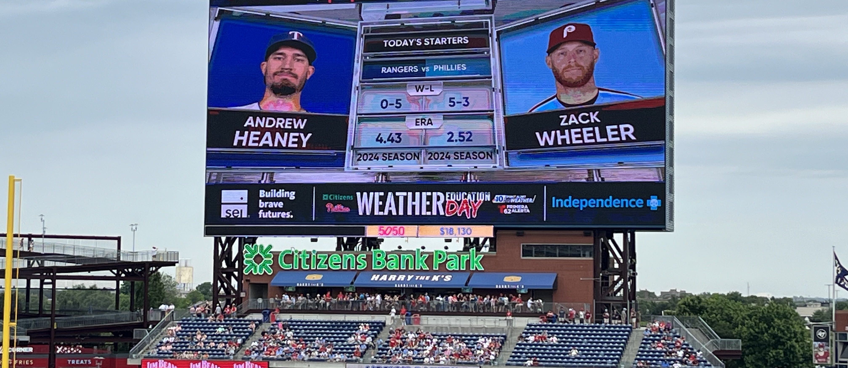
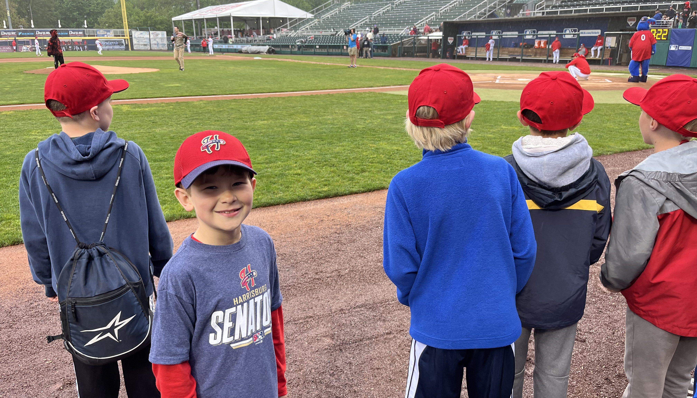

Slide 9
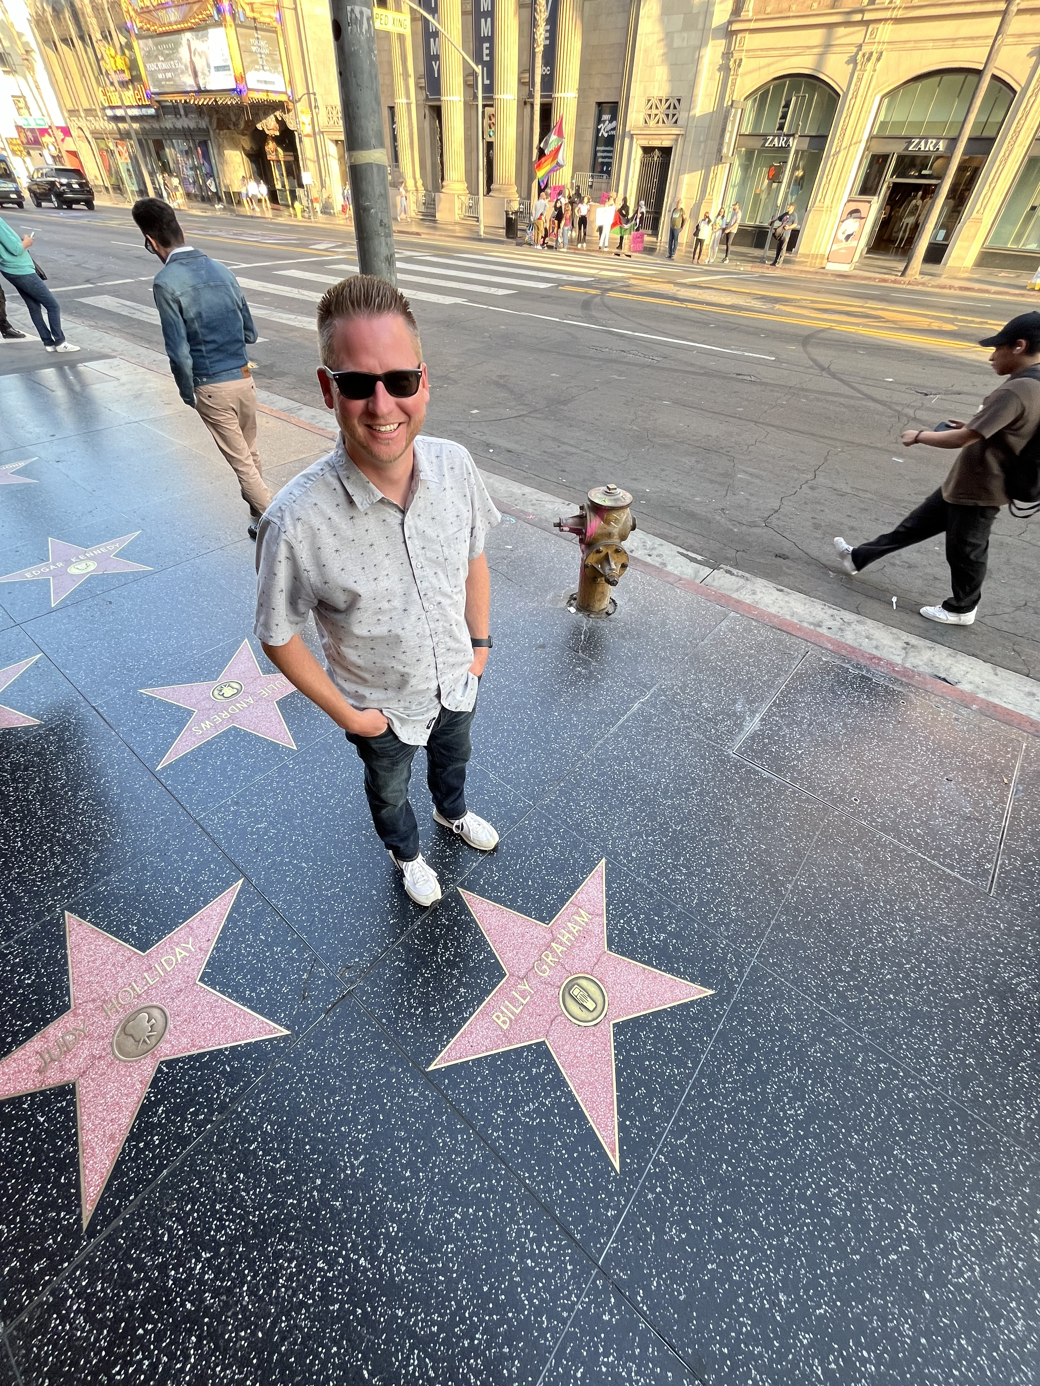
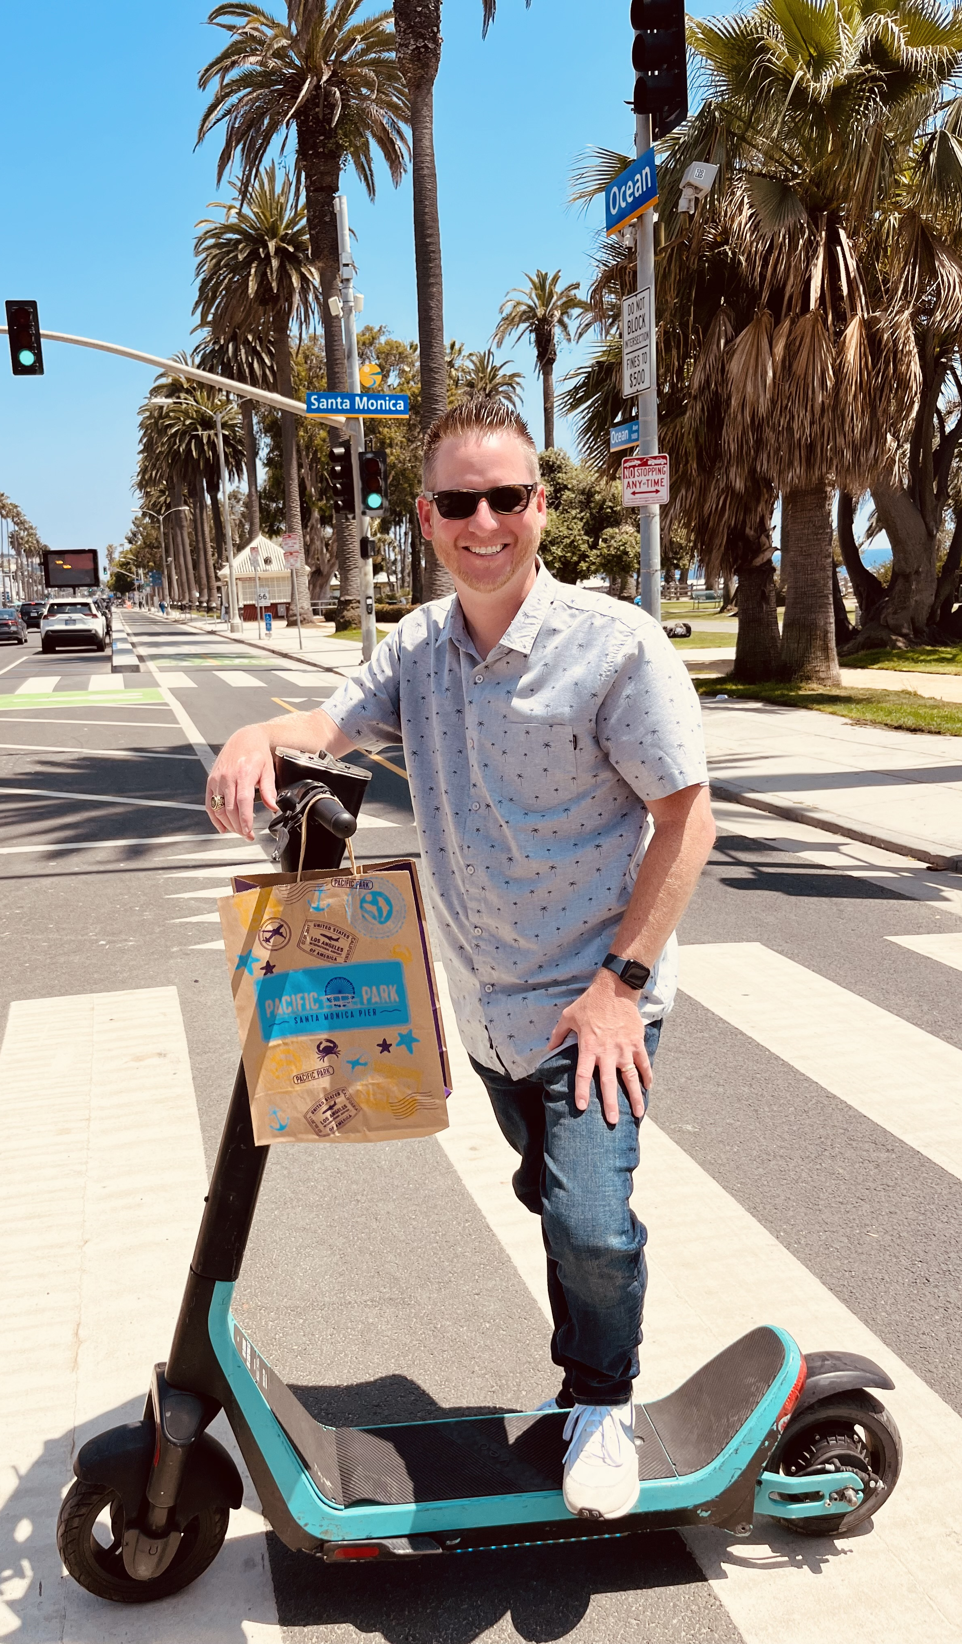
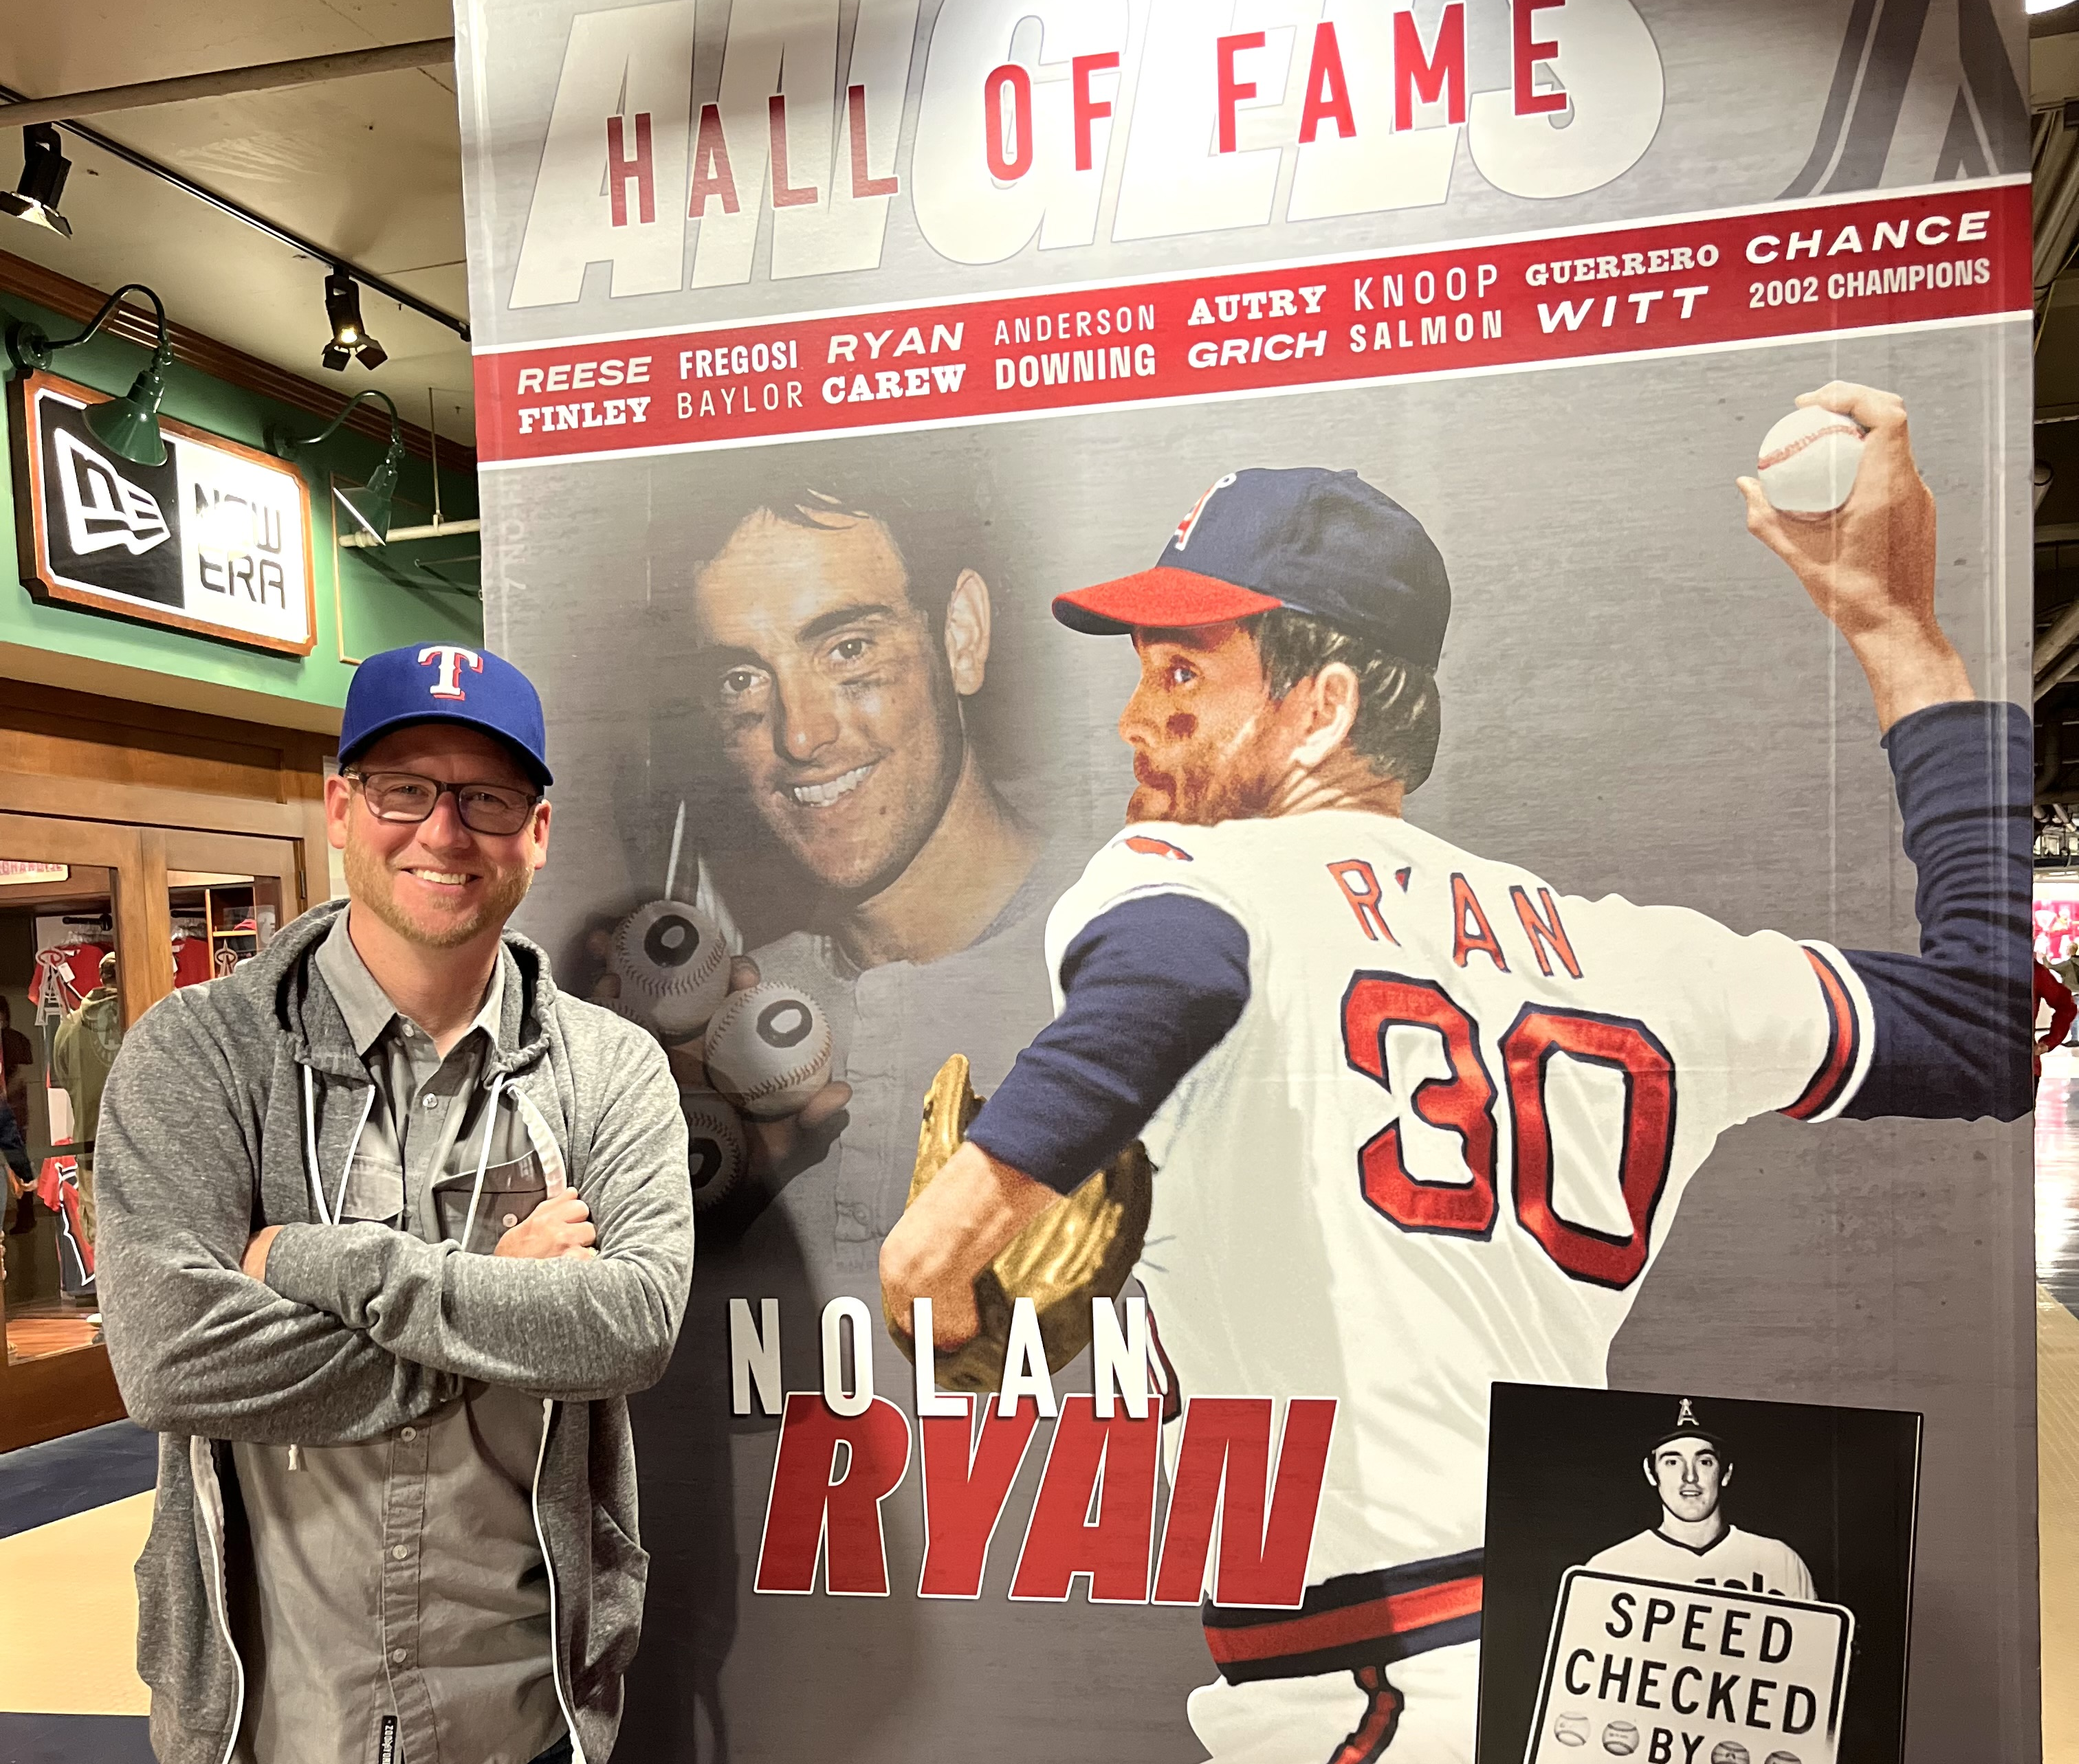
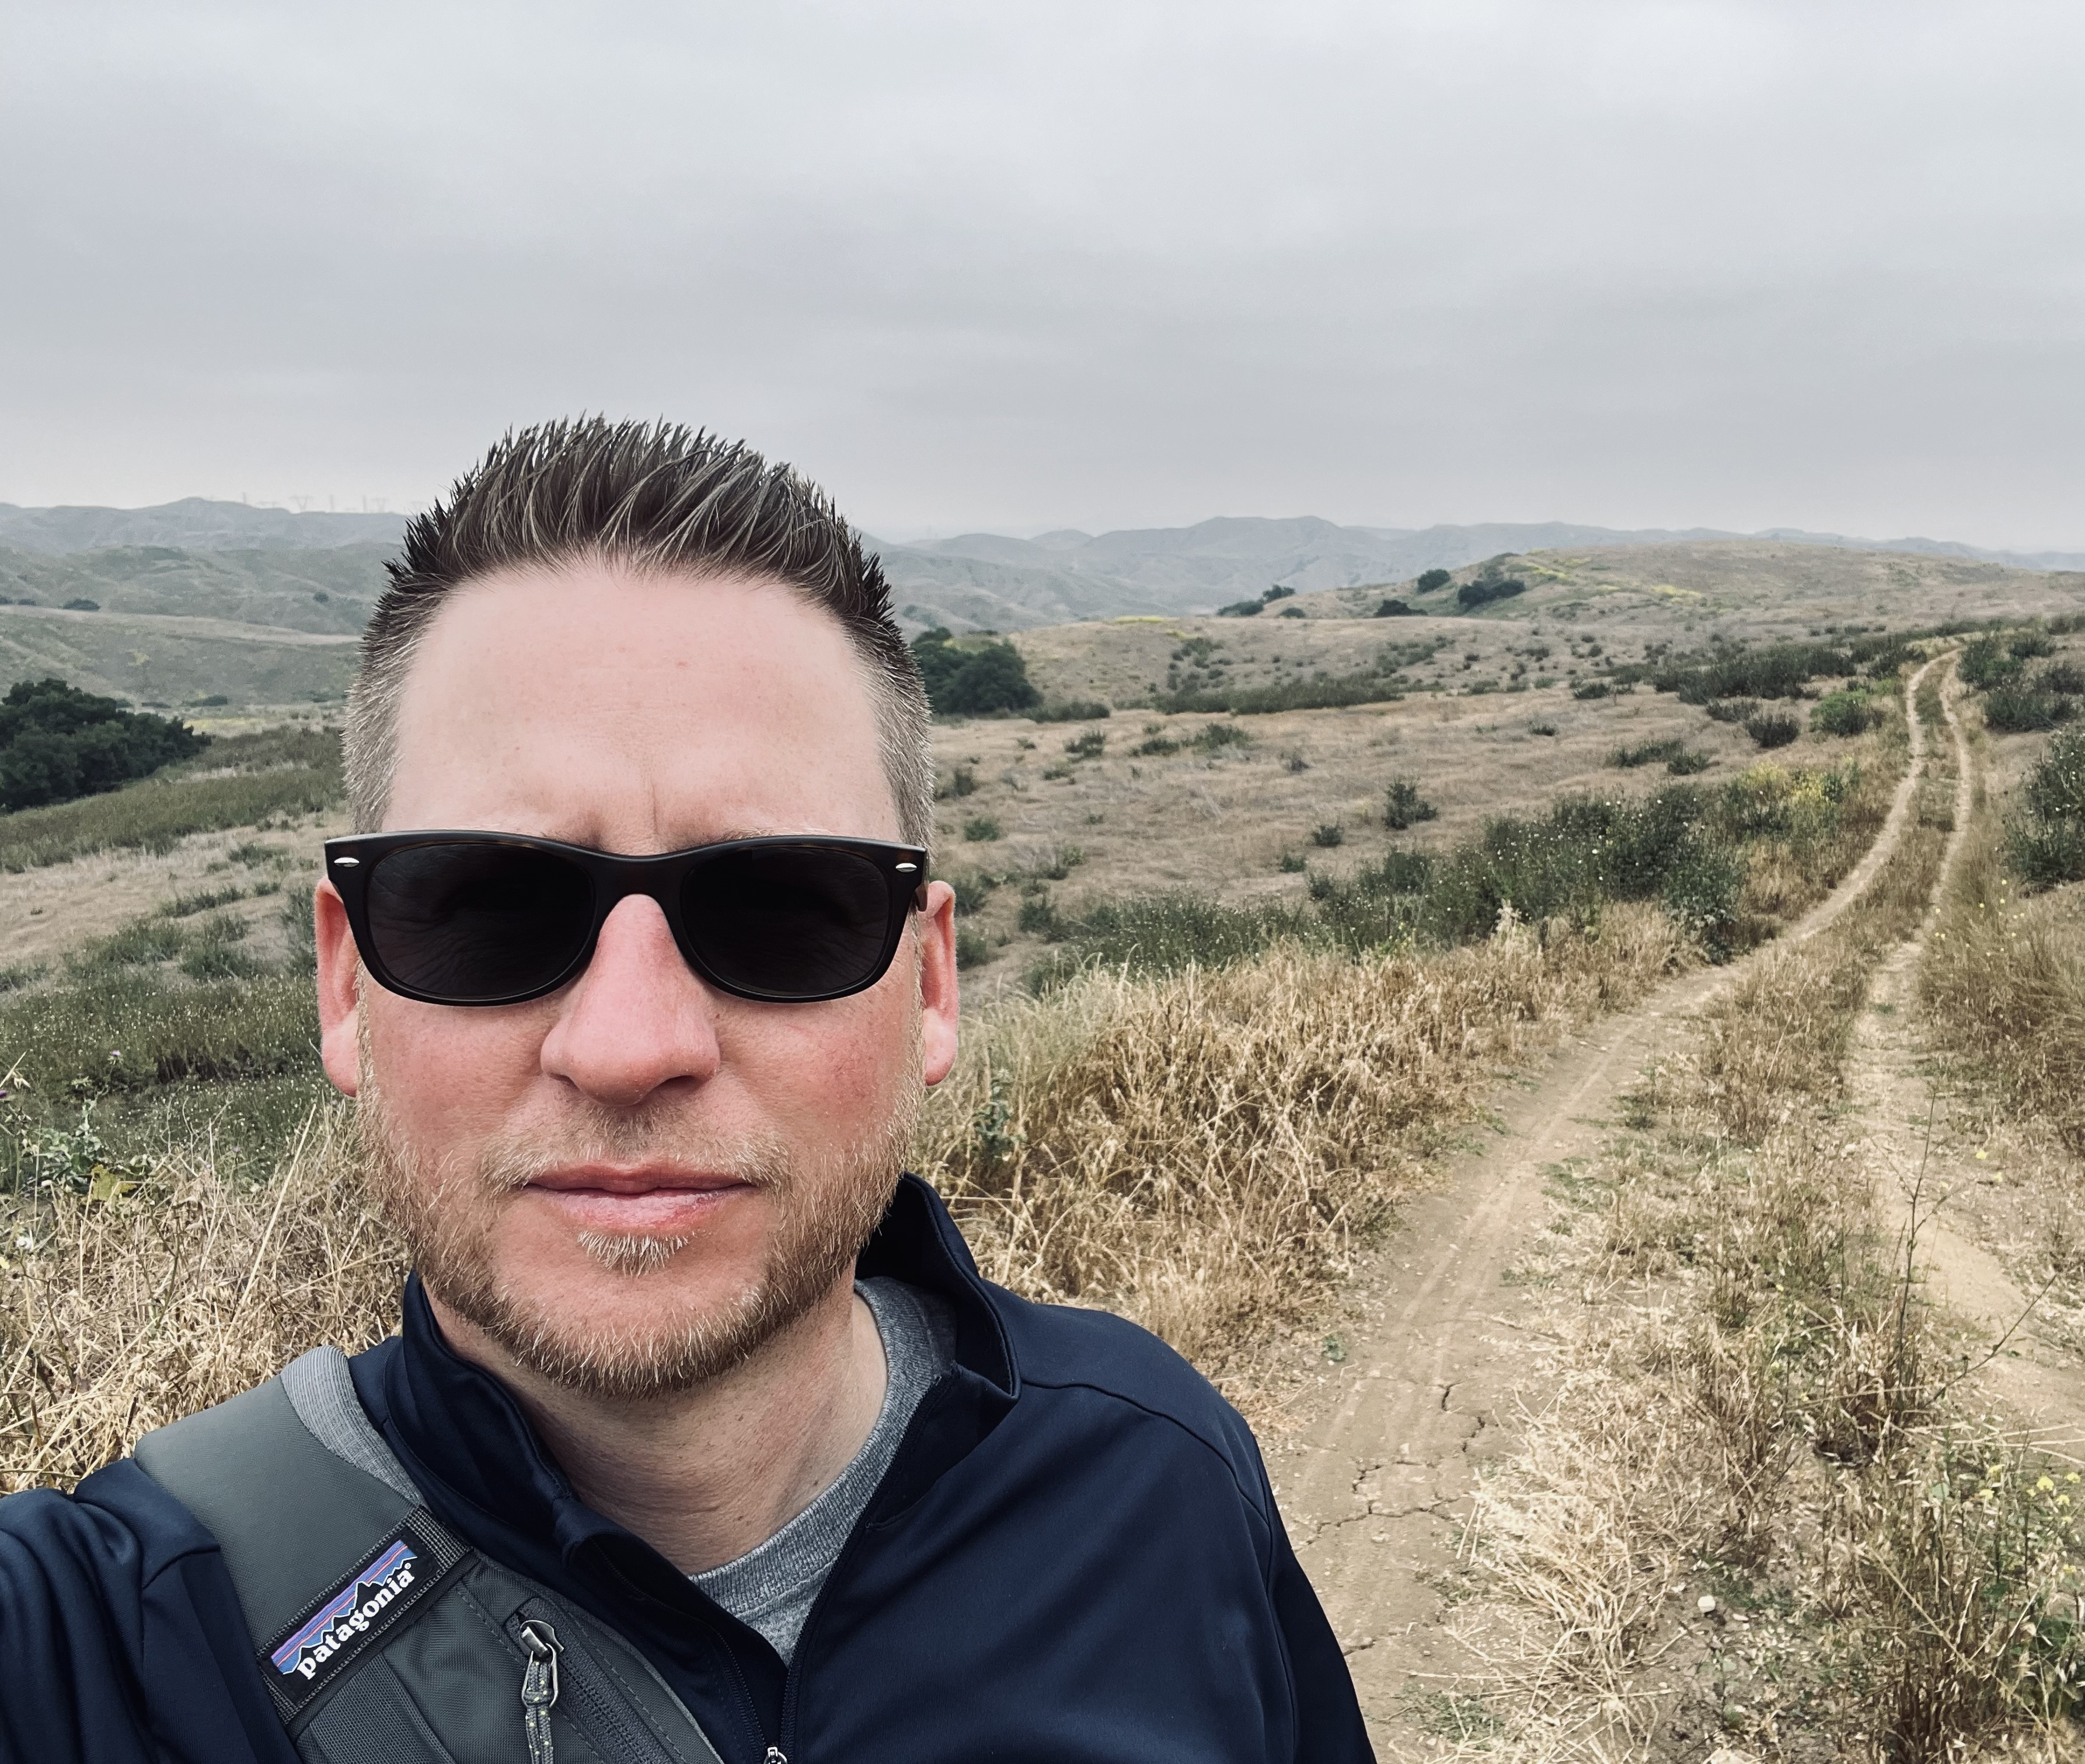
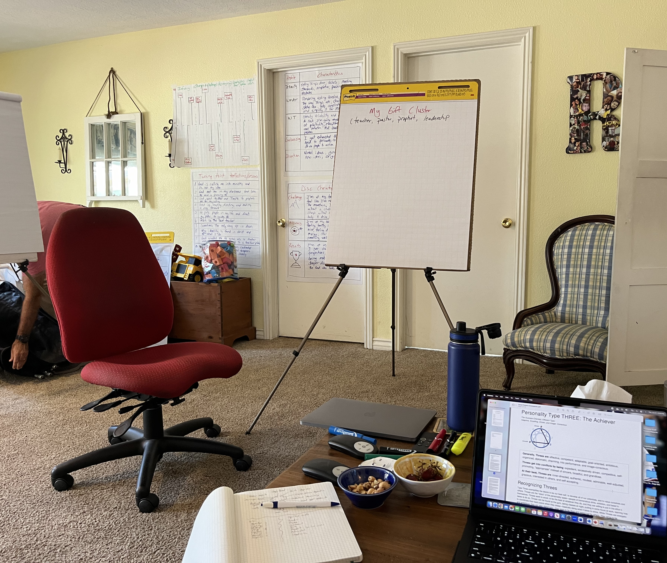

Slide 10
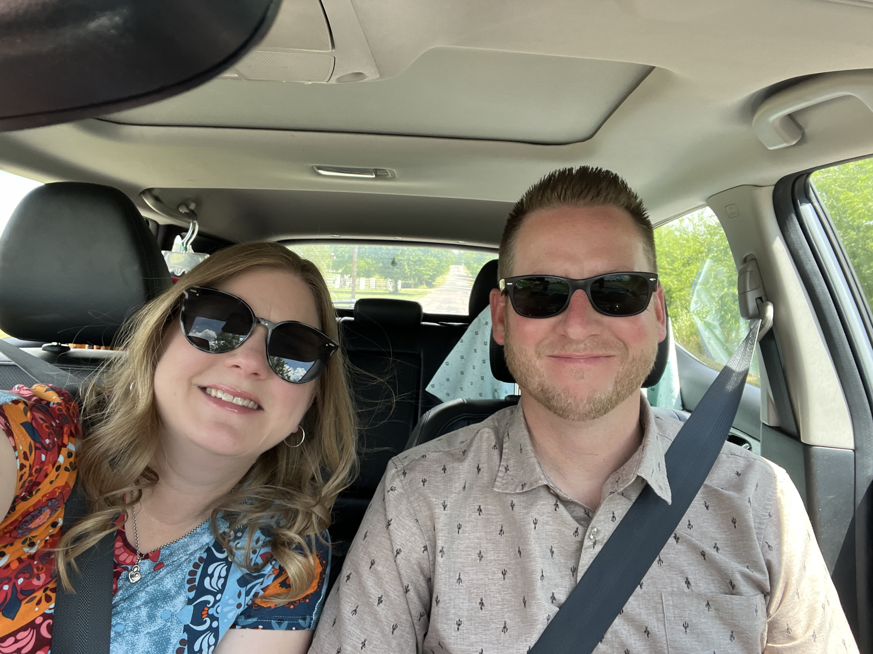
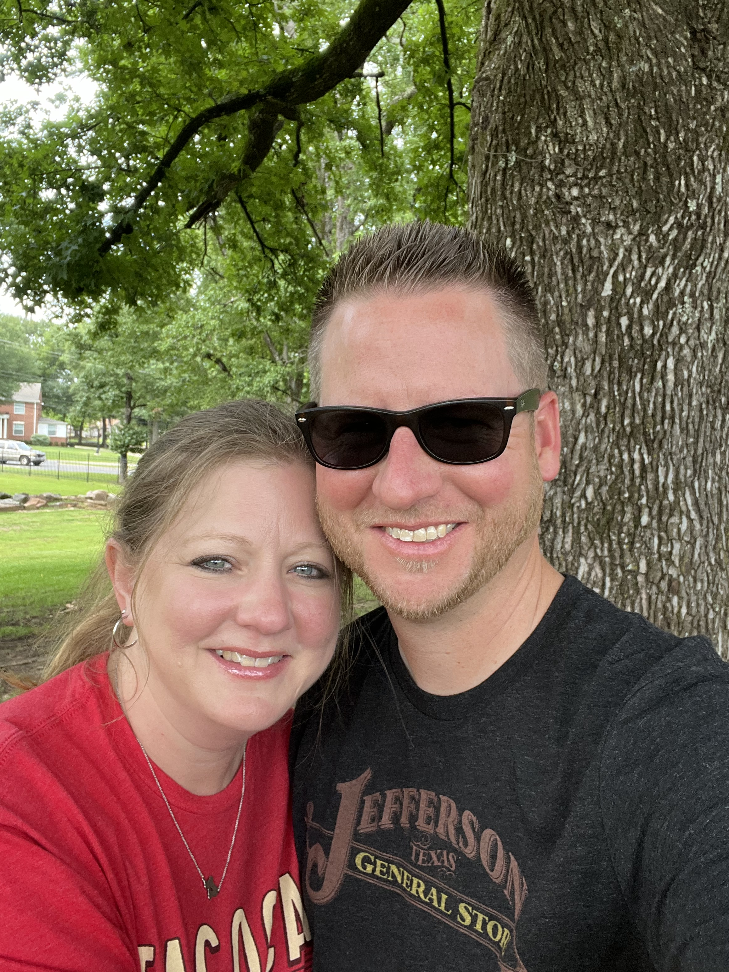
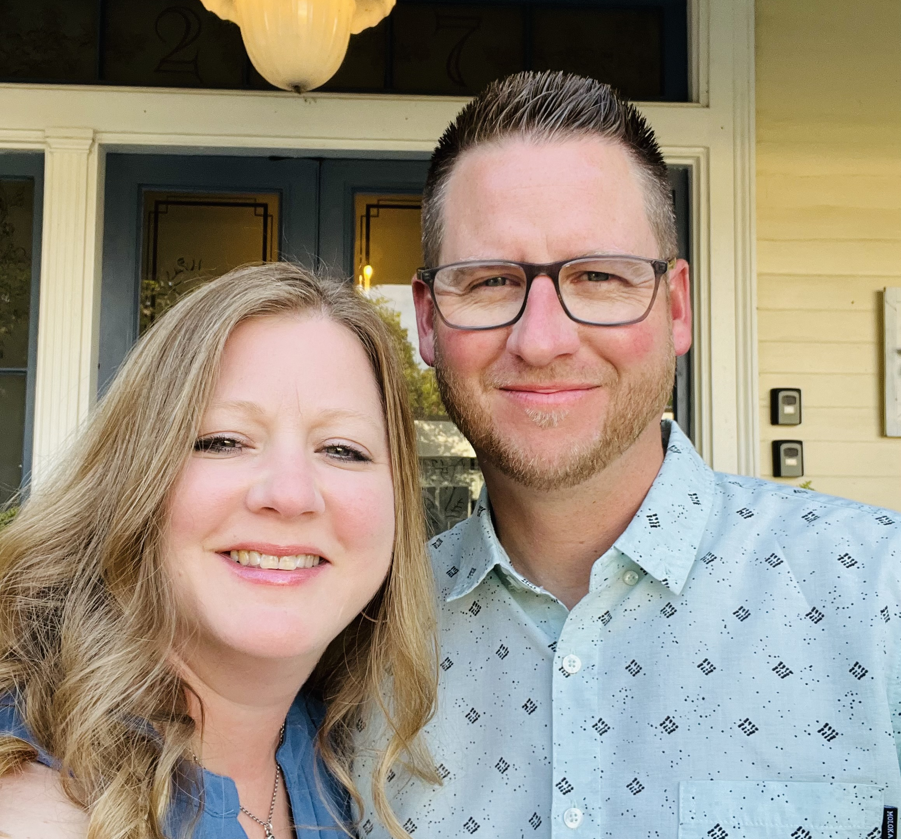
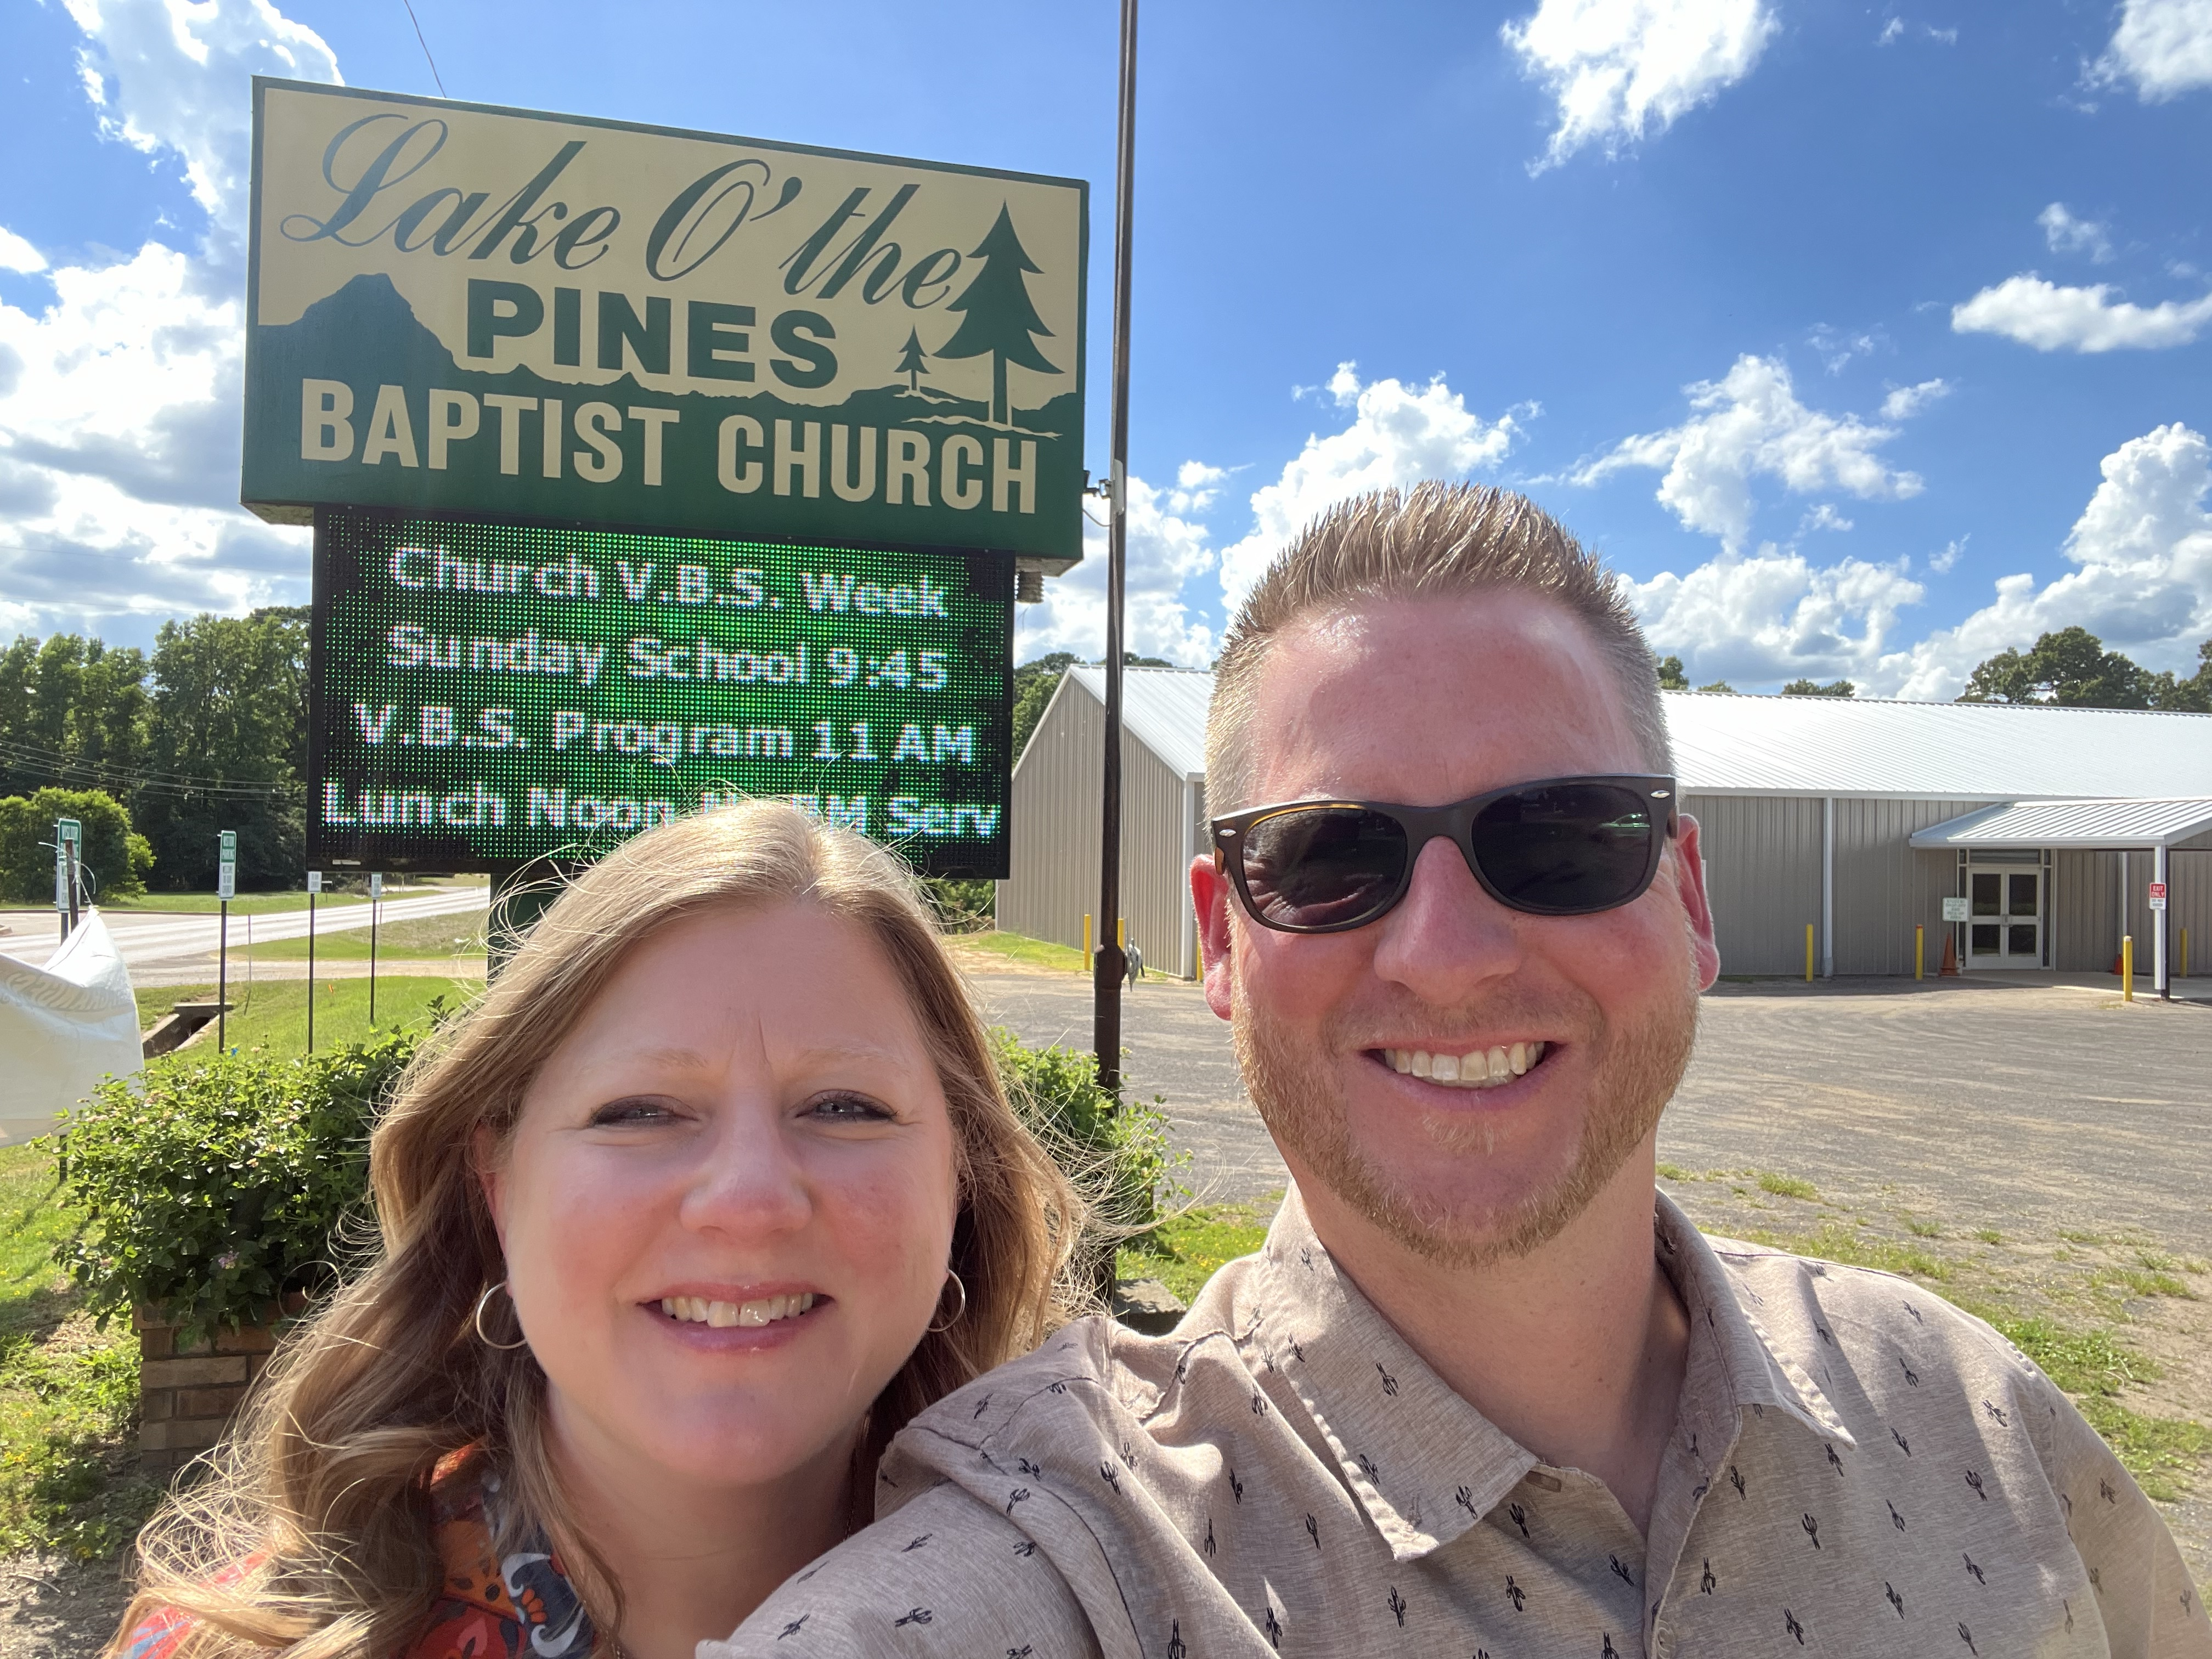
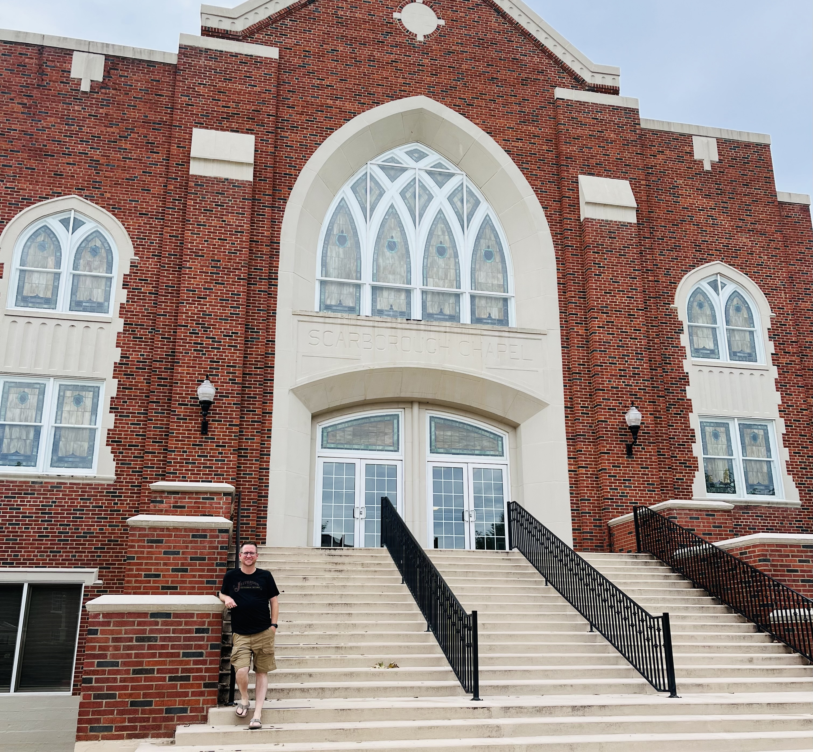

Slide 11
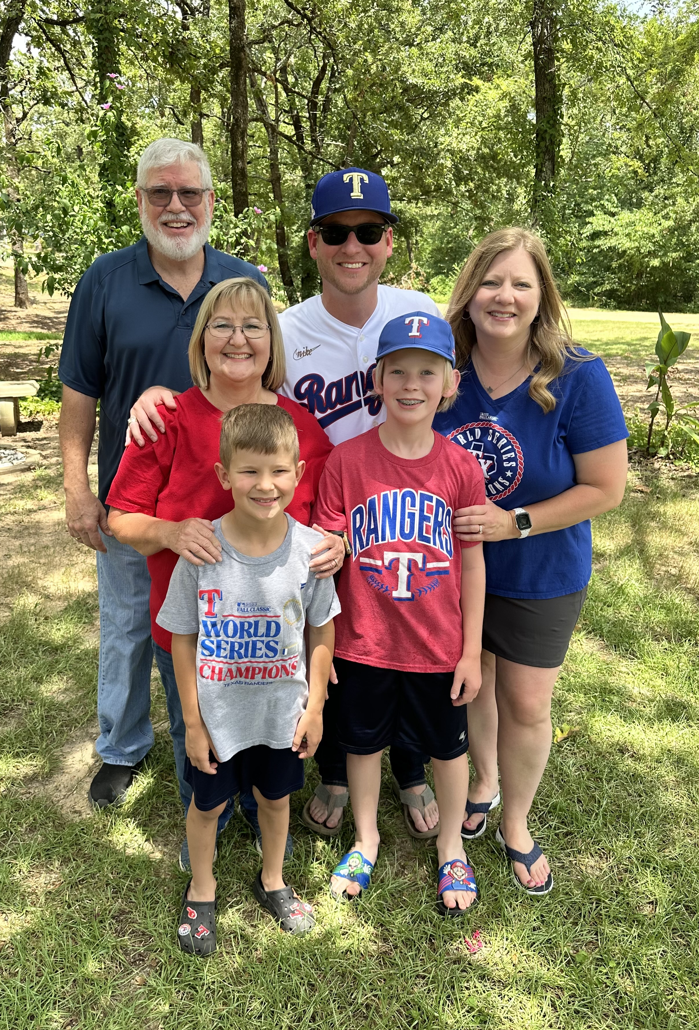
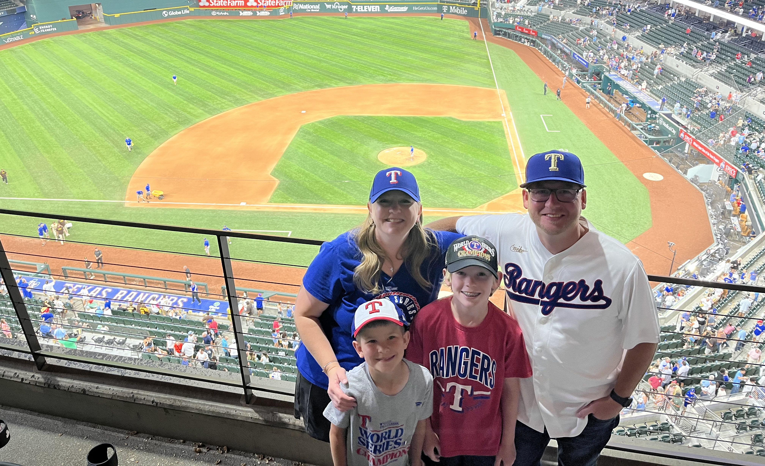
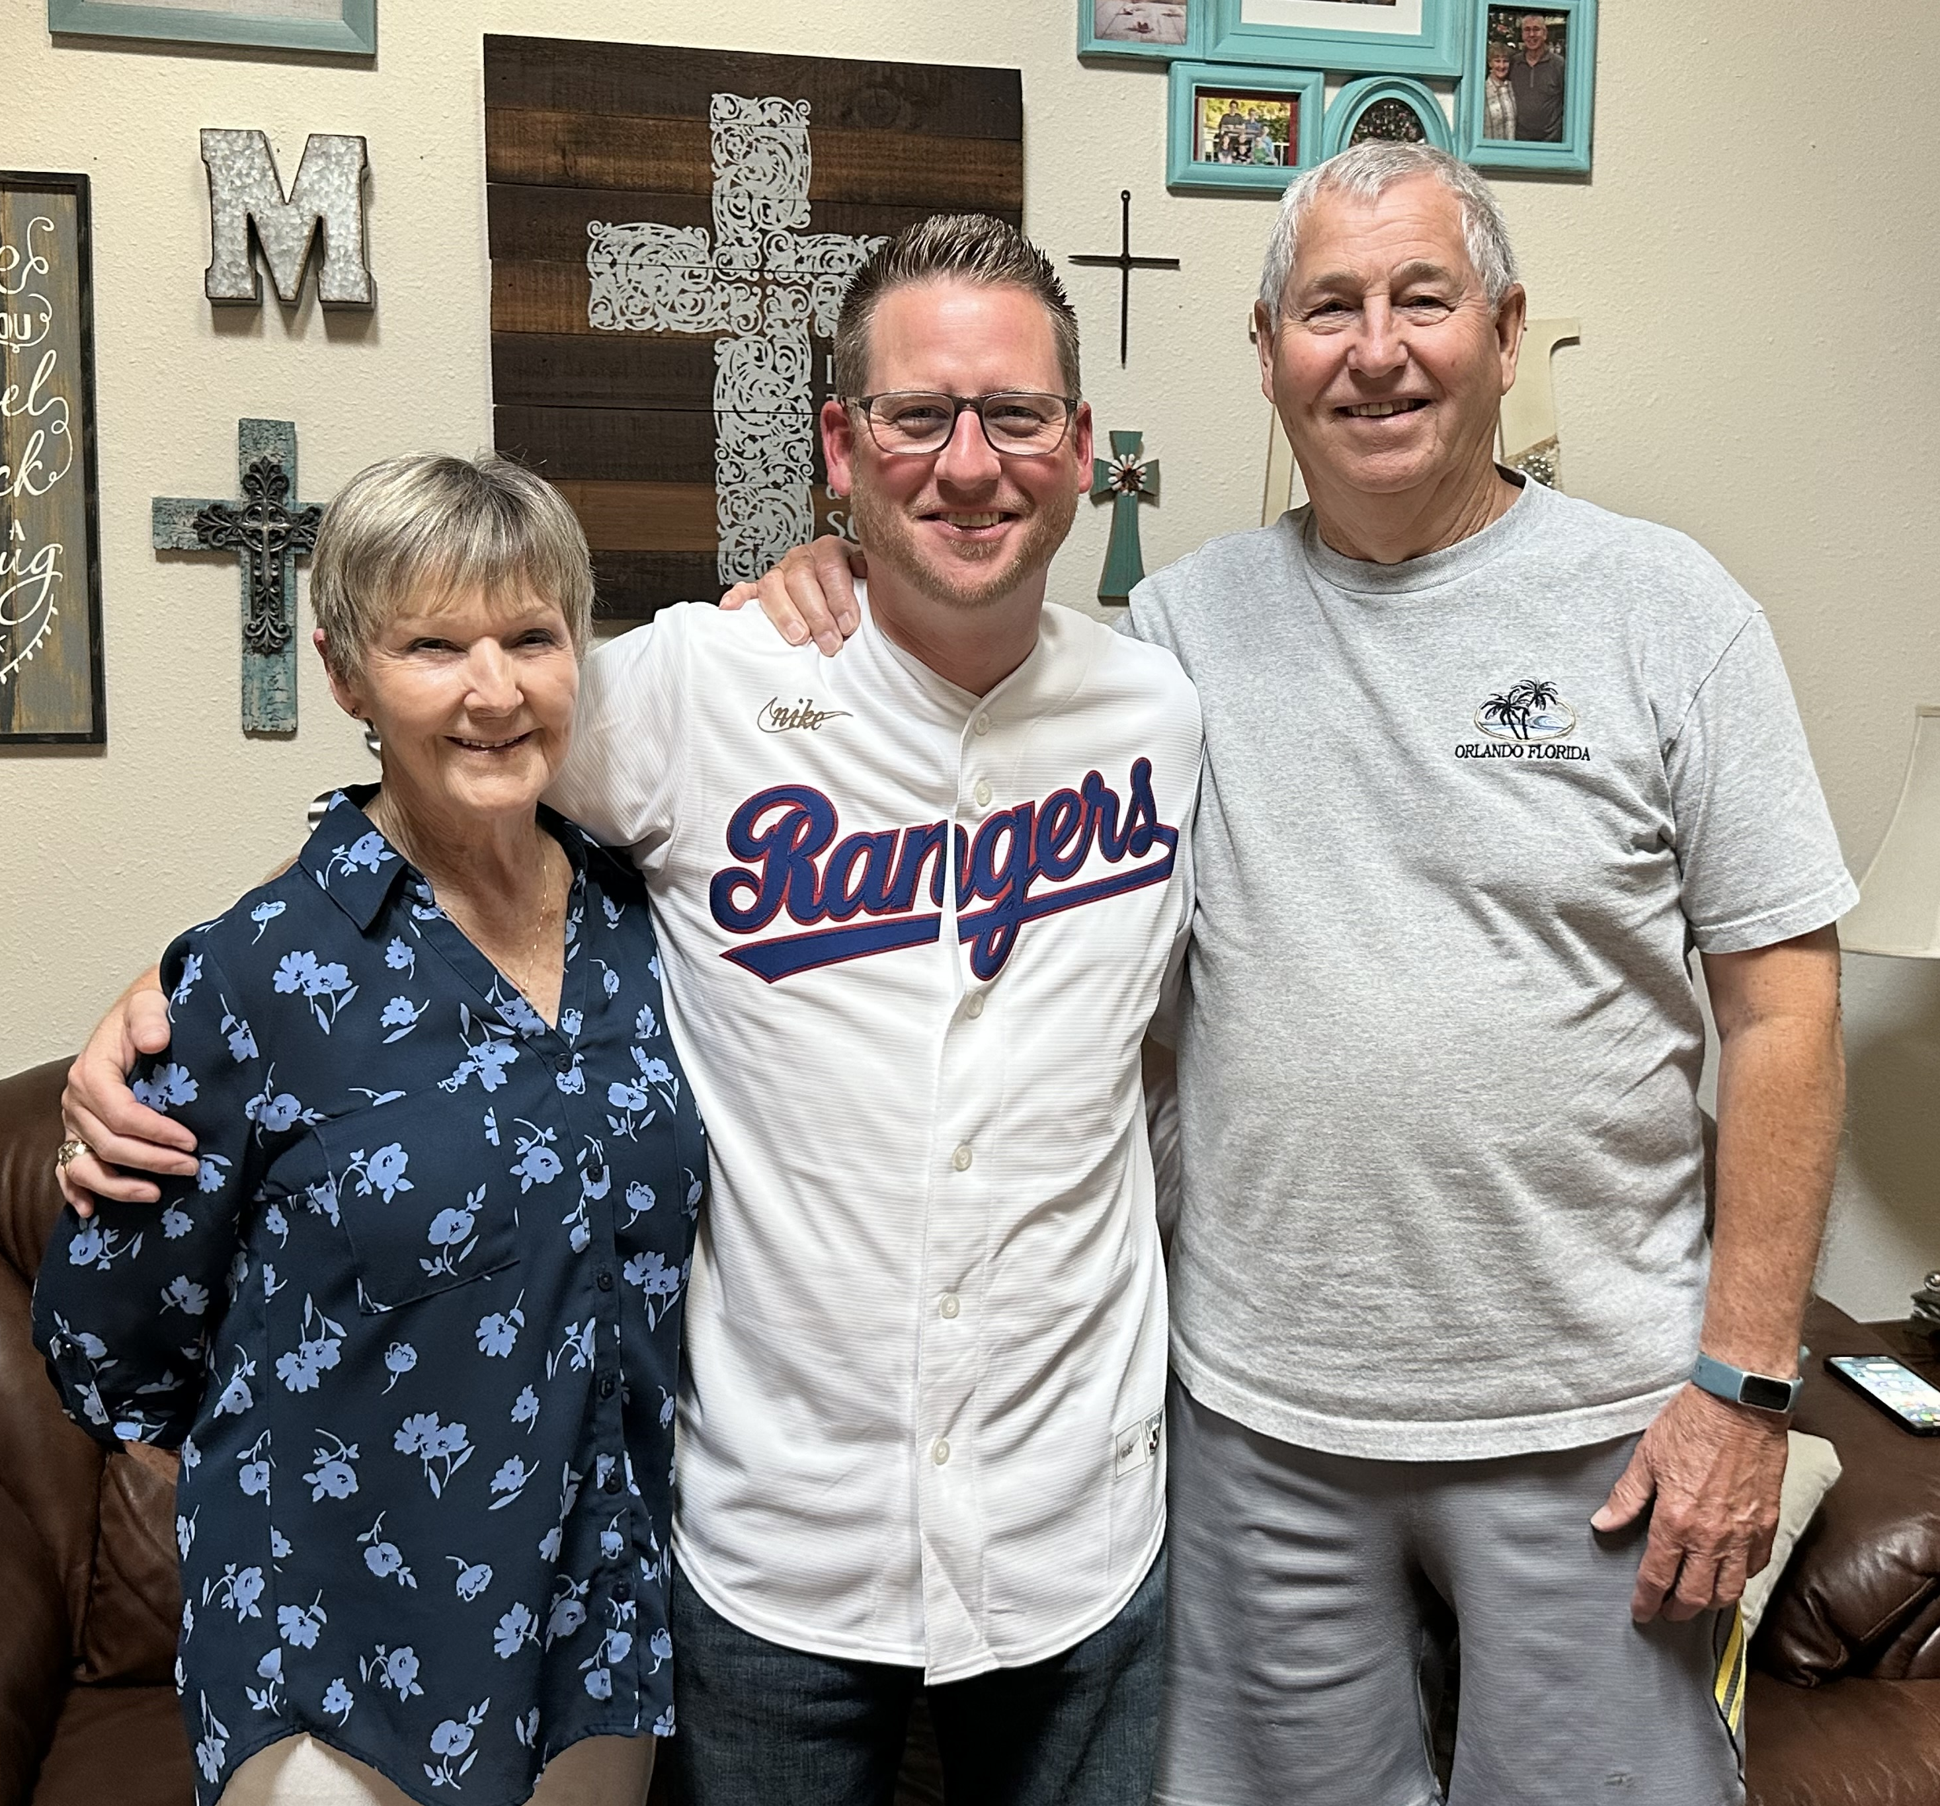
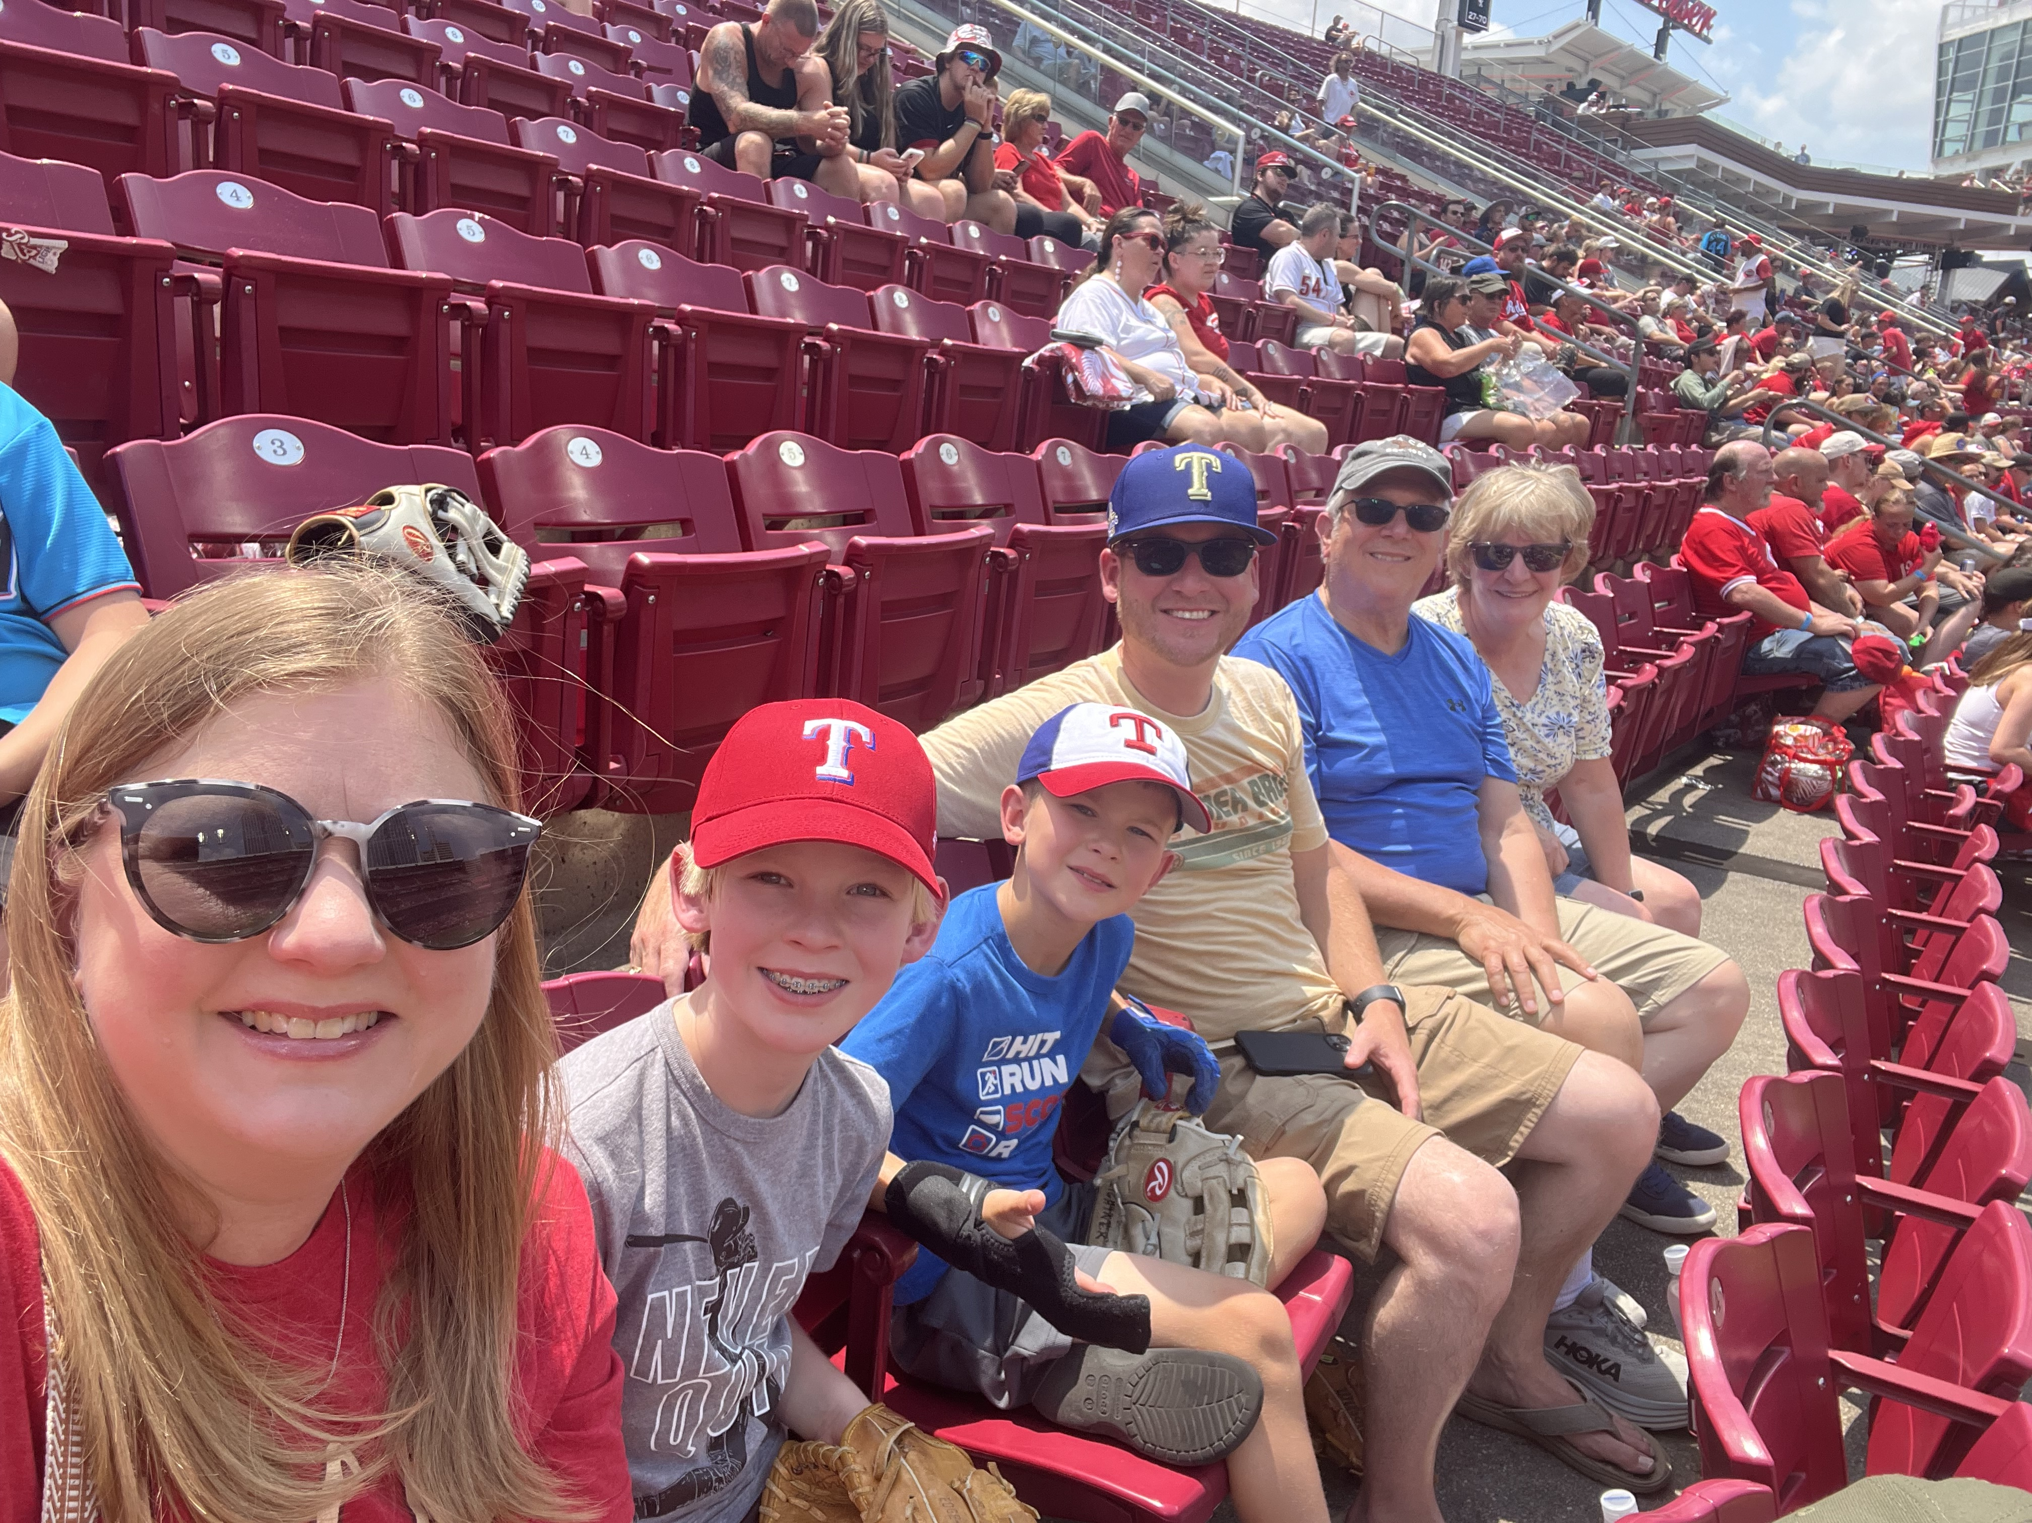

Slide 12
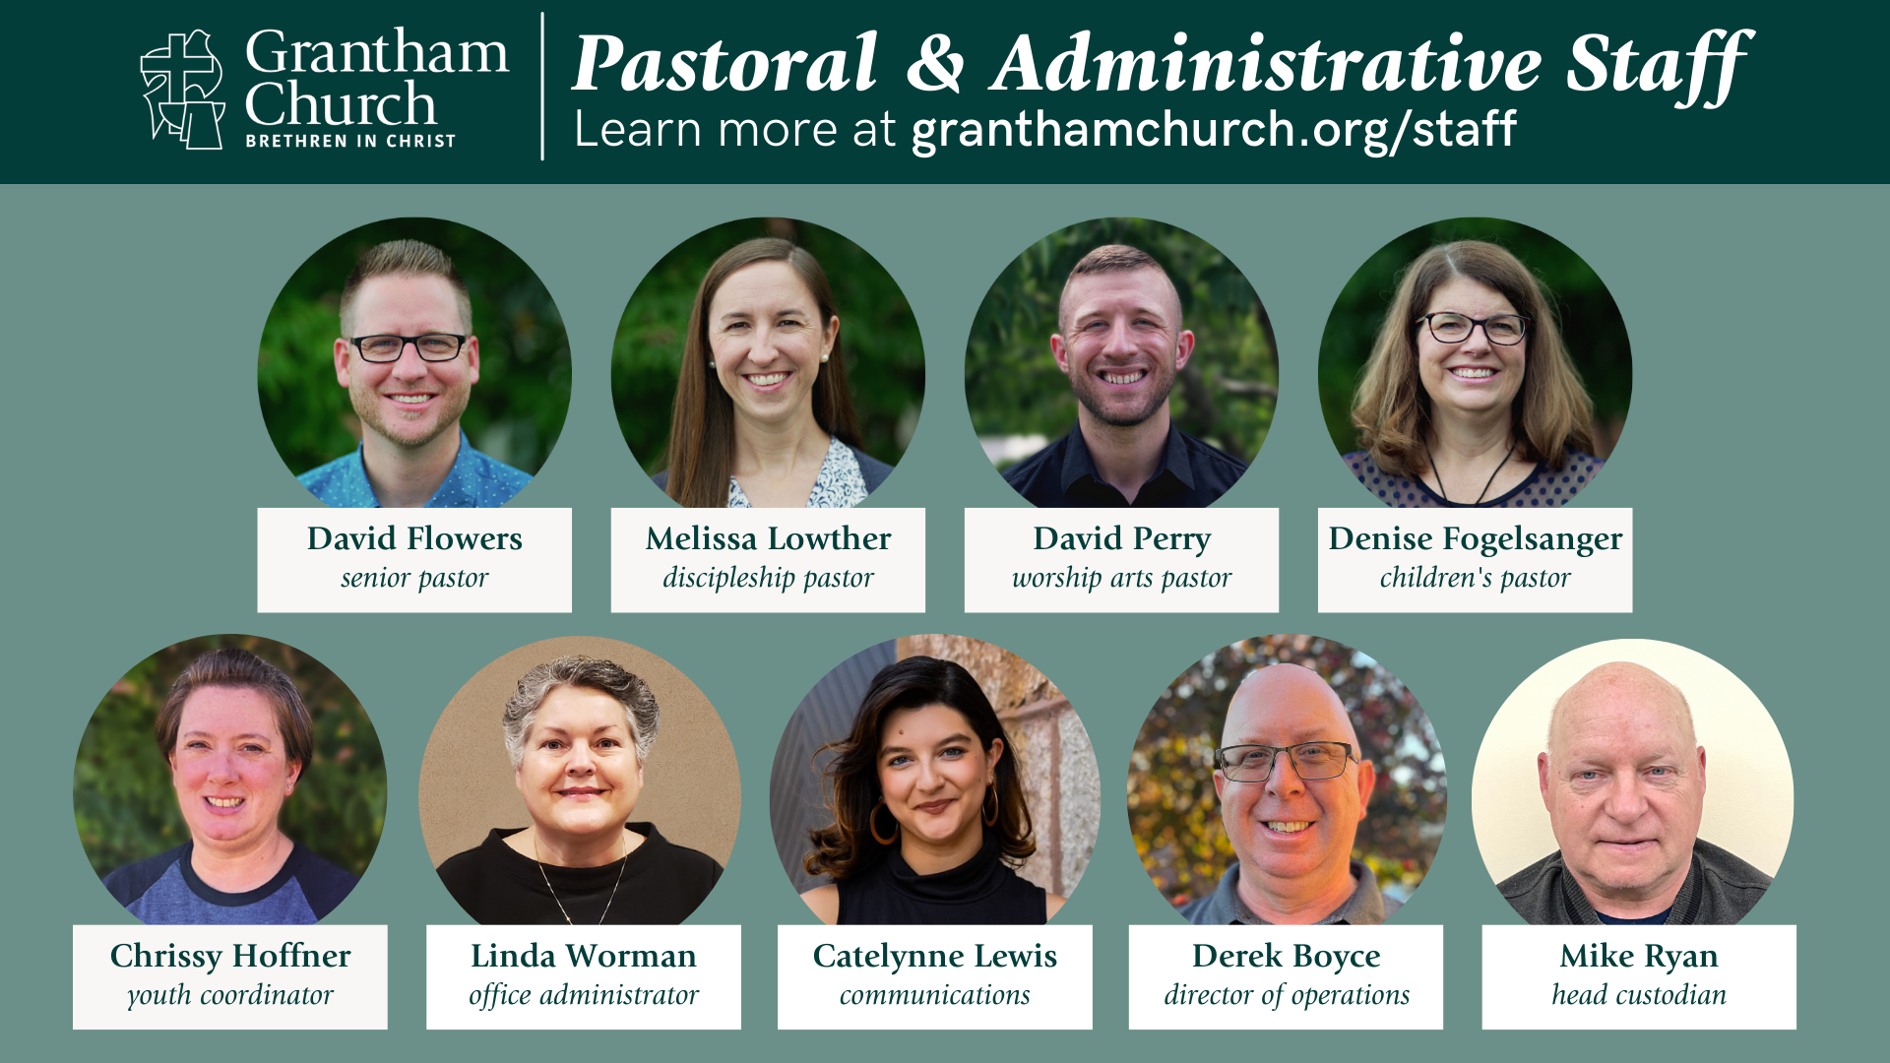

Slide 17
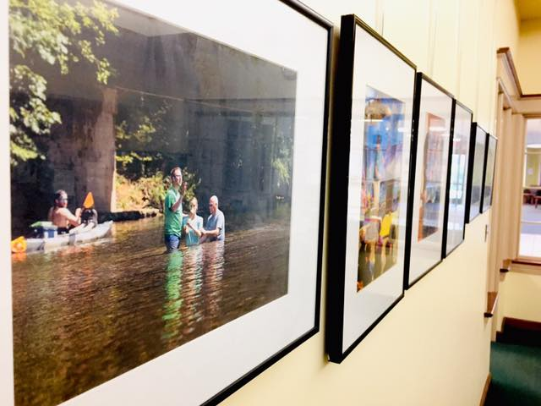
Behind the Scenes
Stuff that leadership has worked on in 2024:
Completed Emergency Response Manual
Hired a full-time Office Administrator!—Linda Worman
Pastors completed work with Christina Embree (consultant)
Formed the Spiritual Leadership Team (SLT) to assist the Senior Pastor
Continued strengthening relationship with Messiah University and forming a working partnership with Campus Ministries
Created an MOU with our ministry partner—One80 Ministries
Applied to join the BIC’s Thriving Congregations Initiative (begins Fall 2025)
Began discussion with Pastor Royal about a “covenant” agreement and an “Exploring the BIC” process with Ignite Church leaders
Search & Hired a new full-time Director of Operations!–Derek Boyce
Successfully navigated another election (Third Way series)

Slide 19
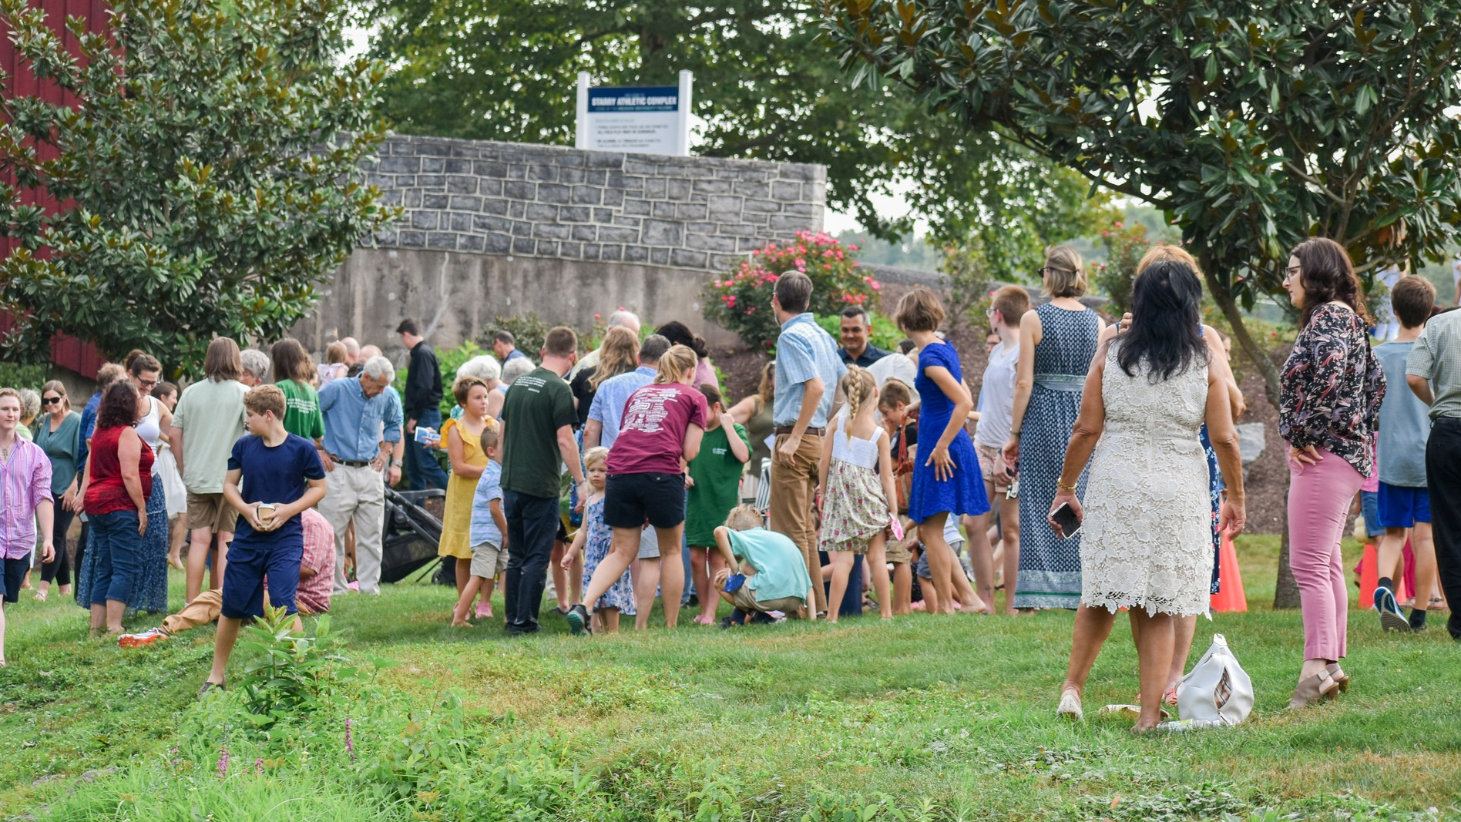
A Look Back at 2024
Avg. in-person attendance: 299 (up from 294 in 2023)
Avg. YouTube livestream views: 75 (up from 68 in 2023 – avg. 374 tuning watching the worship service each Sunday)
Highest Sunday of the year: 451 on Easter Sunday
Other important stats:
8 child dedications (3 more children on Sun, Dec 15)
13 baptisms (Easter, Summer & Fall)
8 new members
Total Membership: 354

Slide 22
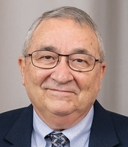
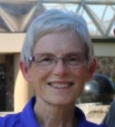
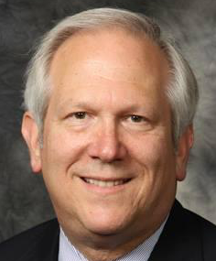
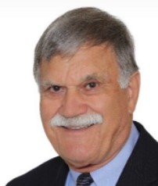
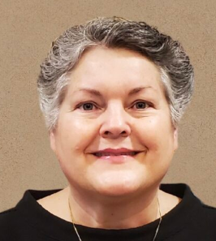
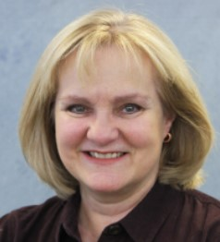
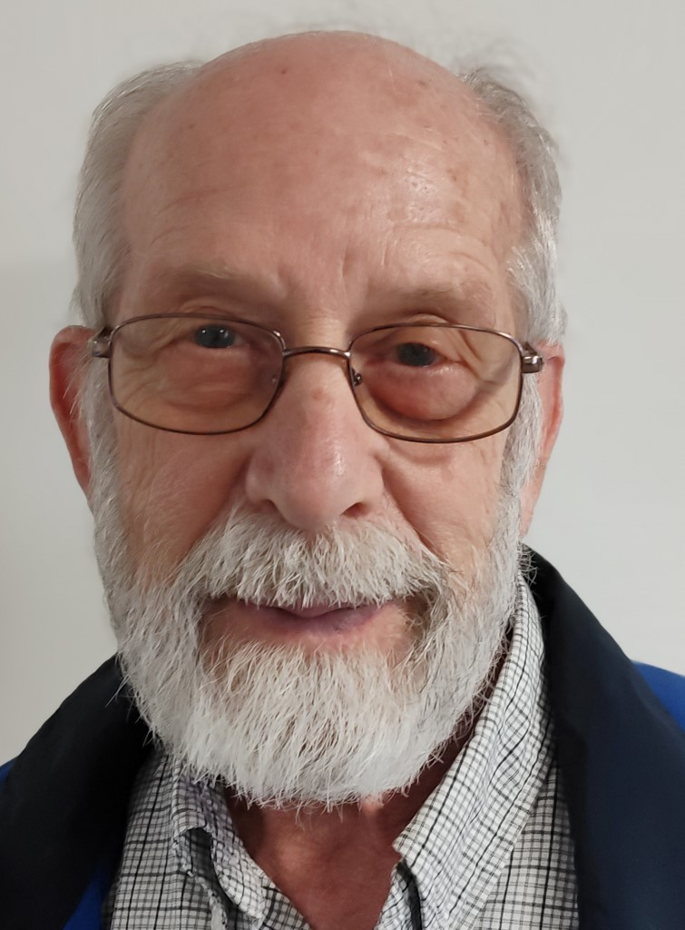
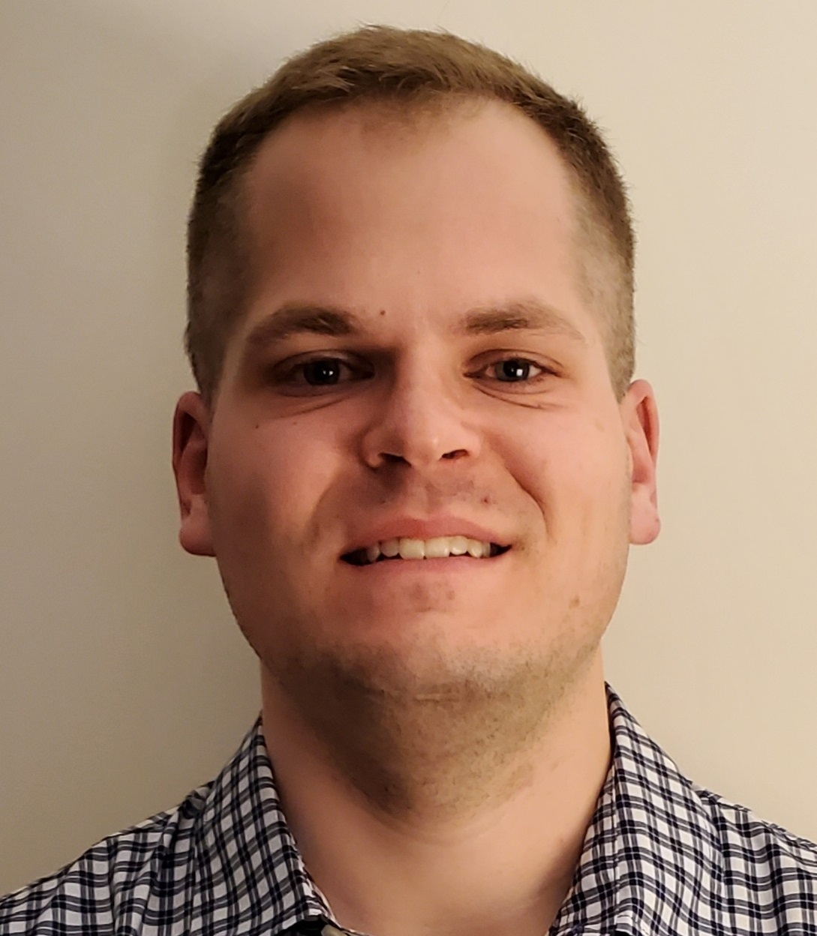
Phil Thuma, Treasurer
Lynn Brown, Assist Treas
Jim Smiley, Secretary
Ken Martin
Linda Worman, Staff Rep
Lisa Sechrist
Roger Johnson
Matthew Haar

Slide 23
HOW HAVE WE DONE FINANCIALLY IN 2024 ?
2024 Income/Expense Report
(year to date vs budget)

Slide 25
Income/Expense Report for 2024 to date Summary
Undesignated (General Fund) income has been better than it was in 2023 (currently 1.2% behind vs 8.8% in 2023)
Expenses have generally been close to the approved budget
BIC Common fund continues to receive 10% of the Undesignated income

Slide 26
FUNDING SENT FROM GRANTHAM CHURCH TO OTHERS – 2024 (YTD)
Common Ministry (BIC Church) - $66,390
Ministry Partners - $8,000
BIC World Missions - $2,444
Grantham Missionaries - $4,500
Peace Sunday - MCC (Gaza) and Thrift Store - $8,194
MCC Thrift on Purpose - $18,210
Missions Sunday – Ignite Church and SPICE - $17,820
Over $ 125,000 year to date

Slide 27
THANK YOU FOR YOUR GENEROUS GIVING!

Slide 28
WHAT ARE WE PROPOSING FOR 2025?
2025 Financial Plan
for Ministry
( see pages 5-6 and then page 10 in booklet)

Slide 29
2025 Proposed Expenses

Slide 30
2025 Proposed Income
* Facility Use/Rental, Credit card use rebate

Slide 31
Questions and Discussion Email: gcfinance@granthamchurch.org

Slide 36
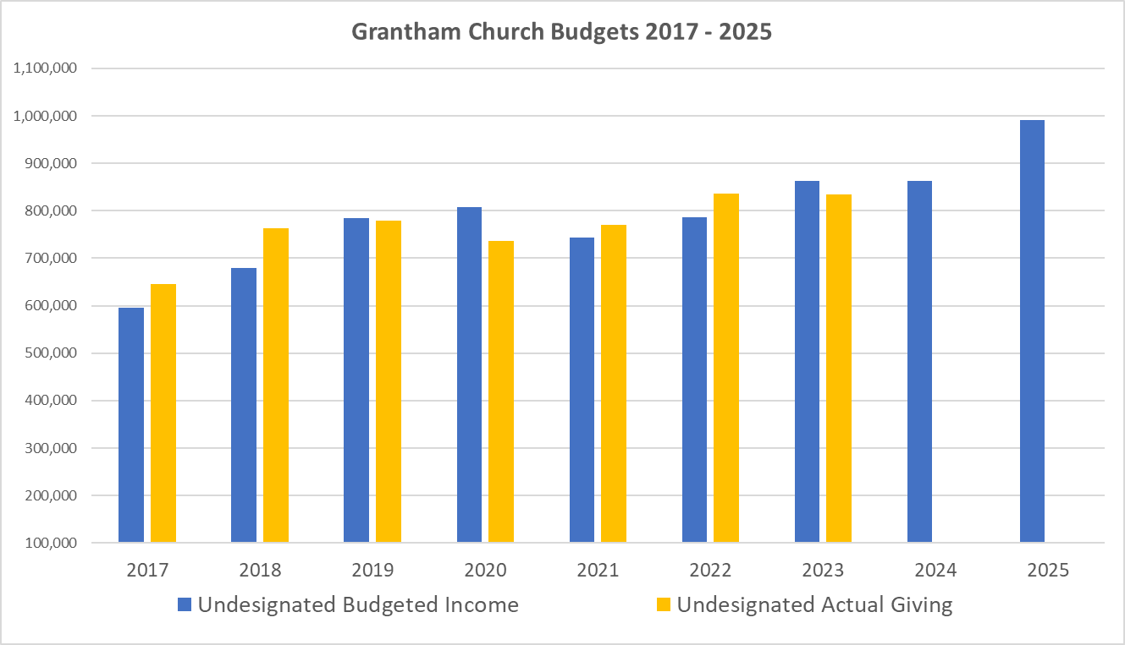
9.7%

Slide 38
General & Administrative
(See page 12)

Slide 40
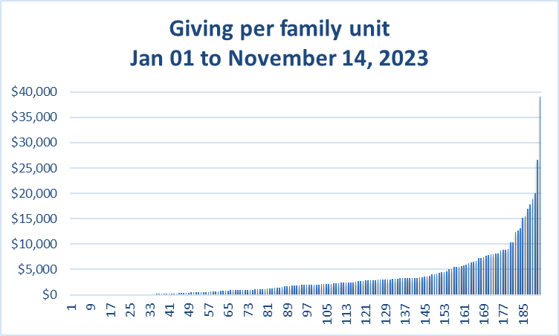

Slide 42
For the Beauty of the Earth

Slide 43
For the beauty of the earth
For the glory of the skies
For the love which from our birth
Over and around us lies
Lord of all to thee we raise
This our hymn of grateful praise

Slide 44
For the beauty each hour
Of the day and of the night
Hill and vale and tree and flower
Sun and moon and stars of light
Lord of all to thee we raise
This our hymn of grateful praise

Slide 45
For the joy of human love
Brother, sister, parent, child
Friends on earth and friends above
For all gentle thoughts and mild
Lord of all to thee we raise
This our hymn of grateful praise

Slide 46
For thyself best gift divine
To the world so freely given
For that great, great love of thine
Peace on earth and joy in heaven
Lord of all to thee we raise
This our hymn of grateful praise

