Slide 1

Notes:
[BRIEF INTRO]
Looking back over the past 18 months - the highs & lows
Email From the Pastor – the next two Sundays
Being a church that holds lament and celebration together
Listen to what the Apostle Paul wrote in Romans 12:15… [NEXT SLIDE]

Slide 2
Rejoice with those who rejoice;
mourn with those who mourn.
Paul, Romans 12:15
Notes:
[BRIEF COMMENTS]
Being a pastor – deathbeds & maternity wards
Life is full of pain of suffering, but also full of beauty and joy
We’re called to embrace it all with a faith in God’s good future
Revelation 21:1-5 – no more weeping and mourning in the future
But until then… there is plenty that’s not right in this world. And so, expressing grief, sadness, anger, and mourning can be a way of calling attention to the brokenness of creation—that things are not as they should be—and we want God to do something about it. Therefore, you could certainly see lament as an act of revolt against evil, as well as a cry for more of the Kingdom, and for comfort from the God who loves us and has proven that love in the death, burial, and resurrection of Jesus.
And this Jesus, who promises to someday rid the world of all sorrow, said this about us expressing our grief and our mourning in Matthew 5:4… [NEXT SLIDE]

Slide 3
Blessed are those who mourn,
for they will be comforted.
Jesus, Matthew 5:4
Notes:
[BRIEF COMMENT]
For disciples, our mourning will always end in comfort
But how can we be comforted if we do not mourn?
We don’t grieve and mourn well as Americans
If we’re honest, many of us avoid mourning and lamenting as long as we can. Lamenting feels like acknowledging defeat. And that just doesn’t fit the American spirit of triumphalism that we’re taught (which of course leaves no room for holding grief and celebration together). So, we tend to live in one ditch or the other—happy all the time or always down in the dumps. Neither of those are healthy.
And unfortunately, the church hasn’t led the way very well because we have often succumbed to that spirit. So, we don’t lament properly, and it leads to all kinds of spiritual malformation, and sometimes deep depression. Or instead of lamenting to God, we (like the Hebrews in the wilderness) complain to and about our leaders. And as we see in Exodus, that doesn’t fair well for God’s people.
In fact, I think it’s a lack of biblical lamentation that leads a church to either be sad and cynical all the time (since there is no shortage of injustices in the world), or leads us to ignoring the suffering of the world and singing happy songs, preach happy sermons, and think happy thoughts all the time. They are both extremes. And neither of them reflect the gospel and our biblical hope. Amen? Therefore, we need to practice lament.
And the Psalms can help us learn to lament in healthy ways. [NEXT SLIDE]

Slide 4
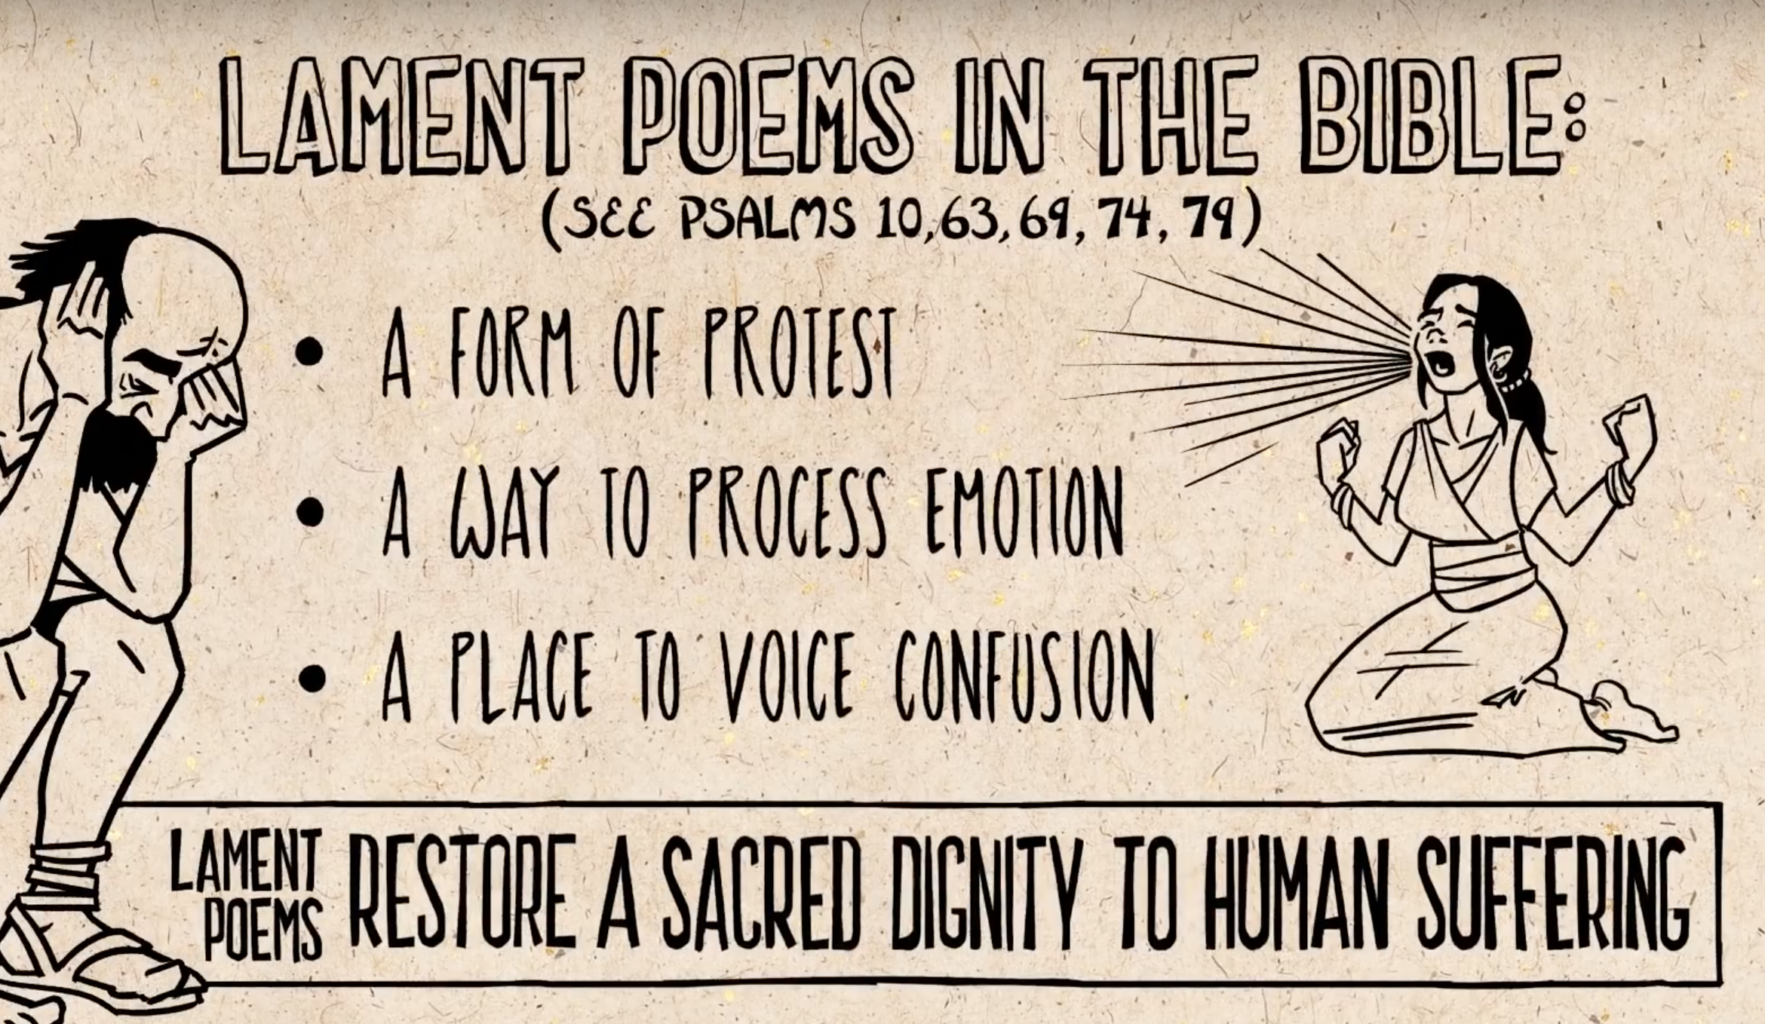
Notes:
[BRIEF COMMENTS]
The Book of Psalms is made up of 150 chapters. Psalms that are straight-up lament make up forty percent of the book of these poems, songs, and prayers. And if you count the other chapters that lament is expressed, it comes out to about 70% of the Psalter.
Also, there are other laments throughout Scripture, most heavily in books like Job, Jeremiah, and Lamentations. But the book of Psalms is the go-to place for expressing lament. Why is that? It’s because they were written and placed within the canon of Scripture for that purpose—to restore a sacred dignity to human suffering and confess our trust in God. The psalms offer a way for us to express our feelings, to protest, to process, to voice our complaints, and more.
Here is what I said about lament earlier this year in our Lent series: [NEXT SLIDE]

Slide 5

The Necessity of Lament
We need to practice lament if we’re
going to develop a resilient faith. Why?
Lament says, “This isn’t right.”
Lament says, “This hurts, but I’m not quitting.”
Lament says, “God, I/we need your help.”
Notes:
[BRIEF COMMENTS]
Don’t miss this, church. Psalms of disorientation and lament summon God into the situation, which he waits for us to do (e.g., Blind Bartimaeus - ”Jesus, Son of David, have mercy on me!”)
Listen to what Soong-Chan Rah wrote in his book on lament. [NEXT SLIDE]

Slide 6
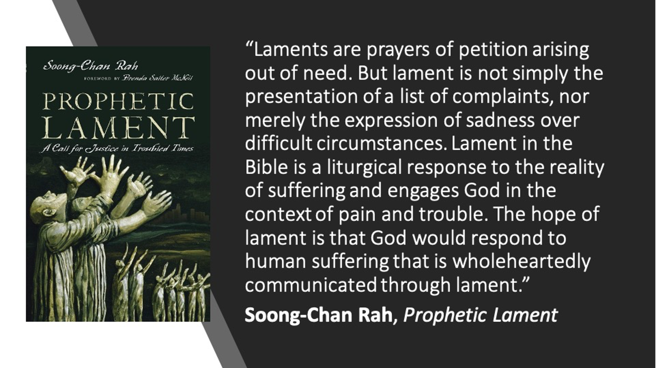
Notes:
[BRIEF COMMENT]
So, let’s reflect on a few of those those psalms together. First, let’s turn to Psalm 6. [NEXT SLIDE]

Slide 7
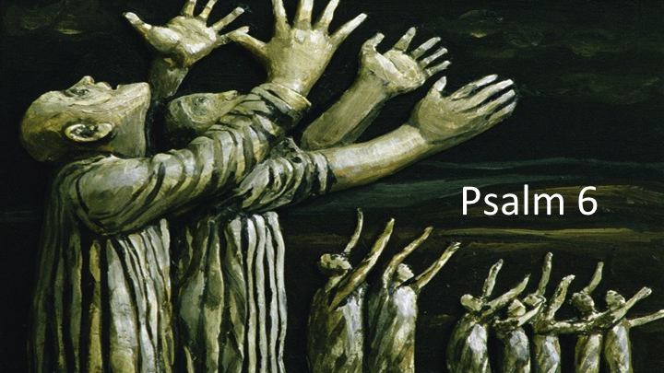
Notes:
[READ & COMMENT ON PASSAGE]
This is a psalm of David. And it’s clear in his prayer that tears are involved in his lament. Have you thought about the reasons why we cry, and need to express ourselves through tears? [NEXT SLIDE]

Slide 8
The Science Behind Emotional Tears
Shedding tears is the only physiological function that humans have that other animals don’t have
Emotional tears contain proteins that are believed to release hormones and relieve stress
People feel better after crying; feel less angry, and less sad
Tearfulness evolved in the eyes as a strong emotional cue to others that a person is in pain or needs help
Tears can be seen up close, but not far away
William H. Frey, PhD. Alzheimer's Research Center at the HealthPartners Institute for Education and Research in St. Paul, MN
Notes:
[READ EACH & BRIEF COMMENTS]
My experience in 2019 – breaking down and crying in the car
Crying is far more effective (and good for the soul) than getting angry
But what do we do when we are angry?
Well, I think it’s helpful to know that related to the lament psalms are the imprecatory psalms, or prayers for vengeance! There are a few of those in the Psalms. What do we do with those? Afterall, we are followers of Jesus who taught us to love our enemies.
I like what OT scholar Walter Brueggemann says about this… [NEXT SLIDE]

Slide 9
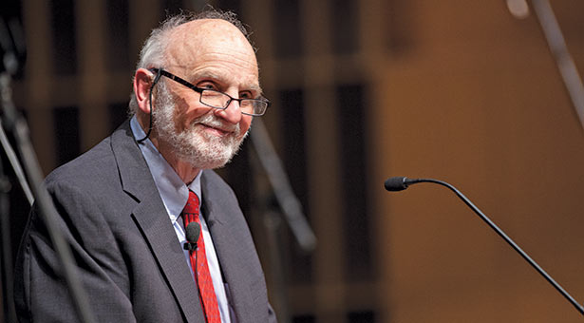
Walter Brueggemann
Notes:
[BRIEF COMMENTS]
In a lecture on this topic, he used Psalm 58:1-6 as an example:
Psalm 58:1-6 NIV
¹ Do you rulers indeed speak justly?
Do you judge people with equity?
² No, in your heart you devise injustice,
and your hands mete out violence on the earth.
³ Even from birth the wicked go astray;
from the womb they are wayward, spreading lies.
⁴ Their venom is like the venom of a snake,
like that of a cobra that has stopped its ears,
⁵ that will not heed the tune of the charmer,
however skillful the enchanter may be.
⁶ Break the teeth in their mouths, O God;
Lord, tear out the fangs of those lions!
What do you do with the anger you feel? Brueggemann says:
Act it out (get violent, seek retribution, buy a gun, etc.)
Deny it (comes out elsewhere, e.g., marriage, family, relationships, etc.)
Give it over to your Divine Therapist
[EXAMPLE OF TWO BROTHERS FIGHTING – “What about him? What are you going to do to him for what he did to me?”]
We need to leave our complaint with God and let him decide what to do about it.
And if you’re still not convinced that you need to lament, or that you can even tell God how you’re really feeling, I would encourage us to follow the example of Jesus, as he used the Psalms this way. [NEXT SLIDE]

Slide 10
“My God, my God, why have you abandoned me?
Why are you so far away when I groan for help?”
Psalm 22:1 NLT
Jesus’ lament from the cross
– Matt 27:46; Mark 15:34
Notes:
[BRIEF COMMENTS]
It’s no surprise that the Psalms is where Jesus goes to express his own feelings of abandonment in what was his greatest moment of darkness and despair. And this is important to note. When Jews quoted the first verse of a psalm, they were evoking the entire passage. So, what does the rest of the lament say. Pay attention then to the flow and rhythm of Psalm 22.
(vs. 1-2) Honest Feeling of Abandonment
(vs. 3-5) Confession of Trust
(v. 11) Petition
(v. 22) Vow of Praise
(vs. 27-28) Belief in the Future Hope
Don’t miss this, church. In Jesus’ darkest moments, while he certainly voiced his complaint and revealed the depth of despair he felt upon the cross, he also trusted the Father, called upon the Father for help, praised the Father for his faithfulness, and expressed a hope in what was to come. And we can do that as well if we will respond to the invitation to a biblical expression of lament. [NEXT SLIDE]

Slide 11


Responding to the invitation:
Notes:
[INVITATION TO WRITE ON INDEX CARDS]
Take your index card and pen
Listen to the questions, reflect, and respond
Place cards in offering plate – which will represent you giving it to God
Here are the questions: [NEXT SLIDE]

Slide 12
Responding to the invitation:
What is it that saddens, grieves, or angers you?

Slide 13
Responding to the invitation:
What is it that saddens, grieves, or angers you?
What is missing in your life? Will you name the losses you’ve experienced?

Slide 14
Responding to the invitation:
What is it that saddens, grieves, or angers you?
What is missing in your life? Will you name the losses you’ve experienced?
What do you need to say to God, entrust to his care, and leave in his hands?
Notes:
[READ QUESTIONS]
[MOMENT OF SILENCE FOR WRITING]
[END SILENCE WITH CLOSING PRAYER]
[INVTE USHERS FORWARD – NEXT SLIDE]

