Slide 1

Notes:
[BRIEF WELCOME & INTRO]
This is the fourth Sunday in our Lent to Easter sermon series, Wandering Heart: Figuring out faith with Peter. In this series, we’re following Simon Peter’s journey with Jesus. And that journey isn’t a smooth, straight path. There are ups and downs—mountains and valleys. His journey is not perfect, polished, or linear. And while Peter doesn’t have all of his stuff together, he is committed to Jesus as he relies upon the Lord’s relentless love and grace.
In our first message… [NEXT SLIDE]

Slide 2
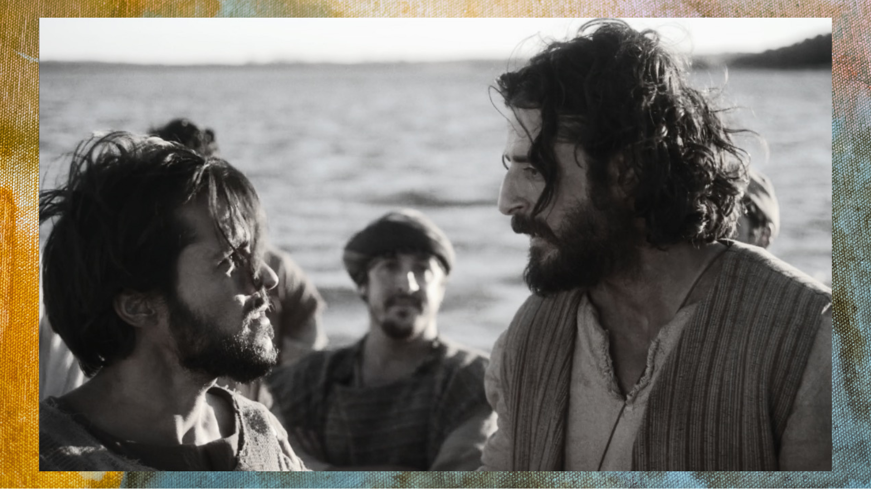
Notes:
…we were introduced to Simon, the fisherman from Capernaum in Galilee. Simon and his brother Andrew had fished all night and caught nothing. Rabbi Jesus comes along and asks to use Simon’s boat to teach and preach from to the crowd on the shore.
And when he’s done teaching, he asks Simon and his friends to go out into deeper water and cast their nets. An exhausted Simon overcomes his feelings of skepticism and incredulity toward Jesus and obeys. As we saw in that first episode, they are then overwhelmed by a miraculous catch so great that the boat begins to sink. After this, Simon Peter realizes he is in the presence of holiness and power. He says, “Away from me, Lord, for I’m a sinful man.” And Jesus calls Simon to leave his nets and follow him, which he does. And Simon becomes a fisher of people as he follows the Lord.
In the second message we looked at the dramatic story… [NEXT SLIDE]

Slide 3
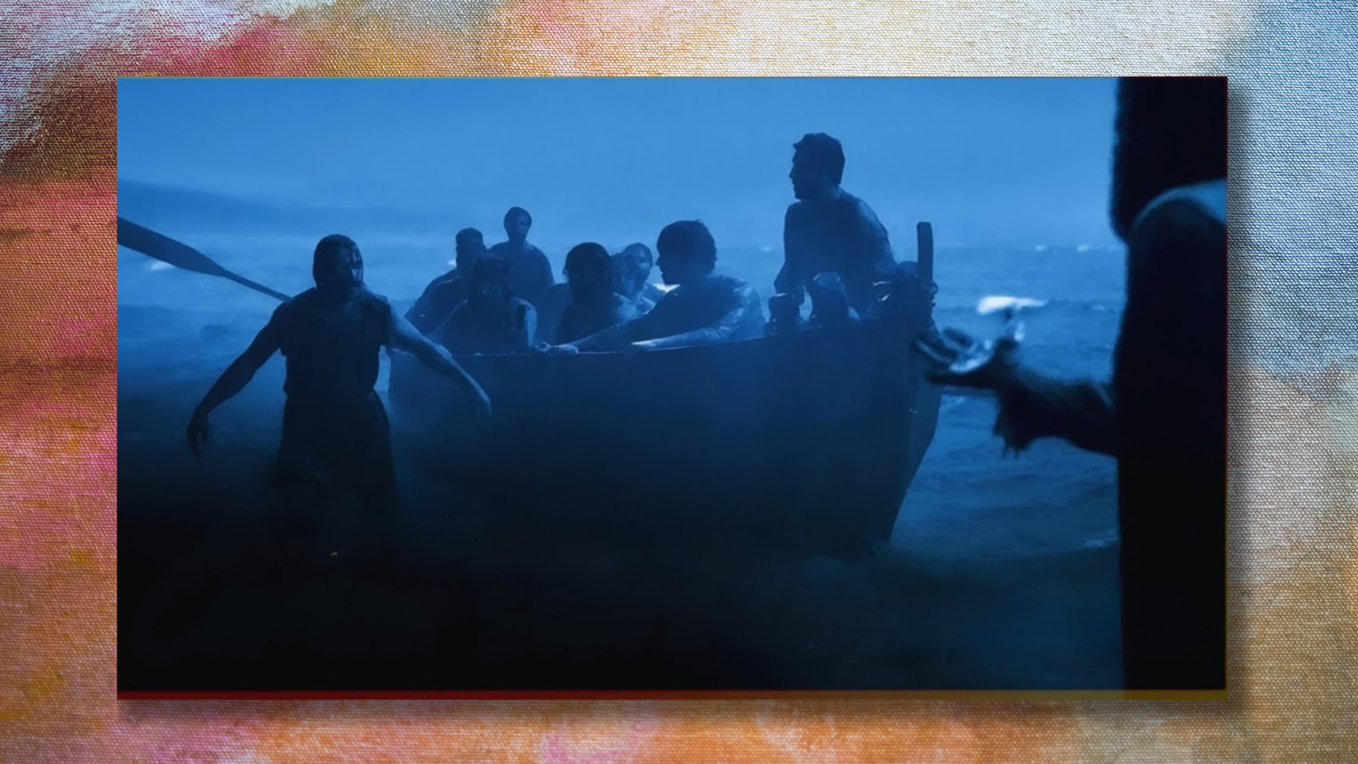
Notes:
When the disciples are in a fishing boat on the Sea of Galilee and a storm hits. Jesus goes out to meet them—walking on the water! And when Jesus approaches, Simon wants to prove that he has the faith necessary to follow him and lead others. He says, ”Lord, if it is you, call me to come out on the water!” Jesus calls him. Simon does OK for a few steps, until he takes his eyes off Jesus and is overcome by his fear of the wind and the waves. He then sinks and Jesus reaches down and saves him from what was sure to be an early death.
But Jesus doesn’t scold Simon. Rather, we should recognize that Simon (of all the disciples) was the only one to get out of the boat, and then hear Jesus saying, “If only you have the faith to keep your eyes on me, imagine what you can do with my help.” And then last week, we were in Matthew 16 and looked at what is no doubt a highpoint in Simon’s faith journey so far. Remember, Jesus takes his disciples to… [NEXT SLIDE]

Slide 4

Notes:
Caesarea Philippi—located in Gentile territory and a major center of pagan worship. And Jesus, along with Simon and the other 11 disciples, stop at a huge rock in front of what was believed to be the entrance to hades ("the gates of hell”), and at the base of Mt. Hermon where the apocryphal book of Enoch said that fallen angels had been cast down to earth.
He asks them, “Who do people say that I am?” And after several names and ideas are thrown out, Jesus asks them, “Who do you say that I am?” That is when Simon makes his great confession, “You are the Christ (the Messiah), the Son of the Living God.” And as I wrote in my letter this past week, It can’t be overstated how monumental this event is in Simon’s faith journey. He knew how significant and scandalous this confession would be before he said it. It could have gotten him arrested or killed. But he said it anyway. And Jesus confirmed it to be true, then he affirmed Simon by giving him the name Peter (rock).
As we can certainly imagine, Simon Peter is on cloud nine. But, as we’re going to see today, it’s in the very next episode (in the same chapter – Matt 16) that Peter is humbled… when Jesus rebukes this well-intentioned disciple and puts him in his place. If you’re taking notes, this message is entitled… [NEXT SLIDE]

Slide 5

Notes:
I’m Fixed Upon It.
[BRIEF PRAYER]
Please open your Bibles to our main Scripture reading… [NEXT SLIDE]

Slide 6

Notes:
Matthew 16:21-28. [INVITE CONGREGATION TO STAND FOR READING]
[READ PASSAGE]
This is the word of the Lord. Thanks be to God. [NEXT SLIDE]

Slide 7

Notes:
A few years ago, a restaurant owner shared a story online about something that happens all the time in the age of online reviews. A customer came into his restaurant, ordered a meal, ate the entire plate, paid the bill… and then later that night left a one-star review. The owner was confused, so he looked up the review. It said something like this: “Food was good. Service was friendly. Restaurant was clean. But this place isn’t what I expected. One star.”
So. the owner reached out and asked what the problem was. The customer said, “I thought it was going to be a steakhouse.” But the restaurant had never claimed to be a steakhouse. The menu clearly said Italian restaurant. The sign outside said Italian restaurant. The website said Italian restaurant. The problem wasn’t the restaurant. The problem was the customer’s expectations. And here’s the reality of our culture today: People do the same thing with Jesus.
I think it’s fair to say that many people reject Jesus, not because of who he actually is, but, because he didn’t turn out to be who they expected him to be. And like the rich young ruler, they go away sad and disappointed with shattered expectations. That’s because some people expect Jesus (after he has welcomed them with open arms) to let them remain as they are. Some expect him to fix all their problems. Some expect Jesus to help them win the culture wars or take their country back for God. Some people expect Jesus to affirm their political party, or their sexual desires, or everything they learned in Sunday School when they were 8, and all the decisions they’re making now. But when Jesus begins to redefine our theology, to challenge some of our deepest held convictions; when he begins to give us new light and redefine what following him really means—when he talks about suffering… sacrifice… and taking up a cross—suddenly people get upset and start leaving bad reviews.
Something like that happens in Matthew 16:21-28. Let’s look again at our main Scripture and walk through the passage verse-by-verse… [NEXT SLIDE]

Slide 8

Notes:
[READ & COMMENT VERSE-BY-VERSE]
v. 21 – “From that time on…” after Peter’s confession and Jesus’ acknowledgement that is in fact the promised Messiah; Jesus begins defining “Messiah” for them; Why?
v. 22 – Peter’s intentions are good; he wants to protect Jesus, but he’s actually interfering with Jesus’ mission and challenging Jesus’ own definition of Messiah
v. 23 – First, Jesus is not calling Peter the devil; Instead:
Peter is voicing the same temptation (Matt. 4:8-10)
he is acting as an adversary (satan) to God’s plan
he is standing in the way of the cross
and Jesus tells him to return to his place as a follower; And notice, the phrase “get behind me” is not only a rebuke, it is also a discipleship command. Disciples are supposed to walk behind their rabbi. Peter had stepped in front of Jesus, trying to redirect the mission. So Jesus is essentially saying: “Stop trying to lead me. Get back behind me and follow.”
Jesus says, “You are a stumbling block to me.” The Greek word skandalon means, an
Obstacle, trap, or something that causes someone to stumble. So, notice the dramatic irony: Just a few verses earlier Peter was called the rock. Now he becomes a rock someone trips over. Therefore, Matthew is deliberately showing how quickly a disciple can move from divine insight to human misunderstanding. It’s humbling, isn’t it?
vs. 24-27 – What’s required? Self-denial. Loving Jesus more than your flesh; as Isaiah says, believing that his ways are higher than your ways; and as Proverbs says, not leaning on your own understanding, but in everything you think and do acknowledge him, then he will make your paths straight. And what’s at stake? Your soul. If your heart isn’t set on Jesus, then your life (soul) is in danger. And, Jesus says, there are rewards for those who choose to accept his definition of Messiah. He is coming back in power. In the meantime, make up your mind. Are you going to do what you want or are you going to surrender to his will and ways?
Listen to how Eugene Peterson translates this in the Message… [NEXT SLIDE]

Slide 9
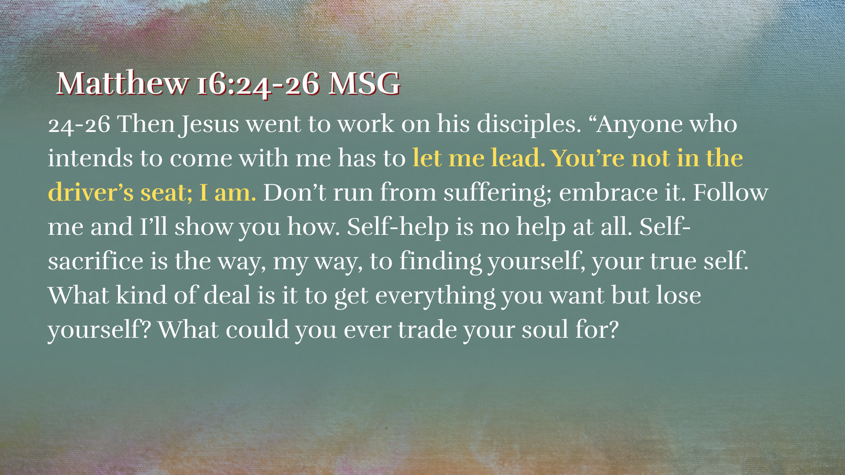
Notes:
[READ & COMMENT]
And lastly, verse 28… [READ VERSE 28]
vs. 28 – “see the Son of Man coming in his kingdom” – What does Jesus mean? Well, six days later (in the next chapter – Matt. 17), Peter, James, and John are going to see Jesus transfigured in glory; Moses and Elijah will appear and God’s voice affirms Jesus as his Son, over the Prophets before him; only “some” of the disciples witness this, which fits Jesus’ wording: “some standing here will not taste death.” In that sense, the Transfiguration becomes a preview or foretaste of the Son of Man’s royal glory. So, Jesus is essentially saying: “Some of you will soon see a revelation of the kingdom and my true identity.”
Clearly, Jesus challenges the Messianic expectations of his day and confronts his disciples’ desire to have him be something he is not. So, let’s consider three modern expectations that we often see folks placing upon Jesus that the Lord then confronts… [NEXT SLIDE]

Slide 10
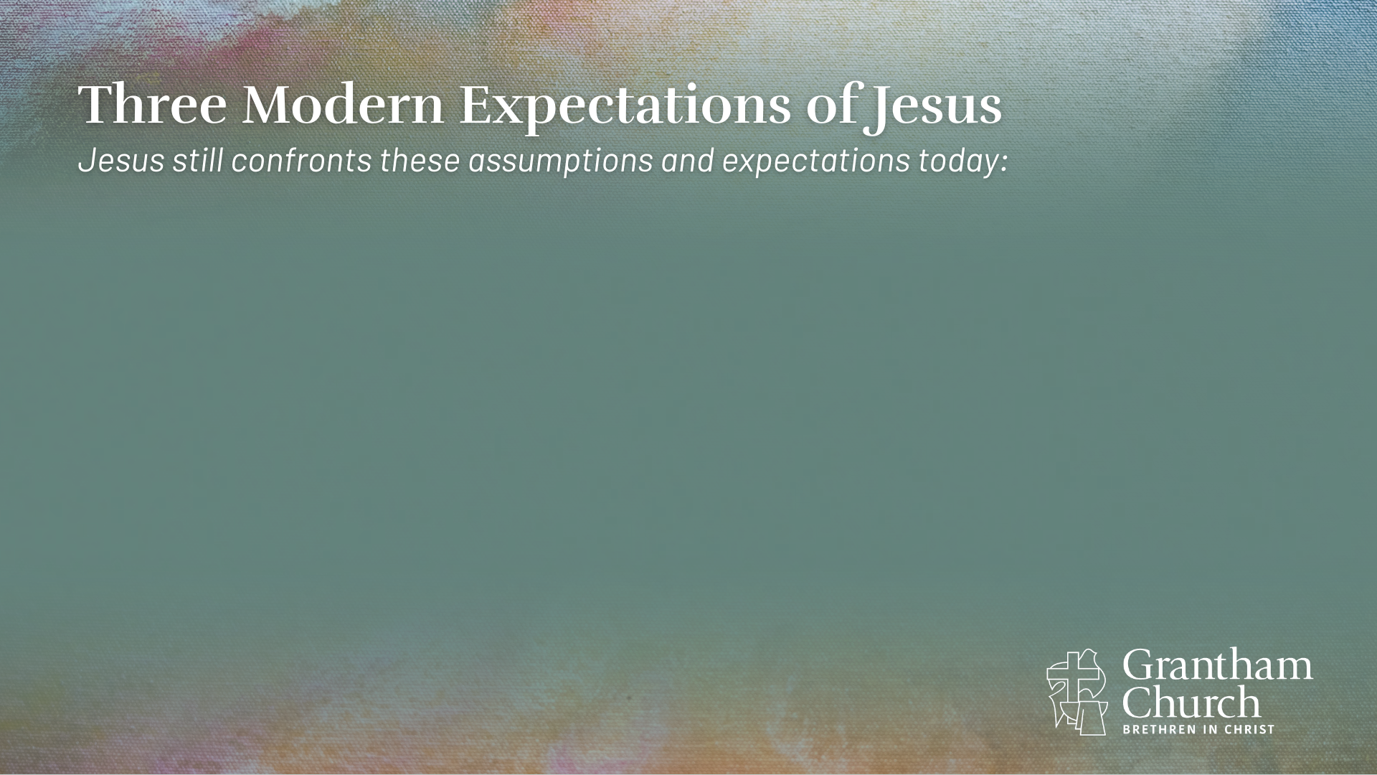

Slide 11
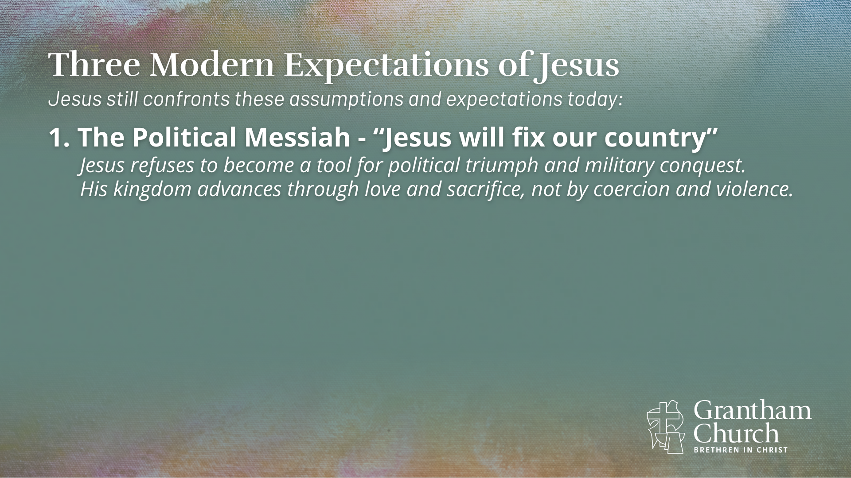

Slide 12
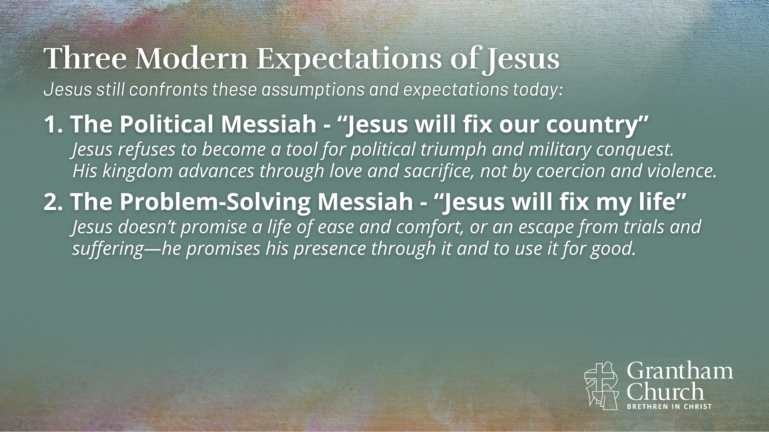

Slide 13
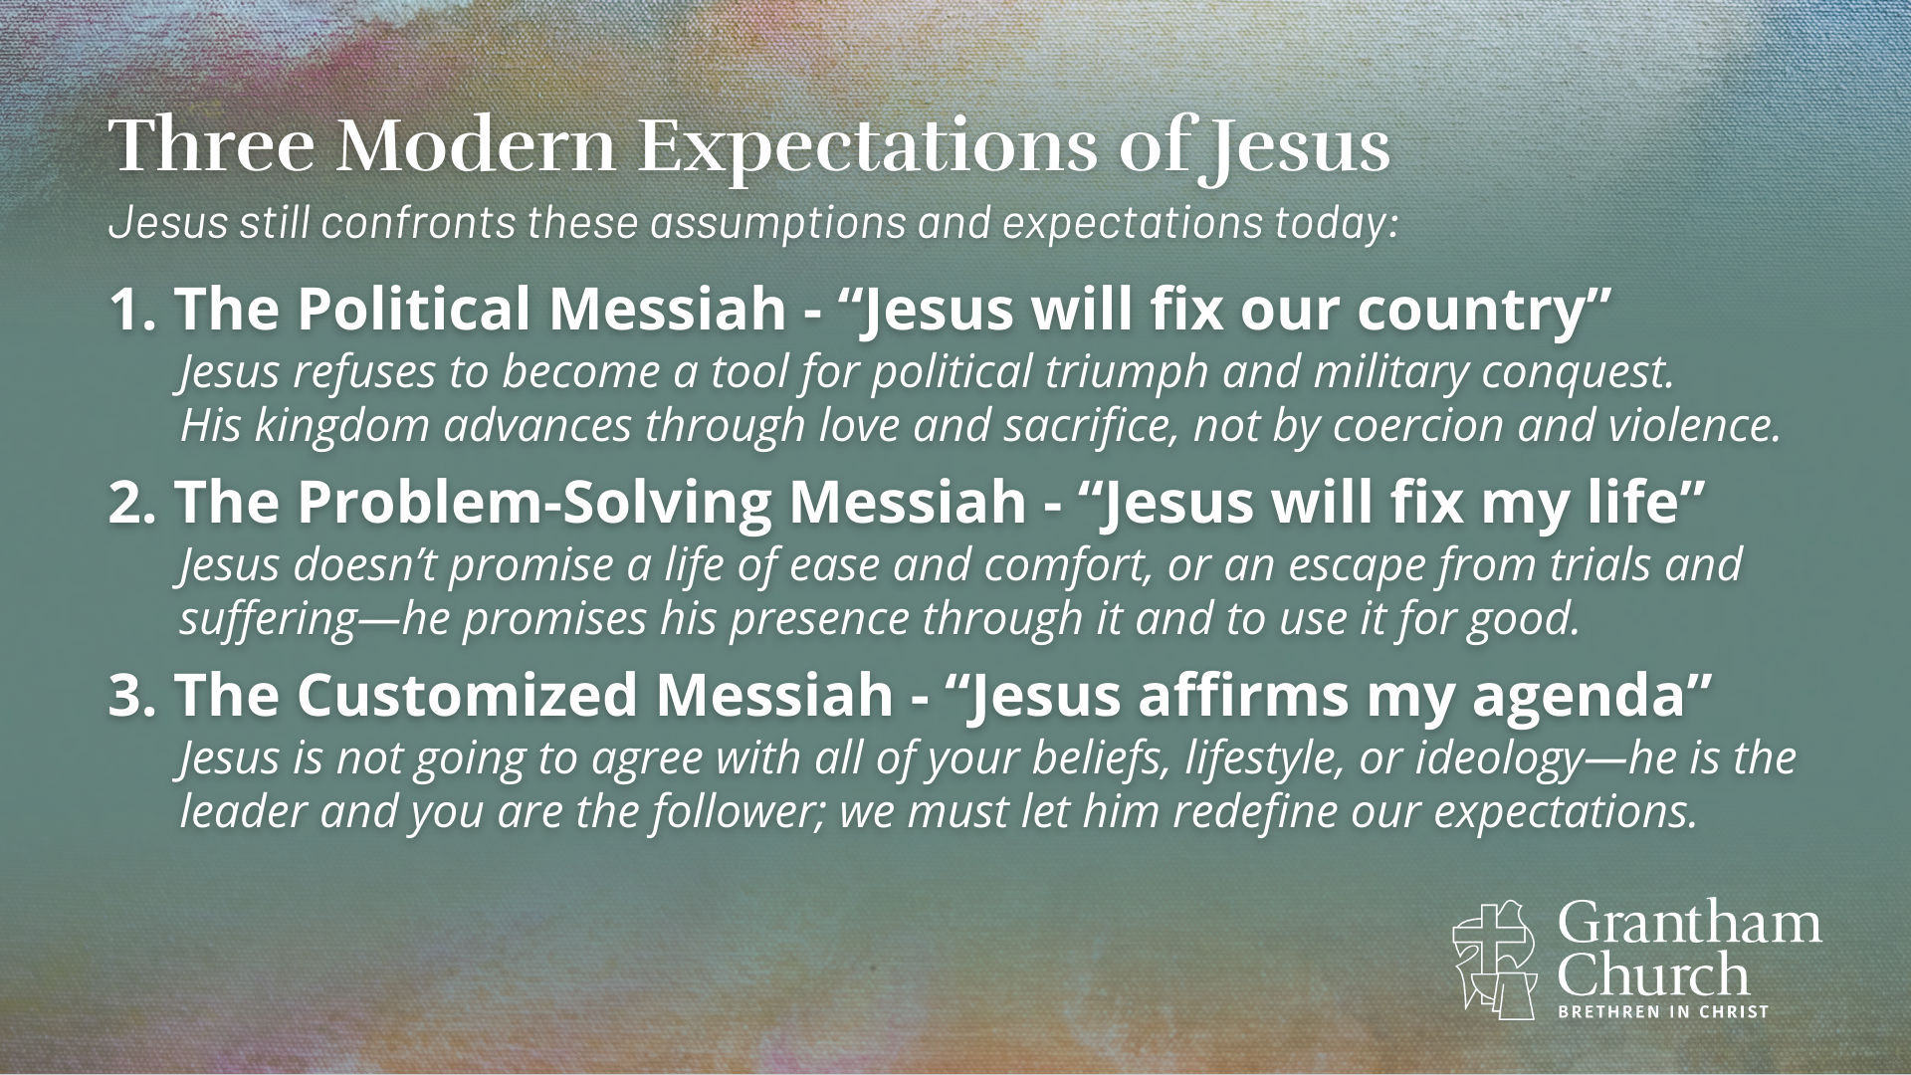
Notes:
[READ EACH POINT & COMMENT]
1. The Political Messiah - “Jesus will fix our country”
Jesus refuses to become a tool for political triumph and military conquest.
His kingdom advances through love and sacrifice, not by coercion and violence.
2. The Problem-Solving Messiah - “Jesus will fix my life”
Jesus doesn’t promise a life of ease and comfort, or an escape from trials and
suffering—he promises his presence through it and to use it for good.
3. The Customized Messiah - “Jesus affirms my agenda”
Jesus is not going to agree with all of your beliefs, lifestyle, or ideology—he is the
leader and you are the follower; we must let him redefine our expectations.
It reminds me of what Tim Keller once said… [NEXT SLIDE]

Slide 14

Notes:
[READ QUOTE & COMMENT]
So, let’s consider some main takeaways for application based on what we’ve read and reflected on today… [NEXT SLIDE]

Slide 15
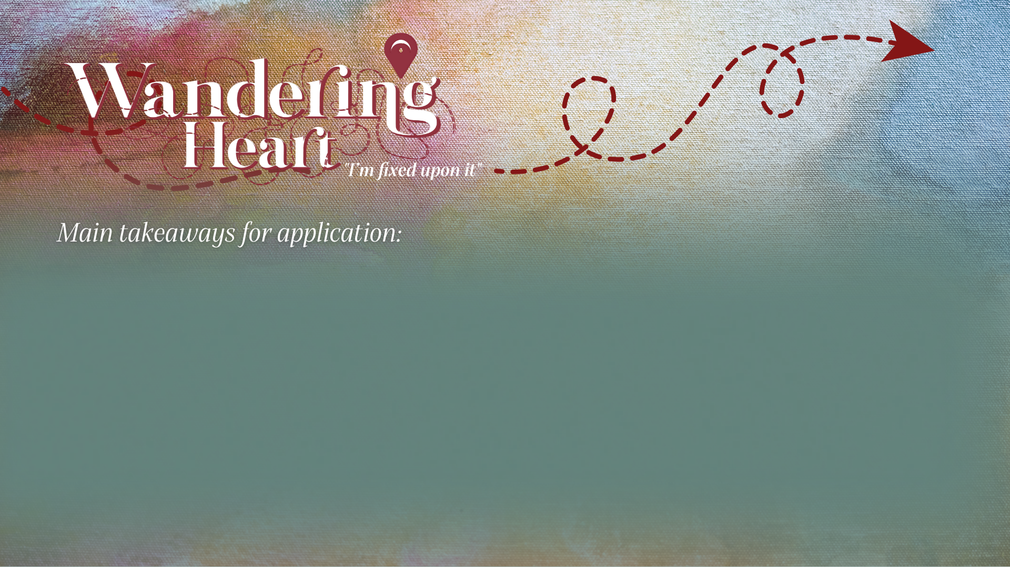
Notes:
Takeaways

Slide 16
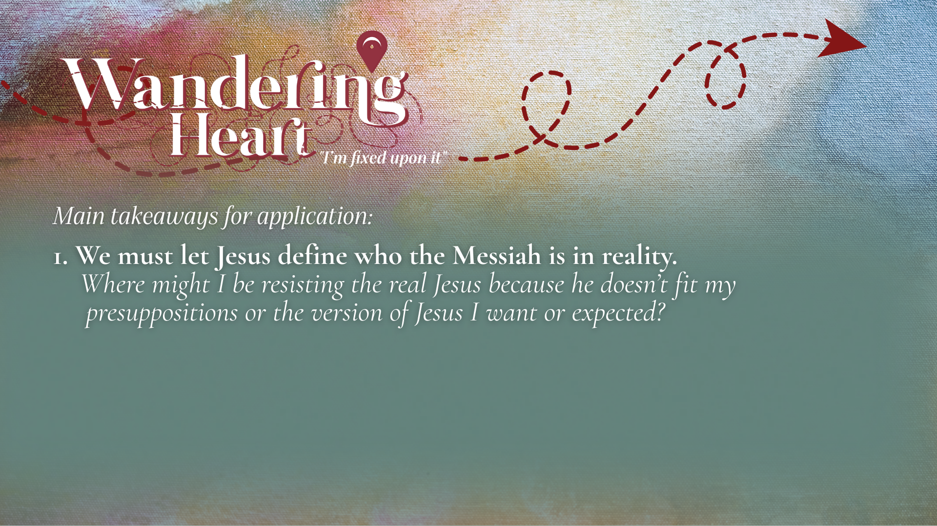

Slide 17
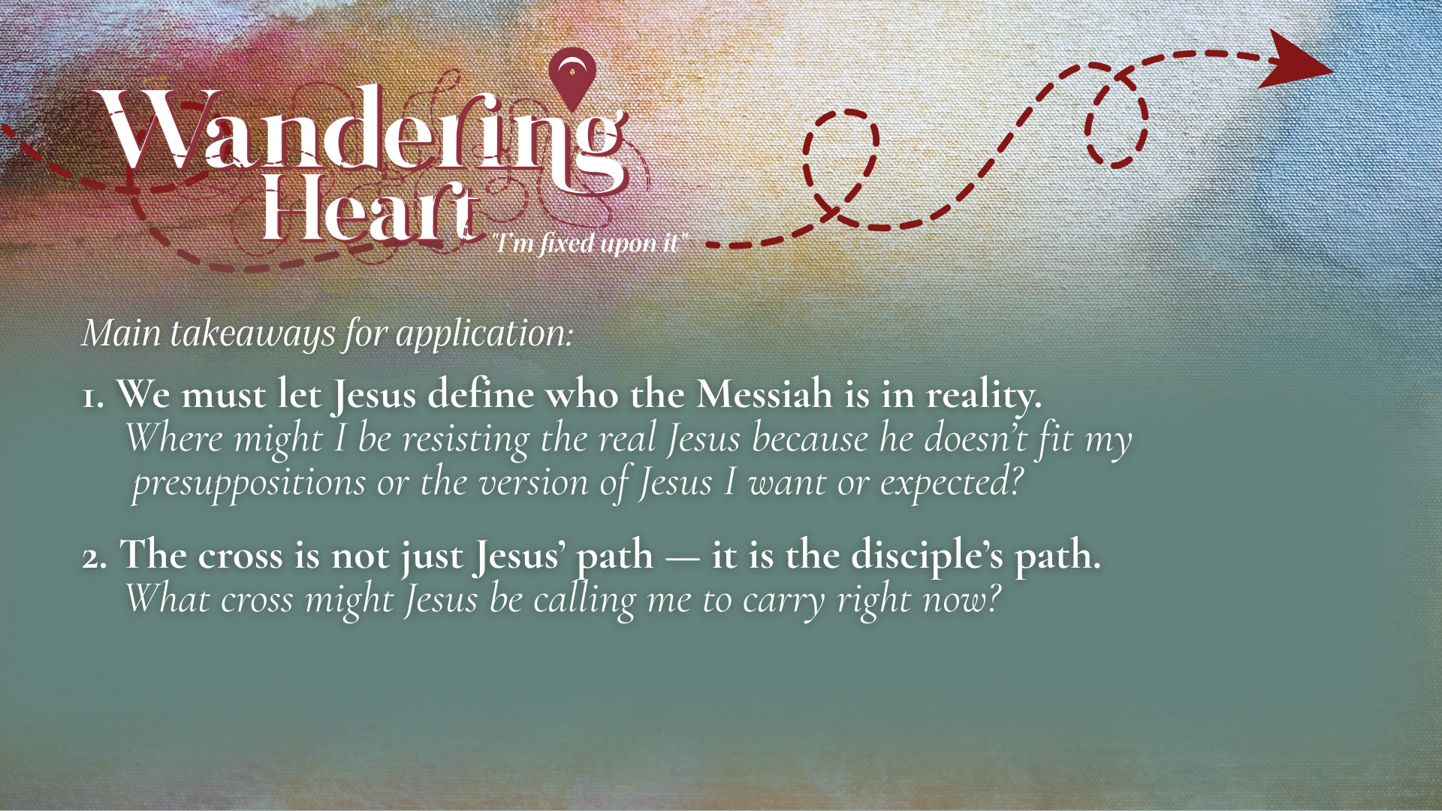

Slide 18
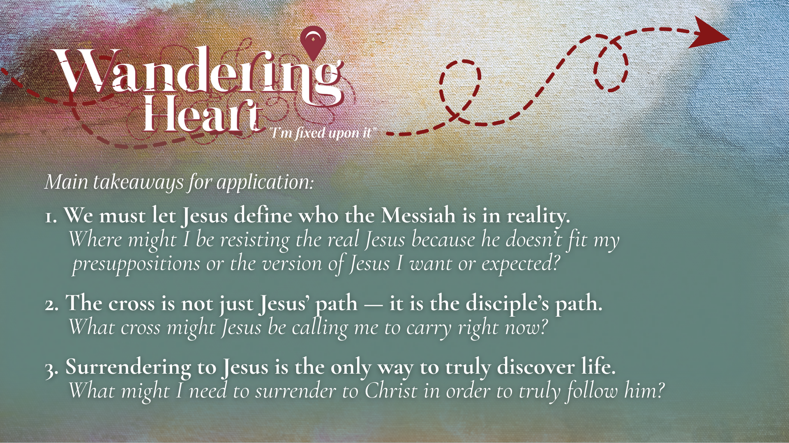
Notes:
[READ TAKEAWAYS & COMMENT ON EACH]
We must let Jesus define who the Messiah is in reality. Peter had the right confession but the wrong expectations. He believed Jesus was the Messiah, but he assumed the Messiah would bring power, victory, and glory without suffering. Q: Where might I be resisting the real Jesus because he doesn’t fit my presuppositions or the version of Jesus I want or expected?
The cross is not just Jesus’ path — it is the disciple’s path. Peter and the rest of the disciples learned that being faithful to Jesus and his good news will eventually lead to opposition, resistance, suffering, and possibly death. Therefore, the “cross” is a symbol of self-denial and surrender to the way of Jesus. Q: What cross might Jesus be calling me to carry right now for his sake?
Surrendering to Jesus is the only way to truly discover life. Our instinct is to protect our lives—our security, reputation, comfort, and control. But Jesus says the path to real life is the opposite: surrender leads to life; sacrifice leads to joy; death to self leads to resurrection life. The kingdom works in a way that feels upside down to human thinking. But it is the way of the cross—and ultimately the way of resurrection. Q: What might I need to surrender to Christ in order to truly follow him?
Brothers and sisters, the invitation of Jesus is not simply to admire him, agree with him, or even confess him with our lips. The invitation is to follow him—to surrender our expectations, our plans, our control, and trust that the way of the cross leads to life. Peter eventually learned this. Watch this… Simon Peter… who once resisted the suffering Messiah and was rebuked by Jesus, wrote this later in his life… [NEXT SLIDE]

Slide 19
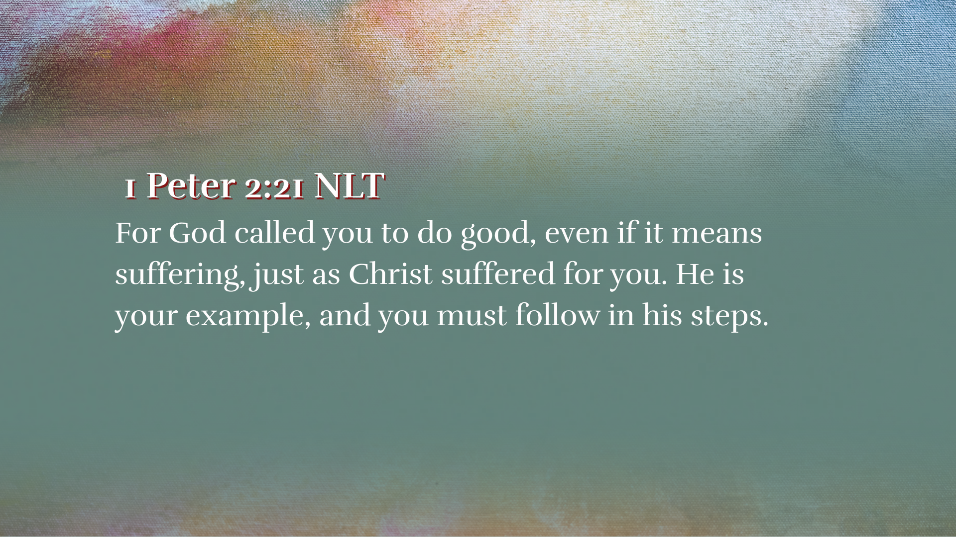
Notes:
[READ VERSE & COMMENT]
Think about this: The disciple who once said “Never, Lord!” eventually tells the church “Follow his suffering path.” What does this tell us? Well, a few things: (1) you might try to teach the Lord a thing or two, but if you keep following him, you will eventually see things his way; (2) Peter says, remember, Jesus suffered for you (i.e., his obedience was your salvation), so you should be willing to endure some hardships yourself; and (3) suffering doesn’t necessarily mean you’ve done something wrong; it may mean that you’re doing something right.
Friends, let us hear what the older, wiser, more Christ-like Peter is saying to us, “The Lord might rebuke you today, but he loves you, will keep pursuing you, and will not leave you. So, keep following in his steps, listening for his voice, and yielding to his will for your life. If you will do this, he will (in time) transform you into the person he created you to be.”
In the hymn Come Thou Fount of Every Blessing, the phrase “I’m fixed upon it” uses 18th-century English where “fixed” means firmly determined, settled, or resolved. “I’m fixed upon it” means “I’m firmly resolved” or “My heart is set on this.” “I’m fixed upon it” expresses a determined faith in the midst of a wandering heart. Just as Jesus was fixed upon his purpose, goal, and mission, may we be fixed and settled upon the God who looks like Jesus and determined to follow him, even when he doesn’t meet our expectations.
Finally, that brings us to our response question for this message… [NEXT SLIDE]

Slide 20
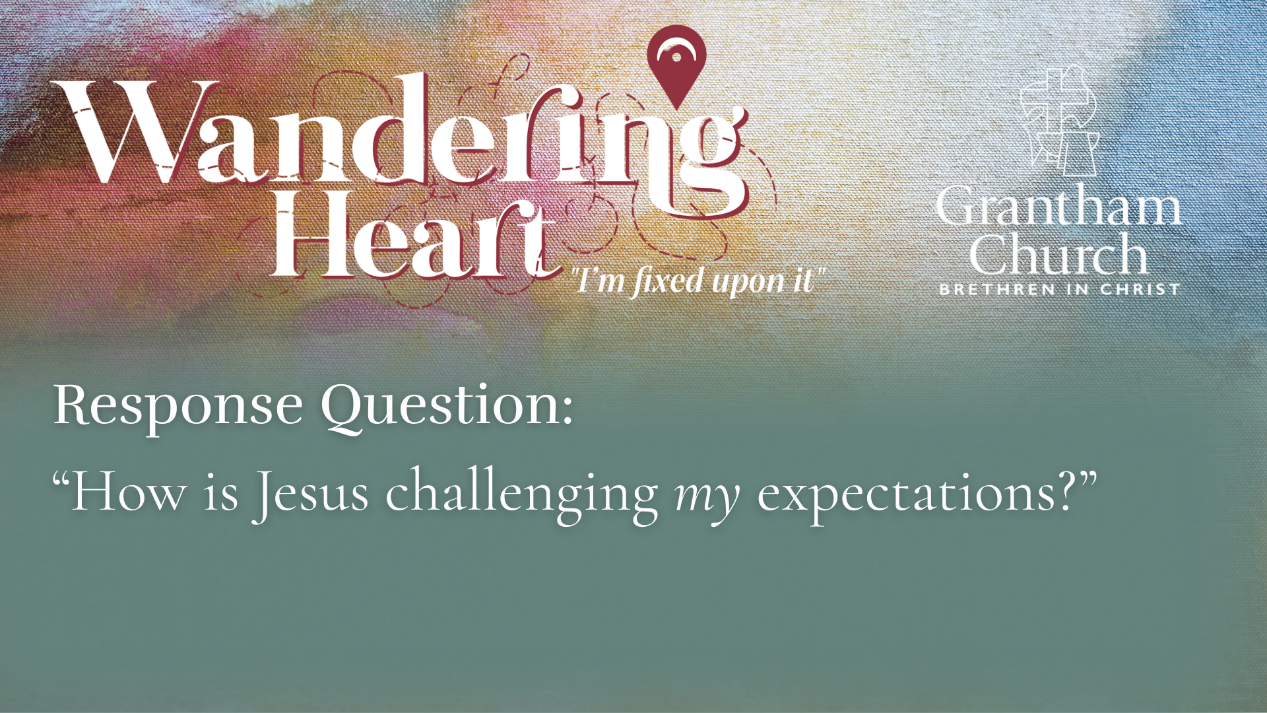
Notes:
Ask yourself… “How is Jesus challenging my expectations?”
[CLOSING WORDS & PRAYER]
[GO TO NEXT SLIDE FOR PRAYER]

Slide 21

Notes:
[CLOSING PRAYER & SONG]
ANNOUNCEMENT: Pastor Dave – Taize Service tonight
Benediction
Beloved wanderer, as you leave this place,
may you carry your curious heart on your sleeve.
May you look for God in every face.
May you find the courage to get out of the boat,
to run to the tomb, and to speak of your faith.
And when the world falls apart,
may you hear God’s voice deep within,
saying, “Take heart, it is I, be not afraid.”
You are called. You are blessed.
In both your ups and your downs,
you always belong to God.
Go now in peace.
Go trusting that good news.
Amen.

