Slide 1
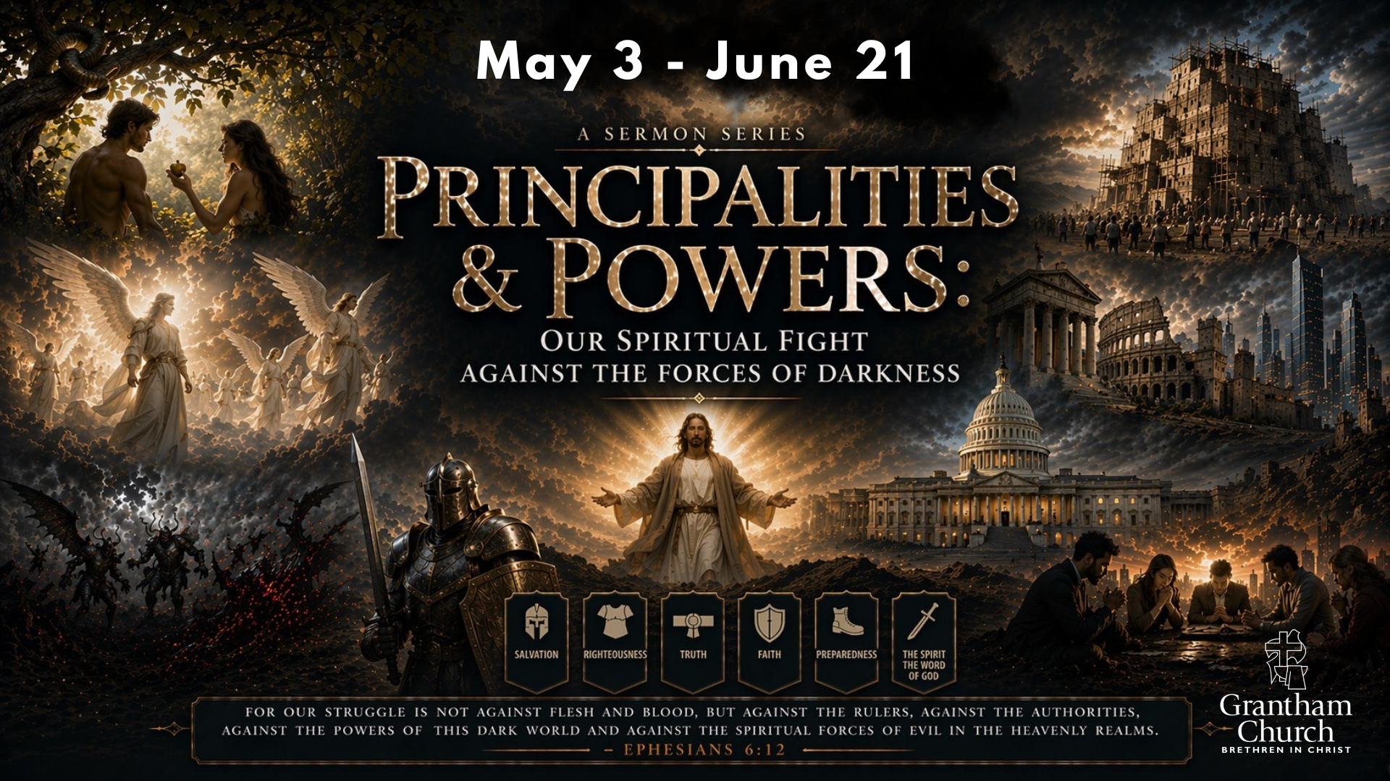
Notes:
Today we begin an 8-week sermon series—Principalities & Powers: Our Spiritual Fight Against the Forces of Darkness. We are living in some troubling times. Regardless of your political views, I think we can all agree that there are clear signs of moral, political, and spiritual degradation in our country. We are seeing an increase in abuses of power, violence, corruption, and greed from leaders in government to large corporations. And it’s especially troubling that we have been witnessing the fusion of the Christian faith with American nationalism, militarism, and imperialism.
As followers of Jesus, how should we respond to this rising darkness? The temptation is to target human beings and speak and act like wicked rulers are the real problem. And while it’s true that immoral leaders are responsible for a great deal of evil (take for example, the Roman emperor Nero in the first century), the Apostle Paul said that we shouldn’t focus our attention on them—which is stunning since Nero was a really bad dude. Instead, at the end of the day, we should pray for kings and those in authority, love our human enemies, and then look past wicked people to the spiritual darkness at work behind the scenes.
Why? Well, here is what Paul wrote to the church in Ephesus while imprisoned in Rome and awaiting an audience with Nero... [NEXT SLIDE]

Slide 2
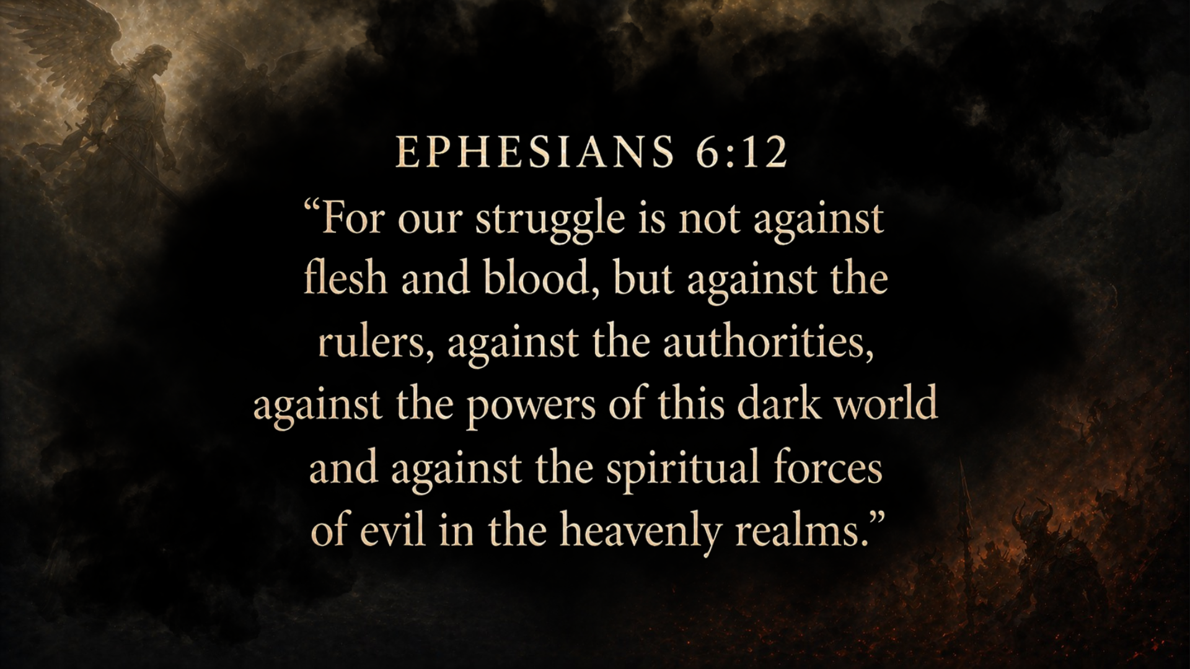
Notes:
[READ VERSE & COMMENT] --- As we will see in this series, these terms are not metaphors—they refer to actual, intelligent, supernatural entities. “Rulers” (archai) “authorities” or “principalities” (exousiai) and “powers” (kosmokratores), and “spiritual forces of evil”… these are not just systems, not just psychological forces, but real sinister beings in the unseen realm. Paul is saying: “Your real opposition is not ultimately human—it is a network of rebellious spiritual beings influencing the world, and you must stand against them.” And this isn’t simply Paul’s idea or imagination run wild. He isn’t “over-spiritualizing” a human problem. As we will see over the next 8 messages, the Bible tells of a real cosmic conflict—where spiritual rebellion has corrupted the world—but through Jesus, God is reclaiming the nations, and he invites his people to participate in this spiritual fight through faithful living and prayer.
And so, in this series we’re going to explore the unseen spiritual conflict behind human history, the victory of Christ over evil, and address the role of believers in spiritual warfare. We will learn about our real enemy and how to fight like Jesus. And since some of what I’m going to share will be challenging to what many of us have heard, if you’d like to go deeper with what I’ll be presenting, check out these resources…[NEXT SLIDE]

Slide 3
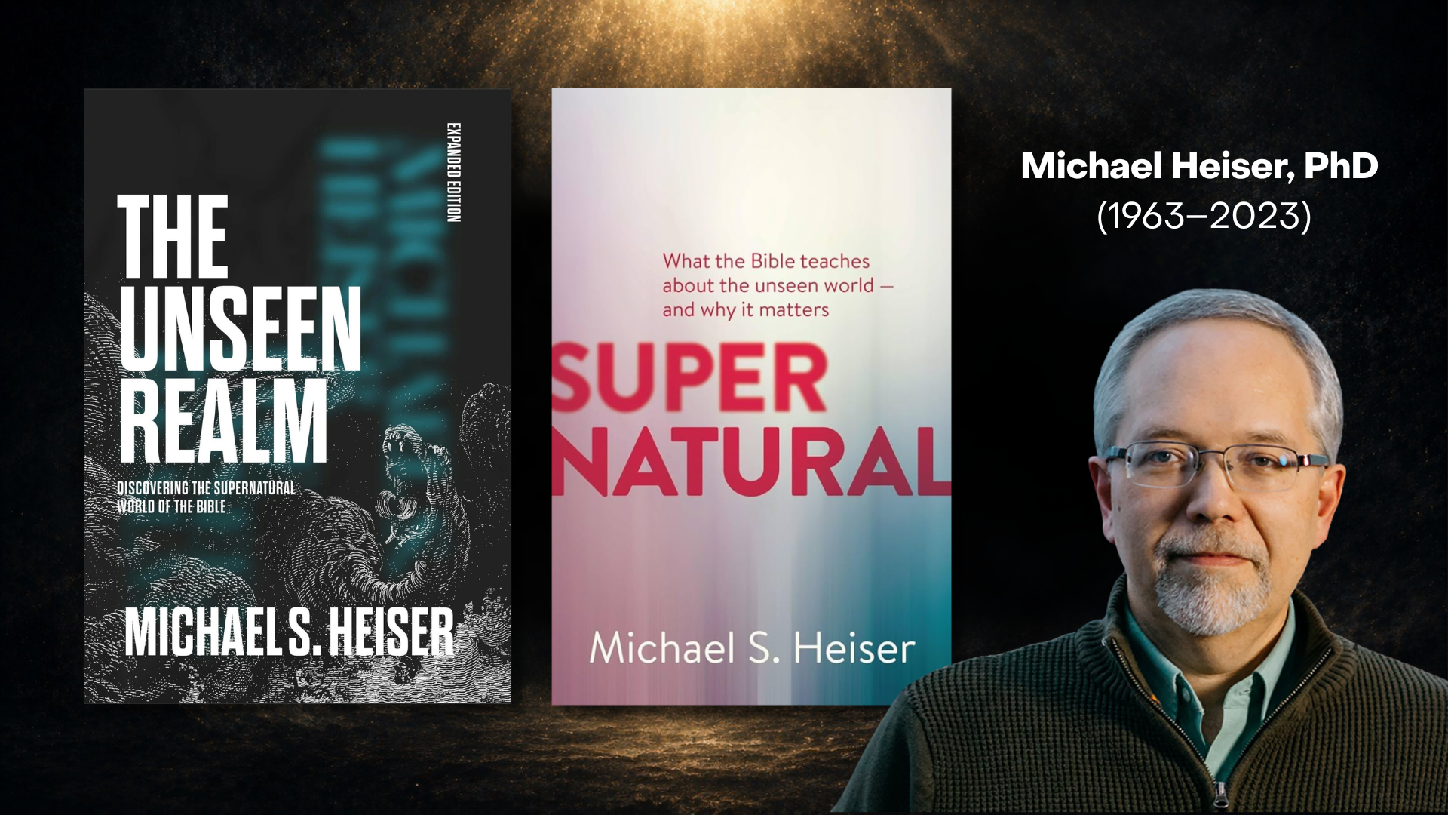
Notes:
As I’ve studied these things over the past couple of years now, I have expanded my view of the principalities and powers mainly through the work of biblical scholar, Michael Heiser. Heiser, who passed away 3 years ago, received an MA in ancient history from Penn State as well as an MA and PhD in Hebrew Bible and Semitic studies from the University of Wisconsin-Madison. For 15 years, Heiser was the Logos Bible Software's scholar in residence.
For those of you who don’t mind a more academic read, his book The Unseen Realm is a best-seller. And for the non-academic, his book, Supernatural: What the Bible Teaches about the Unseen World and Why it Matters, is an easier read.
And if you’re not much of a reader, check out this documentary… [NEXT SLIDE]

Slide 4
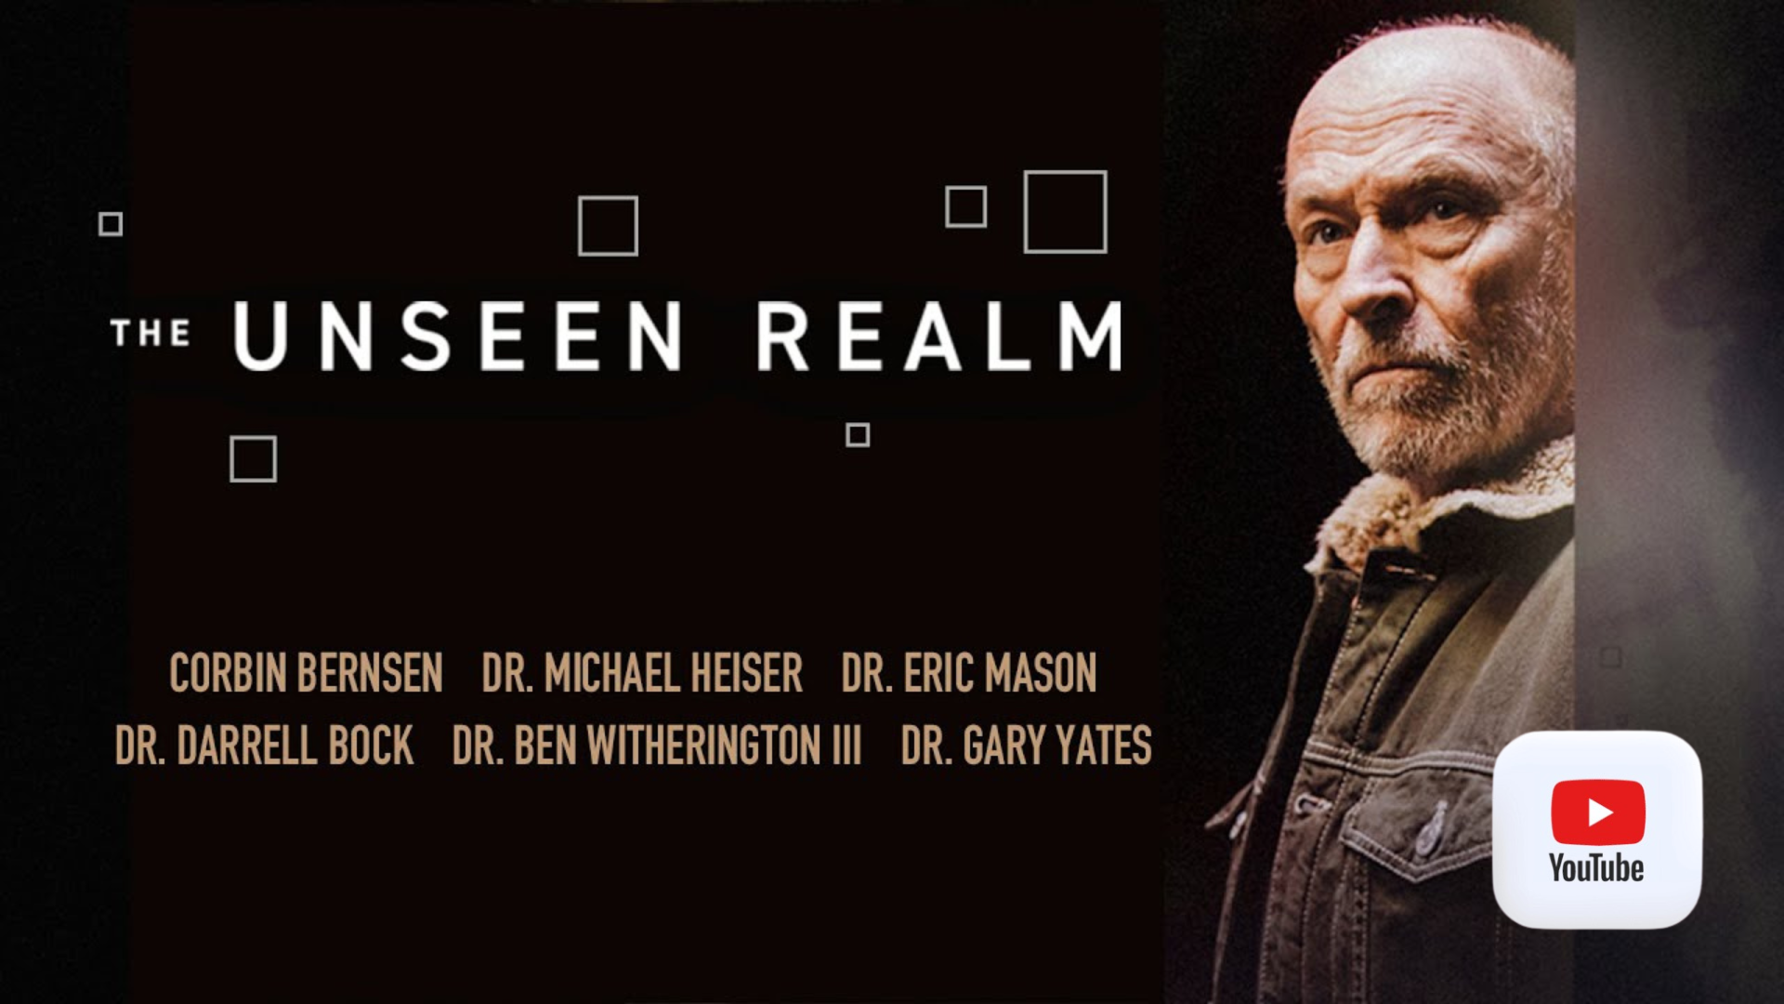
Notes:
The Unseen Realm, narrated by Corbin Bernsen and featuring Michael Heiser, Darrell Bock, Ben Witherington, and other trusted scholars and pastors. You can watch it for free on YouTube. Just search “The Unseen Realm” and you’ll find it. I’ll also link it in the Email From the Pastor this week, which goes out every Wednesday. If you’re not getting the weekly email and would like to receive it, use contact form on the homepage at granthamchurch.org.
Also, if you’d like to jam to some tunes related to the themes we will be covering in this sermon series… [NEXT SLIDE]

Slide 5
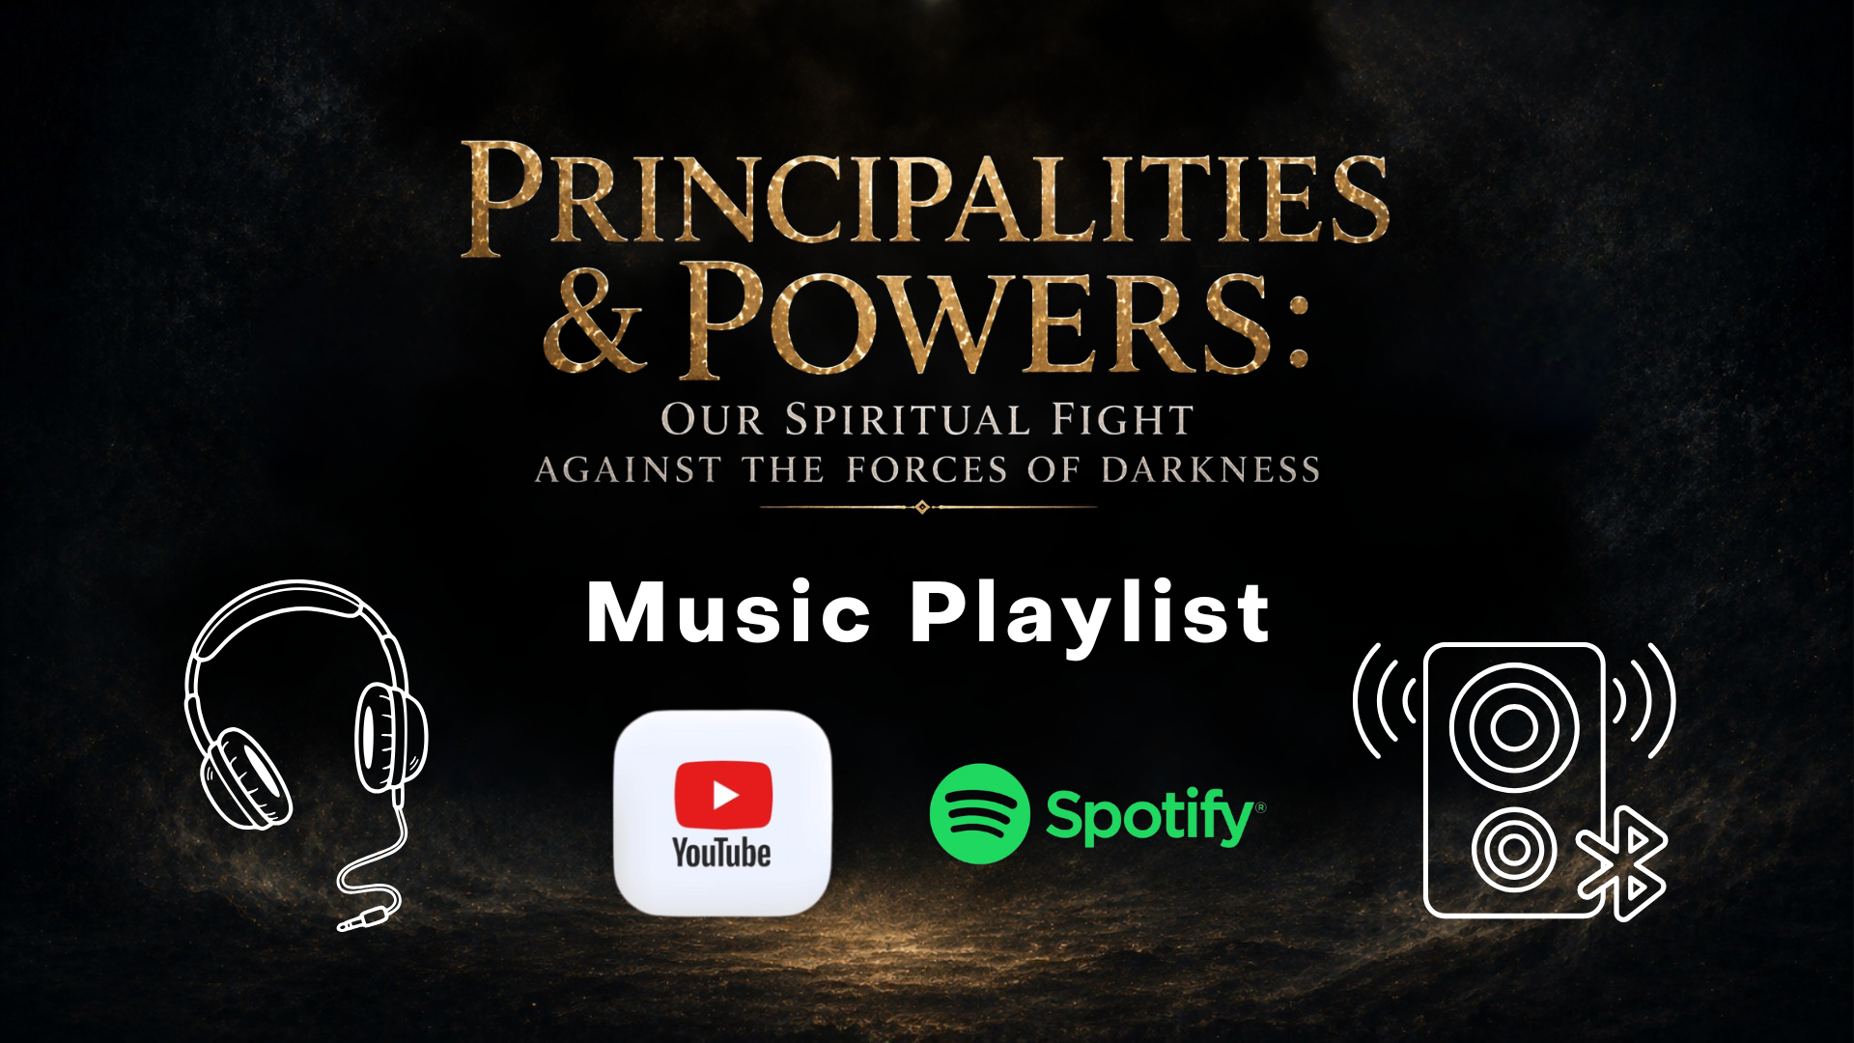
Notes:
I’ve created a playlist at YouTube and Spotify. There are currently 50 songs on the playlist which includes a variety of styles from several eras. So, I’m confident that you’ll hear some songs you like in there. And seriously, I do hope that the playlist will help you throughout the week to be thinking and meditating on the topics we will be covering together.
And lastly, keep in mind that this series is cumulative and each message builds upon the one before it. If you miss a message, be sure to stay up on the series at the website or through the sermon podcast on our My Church App. And another reminder to parents, since we will be dealing with biblical topics and stories related to angels, demons, the devil, and related matters that could be confusing or scary to small children. I encourage you to send any children to Kids’ Own Worship throughout the series.
OK. I think we’re ready. Let’s begin our journey with the first message in our series… [NEXT SLIDE]

Slide 6
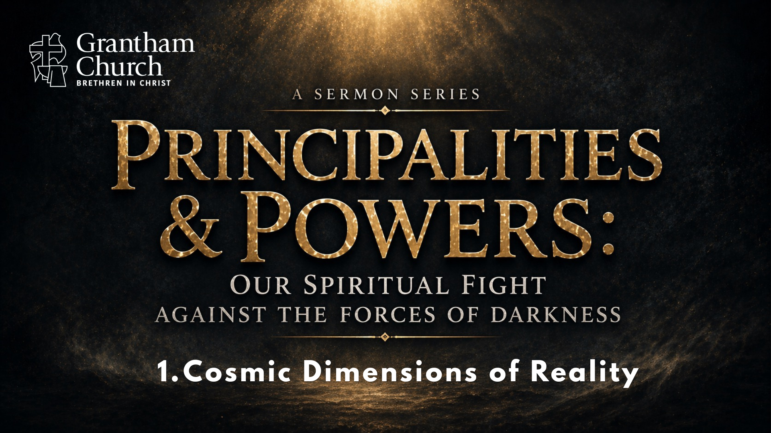
Notes:
Cosmic Dimensions of Reality.
[BRIEF PRAYER]
At the end of last year, a popular coming-of-age television series came to an end after five seasons. Some of you probably watched the original Netflix series… [NEXT SLIDE]

Slide 7
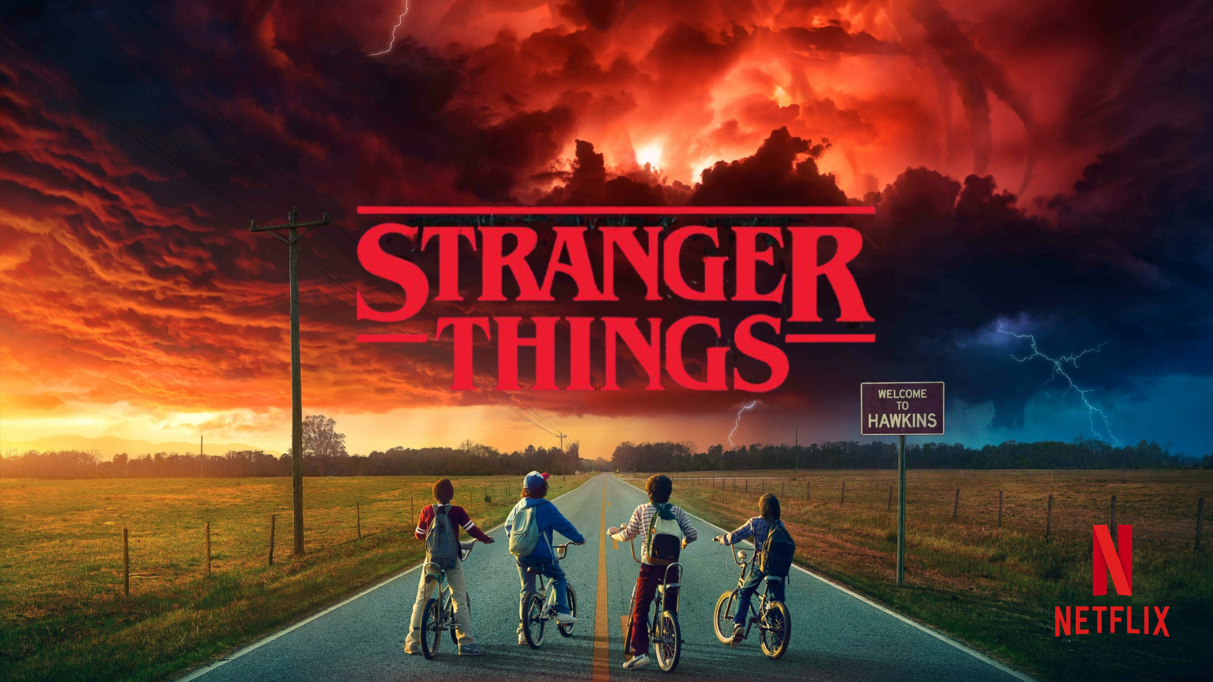
Notes:
Stranger Things. Set in the 1980s, the series centers on the residents of the fictional small town of Hawkins, Indiana, after a young girl with psychokinetic abilities, named Eleven (El, for short), inadvertently creates a wormhole known as the Upside Down, at a nearby secretive government research facility called Hawkins Lab, connecting Earth to a hostile realm called the Abyss. When the show begins it looks like a normal small town—kids on bikes, families, school, everyday life. But then you slowly begin to see the supernatural elements and the unsettling reality that there is another dimension—the Upside Down.
It’s invisible to most people. It’s overlapping our world. It’s affecting things we don’t fully understand. And what’s striking is this: The real danger isn’t just in that other realm—
it’s when it breaks into ours. People start asking: Why are things going wrong? What’s causing this chaos? What are we not seeing? Yes, there are humans doing evil things. But we discover that there are things behind the scenes using and exploiting humans on earth. There is an unseen rebellious force working behind the scenes to bring about our demise.
Now here’s what’s fascinating: our culture is captivated by this idea. Other dimensions. Hidden realities. Spiritual forces. The paranormal. From shows like Stranger Things to podcasts, movies, and TikTok—people are asking: “Is there more to reality than what we can see?” And the answer the Bible gives is: Yes. There is. But here’s the difference: Stranger Things imagines a hidden realm; The Bible reveals one. And when the Stranger Things story leaves people in fear and confusion, Scripture shows that God is sovereign, Christ is victorious, and that we are not alone in the fight against the spiritual forces of darkness.
And here’s where it gets uncomfortable: Our culture is fascinated with the supernatural…
but the Church often avoids it. We binge stories about the unseen realm (acting as if this is all fantasy—just something humans invented to tell a captivating story) but ignore what the Scripture says about it. We talk about stress, anxiety, conflict, war, violence, lies, corruption in politics, bullies, tyrants, and kings—we view these things on the surface—but rarely ask: “Is there a spiritual dimension to all of this?” And I submit to you, church, there is.
And it’s time to start taking the Bible seriously when it comes to the cosmic dimensions of reality… [NEXT SLIDE]

Slide 8
Notes:
Think about it: What if the Bible is telling the truth—that there really is an unseen realm, and your life is happening in the middle of it? What if your struggles aren’t just natural? What if your prayers matter more than you think? What if your life is part of a much bigger story? And if it is… why in God’s name would we act like it’s not true.
Well, the problem for many of us is that we live in an age (particularly in the West) that has pressed us into the materialist mold. We swim in the waters of scientism. We have reduced the world down to physical time and space and we’ve relegated the “supernatural” to the realm of fantasy. But we need to recognize that this anti-supernatural thinking is not the norm in history, nor is it the way many cultures see these things today.
In his book, God at War: The Bible & Spiritual Conflict… [NEXT SLIDE]

Slide 9
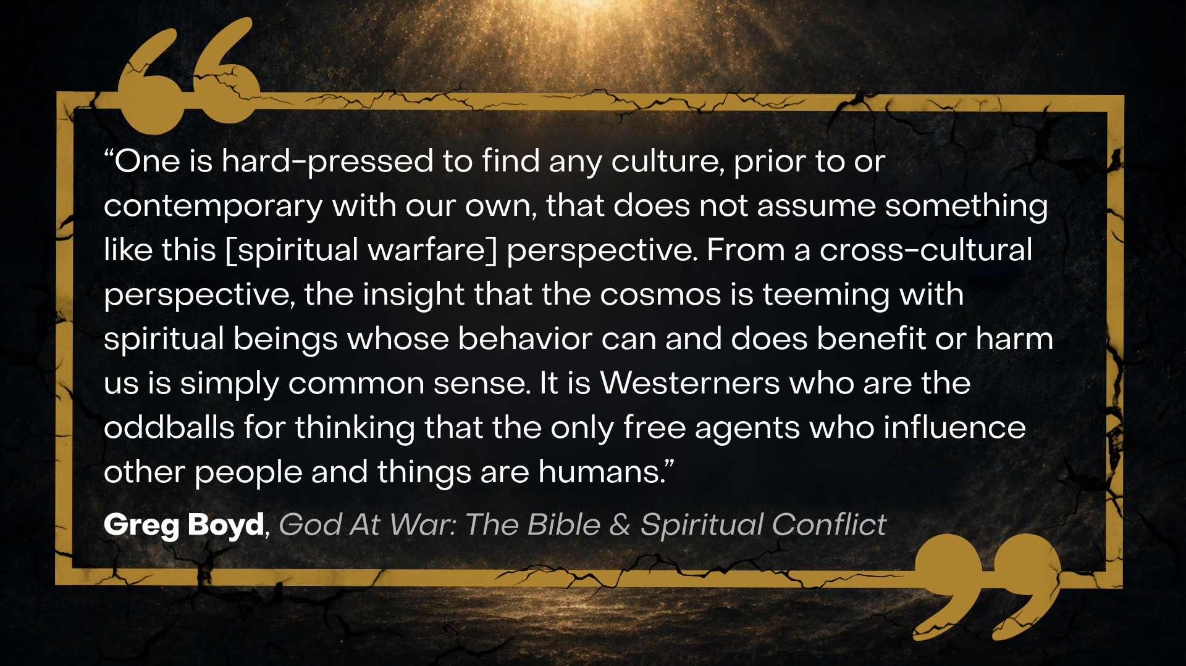
Notes:
[READ QUOTE & COMMENT]
Boyd goes on to say… [NEXT SLIDE]

Slide 10
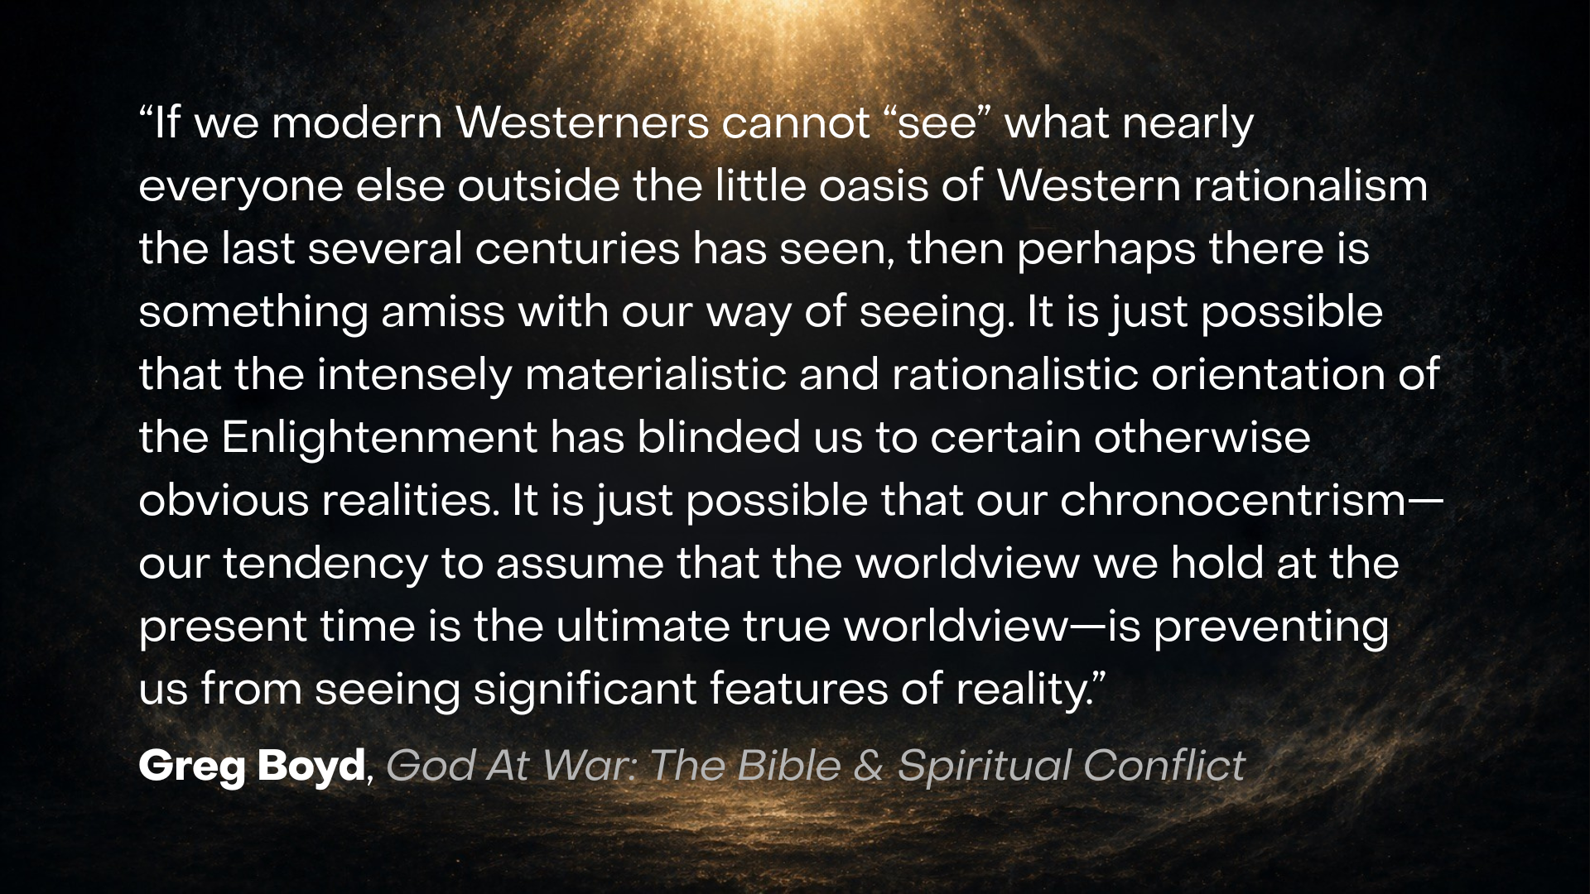
Notes:
[READ QUOTE & COMMENT]
So, according to the Bible, what are these significant features of reality? And where do the Scriptures begin with telling the story of a multi-level cosmos?
Well… at the beginning, of course. [NEXT SLIDE]

Slide 11
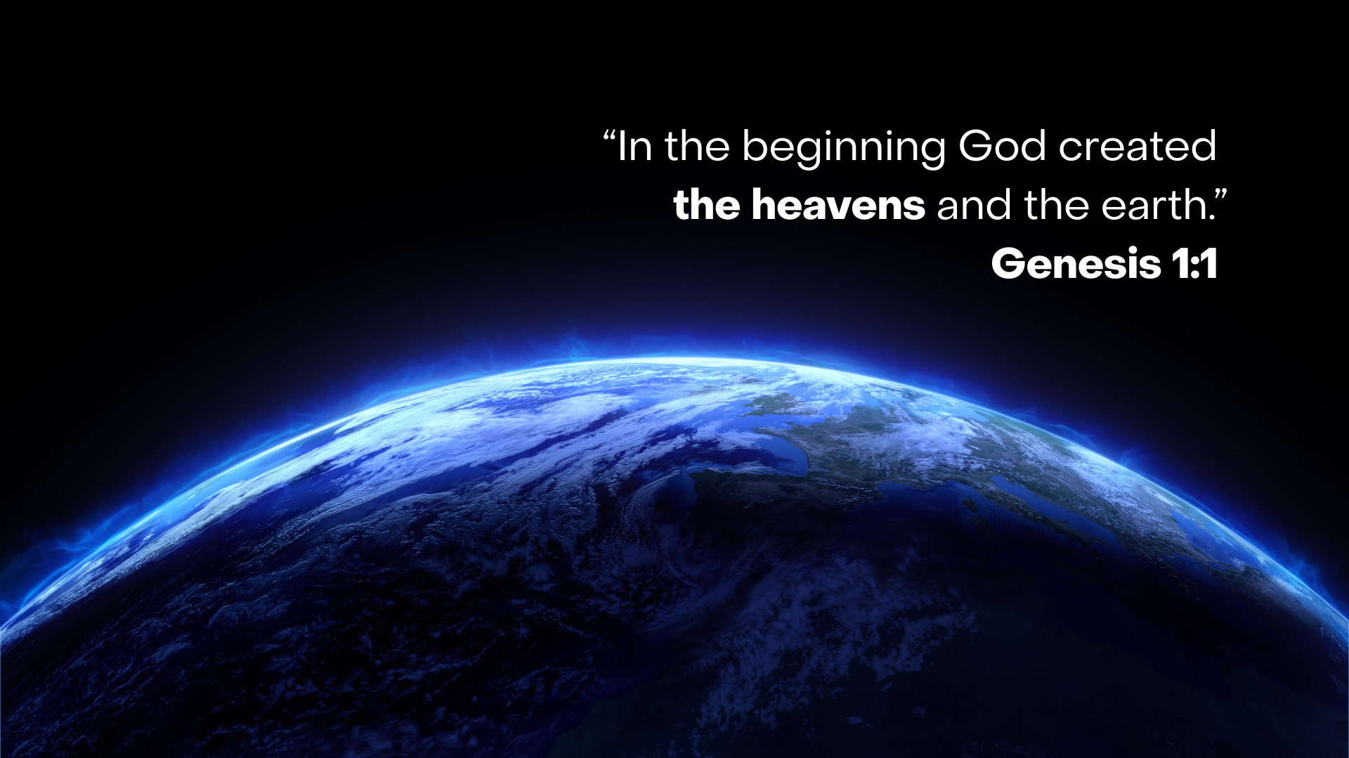
Notes:
“In the beginning God created the heavens and the earth.” It’s likely that you may have not noticed or been taught this before, but the biblical authors use one word (“heavens”) for multiple levels of reality, not separate categories. So “heavens” can refer to the sky (birds, clouds); cosmic space (stars, sun, moon); God’s dwelling or the spiritual unseen realm. These are not three different places but overlapping aspects of one created reality.
In other words, the Scriptures do not divide reality into “natural vs. supernatural” the way we do, particularly in the West. Instead, they thought in terms of: seen vs. unseen; earth vs. heavens (everything above and beyond); So, “heavens” = everything that is not “earth.” Therefore, Genesis 1:1 is not dividing reality into physical vs. spiritual—it’s declaring that God created all realms of existence, both seen and unseen, as one integrated creation.
And notice, the material universe was created after God had made a spiritual world populated by heavenly beings; also described in the Bible as “heavenly hosts” or the “sons of God.” Texts like Job 38:4–7 suggest these divine beings (or “morning stars”) were already present, rejoicing as God formed the earth, indicating they were witnesses to creation, not co-creators. And this is basic biblical theology 101.
Now…this sets the stage for the divine council language seen later in Psalm 82, where God presides over a heavenly assembly of real, created spiritual beings who participate in His governance of the world. Take a look at Psalm 82, verse 1… [NEXT SLIDE]

Slide 12
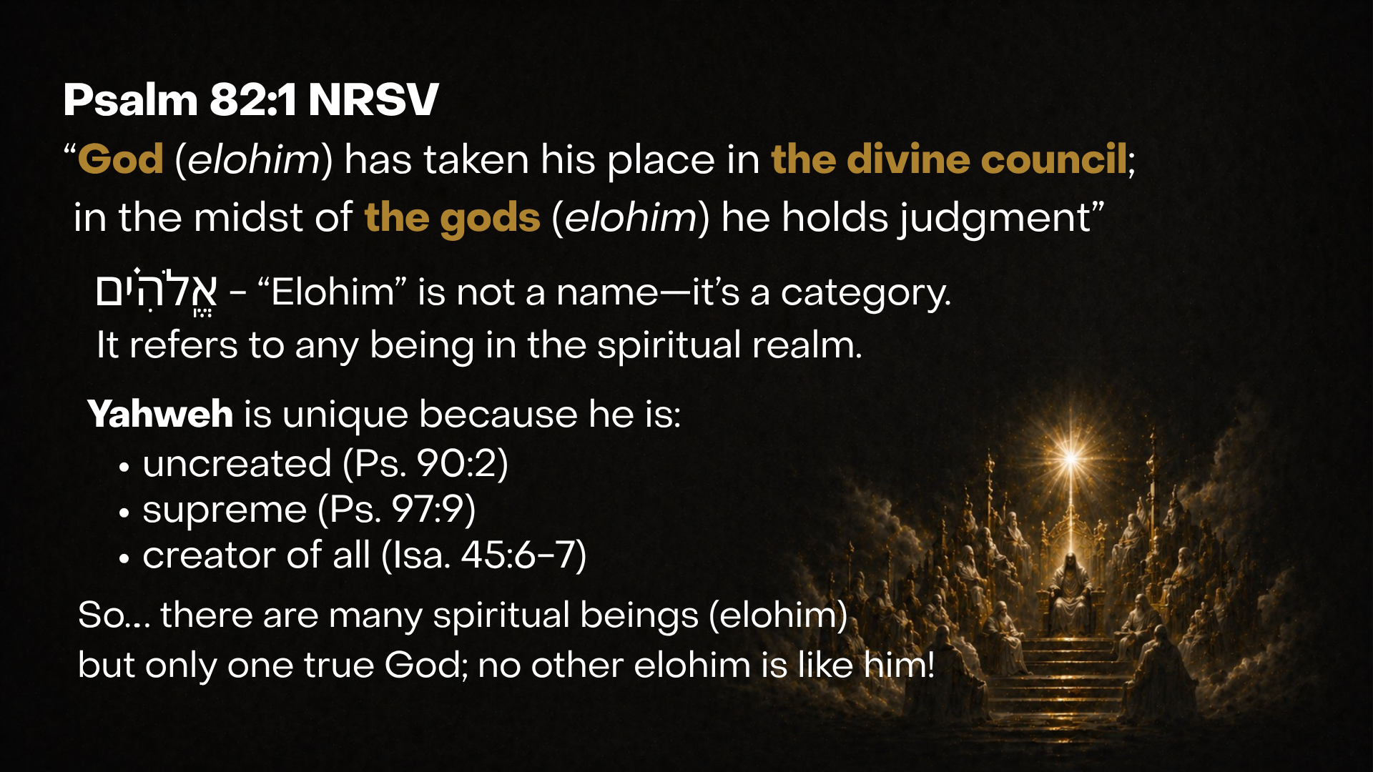
Notes:
[READ & COMMENT]
the “divine council” or “great assembly” is referenced a number of times in the OT; e.g., “let us make man…” or “who will go for us?”
“the gods” may sound strange to our ears because we’re monotheists; but let’s be clear, we’re not talking about the Greco-Roman pantheon or a plurality of equally powerful gods (or divine beings); no, we’re talking about different kinds of elohim.
The Bible doesn’t teach that there are many gods like Yahweh—it teaches that there are many spiritual beings, but only one God who created them all and rules over them. Yahweh is the Most High God, the creator of all things and sustainer of the heavens and the earth.
Open your Bibles to Psalm 82, let’s look at that in context… [NEXT SLIDE]

Slide 13
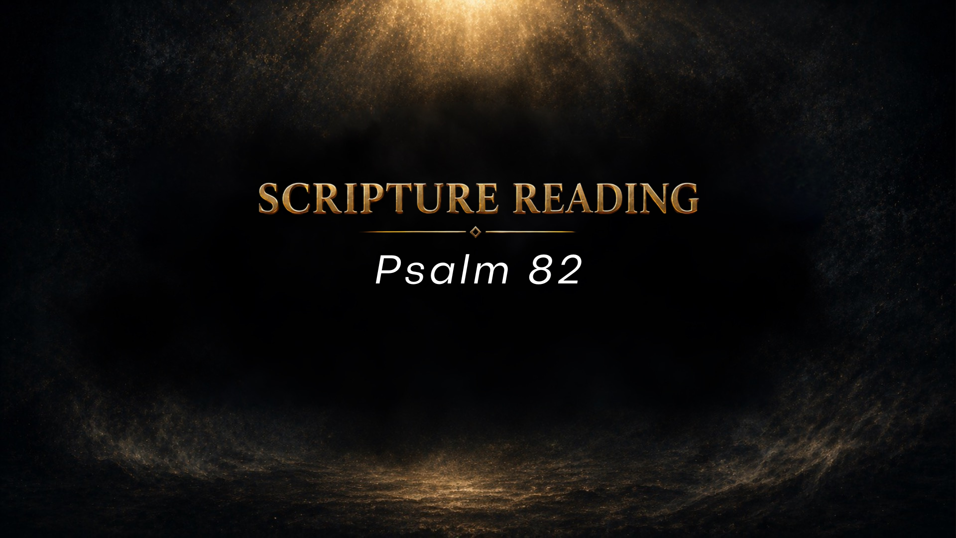
Notes:
[READ PASSAGE & COMMENT] --- We will come back to this passage again in this series, but for now I want you to notice two things about it: (1) these divine beings in the great assembly were created by God to help Yahweh rule over creation and serve humanity, but some of them use their free will to abuse their authority, harm humanity and the earth, and (as we will see throughout this series) lead a rebellion; and (2) pay attention to the “sonship” language used in Ps.82:6—”I say, “You are gods, you are all sons of the Most High.”
And you might be thinking… but how can there be many “sons of god” if there is just one Son of God—Jesus. Well, that is why in John 3:16, Jesus says, “For God so loved the world that he gave his only begotten (unique, one of a kind) son…” As we know, Jesus was not created like these “gods” or other powerful divine beings; Jesus is the uncreated One. Or as John wrote: “In the beginning was the Word, and the Word was with God, and the Word was God. He was with God in the beginning” (John 1:1-2).
So, back to this idea of “sonship” in Psalm 82:6. Don’t miss this… because this reminds us that God wants a family. And the Scriptures tell us that this family first began in the unseen world and is then extended to earth when God creates human beings. Again, listen to the divine council language in Genesis 1:26… [NEXT SLIDE]

Slide 14
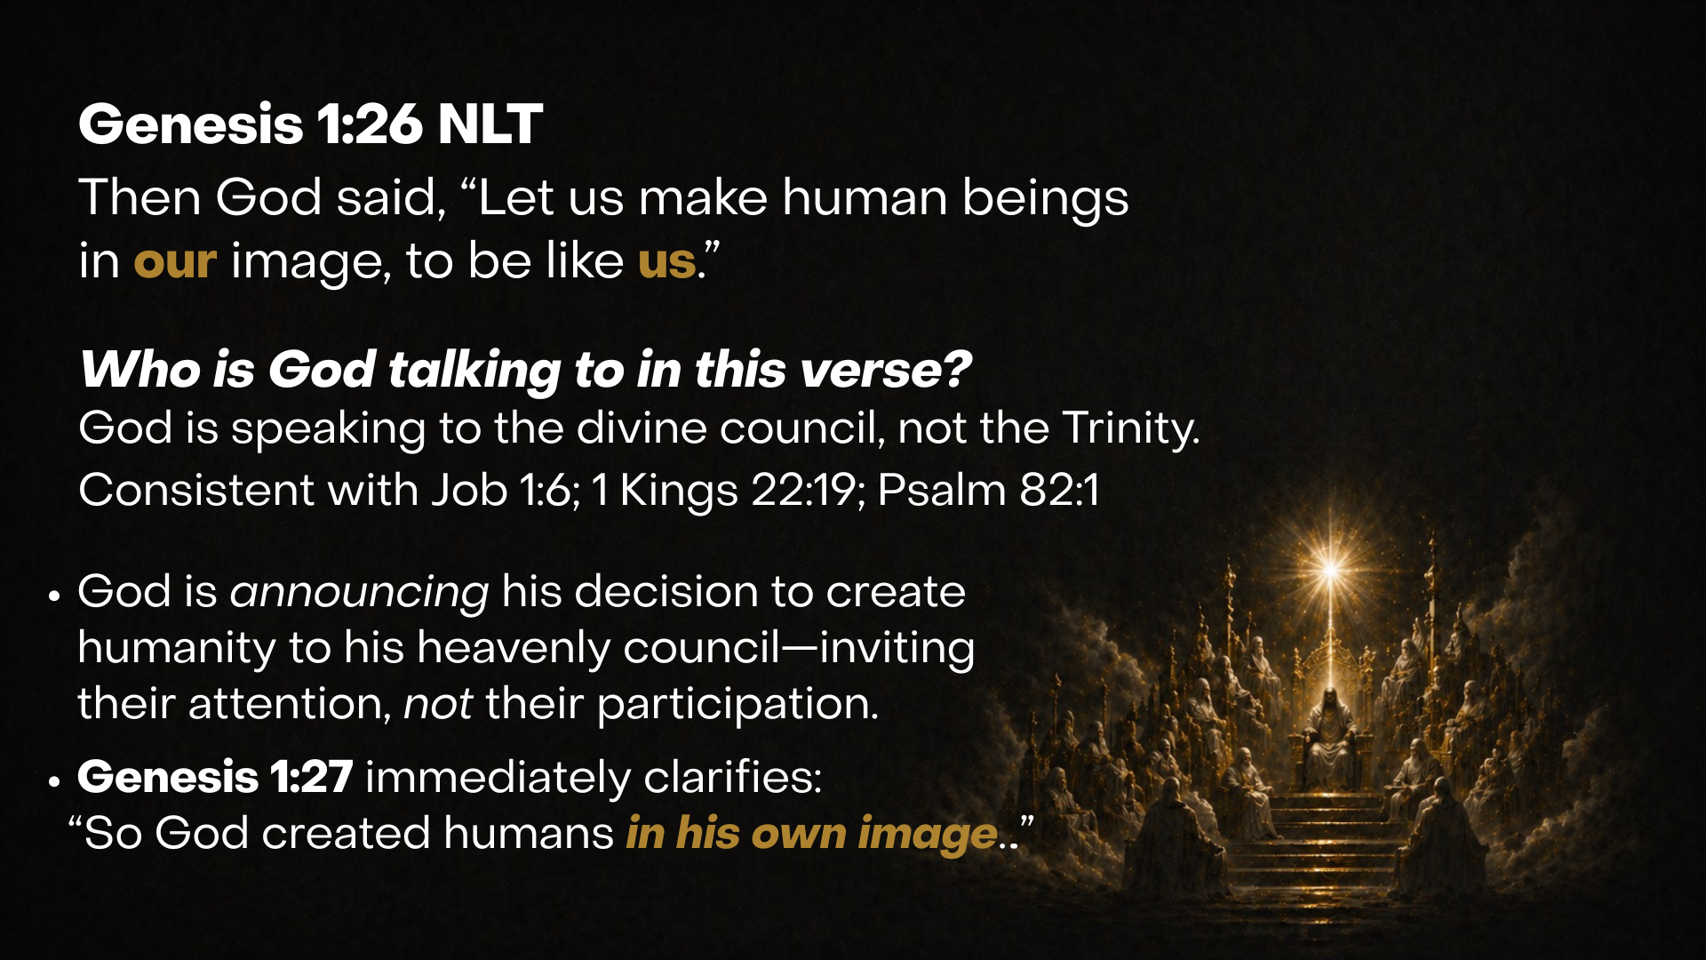
Notes:
Then God said, “Let us make human beings in our image, to be like us.” Who is God talking to in this verse? Who is the us? Well, it’s often been assumed to be the Trinity (Father, Son, and Holy Spirit). And while the Trinity is certainly present (that’s who God is), we should hear this as God speaking to the divine council. And that is consistent with Job 1:6 (angels come to Yahweh, including the satan) and 1 Kings 22:19-20 (the Lord asks the council to help further the demise of the wicked King Ahab). Also, remember that the Trinity is not yet clearly revealed in the OT. Moses didn’t know about the Trinity. Ancient Israel would not have understood this as Father, Son, and Spirit, but as the divine council.
Furthermore, the plural language “let us make” shows divine deliberation in the presence of spiritual beings, while the singular action in v.27 makes clear that God alone creates humanity in His image. If you look at v.27, it says: “So God created human beings in his own image. In the image of God he created them; male and female he created them.”
And these two families (the heavenly and the earthly families) come together in a Garden called Eden, which we will look at next week in Gen 3. Check out this cosmic biblical timeline that helps you to see where we’re going in this series… [NEXT SLIDE]

Slide 15
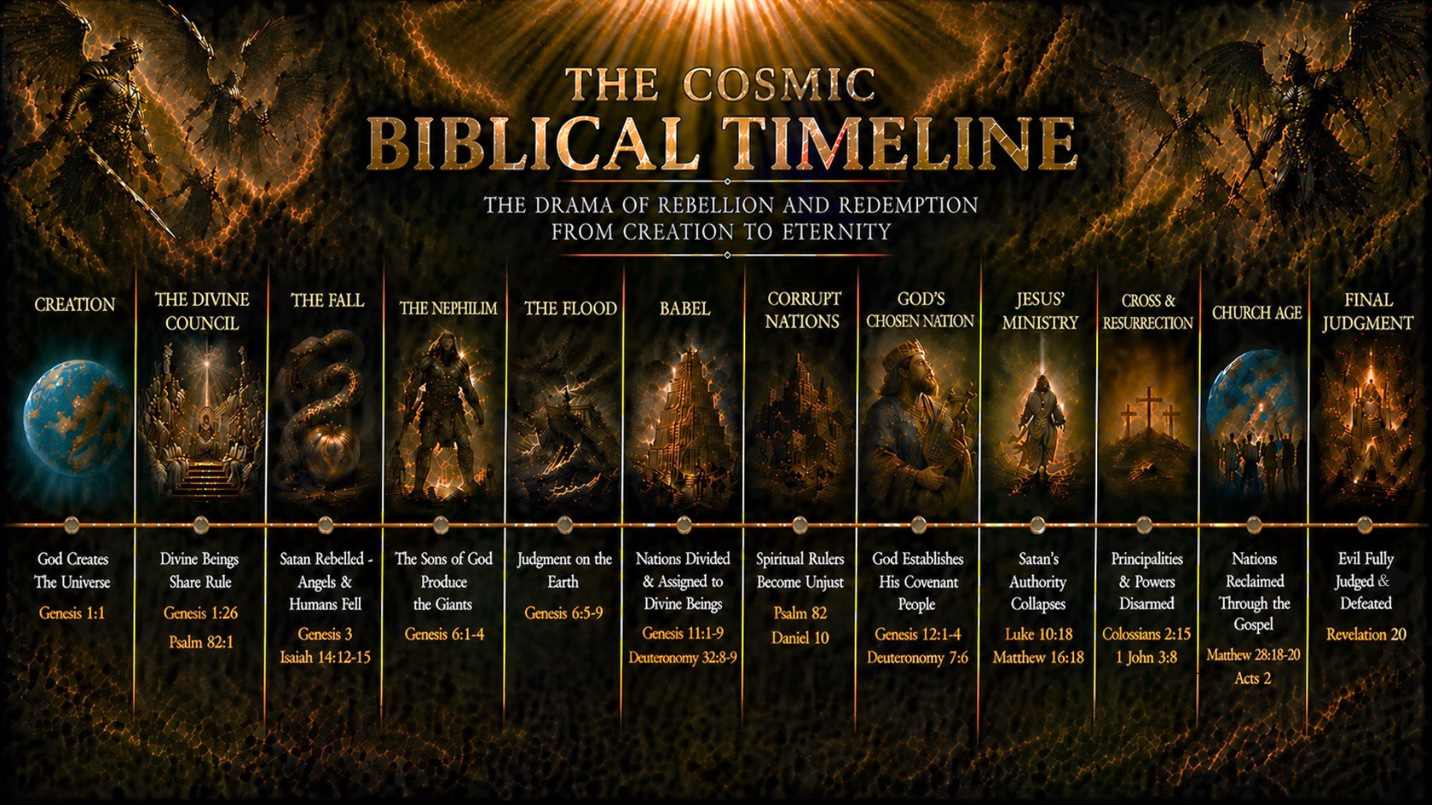
Notes:
If you’d like to look at this timeline more closely, you’ll be able to access the slides when this message is posted to the website and podcast later tomorrow.
Today we have started with creation of “the heavens and the earth” and the divine council. Next week we see the first rebellion in Eden, initiated by the serpent—a divine being that disobeys his heavenly mandate and leads humanity astray. And from there we will make sense of the giants and the flood in Gen 6, the tower of Babel in Gen 11, and much more… as we make our way to Jesus and the final judgment of the principalities and powers.
OK. Let’s sum up this first message with some takeaways and questions. Here is the first one… [NEXT SLIDE]

Slide 16
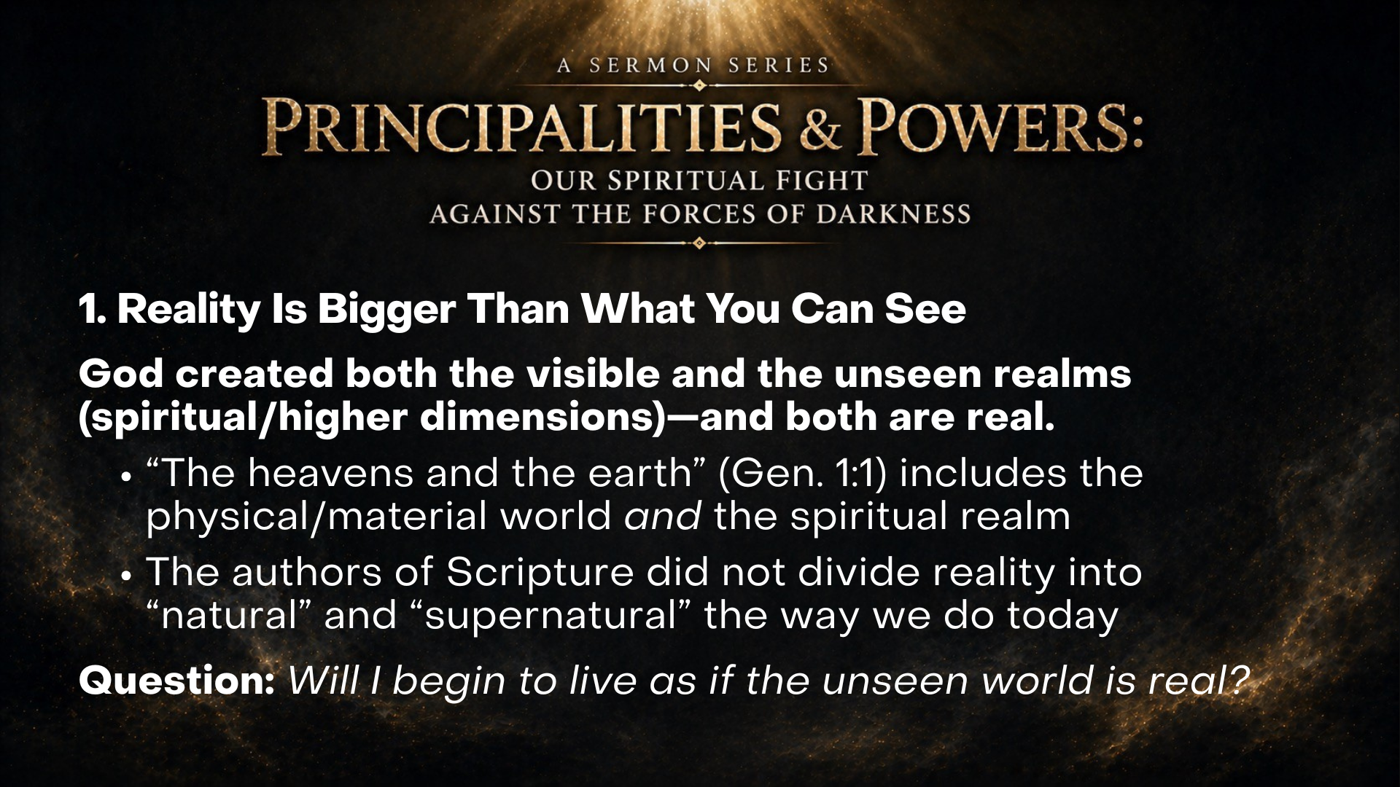
Notes:
1. Reality Is Bigger Than What You Can See
God created both the visible and the unseen realms (spiritual/higher dimensions)—and both are real.
“The heavens and the earth” (Gen. 1:1) includes the physical/material world and the spiritual realm
The authors of Scripture did not divide reality into “natural” and “supernatural” the way we do today
Question: Will I begin to live as if the unseen world is real?
Takeaway number two… [NEXT SLIDE]

Slide 17
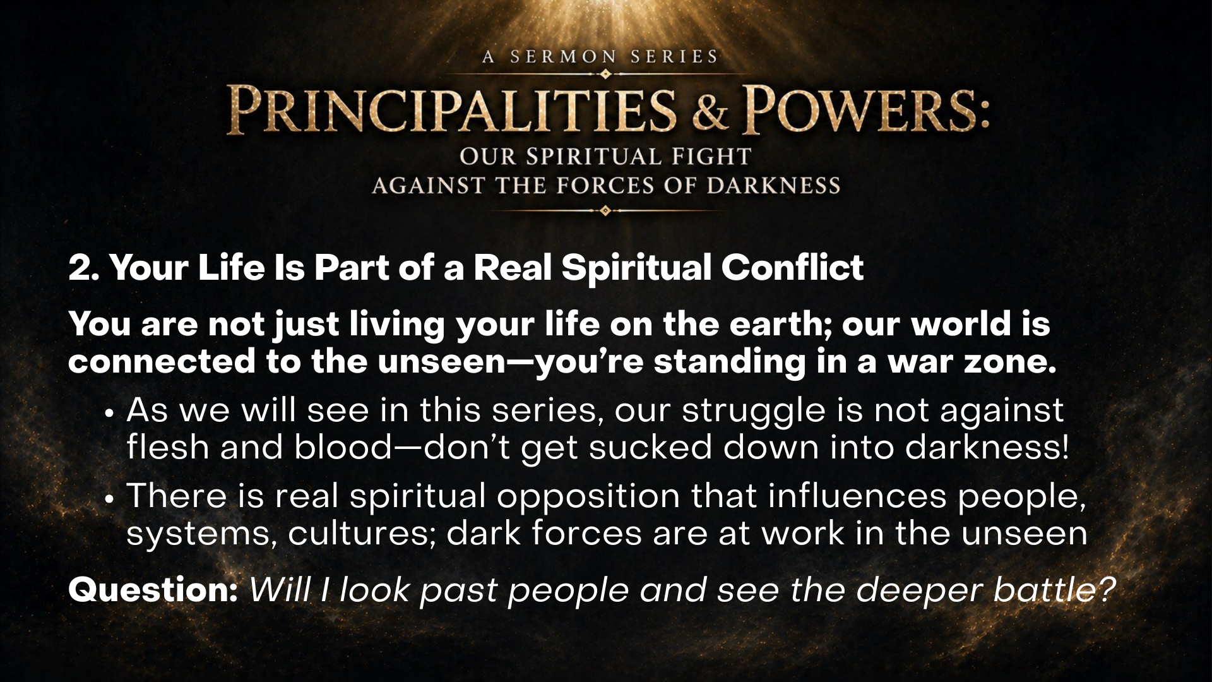
Notes:
2. Your Life Is Part of a Real Spiritual Conflict
You are not just living your life on the earth; our world is connected to the unseen—you’re standing in a war zone.
As we will see in this series, our struggle is not against flesh and blood—don’t get sucked down into darkness!
There is real spiritual opposition that influences people, systems, cultures; dark forces are at work in the unseen
Question: Will I look past people and see the deeper battle?
And lastly, takeaway number 3… [NEXT SLIDE]

Slide 18
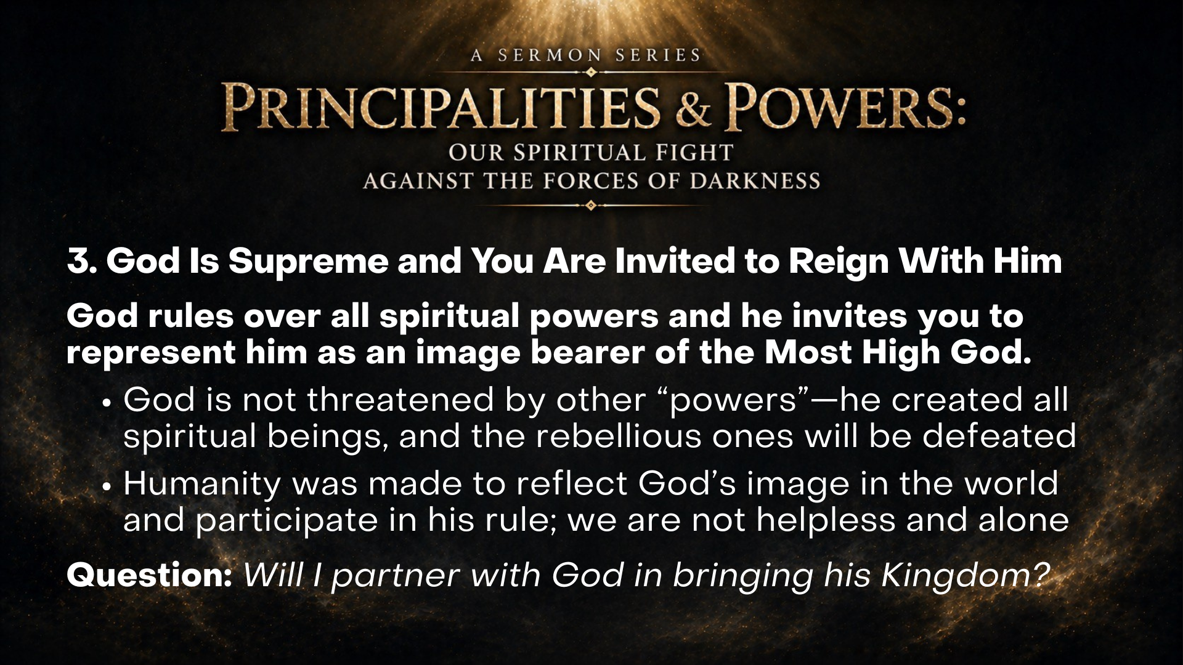
Notes:
3. God Is Supreme—and You Are Invited to Reign With Him
God rules over all spiritual powers—and invites you to represent him as an image bearer of the Most High God.
God is not threatened by other “powers”—he created all spiritual beings and the rebellious ones will be defeated
Humanity was made to reflect God’s image in the world and participate in his rule; we are not helpless and alone
Question: Will I partner with God in bringing his Kingdom?
Finally, each week in this series we will close with a weekly practice. Here is the challenge, invitation, and goal for the first week… [NEXT SLIDE]

Slide 19
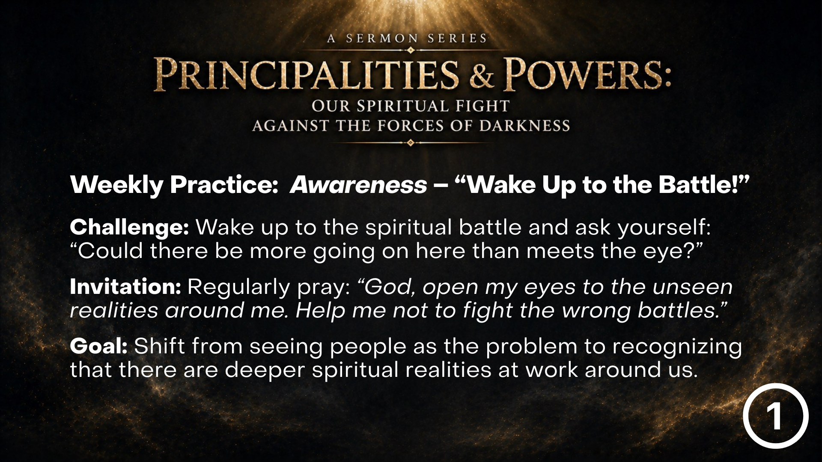
Notes:
[READ & COMMENT]
Weekly Practice: Awareness – “Wake Up to the Battle!”
Challenge: Wake up to the spiritual battle and ask yourself: “Could there be more going on here than meets the eye?”
Invitation: Regularly pray: “God, open my eyes to the unseen realities around me. Help me not to fight the wrong battles.”
Goal: Shift from seeing people as the problem to recognizing that there are deeper spiritual realities at work around us.
Church, may God help us in this series to grow in our awareness of the unseen realm so that we might loves our neighbors and our enemies, and live according to the spiritual warfare worldview given to us in the Scriptures. Let’s pray… [NEXT SLIDE]

Slide 20
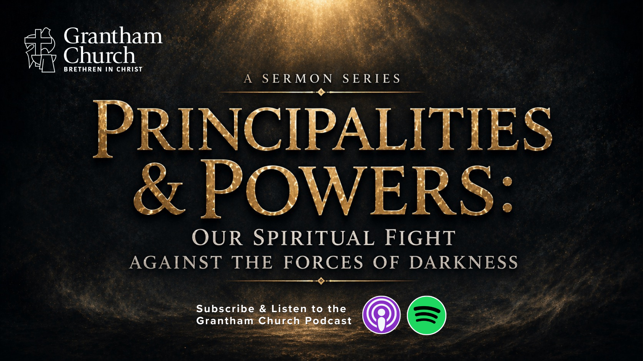
Notes:
[CLOSING PRAYER]
[APOSTLES’ CREED]
[COMMUNION]
ANNOUNCEMENT: Fellowship Meal
Benediction
Church, remember: your battle is not against flesh and blood,
but against the principalities and powers in the heavenly realms.
May the Lord help you stay awake to the unseen realities around you,
as you put on the armor of God and engage in the spiritual fight.
Go now… to love your enemies, resist the devil, and pray without ceasing.
In the name of the Father, Son, and Holy Spirit. Amen.

