Slide 1

Notes:
[BRIEF INTRO]
Welcome
Final Sunday of our winter series – Foundations
We have been looking at how the gospel challenges us to commit to following Jesus together, which involves regular rhythms of prayer, reading and reflecting on the Scripture, and as we will see today… the call to deepen relationships in the church.
If you missed any of the first 3 messages in our series, you can go back and listen to those at our website (granthamchurch.org) or through our podcast.
OK. Let’s jump right in this morning. Please grab a Bible and turn to… [NEXT SLIDE]

Slide 2

Scripture Reading
Colossians 1:15-23 NLT
2 Corinthians 5:15-21 NLT
Notes:
[INVITATION TO STAND FOR SCRIPTURE READING]
[READ 1 COLOSIANS 1:15-23 & 2 CORINTHIANS 5:15-21 NLT]
This is the word of the Lord. Thanks be to God
You may be seated. [NEXT SLIDE]

Slide 3
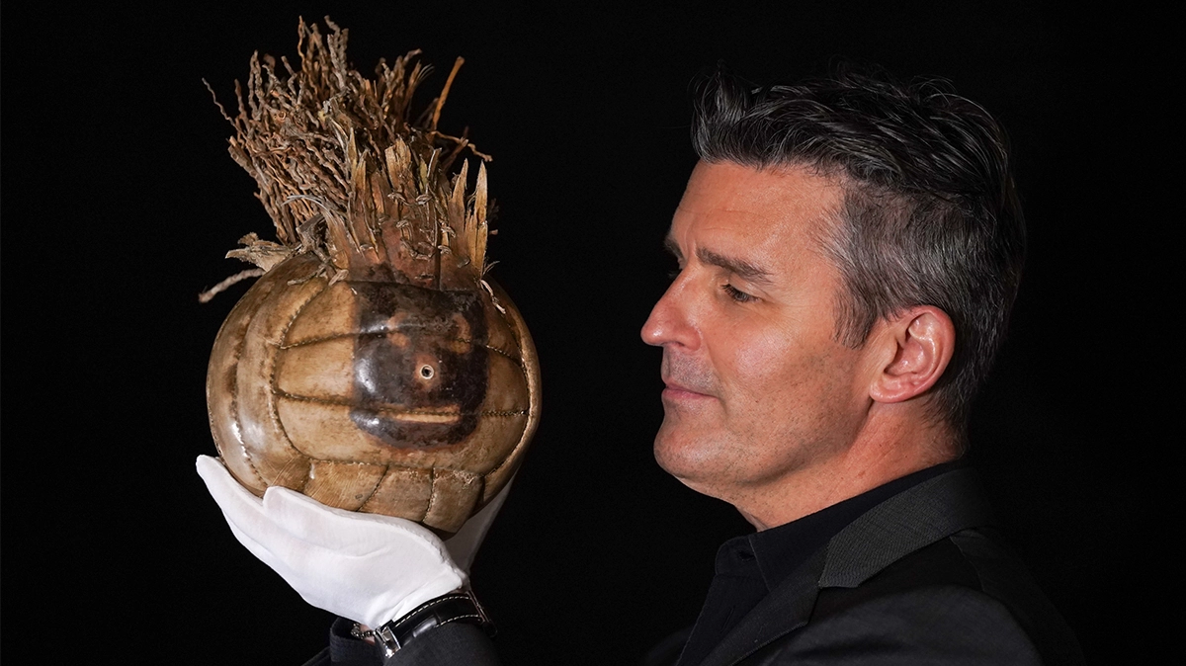
Notes:
[BRIEF COMMENTS[
Who knows what this is?
“Wilson” from the movie Cast Away
This is a picture of “Wilson” at auction last year – The well-recognized movie prop sold to an anonymous buyer for over $308k
If you haven’t seen the movie… [NEXT SLIDE]

Slide 4
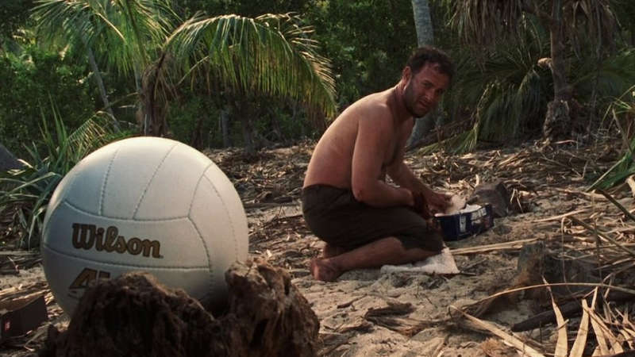
Tom Hanks
Cast Away (2000)
Notes:
[BRIEF COMMENTS]
Tom Hanks plays Chuck Nolan, a FedEx worker who was traveling internationally for his job and his plane crashes in the Pacific ocean.
He wakes up the next morning on an uncharted island.
Packages wash ashore… a Wilson volleyball is one of those items
How he started talking to a volleyball
Why he started talking to it
Cast Away is a great example of how human beings were created by God for relationships… [NEXT SLIDE]

Slide 5
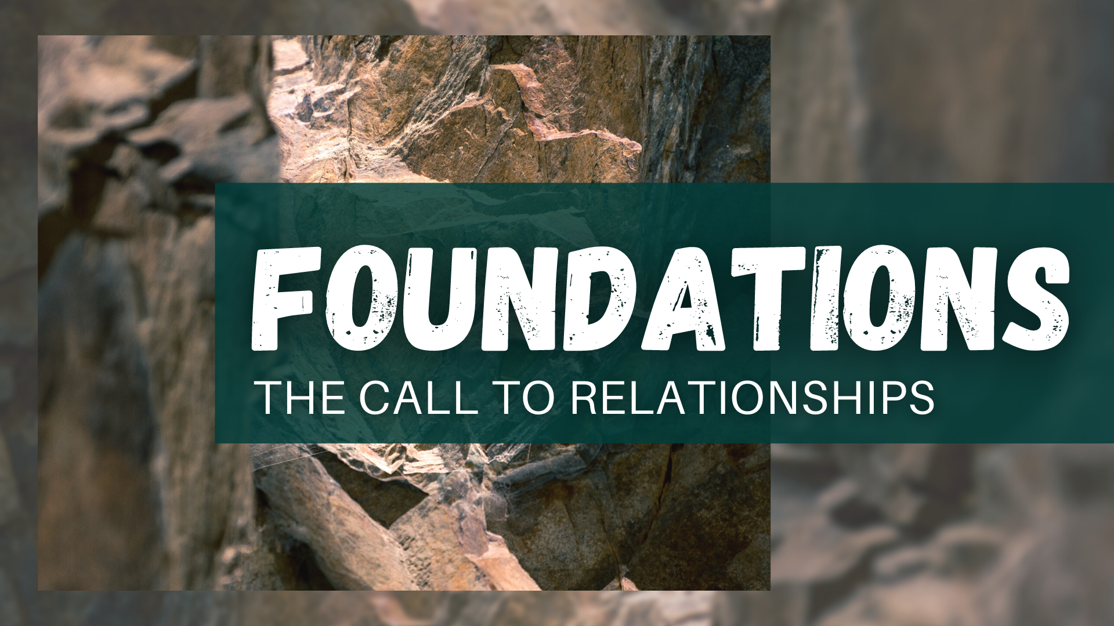
Notes:
[BRIEF COMMENTS]
We are social creatures who desire relationships, companionship, conversation, etc. We actually need it to be healthy and whole human beings
As we can see today, social media and digital communication isn’t helping us fulfill our longings for connection and community—instead, it gives the illusion of it
And so, I’d like us to think about why that is according to Scripture, and begin by rooting the call to relationships in the soil of biblical theology and the very nature of God himself
And then I’ll invite us to see the cultivation of deep relationships as foundational to our life as disciples, and to God’s reconciling work in the world
In the book of Genesis… [NEXT SLIDE]

Slide 6
“Then God said, “Let us make human beings in our image, to be like us.” Genesis 1: 26 NLT
Notes:
[BRIEF COMMENT ON PASSAGE]
Who is the “us” in Genesis?
As we said last week, it’s important to read the Bible through the lens of Christ
The “Trinity” is revealed through Jesus and the NT
And here is a way of communicating God’s Triune (3 in 1) nature… [NEXT SLIDE]

Slide 7
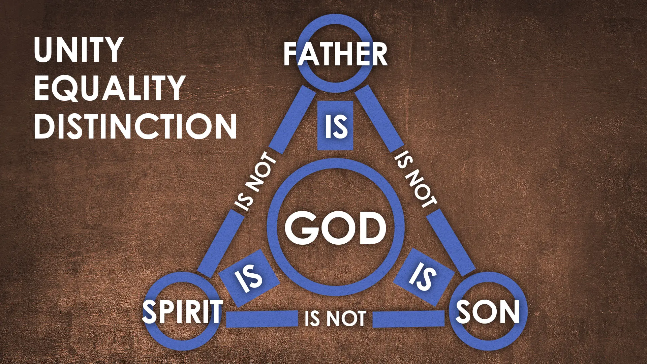
Notes:
[BRIEF COMMENTS]
The “Godhead” is within himself a community of relationships
God is three persons, not three modes of expression
God did not create the Son, he was “with God in the beginning”—eternally God
And while Father, Son, and Spirit are one and equally God, they have distinct functions. Stanley Grenz puts it this way in his book… [NEXT SLIDE]

Slide 8
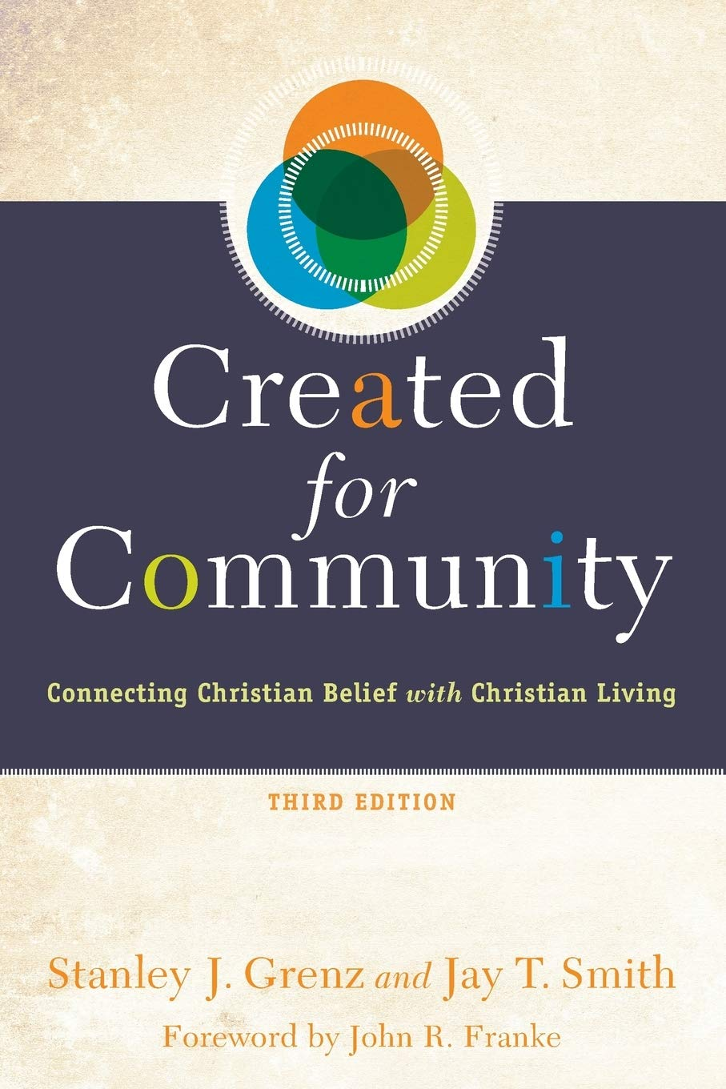
The Trinity - distinct roles and functions
The Father is the originator.
The Son is the revealer.
The Spirit is the completer.
Notes:
[BRIEF COMMENTS]
And this triune God—Father, Son, and Holy Spirit, is love. 1 John 4:16 says, “God is love.” He isn’t just loving, he is love. How is that possible? Well, it’s not only possible… it is necessary for God to be Father, Son, and Spirit. Think about it.
The catholic philosopher Peter Kreeft said it like this… [NEXT SLIDE]

Slide 9
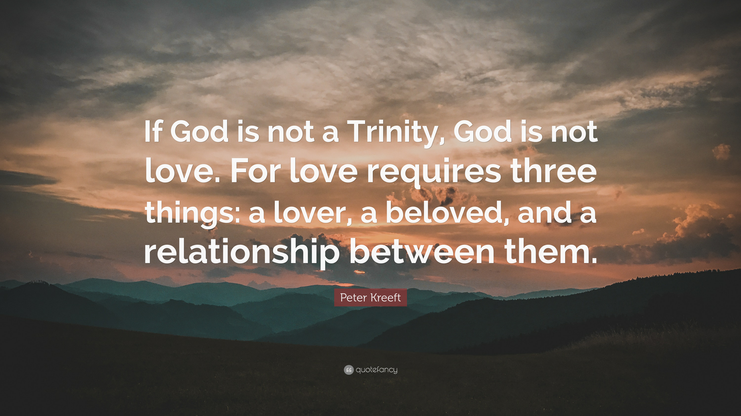
Notes:
[BRIEF COMMENT]
The doctrine of the Trinity matters: (1) Jesus’ relationship to the Father—he reveals God perfectly and is himself God; (2) the Spirit in you and at work in the world (while unseen), is the very loving presence of God the Father and God the Son with us; (3) the Triune God (who is within himself a harmony of relationships) calls us to share in this divine dance.
Therefore, when God created human beings, he desired that we would share in his communal nature and reflect his image and glory into the world (like angled mirrors), living in union with others and the creation he gave us to manage.
Maybe this image will help… [NEXT SLIDE]

Slide 10
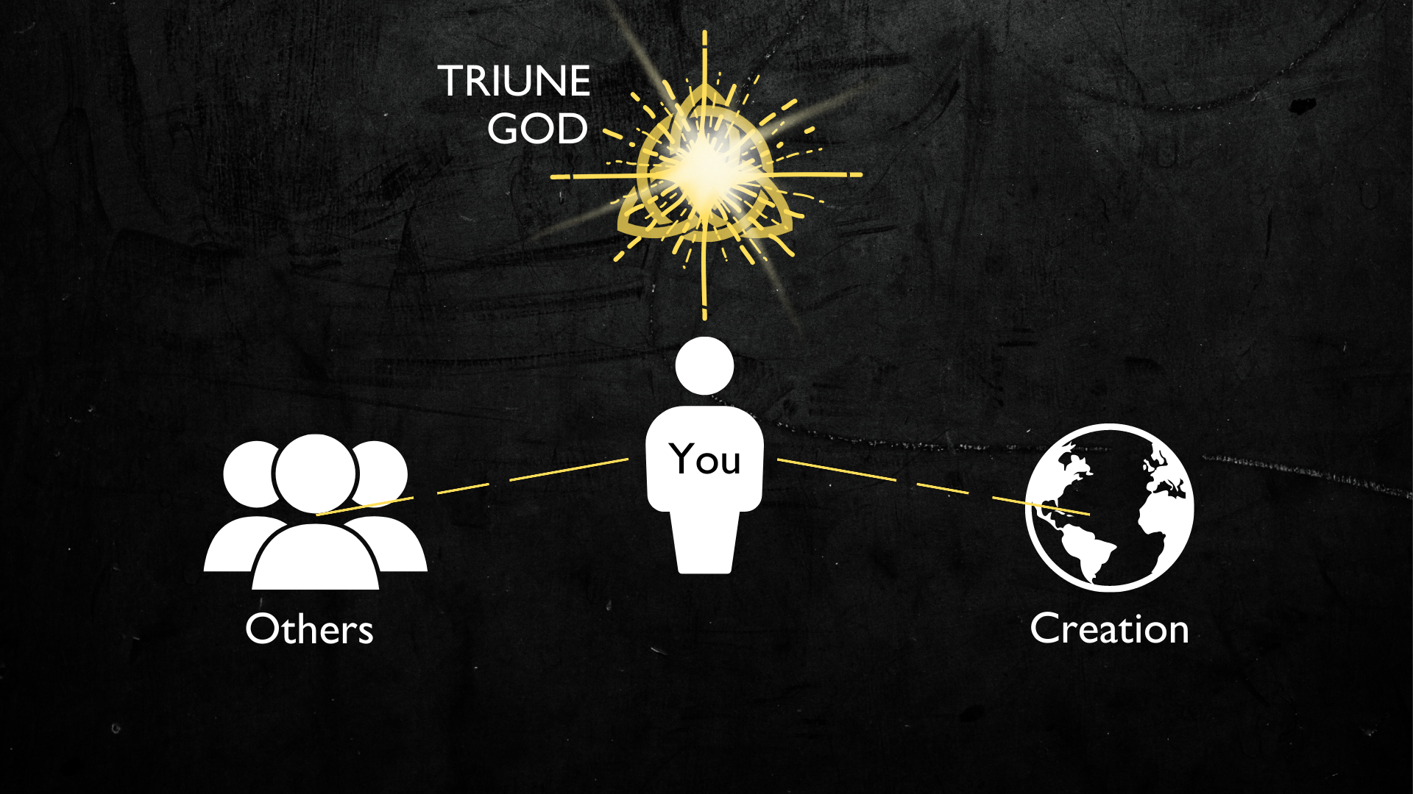
Notes:
[BRIEF COMMENTS]
We were made in God’s image—the image of a relational God who is love
We were created to share in the loving community and oneness of the Triune God
However, sin disrupted and broke apart these relationships (Gen 3)
Therefore, God needed to reconcile us to himself through Christ Jesus, so that we might then be participants in the work of reconciliation, i.e., bringing people back to God and being agents of new creation and working with the Spirit to redeem all that God has made
So, I want to invite us to think about forming and cultivating relationships (particularly in and through the church) as the work of reconciliation. We are being reconciled to God in Christ, and therefore the deepening of our relationships is a part of God’s reconciling work.
That could be a new way for you to hear what Paul wrote… [NEXT SLIDE]

Slide 11
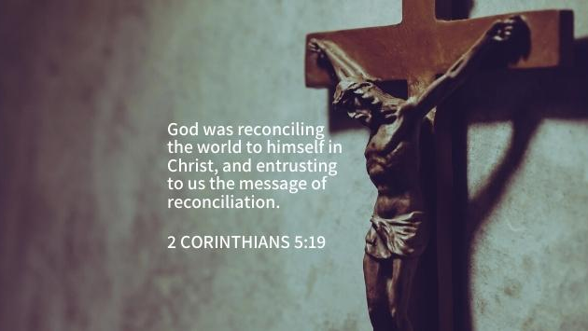
Notes:
[BRIEF COMMENTS]
So, instead of us jumping straight to being ministers reconciliation and peacemakers somewhere out in the world where there is civil unrest, racism, war, violence, etc. (which are all good things, of course), we first need to think of the call to relationships as a way we participating in God’s work of reconciling all things to himself.
In other words, when we open ourselves up to one another and share our true selves (warts and all) in the pursuit of God and the desire to become like Christ—the perfect image of God—we are not only doing the work of real discipleship, but we are also then better suited to serve him out in the world, join the Kingdom resistance, and come into the gospel story.
Here is how I invited us to envision this in the Gospel of the Kingdom series… [NEXT SLIDE]

Slide 12
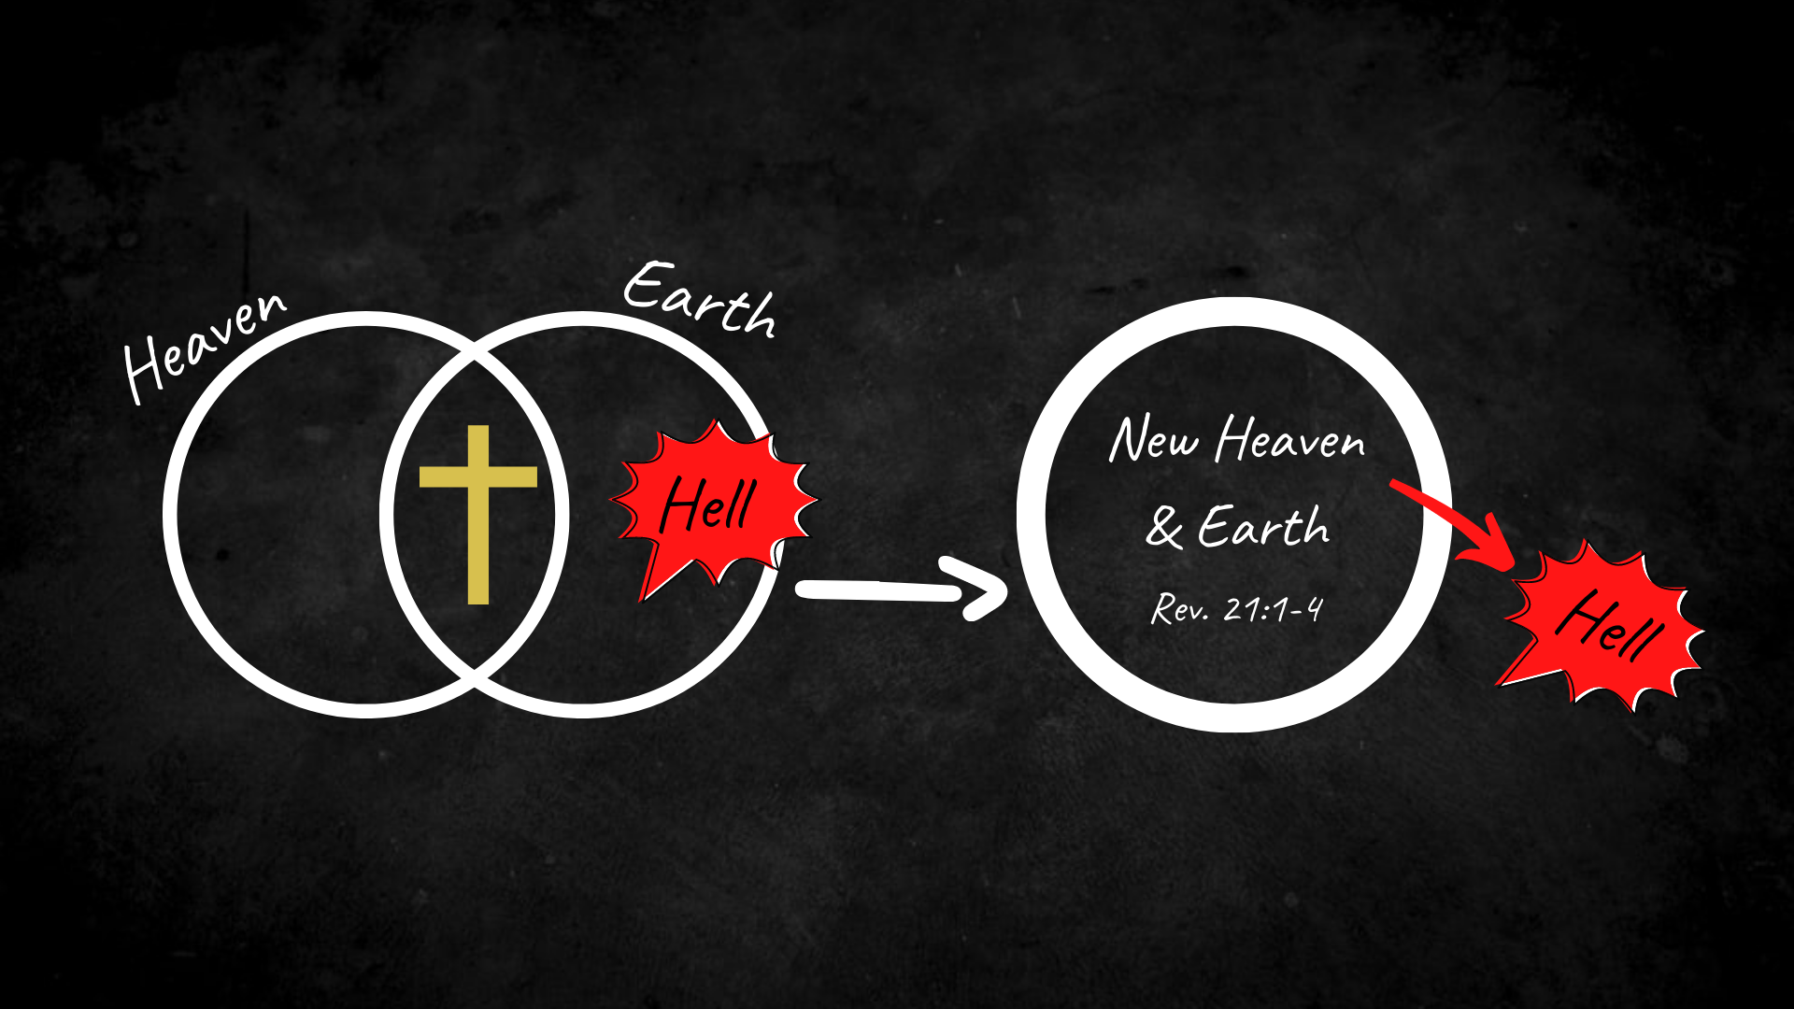
Notes:
[BRIEF COMMENTS]
Yes, Jesus has come to rid the world of sin and death, what we can rightfully call hell. But remember, that means that Christ came to get the hell out of you. And so, how does he do that. He does that as we work out our salvation in relationship with other disciples.
What am I saying? I’m saying that if we’re not forming the sort of relationships and entering into the kinds of spaces that make that possible, we are ultimately not helping anyone. We might be busy, we might be doing a lot of good things, but we’re neglecting our own spiritual health (e.g., like an obese, sleep-deprived, adrenaline junkie EMT).
In fact, you could say that (despite our best intentions) we are forfeiting the real work of discipleship for something else that we hope will make us feel better about ourselves, instead of dealing with the brokenness in our own lives. Look, I know because I’ve experienced it.
My friends, I submit to you that it is possible that well-intentioned disciples can use their busyness, their “ministry” and their consumeristic approach to the church as a way of hiding from God and others. We may not be literally naked in a garden and hiding behind some brush, but if we listen close, we might hear God say to us, “My child, where are you?”
And so… what we need is to recognize that we were created by a relational God who designed us for intimate relationships, which he wants to put on display in the world through the church. Listen to what author Milt Rodriguez writes… [NEXT SLIDE]

Slide 13
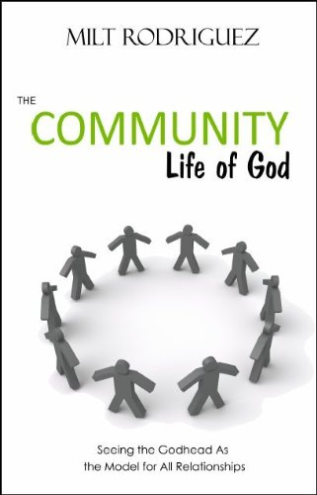
“All natural relationships are but a picture of the one divine relationship that exists within the eternal community of the Godhead. There is only one relationship on this earth that is not a picture or reflection of the divine relationship but is rather an expression of the fellowship of the Godhead. This is the relationship of the members of the Body of Christ. This is because [we are] constituted for the specific purpose of expressing the community life of God.”
Notes:
[BRIEF COMMENT]
And here is how we talk about doing this at Grantham Church… [NEXT SLIDE]

Slide 14
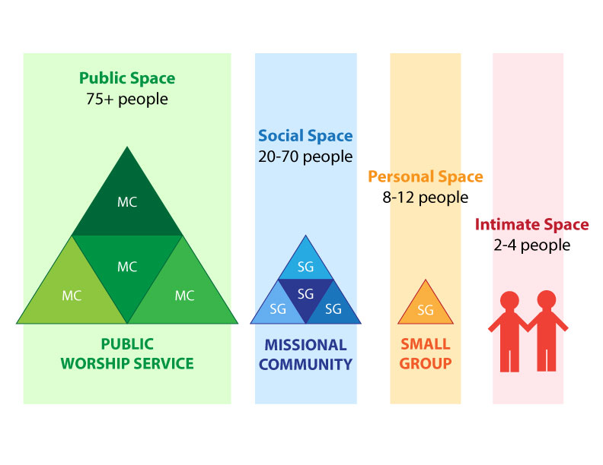
Notes:
[BRIEF COMMENTS]
Coming closer to each other in the personal and intimate spaces
So, what does it actually look like to deepen relationships in the church?
Let’s think about that together as we prepare to respond to this message and ready our souls to receive communion. [NEXT SLIDE]

Slide 15
What does it look like to deepen relationships in the church?

Slide 16
What does it look like to deepen relationships in the church?
Getting close enough to be honest and vulnerable with others.

Slide 17
What does it look like to deepen relationships in the church?
Getting close enough to be honest and vulnerable with others.
Growing in love, humility, patience, trust, mercy and grace.

Slide 18
What does it look like to deepen relationships in the church?
Getting close enough to be honest and vulnerable with others.
Growing in love, humility, patience, trust, mercy and grace.
Submitting to Christ by committing to other disciples—his Body.
Notes:
[BRIEF COMMENT ON EACH]
[CLOSING WORDS]
How might the Lord be speaking to you through this message?
How has the Spirit been at work in your heart through our Foundations series?
May our participation in communion together be a visible and outward expression of our desire to walk in obedience to the word of the Lord in the days ahead.
[GO TO NEXT SLIDE FOR CLOSING PRAYER]

Slide 19


