Slide 1
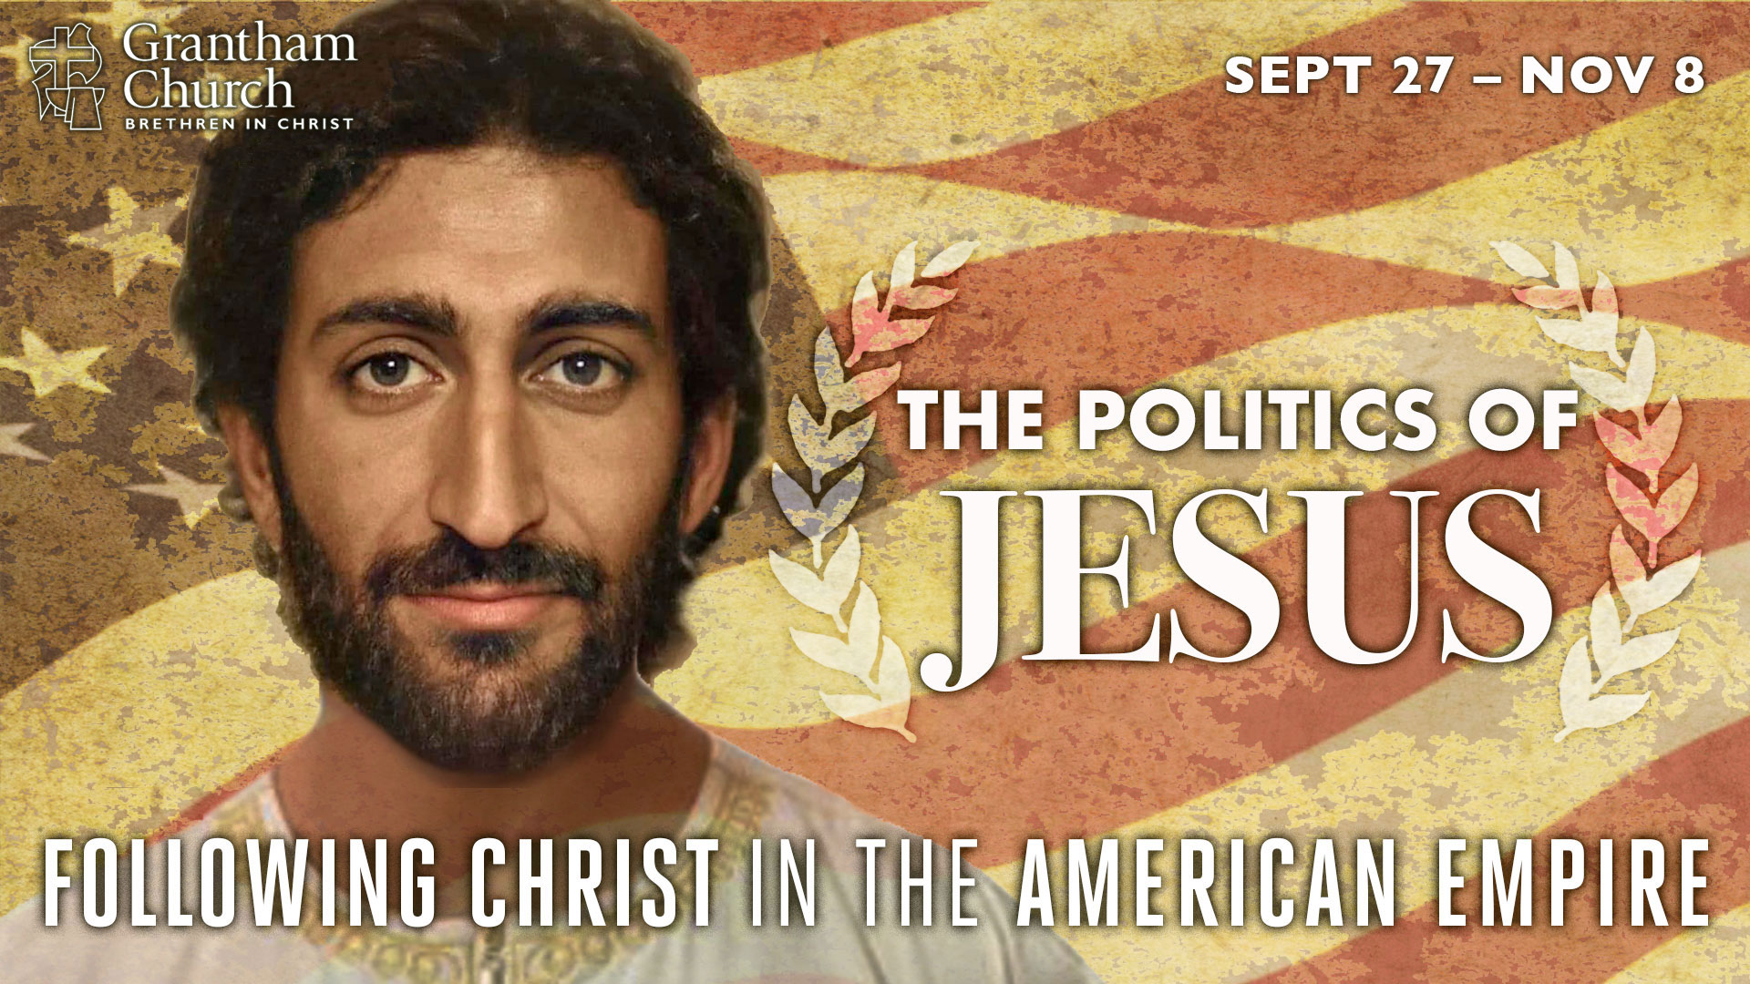
Notes:
This is the fourth message in our fall 2020 sermon series: The Politics of Jesus: Following Christ in the American Empire. In this series we have been giving serious thought to what it looks like to embrace the agenda of Jesus and embody his way of radical love, as we seek to navigate this election season by letting the Messiah from Nazareth lead us, and show us what it means to be faithful to God in a time when our nation is being ripped apart by competing political ideologies.
I’m sure you’ve heard many folks say that we’re living in “unprecedented” times, (you may even said that yourself), but that’s not entirely true. Yes, it’s true that we’ve never been in this exact moment in history. We’ve never lived in a time with the kinds of technological and medical advances we’ve seen, we’ve never had social media and the internet to help fuel division and discord, to propagate fake news, and add to narcissist behavior, echo chambers, and growing mental health issues. And you’d be hard pressed to find a time where we’ve experienced a pandemic, an economic recession, a civil rights movement, and a major presidential election all in the same year. So, yes, in that sense, I suppose it’s true.
But it’s also true that this is not the first time that the world has seen major upheaval amid human progress; advances in the face of destabilizing violence, uprisings, conspiracy theories, greed, grave injustices, and political scandals that (catch this) eventually led to cracks in the concrete of empire from which springs of change burst forth, that in turn led to more of the Kingdom of God on the earth. In fact, these are the kinds of historical, social, and cultural conditions in which God sent Jesus into the world to split time in two on the human calendar. These are the kind of days in which the church was born, thrived, and turned the world upside down. And if we will listen and learn from the early church, I think we will discover what we need to do moving forward.
That’s what we’re going to look at in today’s message, a sermon I’ve entitled, The Patience & Empathy of Exiles. But before I go any further, I want to remind you that if you’ve missed any sermons in this series, it would be helpful for you to go back and listen to those, since each installment builds upon the other. So, at this point I won’t be reviewing what we’ve already covered, you’ll need to stay up on that yourself. Also… I want to let you know that next week I’ve invited a special guest to speak into The Politics of Jesus series. His name is Dennis Edwards. [NEXT SLIDE]

Slide 2
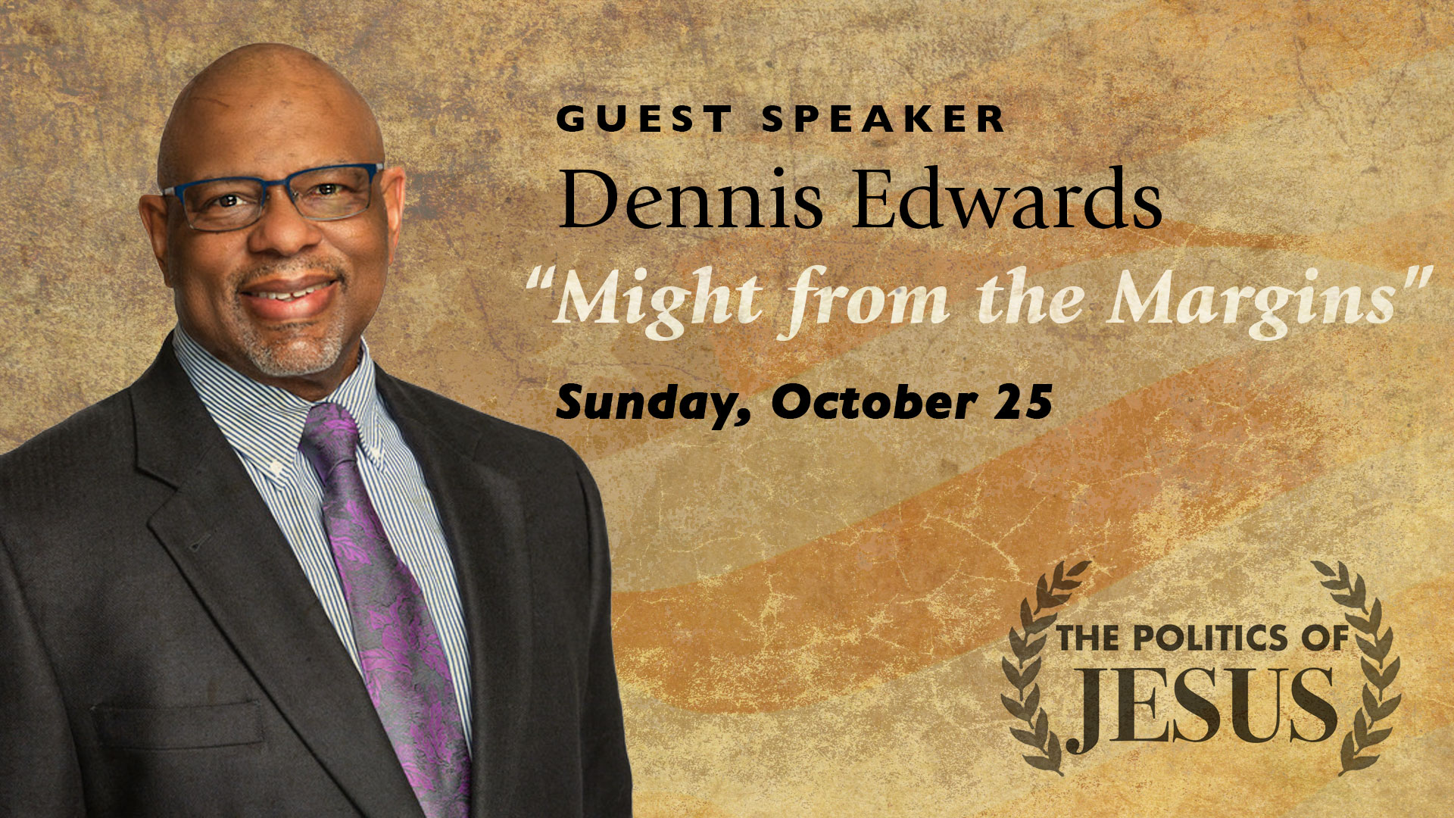
Notes:
Dennis is a pastor, scholar, and professor at North Park Seminary in Chicago. He has written several books. His latest book is on listening and learning from the marginalized. That book is called Might from the Margins. And that is also the title of his message for week 5 of this 7-week series. So, check out Dennis’ work on Amazon or wherever you buy your books, and join us next Sunday as we listen to how God wants to use marginalized Christians to help the church become more like Christ, and what it means to be the church in a post-Christian America where we follow Jesus without the privilege and power once afforded to us.
Alright. Let’s center our hearts and minds in a quick prayer, as we open ourselves up to receive God’s word for us today.
[BRIEF PRAYER]

Slide 3
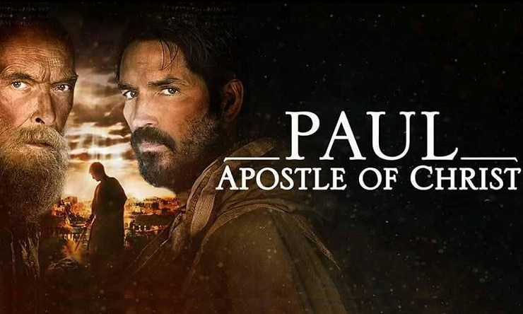
Movie Clip: Argument at Priscilla & Aquila’s house in Rome
Notes:
I’d like to begin this message with a short movie clip from the 2018 film, Paul: Apostle of Christ.
If you’re listening to the podcast, no worries. The dialogue is the most important thing. So let me set up this scene for you. The setting is in first century Rome. There is a community of Christians living within the gates of Priscilla and Aquila's house, who are the leaders of the house church there. The Apostle Paul is in prison awaiting his trial before the emperor Nero, who has already begun persecuting Christians. Nero blames them (particularly Paul) for setting fire to Rome. Luke, the gospel writer and co-worker of Paul, has just been arrested and thrown into prison for trying to speak to Paul in his final days.
What you’re about to see is a quarrel between two Christians arguing about what should be done. One of them wants to fight and violently revolt against Nero in an attempt to achieve justice by force. But listen carefully to how the leaders respond.
Let’s watch this together. [SHOW CLIP]
[NEXT SLIDE]

Slide 4
“Whoever claims to live in him must live as Jesus did.”
1 John 2:6 NIV
Notes:
1 John 2:6 NIV - “Whoever claims to live in him must live as Jesus did.”
I like how the paraphrased Living Bible reads: “Anyone who says that they’re a Christian should live as Christ did.” You can see from the scene that we just watched and heard—albeit a fictional (but accurate) representation—that the first Christians were deeply committed to following Jesus, embodying his teachings, and furthering the Messianic agenda, believing that Christ revealed to us a radical new way of being human and living within the world.
That’s what we talked about last week in the Inaugural Address of Jesus. You’ll recall that we gave attention to Jesus’ message in Nazareth and then his teachings in the Sermon on the Mount, which we said should be seen as the Kingdom Constitution for those who choose to follow Jesus and join the divine program of recreating the world right in the midst of the present evil age.
Again, here is what we said reflects the heart of Jesus’ life, message, and ministry: [NEXT SLIDE]

Slide 5
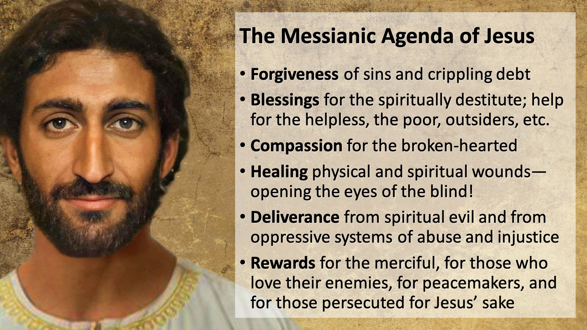
Notes:
The Messianic Agenda of Jesus looks like:
Forgiveness of sins and crippling debt
Blessings for the spiritually destitute; help for the helpless, the poor, outsiders, etc.
Compassion for the broken-hearted
Healing physical and spiritual wounds—opening the eyes of the blind!
Deliverance from spiritual evil and from oppressive systems of abuse and injustice
Rewards for the merciful, for those who love their enemies, for peacemakers, and for those persecuted for Jesus’ sake
And while the early church was by no means perfect, just read 1 Corinthians to see how whacked out a church can be, still, the first Christians were by and large passionately committed to embracing the words and ways of Jesus. For them, it wasn’t about some new set of rules and laws handed down by yet another emperor, as if they just traded Caesar for Jesus—a kinder leader who on your best day still wants to dominate you and enslave you to serve his ends.
No, instead, these first Christians believed that Jesus was Yahweh in the flesh, the God of the universe, the One by whom God created the whole cosmos out of love, a love like no other the world has known. And that this God, who created them in his very image, had come to earth to set the world right, to free them from their captivity to sin and sinful systems, and that through his death on the cross he defeated the principalities and powers, he removed all obstacles that keep us from knowing God and his life in us. And that by his resurrection we can know that we will live even though we die, and that someday God will renew and resurrect the entire world. That brought meaning to their lives, hope for tomorrow, and a glorious vision of the future, something the empire could never give them. And that is why they called Jesus their Lord and Savior. That is why they gave their lives to him and they lived for him.
But that’s also why they were persecuted. To give us a glimpse into those first few centuries of the church—what they believed, how they lived, and how they were treated by those Paul called “enemies of the cross” of Christ—let’s consider some of the reasons why they became the object of scorn and ridicule, even scapegoated for the decline of Roman society. Despite their message of love and commitment to care for the world, here’s why they were despised by the empire: [NEXT SLIDE]

Slide 6
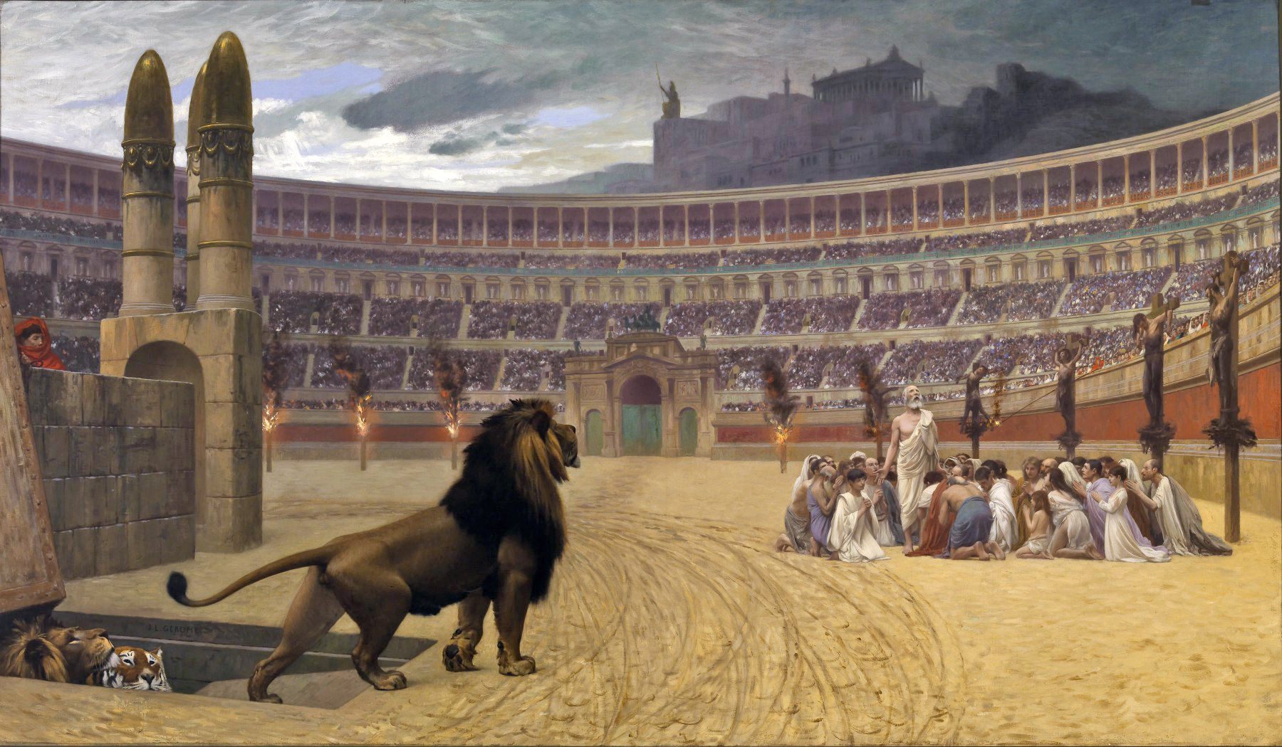
Roman Imperial Opposition to the Early Christians
Christians were despised for…
Not swearing & pledging to Caesar
Refusing to glorify violence & war
Having high ethical & moral standards
Denouncing lust, greed & materialism
Valuing all life (the unborn, the poor, women, widows, the elderly, etc.)
Rejecting the gods of Rome to worship a crucified criminal as the one true God
Rumors due to novelty & secrecy
Notes:
First, Christians lived as aliens and exiles in the Roman world and were despised for…
Not swearing & pledging to Caesar
Which means that they wouldn’t take a ceremonial oath and repeat the phrase “Caesar is Lord,” instead they said, “Jesus is Lord” and hijacked imperial language to communicate the gospel of Jesus (e.g. words like gospel, faith, Lord, Savior, etc.)
Refusing to glorify violence & war
Christians swore off all violence, in their personal lives and in their public life, making no distinction between personal enemies and mortal enemies; they wouldn’t go the Coliseum and other local gladiatorial games; they wouldn’t join the military and fight in the Roman legions; and they refused to be entertained by violence and bloodshed. And there’s good reason to believe that it was Christian influence that brought an end to the imperial games.
Having high ethical & moral standards
You see, the gods don’t care about those things; they don’t care about how you treat your wife or your children, the gods don’t care about you being trustworthy and full of integrity. All they care about is the worship and sacrifices you make to them, and you giving them credit for the good things that happen in your life. And so, without a moral Lawgiver, you can imagine how lost they were and how the early church stood out as ethical, moral, and a virtuous people.
Denouncing lust, greed & materialism
Christians wouldn’t visit prostitutes, didn’t have mistresses, or commit adultery; they also remembered what Jesus said about how the door of the Kingdom is the smallest for rich people, that it’s harder for them to join the Kingdom because they’re drunk on their power and and blinded by their privilege; also, Christians didn’t show favoritism to those who had money and they encouraged sharing all things in common, seeing to it that everyone’s needs were met.
Valuing all life (the unborn, the poor, women, widows, the elderly, refugees, and slaves)
They exercised empathy, i.e. they put themselves in the shoes of the other, saw the world through their eyes, and felt their fears, their pain, and their need to be loved and cared for as a human being created in the image of God; they lived by Paul’s “magna carta of human freedom” outlined in Galatians 3:26-28—in Christ there is neither Jew, nor Gentile, man, woman, slave or free; we’re all equal in Christ—a new humanity, a new race, a new world order.
Rejecting the gods of Rome to worship a crucified criminal as the one true God
It may be hard to believe, but Christians were called “atheists” because they didn’t believe in the gods of the Roman pantheon; and because of all the many things that Christians refused to believe and participate in within the empire. Because of this, they were seen as subversive, insubordinate, unpatriotic, and a threat to the Roman way of life. It’s easy to see that the early church challenged the so-called Pax Romana, the peace of Rome.
And lastly, because of the novelty of the Christian faith, and because the early church met in homes and often in secret, all kinds of rumors spread about them, which made life harder on them. For example, Christians were accused of cannibalism, orgies, magic, and that they were secretly plotting to overthrow the Roman government. [BRIEFLY EXPLAIN]
The concern about the early Christians grew to such an extent that the empire decided to investigate. We have historical evidence that a man named Pliny the Younger, a Roman governor in what is now modern-day Turkey, was commissioned by the emperor Trajan in the early part of the second century to get to the bottom of this growing “illegal” religion. And after some undercover work, Pliny writes a letter to Trajan and reports on what he finds. Here is what Pliny says: [NEXT SLIDE]

Slide 7
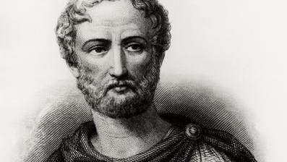
Pliny the Younger to Emperor Trajan
“…the sum of their guilt or error only amounted to this, that on a fixed day they had been accustomed to meet before dawn...
Notes:
[BRIEF COMMENT] – they met on Sunday, the first day of the week (resurrection)
I’m wondering how many of us would be committed to worship at 5:30 am on a Monday morning

Slide 8
Pliny the Younger to Emperor Trajan
“and to sing a hymn among themselves to Christ, as though he were a god…
Notes:
[BRIEF COMMENT] – Philippians 2 hymn?

Slide 9
Pliny the Younger to Emperor Trajan
“and to bind themselves by oath, but not to some crime, or to commit fraud, theft, adultery, or breach of faith, and not to deny trust money [i.e. rent, fees, alms, tithes, etc.] when called upon to deliver it. ”
Notes:
Instead, the “oath” that Pliny refers to is the commitment to worship Christ alone, to obey his teachings, and to love as he loved. Notice, Pliny found no reason to arrest and condemn them based on their character, or because of any immediate threat to Rome (certainly not a violent one), though he did believe they were an absurd superstition and a bunch of wierdos, and that their faith was spreading at a concerning level.
So, all they really had on these first Christians, and ultimately the only reason they arrested, tortured, and executed them, was on the grounds of ”obstinacy” (for simple refusal to pledge their loyalty to Caesar and the empire) and for stubbornly following Jesus despite the threat of death. It was their refusal to deny Christ and his Messianic agenda that Trajan established the first policy for dealing with Christians. But nevertheless, the church saw explosive growth because their love for Jesus and their care for the world was greater than the power of empire.
And it was just as Jesus said… their love proved to the world that they belonged to him and that the Kingdom of God was coming. We can see lots of examples of this radical love in those first three centuries of the Church. [NEXT SLIDE]

Slide 10
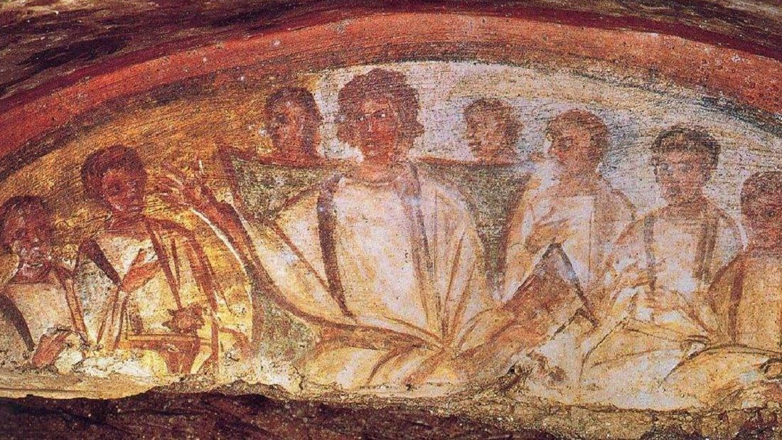
The Faith of the First Christians
Examples of radical love & obedience:
They welcomed everyone to the table, regardless of gender, social status, etc.
They took up regular collections for widows, the poor, & prisoners
They took in abandoned babies, orphans, & unwanted children
They loved those who opposed their faith & values—to the point of death!
They cared for the sick during the 15-year “Plague of Cyprian” (c. AD 250)
Notes:
[BRIEF COMMENT ON EACH]
They welcomed everyone to the table, regardless of gender, social status, etc.
They took up regular collections for widows, the poor, & prisoners
They took in abandoned babies, orphans, & unwanted children
They loved those who opposed their faith & values—to the point of death!
They cared for the sick during the 15-year “Plague of Cyprian” (c. AD 250)
When family members threw their own out in the street or fled towns during the great plague of Cyprian, Christians stayed behind to care for them and embody the presence of Jesus, and bury them if needed. They were not driven by fear, but love. Afterall, they believed in the one who had conquered death. And because of this, they were able to offer answers to the problem of evil and suffering, to give meaning to what was happening in the world, to comfort to those who were afraid, to be a non-anxious presence among their neighbors, and to proclaim the living hope they had in the resurrection of Jesus.
I like what the sociologist Rodney Stark writes in his book, The Rise of Christianity.
“Christianity served as a revitalization movement that arose in response to the misery, chaos, fear and brutality of life in the urban Greco-Roman world.… It revitalized life in Greco-Roman cities by providing new norms and kinds of social relationships able to cope with many urgent urban problems. To cities filled with the homeless and impoverished, Christianity offered charity as well as hope. To cities filled with newcomers and strangers, Christianity offered an immediate basis for attachments. To cities filled with orphans and widows, Christianity provided a new and expanded sense of family. To cities torn by violent ethnic strife, Christianity offered a new basis for social solidarity. And to cities faced with epidemics, fires and earthquakes, Christianity offered effective nursing services.”
\And I think the early church bishop Cyprian said it well when he described early Christianity, he said, ”We do not speak great things, we live them.” You see, brothers and sisters, (please hear this) the NT isn’t nearly concerned with speaking the truth as it is with us living the truth. While we live in a culture today that says, “Speak your truth” (when I much prefer that we all speak “the” truth), what we as Christians should be caught up with and captured by is living the truth. Because it’s living the truth that is lacking. As Brennan Manning once said, “The greatest single cause of atheism in the world today is Christians who acknowledge Jesus with their lips and walk out the door and deny Him by their lifestyle. That is what an unbelieving world simply finds unbelievable.”
That is why the Apostle Paul wrote this in Romans 12, verses 9-21. [NEXT SLIDE]

Slide 11
Romans 12:9-21 NLT
⁹ Don’t just pretend to love others. Really love them. Hate what is wrong. Hold tightly to what is good. ¹⁰ Love each other with genuine affection, and take delight in honoring each other. ¹¹ Never be lazy, but work hard and serve the Lord enthusiastically. ¹² Rejoice in our confident hope. Be patient in trouble, and keep on praying.¹³ When God’s people are in need, be ready to help them. Always be eager to practice hospitality.
Notes:
[BRIEF COMMENTS]

Slide 12
Romans 12:9-21 NLT
¹⁴ Bless those who persecute you. Don’t curse them; pray that God will bless them. ¹⁵ Be happy with those who are happy, and weep with those who weep. ¹⁶ Live in harmony with each other. Don’t be too proud to enjoy the company of ordinary people. And don’t think you know it all!
¹⁷ Never pay back evil with more evil. Do things in such a way that everyone can see you are honorable. ¹⁸ Do all that you can to live in peace with everyone.
Notes:
¹⁴ Bless those who persecute you. Don’t curse them; pray that God will bless them.
How do we curse people? Well, there are all kinds of ways that we do this right now. Instead of speaking about people that acknowledges their inherent worth and that they are loved by God, we curse them by demonizing them, by saying things like, ”the reason they believe that or the reason they’re doing that is because they are evil… they’re just stupid and evil… they’re monsters” because of course we can see their hearts, right? Every single one of them.
And American society has become increasingly bifurcated with everything. We can see this most clearly in our broken two-party system, where it’s us vs. them, black or white, friend or enemy. No middle ground. No nuance. No way to kindly discuss ideas and disagree without wanting to cancel or kill someone. And so we say things like… “All democrats are corrupt. They’re all socialists. They’re nuts. They hate police officers. They’re all fine with killing babies. They want a godless nation full of a bunch of freeloaders. How could any Christian vote for a democrat? They are destroying the country!” or we say, “All republicans are heartless, they’re all racists. They only care about unborn lives, but not poor lives, gay lives, and black lives. They love their guns more than God. How could any Christian vote for a republican? They are destroying the country!” And I’m wondering… when are we going to get off this merry-go-round of insanity? When will we stop with the gross caricatures of entire groups of people?
Folks, honestly… and I mean this in love… we need to know that mature, rational, emotionally intelligent, curious, empathetic people don’t fall for that way of thinking. Wise people don’t get sucked into the extremes, into demonizing, misrepresenting, and following the demagogues who do this on a regular basis, nor are wise people lured in by the 24 hr. cable news networks and talking heads who make a living off this polarizing, irrational, unhelpful nonsense.
¹⁵ Be happy with those who are happy, and weep with those who weep. ¹⁶ Live in harmony with each other. Don’t be too proud to enjoy the company of ordinary people. And don’t think you know it all! Don’t think you know it all. Take up a posture of listening and learning. If you’re saying, “I don’t know how anyone could believe that?” That’s a good indicator that you need to talk to them and listen to them so you can understand. It’s what Jesus would do. And if all of us did that, or if the church of all people did that, we might be able to stop the countdown and get off the scary path America is on right now.
But we have to start blessing and stop cursing. We have to start listening and stop lying to ourselves and to each other about this: that what we see in our leaders is a reflection of us. It’s a reflection of the sickness that is in our society. And whenever we’ve had enough, Jesus wants us to know he’s there waiting. Waiting for us to believe again that people really do need the Lord, that Jesus is still the answer, that the Lamb is greater than the donkey or the elephant.
¹⁷ Never pay back evil with more evil. Do things in such a way that everyone can see you are honorable. ¹⁸ Do all that you can to live in peace with everyone. Church, Paul is echoing the words of Jesus here. Stop the tit for tat. It doesn’t work. [NEXT SLIDE]

Slide 13
Romans 12:9-21 NLT
¹⁹ Dear friends, never take revenge. Leave that to the righteous anger of God. For the Scriptures say,
“I will take revenge;
I will pay them back,”
says the Lord.
Notes:
God has his own way of humbling people and bringing them to their senses. According to Romans 1, his wrath is built into the system—the NT calls it reaping what you sow. And sometimes God will actually give folks over to their sin and let it destroy them. In other words, he doesn’t need your help. The church’s job isn’t to rule or punish like that of the government in Romans 13. Instead, our role is to love. That is the contrast that Paul is giving here in Romans 12 and 13. The church is to be agents of love, carriers of the cross, not agents of wrath and carriers of the sword. [NEXT SLIDE]

Slide 14
Romans 12:9-21 NLT
²⁰ Instead,
“If your enemies are hungry, feed them.
If they are thirsty, give them something to drink.
In doing this, you will heap
burning coals of shame on their heads.”
²¹ Don’t let evil conquer you, but conquer evil by doing good.
Notes:
v. 20 – This is an ancient near eastern way of saying, “Do good and let your acts of love speak for itself. In time it’s going to highlight the righteousness of your acts and the folly of their own. Then they will feel the shame of their sin and repent.” That’s what Jesus meant when he told us to turn the other check. We should go out of our way to love those who hate us (I mean really love them), and it will in time expose the evil being done and increase the likelihood that our enemies will change. That’s what Paul means when he says in v. 21 – Don’t let evil conquer you, but conquer evil by doing good.
As I said, the first Christians were committed to this way of love and empathy for the world, even for those they didn’t like or for those who hated them. So much so that their enemies said this about them. The church father and apologist Tertullian recorded this: [NEXT SLIDE]

Slide 15
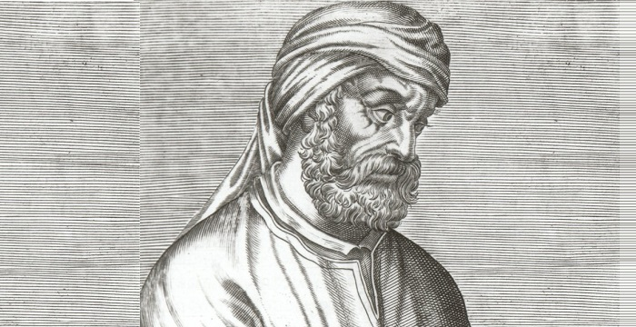
Tertullian Quotes the Church’s Enemies
“Look,” they say, “how these Christians love one another.”
Tertullian (c. AD 160-225), Apologeticus ch. 39
Notes:
But it wasn’t just the love and empathy of the first Christians that attracted unbelievers to the early Jesus movement, it was also their patience in the face of oppression, injustice, and suffering. Certainly, if you’re going to love people as Jesus loves people, patience is required, right? And the first Christians knew this. That’s why Tertullian encouraged Christians to wear their oppressors out with patience. It was the key to their growth. It’s how the church went from 3,000 at Pentecost to 3-5 million by the fourth century.
As Alan Krieder says in his book, The Patient Ferment of the Early Church, there was no church growth strategy, no reliance upon power or privilege, and no support from politicians that accounts for the growth of the early church. They didn’t even use their worship services to attract people. That’s because the only way you could find a Christian church was to know a Christian and be invited by them to their house church. Even then there were high demands a person had to meet to attend, and at one point there was a 3-year catechesis process before you could be baptized and take communion. They didn’t make it easy or worry about being seeker friendly. They were solely focused on patiently making disciples who love like Jesus loved and were true to the Messianic agenda.
There is no evidence that there was an evangelism strategy to win new converts and grow their churches through conversions. Yet the church grew. As Alan Krieder writes, “The Christians’ focus was not on “saving” people or recruiting them; it was on living faithfully—in the belief that when people’s lives are rehabituated in the way of Jesus, others will want to join them.” And they did join them. And the early church attributed their growth to the patient character of God. Looking back through the history of Israel leading up to Christ, it’s easy to see that God has always been a patient, long-suffering, accommodating God. And so it’s not surprising that Jesus calls us to a life of patience and empathy. The Apostle Paul said it this way…
[NEXT SLIDE]

Slide 16
“Therefore, as God’s chosen people, holy and dearly loved, clothe yourselves with compassion, kindness, humility, gentleness and patience.”
Paul, Colossians 3:12 NIV
Notes:
I know what you’re thinking. “Pastor, I’m not very patient. I don’t even pray for patience because it may mean more testing of my patience.” I get it. Patience isn’t an American virtue. It goes against our nature. But you know what, it wasn’t a virtue in the Roman Empire either. Patience was the work of the poor, the lower class, for women, widows, and slaves. It wasn’t something to be desired among the rich, elite, upper class. And you know why, don’t you? Because what’s the opposite of patience? Uh, impatience? Close. Go further. Go deeper. The opposite of patience is… power.
You see, when we’re impatient it’s because we want it now, we want control. Forget discipline, forget waiting on God. But doesn’t the healthiest growth come with soil, water, sunlight, and time? So, what happens when you turn the oven up hotter to cut the baking time in half? What happens when you give a child solid food before they have any teeth? What happens when you rush your homework so you can hurry and play? What happens when you stop exercising in the first month or two because it’s too hard and the weight isn’t coming off fast enough? And what happens when the Jesus way is too slow, arduous, and painful, and someone comes along and says, “You know, you don’t have to struggle anymore. Don’t you want a life where you don’t have to be patient? I can give that to you.”
Sounds sinister, right? Sounds like something Satan might say to us. That it is. But, in this case, I was thinking of what happened to the church in the early fourth century. After years of being patient, in their weariness and frustration, knowing that they were vulnerable and could be used to his advantage, the emperor Constantine claimed he had a conversion, and that God was now going to unite the empire in their religion. And in return for their support, he would give them buildings to meet in, tax breaks and benefits, and positions of privilege and power. That’s how Christendom, the church militant and triumphant, was born.
And for a thousand years this unholy alliance continued between the church and the state. While it has mostly faded into the pages of history at this point, what we’ve seen in the US over the last several decades have been folks in the church, particularly evangelicals, who are trying to revive what is dying and needs to die, for the sake of the gospel. And while it’s much more complicated than this I know, it’s really about power. Christendom is a refusal to deny ourselves, to take up our cross, and follow Jesus. It comes as a result of us not wanting to embrace the patience and empathy of the early church.
Here is how one historian put it: [NEXT SLIDE]

Slide 17
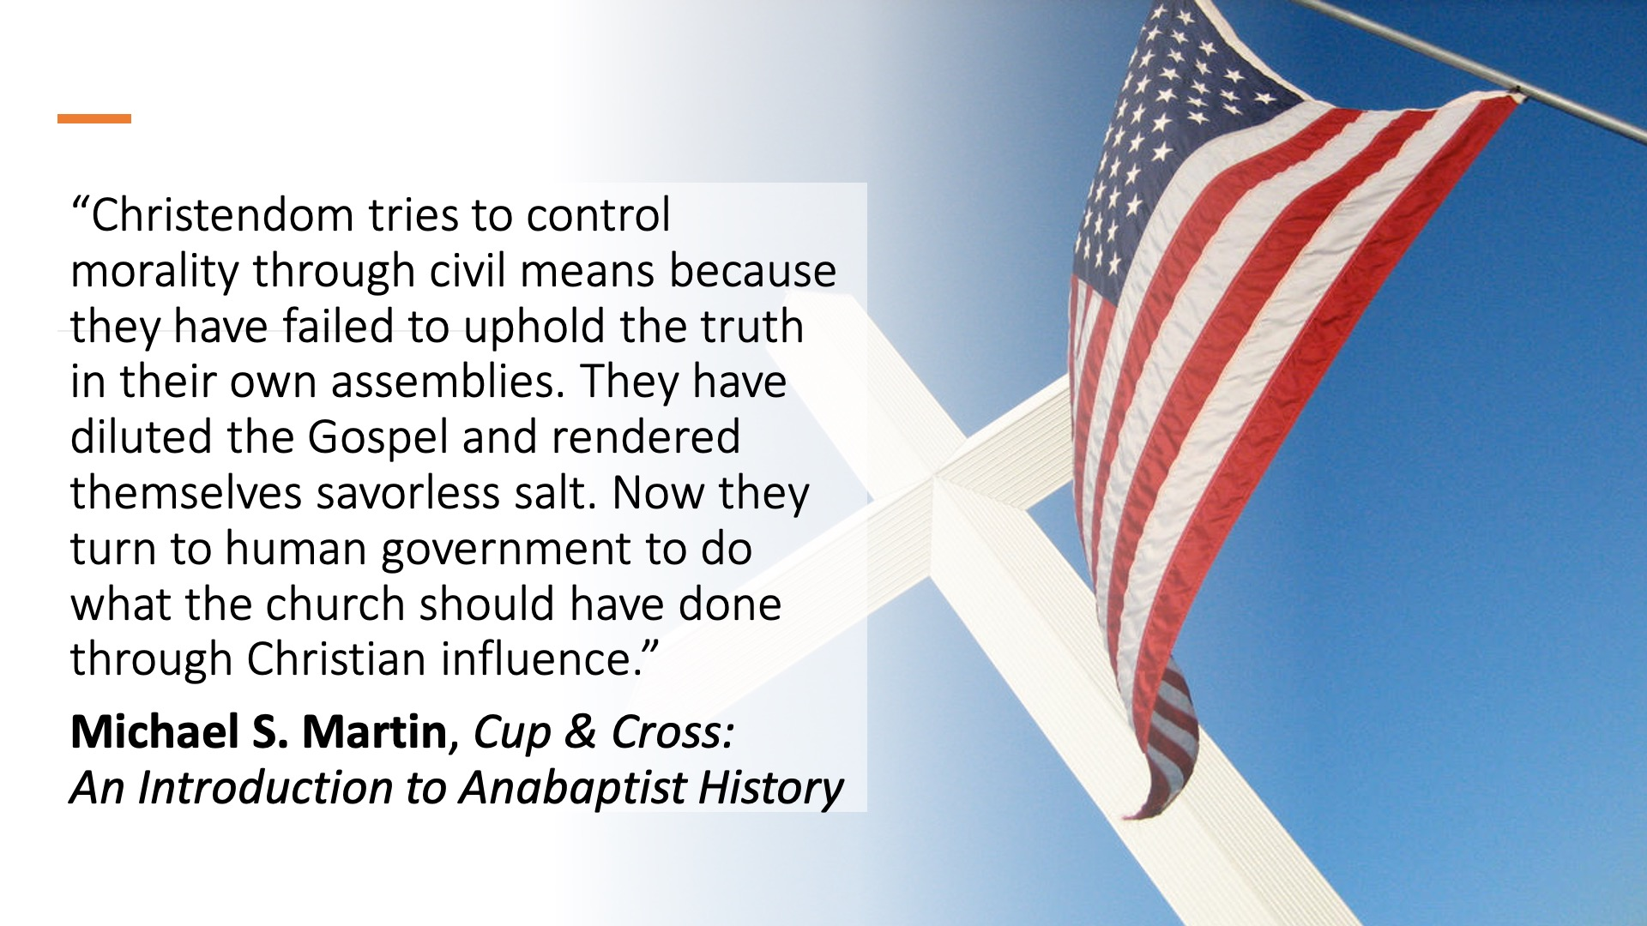
Notes:
(WINCE) Those are hard words. But words we need to hear, church.
And then hear these words about who we really are what we’re called to as followers of Jesus. [NEXT SLIDE]

Slide 18
1 Peter 2:9-12 NRSV
⁹ But you [the Church] are a chosen race, a royal priesthood, a holy nation, God’s own people, in order that you may proclaim the mighty acts of him who called you out of darkness into his marvelous light.
¹⁰ Once you were not a people,
but now you are God’s people;
once you had not received mercy,
but now you have received mercy.
Notes:
[BRIEF COMMENT]

Slide 19
1 Peter 2:9-12 NRSV
¹¹ Beloved, I urge you as aliens and exiles to abstain from the desires of the flesh that wage war against the soul. ¹² Conduct yourselves honorably among the [unbelievers], so that, though they malign you as evildoers, they may see your honorable deeds and glorify God when he comes to judge.
Notes:
My fellow believers, as aliens and exiles, what conduct will unbelievers see from us in the coming days and weeks. Will we clothe ourselves with compassion, kindness, humility, gentleness, and patience? Or will we give in to the desires of the flesh that war against our soul? Will we resist the evil one and the principalities and powers that seek to exploit our weaknesses and turn us against one another? Or will we allow ourselves to be lured into the trap of hate, vitriol, and violence? Will we look back to our faithful past and emulate the patience and empathy of those first Christian exiles, or will we dilute the gospel and render ourselves savorless salt?
Let’s be God’s chosen race, his royal priesthood, his holy nation. We can do this. By the Spirit of Christ in us, we can be the difference the world needs to see in the church today. We only need to commit ourselves to the politics of Jesus and believe in the grassroots work of the Spirit in the local church and out to our communities. This is how change happens with the Kingdom of God. It begins with you. It begins with us.
Finally, to help us aapply this message, here are some questions for reflection and our response: [NEXT SLIDE]

Slide 20

Invitation & Response
Questions for reflection and response:
Notes:
[BRIEF COMMENTS ON EACH POINT]
What is God saying to you, and what are you going to do about it? Do something, would you? As I’ve been saying in this series, don’t just be hearers of the word, be doers… for doers are those who get to call themselves followers.
May the Spirit guide us in our reflection and empower us in our response. For the glory of his name and the furtherance of his Kingdom.
Let’s pray.
[CLOSING PRAYER]

Slide 21
Invitation & Response
Questions for reflection and response:
Reflect on why the early church was despised in the Roman world. How does our faith compare?
Notes:
[BRIEF COMMENTS ON EACH POINT]
What is God saying to you, and what are you going to do about it? Do something, would you? As I’ve been saying in this series, don’t just be hearers of the word, be doers… for doers are those who get to call themselves followers.
May the Spirit guide us in our reflection and empower us in our response. For the glory of his name and the furtherance of his Kingdom.
Let’s pray.
[CLOSING PRAYER]

Slide 22
Invitation & Response
Questions for reflection and response:
Reflect on why the early church was despised in the Roman world. How does our faith compare?
Reflect on the radical love of the early church. What challenges you? What inspires you?
Notes:
[BRIEF COMMENTS ON EACH POINT]
What is God saying to you, and what are you going to do about it? Do something, would you? As I’ve been saying in this series, don’t just be hearers of the word, be doers… for doers are those who get to call themselves followers.
May the Spirit guide us in our reflection and empower us in our response. For the glory of his name and the furtherance of his Kingdom.
Let’s pray.
[CLOSING PRAYER]

Slide 23
Invitation & Response
Questions for reflection and response:
Reflect on why the early church was despised in the Roman world. How does our faith compare?
Reflect on the radical love of the early church. What challenges you? What inspires you?
Reflect on how the early church impacted society at a grassroots level?
How might God be calling you and
our church to do the same?
Notes:
[BRIEF COMMENTS ON EACH POINT]
What is God saying to you, and what are you going to do about it? Do something, would you? As I’ve been saying in this series, don’t just be hearers of the word, be doers… for doers are those who get to call themselves followers.
May the Spirit guide us in our reflection and empower us in our response. For the glory of his name and the furtherance of his Kingdom.
Let’s pray.
[CLOSING PRAYER]

