Slide 1
Notes:
[SHOW SLIDE BRIEFLY & THEN GO TO SCRIPTURE READING]

Slide 2

Scripture Reading
2 Chronicles 7:11-22 NIV
Notes:
[INVITATION TO STAND FOR SCRIPTURE READING]
[READ 2 CHRONICLES 7:11-22]
This is the word of the Lord. Thanks be to God
You may be seated. [NEXT SLIDE]

Slide 3
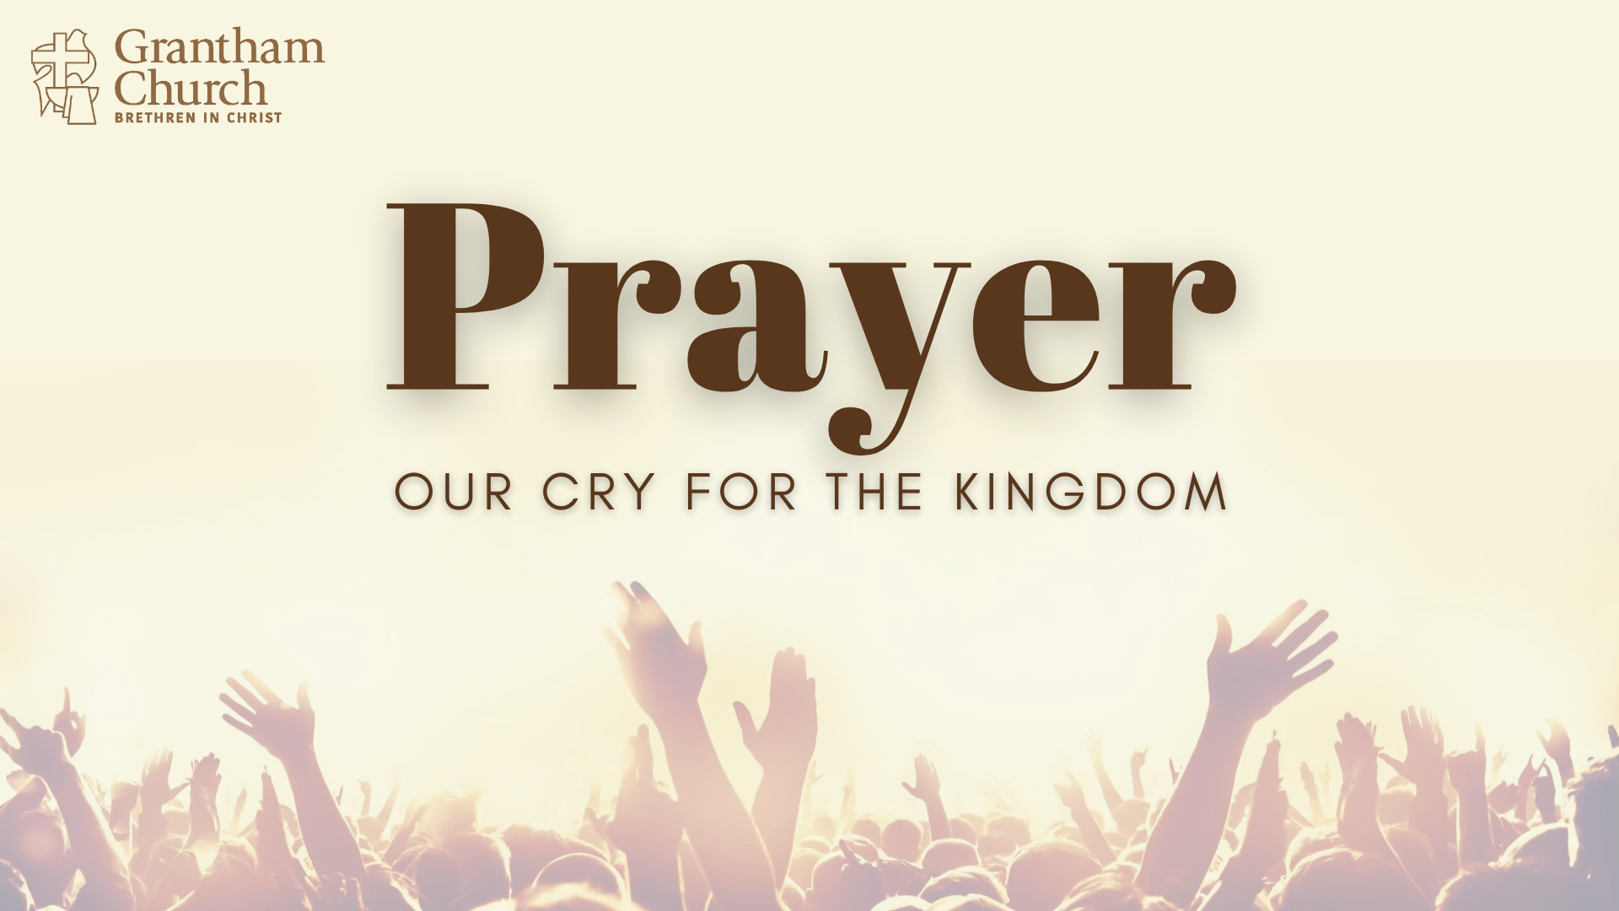
Notes:
[BRIEF INTRO TO NEW SERIES]
3-part sermon series – Prayer: Our Cry for the Kingdom
Our series will address both the why and how we pray.. but will focus primarily on a specific sort of prayer—prayer that is corporate, Kingdom-centered, and seen as a call for God to intervene; not for personal needs, but for the presence and power of God to be known among his people.
[THE CHURCH, SOCIETY & THE FUTURE]
Throughout the Scriptures and church history, every spiritual awakening and renewal was founded on intense, corporate, Kingdom-centered prayer. Therefore, we must see prayer as being about more than going to God for our own spiritual and physical needs, or for the purpose of our own personal growth. In addition to those things, we must see prayer as our cry for more of the Kingdom—for God’s reign and rule to be known on the earth, beginning with the awakening and renewal of the church.
What does the Bible say about this? And what might it look like if we began to pray this way at Grantham? That’s what I want us to look at over the next three weeks.
[BRIEF PRAYER & NEXT SLIDE]

Slide 4
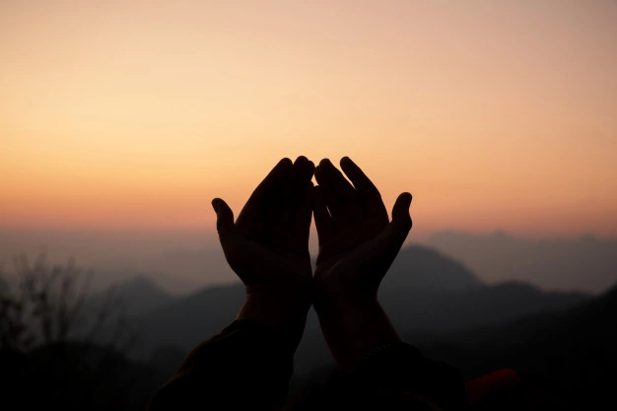
A Biblical View of Prayer
Why do we pray?
How should we pray?

Slide 5
A Biblical View of Prayer
Why do we pray?
How should we pray?
We acknowledge Creator and seek to know him

Slide 6
A Biblical View of Prayer
Why do we pray?
How should we pray?
We acknowledge Creator and seek to know him
It’s the only real way to know ourselves

Slide 7
A Biblical View of Prayer
Why do we pray?
How should we pray?
We acknowledge Creator and seek to know him
It’s the only real way to know ourselves
No way to change who we are or our actions without it

Slide 8
A Biblical View of Prayer
Why do we pray?
How should we pray?
We acknowledge Creator and seek to know him
It’s the only real way to know ourselves
No way to change who we are or our actions without it
It’s how we partner with God in bringing the Kingdom

Slide 9
A Biblical View of Prayer
Why do we pray?
How should we pray?
We acknowledge Creator and seek to know him
It’s the only real way to know ourselves
No way to change who we are or our actions without it
It’s how we partner with God in bringing the Kingdom
Privately and in different ways (various methods)

Slide 10
A Biblical View of Prayer
Why do we pray?
How should we pray?
We acknowledge Creator and seek to know him
It’s the only real way to know ourselves
No way to change who we are or our actions without it
It’s how we partner with God in bringing the Kingdom
Privately and in different ways (various methods)
As Jesus taught (Lk 11:1-4)

Slide 11
A Biblical View of Prayer
Why do we pray?
How should we pray?
We acknowledge Creator and seek to know him
It’s the only real way to know ourselves
No way to change who we are or our actions without it
It’s how we partner with God in bringing the Kingdom
Privately and in different ways (various methods)
As Jesus taught (Lk 11:1-4)
In all of the spaces (intimate, personal, social, and public)

Slide 12
A Biblical View of Prayer
Why do we pray?
How should we pray?
We acknowledge Creator and seek to know him
It’s the only real way to know ourselves
No way to change who we are or our actions without it
It’s how we partner with God in bringing the Kingdom
Privately and in different ways (various methods)
As Jesus taught (Lk 11:1-4)
In all of the spaces (intimate, personal, social, and public)
Corporately repent and petition God in one voice, e.g., “Renew our church!”
Notes:
[BRIEF COMMENTS ON EACH POINT]
You may recall that throughout the Old Testament, God’s people continually fall into periods of spiritual atrophy and stagnation, and then cultural accommodation to idol worship and conforming themselves to the thinking, beliefs, and practices of surrounding pagan societies.
And then over time things get so bad that there is eventually a turning (or returning) back to God, the raising up of new leaders, and a return and renewal of the covenant—ultimately a restoration of spiritual vision and vitality. We see this pattern in Israel’s story, particularly in the time of the Exodus, judges, kings, and the return from exile in the day of Nehemiah.
And if we look at those various examples of spiritual awakenings and revivals, we can see they are all very different. Some are led by strong leaders, some are sparked by the words of prophets, and some seem to slowly emerge like water seeping up from dry cracks in a desert wasteland. In fact, the only thing they share in common is this: the intentional, intense, persistence of corporate prayer that is expressed over and over again in this phrase: the people “cried out to the Lord.” Here are a few examples… [NEXT SLIDE]

Slide 13
“As Pharaoh approached, the Israelites looked up, and there were the Egyptians, marching after them. They were terrified and cried out to the Lord.” Exodus 14:10
“but when we cried out to the Lord, he heard our cry and sent an angel and brought us out of Egypt.” Numbers 20:16
“Then we cried out to the Lord, the God of our ancestors, and the Lord
heard our voice and saw our misery, toil and oppression.” Deut. 26:7
“But when they cried out to the Lord, he raised up a deliverer” Judges 3:9
“They cried out to the Lord and said, ‘We have sinned; we have forsaken
the Lord and served [false gods]. But now deliver us from the hands of our enemies, and we will serve you.’” 1 Samuel 12:10
Notes:
[BRIEF COMMENTS]
This is a repeated pattern in the Old Testament. And it’s part of the story of God’s people to tell the redemptive story this way,,, again and again we were in trouble, but then we collectively cried out to God and he revealed his presence and power, delivering us, restoring us, and blessing us with his favor.
We can hear this in Psalm 107, an ancient hymn that repeats this refrain several times. [NEXT SLIDE]

Slide 14
Psalm 107:13-14 NIV
Then they cried out to the Lord in their trouble,
and he saved them from their distress.
He brought them out of darkness, the utter darkness,
and broke away their chains.
Notes:
[BRIEF COMMENTS]
But we (as God’s people) must first come to this place of calling on God for help.
What does that mean? What does that look like? [NEXT SLIDE]

Slide 15
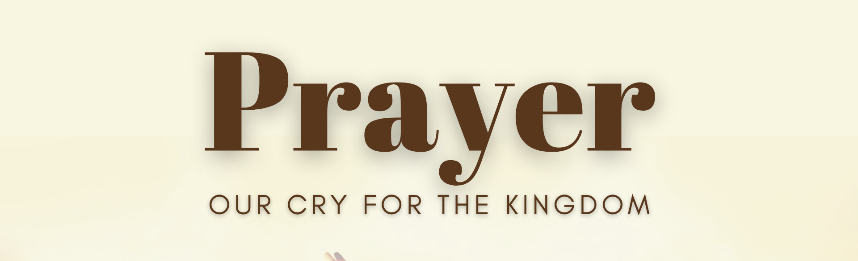
In order for us to receive and experience God’s help and deliverance, we must first come to a place where we…

Slide 16
In order for us to receive and experience God’s help and deliverance, we must first come to a place where we…
See the darkness in us, the church, and the world

Slide 17
In order for us to receive and experience God’s help and deliverance, we must first come to a place where we…
See the darkness in us, the church, and the world
Humbly admit that we need a divine breakthrough

Slide 18
In order for us to receive and experience God’s help and deliverance, we must first come to a place where we…
See the darkness in us, the church, and the world
Humbly admit that we need a divine breakthrough
Persistently voice a corporate call for help!
Notes:
See the darkness in us, the church, and the world.
Can we acknowledge how messed up things are right now?
Can we agree that we are broken—the darkness is in us too?
Can we see how the Church in America is undergoing major changes?
Can we see our need to confess our sins and repent?
Humbly admit that we need a divine breakthrough.
Can we admit that our own smarts and best efforts won’t do?
Are we willing to lay down our pride and lean on the everlasting arm?
What more must happen before we come together in breakthrough prayer?
Persistently voice a corporate (or collective) call for help!
”Why must it be a corporate call for help? Do more people praying matter?”
So, let’s go back to where we began this message—2 Chronicles 7:14. [NEXT SLIDE]

Slide 19
“if my people, who are called by my name, will humble themselves and pray and seek my face and turn from their wicked ways, then I will hear from heaven, and I will forgive their sin and will heal their land.”
2 Chronicles 7:14 NIV
Notes:
[BRIEF COMMENTS]
“my people” – then: Israel (God’s people); now: the Church—the Body of Christ—not America!
It starts with humility, an intentional pursuit of God, self-reflection, and repentance
And all of this must start with us.
What will we do? How will we respond?
[CLOSING PRAYER]

