Slide 1
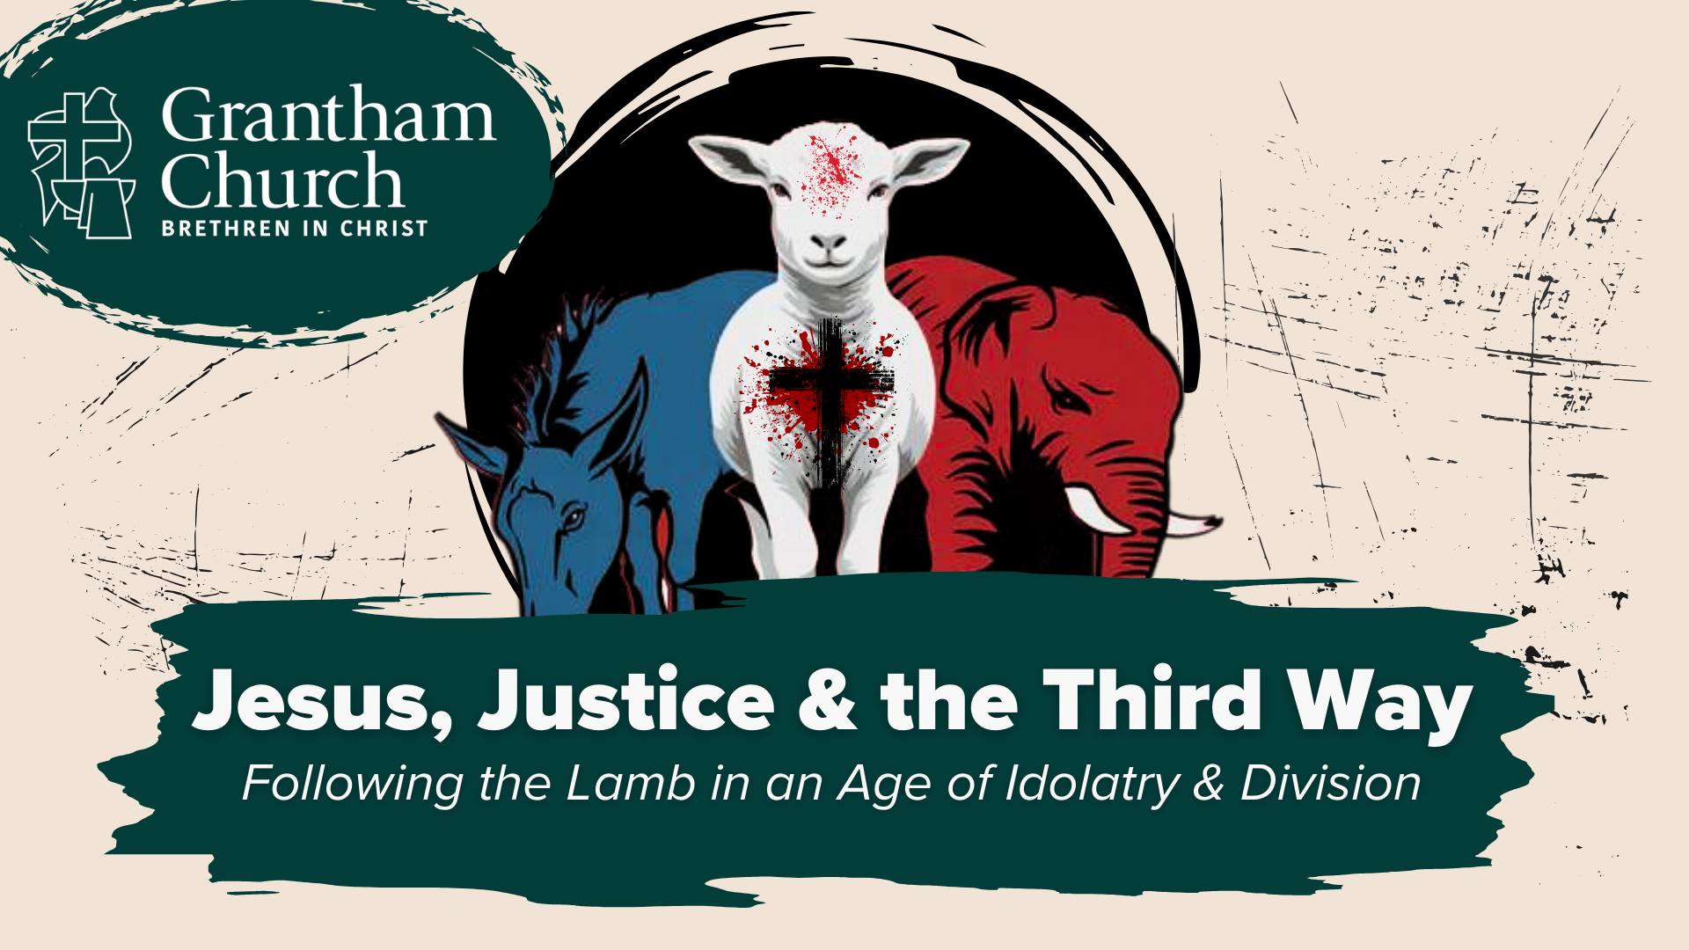
Notes:
[BRIEF INTRO]
This is part 3 of our 6-part series called, Jesus, Justice & the Third Way: Following the Lamb in an Age of Idolatry & Division. In this series we are reflecting on the political nature of the gospel and how we are called to pledge allegiance to the Lamb—not the donkey or the elephant. And to do that, we are going to the Scriptures and back to the first century so we can examine Jesus’ posture and approach to political matters, and see how he dealt with political parties, hot-button issues, and the partisan mind.
Two weeks ago we began our series with the message… [NEXT SLIDE]

Slide 2
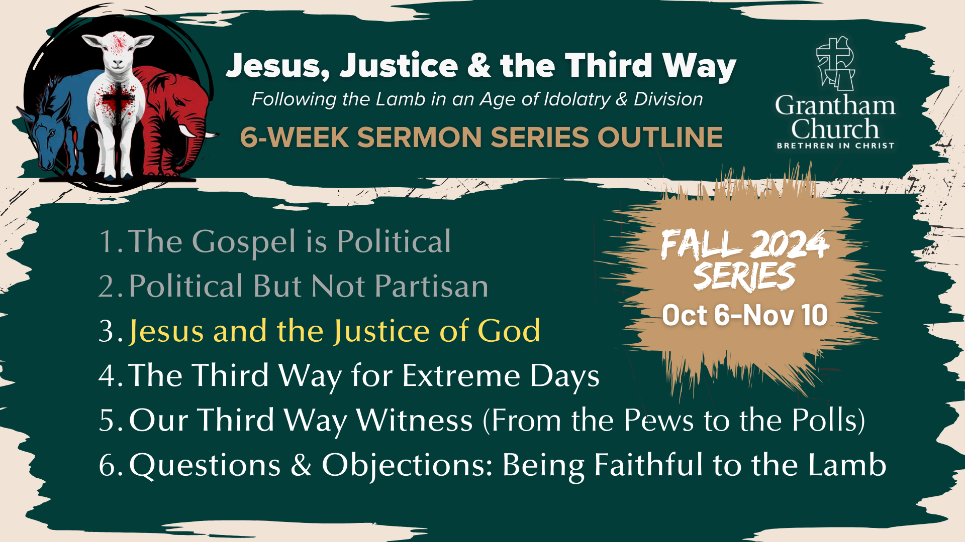
Notes:
The Gospel is Political – we looked at how and why the gospel is political in nature, and that it has real-life implications; I made the case for a holistic understanding of the gospel, and that we must beware of political idolatry as we seek to follow the slain Lamb into his upside-down Kingdom.
In last week’s message, Political But Not Partisan, we saw how the gospel doesn’t fit neatly into our political categories. Jesus is not a cheerleader for any political party. And while he may have agreed with folks on various points, he didn’t fully align himself with any party in his own day. Instead, Jesus intentionally chose a politically diverse group of disciples and said, “Follow me.”
That brings us to today’s message, Jesus and the Justice of God. We can see in the gospels that Jesus cared deeply about justice. While he rejected the standard path of earthly kingship and political power, Jesus still furthered an ancient vision of God’s justice for all nations. But as we will see this morning, this “justice” often looks much different than the way the world defines and imagines it. And so, before we dive deeper into the Third Way of Jesus, we need to give attention to his unique Kingdom vision for justice, so that we can follow him and ensure that Christ remains the center of our church life.
Please join me in opening your Bibles… [NEXT SLIDE]

Slide 3
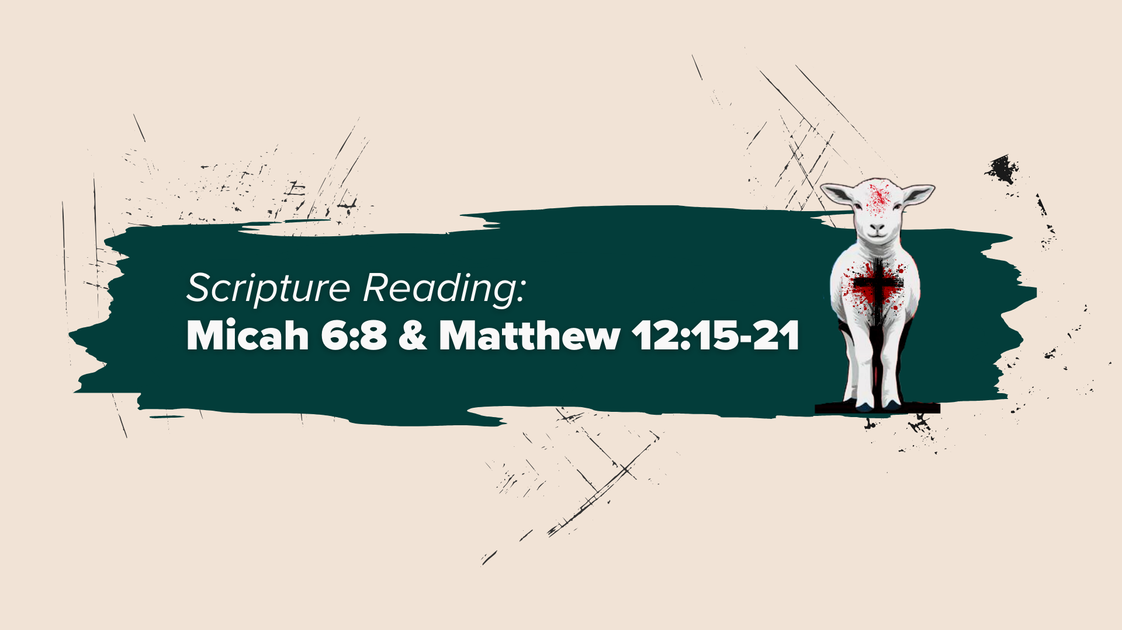
Notes:
[MICAH 6:8 & MATTHEW 12:15-21 - INVITE CONGREGATION TO STAND - READ SCRIPTURE]
This is the word of the Lord. Thanks be to God. You may be seated.
Charlottesville, August 12th, 2017… [NEXT SLIDE]

Slide 4
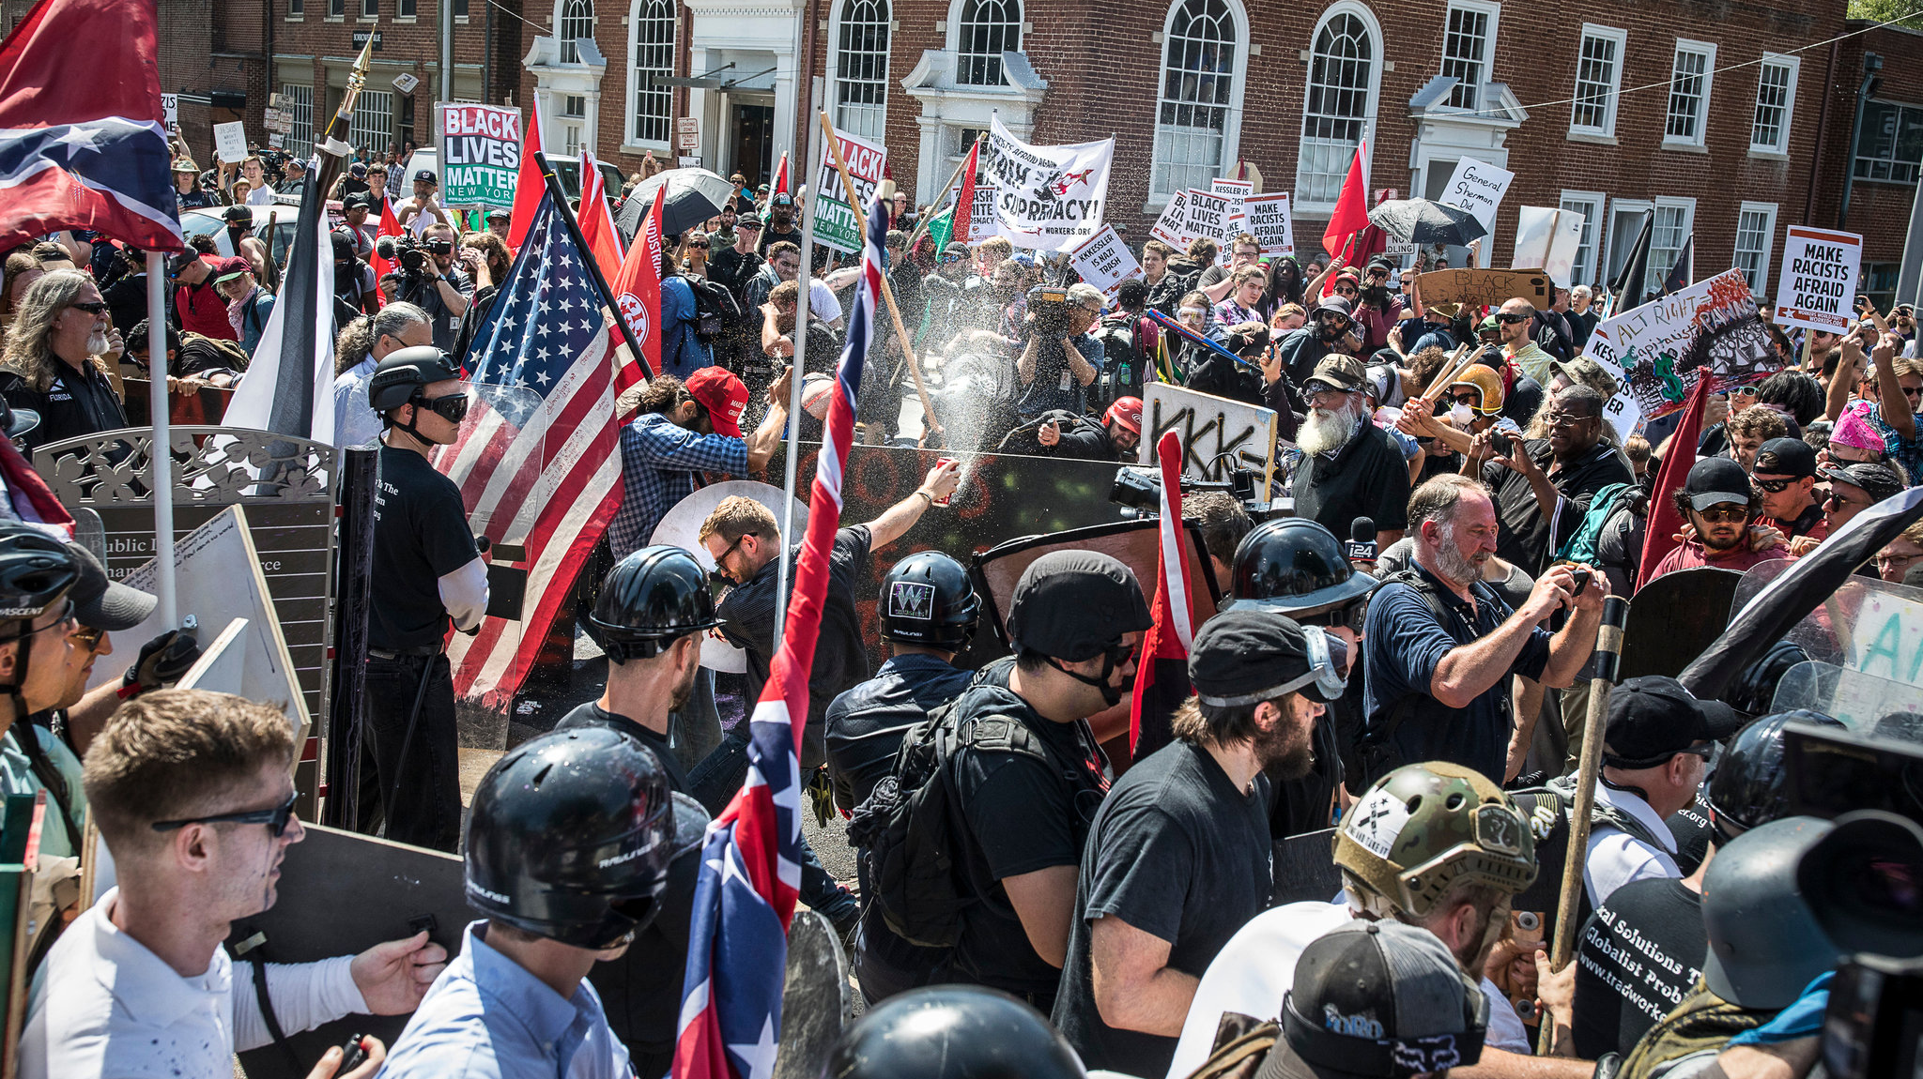
Charlottesville – August 12, 2017 (New York Times)
Notes:
A Far-Right rally was set to take place that day. And it wasn’t long before violence broke out between white supremacists and counter protestors, where they converged on the streets of downtown Charlottesville; that afternoon a woman was killed, and dozens of peaceful protestors were injured by a speeding car driven by a self-professed white supremacist; and the rally continued that evening. US officials say that the driver of the car, had used social media accounts prior to that day to express and promote white supremacist views; to express support for the social and racial policies of Adolf Hitler and Nazi-era Germany, including the Holocaust; and to espouse violence against African Americans, Jewish people, and members of other racial, ethnic, and religious groups he perceived to be non-white.
That evening I talked to another BIC pastor on the phone
The next day we had church – Todd Allen; prayer for racial reconciliation; someone yelled, “Get over it!”
Follow-up conversation with that man (a civil 20-min phone conversation)
I explained our Third Way posture and approach: At Grantham... “We are addressing injustice and working for more of the Kingdom without mixing the gospel with partisan politics in the process.”
He said “Good luck with that. Because you’re going to make enemies on both sides.”
Is “justice” and “social justice” code for the American political Left? No, not if we’re listening to Jesus and we acknowledge the biblical vision for justice, as we read a few moments ago. But this has become a concern for some because every issue under the sun has become politicized in America. And because, once again, the church has failed to embrace a holistic understanding of the gospel. You see… here is what happens. For years conservative Christians have reduced the gospel down to the forgiveness of sins, life-change, and personal salvation. And for years, progressive Christians have let go (or at least gone silent) on those gospel truths only to emphasize doing justice and works of service. And I submit to you that it’s time that we bring these two sides of the same gospel together.
Turn again in your Bibles… this time to the prophet Jeremiah… [NEXT SLIDE]

Slide 5
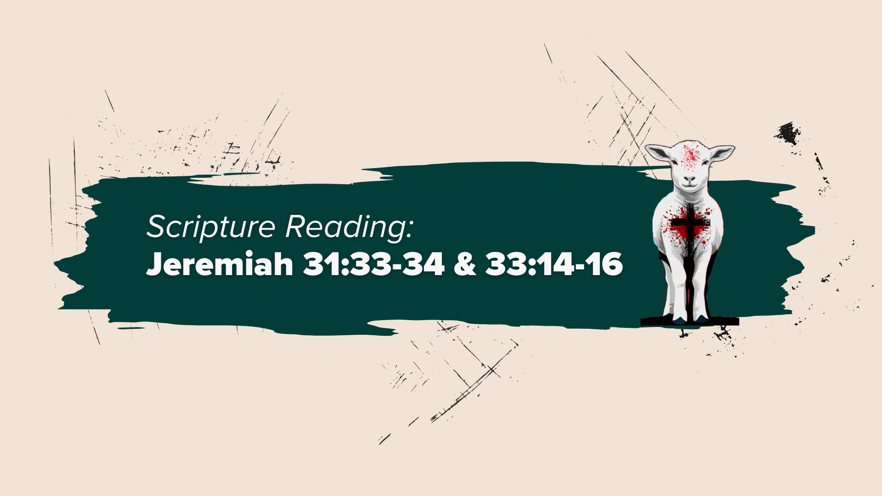
Notes:
[READ SCRIPTURES & COMMENT]
Jeremiah 31:33-34 – notice that the new covenant includes experiences that we associate with personal salvation—the work of God within our own hearts, knowledge of God that transforms, forgiveness, etc.
Jeremiah 33:14-16 – now notice that the new covenant includes God’s work of justice on the earth; that God desires not only inner transformation, but heart-change for the sake of social justice and societal wholeness; for God’s shalom (peace) to be known in all nations
Listen to what Derek Vreeland writes in his book, Centering Jesus: How the Lamb of God Transforms Our Communities, Ethics & Spiritual Lives… [NEXT SLIDE]

Slide 6
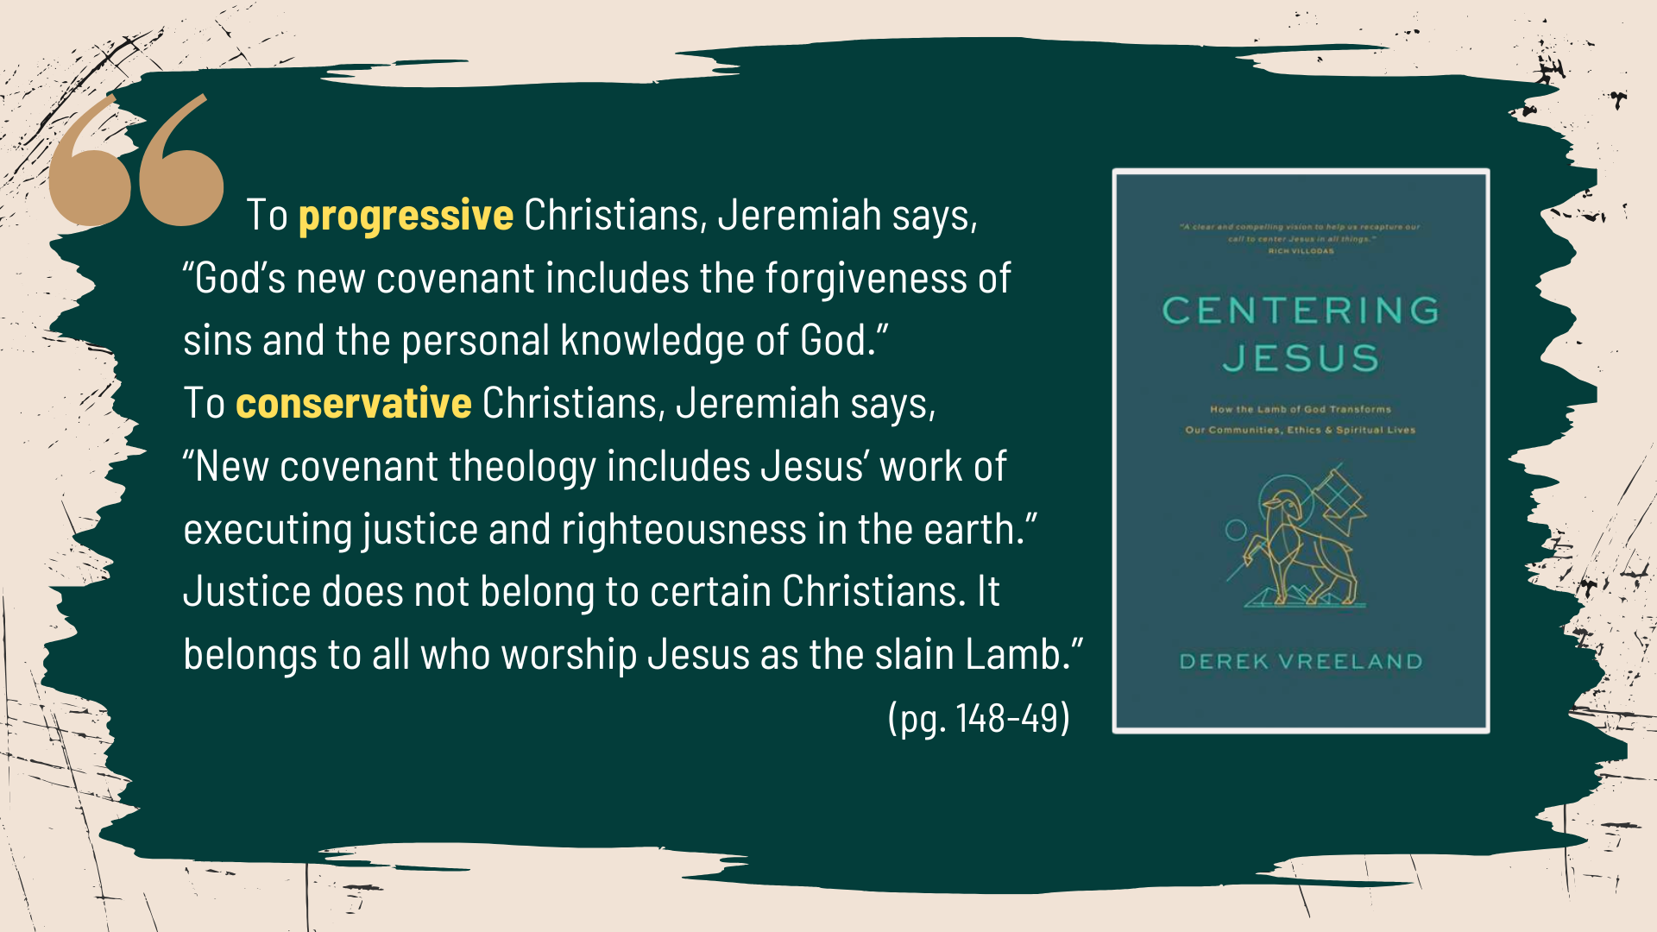
Notes:
[READ QUOTE & COMMENT]
So, brothers and sisters, we can see that “justice” and “social justice” is not code for the American political Left, as if any political party could ever fully contain or embody the justice of God. As Vreeland says, it is something all disciples of Jesus ought to be concerned about because it reflects the heart of God. Therefore, it’s the people of God from every tribe, group, and party who are called to work for it.
And this is evident throughout the Old and New Testaments… [NEXT SLIDE]

Slide 7
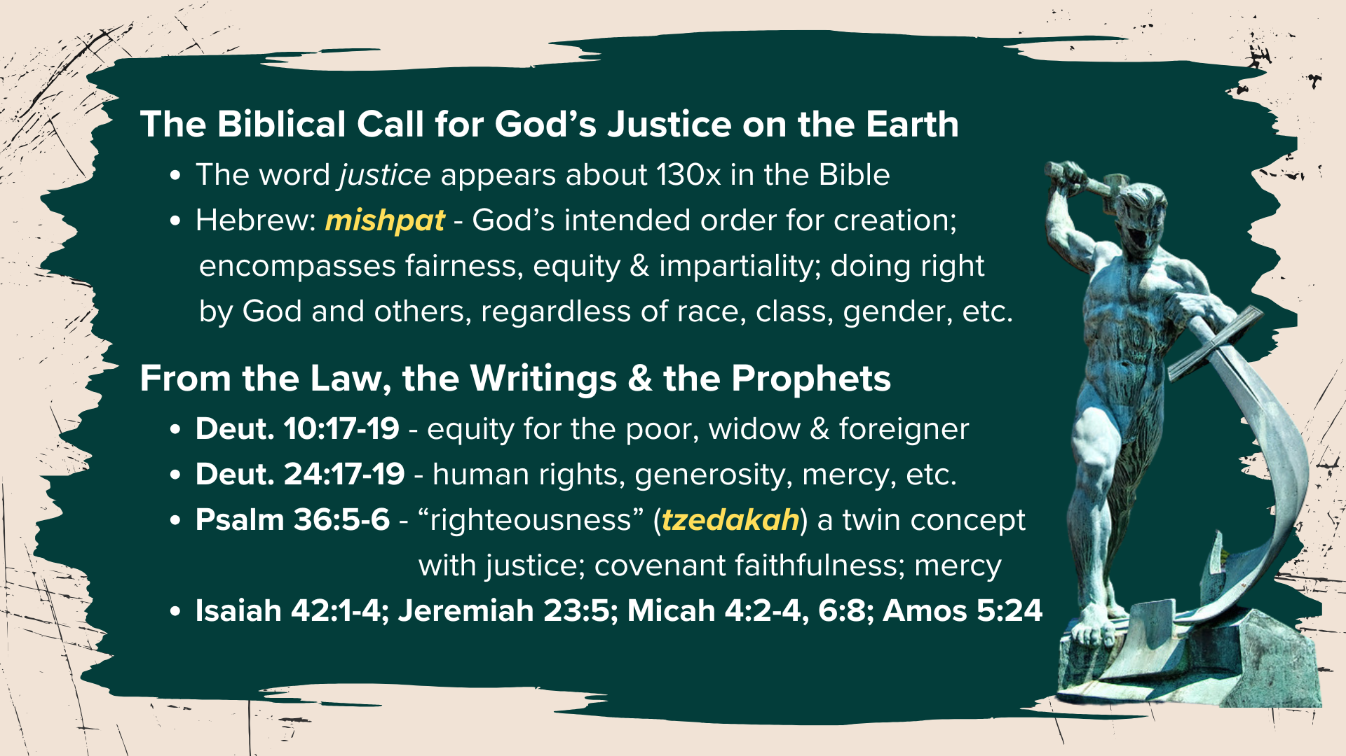
Notes:
[READ & COMMENT]
The word “justice” appears about 130x throughout the Scriptures. The Hebrew word is mishpat. It means God’s intended order for creation; it encompasses fairness, equity, and impartiality; God’s justice is relational; it means doing right by God and by others, regardless of ethnicity, class, gender, and so on. It’s about reflecting God’s harmonious design in all things. We can see examples of what this looks like from the OT: in the time of Jesus, they would have read in the Scriptures about God’s commands that we care for the poor, the widow, and the foreigner; to show hospitality and kindness to outsiders; they would have read about human rights, about generosity as justice, and that mercy and righteousness go hand-in-hand with justice. As David penned in his song: Ps. 36:5-6 – “Your love, O Lord, reaches to the heavens, your faithfulness to the skies. Your righteousness is like the highest mountains, your justice like the great deep.”
And they would have read and known the calls to do justice from the OT prophets; that biblical justice is about reconciliation, rehabilitation, and restoration; that it’s aim is not punitive and retributive. But even though it was in their Scriptures, they either chose to ignore it or explained it away. That is until Jesus left the wilderness where he was tempted and then came home to Nazareth… [NEXT SLIDE]

Slide 8
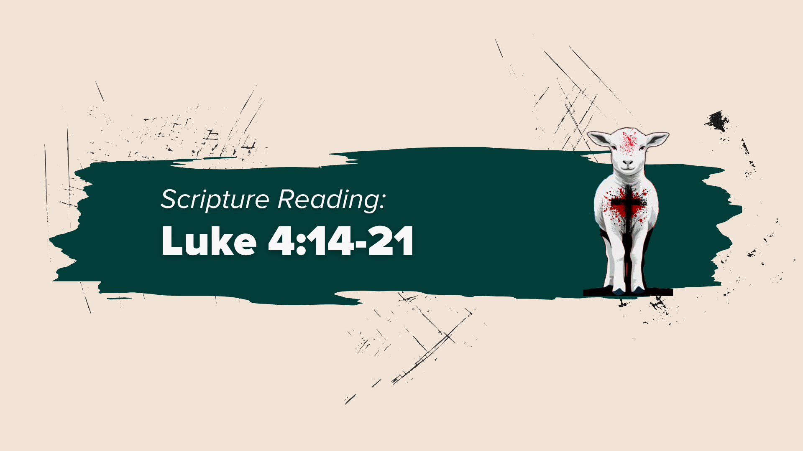
Notes:
[READ & COMMENT ON PASSAGE]
Lk.4:18-19 - Jesus reads from our Isaiah 61:1-2. But notice that he stops in the middle of a sentence: “and the day of vengeance of our God.” He is showing his authority of interpretation over Isaiah.
And if you keep reading in v.22, Luke says at first ”all spoke well of him” literally means “they bore witness to him”; i.e. their initial impression was favorable, and they can’t believe this is the same Jesus who grew up in their village. But their response, ”Isn’t this Joseph’s son?” makes us think of the saying, “familiarity breeds contempt.” Because you see, their proximity to Jesus and their feelings of privilege (being the villagers who watched Jesus grow up) are going to make it impossible for them to hear his words and embrace his mission. They want Jesus to do the miraculous things they’ve heard that he has done in Capernaum (his new home and base for ministry), but they clearly don’t want to hear his claims or hear about his vision of the Kingdom of God.
And likely having expected this response, Jesus reminds them that prophets were never welcomed by their own people (by their hometown). He then goes on to give them two examples, Elijah and Elisha, OT prophets who used their miraculous powers to bless and benefit outsiders, and in one case, heal the Gentile commander of the enemy army. So, catch this, Jesus has not only jolted them by not reading all of verse 2, and then shocked them with “Today this scripture is fulfilled in your hearing,” he now lays on them more than they can handle with his seemingly unpatriotic (anti-Israel sounding) words. They then want to kill him by throwing him off the town cliff. And Derwin Gray sums this up about right… [NEXT SLIDE]

Slide 9
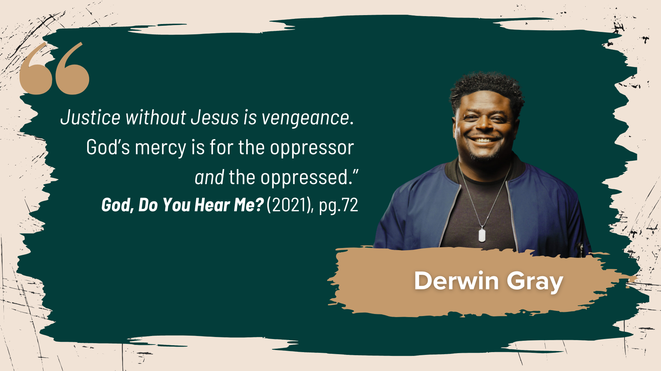
Notes:
[READ & COMMENT]
And I think this is one of the distinguishing marks of a Christ-centered approach to doing justice. If justice concerns are coming out of a saving knowledge of Christ and his gospel of peace, there will be no vengeance, rage, retribution, or revenge-seeking in the process (e.g., MLK vs. Malcom X).
So, let’s look more closely at the justice of God according to Jesus… [NEXT SLIDE]

Slide 10
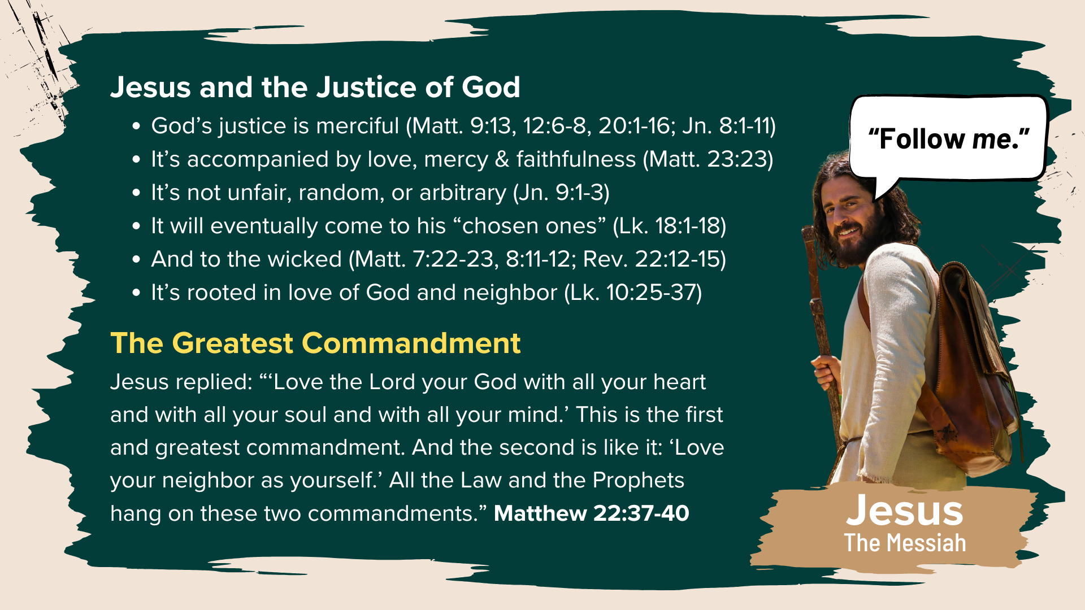
Notes:
[READ POINTS ON SLIDE & COMMENT]
For Jesus, justice is about being present with those suffering injustice. That is how we live out the “Greatest Commandment” in Matthew 22:37-40. We embody justice through faithful presence—loving God and loving others, just as Jesus did. We confess, repent, and seek reconciliation where there is division and discord. And when we do this, God manifests his power and presence around us, and then HE changes things
So, consider this: Real Jesus-centered churches will naturally act justly, love mercy, and walk humbly with God. But “justice-centered” churches will use Jesus to champion their social-justice causes, and that usually leads to whatever power-over method it takes to win; justice then becomes the reason for gathering, which ultimately leads to disaster. And unfortunately, we’ve recently seen that truth become a reality with Circle of Hope, a BIC congregation in Philly… [NEXT SLIDE]

Slide 11
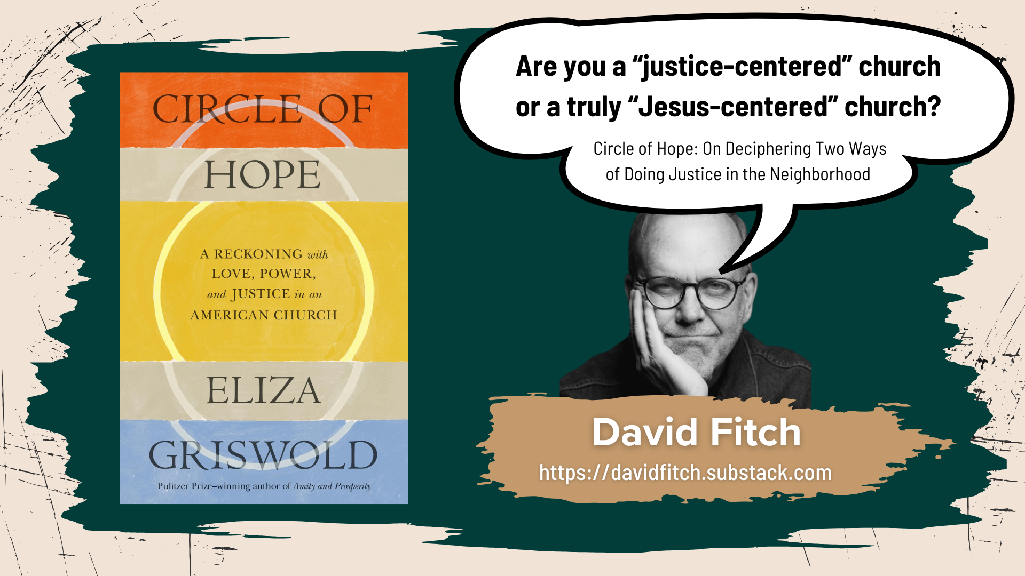
Notes:
In her new book, Circle of Hope: A Reckoning with Love, Power, and Justice in an American Church, Eliza Griswold reports on how she witnessed (through immersive journalism) the fall of this congregation. I’m making my way through this book right now. Many of you have read it. Some of you know the people involved. And while I know the story is more nuanced and complex, I do think that its demise ultimately came about because this congregation (doing many great works of justice) had lost its center.
This past week I came across a brief review and musings from Dave Fitch, an author and professor at Northern Seminary in Chicago. Fitch shared his thoughts at his substack page (link on the screen). In short, Fitch said that once knowing Jesus and growing into Christ-likeness (i.e. discipleship) ceases to be a church’s primary concern and focus, their light and witness eventually fades, as it did with Circle of Hope. Because once “justice” replaces Jesus, we then adopt the posture and approach of the world.
Brothers and sisters, the only center that holds is Jesus, the Lamb. Jesus himself warned of this sort of idolatry and mission drift in Revelation 2. Remember what he said? He told the church in Ephesus, “You have forsaken your first love. Consider how far you have fallen! Repent and do the things you did at first. If you do not repent, I will come to you and remove your lampstand from its place” (2:4-5).
May the Lord help us at Grantham Church to see the Third Way of Jesus clearly so that our light may continue to burn brightly, and our witness would be reflective of Christ and the coming Kingdom. Amen? Here are some main takeaways: [NEXT SLIDE]

Slide 12
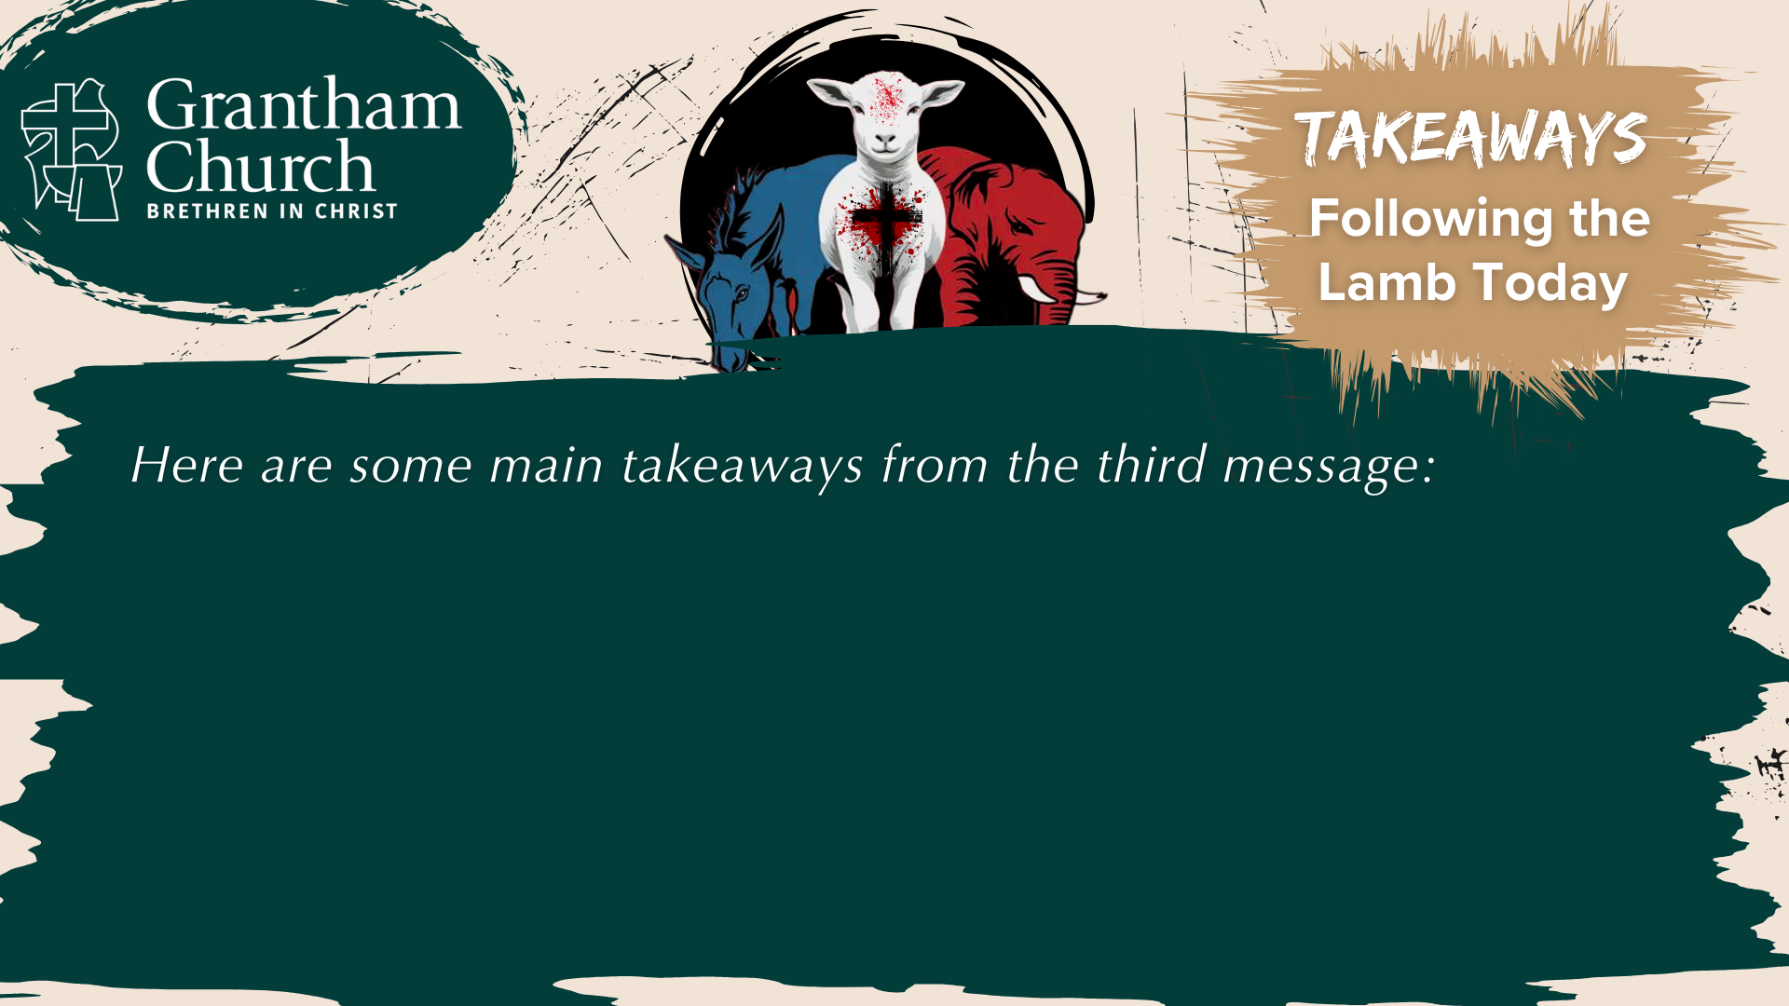

Slide 13
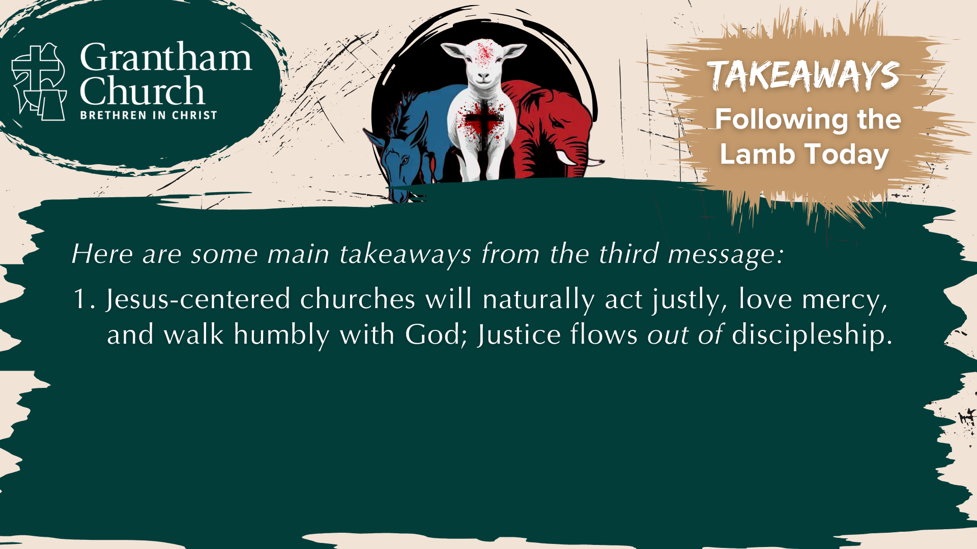

Slide 14


Slide 15

Notes:
[READ & COMMENT ON EACH POINT]
Jesus-centered churches will naturally act justly, love mercy, and walk humbly with God; Justice flows out of discipleship.
Biblical justice is only made possible by the presence of God manifested via our confession, repentance, reconciliation, etc.
God’s justice begins with us being present with others in the midst of injustice; It’s sacrificial, power-under, and patient. It’s also a justice that’s informed and shaped by the eschaton!
And finally, here are some questions to help us reflect and respond together… [NEXT SLIDE]

Slide 16
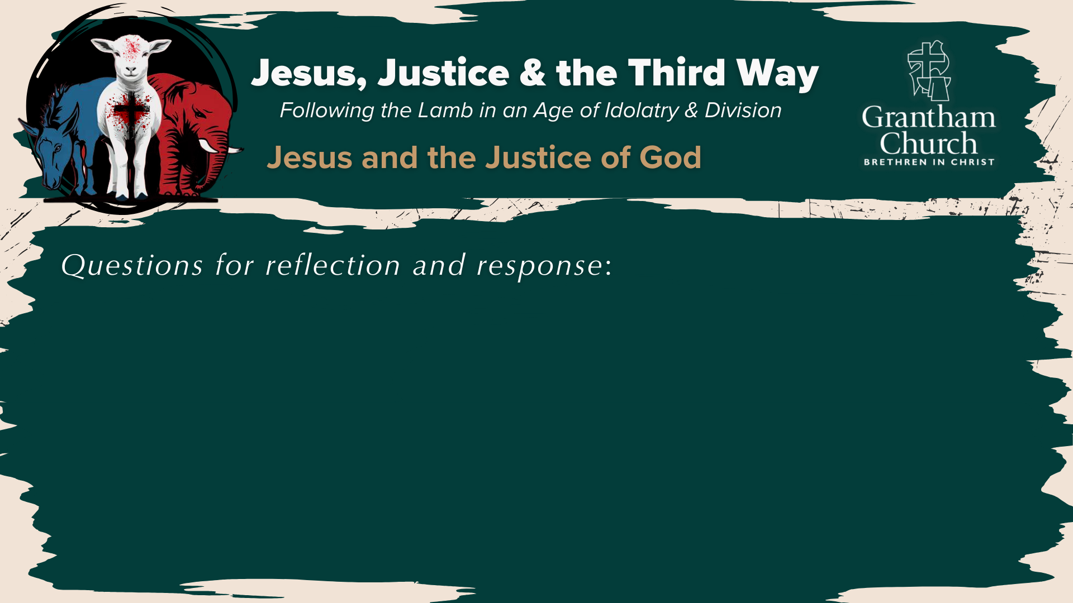

Slide 17
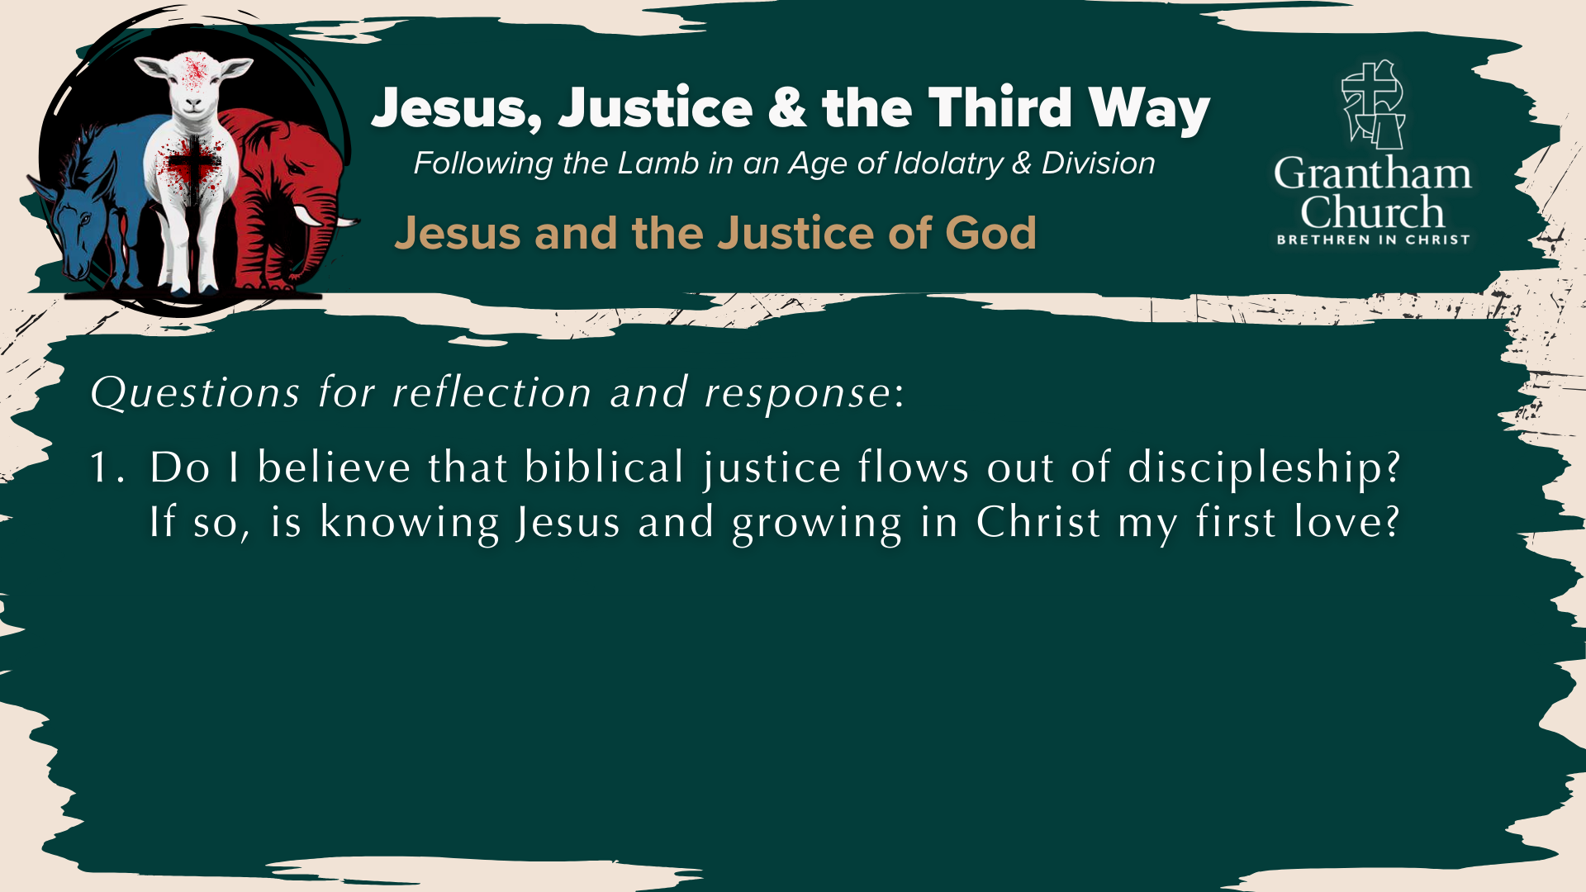

Slide 18


Slide 19
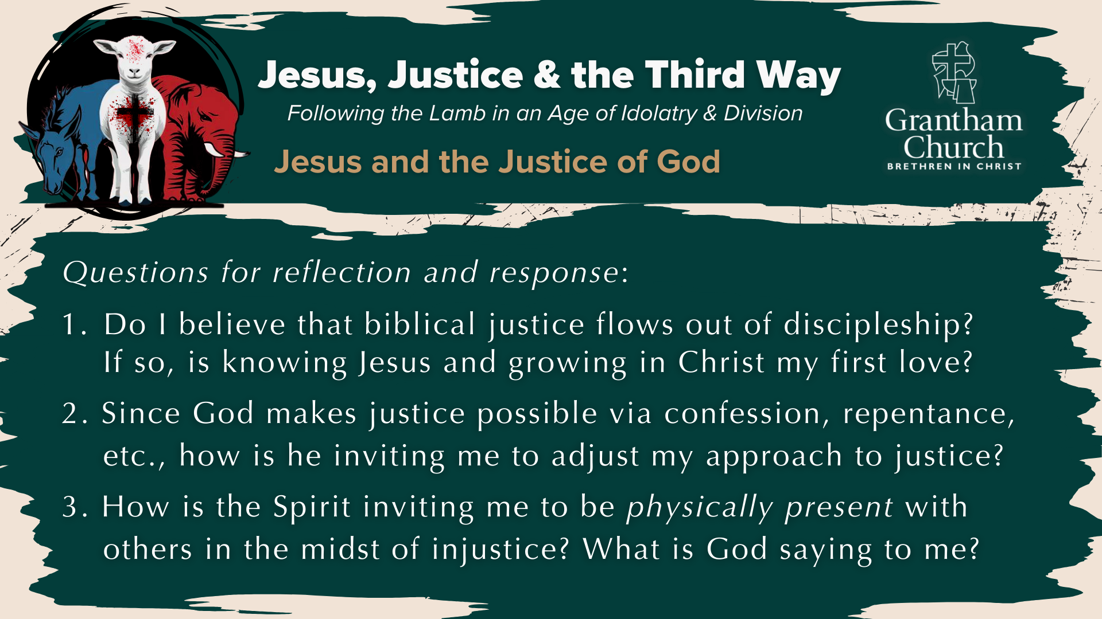
Notes:
[READ & BRIEF COMMENT ON EACH QUESTION]
Do I believe that biblical justice flows out of discipleship? If so, is knowing Jesus and growing in Christ my first love?
Since God makes justice possible via confession, repentance, reconciliation, etc., how is he inviting me to adjust my posture and approach to justice issues?
How is the Spirit inviting me to be physically present with others in the midst of injustice? What is God saying to me?
Let’s pray… [NEXT SLIDE]

Slide 20
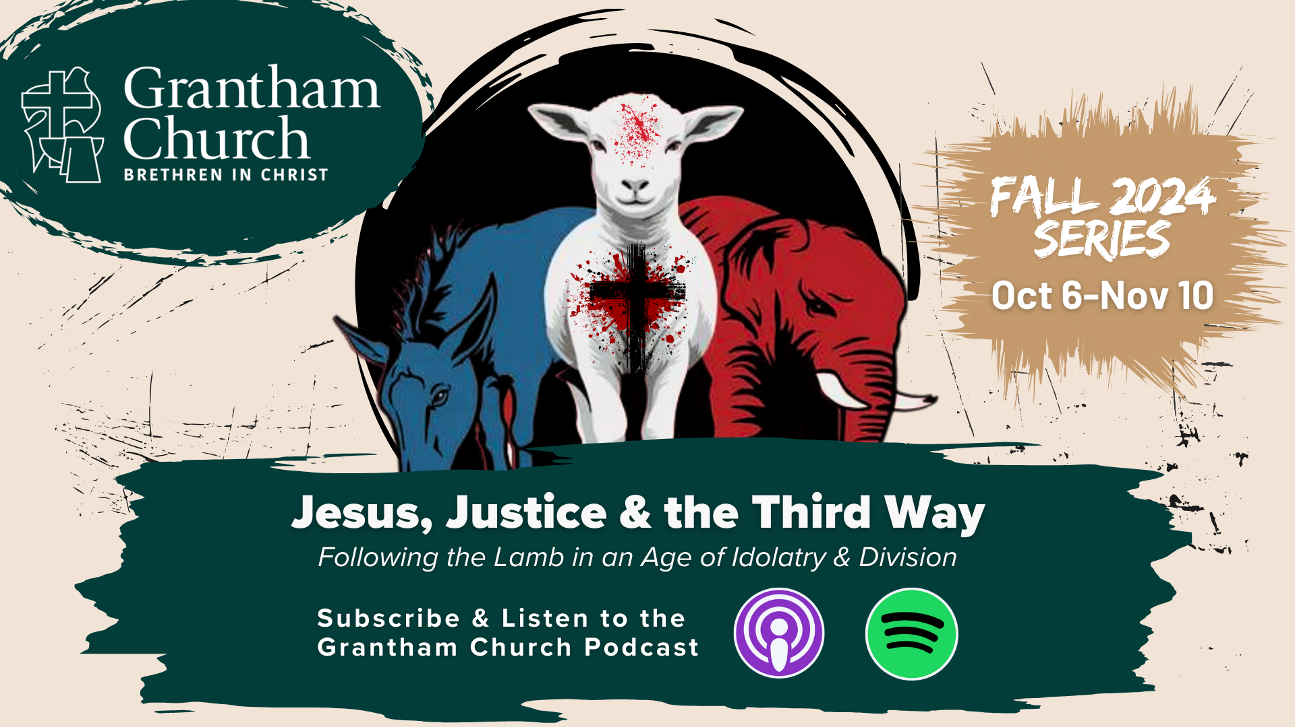
Notes:
[CLOSING PRAYER]
[REMINDER ABOUT THE BENEDICTION]
Benediction: Brothers and Sisters, the Lamb has conquered. Let us follow him. And may the God who looks like Jesus equip you with all you need to live for him in a world of competing loyalties and allegiances. In the name of the Father, the Son, and the Holy Spirit. Amen. Go in peace, church.

