Slide 1
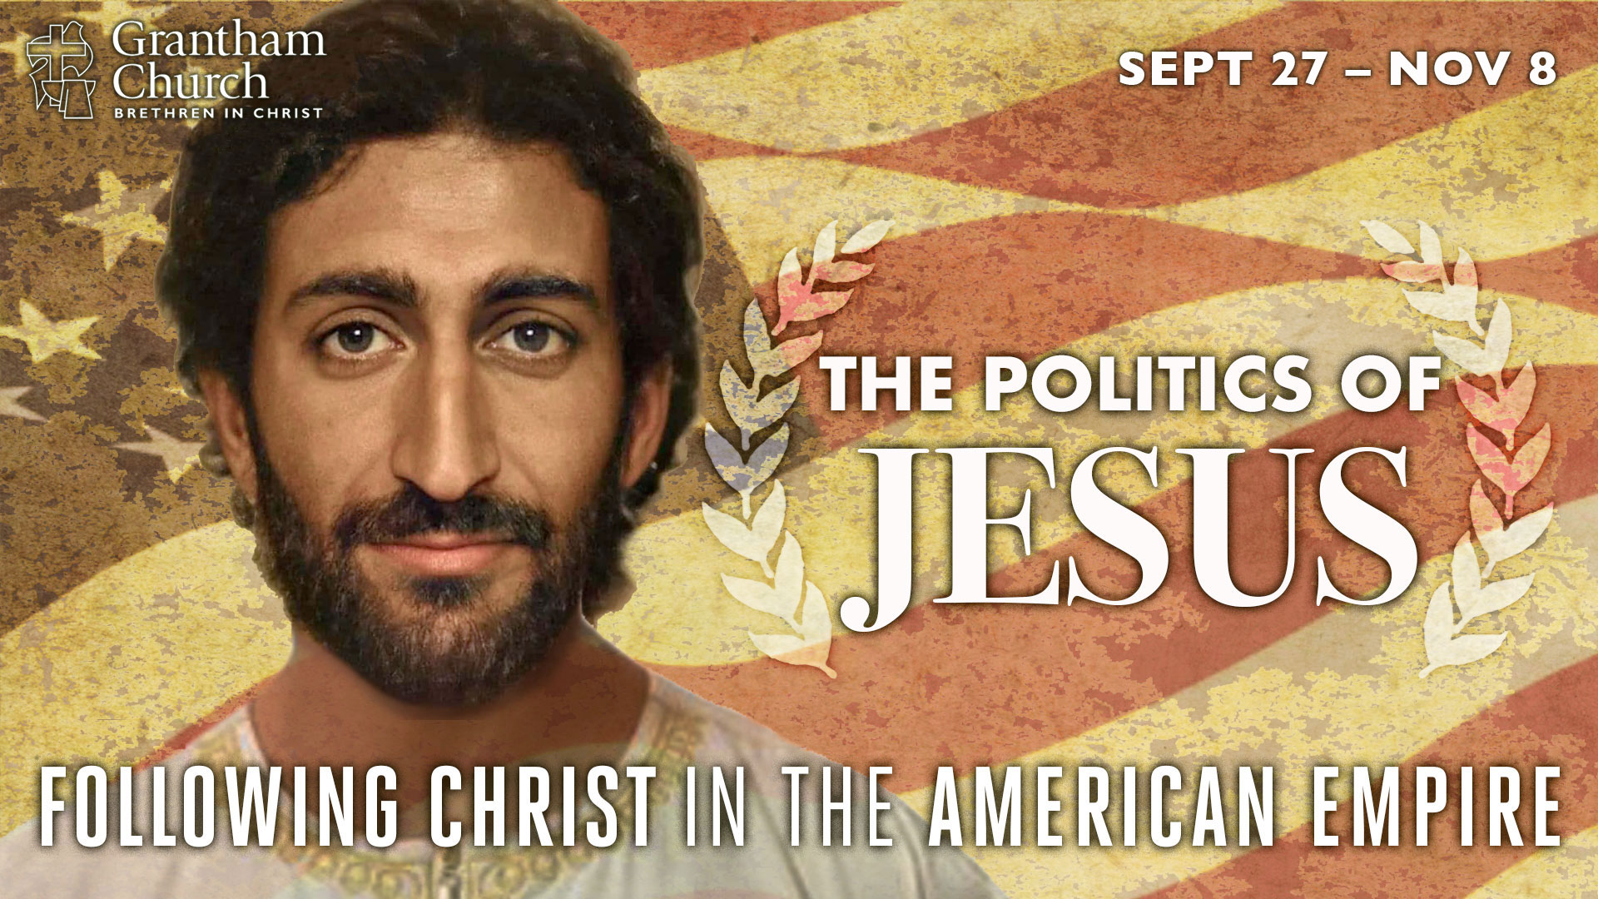
Notes:
We are continuing our fall sermon series this morning: The Politics of Jesus: Following Christ in the American Empire. In this series we want to give serious thought to what it looks like to embrace the agenda of Jesus and embody his way of radical love, as we seek to navigate this election season by letting the Messiah from Nazareth lead us, and show us what it means to be faithful to God in these tumultuous times.
We began the series last week by reflecting on how Jesus said that his disciples are to be known by their love. I said that judging by the church’s reputation in America, and what we’re observing in the media, something is definitely amiss with our witness today, and I called us to remember who we are, and invited us to return to the way of Jesus, the way of love, not of trusting in political power and winning with the weapons of the world.
And because this series really builds on itself week-to-week, if you missed that message, I want to encourage you to go back and listen to it. Remember, whether you’re a regular attender at Grantham, or you’re a podrishioner, you can follow this series through the Grantham Church Podcast however you like to subscribe and listen on the go. And please know that I’m grateful that you would take the time to listen and apply these messages to your life.
So, today is the second sermon in our series, and we’re going to look at how Jesus purposely chose not to use worldly kingdom power or to let himself be co-opted by the parties of his own day. Instead, we will see how Jesus refused to be pigeon-hold or to be identified with any political ideology, and how he manifested a Kingdom that is about power-under, not power-over. Also, we will see how he called his first disciples, a rather rag tag group of misfits with divergent political views, to set aside their political opinions on how the kingdoms of the world ought to operate in order to follow him and discover a “third” way to live within the empire.
But before we jump into today’s message, I want to let you know that I have put together a suggested reading and resource list to go along with this series. You can find this list at our website with this sermon entry or click on the link in the podcast notes. There you’ll find some books and videos that I believe will be helpful to you, some of which have influenced my own thinking over the years. So, check those out if you’re interested.
And secondly, I want remind you that we want to follow the Jesus of history, as well as the Jesus of faith. As I said last week, the Jesus of history ought to be the same Jesus we’re following and worshipping today, both in the life of our mind and in our actual experience. It’s critical that we get this right. Our portrait of Jesus can make all the difference. As A.W. Tozer once said, “your portrait of God is the most important thing about you.” That’s because we live and act out of our portrait of God. Which is why I spent time last week showing us how Jesus’ way of love is rooted in his very character—the portrait of God we read about in Philippians chapter 2.
So let’s be honest about the Jesus we’re picturing in our head, not just what he looks like, but what he believed, taught, and expects from us. And let’s acknowledge that there are all kinds of competing portraits of Jesus at work in the church and in society. For example… [NEXT SLIDE]

Slide 2
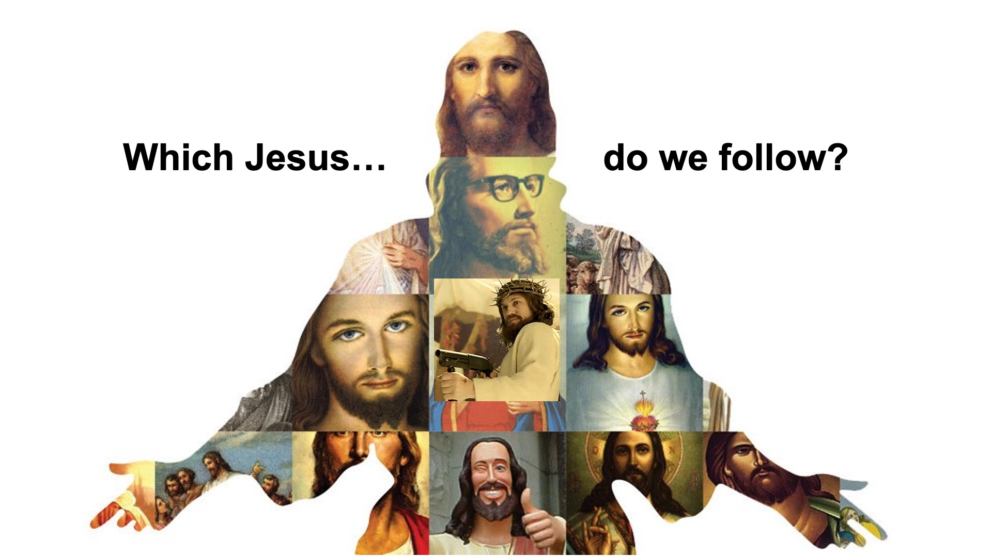
Notes:
In the academy, there is a field called Historical Jesus Studies, which is the pursuit of discovering the real Jesus of antiquity. And scholars have come up with all kinds of portraits of Christ over the years. Some folks have wanted to read the Gospels through their own post-Enlightenment filters and cultural lenses and see Jesus as moral teacher (not divine) who simply wants us to be nice to each other.
Some see Jesus the cynic preacher, or Jesus the prophet, or Jesus the Jewish reformer, or Jesus the revolutionary, or Jesus the gnostic guru or philosopher. Of course to get any of those portraits, you have to pick and choose what is “historical” and what you believe is “reliable” (or what you like and don’t like), because the NT Jesus doesn’t fit neatly into any of those categories.
And then think about the many portraits of Jesus we find within American pop-culture. We of course have the white Jesus, the republican Jesus, the progressive Jesus, the nice therapist Jesus, the hipster Jesus, SNL’s Jesus unchained; the hipster Jesus, the social activist Jesus, and if you’ve ever seen Talladega Nights, we have those who only want to picture a Baby Jesus who is forever in a state of infancy; cute, cuddly, tame, and silent in a manger.
But if you’ve been paying attention lately, many folks (especially millennials and Gen Z, I think) are desiring to know the first-century Jesus in all of his complexities, mystery, and subversiveness. And not just as the timeless teacher, preacher, and prophet, but specifically the Jesus who was from an oppressed minority, the Jesus who wasn’t born into privilege, the Jesus who had once been a refugee after his parents fled from a ruthless king—the Jesus who, unlike the many portraits we’ve created over the past 500 years, wasn’t white and of European descent, but instead looked something like this:
[NEXT SLIDE]

Slide 3
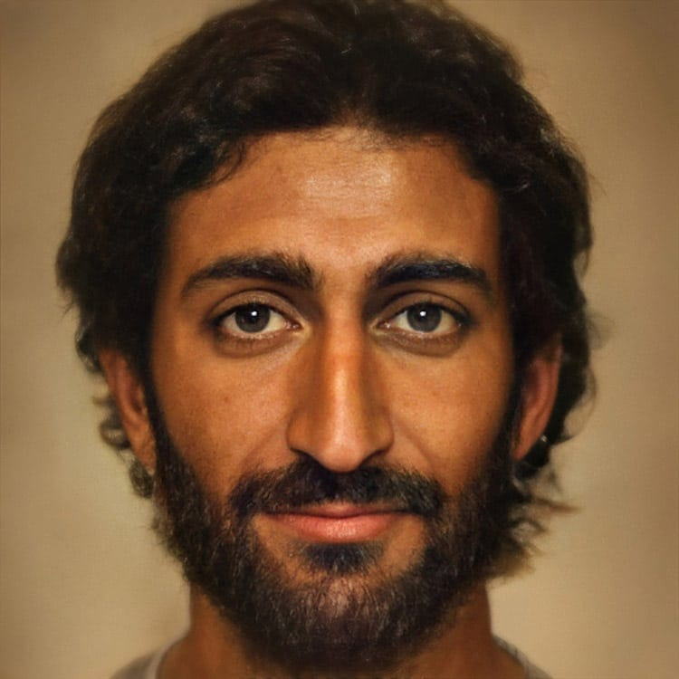
Notes:
This is the portrait of Jesus we’ve included in the series graphic. You might recognize it if you’re on social media. A few months ago, a Dutch artist used AI technology to reimagine what Jesus might have looked like in the first century. He took a variety of artistic renditions of people who lived before the era of photography, including paintings, statues, icons, and whatever else was available, and he fed those to an artificial intelligence program to see what would emerge out of the combination and commonalities among all of them. And this is the picture it produced. Fascinating, isn’t it?
And my intention with choosing to use this picture in The Politics of Jesus series, is (I hope) to help us to see Jesus differently. But not just his brown-skin and brown eyes, though I do hope it humanizes Jesus and prompts a reframe of our faith, but also to provoke us to reconsider his teachings, his example, and his politics. If you don’t know, politics comes from the the Greek word “polis” (or city), and it pertains to the way society is organized and how human communities function. Therefore, this series is about what Jesus thinks about that, how he envisions real transformation and human flourishing, and why we should share his passion and perspective about the way the Kingdom comes.
Alright, as we did last week, let’s stop, pray, and invite the Spirit to speak to us.
[BRIEF PRAYER]
Jesus & the Third Way. That’s the title of this second message in our 7-week series. And as I said earlier, I want us to think more deeply about how Jesus didn’t choose the expected Messianic pathway of worldly kingdom power, but instead he chose to be a King with a Kingdom that is unlike any upon the earth.
Let’s begin by reading from Matthew chapter 4, verses 8-11. If you want to turn there in your Bible, please go ahead and do so. And while you’re doing that, let me set the context for us. Many of you will recall that this is the scene after Jesus was baptized in the Jordan by John the Baptist, his cousin. And the baptism of Jesus marks a turning point in his life. Up to this point he had lived life in obscurity, but he is now about to accept his Messianic identity and begin his ministry. But before he does that, he goes into the Judean desert for 40 days (a picture of Jesus embodying Israel’s time in the wilderness), where he prays and prepares himself for the next three years of ministry, and endures testing and temptation by the devil in the process.
Satan has already tested him twice with “If you are the Son of God (the Messiah), then…” (1st) turn these stones to bread; and the (2nd) throw yourself down from the highest place in the Temple. And now in verse 8, the third temptation comes: [NEXT SLIDE]

Slide 4
Matthew 4:8-11 NIV
⁸ Again, the devil took him to a very high mountain and showed him all the kingdoms of the world and their splendor. ⁹ “All this I will give you,” he said, “if you will bow down and worship me.”
¹⁰ Jesus said to him, “Away from me, Satan! For it is written: ‘Worship the Lord your God and serve him only.’” ¹¹ Then the devil left him, and angels came and attended him.
Notes:
There are a few things you need to know about what’s going on with these temptations:
The devil is likely tempting Jesus as we are all tempted – in our heads (in our thoughts)
As Donald Kraybill points out in his classic book, The Upside-Down Kingdom, these are not random temptations just so you can see how Jesus didn’t sin, but instead they symbolize three social institutions that kings must control: the bread represents the economy, the temple represents religion, and the mountain is all about wielding political power over a king’s domain
So, this is about Jesus deciding what kind of Messiah he is going to be, and how is Kingdom will operate.
Look at verse 9. The devil tells Jesus that he is in possession of the worldly kingdoms and he can give them to Jesus. A claim that Jesus doesn’t dispute. In fact, all throughout the NT we’re told that Satan has power over the kingdoms of the world. Three times in the gospels we hear Jesus refer to Satan as the “ruler of this world” (Jn 12:31; 14:30; 16:11), Paul says he’s the “ruler of the power of the air” (2 Cor 4:4; Eph 2:2), and in 1 John 5:19 we read that “the whole world lies under the power of the evil one.”
So, don’t miss this, because we not only learn something here about earthly governments, but we also learn something about the the kind of Kingdom that Jesus has come to establish—it’s not like anything this world has known. Still, this is a real temptation. Afterall, the Messiah is supposed to be the King of kings and rule over all nations. So, this thought for Jesus (or temptation in this case) should be expected, i.e. that Jesus should reign and rule by following in the expected path of kings, like King David, or even an Alexander the Great, or a Julius Caesar. Right? That’s what you’d expect. And yet Jesus is ready for it—ready to resist the offer and reject the path of political power.
For Jesus, and later the early church, he will not choose the Roman way, or the Jewish way, but instead he’ll chose a third way. The third way is political, to be sure. It does have something to say about the polis, but it’s economy, its religion, its politics are nothing the world has ever seen. The third way of Jesus isn’t weak. There is a power there. But it’s about power-under, not power-over. It’s about calvary-love, self-sacrifice, and at times patient suffering, even if it means giving your life as you go about being faithful to God. Which is what Jesus did.
And despite persecution in those earliest days, the early church saw explosive growth by simply being filled with the Spirit, living out the teachings of Jesus with simple faith, and adopting an amazing evangelistic strategy, it was called patience. I’ll talk more about that next week. But for now, we need to know that this is the way that the early church followed Christ up until the 4th century when the emperor Constantine claimed to have had a conversion experience and then pandered to some 3-5 million Christians to support him unifying the empire under one God and one leader.
From there, Christendom was born. The Christian faith became the religion of the empire and for about a thousand years Christianity’s relationship with the state almost seemed to go unquestioned. That is until the Anabaptists of the 16th century reformation. They dared to call for the separation of the two kingdoms. But still Christendom limped along, even manifesting itself in the founding of this country. And we can still see what’s left over from the fusion of our faith with American identity and partisan politics. And as Christendom in America has been gasping for its final breaths over the past 30-40 years and fighting to stay alive, we have seen a rise in nationalism within the church. And I literally mean within the church. I know you’ve never experienced this at Grantham, but maybe you have at another church, or at least heard stories of the so-called ”patriotic” services held over July 4th weekend in places like First Baptist Dallas. [NEXT SLIDE]

Slide 5
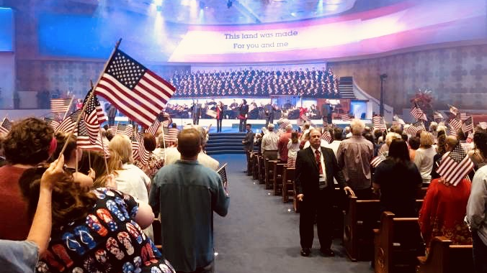
Notes:
Now, depending on where you are in your walk, you might see this scene differently. But for me, at least for the past 15 years, this idolatrous worship has grieved, sickened, and burdened my soul. And I don’t mean this in some self-righteous way, but rather as a Christ-follower who is convinced that this practice goes against everything Jesus believed, taught, and called us to as Kingdom people. That we would try to wrap the God of the universe in an American flag, that we would take the Jesus who envisioned a Kingdom made up of many nations and make him subservient to the empire, or any political party within that empire, is so primitive, arrogant, and blasphemous, it’s a wonder it has lasted this long.
But I never would have seen this if I hadn’t decided to re-read the gospels with an open heart and mind in my early twenties. It began by me asking, “What if Jesus really meant what he said? What if his life is to be emulated? What if he was showing us how we’re called to live and what it means to live in the Kingdom? What if America is just another empire that will one day come to an end?” And the more I understood the difference between the two kingdoms, the more I could start seeing that American Christians have accepted an imperial civic religion with the veneer of Christianity.
[PATRIOTIC CHURCH SERVICE IN TX – 2006] – What if Jesus had walked in the sanctuary?
Brothers and sisters, we do this same thing to Jesus when we kidnap him and recruit him against his will to our political parties. We bring Jesus down to our petty tribalism and reveal that our belief in political power, national identity, and our desire for our side to “win” is more important than Christ and the Christian faith. But Pastor, isn’t Jesus on the side of the poor, the vulnerable, the unborn, and the oppressed? Yes! And we will talk about that more in the coming weeks. But church, don’t be deceived into thinking any political party (with all the complexities, ambiguities, greed, desire for power, and many other ulterior motives) could ever fully capture the heart and concerns of Jesus.
Remember, Jesus said this to Pontius Pilate before he was crucified. Pilate asked, they say you claim to be a king. Are you a king? Jesus said… [NEXT SLIDE]

Slide 6
“My Kingdom is not an earthly kingdom. If it were, my followers would fight to keep me from being handed over to the Jewish leaders. But my Kingdom is not of this world.”
Jesus, John 18:36 NLT
Notes:
What is Jesus saying? Let’s be clear. What he’s not saying is that my Kingdom doesn’t really have nothing to do with earth. He is not saying my Kingdom is in heaven, far removed from sight and any concerns you might have about me, Pilate. No. Jesus is saying, as he stares into the face of a Roman governor, I’m a king but my Kingdom doesn’t work like yours. It doesn’t come by force, threats, and violence. Instead, it comes by trusting in power-under, not power-over. That’s the way stuff really gets done. That’s the way things really change.
In other words, Jesus is saying while my Kingdom isn’t of this world, it is for this world. Make no mistake about that. As Paul will later write, it looks like weakness to the world, but to us who have experienced it for ourselves, it is the power of God unto salvation. And that’s the big difference between the two kingdoms. Worldly kingdoms can threaten law breakers, pass endless laws, and go to war against their enemies, but they can never change hearts. They can not bring the peace and freedom they promise. Only the Kingdom of God can do that.
Jesus knew that. He wants us to know that. And he wants us to talk like it and act like we believe it. Because people’s lives are at stake. And the future of the nation could very well be dependent upon the church’s rediscovery of the Jesus way, for such a time as this.
So, Jesus was charting the third way of the Kingdom, which is why he did not join with or too closely associate himself with any party or group of his own day. And Jesus had options. He could have joined with the aristocratic, conservative Sadducees, or the pious, progressive Pharisees, or the independent, monastic Essenes, who lived out in the desert and in caves by the Dead Sea. He could have just got behind King Herod and been a Herodian, but Jesus thought he was a fox, so he didn’t do that. Or Jesus could have joined up with the Zealots or the Sicarii, who were the first century version of Hezbollah or the Proud Boys, believing that violent extremism is the answer.
Yet, Jesus didn’t align himself with any of them. But that certainly didn’t stop people from trying to get him to weigh in and pick a side. A classic example of this is in Matthew 22, verses 15-22. [NEXT SLIDE]

Slide 7
Matthew 22:15-22 NIV – Paying Imperial Taxes
¹⁵ Then the Pharisees went out and laid plans to trap him in his words. ¹⁶ They sent their disciples to him along with the Herodians. “Teacher,” they said, “we know that you are a man of integrity and that you teach the way of God in accordance with the truth. You aren’t swayed by others, because you pay no attention to who they are. ¹⁷ Tell us then, what is your opinion? Is it right to pay the imperial tax to Caesar or not?”
Notes:
[BRIEF COMMENTS]
Verse 18... [NEXT SLIDE]

Slide 8
¹⁸ But Jesus, knowing their evil intent, said, “You hypocrites, why are you trying to trap me? ¹⁹ Show me the coin used for paying the tax.” They brought him a denarius, ²⁰ and he asked them, “Whose image is this? And whose inscription?”
²¹ “Caesar’s,” they replied.
Then he said to them, “So give back to Caesar what is Caesar’s, and to God what is God’s.”
²² When they heard this, they were amazed. So they left him and went away.
Notes:
Yeah they were amazed. Jesus just smoothly avoided a trap and did a mic drop on his enemies. He says, ”Give to Caesar what is Caesar’s (his face is on the coin, well give it back to him), but then give to God what is God’s (meaning, everything else belongs to him).” Jesus dumbfounds his audience and evades being pigeon-holed and being forced into their worldly kingdom categories and debates. Jesus chooses a third way out of this very political predicament. He says, you‘re thinking about this all wrong. And if you‘d follow me, you‘d eventually see that.
For another example, take a look at Luke 12:13-15. A man comes up to Jesus wanting him not only to settle a family dispute, but also to weigh in on a larger matter being debated within Judaism. Is it right for the firstborn to receive the entire inheritance, or should it be distributed equally among all the children. Again, Jesus refuses to pick sides and get lured in to the “us vs. them“ debates and battles of the day. And it wasn‘t because Jesus didn‘t care, have an opinion, or believe in right and wrong, of course he did. But he believed there was another way to doing justice, fairness, and righting the wrongs in the world. Jesus saw that people‘s hearts must change. Starting with yours and mine. That‘s what he wants from his disciples. That we would be the people who repent and reveal the third way. Think about how Jesus was doing that in the choosing of his first disciples. [NEXT SLIDE]

Slide 9
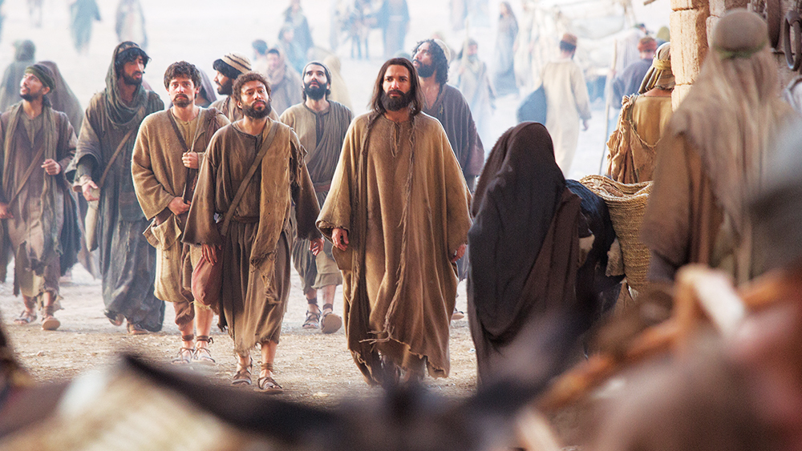
Notes:
Jesus called 12 disciples with divergent political views:
Uneducated, rural Galilean fisherman
Banker/accountant (Judas, who would betray him)
Matthew the Tax collector (traitor)
Simon the Zealot (violent extremist)
And yet, Jesus intentionally chose them and said follow me. And he wants to do that in the church today. He calls people together with divergent views and various opinions about all kinds of things, and wants to create a third way space for us to hear from the Spirit; in the hopes that in that space, we will all over time be challenged and changed, moving toward the center where Christ can be found.
But you might be wondering, how is this possible? How can followers of Christ all across the political spectrum stay together, committed to Jesus and each other, and move toward the center of his will? Well, according to our Lord, it’s through our love and desire for unity. That’s actually one of the last things Jesus prayed for his disciples before his crucifixion. [NEXT SLIDE]

Slide 10
John 17:20-23 NIV
²⁰ “My prayer is not for them [his disciples] alone. I pray also for those who will believe in me through their message, ²¹ that all of them may be one, Father, just as you are in me and I am in you. May they also be in us so that the world may believe that you have sent me. ²² I have given them the glory that you gave me, that they may be one as we are one— ²³ I in them and you in me—so that they may be brought to complete unity. Then the world will know that you sent me and have loved them even as you have loved me.
Notes:
Look at that. Jesus wants the same unity and oneness he shared with the Father, made possible by the Spirit, to be known in his church. And notice that in his mind, if the power of this Trinitarian unity isn’t experienced by his disciples, if they are not brought to complete unity and overcome their differences, the world will not believe in Christ and not know that God’s loves them; that the gospel is greater than all of our sins.
To my knowledge, the only other time that the gospel of John records Jesus saying something like this is a few chapters earlier when he gave his disciples a new commandment to love one another. As we heard last week from John 13:34-35, Jesus said, “A new command I give you: Love one another. As I have loved you, so you must love one another. By this everyone will know that you are my disciples, if you love one another.”
In other words, if we do not love each other with the love of Christ, and if we’re not united in that loyalty and love for the Christ of the gospels, then the flock will scatter and the world will never be able to believe, nor will people see the beauty and wisdom of the power-under Kingdom put on display through the local church. It’s up to us. This is our part. That’s why the Apostle Paul said this in Ephesians 4, verses 2 and 3. [NEXT SLIDE]

Slide 11
“Be completely humble and gentle; be patient, bearing with one another in love. Make every effort to keep the unity of the Spirit through the bond of peace.”
Paul, Ephesians 4:2-3 NIV
Notes:
Friends, the NT teaches that our unity is both a spiritual fact and a spiritual fight. In Romans 15:6, Paul instructed us to pursue unity with one mind and one voice (homothumadon) - with passionate fury, pursue unity in Christ. And don’t make the mistake of thinking that acceptance equals agreement. When we confuse acceptance and agreement, we will tend to withhold acceptance in order to communicate our disagreement. And when we do this, we move away from Jesus and the third way; we move away from the Kingdom.
Remember, if we’re all pursuing Christ together, through love and unity, we can create a third way space for us to come as we are, to be honest, to listen, to be vulnerable, and to be open to the Spirit’s ability to transform our hearts and minds to be more like the heart and mind of Jesus. Not everyone will understand the third way or be interested. Some will even scoff at it. But I suspect that those who have the hardest time accepting Jesus and the third way, or those who are living either on the extreme right or the extreme left. Think about it.
You know, I get it. The third way may not sound as exciting as continuing to live out of our amygdala and the “us vs. them” mindset. But folks, listen to me, while you can raise a lot of money, write a lot of books, and draw a lot of people on the far right and far left… hear me… you can’t solve problems there, you can’t love people well there, and you won’t find Jesus there.
Finally, I want to leave you with some action steps and ways to respond. Because if we don’t do something with this message, we just become hearers and not doers. And if we’re not doing, then we’re not really followers. Amen? [NEXT SLIDE]

Slide 12

Invitation & Response
Ways that we can follow Jesus in the third way:
Notes:
[BRIEF COMMENTS ON EACH POINT]
What is God saying to you? And what are you going to do about it? I hope you will do something.
Because, church, if we don’t follow Jesus and the third way, no one will.
[CLOSING PRAYER]

Slide 13
Invitation & Response
Ways that we can follow Jesus in the third way:
Reflect on ways you’ve trusted in power-over, rather than the power-under way of Christ
Notes:
[BRIEF COMMENTS ON EACH POINT]
What is God saying to you? And what are you going to do about it? I hope you will do something.
Because, church, if we don’t follow Jesus and the third way, no one will.
[CLOSING PRAYER]

Slide 14
Invitation & Response
Ways that we can follow Jesus in the third way:
Reflect on ways you’ve trusted in power-over, rather than the power-under way of Christ
Enter relationships with folks who have divergent views and follow Jesus together
Notes:
[BRIEF COMMENTS ON EACH POINT]
What is God saying to you? And what are you going to do about it? I hope you will do something.
Because, church, if we don’t follow Jesus and the third way, no one will.
[CLOSING PRAYER]

Slide 15
Invitation & Response
Ways that we can follow Jesus in the third way:
Reflect on ways you’ve trusted in power-over, rather than the power-under way of Christ
Enter relationships with folks who have divergent views and follow Jesus together
Use your words and influence to
create third way spaces
Notes:
[BRIEF COMMENTS ON EACH POINT]
What is God saying to you? And what are you going to do about it? I hope you will do something.
Because, church, if we don’t follow Jesus and the third way, no one will.
[CLOSING PRAYER]

