Slide 1
Notes:
[BRIEF INTRO]
This is the second week of our 5-week sermon series, We the Church. The Scriptures tell us that God’s heart is that all would come to know him in all his glory. His plan for accomplishing that mission is to work through disciples who make disciples. God wants us to share his heart in proclaiming the good news of Jesus in word and deed to every man, woman, and child that we encounter in life. And so, this series is intended to stir our imagination for what Jesus can do through us if we will join his Kingdom mission and respond to his calling on our lives to reach others with the gospel.
We begin our series last week with a message called, One Church, One Mission, with a focus on unity… [NEXT SLIDE]

Slide 2
Notes:
[READ EACH POINT & COMMENT]
The Church Growth Mindset focuses on growing our own congregation; But Jesus calls us to be one with other Christians and churches in furthering the gospel in our community
Remember, we’ve defined the gospel this way at Grantham Church… [NEXT SLIDE]

Slide 3
Notes:
[READ DEFINITION & COMMENT]
The gospel is for you; to bring forgiveness, healing, and transformation
But the gospel is also for others (e.g., our family, friends, neighbors, enemies)
Also, the gospel is about the renewal of all creation when Christ returns
In the meantime, we are seeking to become like Jesus as his disciples, and we’re called by Jesus to tell others about him, because he is the only one who can change us, our communities, our nation, and save our world.
And so, we want to respond to this calling by… [NEXT SLIDE]

Slide 4
Notes:
…owning the lostness of the people who live in our area… so that every man, woman, and child has repeated opportunities to see, hear, and respond to the Good News of Jesus Christ. And again, we can’t do this ourselves. In fact, no one church can do this work. We must partner with others who love Jesus and want to see people’s lives changed by Christ. And as I said last week, that’s what the Capital Region Gospel Partnership is all about.
Brothers and sisters, underneath this concern and the motivating force of this gospel mission is the most fundamental and basic conviction, as the old song goes: “People need the Lord.” And why do people need the Lord? [BRIEF COMMENTS]
My friends, without the transformation of the heart of a person, which can only happen through Christ, we cannot see lasting change in ourselves or in our world. We will not see God’s Kingdom come, his will be done, on earth as it is in heaven.
Therefore, that’s the focus of this second message… [NEXT SLIDE]

Slide 5
Notes:
Transformation. The aim of the gospel is to first and foremost transform individuals who embody the character and the competencies of Jesus. And the inevitable result will be the transformation of our church, our community, and our world. When our own life is being transformed by Jesus, we will want nothing more than to see others experience the same kind of life-giving change. So, how does this transformation really happen? And what we must do to become like Christ, so that we are then motivated to go and tell others about Jesus? That is what we’re giving attention to this morning.
[BRIEF PRAYER]
Have you ever looked at a picture of yourself when you were younger and wondered, “Who is that? Where did that person go?” Maybe the days of a full head of hair have passed you by or new wrinkles have replaced your formerly smooth, tight skin. Or, even more noticeably, your body doesn’t quite look like your 18-year-old self who was in shape and ready for the beach! We can be assured that if we live long enough, our exterior will change. But what about our interior life? Does it change the same way?
[STORY OF MY OWN TRANSFORMATION]
What if I told you that the ongoing purpose of the gospel is to change your inner life beyond comprehension? Does that sound like an overstatement? I’d like to show us in this message that it’s not. Our main Scripture reading is found in the book of Romans… [NEXT SLIDE]

Slide 6
Notes:
The Apostle Paul wrote this letter to his fellow Christians in Rome where he does his best, as a former Pharisee, to explain the good news of Jesus, how Christ fits into the story of Israel, and to describe the effect that the gospel has on our lives today.
In what is arguably the densest theological material we have in the Bible, Paul takes his readers on a mountaintop tour of the gospel in Romans chapters 1-11. He shares how God’s righteousness overcomes our guilt as sinners; that we are justified by faith (not by works), giving us a new status, family, and future; where previously we were in the “Old or First Adam”, we are now in Jesus, “The New or Second Adam” (God’s way of being human); and how the Law was insufficient, so Jesus fulfilled the law and wrote it on our hearts by the Spirit of God living in us. And finally, that Jesus completes what Israel could not accomplish, and that he now fulfills God’s promise to all who put their faith in him.
And after straining to describe the gospel that is so deep, and almost inexplicable, he takes a turn to the practical outcome: the transformation that occurs because of the good news. Let’s look now at Romans 12:1-2… [NEXT SLIDE]

Slide 7
Notes:
[READ PASSAGE & THEN COMMENT VERSE-BY-VERSE]
v. 1 – “plead” with or “appeal” to you; living a transformed life is just too urgent to categorize it as interesting or optional; “give/offer your bodies” to God “in view of his mercies” (NIV), meaning it’s not our efforts that brings transformation, it’s his mercy and compassion for us; Our transformation comes by responding to his love for us!
Church, there is no amount of human resolve that compares when we understand how deeply we are loved. Pride breeds selfish agendas - being humbly loved breeds change. When the motivation for transformation is found in the love and compassion God has for us, we begin to cooperate with his process at increasing levels. Paul says let your bodies be “a living and holy sacrifice” for God. One of the profound ironies in offering our bodies as a
living sacrifice is found in the very essence of the term “living sacrifice.” Sacrifices are lifeless yet, as followers of Christ, we are called to present our living bodies as sacrifices. That is what real worship looks like: Being transformed by God and offering him your life.
This is a paradox, a beautiful contrast that reveals the transformative power of God’s grace. Instead of ending our lives, God invites us to a life of sacrifice for His glory. It’s not about ceasing to exist; it’s about existing with greater purpose and significance. By offering our living selves to God, we acknowledge that every breath, every step, every action, and every thought can be devoted to His service, embodying a continual act of worship and devotion that transforms the mundane into the sacred. In this paradox, we find that in losing our lives for Christ’s sake, we truly find life in all its fullness.
And then in verse 2… the NIV says, “‘Do not conform to the pattern of this world…” Obviously, the ultimate standard and pattern for living is not this world. So, don’t just mimic what the world is doing. Don’t react and respond the way the world does. Don’t give into the extremes. Don’t think you have to choose between a left or right political narrative? When in Rome, don’t do as they do and speak like they do if it’s antithetical to Christ and the gospel.
But of course, how will you know the difference if you’re not letting God transform you in the secret… in the quiet place; if you’re not regularly experiencing God’s love for you or daily allowing the Spirit to chisel off the rough edges of your soul, attitude, and behavior through prayer and spiritual disciplines. How can you know God’s will—his good and pleasing and perfect will—if you’re not resisting your flesh but rather rushing off to do good in the world without first surrendering your heart and mind to the Christ who knows all and see all?
You see, as Paul says, you must “let God transform you into a new person” and that happens by allowing God to transform your thinking. Starting with the thinking that you can transform yourself. Instead, this transformation happens through the recognition that without Christ, you can do nothing. Remember that’s what Jesus said… [NEXT SLIDE]

Slide 8
John 15:5 NIV
“I am the vine; you are the branches. If you remain in me and I in you, you will bear much fruit; apart from me you can do nothing.”
Notes:
[READ SCRIPTURE & COMMENT]
Jesus is using the metaphor of a tree and branches to us to remain in relationship with him; he is the source of all life and the one who causes us to bear fruit.
And not the fruit of the flesh, but that of the Spirit of God. Paul said it this way in Galatians 5… [NEXT SLIDE]

Slide 9
Paul, Galatians 5:19-25 NLT
¹⁹ When you follow the desires of your flesh, the results are very clear: sexual immorality, impurity, lustful pleasures, ²⁰ idolatry, sorcery, hostility, quarreling, jealousy, outbursts of anger, selfish ambition, dissension, division,²¹ envy, drunkenness, wild parties, and other sins like these. Let me tell you again, as I have before, that anyone living that sort of life will not inherit the Kingdom of God.
²² But the Holy Spirit produces this kind of fruit in our lives: love, joy, peace, patience, kindness, goodness, faithfulness, ²³ gentleness, and self-control. There is no law against these things! ²⁴ Those who belong to Christ Jesus have nailed the passions and desires of their flesh to his cross and crucified them there. ²⁵ Since we are living by the Spirit, let us follow the Spirit’s leading in every part of our lives.
Notes:
[READ & COMMENT ON PASSAGE]
And so… how do we remain or abide in Christ so that we can experience transformation? Or put another way, since it’s the Spirit that bears the fruit of change in us, what’s our role in participating with the Lord in our own transformation? [NEXT SLIDE]

Slide 10
Notes:
[READ & COMMENT ON EACH POINT]
Surrender to Christ and his purpose and plans for your life (the posture of a disciple: deny yourself & carry your cross)
Stay connected to Jesus via spiritual disciplines (e.g., regular prayer, Bible reading, fasting, worship, etc.)
Prioritize inner transformation in your Christian journey (service & good works should flow from a relationship with Christ)
Work the spaces -- public, social, personal, and intimate (disciples are formed in relationship with other disciples)
Here is a fresh image of the spaces to help us envision transformation… [NEXT SLIDE]

Slide 11
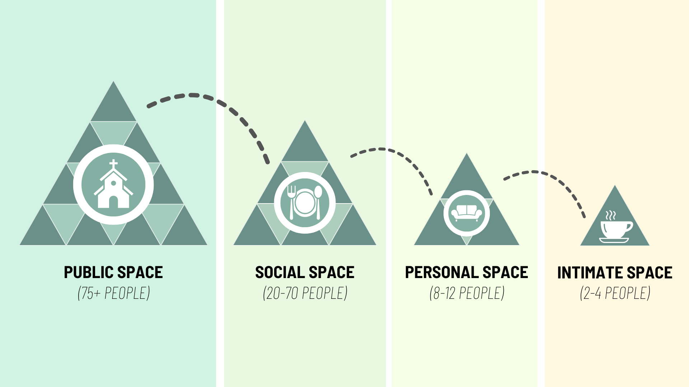
Notes:
[COMMENT ON SPACES GRAPHIC]
The spaces represent the various ways we can engage in the life of the church and grow in our faith, but notice that Jesus calls his disciples to go deeper in our relationships
And it’s in the personal and intimate spaces that we have opportunities to engage in conversation with other disciples about where we are in our walk with Christ; to ask questions, to confess sins, to hold each other accountable, to pray for one another, to share each other’s burdens, and to experience Jesus in close-knit community
It’s in the personal and intimate spaces where we can say to each other things like, “God is saying this to me… and I know that I need him to transform my heart on this” or “I need you all to pray for me because I’m struggling with… [fill in the blank].” Whether it’s a small group, a bible study, or an intimate meeting among friends, it’s a space where we can be real with each other an invite the Holy Spirit to transform us into the image of Christ.
One way we’re doing that at Grantham is through an intimate space ministry called Intentional Discipleship Groups. And I’d like to invite Pastor Melissa to say more about that and talk with a participant in one of those groups… [NEXT SLIDE]

Slide 12
Notes:
[PASTOR MELISSA & KIRK CONVERSATION]
[PASTOR DAVID RETURNS]
Finally, here are some questions to help us reflect and respond together… [NEXT SLIDE]

Slide 13
Notes:
Questions

Slide 16
Notes:
[READ & BRIEF COMMENT ON EACH QUESTION]
Am I prioritizing inner transformation? Are my words, actions, and service to others flowing out of a real relationship with Jesus?
Am I staying connected to Jesus through spiritual disciplines? What can I do today to invest more in my relationship with Christ?
How is the Spirit calling me to go deeper with Jesus and other disciples at Grantham in the personal and intimate spaces?
[NEXT SLIDE FOR CLOSING PRAYER]

Slide 17
Notes:
[CLOSING PRAYER]
Benediction
Brothers and sisters, God wants us to share his heart by embodying and proclaiming the good news of Jesus to every man, woman, and child that we encounter in life. Therefore, let us go into the world and make disciples who make disciples. May the Holy Spirit empower you to carry out the mission we’ve been give to lead others to the God who looks like Jesus. In the name of the Father, and the Son, and the Holy Spirit. Amen.

