Slide 1
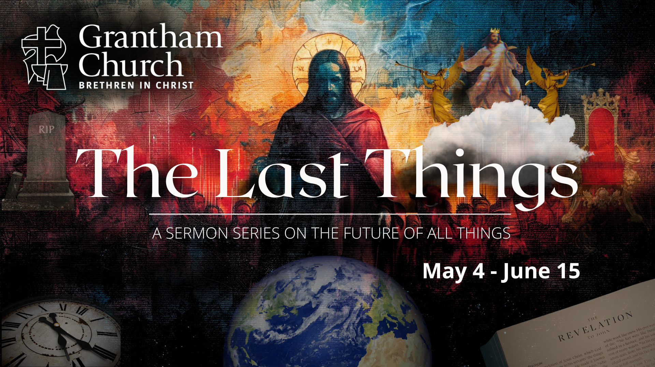
Notes:
[BRIEF WELCOME & INTRO]
Last Sunday we concluded our 7-week sermon series, The Last Things. In that series we looked at what is known in Christian theology as the eschaton… [NEXT SLIDE]

Slide 2
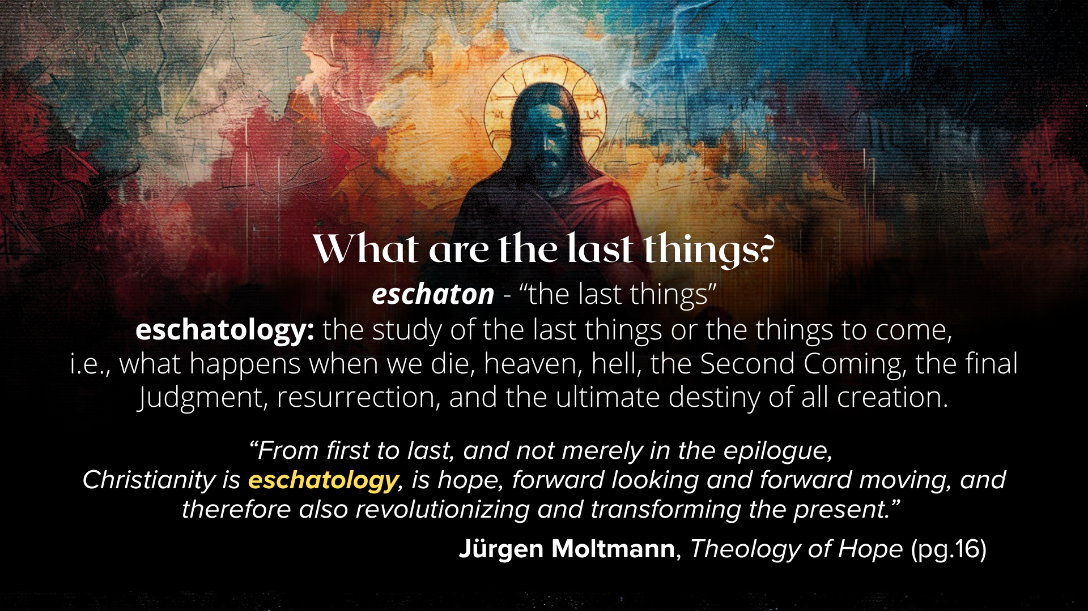
Notes:
[READ SLIDE & COMMENT]
So, in The Last Things series we saw how God is guiding all of human history to its divinely intended goal. And from a 30,000-foot view, this is what that looks like… [NEXT SLIDE]

Slide 3
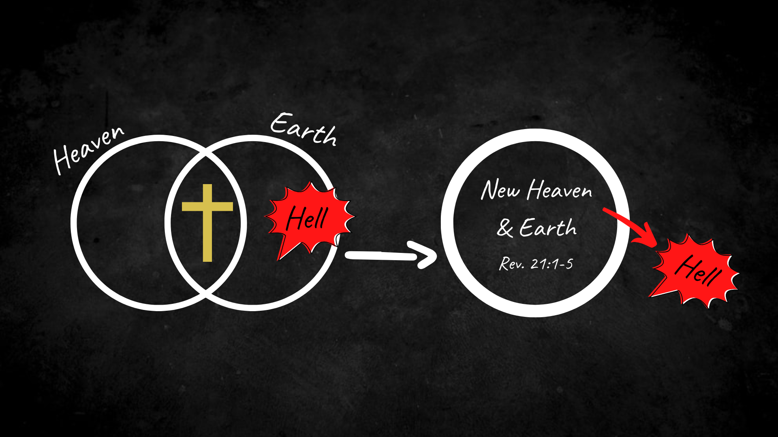
Notes:
The Bible teaches that…
Heaven and earth are two spheres or dimensions; God’s space and our space overlap and interlock; these spaces have experienced a break from each other, but it will be restored
Again, in the crucified and resurrected body of Jesus, we see heaven and earth coming together; and we heard from Jesus and his first disciples that he has defeated sin and death, and is driving it out of God’s good creation
Therefore, upon the return of Christ, God will fully consummate these realms, marry heaven and earth, resurrect and renew the cosmos, and cast out sin, death, and hell forever. This is the divine movement and ultimate trajectory of all things.
In a timeline, it looks like this… [NEXT SLIDE]

Slide 4
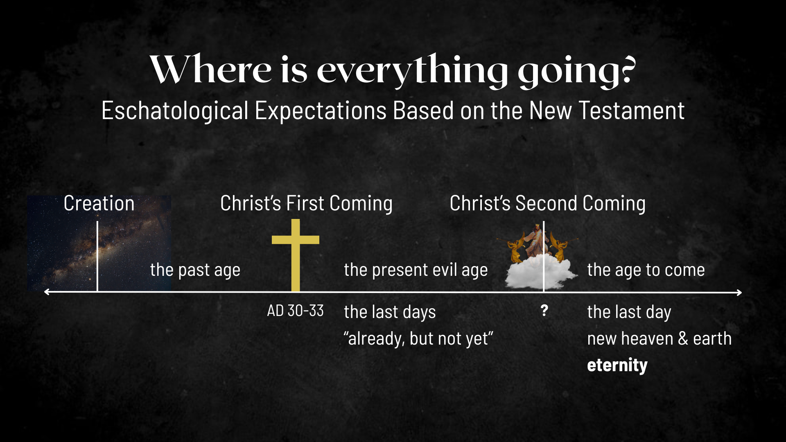
Notes:
Based on the New Testament…
Jesus’ first coming split our historical timeline (the past age & the present evil age)
And according to the Scriptures, since the life, death, and resurrection of Christ, we’re living in the “last days”; we live in the ”already, but not yet” of the Kingdom of God; and so, we live in the overlap of the present evil age and the age to come.
And while there is currently a struggle between the forces of good and evil in the overlap of these ages, it’s through the gospel of Jesus that we can know that the decisive battle has been won, the victory is certain, and God’s good future is secure.
Therefore, we’re called to live as disciples of Jesus as we eagerly await his return or ”second coming” when this present evil age comes to an end, God raises the dead, brings heaven to earth and we fully enter eternity in the new heaven and earth.
And so it’s fresh on our minds this morning, here is a summary of what the Scriptures teach about the last things… [NEXT SLIDE]

Slide 5
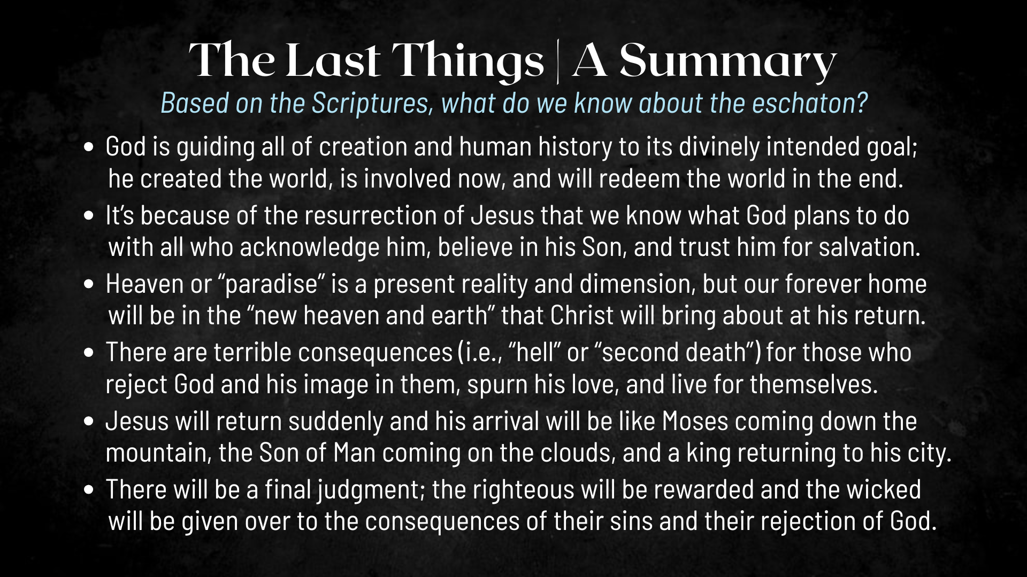
Notes:
[READ EACH POINT & COMMENT]
And it’s no surprise that this 7-week sermon series generated some questions from our congregation. A few weeks ago, I told that you that we would create some space to respond to those questions, and so that’s what we’re going to do this morning… [NEXT SLIDE]

Slide 6
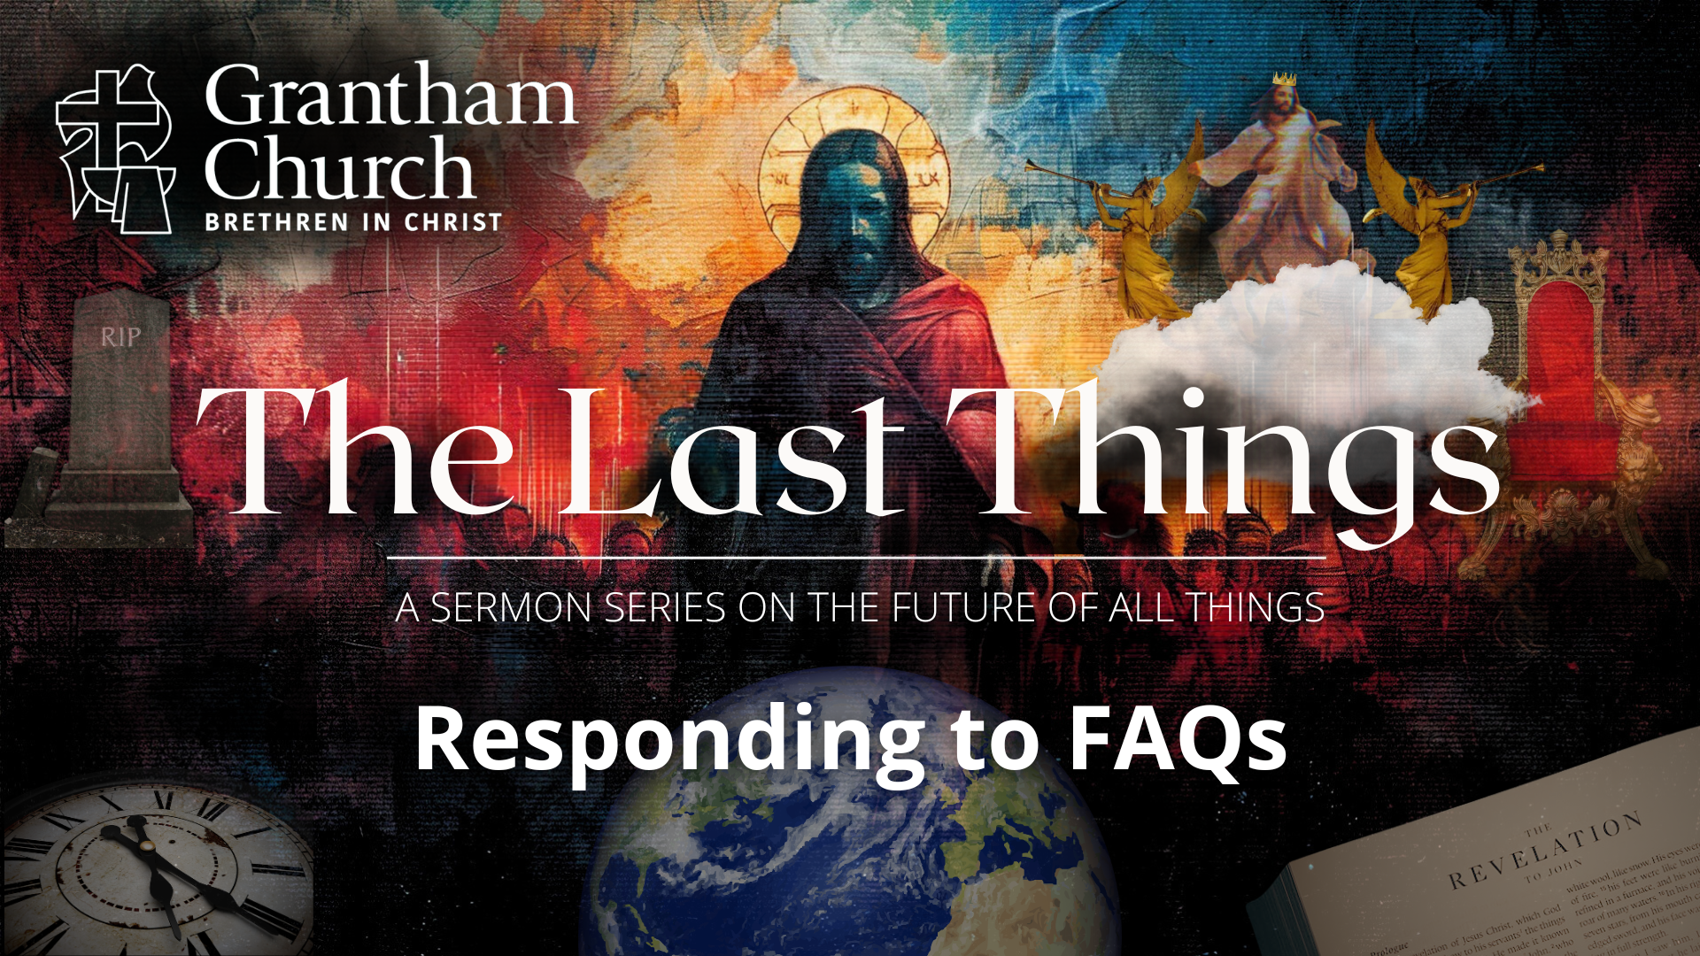
Notes:
I received emails from around a dozen folks (in and outside our church) who have followed this series and asked me to respond to their questions. And so, I have prepared a message to respond to the 5 most frequently asked questions, plus 2 other questions that I thought were worth addressing and sharing my response with all of you.
But before we begin… let’s go to God in prayer. [BRIEF PRAYER]
Question #1… and the one I received the most… [NEXT SLIDE]

Slide 7
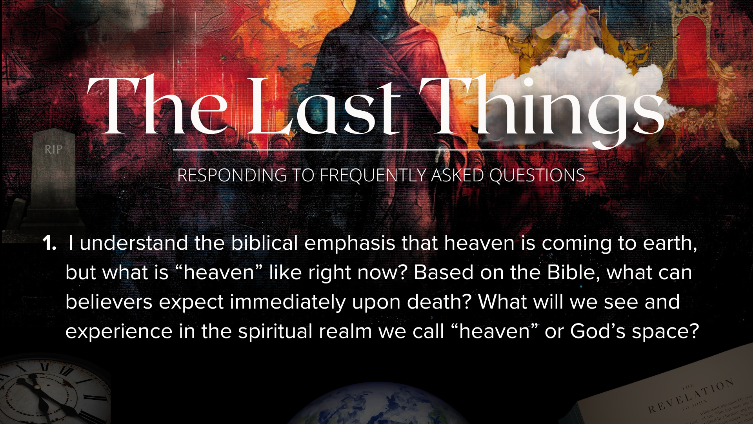
Notes:
[READ QUESTION & COMMENT]
Well, “Based on the Bible” we don’t know a lot; the emphasis of the Scriptures is “new heaven and earth” and not on what happens upon death
As I shared in the third message, Life After Death: Rethinking Heaven…
Jesus mentions ”paradise” to the thief on the cross
In Revelation chapters 4-5 (throne room); chapters 21-22 (New Jerusalem)
In 2 Cor. 12:1-4, Paul said he was caught up into paradise or the “third heaven” (likely a NDE after being stoned in Lystra—Acts 14:19-20); he said that words can’t express what he saw there
Which is why I shared the serious research that has been done on near-death experiences. 1 in 25 people have experienced one; that’s 13 million Americans.
I recommended a couple books to you earlier in the series, including the book, Imagine Heaven, by John Burke. [NEXT SLIDE]

Slide 8
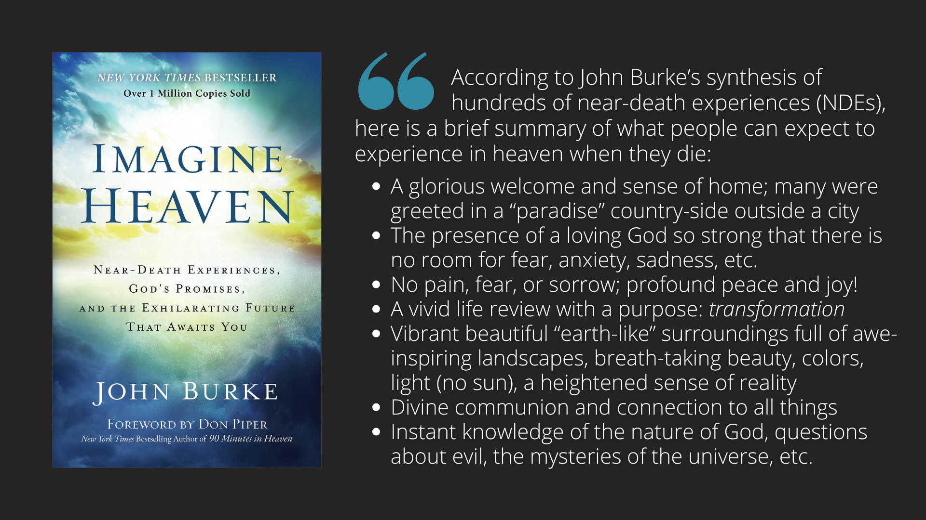
Notes:
[READ SLIDE & COMMENT]
My friends, when you take into account all of the common elements of NDEs, which we looked at in week 3 (and that they’re all uniquely tailored for the person) I think there is plenty of reason to believe that these people experienced something extraordinary that can’t be explained through materialistic science. And so, I’m persuaded that those NDEs that appear to be consistent with the Scriptures can give us insight into what happens when we die and serve as a deep source of encouragement and hope about things to come.
As Paul wrote in 1 Corinthians 2:9:
“What no eye has seen,
what no ear has heard,
and what no human mind has conceived”—
the things God has prepared for those who love him”
Question #2… [NEXT SLIDE]

Slide 9

Notes:
[READ QUESTION & COMMENT]
In Matthew 22:23-33, the Sadducees try to make Jesus look stupid
Seven brothers died. Whose wife will she be in the resurrection?
Jesus said, there will be no marriage; we will be like the angels in heaven
This implies that the institution of marriage, as it exists for companionship, procreation, and covenant in this life, will not exist in the same form in eternity.
In Ephesians 5:31-32, Paul indicates that earthly marriage is temporary, pointing forward to the ultimate union between Christ and His people.
In the Kingdom come, all relationships are redeemed, but the form and function of human marriage is transcended by a deeper communion with God and all of creation.
In his book, Imagine Heaven, John Burke writes: “People often ask me, ‘Will I be married in Heaven? What if I’ve been married more than once?’ Jesus said there will be no marriage in Heaven like on earth... but that doesn’t mean you won’t know your spouse or have a relationship. In fact, according to NDE accounts, the love and connection people experience in Heaven with others—including spouses—is far deeper and purer than earthly love.”
Burke goes on to say: “Several people who had been married more than once reported encountering both spouses in Heaven. There was no awkwardness, no jealousy, only complete love, peace, and mutual joy in each other’s presence. The relationships were not exclusive but were part of a much larger relational unity and wholeness in the presence of God.”
For those who enter the Kingdom of God in the age to come, it’s not longer about exclusive human roles or attachments, but about complete transformation of our relationships through divine love. What once was defined by human needs or conditions (like marriage for companionship or survival) becomes transcendent communion with God and others.
Now, if you’re like me and this isn’t entirely comforting, let us remember the words of Paul who said, “For now, we see only a reflection as in a mirror; then we shall see face to face. Now I know in part; then I shall know fully, even as I am fully known” (1 Cor. 13:12).
Question #3… [NEXT SLIDE]

Slide 10
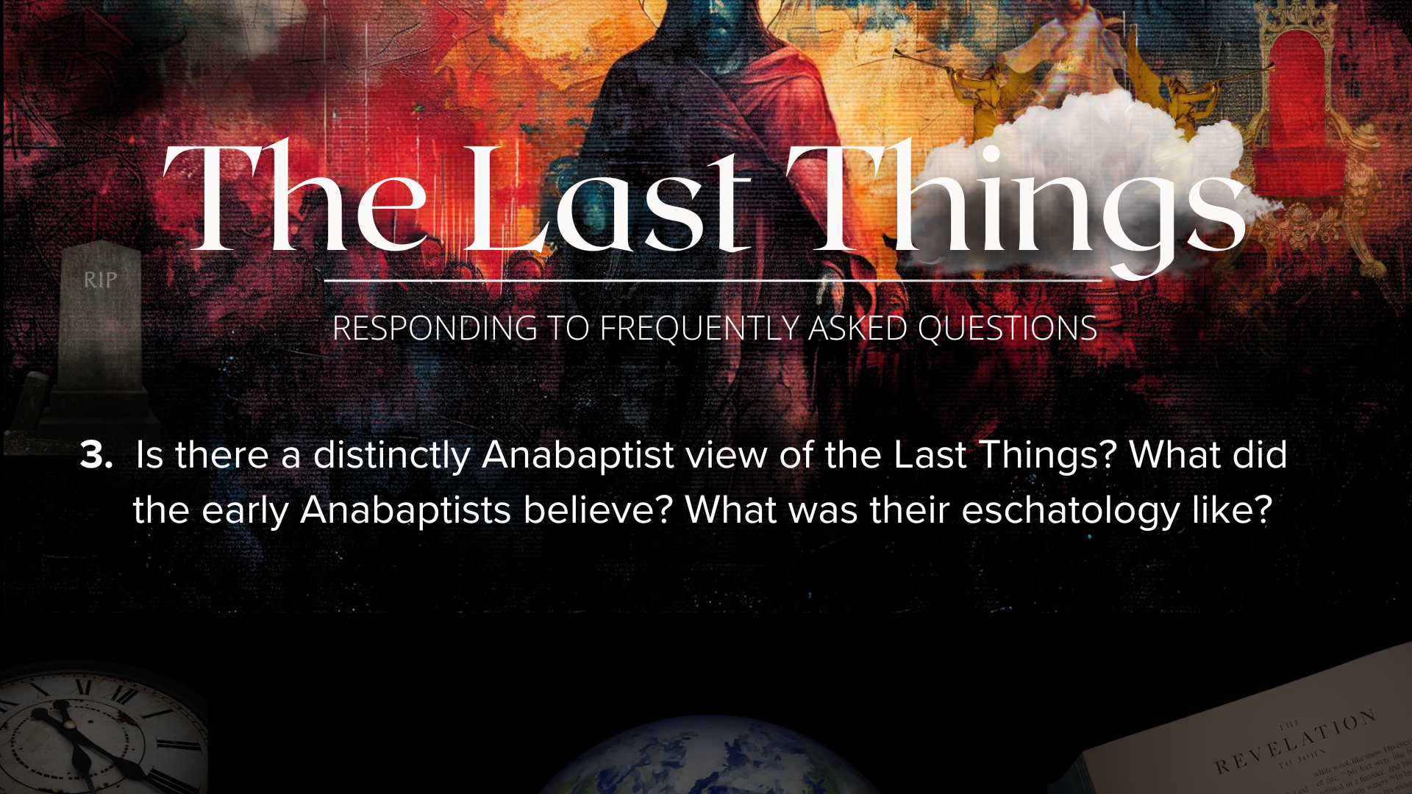
Notes:
[READ QUESTION & COMMENT]
As I said last week, Grantham Church is part of the Brethren in Christ denomination, which comes out of the Anabaptist tradition of the 16th century, during the Reformation.
Anabaptism began as a radical reform movement that called for a return to the centrality and supremacy of Christ and a strict obedience to the teachings and living of Jesus
Distinctives of Anabaptism include serious attention to the Sermon on the Mount and discipleship, being peacemakers, embracing non-violence, simple living, living in close-knit community as a church, and interpreting the Scripture through the lens of Christ.
So, what did the Anabaptists believe about the Last Things? [NEXT SLIDE]

Slide 11
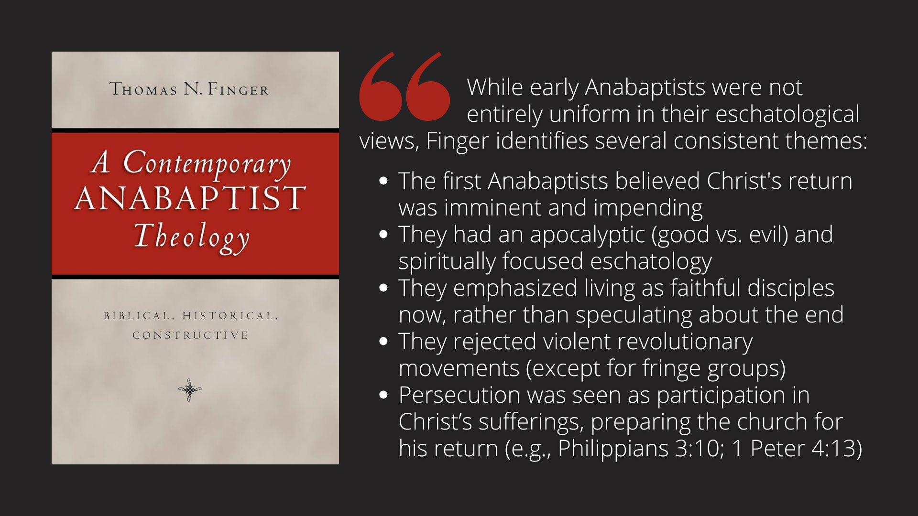
Notes:
[READ SLIDE & COMMENT]
I love how the Anabaptists kept this stuff simple; Christ is coming soon, are you living for him? Are you willing to die for him? Are you telling others about him?
Question #4… [NEXT SLIDE]

Slide 12
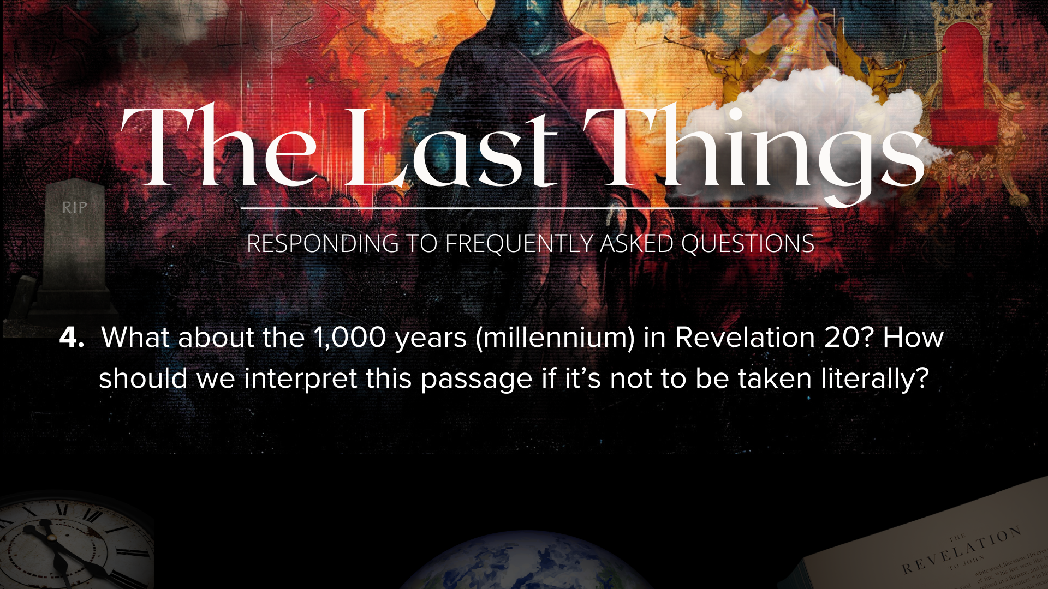
Notes:
[READ QUESTION & COMMENT]
Revelation 20, particularly verses 1-10, describes:
Satan being bound for 1,000 years.
The reign of Jesus and the saints during this millennium.
And then Satan's release and final defeat.
Many of us were taught to read this passage literally: after the rapture and 7-year tribulation, Christ would come again to reign on the earth in its present state, and Satan will be bound and unable to do anything during that time; and at the end of the 1,000 years, Satan is released for a final battle where evil is destroyed forever
At this point, it shouldn’t be a surprise that I don’t hold that view. Rather, I would encourage us to see the “millennium” in Rev 20 as a symbolic period, not a literal 1,000-year reign on earth. It represents the current age of Christ’s rule from heaven, inaugurated at the resurrection and continuing until His return. Therefore, Satan is currently bounded by Christ’s power in this age, though not powerless; And so, Satan’s “release” and final rebellion symbolize a final intensification of evil before Christ returns.
If you’d like to study and understand Revelation better from the perspective of the first century audience, I’ve recommended two books to you… [NEXT SLIDE]

Slide 13
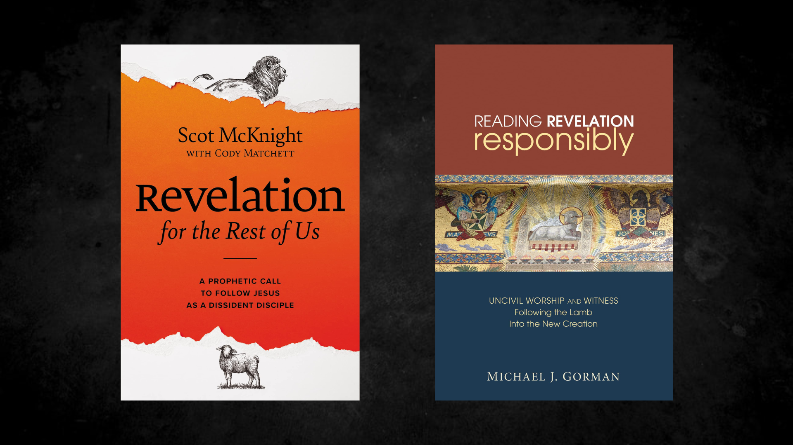
Notes:
[READ PASSAGE & COMMENT]
“Revelation for the Rest of Us” by Scot McKnight
”Reading Revelation Responsibly” by Michael Gorman
And if you’d like to go verse-by-verse, check out our own John Yeatt’s commentary on Revelation from the Believers Church Bible Commentary set (see the church library)
Let’s go on to question #5… [NEXT SLIDE]

Slide 14

Notes:
[READ QUESTION & COMMENT]
Well,, first we need to begin by recognizing the exclusivity of Christ for salvation, as the New Testament is quite clear about. For example:
In John 14:6, Jesus said, ”I am the way and the truth and the life. No one comes to the Father except through me.”
In Acts 4:12, Peter said, "Salvation is found in no one else, for there is no other name under heaven given to mankind by which we must be saved.”
In 1 Timothy 2:5, Paul said, "For there is one God and one mediator between God and humankind, the man Christ Jesus.”
And in 1 John 5:11-12, John wrote: "God has given us eternal life, and this life is in his Son. Whoever has the Son has life; whoever does not have the Son of God does not have life."
But what about the “good” lost person and those who haven’t heard? [NEXT SLIDE]

Slide 15
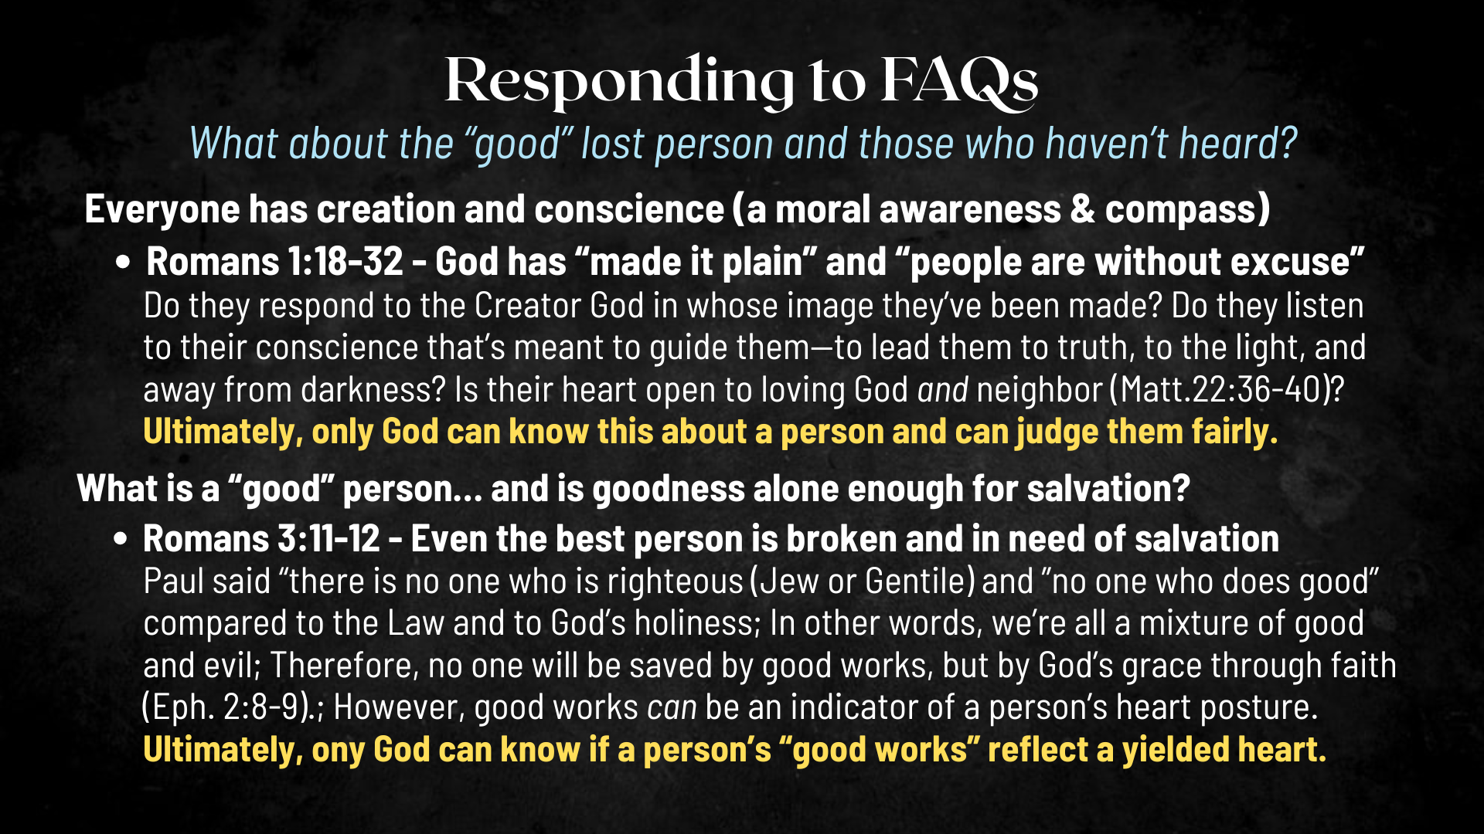
Notes:
[READ SLIDE & COMMENT]
But what about those who claim the name of Christ and believe they are saved, yet don’t obey Christ? Will they make it into the Kingdom? Well, we’ve already looked at Matthew 25 in this series, where Jesus separates sheep from goats—a sobering passage that reminds those who don’t take Jesus’ call to discipleship seriously that they’re walking on thin ice.
Now let’s consider this parable told by Jesus a few chapters earlier in Matthew… [NEXT SLIDE]

Slide 16
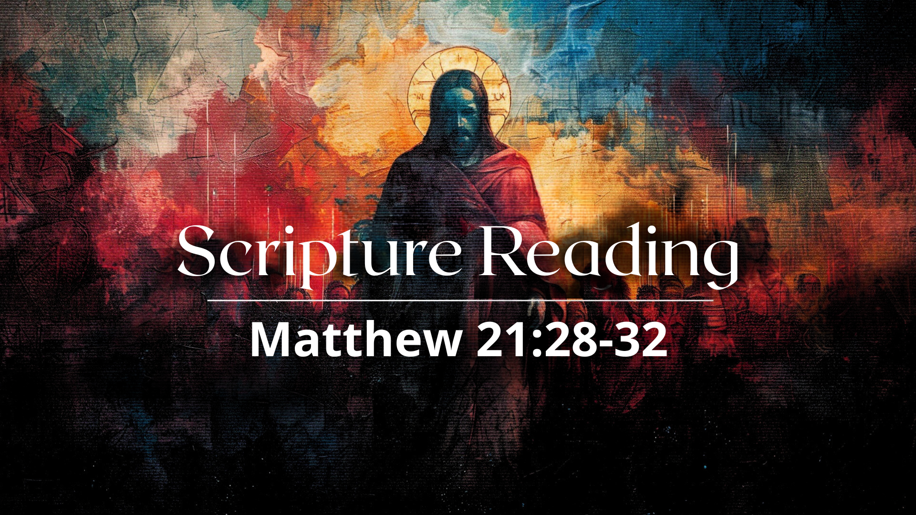
Notes:
In Matthew 21:28-32, Jesus tells the Parable of the Two Sons. One son first said “no” to obeying his Father by working his vineyard but then changed his mind late in the day; the other son said “yes” to the Father but didn’t do the work; he wasn’t faithful. The parable ends with Jesus saying to the religious leaders: “Truly I tell you, the tax collectors and the prostitutes are entering the kingdom of God ahead of you. For John the Baptist came to you to show you the way of righteousness, and you did not believe him, but the tax collectors and the prostitutes did. And even after you saw this, you did not repent and believe him.”
Clearly, Jesus is telling those who believe they are “chosen” and claim to know and belong to God that if they do not obey and do what he says, they stand condemned already. And he is also saying… and don’t miss this… that you and I might be quite surprised who makes it into the Kingdom before those who appear to be religious. So, at the end of the day, here is what we need to know: (1) God is loving, merciful, and good. And he will do everything in his power to save those who want to be (so we can trust him to do what is right); and (2) we have a responsibility in sharing our faith and this good news of Jesus with others.
Lastly, let me just say this… there simply are no easy answers to this question and ultimately God's judgment is beyond human comprehension. While Jesus is the only way to salvation, we can also trust that God's judgment is fair and just, and he will take into account the circumstances and opportunities available to each individual. And so, remember, he is the Judge, we are not. We have one job and one job only, and that is to live in love as Christ loves us and gave himself for us. Amen? God will take care of the rest. Question #6… [NEXT SLIDE]

Slide 17
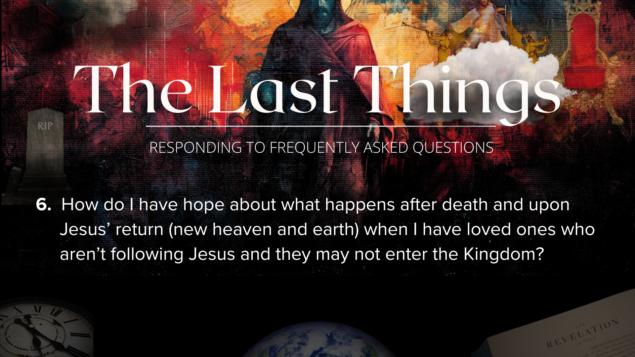
Notes:
First, we all need to be reminded that our loved ones or friends that don’t know or aren’t following Jesus… are loved far more by God than by us… more than we can possibly imagine. So, if you have a heavy heart at the the thought of someone being lost forever, then magnify that at least three God-sized times for the Father, Son, and Holy Spirit.
Secondly, if we have loved ones that have rejected God at their core, said no to the real Jesus, who have loved evil rather than the good, and have entered into a dehumanization process even now, and they die and enter into hell, there will come a time (in my understanding of Scripture) that they will undergo a second death and all things that would bring us pain or sorrow (including thoughts of those who have rejected the God who made them) will be no more. And for us who enter the new heaven and earth, the love of God will be so all-consuming that there will be no room in our hearts and minds for anything else but the love, peace, and joy of knowing that God is finally in all and living through all.
And thirdly, once again, this should prompt us to see the urgency in sharing the good news with the lost. I want to encourage us to sit with the thought of the lost (rather than brush it away) until it motivates you to action. Because salvation is found in Christ alone and we’re called to share that with others. Listen to what Paul wrote in Romans 10:9-15… [NEXT SLIDE]

Slide 18
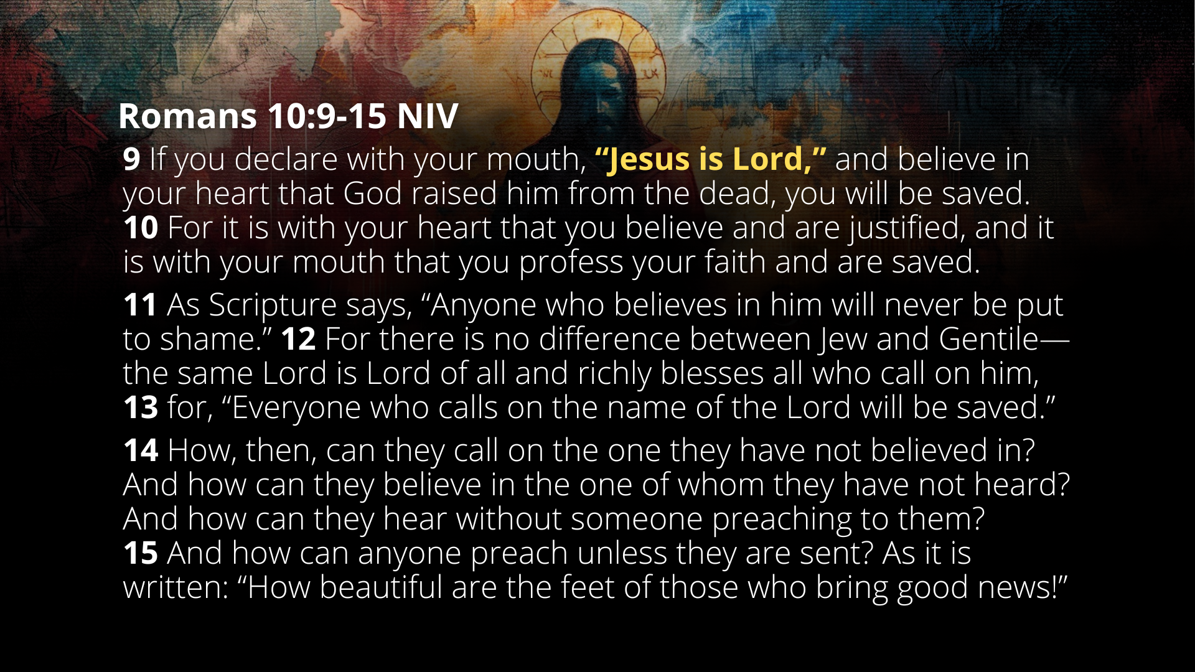
Notes:
[READ PASSAGE & COMMENT]
Finally, and this is a great segway, and a fitting conclusion, to the final question… Question #7... [NEXT SLIDE]

Slide 19

Notes:
[READ QUESTION & COMMENT]
Let’s look at those verses together… [NEXT SLIDE]

Slide 20
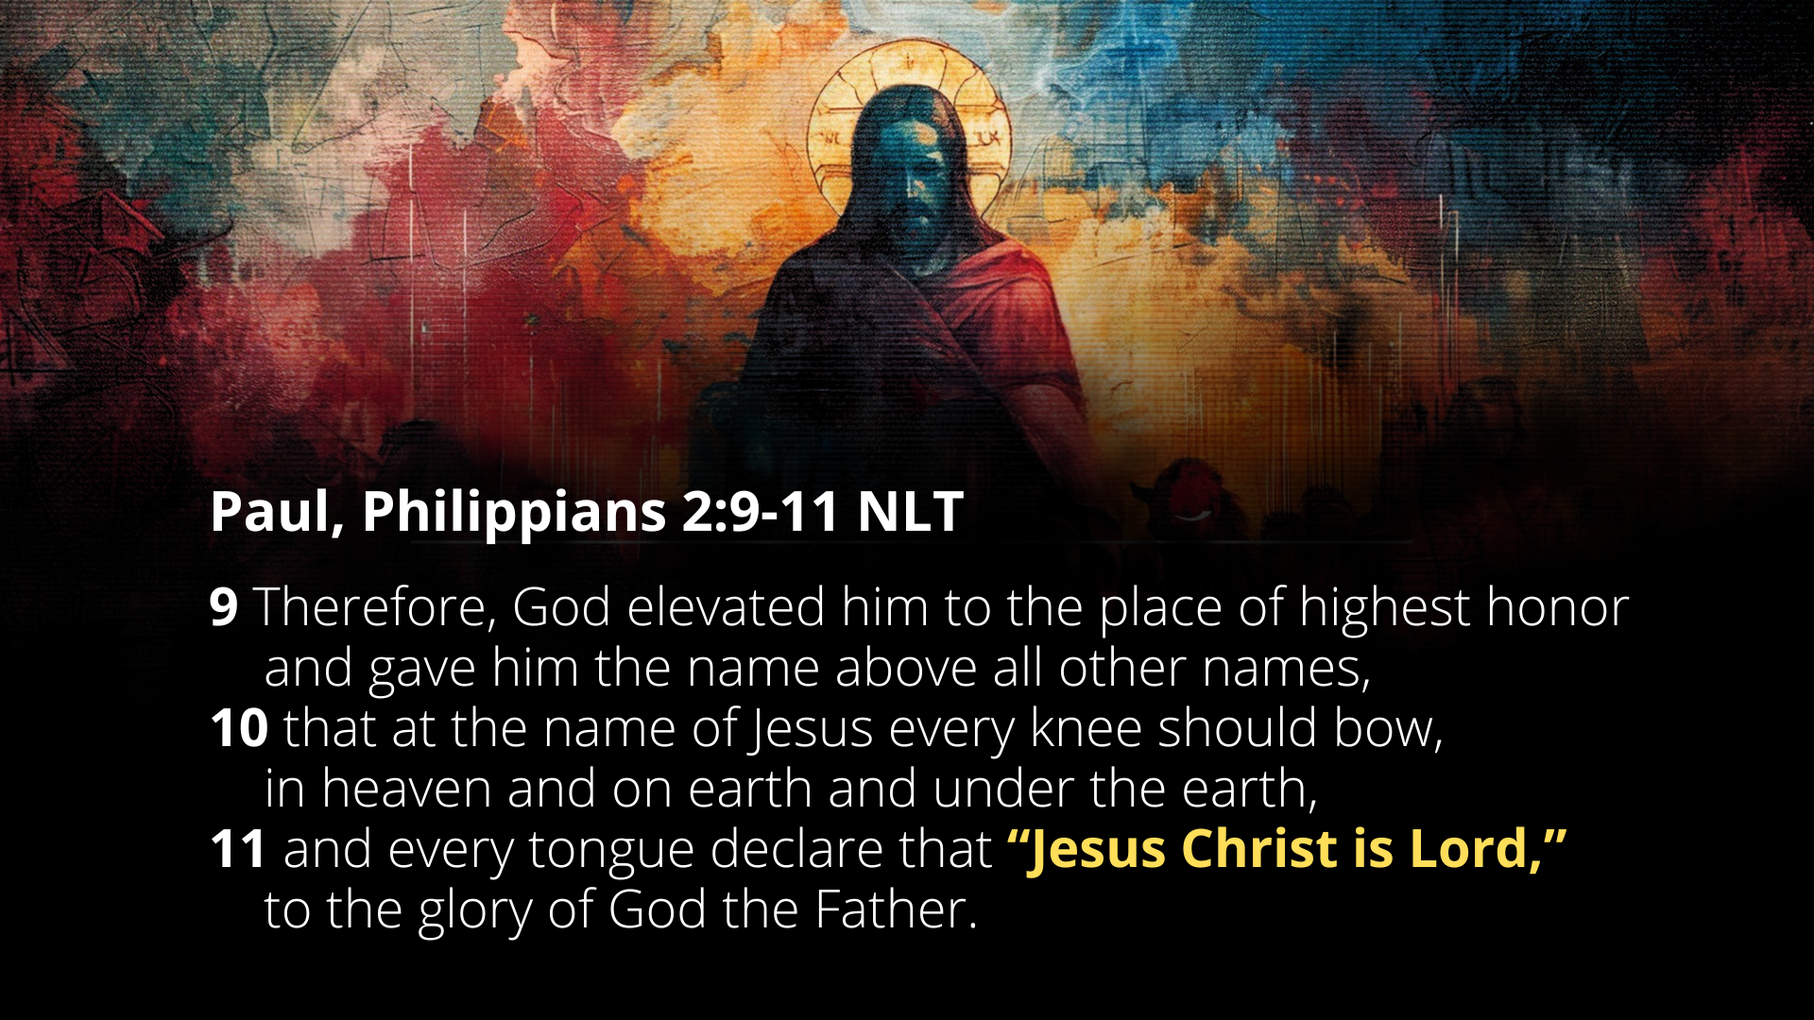
Notes:
Brothers and sisters, to say that “every knee will bow… and every tongue confess that Jesus Christ is Lord” is a profound Christological and eschatological claim. What does Paul mean? He is drawing directly from Isaiah 45:23, where God says, “to me every knee shall bow.” By applying this to Jesus, Paul is identifying Jesus with the God of Israel and asserting that Jesus is now sovereign over all creation, including both heavenly, earthly, and underworld powers. Jesus is not just exalted above others; he is now enthroned as the one true Lord.
This is not a private religious truth, but a public, cosmic, political one — “Jesus is Lord” stands in contrast to the Roman confession that “Caesar is lord.” Some first century believers would have been put in the difficult position: to confess “Caesar is lord” or face the consequences. And here, Paul is saying that a day is coming when that will get turned around on all of humanity. Every knee bowing and every tongue confessing speaks to a universal recognition of Jesus’ Lordship — willingly or unwillingly. All will bow and all will confess the cosmic truth. All people will, one way or another, acknowledge that Jesus Christ is Lord and God.
And the invitation through The Last Things series and this message today… is that we would all do that on this side of eternity. So, how is the Spirit speaking to you?
[CLOSING WORDS]
As Paul told the Romans, “May the God of hope fill you with all joy and peace as you trust in him, so that you may overflow with hope by the power of the Holy Spirit.”
Let’s pray… [NEXT SLIDE]

Slide 21
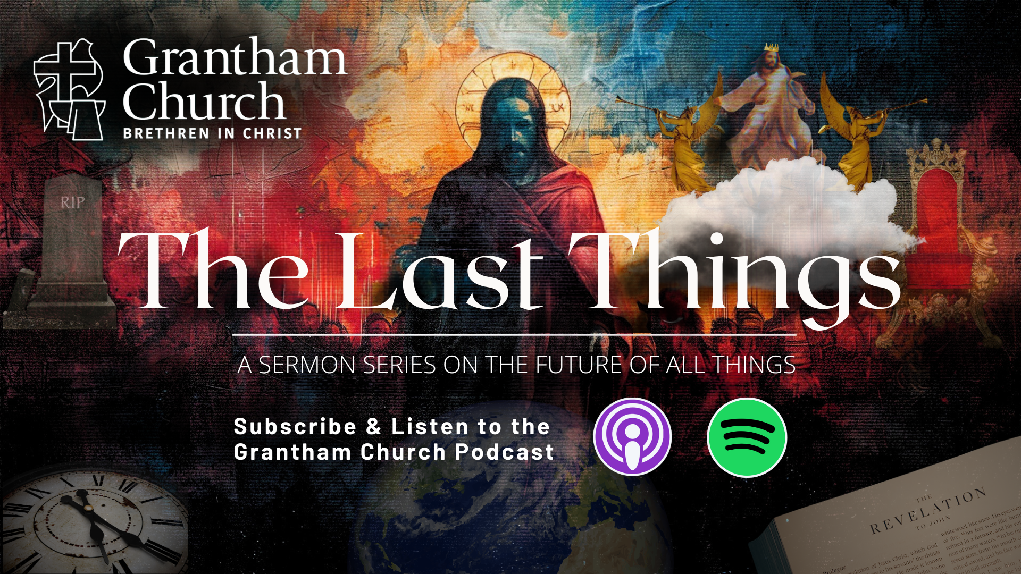
Notes:
[CLOSING PRAYER]
[CLOSING SONG]
[ANNOUNCEMENT – NEXT SUNDAY] – Pastor Melissa
Benediction
Church, may our sovereign God fill you with peace as you look to the future with faith, not fear. May the promise of resurrection and eternal life anchor your soul in times of uncertainty and give you hope. And may you live in light of the last things with confidence that Christ will return and bring heaven to earth. Until we gather again, go in peace, church, to love and serve the Lord. Amen.

