Slide 1
Notes:
[BRIEF WELCOME & INTRO]
This morning we are continuing our series, The Last Things – a 7-week sermon series on the future of all things. This is the second message in the series.
Last week I shared that the ”last things” comes from… [NEXT SLIDE]

Slide 2
Notes:
[READ SLIDE & COMMENT]
Again, why does Christian eschatology matter and why are we doing a series on it? Well, here are some reasons that I asked us to consider last week… [NEXT SLIDE]

Slide 3
Notes:
It matters because…
It helps us to know God’s story and our part in that story.
It guides us and keeps us from living by a false story.
It keeps us focused on the gospel and the mission of the church.
It deepens trust in God, produces hope, and holds us to a biblical worldview when the world is falling down around us.
For those in Christ, it says that we do not need to fear the future.
It assures us that God will judge sin, death, evil, and injustice.
It reminds us that God is guiding all of history to its completion.
Or as the theologian George Eldon Ladd said, “God is King and acts in history to bring history to a divinely directed goal.”
And here is that that divinely directed goal in a single image… [NEXT SLIDE]

Slide 4
Notes:
[EXPLAIN GRAPHIC]
Heaven and earth: two spheres or dimensions; God’s space and our space overlapping and interlocking; in the OT we see this reflected in the Temple; in the NT we see this in Jesus (the true Temple)—his life, his miracles, healings, and most clearly in his death and resurrection
In his resurrection body, we see heaven and earth coming together; and we heard from Jesus and his first disciples that he has defeated sin and death, and is driving it out of God’s good creation
Therefore, God will eventually (upon the return of Christ) fully consummate these realms, marry heaven and earth, resurrect and renew the cosmos, and cast out sin, death, and hell forever.
And so, I want us to keep this image in mind as we move forward, as well as this one…[NEXT SLIDE]

Slide 5
Notes:
…that captures eschatological expectations based on the New Testament.
[EXPLAIN IMAGE – CREATION TO ETERNITY]
Jesus’ first coming split our historical timeline (the past age & the present evil age)
So, according to the Scriptures, since the life, death, and resurrection of Christ, we’re living in the “last days”; we live in the ”already, but not yet” of the Kingdom of God; the decisive battle has been won, the victory is certain, and the future is secure.
And when Christ returns a second time, the “age to come” will be realized; this is when God raises the dead, brings heaven to earth and we enter the eternal (aionios); and this ”eternal” life is not simply about immortality, it’s about “age to come” life and God’s good future.
Last week we began our series with the message… [NEXT SLIDE]

Slide 6
Notes:
Existential Threats, Eternity & the Eschaton - In the intro of the series, I invited us to adopt an eternal perspective, build our lives upon God’s story, and deepen our trust in his power to guide history to its divinely intended goal. If you missed that, or miss any of the messages in this series, I encourage you to listen online at our YouTube channel or on the go through our podcast.
In today’s message, The Resurrection of Jesus & God’s Good Future, we’re going to look at how the resurrection of Jesus changed everything, what it means for us in the present (as we reflect on what it means to someday be resurrected ourselves as believers in Christ), and why it’s essential for understanding where God is taking all of creation.
But before we move into today’s focus… [NEXT SLIDE]

Slide 7
Notes:
Please join me in prayer, as we prepare ourselves to receive a word from the Lord. [BRIEF PRAYER]
In March of 2003, my wife and I were still in college when we went on a 10-day study tour to Italy. It was the first time that either of us had been out of the US. While there, we went to Venice, Florence, Pisa, the Amalfi coast, Sorrento, Pompeii, Naples, and Rome.
When we were in Rome we saw some amazing things, things like the Trevi fountain, the Roman pantheon and colosseum, the catacombs, and Vatican City. And still being a Baptist at the time, and having been taught to view Roman Catholicism negatively, I wasn’t all that impressed with the opulence of the buildings and the icons at the Vatican. And I remember feeling a great deal of skepticism and cynicism, even disgust, when we saw the relics there (e.g., what was alleged to be the fragments of the true cross or chains that supposedly held the Apostle Peter). And of course, there are good reasons to be skeptical of these things, especially when relics have often been venerated like idols and used to take advantage of poor pilgrims and people starving for hope and transcendence.
And so, with that said, before I share what I’m about to share with you, I want you to know that I’m still quite skeptical of these things, but I must confess that in the last several years I’ve been following and investigating one particular story of an ancient artifact, and I’m finding the evidence for its authenticity quite compelling. I’m talking about what is known as… [NEXT SLIDE]

Slide 8
Notes:
The Shroud of Turin is a 14-foot-long linen cloth that bears a faint, brownish image of a naked, crucified man, which is believed by many to be the burial shroud of Jesus. The shroud is housed in the Cathedral of St. John the Baptist in Turin, Italy. But it’s important to note that it wasn’t acquired by the Vatican and put under the pope’s control until 1988. While some believe it to be the real deal, others consider it a medieval forgery. Carbon-14 dating tests from the 1980s suggested the shroud was created sometime between 1260 and 1390 AD, leading to the conclusion that it was a medieval hoax.
However, scientists are now saying that those tests were flawed because we now know they had tested what ended up being a patch on the cloth which was used to repair it after a fire in the 16th century. And so, more recent studies, using new high-tech methods (Wide-Angle-X-ray-Scattering), suggest that the shroud is 2,000 years old and can be dated back to the first century. In addition, some researchers have identified pollen spores on the shroud that are consistent with spring-flowering plants found in Israel, as well as limestone particles; particles that have a unique chemical composition, similar to that found in Jerusalem tomb rock.
Furthermore, the markings on the shroud appear to correspond to the crucifixion wounds of Jesus, including nail wounds in the wrists and feet, and, even more peculiar, thorn wounds on the head and a pierced side. And the shroud’s image and blood patterns align remarkably well with the biblical account of Jesus’ crucifixion—especially Roman execution methods and the specific details mentioned in the Gospels. While not proof, these correlations are a major reason why some believe the shroud is legit.
But the most bizarre and compelling evidence that this may be the authentic burial cloth of Jesus comes from what I’m about to show you. In 1898 an Italian photographer took a picture of it and then looked at the photographic negative. This is what he captured and what modern digital photographs and testing reveal on the cloth… [NEXT SLIDE]

Slide 9
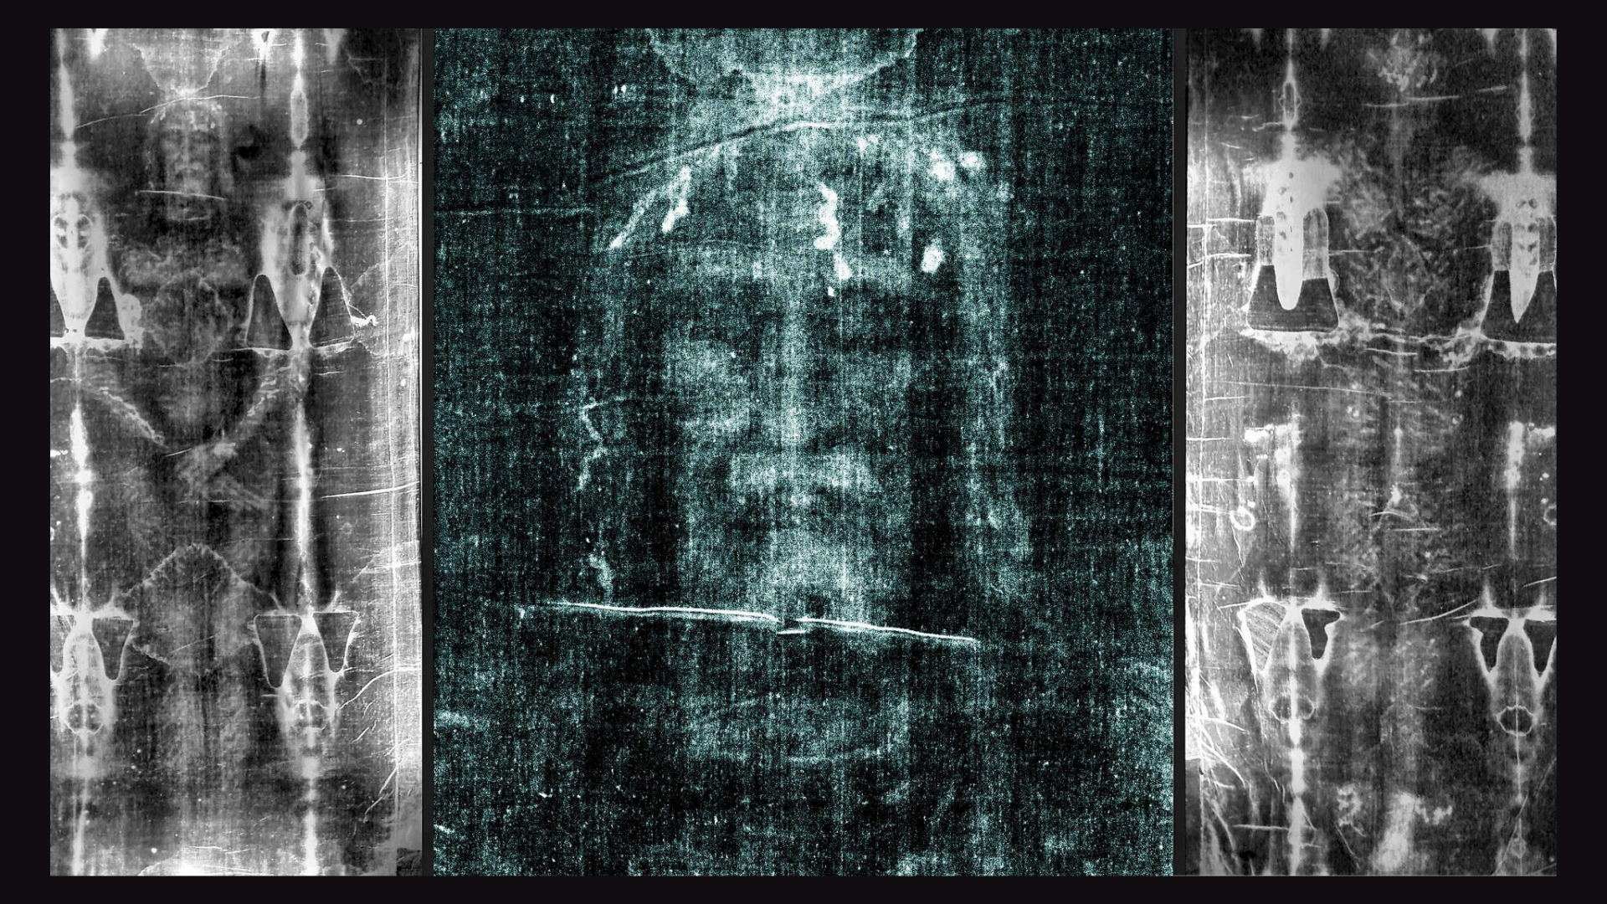
Notes:
Now, the big question is: How was this image produced? Even if it were a medieval forgery, it remains a mystery as to how it was made. There is no verified natural or artificial process—especially from ancient times—that replicates such an image exactly, even with modern technology. And to be clear, this is the most studied and scrutinized artifact in human history, examined by countless scientists across 102 scientific disciplines that have spent over 600,000 hours of study on the shroud, and they’re still not sure how this 3-D, X-ray-like image was imprinted on the fibers of the linen cloth.
Scientists say that no known ancient or medieval technique could reproduce this, and no physical contact seems to explain the image. There are no brush strokes, pigments, or paint detected. Was it some sort of chemical reaction with bodily fluids and the spices used for burial? Is it a bas-relief rubbing? If so, how do you explain the 3-D image? None of the forgery methods seem to add up.
And so, an increasing number of experts are being led to conclude that it appears to be caused by a radiation burst. In other words, the image on the cloth was created by an explosion of light that came from the body and projected outward. To reproduce the entire image with the same depth and coloration, experts estimate that there would need to be a burst of UV radiation with an intensity of around 34 billion watts of power, delivered in a few billionths of a second. This is nuclear-scale energy released in a controlled flash—within the blink of an eye. Therefore, this has led some researchers and theologians to believe that the image was created by an unprecedented event—i.e., the exact moment of the resurrection of Jesus.
Of course, this is, and will always be, a theological interpretation, not testable science. Like all “supernatural” claims that push the boundaries of science and defy the laws of physics as we know them, there will always be only so much that can be gleaned from scientific study of the observable, natural world. So, as it would seem, where science ends, faith begins. Or as I’ve said before, faith doesn’t go against reason, it goes beyond it. Because it requires us to recognize spiritual realities.
And just in case you’re curious about what this man in the shroud may have looked like in real life, check out this AI-generated image… [NEXT SLIDE]

Slide 10
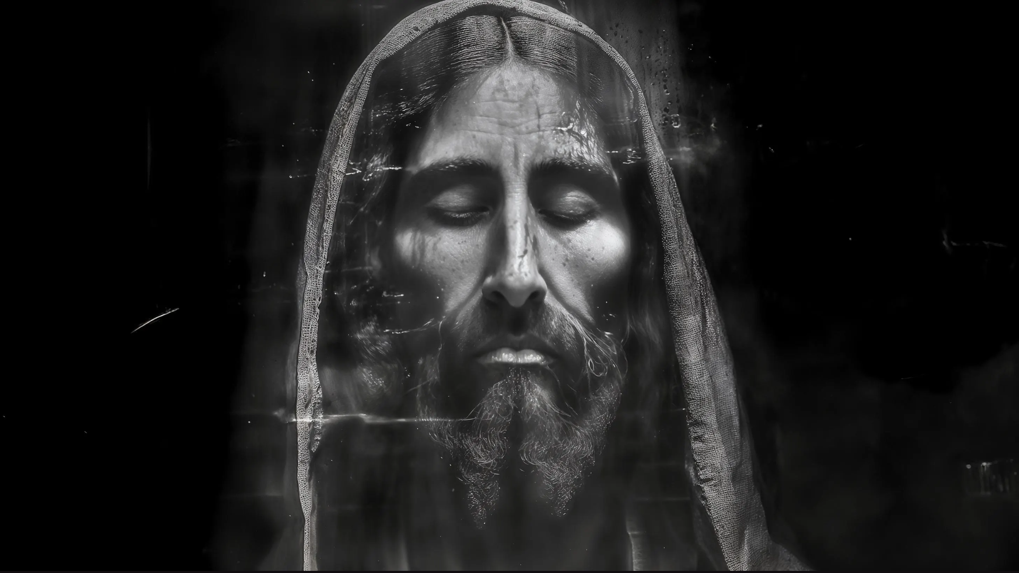
AI-created depiction of the
man in the Shroud of Turin
Notes:
My friends, I don’t know about you, but I personally find myself being moved by this picture.
And so, let me just say this… whatever one believes about the Shroud of Turin, I share all of this with you to stir our imaginations for what we say happened when God the Father, through the power of the Spirit, raised Jesus of Nazareth from the dead.
Regardless of one’s thoughts about the shroud, we already have good reason to believe that Jesus was raised from the dead. I’ve addressed that in several sermons in the past. And since we believe in his resurrection into a glorified body, this has serious implications for us in the present and in the future. Because, in addition to the resurrection being God’s vindication of Jesus as the sinless Son of God, and validation of his life and teachings, this event has revealed God’s intended aim and goal.
Let’s now look at the importance of the resurrection of Jesus and what it means for us who believe. If you would, please turn with me to our main Scripture reading this morning… [NEXT SLIDE]

Slide 11
Notes:
After a long letter addressing many issues and challenges facing the church in Corinth, the Apostle Paul responds to the most troubling matter of all toward the end of his epistle, as it seems there were some among them who were doubting and/or denying the resurrection of Jesus from the dead. And so, Paul writes this chapter (the “resurrection chapter”) in response.
[READ 1 COR. 15:1-58 & COMMENT ON PASSAGE]
NOTES:
v.20 – “first fruits” - NLT: “He is the first of a great harvest of all who have died.”
v.29 – “baptized for the dead” – it seems that some of the Corinthians were being baptized on behalf of people who had died, possibly family members or friends. Paul knew about this and, even if he didn’t fully approve (after all, there is no evidence of this practice elsewhere), his casual tone shows it wasn’t a major error. Our best guess, then, is not that they thought baptism played a role in saving the dead, which would be a major error, but that they simply exaggerated the value of baptism. Therefore, it seems likely the Corinthians were concerned about believers who died before they could be baptized, and feared some spiritual loss as a result. And so, Paul uses this to make his point.
[FINISH READING PASSAGE & COMMENT]
And now, turn with me back to the book of Romans… [NEXT SLIDE]

Slide 12
Notes:
In Romans 8:18-25, we’re going to hear Paul refer to the future resurrection, but not just for those who trust in Christ for salvation, but a renewing work for all of creation.
[READ ROMANS 8:18-25 & COMMENT]
But will this really happen to the entire cosmos? And once again, what might (if anything) science have to say about the future of the space-time material universe in which we live?
Well, there is actually a branch of cosmology that gives attention to the end of all things. You want to guess what it’s called? Eschatology. Physical eschatology… [NEXT SLIDE]

Slide 13
Notes:
[READ & COMMENT]
And one of the most popular theories right now is that the universe will continue to expand at a rapid speed, everything will grow further and further apart, stars will die out, galaxies will grow dark, and the cosmos will eventually end in what they’re calling a big freeze. But don’t worry… because it could take trillions of years before that happens. Plus, before that happens, about 4-5 billion years from now, our sun will begin dying and scorch the earth in the process. So, there’s that.
But what’s really fascinating is that there is a theory coming out of our growing knowledge of quantum mechanics (which deals with matter and light at the atomic and subatomic levels) that some extraordinary things are possible; even an unforeseen event that could change the universe as we know it. And on that theory, the renowned philosopher and Christian apologist William Lane Craig said this a few years back as it relates to physical eschatology… [NEXT SLIDE]

Slide 14
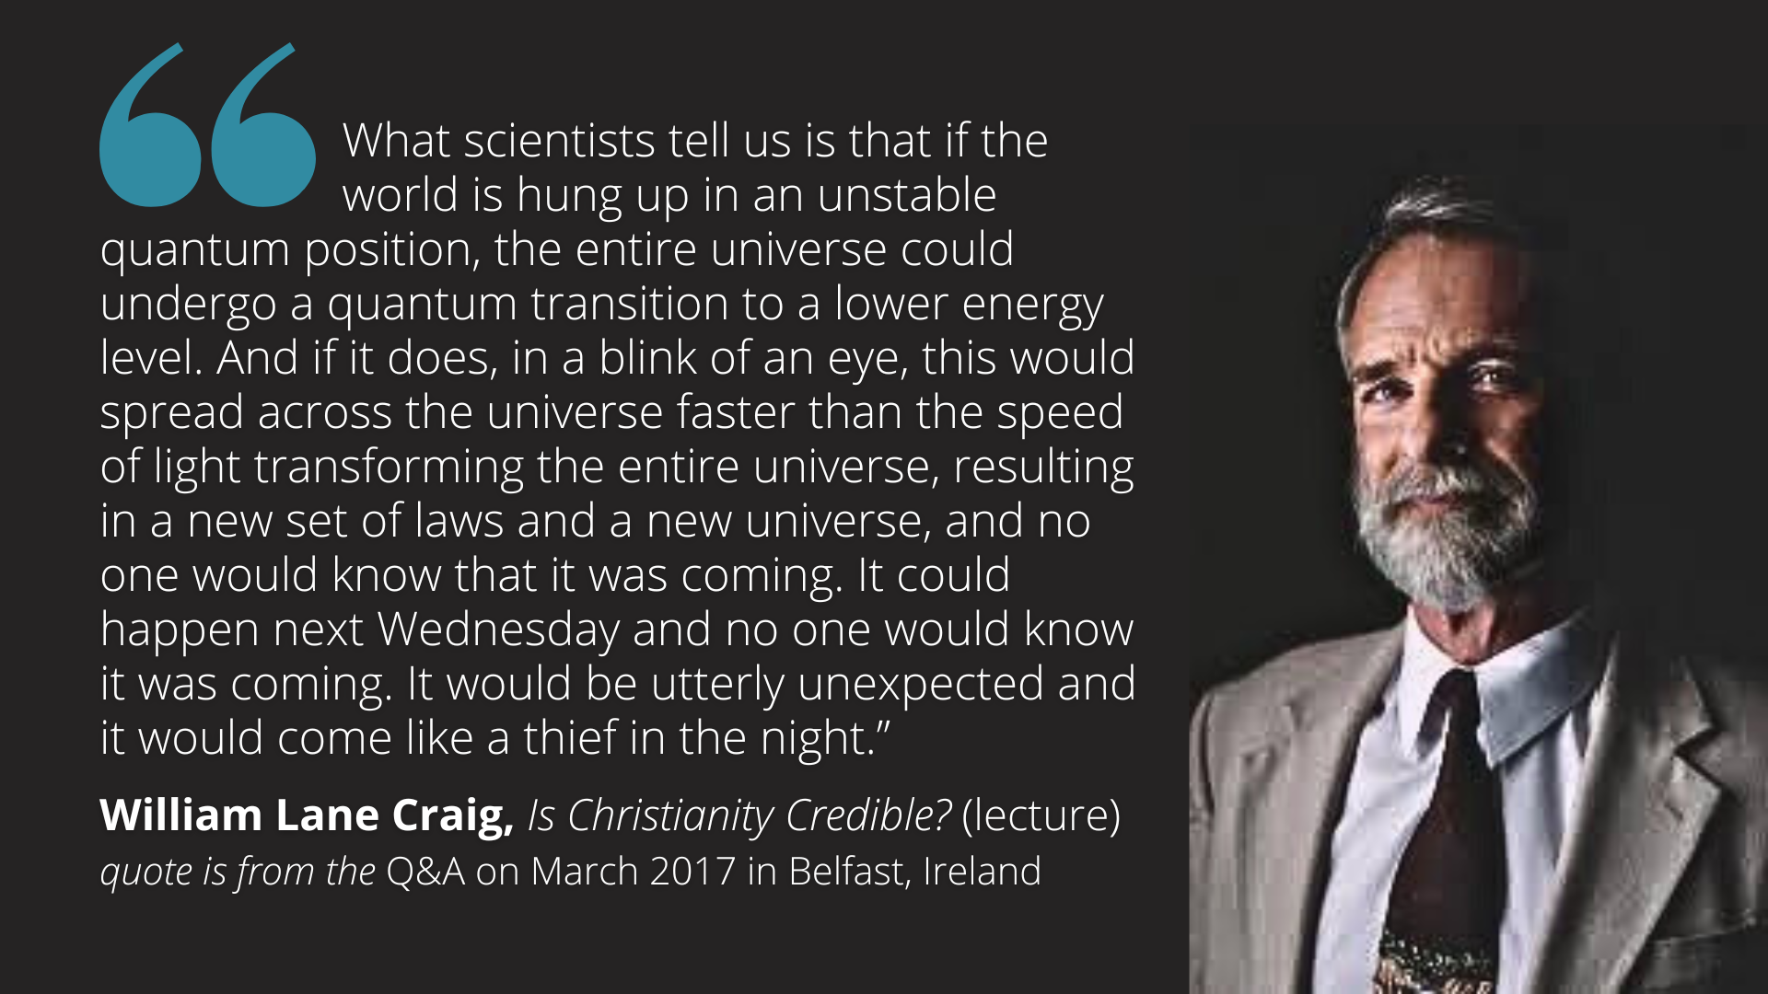
Notes:
[READ QUOTE & COMMENT]
And over at his website, ReasonableFaith.org, Craig writes: “The naturalist might insist that we have no good reason for thinking that the personal Creator would intervene in the natural world so as to avert the consequences toward which the universe tends. But Christian eschatology is inextricably bound up with the person of Jesus of Nazareth: his physical resurrection is the harbinger not only of our own eschatological resurrection but also of a sort of cosmic resurrection as well (Rom. 8.19-23). The Christian eschatological hope is therefore based on the historical reality of Jesus' resurrection.”
And this is the great resurrection effect and promise for all of creation; that what happened to Jesus will happen to all who believe and to the entire cosmos upon what we refer to as his second coming. And we read about this in John’s vision in Revelation chapter 21… [NEXT SLIDE]

Slide 15
Notes:
[READ REVELATION 21:1-5 NIV]
I want to invite you now to think back over what we’ve covered today, as I offer these takeaways and suggested application based on the message… [NEXT SLIDE]

Slide 16
Notes:
[READ & COMMENT ON EACH TAKEAWAY]
If Jesus wasn’t raised from the dead, then our faith is meaningless. We must see the resurrection of Jesus as the sole basis for our hope.
Because Jesus was resurrected, we too will be raised when he returns. We must set our sights upon the future resurrection, not on going to heaven.
The resurrection of Jesus has secured God’s good future for all creation.
We must live into the belief that God has promised to make all things new.
And finally, here are some questions to help us reflect and respond… [NEXT SLIDE]

Slide 20
Notes:
[READ & BRIEF COMMENT ON EACH QUESTION]
Have I placed as much of an emphasis on the resurrection of Jesus as the New Testament does? Is it the sole basis for my faith and hope?
As I think about the future (beyond this life), has the future resurrection been in the forefront of my mind, or has it been something else?
How is the Spirit inviting me to live into the reality that Jesus has defeated sin and death and has secured God’s good future for us?
[CLOSING WORDS]
Let’s pray… [NEXT SLIDE FOR CLOSING PRAYER]

Slide 21
Notes:
[CLOSING PRAYER]
[CLOSING SONG]
Benediction
Church, may our sovereign God fill you with peace as you look to the future with faith, not fear. May the promise of resurrection and eternal life anchor your soul in times of uncertainty and give you hope. And may you live in light of the last things with confidence that Christ will return and bring heaven to earth. Until we gather again, go in peace to love and serve the Lord. Amen.

