Slide 1


Slide 2

What is the Good News?
The gospel story of how God has been at work in the world and is now redeeming it in Jesus Christ—who will one day return to bring the fullness of the Kingdom

Slide 3


Slide 4
Ephesians 1-3
Getting the gospel story clear
Ephesians 4-6
Living in light of the gospel story

Slide 5
Gospel Living Is
Rooted in our gospel identity
Empowered by gospel grace

Slide 6
Ephesians 1:3-6 NIV
³ Praise be to the God and Father of our Lord Jesus Christ, who has blessed us in the heavenly realms with every spiritual blessing in Christ. ⁴ For he chose us in him before the creation of the world to be holy and blameless in his sight. In love ⁵ he predestined us for adoption to sonship through Jesus Christ, in accordance with his pleasure and will— ⁶ to the praise of his glorious grace, which he has freely given us in the One he loves.

Slide 8
Orphan Mindset
Ungrateful, bitter, cynical Tears down others Prideful, defensive Anxious Performance-oriented Lonely

Slide 9
Orphan Mindset | Adoption Mindset
Ungrateful, bitter, cynical Tears down others Prideful, defensive Anxious Performance-oriented Lonely | Assurance that you are loved Doesn’t feel need to prove oneself Able to receive criticism Can confess failures Leads to life of joy and freedom Welcomes others

Slide 11
Ephesians 2:8-10 ESV
For by grace you have been saved through faith. And this is not your own doing; it is the gift of God, not a result of works, so that no one may boast. For we are his workmanship, created in Christ Jesus for good works, which God prepared beforehand, that we should walk in them.
Ephesians 4:1 ESV
I therefore, a prisoner for the Lord, urge you to walk in a manner worthy of the calling to which you have been called…

Slide 12
The Gospel Shapes What We Do
4:17 “no longer walk as the Gentiles do, in the futility of their minds”
5:2 “walk in love, as Christ loved us and gave himself up for us”
5:8 “Walk as children of light”
5:15 “Look carefully then how you walk, not as unwise but as wise”

Slide 13
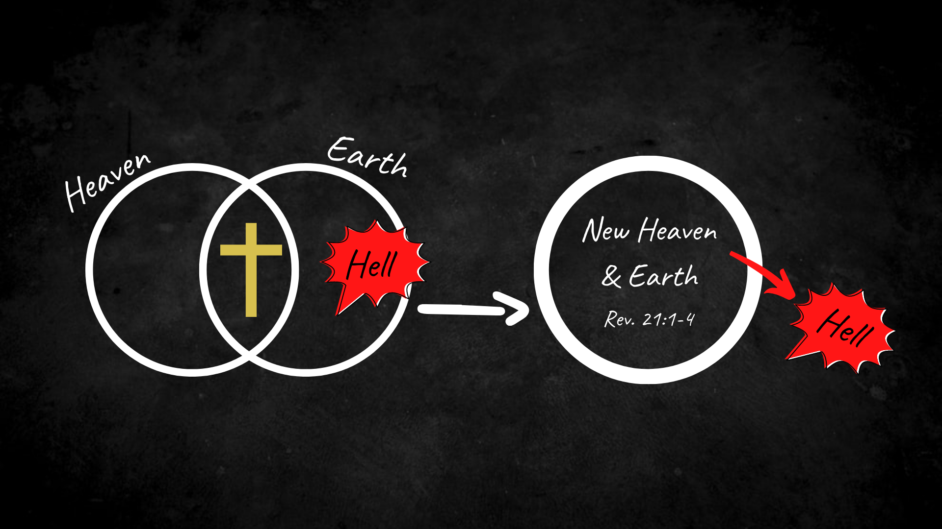

Slide 15
Ephesians 1:18-21 NIV
I pray that the eyes of your heart may be enlightened in order that you may know the hope to which he has called you, the riches of his glorious inheritance in his holy people, and his incomparably great power for us who believe. That power is the same as the mighty strength he exerted when he raised Christ from the dead and seated him at his right hand in the heavenly realms, far above all rule and authority, power and dominion, and every name that is invoked, not only in the present age but also in the one to come.

Slide 16
Ephesians 3:16-19 NIV
I pray that out of his glorious riches he may strengthen you with power through his Spirit in your inner being, so that Christ may dwell in your hearts through faith. And I pray that you, being rooted and established in love, may have power, together with all the Lord’s holy people, to grasp how wide and long and high and deep is the love of Christ, and to know this love that surpasses knowledge—that you may be filled to the measure of all the fullness of God.

Slide 18

Pray for God to meet you where you are.
Get familiar with the gospel story through the Scriptures.
Ask others about their story or share yours!
Gospel Living

