Slide 1
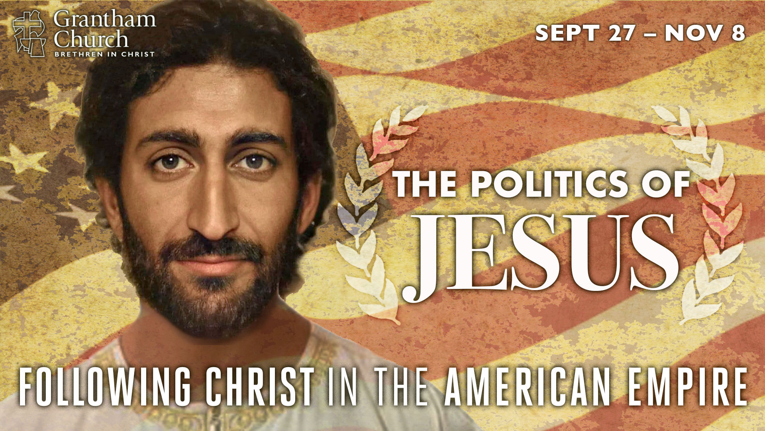
Notes:
Today we begin a brand-new 7-week sermon series called, The Politics of Jesus. If you’re part of our fellowship here at Grantham Church, you may have read the series summary I gave you in my weekly letter. Here is what I said this fall series is all about:
“The quest for political power is destroying the church’s witness in America. At a time when our country is polarized, hurting, and afraid, many who claim the name of Christ are fueling the engine of empire with their lust for power and winning the culture wars at any cost. We need to be reminded that Jesus never called us to change the world by grabbing hold of the horns of power, but he did command us to take up our cross and follow his teachings and example.
And while Jesus didn’t directly weigh in on the hot-button issues of his day, his “good news” was politically subversive, as he was casting a new vision of human society—the Kingdom of God—where the world is transformed by the power of God’s love and our faithful presence in it. In The Politics of Jesus: Following Christ in the American Empire, we will consider what it looks like to embrace the agenda of Jesus and embody his way of radical love. Join us as we seek to navigate this election season by letting the Messiah from Nazareth lead the way.”
As you can see, this is (I think) a timely series, and one that I hope will ultimately be helpful to you—whether you’re a member of Grantham Church or you’re listening through our podcast, wherever you are in the country. Whatever the case, thanks for tuning in and being willing to grow in your faith.
Before I move from the intro into the heart of this first message, I’d like to share a bit of a disclaimer, especially for those who don’t know me that well (or maybe as much as you think) and for those who haven’t been following our church very closely. Here is what I want to say.
We’re a BIC church and our leadership is committed to our Anabaptist heritage.
We’re a “third way” congregation, as we think it reflects the Jesus way—we’re political but not partisan
I’m an “unaffiliated” voter, which in the state of PA means I don’t align myself with any political party.
Why would I register this way? It’s not to be PC (so I can convince you that I’m not partisan), but truly because (a) I think the two-party system is broken; (b) my desire is for the common good; and (c) my allegiance is to Christ and I don’t want to be tempted to pledge my loyalty to a party.
I say all of this because at various points throughout this series, due to our cultural conditioning, you may want to put me in a theological or political box in an attempt to pigeon-hole me as one of “those” people (conservative or liberal) or dismiss what I’m saying altogether. Maybe you’ve already done this. I hope not. I can only ask that you believe that I’m speaking out of 20 plus years of studying the Bible, out of my training as a theologian and pastor, and from immersing myself into historical Jesus studies for two decades. And most of all, speaking to you out of my deep love of Jesus, his church (i.e. you), and my passion for the Kingdom of God, which I believe is far better than any nation, party, or system of government we want to enshrine or glorify.
As I’m sure you can see already, this series is meant to provoke us all. Even the series graphic is meant to provoke us, which I’ll talk about more next week. But I want to be clear, this provocation is intended to spur us on toward greater faith in and love of Jesus and his gospel of the Kingdom. Amen?
Alright. Let’s pause for a moment and invite the Spirit of Jesus to join us on this journey and speak to our hearts and minds. [BRIEF PRAYER]

Slide 2
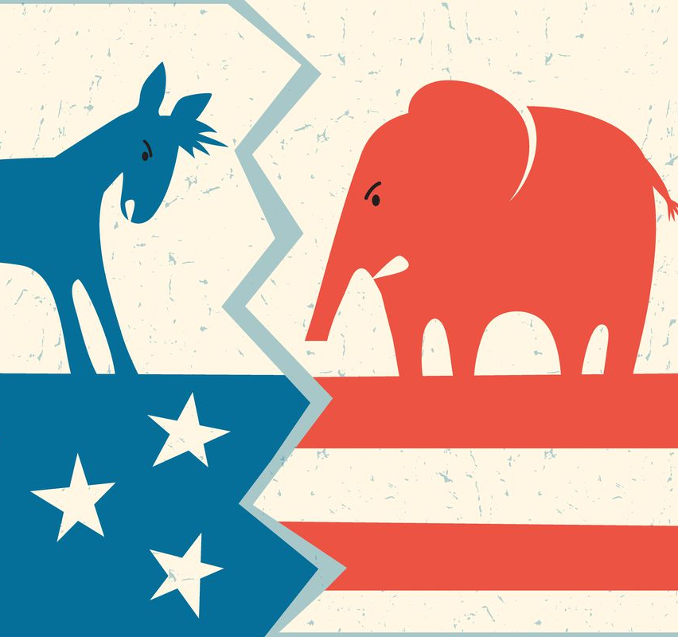
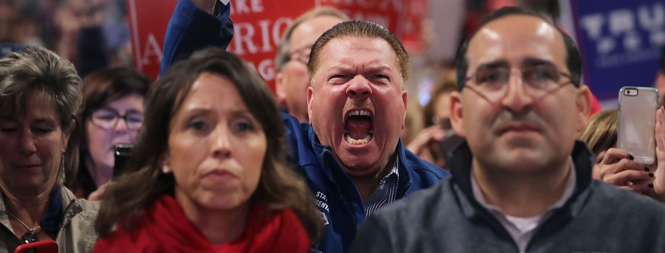

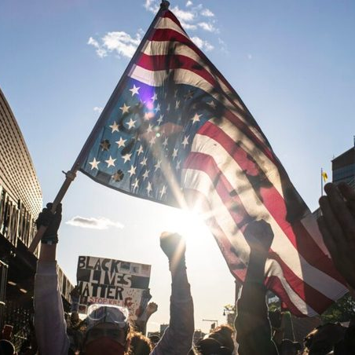
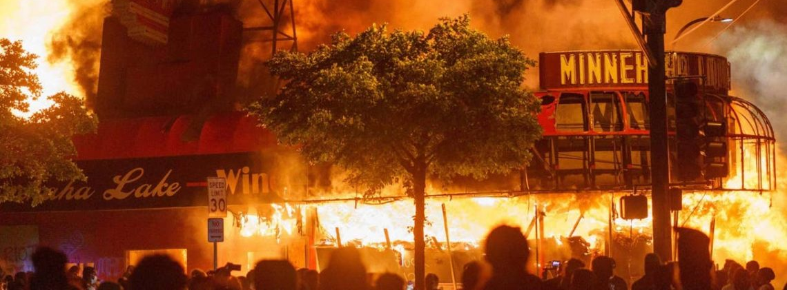
Notes:
Church, We Have a Problem! That is the title of the first message in our series.
You have heard me say before that we’re living in the Divided States of America. Experts are saying that we haven’t been this divided since the Civil War (e.g. we’re seeing a battle between the far right vs. far left visions for the country, protests & riots, police brutality, white supremacy, the rise of conspiracies like Q-Anon, the cult-like following of politicians, the win-at-all-costs political mindset of folks on the right and the left, especially among Evangelicals, the fear-mongering media, the newsfeeds of hate, etc.) And the pandemic has widened the divide as COVID and mask-wearing has been politicized, which is keeping us from coming together in solidarity and unity.
In fact, everything has been politicized. You can’t say or do anything that folks don’t use to identify whether you’re a friend or an enemy. Everything has been politicized. That is actually the first of three forces at work that have formed a perfect storm that’s hitting our nation at full force: Cancel Culture is another one. If someone says something or does something wrong or politically incorrect, or just something you disagree with (big or small), that person is ostracized, shamed, and defamed, nullifying every good thing they’ve ever done. People just “cancel” them.
We’re seeing this in the church. I was on a Zoom call this past week with pastors in our conference who said they have people leaving their churches because they don’t agree with the way they’ve responded to the pandemic. Some people are leaving their churches because they don’t agree with the restrictions in place, and others because they’re not strict enough. And meanwhile, pastors are thinking if this is what years of preaching, teaching, and discipleship have gotten us, why even continue in leadership? What does it say about our faith? What does it say about what’s central to our lives? Is it our faith? Or is it our politics and demanding our way and our rights, without a thought given to any realities beyond ourselves?
Which brings me to the third force at work, which has been around for a while. It’s what we call Culture War Christianity. For many evangelicals, they believe we must force our will (our faith, values, politics, and worldview) on the culture and win the war against growing secularism. It’s about winning, at any and all costs, even if it means compromising our own values—the ends justify the means. And if we’re honest, a lot of what we’re seeing is the suppressed undercurrent of white supremacy and racism (America’s original sin). How can we ever heal and move on until it’s been fully acknowledged?
In addition, we’re seeing a loud portion of the country fight to save the misplaced and destructive belief in American exceptionalism and hold on to what’s left of the Christian nation myth. Christendom is dying, we’re losing our privilege and power, we’re being forced into exile, and frankly, many in the church don’t like it. So, we then fashion a theology that supports our beliefs, we cherry-pick verses in the Bible to make our case, and then try and rationalize our attitudes, behaviors, and our political choices, so that we can in good conscience ignore Jesus’ example and teaching.
And then once we’ve wrapped God in the American flag, made Jesus out to be a cheerleader for our righteous causes, muted Jesus when he has anything to say that challenges our way of life or our need to hate our enemies (which partisan politics requires), and that ultimately reduces Christ down to the secretary of after-life affairs, then we can go about our business of running the world as we see fit—which means that we can now grab hold of the horns of power and force our way on the world by legislating people’s sins—mostly the ones that we don’t like—and setting up a Christian version of Sharia law. Do you see anything wrong with this picture? Does any of this sound like the Jesus you’ve read about in the gospels?
It shouldn’t. Because if you’ve spent any time reading the gospels, you can’t help but notice that Jesus never took that approach to solving the world’s problems or advancing the Kingdom of God on the earth. Actually, Jesus outright rejected the way of worldly power to advance his agenda and corrected his disciples when they thought that the Kingdom of God operated like the kingdoms of the world. If we’re knowledgeable of the Scripture, some examples should come to mind. How about when…
Jesus rebuked Peter for using his sword (“all who live by the sword”)
The mother of two disciples asks Jesus to give them power (”rulers of the Gentiles”)
And then in Luke 9:52-56, the disciples James and John want to call down fire
You see, James and John, like so many disciples today who still don’t get it, think that it’s about winning, but Jesus wasn’t in it to win it; not in the way we think. As Andy Stanley recently pointed out, they didn’t realize, like we often don’t realize, that Jesus was playing a different game, with different rules, and after a different kind of win. His winning comes by dying, not by killing. His winning comes through love and self-sacrifice, by laying his life down for others, not by trying to dominate his enemies. But instead by showing us a better way: that love is the key to lasting change and transformation.
And folks, this wasn’t a strategy of Jesus or some guise that Jesus assumed so he could die on the cross. No, this is who he is. This is what God is like. This is what the Kingdom is all about. And this is the Lord and the good news that we’re called to follow.
Listen to what the Apostle Paul wrote of Jesus in Philippians 2:6-8.
[NEXT SLIDE]

Slide 3
Paul, Philippians 2:6-8 NLT
⁶ Though he was God,
he did not think of equality with God
as something to cling to [exploited].
⁷ Instead, he gave up his divine privileges;
he took the humble position of a slave
and was born as a human being.
When he appeared in human form,
⁸ he humbled himself in obedience to God
and died a criminal’s death on a cross.
Notes:
[BRIEF COMMENTS ON PASSAGE]
And listen what Paul said in Colossians 2 about what Christ did through the cross. [NEXT SLIDE]

Slide 4
He [Jesus] disarmed the rulers and authorities and made a public example of them, triumphing over them in it.
Paul, Colossians 2:15 NRSV
Notes:
[BRIEF COMMENT ON VERSE] - irony
In other words, cross-power is greater than political power, threats, coercion, the rule of law, etc. Remember, it was “law and order” that resulted in Jesus’ own death. Sure, laws can be good, but evil can also be done in the name of law in an effort to silence cries for justice and change—any prophetic calls for a new order that challenges the status quo, that questions the power and might of the empire’s authority over people’s lives, which is why Jesus was crucified. As we will see next week, that is certainly why Pontius Pilate ordered it to be done. Jesus’ ”gospel” was fake news, a threat to Caesar’s.
And so, it’s the message of the cross, the way of love, that we’re to follow and believe has power to bring about real lasting change to people’s lives and to transform society. And it’s this love that we’re to be known by in the world. Jesus said so after washing his disciples’ feet and changing the meaning of the Passover meal to be a symbol and a sacrament of his sacrificial love… [NEXT SLIDE]

Slide 5
“So now I am giving you a new commandment: Love each other. Just as I have loved you, you should love each other. Your love for one another will prove to the world that you are my disciples.”
Jesus, John 13:34-35 NLT
Notes:
Don’t miss what Jesus is saying. He is telling us that the defining mark of those who follow him (those who truly follow Christ), is our love. That’s it. Jesus didn’t say the world will know you belong to me by your stand for keeping me in Christmas, or your boycotting of Netflix, or by being belligerent about your religious rights and freedoms, or by your bumper stickers, or your church marquees. No, it’s love. Period.
So, the response from non-believers when they’re asked, “Do you know any Christians? What are they like?” shouldn’t be, “They’re self-righteous jerks.” Or “they only care about life in the womb, but not about black lives, and poor lives, and lives on death row.” Or when you do a Google search, “Why are Christians so…” the results that pop up shouldn’t be ”hypocritical, judgmental, antigay” or “likely to believe in conspiracies.” No, we ought to be shocking people with the gravity and magnitude of our love, that is as wide as Jesus’ arms on the cross.
But sadly, as Shane Claiborne writes, that is not what most of our neighbors think about us: [NEXT SLIDE]

Slide 6
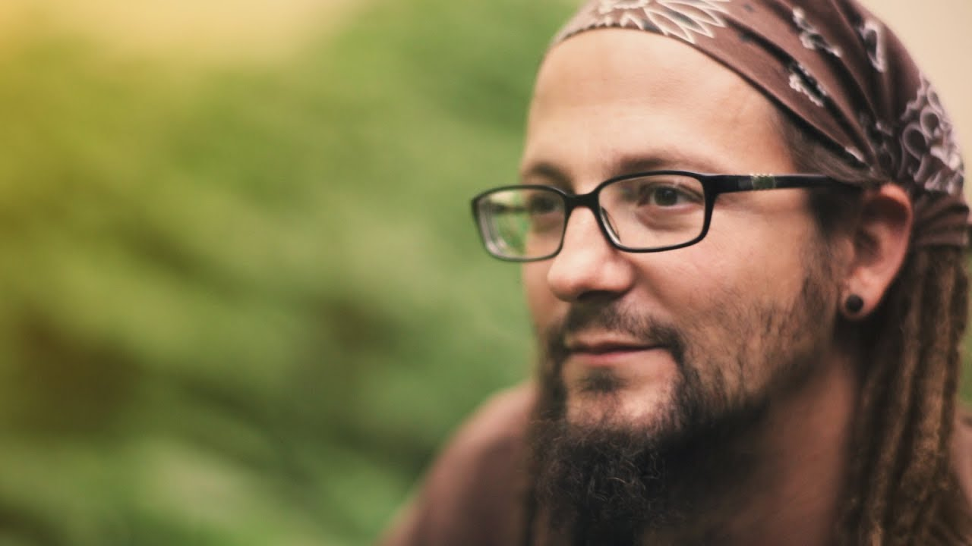
“It’s clear that we have become known for some of the very things that Jesus spoke out against, like self-righteousness, and we haven’t been known for how we love like Jesus loved. We’ve been known more for who we’ve excluded than for who we’ve embraced, more for what we’re against than what we’re for.”
Shane Claiborne
Notes:
And brothers and sisters, this should grieve our hearts. The lost sheep of Israel, and later the Gentiles, who found their religions lacking and the empire full of empty promises, flocked to Jesus and the gospel in the first few centuries of the church. In Jesus’ own ministry, they ran to Jesus, they threw themselves down at his feet, sometimes begging for mercy, pleading for his grace, looking for life because it couldn’t be found anywhere else. And Jesus gladly extended God’s grace, forgiveness, and love to them so that they might be born again and begin to live life in the Kingdom.
But you see, in order for us to do this, Christ must be greater than our fears. Because if we don’t let go of our fears, those fears turn to anger, and then that anger turns to hate. And then we find we need to hate, we need enemies (like liberals, or republicans, or gays, or abortionists, or the NRA) to live and make sense of things. And when that happens, when we’ve fed on a steady diet of fear-mongering and enemy hate, we can’t hear the words of Jesus. The flood of competing forces determine our reality, our identity, and our future—the forces and our flesh that say we must destroy our enemies.
But remember what Jesus said in Matthew 5:43-45.. “You have heard that it was said, ‘Love your neighbor and hate your enemy.’ But I tell you, love your enemies and pray for those who persecute you, that you may be children of your Father in heaven.” Church, Jesus, not me, and not some hippy dippity socialist, commanded us to do this. And he said that it’s when we do… that’s when we can be identified as God’s children.
“That’s hard, pastor.” Yes, it’s hard. That’s what Jesus was talking about in Matthew 16:24-25… [NEXT SLIDE]

Slide 7
“If any of you wants to be my follower, you must give up your own way, take up your cross, and follow me.
If you try to hang on to your life, you will lose it. But if you give up your life for my sake, you will save it.”
Jesus, Matthew 16:24-25 NLT
Notes:
What does Jesus mean? He is saying that the way of the disciple is one of being the learner and rethinking what you thought you knew, and what you think you understand about the world, about the gospel, and what it means to follow Jesus. He is saying, as he did to Peter who was trying to stop him from going to the cross, the path of a Christian requires that we learn to see life, power, and winning differently. Because Christ’s kingdom is upside-down.
What does Jesus mean? He is telling us that letting go of the control we think we have, which we try to maintain by fighting and resisting with the weapons of this world, is the only way to experience the salvation, peace, and freedom that Christ came to give us. Just as Jesus himself entrusted his life to the Father, we must do the same if we’re ever to experience what the Spirit can do through our faithful presence and our commitment to love.
My friends, this is the way. [NEXT SLIDE]

Slide 8
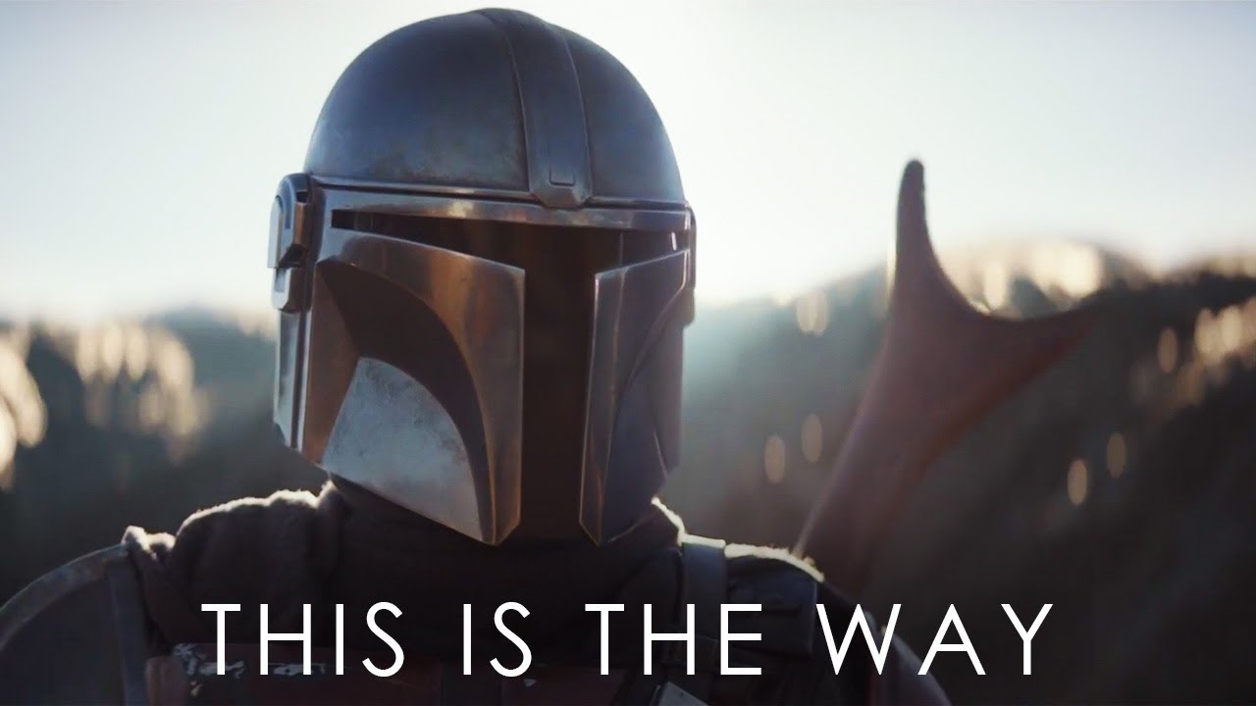
Notes:
Some of you will recognize that phrase, “This is the way.” It’s what the Mandalorians say in the Disney series, The Mandalorian. The Mandalorians are a fictional people associated with the planet Mandalore in the Star Wars universe. They are mostly bounty hunters and mercenaries. And at various points in the show, they conclude their interactions with each other saying, “this is the way.” The Way of the Mandalore involved protecting fellow Mandalorians and wearing a helmet at all times. The Way stated that if a Mandalorian removed their helmet in front of another living being, they were no longer permitted to wear it. And so they lived by this code of conduct, as it was central to their identity.
And you know, isn’t that what Christ has called us to as his followers? Our code of conduct, what is central to our identity, is love. But not just love for our own. As Jesus said, “For God so loved the world…” And as Paul said in Colossians 3:14, we are to “put on love” and wear it for the sake of the Kingdom. Don’t take it off, church. Don’t forsake your calling. Not for anyone, not for anything. No matter how dire our circumstances seem to be. Don’t fail to extend to others what Christ has given to you, over, and over again. Because the world needs love… now more than ever. [NEXT SLIDE]

Slide 9

Invitation & Response
Ways that we can follow Jesus in love:
Notes:
[BRIEF COMMENTS ON EACH POINT]
What is God saying to you? And what are you going to do about it?
I hope that you will seriously consider what you need to do to repent and return to the Jesus of the gospels—to the Christ who is our Lord and King—and who calls us to follow him in the midst of the American Empire. And may the Spirit empower you to respond in faithfulness, whatever the cost.
Let’s pray.
[CLOSING PRAYER]

Slide 10
Invitation & Response
Ways that we can follow Jesus in love:
Affirm the dignity and inherent worth of others.
Notes:
[BRIEF COMMENTS ON EACH POINT]
What is God saying to you? And what are you going to do about it?
I hope that you will seriously consider what you need to do to repent and return to the Jesus of the gospels—to the Christ who is our Lord and King—and who calls us to follow him in the midst of the American Empire. And may the Spirit empower you to respond in faithfulness, whatever the cost.
Let’s pray.
[CLOSING PRAYER]

Slide 11
Invitation & Response
Ways that we can follow Jesus in love:
Affirm the dignity and inherent worth of others.
Befriend and listen to those not like you.
Notes:
[BRIEF COMMENTS ON EACH POINT]
What is God saying to you? And what are you going to do about it?
I hope that you will seriously consider what you need to do to repent and return to the Jesus of the gospels—to the Christ who is our Lord and King—and who calls us to follow him in the midst of the American Empire. And may the Spirit empower you to respond in faithfulness, whatever the cost.
Let’s pray.
[CLOSING PRAYER]

Slide 12
Invitation & Response
Ways that we can follow Jesus in love:
Affirm the dignity and inherent worth of others.
Befriend and listen to those not like you.
Don’t assume, think the worst, or judge others.
Notes:
[BRIEF COMMENTS ON EACH POINT]
What is God saying to you? And what are you going to do about it?
I hope that you will seriously consider what you need to do to repent and return to the Jesus of the gospels—to the Christ who is our Lord and King—and who calls us to follow him in the midst of the American Empire. And may the Spirit empower you to respond in faithfulness, whatever the cost.
Let’s pray.
[CLOSING PRAYER]

Slide 13
Invitation & Response
Ways that we can follow Jesus in love:
Affirm the dignity and inherent worth of others.
Befriend and listen to those not like you.
Don’t assume, think the worst, or judge others.
Meditate on the words of Jesus.
Notes:
[BRIEF COMMENTS ON EACH POINT]
What is God saying to you? And what are you going to do about it?
I hope that you will seriously consider what you need to do to repent and return to the Jesus of the gospels—to the Christ who is our Lord and King—and who calls us to follow him in the midst of the American Empire. And may the Spirit empower you to respond in faithfulness, whatever the cost.
Let’s pray.
[CLOSING PRAYER]

Slide 14
Invitation & Response
Ways that we can follow Jesus in love:
Affirm the dignity and inherent worth of others.
Befriend and listen to those not like you.
Don’t assume, think the worst, or judge others.
Meditate on the words of Jesus.
Pray for your enemies.
Notes:
[BRIEF COMMENTS ON EACH POINT]
What is God saying to you? And what are you going to do about it?
I hope that you will seriously consider what you need to do to repent and return to the Jesus of the gospels—to the Christ who is our Lord and King—and who calls us to follow him in the midst of the American Empire. And may the Spirit empower you to respond in faithfulness, whatever the cost.
Let’s pray.
[CLOSING PRAYER]

