Slide 1
Notes:
[READ SUNDAY AGANG LETTER & PRAY]
[SHOW VIDEO]

Slide 2

Notes:
Today we are concluding our Lent-to-Easter sermon series, Wandering Heart: Figuring out faith with Peter. For the past 7 weeks we have been looking at the ups and downs in Peter’s walk with Jesus, highlighting certain moments in his journey that we can learn from and apply to our own relationship with the Lord and his people.
Each week in this series… [NEXT SLIDE]

Slide 3

Notes:
… we selected a phrase from the hymn, Come Thou Fount, and we connected it to a significant moment in Peter’s winding faith journey with Jesus.
It’s easy to relate to Simon Peter because he was an obvious mix of astounding faith at times, and then at other times… he was a real stinker. He could be stubborn, quick to speak and slow to listen, and often wanted to lead without first learning how to be a follower.
But thankfully, God loves imperfect people. And as we will see today, he doesn’t do that begrudgingly or impatiently, but with great love in his heart for people who are made in God’s image but also broken and not as they should be.
In this final week… [NEXT SLIDE]

Slide 4
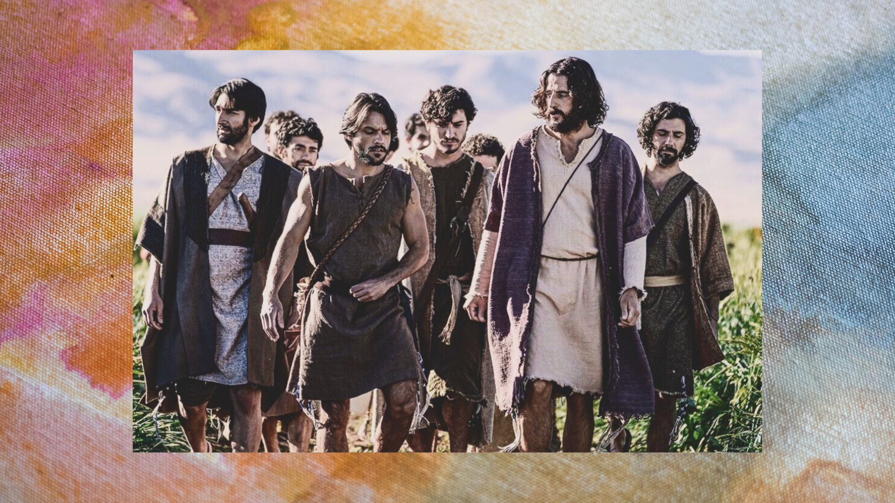
Notes:
We come full circle with Peter. We have seen him drop his fisherman’s nets to follow Jesus, walk on water in the storm, publicly profess his faith in Jesus as Messiah and then rebuked by the Lord for being a stumbling block on the way to the cross; we’ve seen Peter reluctantly receive foot washing, deny Jesus three times, and then run to the empty tomb… left wondering to himself: “Could it really be true? Was Jesus raised from the dead?”
And now, according to gospels, the risen Jesus appeared to his disciples several times in 40 days, first in the locked Upper Room. But in those first appearances, Jesus has not addressed Peter directly since his three denials… until the episode we’re looking at today… where Jesus catches up with the disciples in the place where the Lord first called Peter—on the shoreline of the Sea of Galilee.
If you’re taking notes, today’s message is entitled… [NEXT SLIDE]

Slide 5

Notes:
Here’s My Heart.
[BRIEF PRAYER]
“Father, may the words of my mouth and the meditation of my heart be acceptable in your sight, O LORD, my Rock and my Redeemer. Lord, give us ears to hear, minds to understand, eyes to see, and hearts to receive what you have for us today. Holy Spirit, speak to us, for your servants are listening. We surrender our whole selves to you now for the glory of God and the furtherance of his Kingdom. And all God’s people said… Amen.”
Please open your Bibles to our main Scripture reading this morning… [NEXT SLIDE]

Slide 6
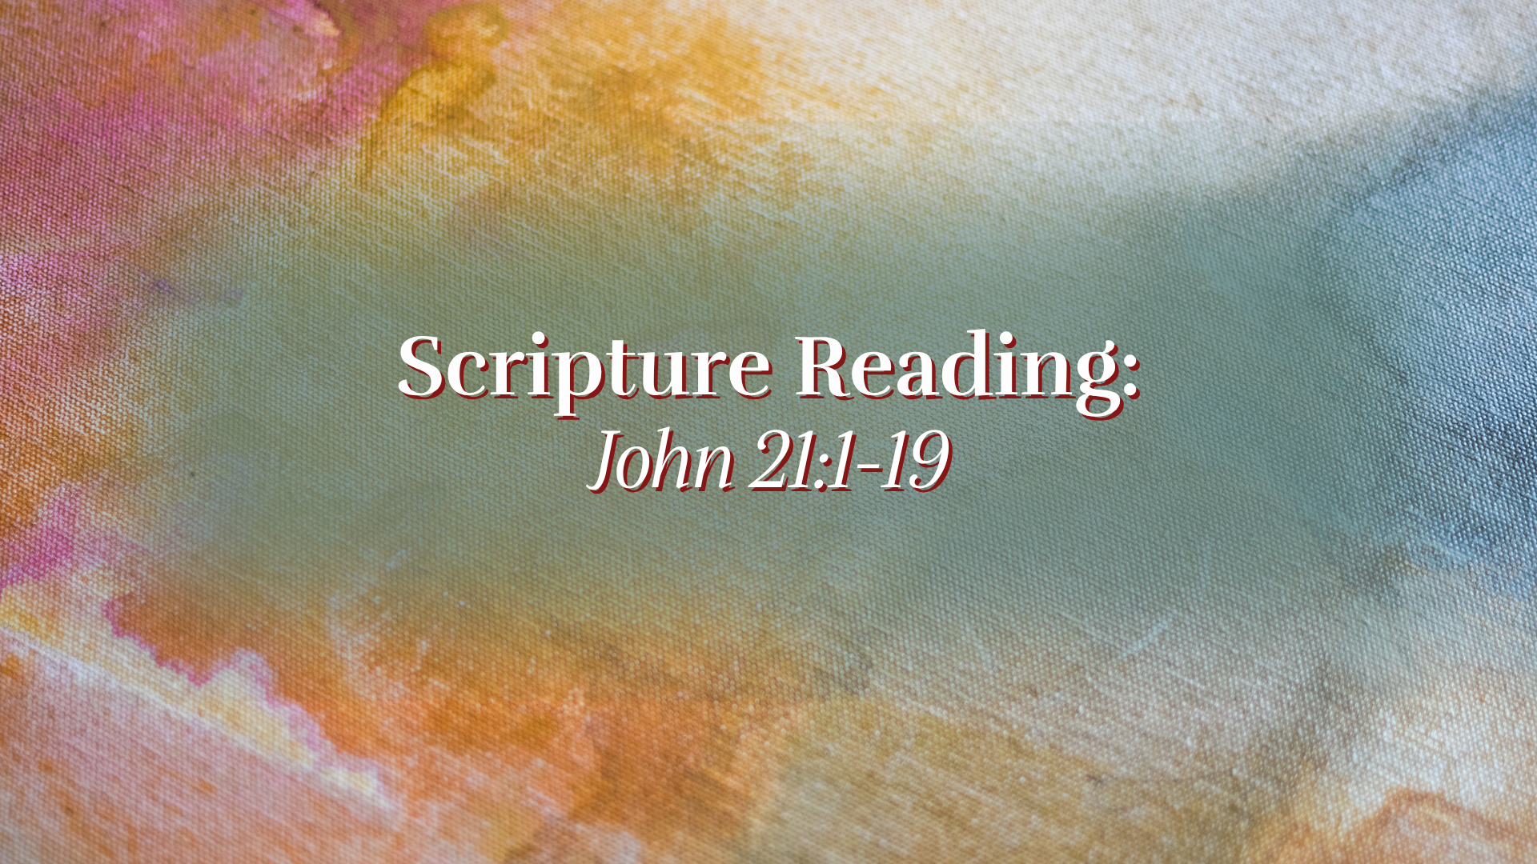
Notes:
[INVITE CONGREGATION TO STAND & READ SCRIPTURE]
This is the word of the Lord. Thanks be to God. You may be seated.
It’s my conviction that real fans of film don’t just flock to the blockbusters and big-budget movies, but they will also appreciate the lesser-known actors and writers who are creating stories worth telling—particularly stories that make objective truth claims, promote morals and values consistent with the Christian tradition, and inspire us to believe in redemption.
One of my favorite films fitting this description is from 20 years ago. It’s called… [NEXT SLIDE]

Slide 7

Notes:
Peaceful Warrior, starring Scott Mechlowicz, Amy Smart, and Nick Nolte.
The main character, Dan Millman, has it all: good grades, a shot at the Olympic gymnastics team on the rings, girls lining up for this handsome Berkely college athlete, and all his teammates look up to him with envy. Only one man shakes his confidence and challenges his haughty spirit—an anonymous evening gas station attendant who turns out to be a wise sage named Socrates. Dan encounters Socrates on a jog one night.
This mysterious wise man keeps questioning every assumption in Dan’s life. Dan is skeptical, but he’s curious and continues to listen. But things remained unchanged in his life until a motorcycle accident shatters Dan's legs, and his bright future. At that point (in his brokenness and humble state) he is more open to his wise, other-worldly teacher. And with the help of Socrates, Dan not only returns to the rings… but more importantly… he becomes a healthy and whole human being who achieves true peace and balance in his life.
In a similar way, that is what happens to Peter in this final gospel episode… [NEXT SLIDE]

Slide 8

Notes:
Let’s return to our Scripture text and unpack the story verse-by-verse.
[READ VERSE-BY-VERSE & COMMENT]
vs. 1-3 - ”Sea of Galilee” – we’re back where we started (Lk.5); 7 disciples + Jesus (8-new creation); “I’m going out to fish” – Why? Are they still confused? Are they returning to what they know in order to find a “new normal”? Are they uncertain about what to do next? Notice, they are fishing in darkness and caught nothing (darkness vs. light).
vs. 4-6 – “morning” (light has come); right side of the boat? A seemingly ridiculous request, but it’s always about trusting Jesus over your own logic and intellect; the “large catch” is what triggers John’s memory and leads to revelation.
vs. 7-9 – Peter was down to his loin cloth (undergarment); Fishermen often removed their outer garment because it would get wet and heavy, it restricted movement, and fishing was physically demanding work. So, Peter was simply dressed for labor. And notice, Peter once ran away from Jesus in fear. Now he throws himself into the water just to get to him faster. It may not be graceful—but it’s real. It’s love that compels Peter overboard.
And don’t miss this, Jesus has a ”charcoal fire” waiting for him. Why is that significant? Well, because the only other place this sort of fire is mentioned in John’s gospel was earlier… [NEXT SLIDE]

Slide 9
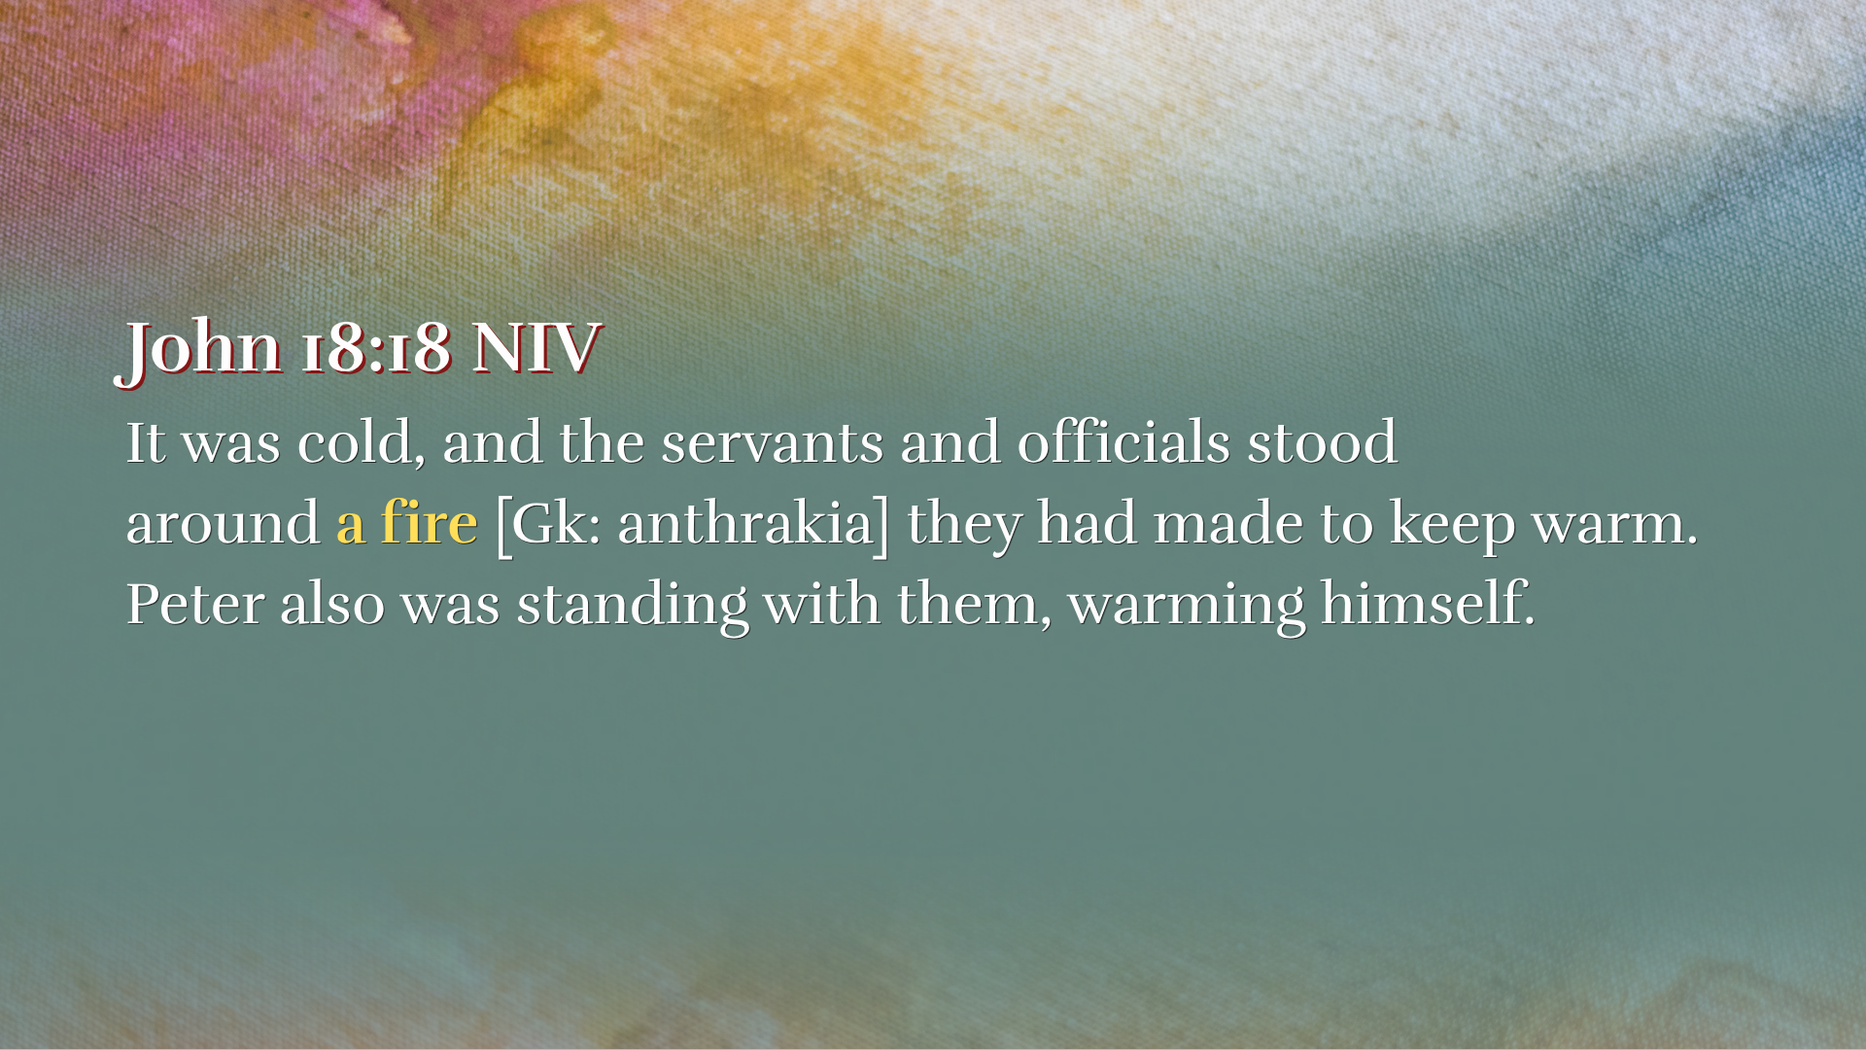
Notes:
[READ & COMMENT]
John wants us to know that a similar setting has been recreated for Peter. Readers of the Greek (who have an eye for detail) would see this and know that Jesus is preparing to address Peter’s denials.
Back to John 21, verse 10… [NEXT SLIDE]

Slide 10
Notes:
[READ VERSE-BY-VERSE & COMMENT]
vs. 10-11 – Why 153 fish? There has been a lot of speculation about the number, but John tells us there were 153 fish—not because the number is a secret code, but because it’s a memory. Someone was there. Someone counted. This actually happened. And the same Jesus who once filled their nets before the cross is still providing after the resurrection.
vs. 12-14 – two things I want to point out: first. the resurrected Jesus is eating with them; and second, saying that they "dared not" ask Jesus if it’s him suggests that the awe of the moment made them hesitate to speak, rather than a lack of knowledge, emphasizing the profound reality of his resurrection. It also suggests that the resurrected Jesus was not initially recognizable, which may have more to do with John’s emphasis that seeing the real Jesus is based upon a spiritual revelation (e.g., the two on the road to Emmaus).
And now, the moment we’ve been waiting for, Jesus directly engages in conversation with Peter. Verse 15… [NEXT SLIDE]

Slide 11
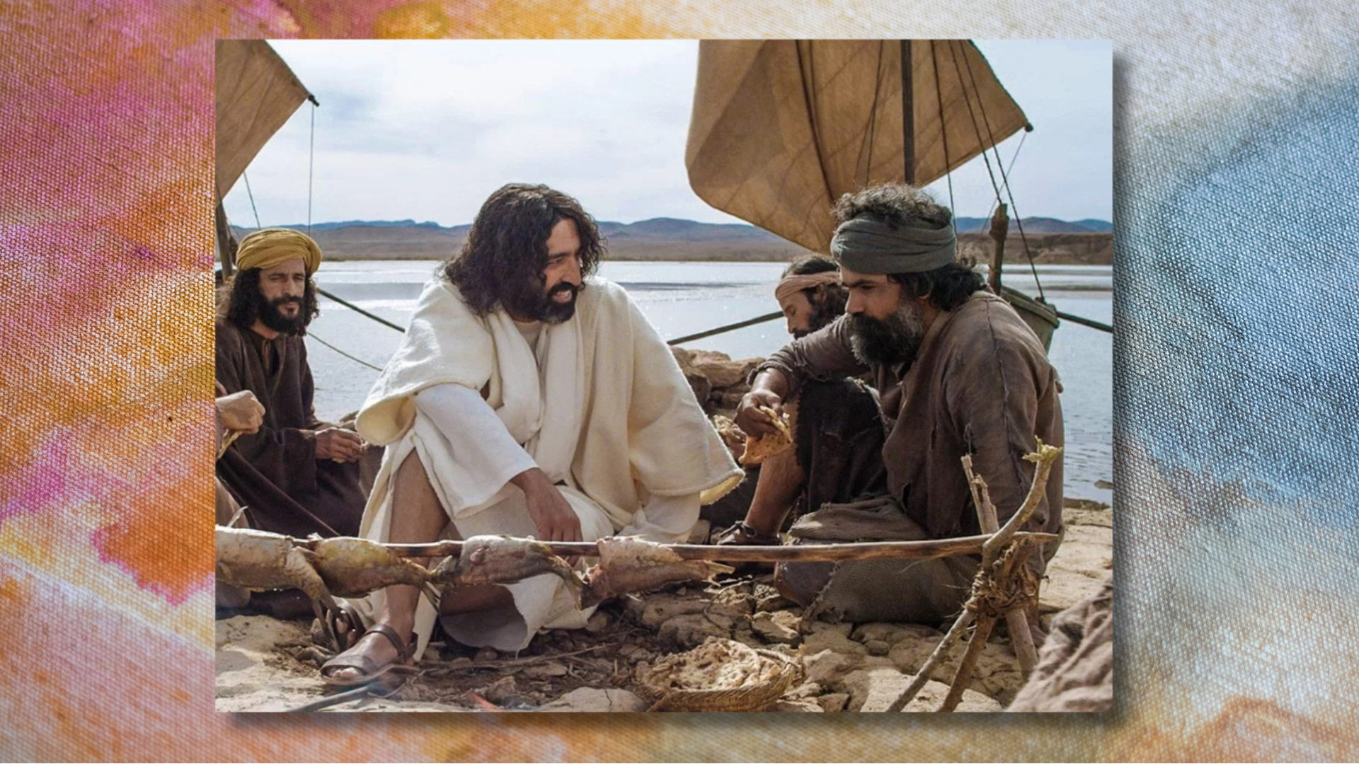
Notes:
v. 15 – What does Jesus mean by “these”? Well, he could mean several things: (1) the other disciples, e.g., “Do you love me more than your fishing friends?” (2) more than the love of the other disciples; or (3) more than fish and fishing (Peter’s old occupation). It’s not entirely clear. And while each of these are worth considering… it appears that Jesus wants to see if Peter is still into comparing himself with the other disciples. Remember what he said at the Last Supper: “Even if all the others fall away and deny you, I will never deny you.” So, Jesus asks, ”Simon, son of John, do you love me more than these?” And Peter responds, this time with humility and belief that Jesus sees and knows all things about him.
[READ & COMMENT ON VERSES 16-17]
Three denials – three questions (undoing Peter’s failure)
Finally… look at verses 18-19. [READ & COMMENT]
Let’s sum up this final story with some takeaways for application… [NEXT SLIDE]

Slide 12


Slide 13
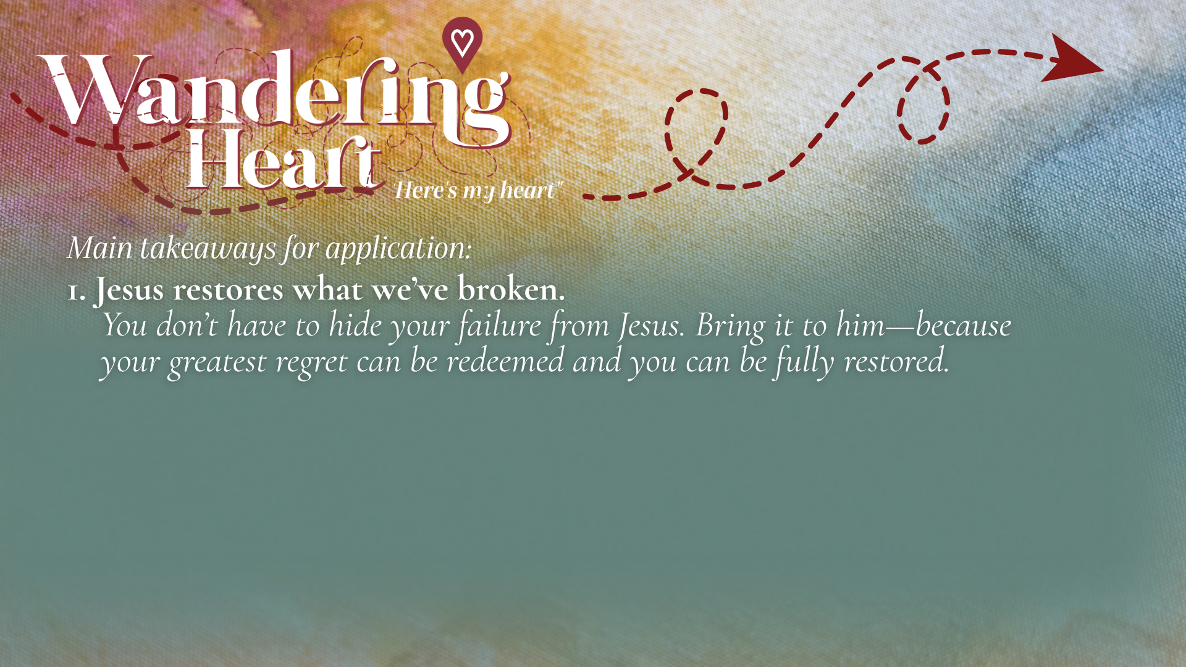

Slide 14
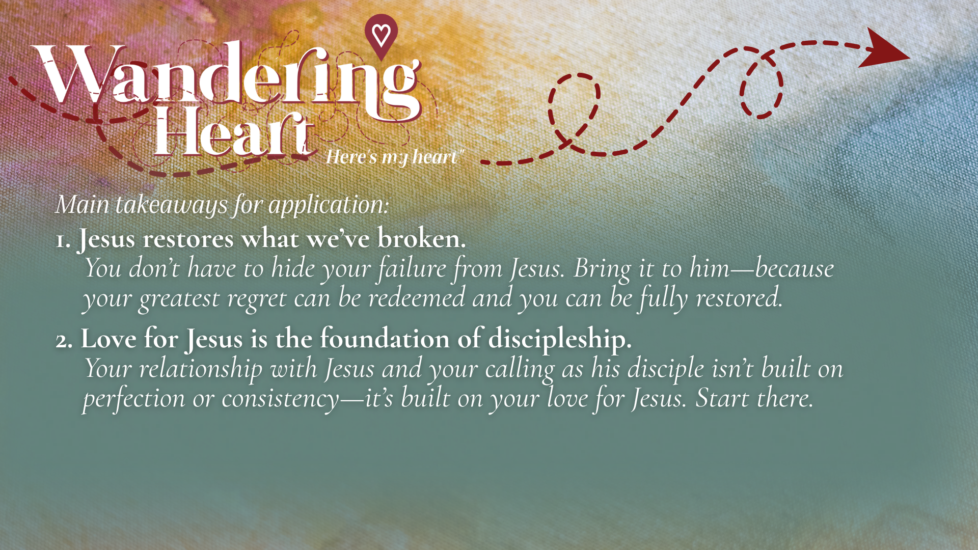

Slide 15
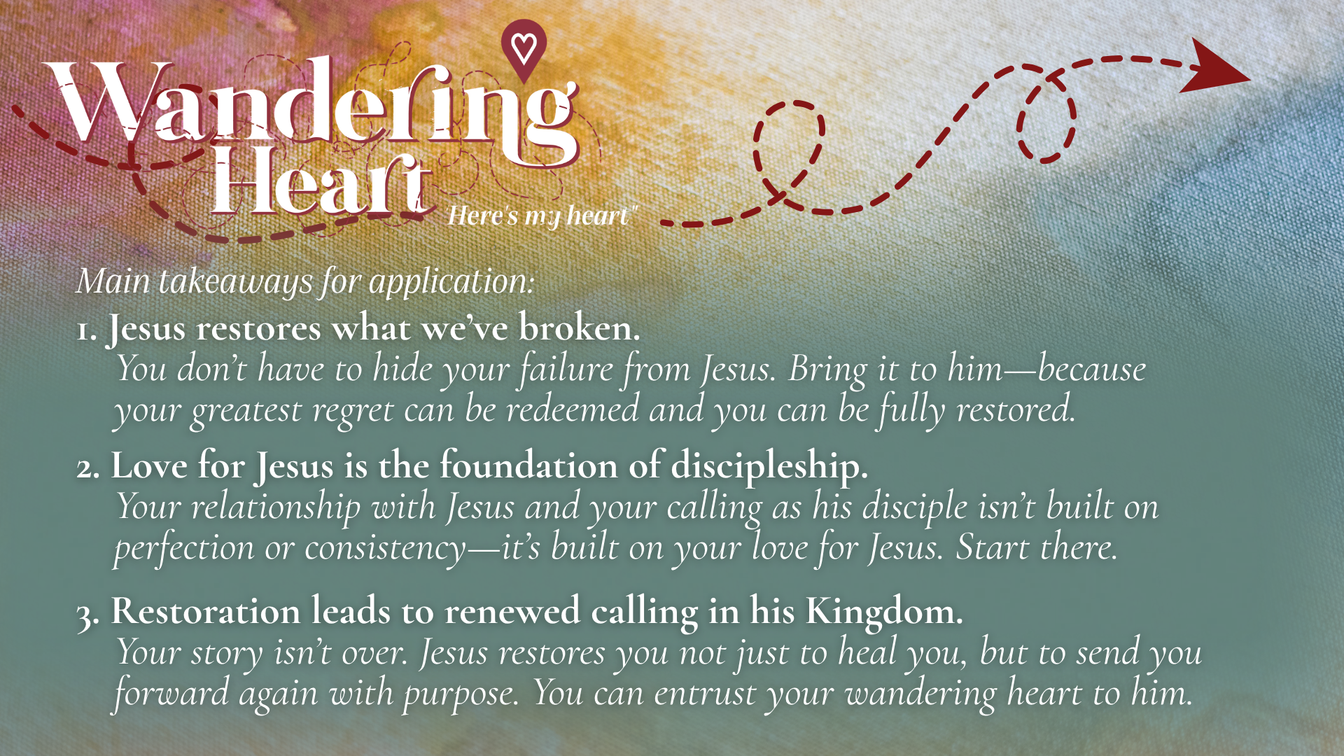
Notes:
[READ & COMMENT ON EACH POINT]
Jesus restores what we’ve broken. You don’t have to hide your failure from Jesus. Bring it to him—because your greatest regret can be redeemed and you can be fully restored.
Love for Jesus is the foundation of discipleship. Your relationship with Jesus and your calling as his disciple isn’t built on perfection or consistency—it’s built on your love for Jesus. Start there.
Restoration leads to renewed calling in his Kingdom. Your story isn’t over. Jesus restores you not just to heal you, but to send you forward again with purpose. You can entrust your wandering heart to him.
Your story isn’t over. It reminds me of this quote from Bryan Stevenson, which our family has on a magnet on our fridge at home… [NEXT SLIDE]

Slide 16
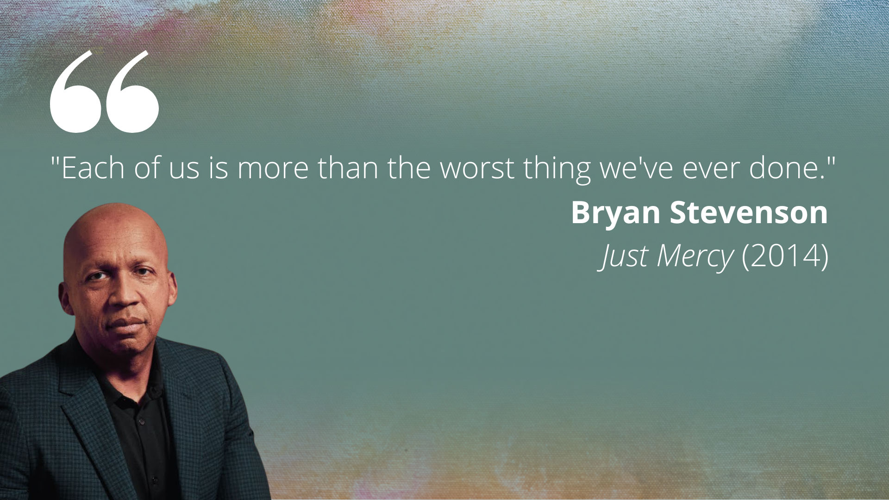
Notes:
[READ QUOTE & COMMENT]
Doesn’t that just sound like Jesus? You see… our culture might be into cancelling people… but Jesus is into redeeming and restoring them. Church, with the Lord… this sort of mercy, grace, and love… this sort of redemption… is possible. All we must do is repent, believe this good news, and be willing to share it with others… in the name of Jesus. Amen?
Here are some questions for reflection and to help us respond… [NEXT SLIDE]

Slide 17


Slide 18
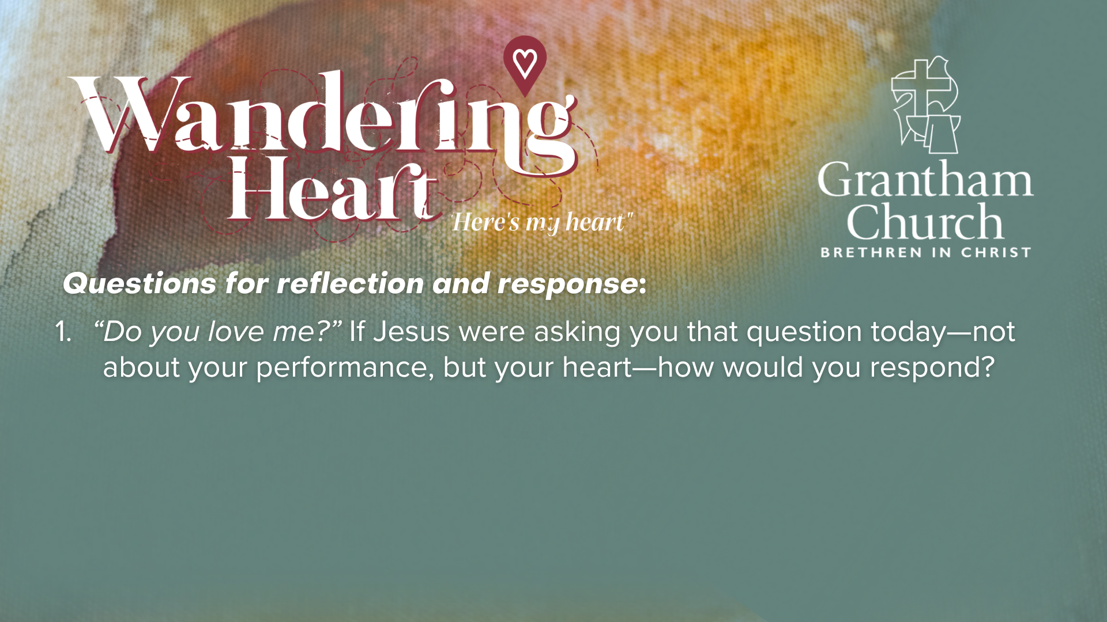

Slide 19
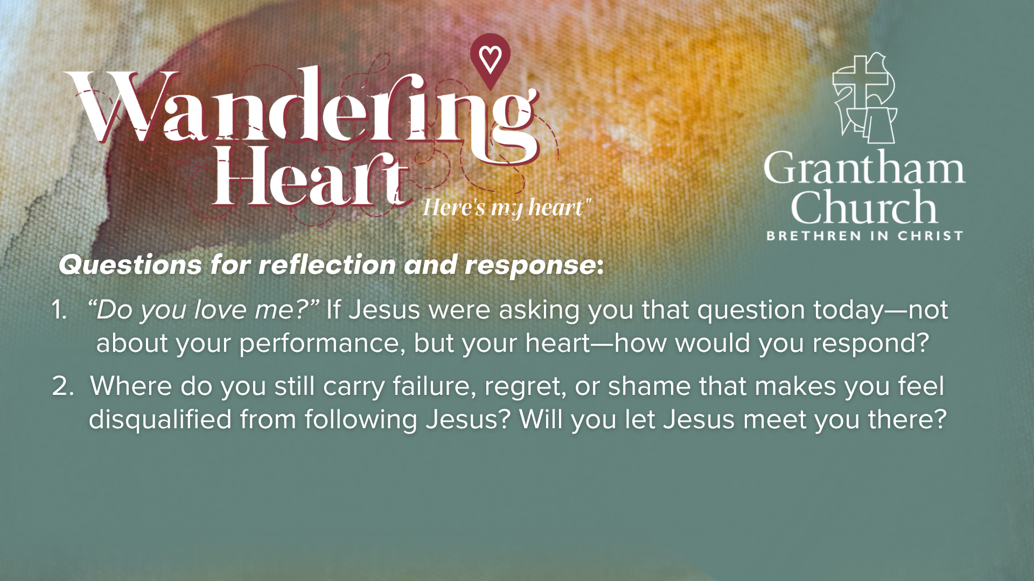

Slide 20
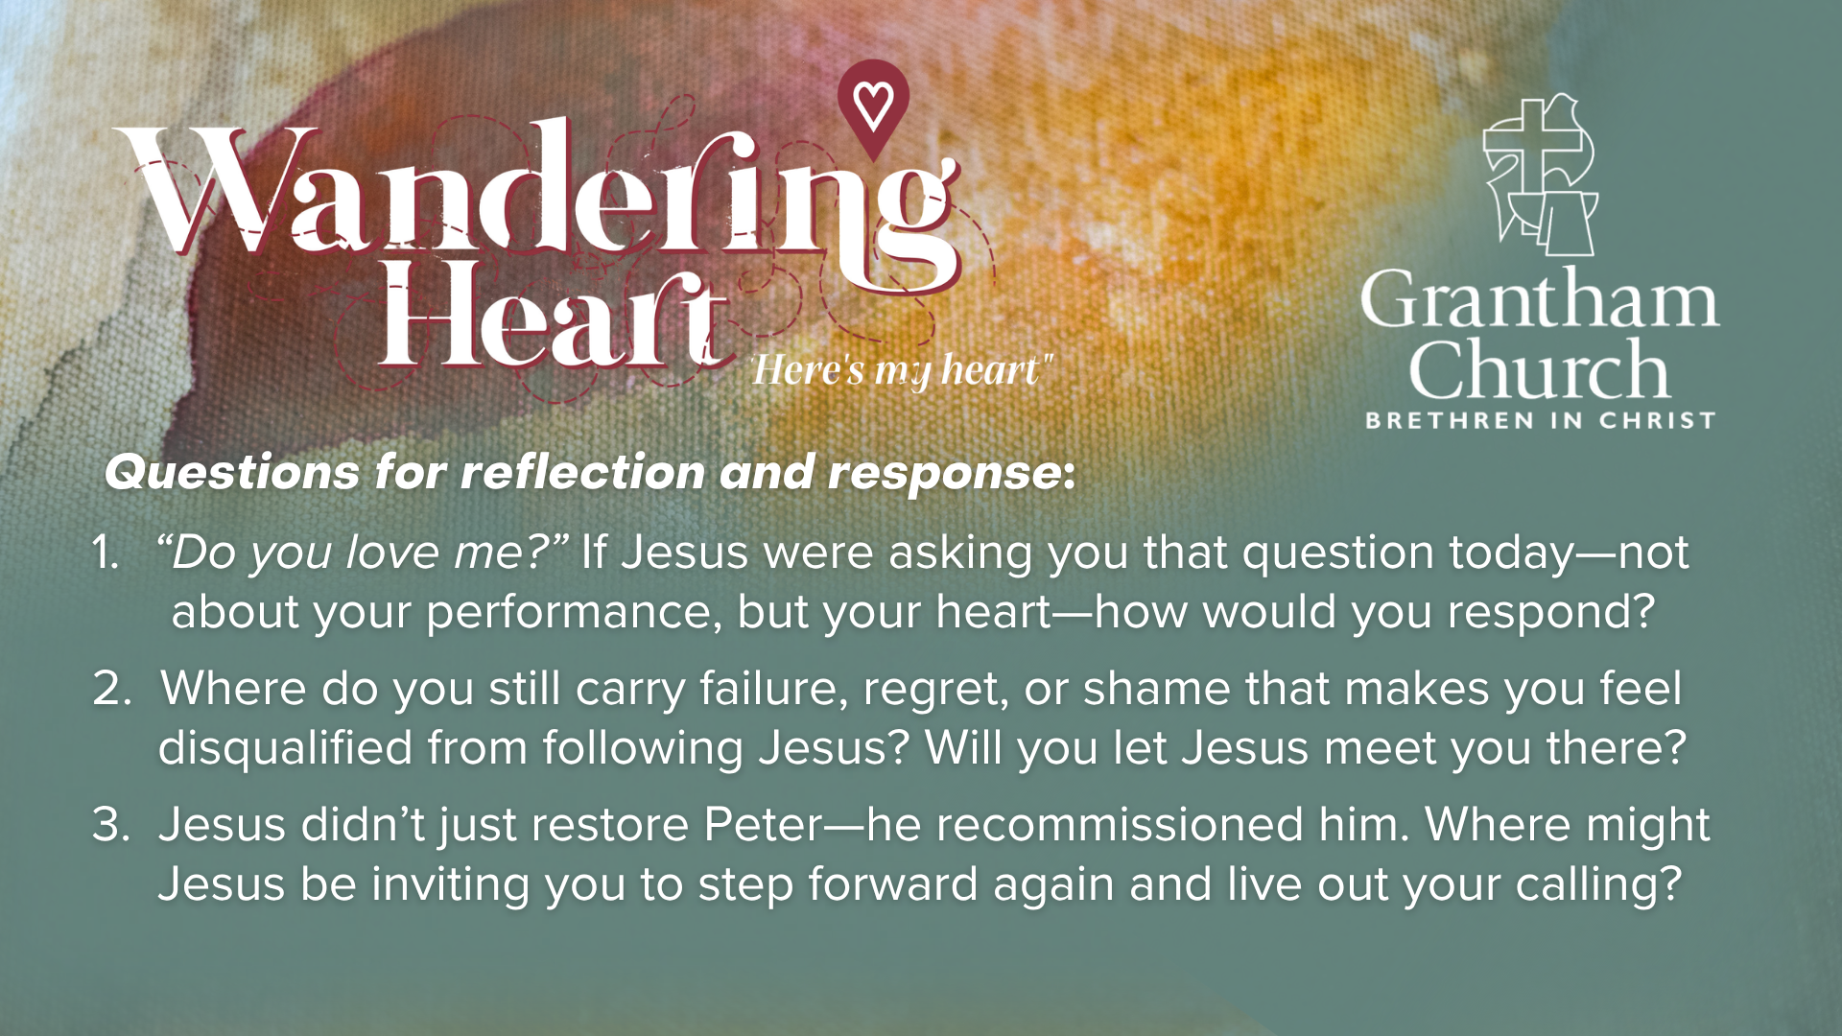
Notes:
[READ QUESTIONS & COMMENT]
“Do you love me?” If Jesus were asking you that question today—not about your performance, but your heart—how would you respond?
Where do you still carry failure, regret, or shame that makes you feel disqualified from following Jesus? Will you let Jesus meet you there?
Jesus didn’t just restore Peter—he recommissioned him. Where might Jesus be inviting you to step forward again and live out your calling?
Brothers and sisters, how is the Spirit speaking to you through Peter’s story? [NEXT SLIDE]

Slide 21

Notes:
To conclude this message and our Wandering Heart series, I want to invite you into a minute or two of imaginative prayer. First, take a look at this picture of the fire and the fish along the seashore. Study that for a moment. Get an imprint of that in your mind. And now, I invite you to close your eyes.
Place yourself on that shoreline with Jesus. The fire is burning. The morning is quiet. And Jesus is looking at you—not with disappointment… but with compassion. Hear him ask you: “Do you love me?” Don’t rush your answer. Just sit with Jesus for a moment…” (pause 10 seconds) Now bring to mind any place in your life where you feel like you’ve failed… where you’ve fallen short… where you’ve been carrying regret or shame. Don’t hide it. Let Jesus meet you there. And hear his voice—not condemning you… but inviting you: “Do you love me?” (pause 10 seconds)
Now, as best you can, respond to him. In your own words… quietly in your heart… Tell him you love him.” (pause 10 seconds) Now hear Jesus speak over you: “Feed my sheep… Follow me.” My brother… my sister… He is not finished with you. Your story is not over. What feels like failure… he is restoring. What feels like the end… he is rewriting. So today, receive his grace. Receive his restoration. And step forward again in his calling on your life.
[GO TO NEXT SLIDE FOR CLOSING PRAYER]

Slide 22

Notes:
[APOSTLES’ CREED]
[COMMUNION]
[ANNOUNCEMENT]
Benediction
Beloved wanderer, as you leave this place,
may you carry your curious heart on your sleeve.
May you look for God in every face.
May you find the courage to get out of the boat,
to run to the tomb, and to speak of your faith.
And when the world falls apart,
may you hear God’s voice deep within,
saying, “Take heart, it is I, be not afraid.”
You are called. You are blessed.
In both your ups and your downs,
you always belong to God.
Go now in peace.
Go trusting that good news.
Amen.

