Slide 1

Notes:
[BRIEF INTRO]
This is week 6 of our 8-week series on Philippians: Cruciformed Community & Our Civic Witness. Each week we have been going verse-by-verse through Philippians—one of the most politically subversive books in the NT—as Paul shares how these early Christians ought to think and live in a city that is committed to the empire. He wants their civic and political life within Philippi to reflect Christ and the gospel of his Kingdom.
Which means they can expect resistance to their faith from their Roman neighbors, as two kingdoms collide with their opposing beliefs and values. Paul had experienced this himself when he planted the church in Philippi in 52 AD, as recorded in Acts 16… [NEXT SLIDE]

Slide 2
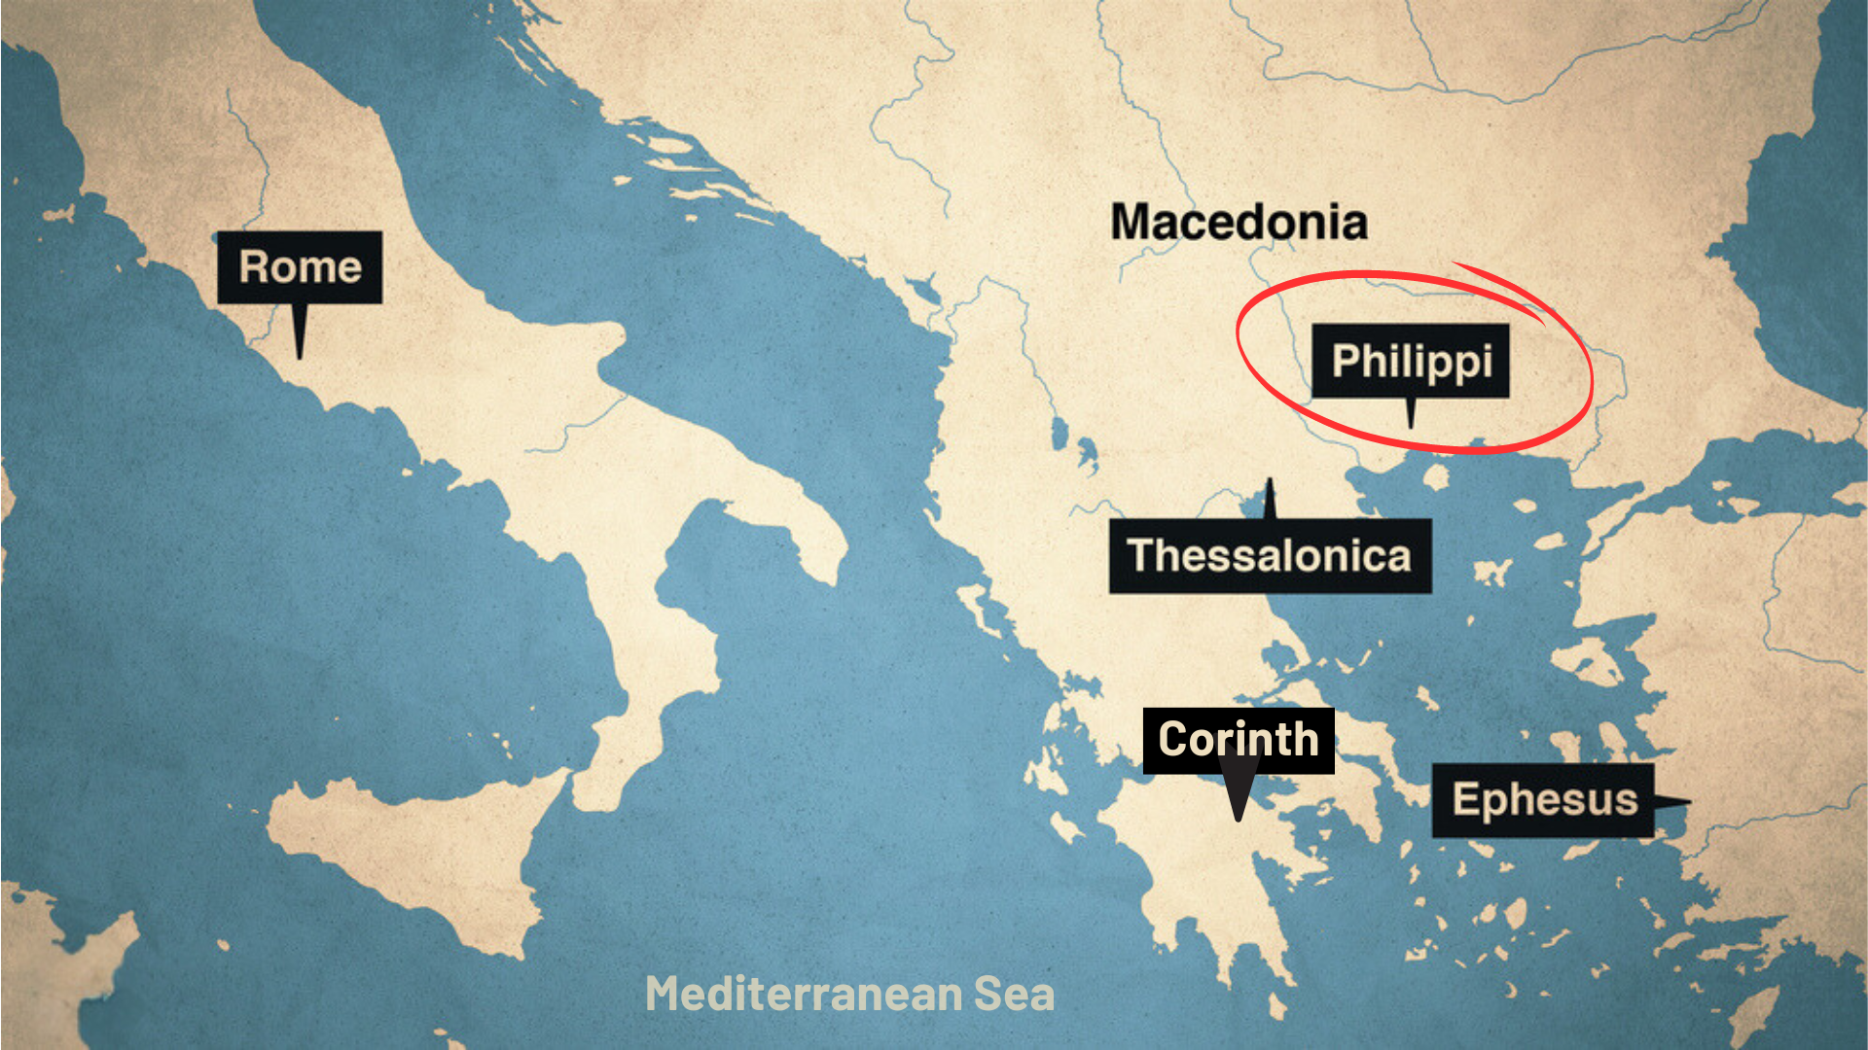
Notes:
And then about 10 years later (62 AD), Paul writes to the Philippian church from Rome, where he is being kept under house arrest, awaiting his trial before the emperor Nero. The Philippians are concerned for Paul. So, they sent Epaphroditus from Philippi to Paul (and Timothy, his co-worker) to help him and then bring word back about how he is doing.
Therefore, the letter to the Philippians is Paul’s response to those concerns, as well as his reminders of what the gospel means for how they are to follow Jesus in an idolatrous city that demanded of its citizens what these early Christians could not give.
Remember… [NEXT SLIDE]

Slide 3
Notes:
[BRIEF COMMENTS]
Philippi was an affluent Roman colony of 10,000 people; it’s full of retired Roman military veterans and patriotic nationalists who are fiercely loyal to empire. They have a special status with Caesar, and they will not tolerate any competing “good news” or rival “Lord”
And there were strong societal and cultural forces that pressured the city’s inhabitants (citizen status or not) to express their patriotism publicly, and an expectation that all Philippians would respect and uphold Roman values and virtues
So, these cultural forces would have impacted every aspect of life: social, political, religious, and economic; and to go against the dominant cultural current was to draw negative attention to yourself, which is what was happening to the church in Philippi
But despite their circumstances, they are trying to stay the course; Paul believes in them and wants to inspire them to remain faithful to Jesus, no matter what happens
It’s important that we keep in mind the flow of Paul’s letter to the Philippians and the content of his message so far… [NEXT SLIDE]

Slide 4
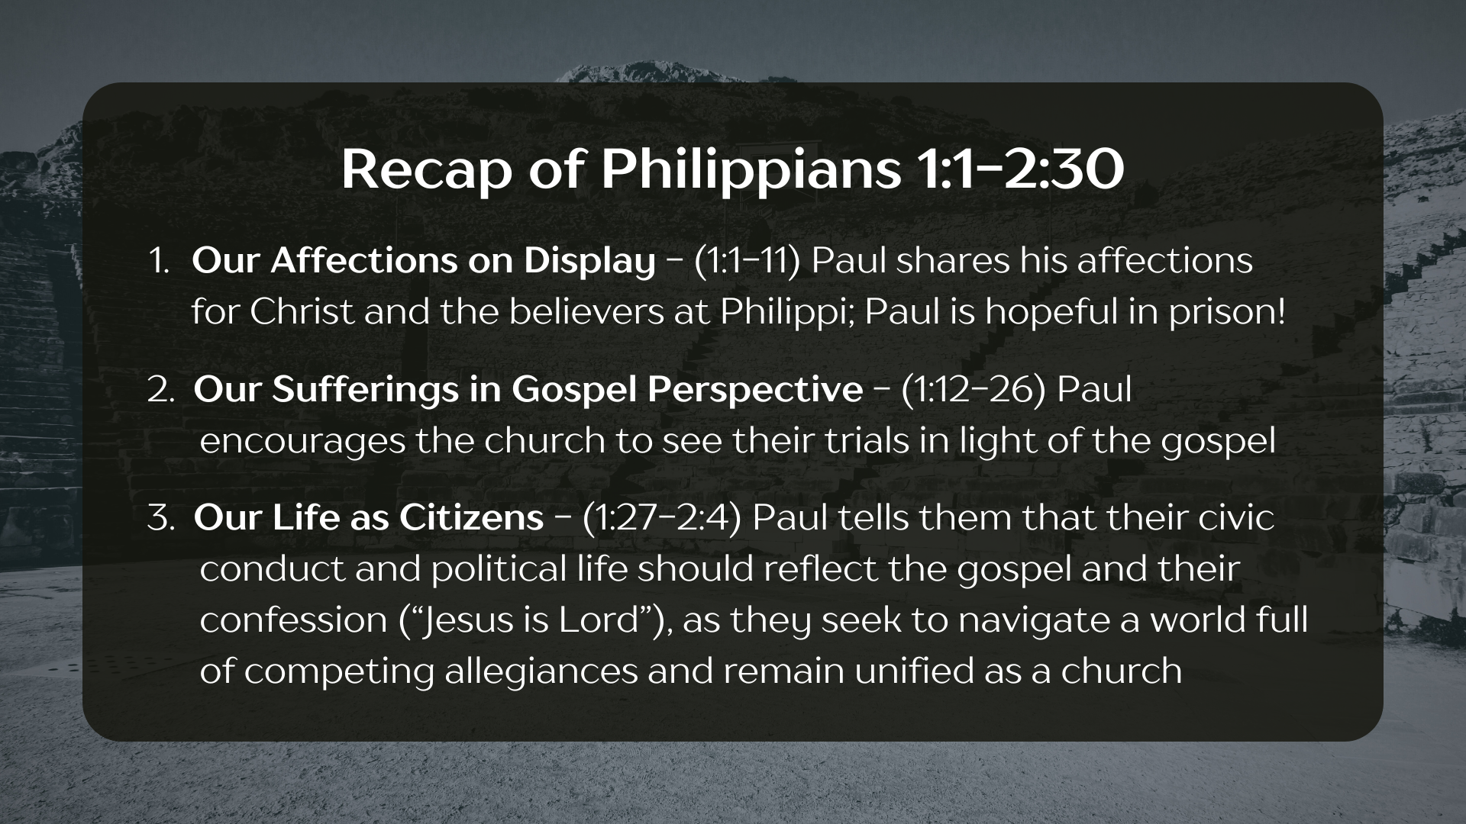
Notes:
[BRIEF COMMENTS]
Paul begins by sharing his deep love for Christ and for the believers at Philippi (1:1-11); Even though he is under house arrest, he is hopeful and wants them to be as well.
In the second message (1:12-26), we heard Paul encourage the Philippian Christians to see their own sufferings in light of the gospel and the Kingdom that is coming in Christ, in the same way Paul sees his own sufferings and the possibility that he might be executed
In the third message (1:27-2:4), we heard Paul tell the Philippian believers that their civic conduct and political life should reflect the gospel and their confession that “Jesus is Lord” (not Caesar), as they seek to navigate a world full of competing allegiances and remain unified as a church; and we unpacked chapter 1, verse 27—a key verse in the letter
And last week in the fourth message, we looked at chapter 2, verses 5-18… [NEXT SLIDE]

Slide 5
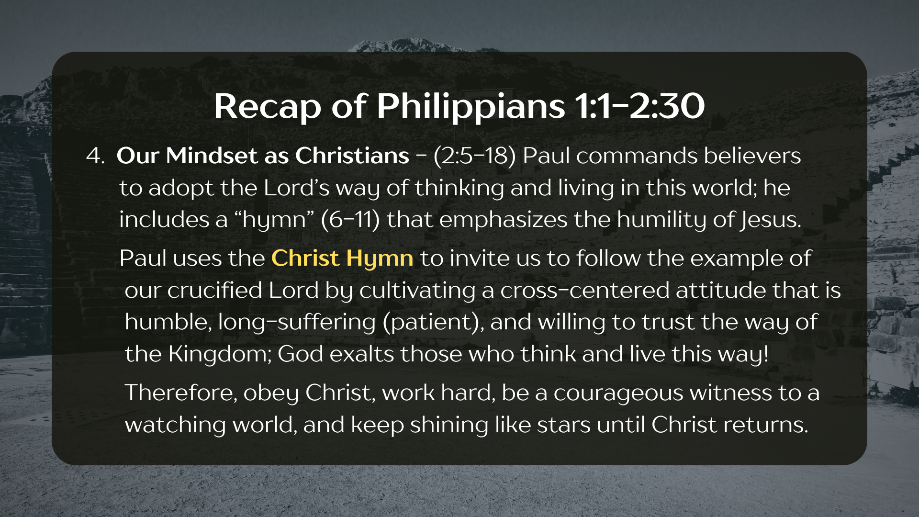
Notes:
[BRIEF COMMENTS]
Paul commands the Philippian believers to adopt the Lord’s way of thinking and living in this world, and he includes a “hymn” in verses 6-11 that emphasizes the humility of Jesus
Paul uses the Christ Hymn to invite us to follow the example of our crucified Lord by cultivating a cross-centered (or cruciformed) attitude that is humble, long-suffering, and willing to trust the way of the Kingdom, because, as we saw with Jesus himself, God exalts those who think and live this way!
Therefore, Paul’s encouragement is to obey Christ, work hard, be a bold and courageous witness to a watching world, and keep shining like stars until Christ returns
And then last Sunday we looked at Philippians 2:19-30… [NEXT SLIDE]

Slide 6
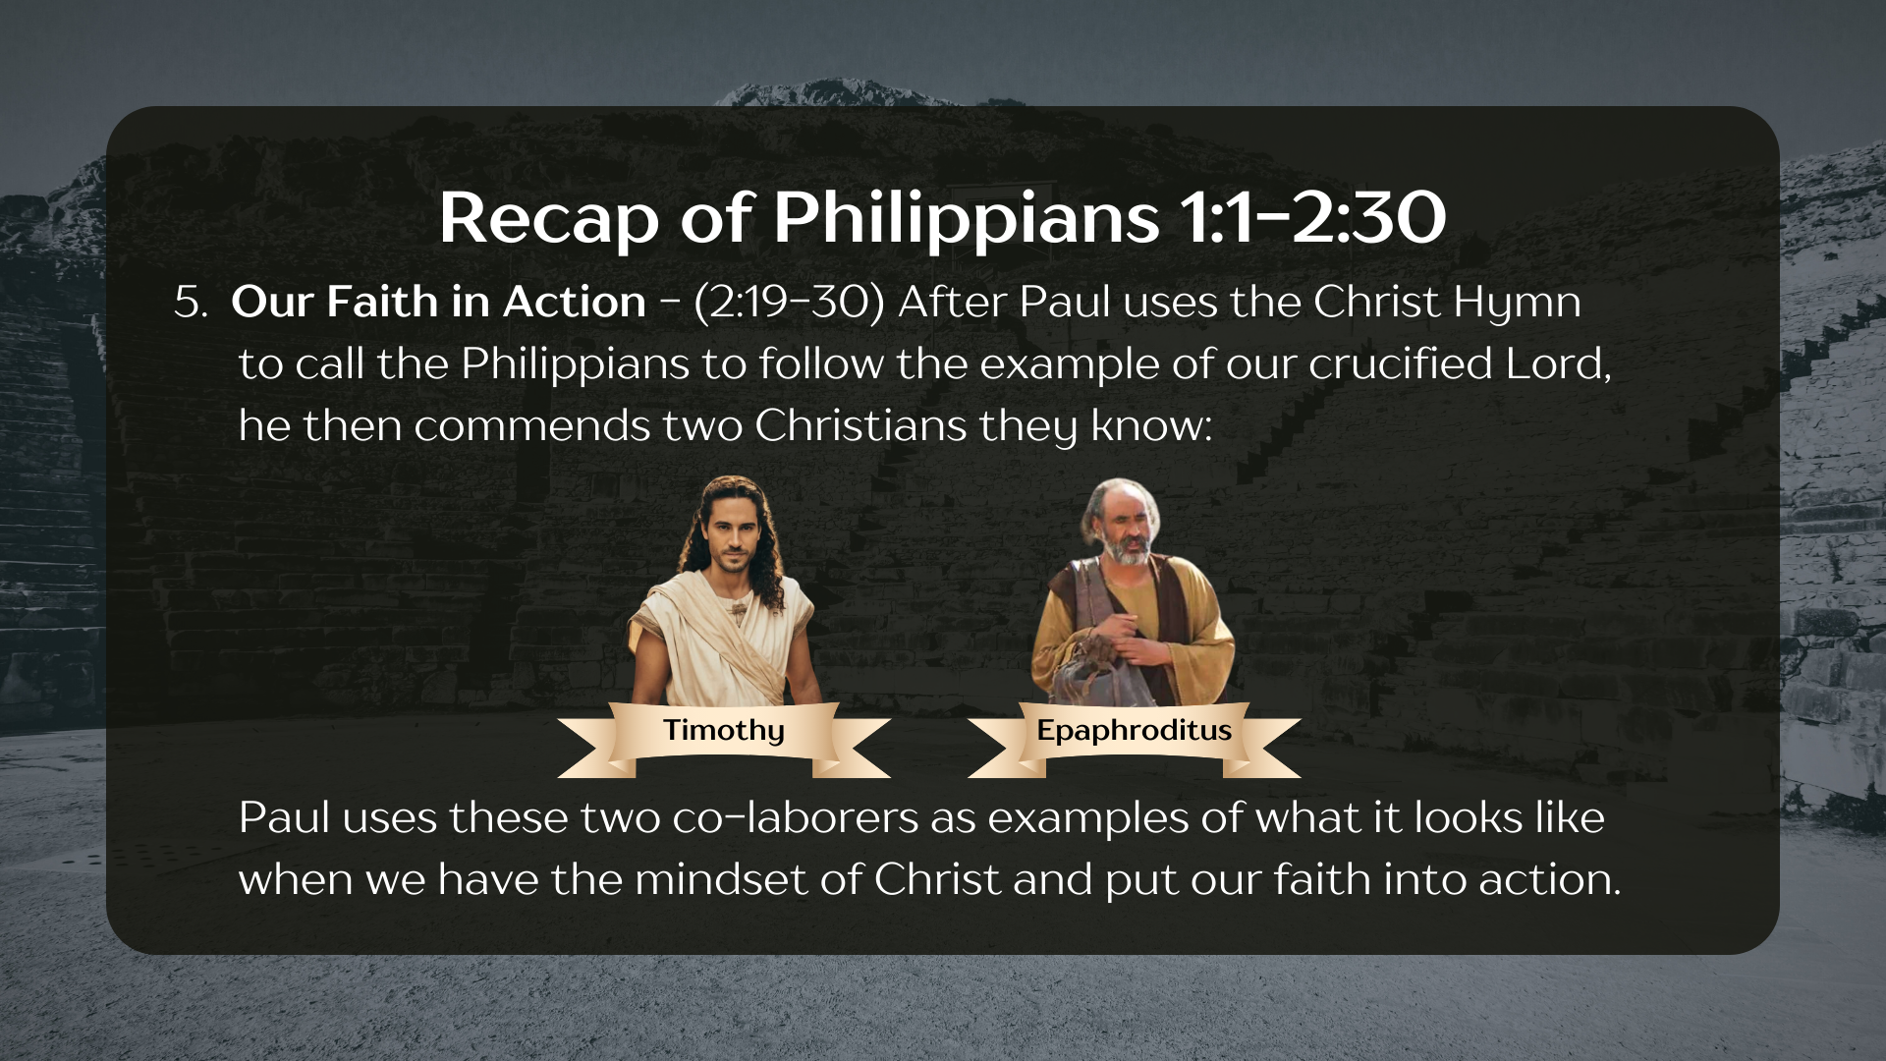
Notes:
[BRIEF COMMENTS]
After Paul uses the Christ hymn to call the Philippians to follow the example of our crucified Lord, he then commends two Christians they know: Timothy and Epaphroditus.
Paul uses these two co-laborers: Timothy, a young church-planting companion, and Epaphroditus, a messenger sent from Philippi with a care-package, who got sick and almost died trying to bring aid and comfort to Paul in Rome. Paul uses their life and their faithful witness to encourage the Philippians to have the mindset of Jesus and embody Christ to each other and their Roman neighbors, who live by different loyalties and allegiances.
Which brings us to our focus for today in the next section of Paul’s letter… [NEXT SLIDE]

Slide 7
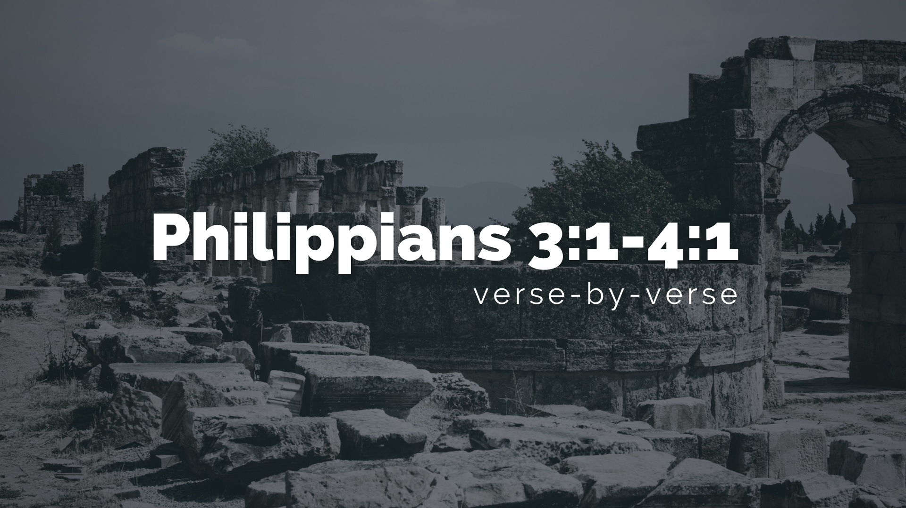
Notes:
Where Paul will now use himself as an example that they (and we) should follow. Paul has no problem telling the Philippian believers to follow his example because (as we’re about to see) he has renounced all his privileges and the pride of his flesh to adopt the mindset of Christ. Let’s go verse-by-verse now, beginning with Ch. 3, verse 1.
[READ & COMMENT ON VERSES 1-9]
v. 1 – “rejoice” just as Paul did in that Philippian prison with Silas; for Paul, joy and rejoicing comes not from things or circumstances, but from people; from relationships
v. 2 – “dogs” were scavengers (not pets); they eat garbage and scraps; it was usually used as an ethnic slur against Gentiles because they eat “unclean” foods
v. 3 – “circumcision” or consecration of the heart to God is a work of the Holy Spirit
v. 4 – if you want to play the “works” and “boasting” game, I could play it
v. 5 – “tribe of Benjamin” was the line of Saul, the first king of Israel; the Pharisees were more ”progressive” in their theology, but went above and beyond in keeping the Law
v. 6 – being “zealous” does not make a person more right, but could be setting you up for a great fall and revelation; for Paul, his misguided zeal led to his conversion; Also, notice that strict law-keeping (a bounded-set faith) produced a false sense of certainty in Paul
v. 7 – NIV: "But whatever were gains to me I now consider loss for the sake of Christ.”
v. 8 – “knowing” Christ is everything for Paul; “garbage” - (skubala) refuse or excrement!
v. 9 – trying to prove your worthy of salvation (or doing works to earn it) or setting yourself apart from others by the things you don’t do… is not the way of Christ; it doesn’t lead to anything good; salvation and the Christian life is to be lived by grace through faith!
And this is significant because Paul is saying that none of us have a special standing with God based on race, ethnicity, or socio-economic status. As Sydney Park writes in the multi-ethnic commentary, The NT in Color… [NEXT SLIDE]

Slide 8
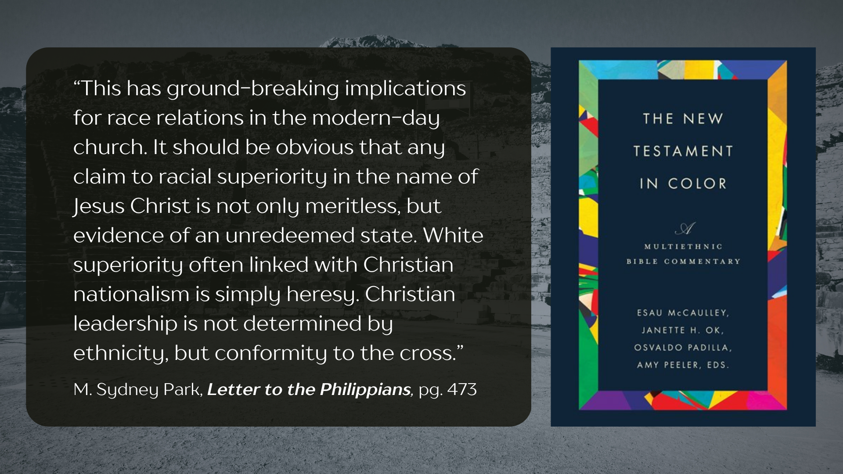
Notes:
[READ QUOTE & COMMENT]
Back to verse 10… [NEXT SLIDE]

Slide 9
Notes:
[READ & COMMENT ON VERSES 10-21]
Let’s look more closely in verse 20… [NEXT SLIDE]

Slide 10
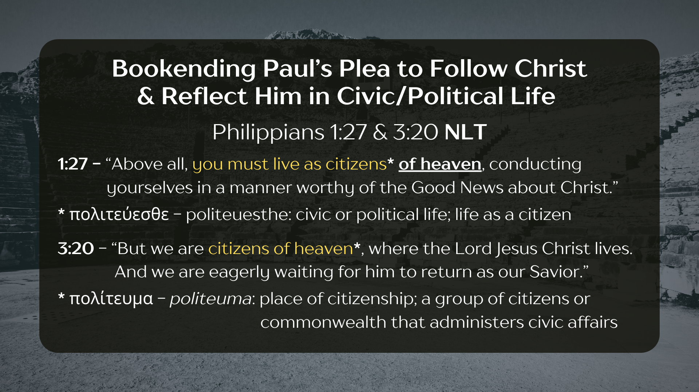
Notes:
[READ & COMMENT]
“Our citizenship is in heaven” (NIV) implies that we should see ourselves as representatives of another Kingdom; we are ambassadors of that Kingdom on behalf of the King who rules over it from heaven, i.e., God’s throne room!
And though we might obtain rights and privileges of earthly citizenship (as did some in Philippi), Paul is saying that isn’t your true citizenship, nor should you think too much of it, lest you be wooed and lured away in idolatry, and put it before your allegiance to Christ
And this is a unified message within the NT, not just from Paul. For example, listen to the author of Hebrews… NEXT SLIDE]

Slide 11
Hebrews 11:13-16 NIV
¹³ All these people were still living by faith when they died. They did not receive the things promised; they only saw them and welcomed them from a distance, admitting that they were foreigners and strangers on earth. ¹⁴ People who say such things show that they are looking for a country of their own. ¹⁵ If they had been thinking of the country they had left, they would have had opportunity to return.
¹⁶ Instead, they were longing for a better country—a heavenly one. Therefore, God is not ashamed to be called their God, for he has prepared a city for them.
Notes:
[READ & COMMENT ON PASSAGE]
Now, we need to think for a moment about what Paul means by the “return” of Jesus. What can we expect? What might that look like? And what difference does it make?
Well, let’s reflect for a moment on how Paul describes it in… [NEXT SLIDE]

Slide 12
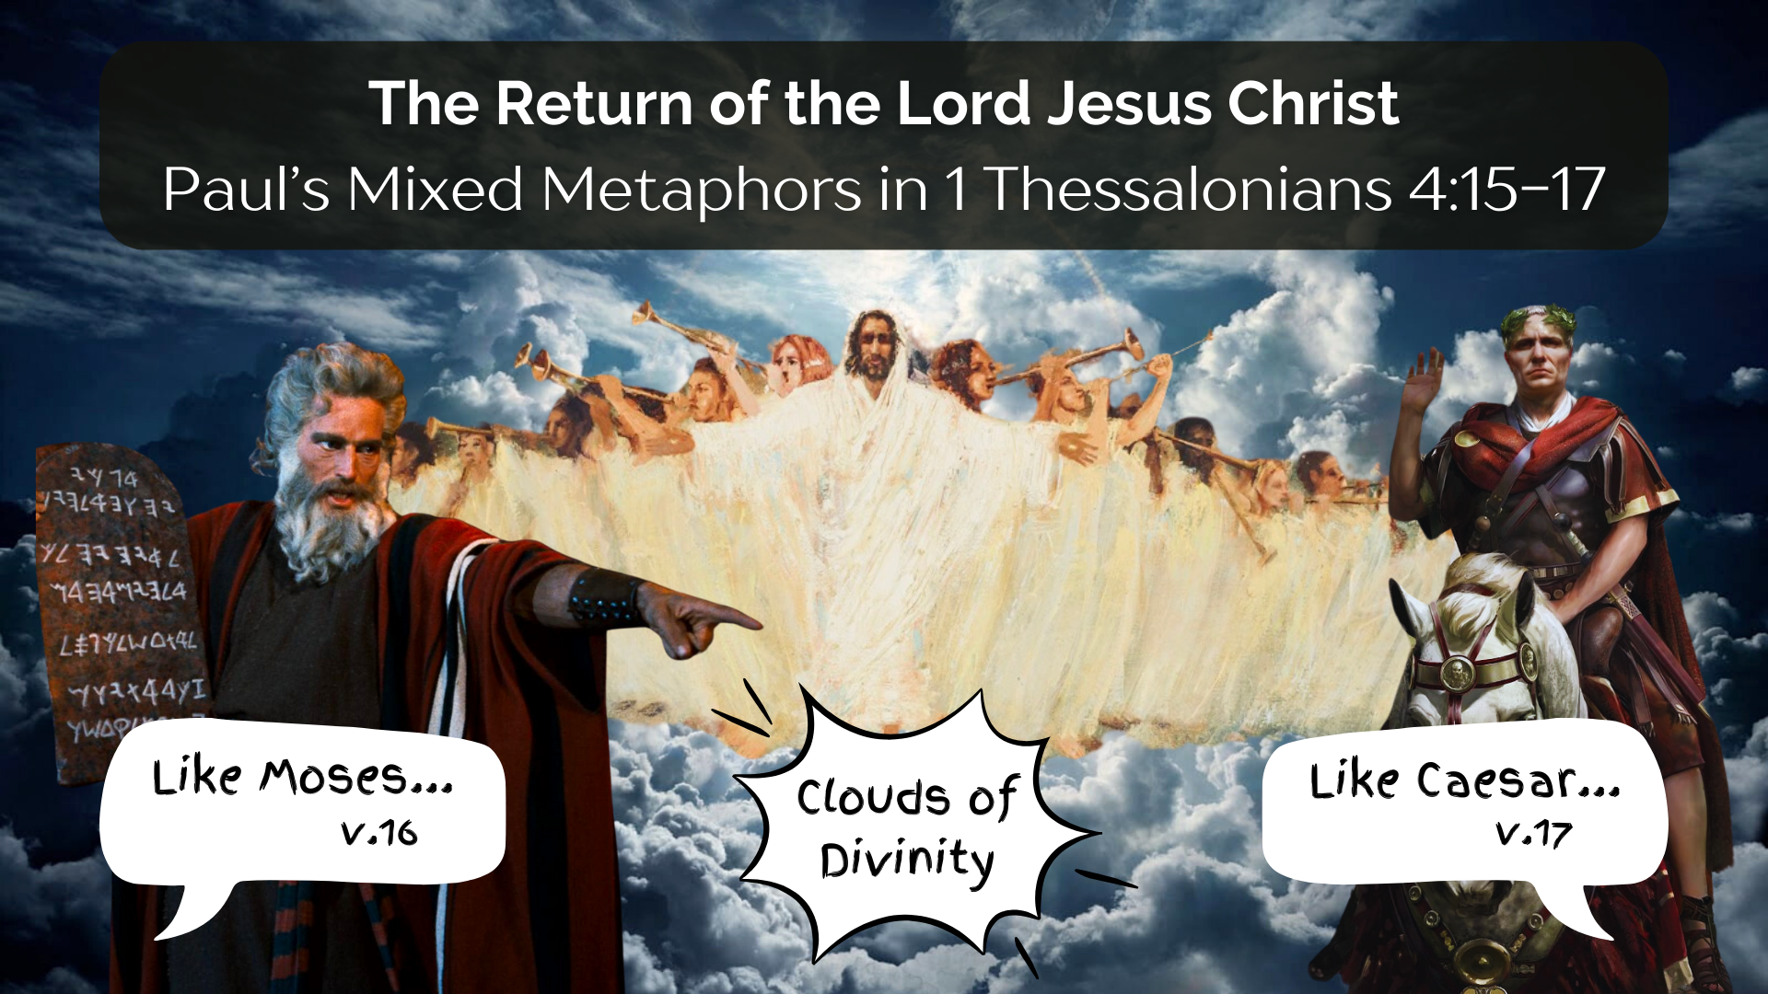
Notes:
[READ SCRIPTURE & COMMENT ON THE METAPHORS]
15 According to the Lord’s word, we tell you that we who are still alive, who are left until the coming of the Lord, will certainly not precede those who have fallen asleep. 16 For the Lord himself will come down from heaven, with a loud command, with the voice of the archangel and with the trumpet call of God, and the dead in Christ will rise first. 17 After that, we who are still alive and are left will be caught up together with them in the clouds to meet the Lord in the air. And so, we will be with the Lord forever.
Again, remember what Paul said in Philippians 3:21, “He will take our weak mortal bodies and change them into glorious bodies like his own, using the same power with which he will bring everything under his control.”
And finally, Paul writes in chapter 4, verse 1… NEXT SLIDE]

Slide 13
Notes:
[READ & COMMENT ON 4:1]
Paul is speaking of the eschaton (Gk: last things)
Our belief in where things are going should impact our present faith and living!
So, knowing that our citizenship is in heaven, and knowing that Christ will someday return “to judge the living and the dead” (and bring heaven to earth), we ought to think and live in keeping with that reality, no matter what happens
And that is why Paul didn’t use his power and privileges for his own advantage, but (like Jesus) he used them to glorify God the Father. Therefore, he used his rights as a Roman citizen, his status from the tribe of Benjamin, and his training as a Pharisee, as well as his unique gifts and skills as an apostle of Christ, to serve others and not live for himself.
Everything Paul was, is, or ever will be is now wholly devoted to Christ and his gospel mission. And that’s the way he wants the Philippians to see their own existence. And that’s the way he wants us to see ours.
As we prepare to respond to the Spirit together, here are some questions to help… [NEXT SLIDE]

Slide 14
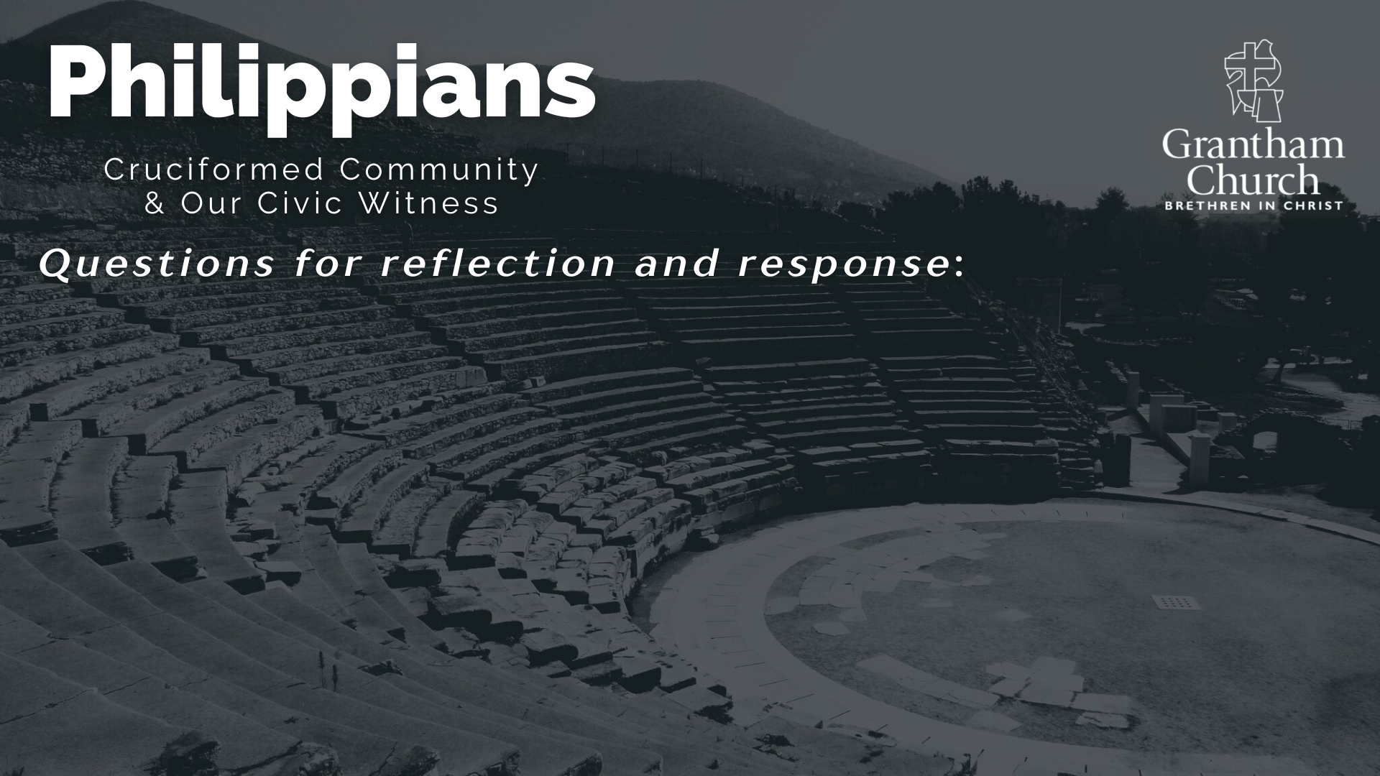

Slide 15
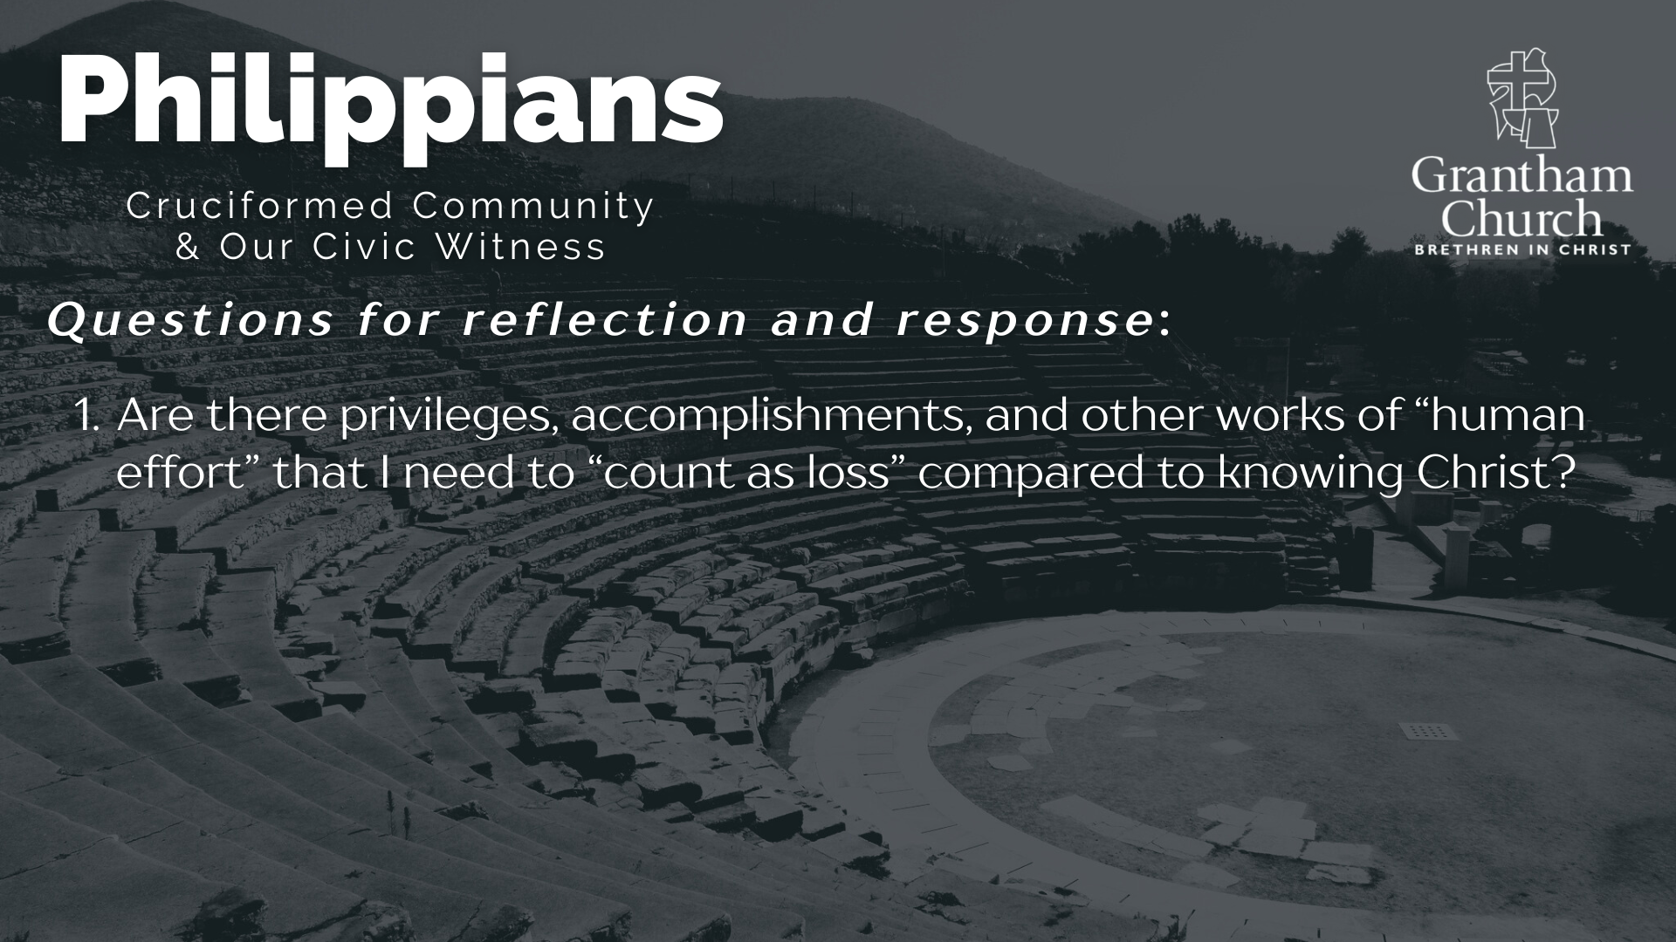

Slide 16
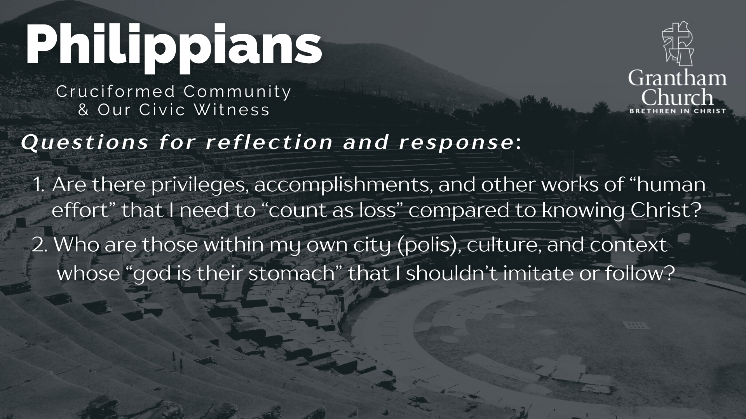

Slide 17
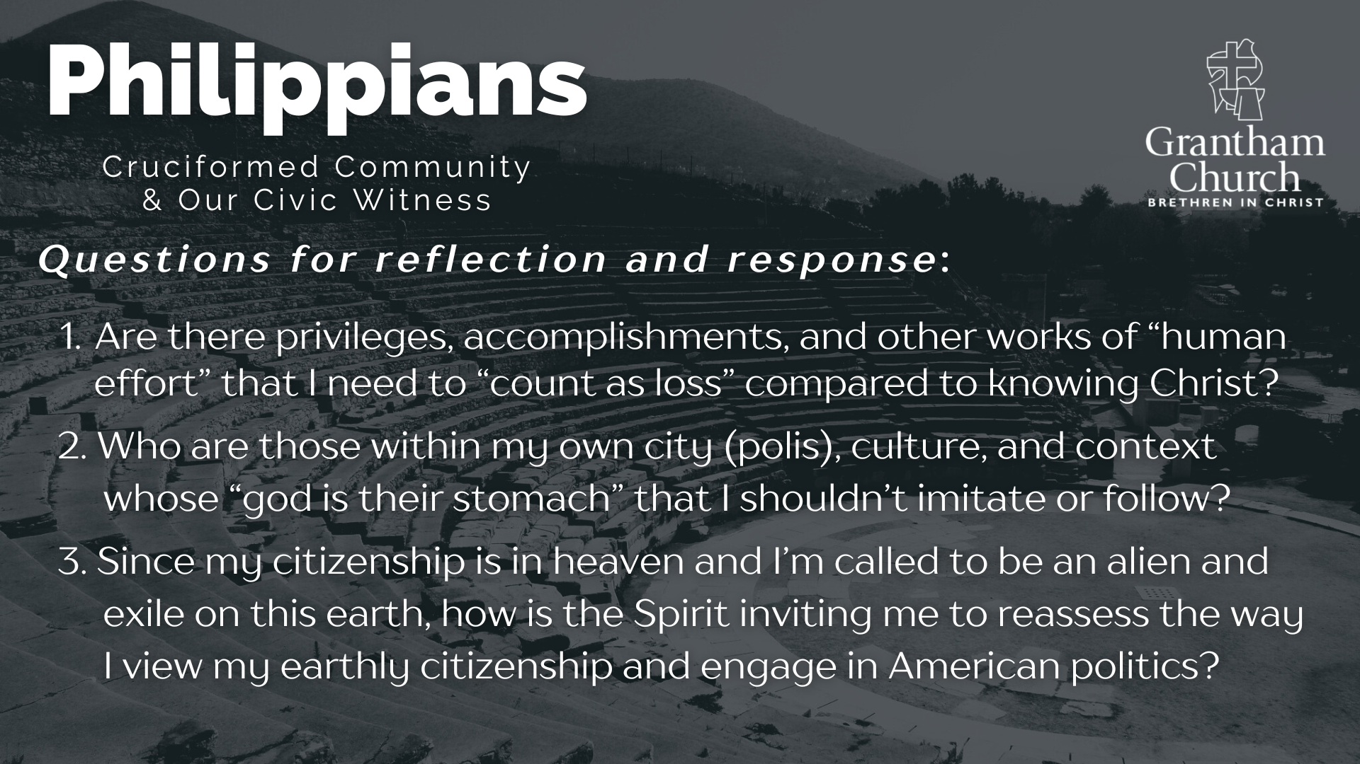
Notes:
[READ & BRIEF COMMENT ON EACH QUESTION]
Are there privileges, accomplishments, and other works of “human effort” that I need to “count as loss” compared to knowing Christ?
Who are those within my own city (polis), culture, and context whose “god is their stomach” that I shouldn’t imitate or follow?
Since my citizenship is in heaven and I’m called to be an alien and exile on this earth, how is the Spirit inviting me to reassess the way I view my earthly citizenship and engage in American politics?
Let’s pray… [NEXT SLIDE]

Slide 18

Notes:
[CLOSING PRAYER]
Benediction
May the God who looks like Jesus lead you to faithfully follow him in a world that needs to hear and see the Gospel of Jesus Christ. And may the grace and peace of the Lord Jesus comfort and sustain you as a witness of his coming Kingdom. Amen.

