Slide 1
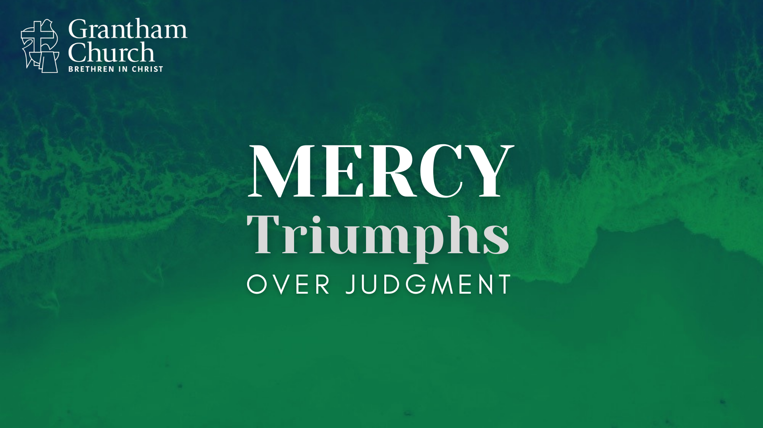
Notes:
[BRIEF INTRO]
Taking a wrong turn in Baltimore—a child’s heart reflects the mercy and grace of God.
Luke 18:16-17 - “For the Kingdom of God belongs to those who are like these children. I tell you the truth, anyone who doesn’t receive the Kingdom of God like a child will never enter it.”
Over the next two weeks I’m sharing a two-part message on mercy and grace.
What is mercy and grace? You might be thinking… aren’t those basically the same thing? [NEXT SLIDE]

Slide 2

Mercy & Grace – Related But Different
Both mercy and grace are gifts from God.
Mercy is about forgiveness and pardon—
not getting the punishment we deserve.
Grace is about blessing and empowerment—
getting good things we don’t deserve.
Notes:
[BRIEF COMMENTS]
Think of it this way… picture a prison. Mercy is pardoning someone; charges are dropped, the cell door is opened—they’re free to go, record is cleared. They can begin again. Grace says… here is some food, clothes, a driver’s license (a new identity), some family/friends, and keys to a car & house. Both are gifts that can be accepted or rejected. But make no mistake… this is God’s heart toward us. And he wants it to be our heart toward others. But unfortunately, it seems that our society is short on mercy and grace these days.
In fact, I’d say that America has a mercy and grace problem. Think about this:
The US was born in violent revolution – perpetuating the myth of redemptive violence, so we tend to think of “justice” as retributive - “eye for eye” (e.g., Rambo & John Wick)
The US is the world leader in incarceration – over 2 million!
27 states in the US still practice capital punishment
Our country aborts over 3 quarters of a million babies each year
Almost 50% of marriages will end in divorce
Over 27 million Americans don’t have health insurance
Almost 34 million people live below the poverty line
Over the past several years, the number of refugees admitted to the US dropped by 86 percent
And as we’ve all seen, our political parties have thrown mercy and grace out the window
Of course, if you really want to see us at our worst today, look no further than social media. [NEXT SLIDE]

Slide 3
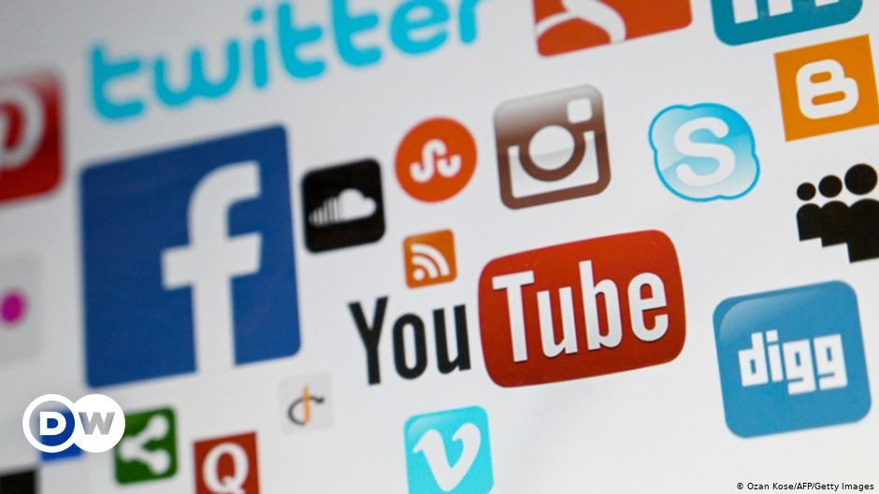
Notes:
[BRIEF COMMENTS ON SOCIAL MEDIA]
So, what’s happening here? Why are we lacking in mercy and grace today?
Well, this is a multifaceted problem – (1) we’ve lost the biblical concept of sin, particularly our own sinfulness; (2) we are polarized and trapped in our echo chambers and social media algorithms, so we tend to think we’re right and everyone else is wrong; (3) we live in a hyper-critical, judgmental culture that looks for scapegoats and people to transfer our sins and the blame; and (4) our hyper-individualistic, self-centered society has convinced us that we’re OK the way we are; we just need to accept ourselves and express our ”authentic” selves to the world.
And you know… our society isn’t all that different from ancient Rome and the time of the early church. Mercy was seen as weakness—it reflected a character defect because mercy involved pardoning the guilty and providing help or relief to those who haven’t earned it; it was seen as contrary to justice. Mercy was only given by children, the naïve, and the weak-minded. It reminds me of what Sensei Kreese taught his Cobra Kai students. [NEXT SLIDE]

Slide 4
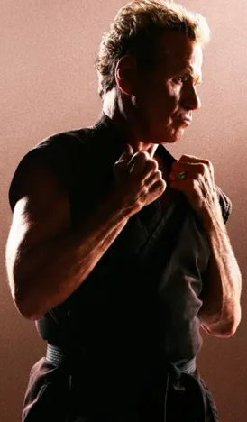
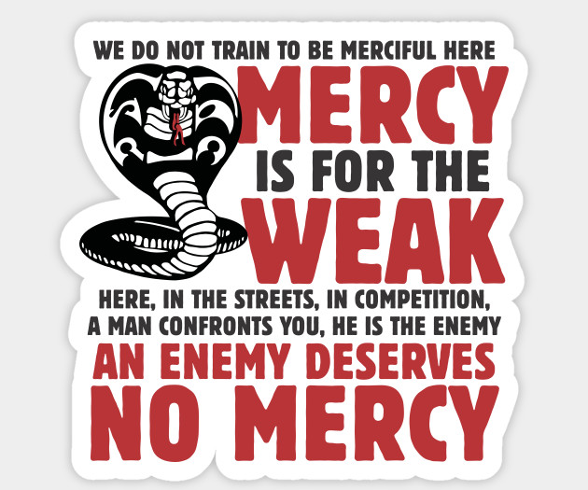
Notes:
[BRIEF COMMENT]
But folks, the Bible teaches us that God is a God of mercy. And remember what Jesus said in Matthew 5:7, “Blessed are the merciful, for they will be shown mercy.” You see, the gospel tells us that without his mercy, none of us can stand. According to the Scriptures, without God’s mercy and grace, both receiving it and extending it to other sinners like us, we (along with our world) are headed for hell. We will not be able to escape the wrath to come when the curtain of the cosmic stage finally drops and the show is over if we do not acknowledge our sin, see our need for God’s mercy, receive it, and give it away as we have so graciously been given it through the cross of Christ.
So, we need to reflect on this for our own salvation and for the salvation of others, especially if the church is going to be agents of mercy and grace (and true believers in the gospel) amidst a merciless and graceless world. [NEXT SLIDE]

Slide 5
The Bible On God’s Mercy & Our Calling
Deuteronomy 4:31
1 Chronicles 21:13
Nehemiah 9:31
Ps. 51:1-2, 16-17; 57:1-3
Isaiah 55:6-7
Hosea 6:6
Micah 6:8, 7:18
Jonah 4:2
Matthew 5:7; 7:1-3; 9:10-13; 23:23
Luke 7:36-50
Romans 9:16; 11:32; 12:1
Ephesians 2:3-5
Hebrews 4:16
James 2:13
1 Peter 1:3; 2:10
Notes:
[BRIEF COMMENTS]
Let’s look at a few of these together and then we will look at our main passage in Luke 7. [NEXT SLIDE]

Slide 6
Isaiah 55:6-7 NIV
Seek the Lord while he may be found;
call on him while he is near.
Let the wicked forsake their ways
and the unrighteous their thoughts.
Let them turn to the Lord, and he will have mercy on them, and to our God, for he will freely pardon.
Notes:
[BRIEF COMMENT ON PASSAGE]
King David said, don’t let me fall into human hands but rather into the hands of God—the One who is merciful and forgiving. Even when David had sinned greatly in committing adultery with Bathsheba, he prayed this in Psalm 51.
[READ PSALM 51 NLT & COMMENT]
Listen as the mercy of God and our calling to be merciful comes through in another Old Testament passage… [NEXT SLIDE]

Slide 7
He has shown you, O mortal, what is good.
And what does the Lord require of you?
To act justly and to love mercy
and to walk humbly with your God.
Micah 6:8 NIV
Notes:
[BRIEF COMMENT]
Notice that holding justice and mercy together (in humility) creates a unique Kingdom approach. This justice is restorative, not retributive. It’s about healing and setting things right (which requires confession, forgiveness, and repentance). It’s not about vengeance, revenge, payback, and getting even! And it’s ultimately not about the law and order of human governments. Why? Because they do not operate according to restorative justice.
While there is certainly a divine purpose for government and laws to suppress evil, to ensure that people are treated fairly, and restrain those who have unregenerate hearts (as the apostle Paul will tell us in Romans 13), remember that it’s not the role of the state to follow the teachings of Jesus and model his radical upside-down Kingdom. Brothers and sisters, that is the church’s job. It is our calling. As Paul wrote about in Romans 12.
That’s why Jesus said this to his followers in the Sermon on the Mount… [NEXT SLIDE]

Slide 8
Jesus, Matthew 7:1-3 NIV
¹ “Do not judge, or you too will be judged. ² For in the same way you judge others, you will be judged, and with the measure you use, it will be measured to you. ³ “Why do you look at the speck of sawdust in your brother’s eye and pay no attention to the plank in your own eye?
Notes:
[BRIEF COMMENT]
Taking from The Tree of the Knowledge of Good & Evil made us judges over others and condemned ourselves.
The problem with judgment in our nature: (1) we have a distorted view of self; (2) we compare & contrast
The problem with judgment in our society and politics – it will always reflect the broken, sinful people in them; only so much can and will be accomplished through worldly means.
That is why Jesus is calling the church to be his called-out community of mercy and grace (not of judgment; to carry our cross, not a sword; to love mercy not the gavel; to see a justice that restores everyone involved), which begins by being people who are honest about how we measure up to God’s standards (Rom. 3:23) and living in a way that says to others—we know that we are the worst of sinners and that God has lavished his mercy out upon us.
That is what Paul was getting at when he told his young padawan learner this in 1 Timothy 1:15-16. [NEXT SLIDE]

Slide 9
Paul, 1 Timothy 1:15-16 NIV
¹⁵ Here is a trustworthy saying that deserves full acceptance: Christ Jesus came into the world to save sinners—of whom I am the worst. ¹⁶ But for that very reason I was shown mercy so that in me, the worst of sinners, Christ Jesus might display his immense patience as an example for those who would believe in him and receive eternal life.
Notes:
[BRIEF COMMENT]
Can you say that? “I am the worst of sinners.” Or do you think it’s fairly reasonable that God would love you? Maybe you’d say, “You know… I’m not that bad… at least not as bad as some others I know.”
You see… that’s the Pharisee in us. Remember them?
Let’s turn now to our main Scripture passage this morning in Luke 7:36-50. [NEXT SLIDE]

Slide 10
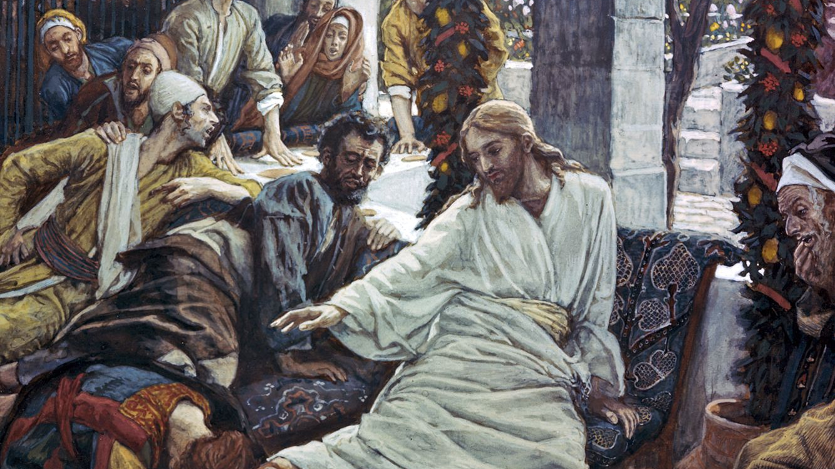
Luke 7:36-50 NLT
Notes:
[READ PASSAGE & COMMENT]
My friends, look how mercy opens the door…
to forgiveness
to reconciliation
to restored relationships
to reconnection to God and the community
to healing
to the release of burdens and debts
to new beginnings and seasons of life
and ultimately… to the Kingdom of God
That is why, as James says in his epistle of wisdom… [NEXT SLIDE]

Slide 11
“Mercy triumphs over judgment.”
James 2:13 NIV
Notes:
So which character are you in the story we read from Luke 7? Can I make a suggestion? Don’t be like Simon. See yourself in the sinful woman, and then let us be like Jesus who said this to the religious leaders in Matthew 9. He said, “It is not the healthy who need a doctor, but the sick. Go and learn what this means: ‘I desire mercy, not sacrifice.’ For I have not come to call the righteous, but sinners.”
Finally, let’s respond to this message in the following ways: [NEXT SLIDE]

Slide 12
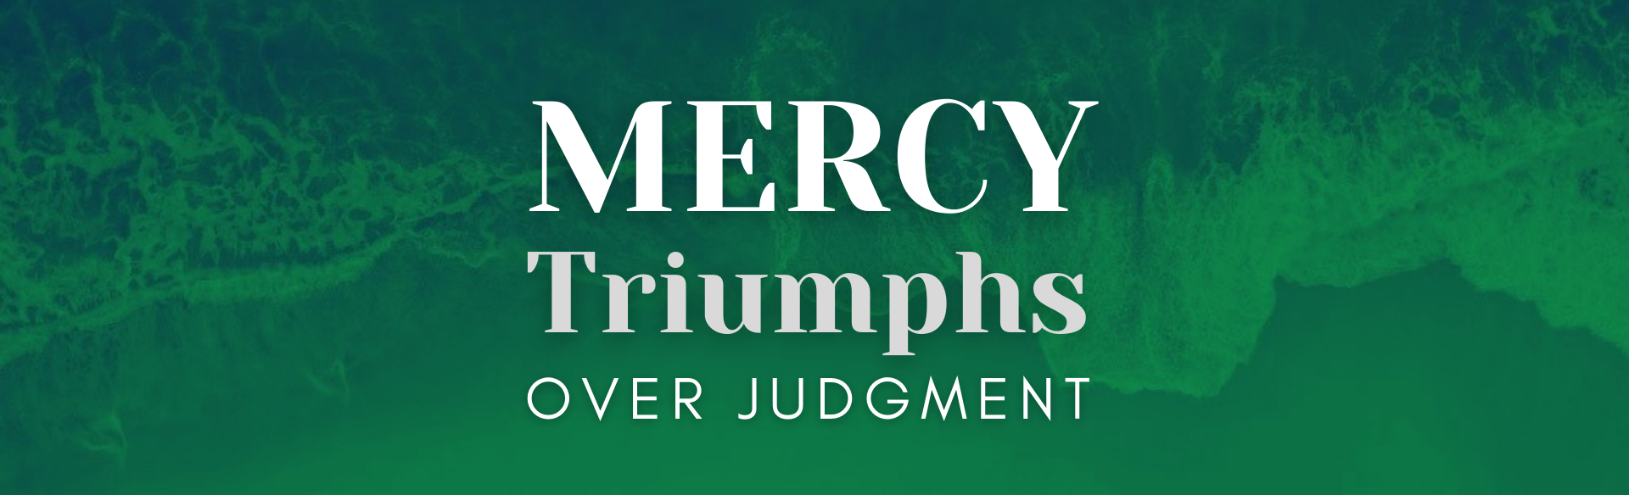
The Challenge
& Invitation
How you can respond to the message:

Slide 13
The Challenge
& Invitation
How you can respond to the message:
Come as you are to the God of mercy.
Notes:
[BRIEF COMMENT]
The Lord of mercy invites us to come as we are and bring our burdens with us.
Revelation 4:2-3 – the emerald rainbow over the throne of God in heaven; a symbol of mercy!
Hebrews 4:16 “Let us then approach God’s throne of grace with confidence, so that we may receive mercy and find grace to help us in our time of need.”
Secondly… [NEXT SLIDE]

Slide 14
The Challenge
& Invitation
How you can respond to the message:
Come as you are to the God of mercy.
Consider your own sinfulness in light of
God’s holiness and the cross of Christ.
Notes:
[BRIEF COMMENT]
Stop comparing yourself to others and sit in the presence of a holy God
Isaiah 6:5 - “Woe to me!” I cried. “I am ruined! For I am a man of unclean lips, and I live among a people of unclean lips, and my eyes have seen the King, the Lord Almighty.”
While we may mean well, our busyness is often used to avoid the silence and avoid looking in the mirror and being honest about who we are and where we’re at with God. And as long as we do that, we will not find rest for our souls—we won’t discover God’s mercy or have any to give others.
And lastly… [NEXT SLIDE]

Slide 15
The Challenge
& Invitation
How you can respond to the message:
Come as you are to the God of mercy.
Consider your own sinfulness in light of
God’s holiness and the cross of Christ.
Commit to loving mercy and blessing others.
Notes:
[BRIEF COMMENT]
When you’ve acknowledged who you are standing alone before a holy God and you’ve experienced his mercy for yourself, let it inform the way you relate to others. Believe that mercy triumphs over judgment and trust in God’s power to change the world in this way. Exchange the gavels of your heart for the gospel of mercy.
Church, have only one opinion of yourself: “I’m the worst of sinners and yet Jesus died for me.” And one opinion for everyone else: “They are loved by God and worthy of Jesus dying for on the cross.” And in this way, we do as Paul commanded us in Romans 12:1 “in view of God’s mercy… offer your bodies as a living sacrifice.”
Brothers and sisters, if we will do that… we will truly live. And others who acknowledge they are also sinners in need of a merciful savior will join us in the Kingdom, just as Jesus desires. [NEXT SLIDE]
[CLOSING PRAYER]
Lord, our sins are many, but your mercy is more.

