Slide 1

Notes:
[BRIEF INTRO]
4 Sundays before Lent / stand-alone messages
Sun, Dec 31 – congregational exercise & responses
“With God’s help in 2024, I will stop… I will start…”
Over 90 response cards - Thank you for your honesty & vulnerability!
So, over the next few weeks, I’ll be addressing the most repeated responses
And as you can see, today’s message is entitled, Winning the War on Worry
[BRIEF PRAYER]
If you have a Bible, please open up to our main Scripture reading… [NEXT SLIDE]

Slide 2

Notes:
[INVITE CONGREGATION TO STAND FOR SCRIPTURE READING]
[READ PASSAGE]
“This is the Word of the Lord…. You may be seated.” [NEXT SLIDE]

Slide 3
Notes:
[BRIEF COMMENTS]
2019 (pre-pandemic) – my first real challenges with anxiety
What happened? – heavy sermons/series, several pastors in the US had taken their own lives, an influential author my age passed away, stresses on the job, challenges within our staff, some serious difficulties with my family in Texas, and as a result I was having health issues.
I began having anxiety attacks – shortness of breath, heart-racing, a sense of impending doom, and at my worst… thoughts that I just wanted to die.
Cracker Barrel – anxiety attack, finished sermon, on the drive home
How I responded – I saw my doctor, I started seeing a counselor, and a spiritual director; I started learning what was happening, why it was happening, and how to manage it
And you know me… I had to learn about the brain a little bit… [NEXT SLIDE]

Slide 4
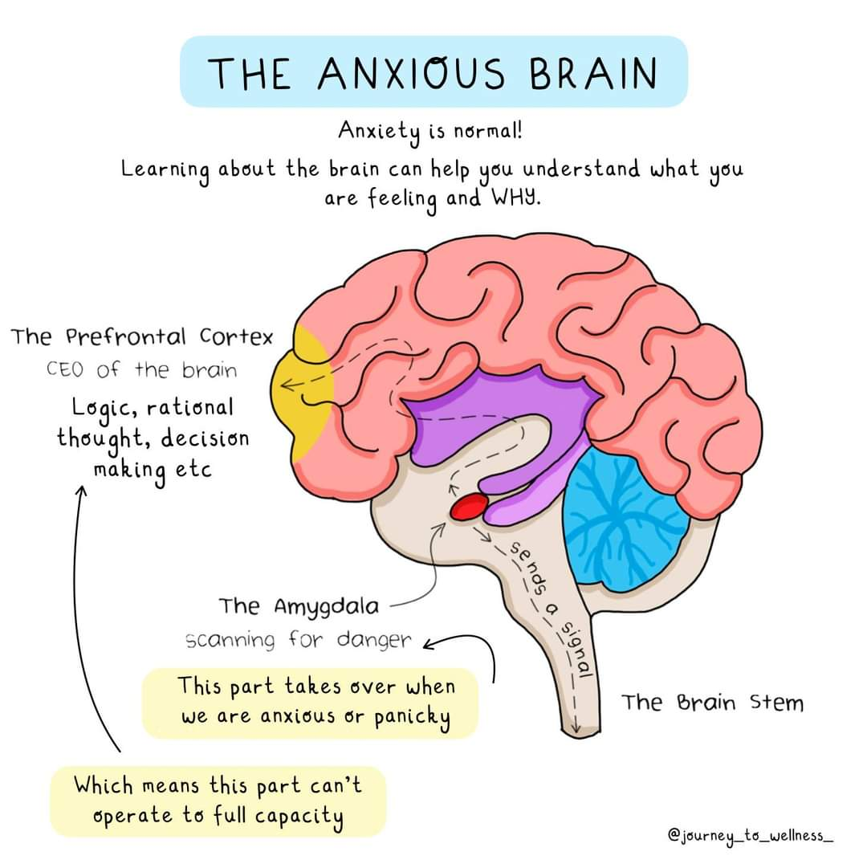
Notes:
[BRIEF COMMENTS ON THE BRAIN & ANXIETY]
Explain how the brain works (cortex, limbic system, and brain stem)
What happens when we experience fear, danger, stress, worry, anxiety, etc.?
But the amygdala is only meant to act in short bursts, not continually on high alert
So, what happens when we spend too long swimming around in cortisol and our anxious thoughts? We can get trapped in our limbic system, which can lead to chronic anxiety and illness.
Worry and anxiety is normal part of life, but when we’re always in survival mode (danger everywhere all the time!), we’re not able to think clearly, accurately assess situations, cultivate healthy relationships, stay calm, trust others, see the good in others, experience peace, etc. And in time, it negatively impacts our mental, emotional, physical, and spiritual health.
In his book… [NEXT SLIDE]

Slide 5
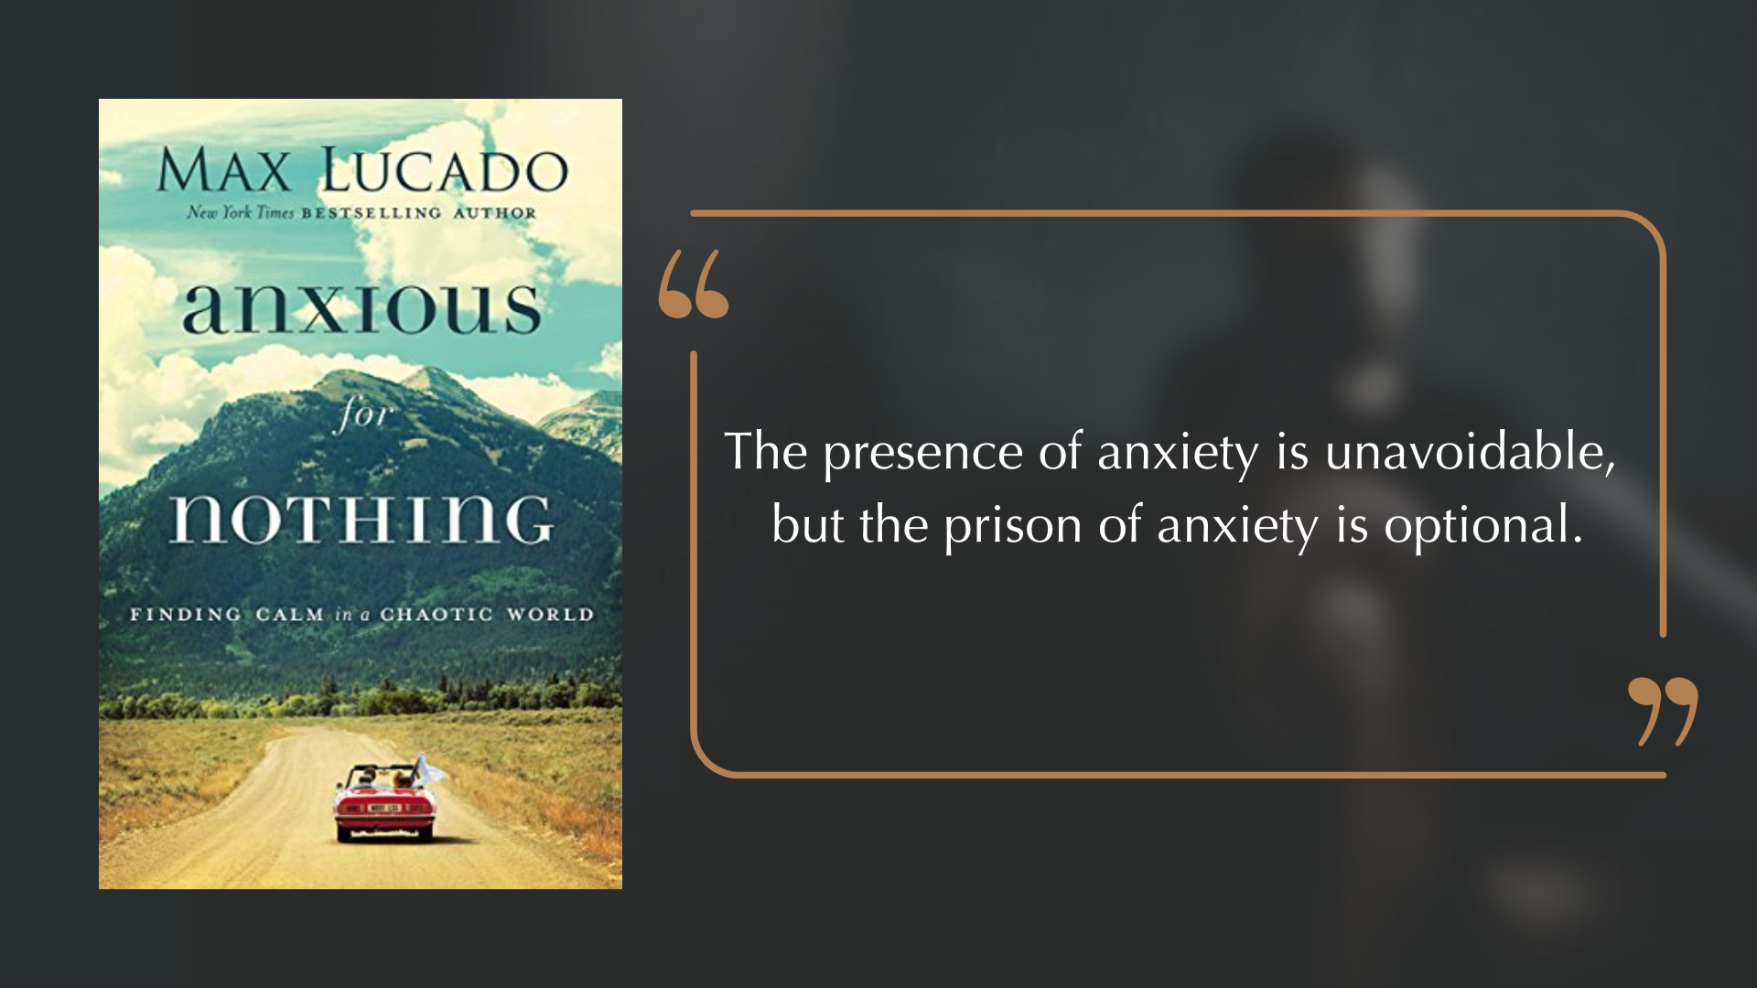
Notes:
Anxious for Nothing: Finding Calm in a Chaotic World, Max Lucado says, “The presence of anxiety is unavoidable, but the prison of anxiety is optional.”
Now, there can certainly come a point (whether it is genetic or it is simply brought on by long periods of unchecked and unregulated anxiety and emotions) when you might need professional help, including medications. But we should not be quick to resort to meds and quick fixes to get out of the prison of anxiety without first trying (with God’s help) to escape it through spiritual disciplines, better life choices, and healthy practices that lead to human flourishing.
And so, let’s look more closely at what Paul wrote in Philippians 4:4-9 and open our hearts and minds to this Spirit-inspired wisdom and advice on how to navigate worry and anxiety… [NEXT SLIDE]

Slide 6
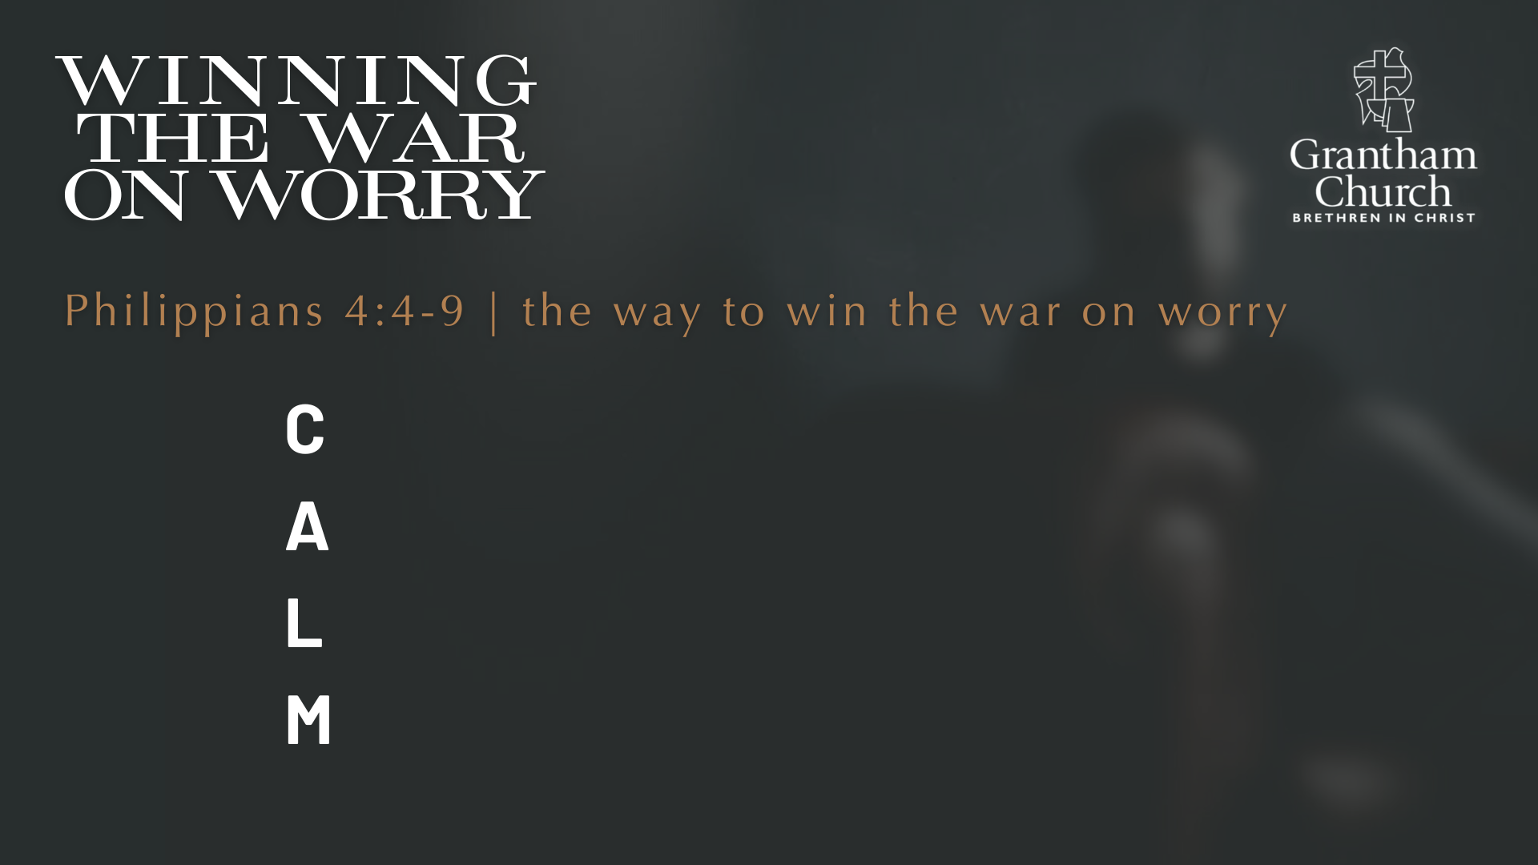
Notes:
In his book, Lucado gives this helpful acrostic—CALM—that captures what the Spirit through Paul is telling us to do when we encounter worry and anxious thoughts.
And I want to encourage you to write this down or type it into notes on your smart phone as we walk through it together and we look again at Philippians 4:4-9 verse-by-verse.
First, what do we need to remember with ”C”… [NEXT SLIDE]

Slide 7
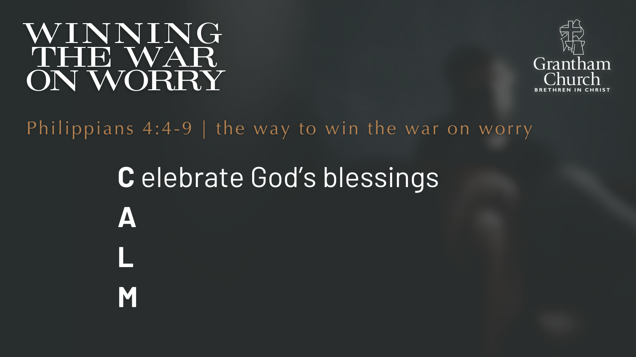
Notes:
[READ & COMMENT] – Celebrate God’s blessings
Philippians 4:4 – “Always be full of joy in the Lord. I say it again—rejoice!” (NLT) And you might be thinking, “How am I supposed to rejoice when I’m feeling anxious?” What is Paul getting at? Well, I believe he is saying that we must begin by looking at the Master instead of the mess. Psalm 121:1-2 says, “I lift up my eyes to the mountains—where does my help come from? My help comes from the Lord, the Maker of heaven and earth.” Look up to the Lord, not at the waves in the storm.
My friends, it doesn’t help us to marinate in worry. Don’t fix your eyes on the problem, fix your eyes on Jesus. Because in order to “celebrate God’s blessings” we have to look to the Lord. It shifts our focus away from what is wrong to who is on the throne; away from the brokenness of earth to the beauty of heaven that is coming to earth; away from our fears and to the one who has been faithful and will save us. In verse 5 he says, “The Lord is near (he is coming soon).” In other words, live with a sense of urgency and know that what you’re going through will not last forever.
C-celebrate God’s blessings. And A… [NEXT SLIDE]

Slide 8
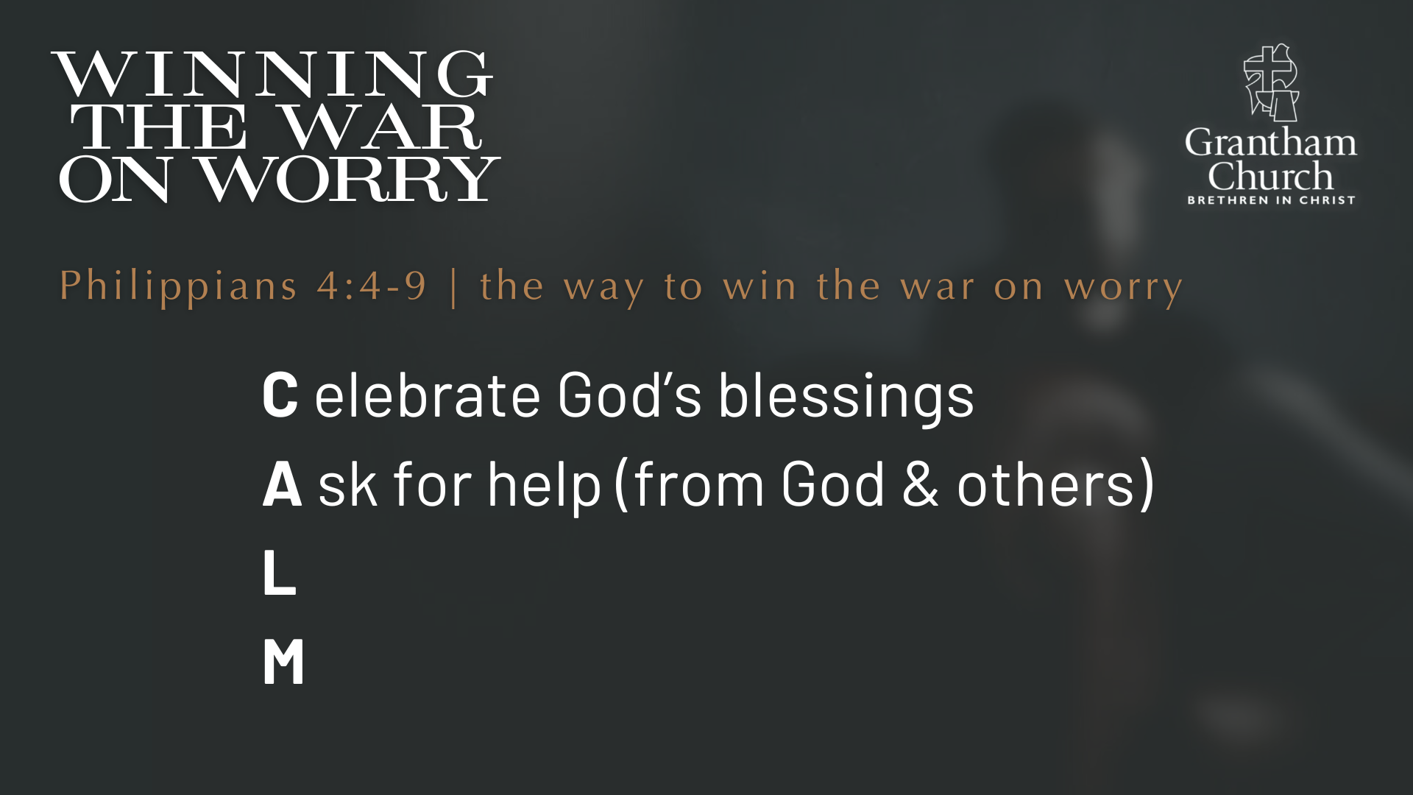
Notes:
[READ & COMMENT] – Ask for help (from God & others)
Philippians 4:6 – Paul says, “Don’t worry about anything; instead, pray about everything. Tell God what you need, and thank him for all he has done.” In the Greek, it appears that Paul is thinking of ongoing worry and anxiety. Lucado points out: “It’s the life of perpetual anxiety that Paul wants to address. Don’t let anything in life leave you perpetually in angst.”
So, what do we do? We take our anxious thoughts to the Lord. This requires that we notice and interrupt our anxious thoughts when they arise, and we replace them with the truth — maybe a memorized Scripture or a prayer. We are ready to go when the unwanted thoughts come. We are ready to take them to the Lord and ask for his help. And we use gratitude to access God’s peace. With the way our brains work, worry and anxiety cannot occupy the same space with thankfulness.
Of course, asking for God’s help can also come through others. As I shared earlier, we may need to talk to a pastor or trusted believer or see a Christian counselor who can help us process what we’re thinking and feeling. God can use others to help us work through our anxiety, because bottling it up and going at it alone will not help. Also, getting counsel from other anxious people won’t help either. We need to go to the Prince of Peace and seek out his people of peace to help us receive that peace ourselves. Who are those people in your life that can help you win the war on worry?
Next is the L… [NEXT SLIDE]

Slide 9
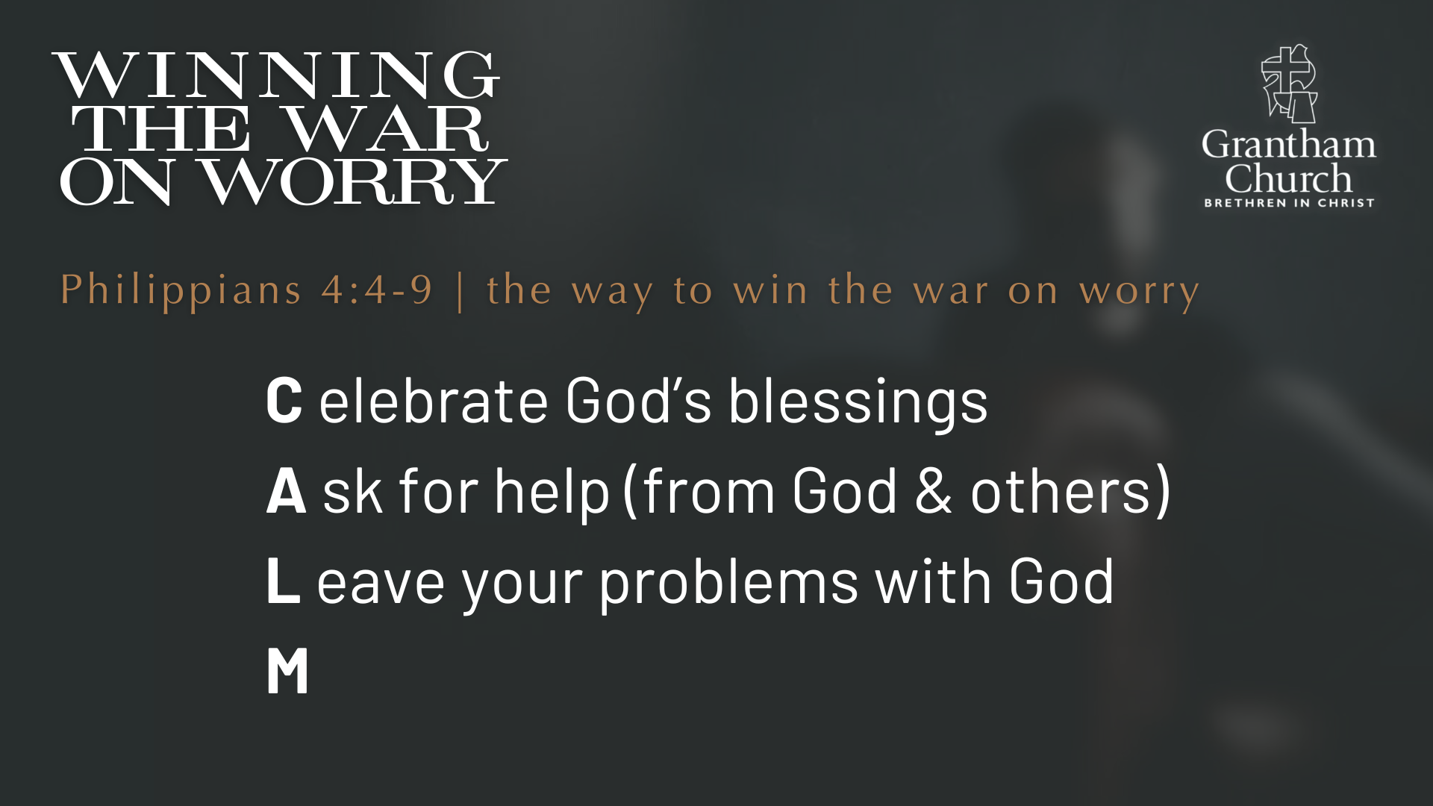
Notes:
[READ & COMMENT] – Leave your problems with God
Philippians 4:7 – “Then you will experience God’s peace, which exceeds anything we can understand. His peace will guard your hearts and minds as you live in Christ Jesus.” So, gratitude and thankfulness for God’s good gifts helps us to access his peace in our life. And notice, it’s his peace (the Lord himself) who will fight for you and work on your behalf. He will take care of the problem. It may take a little time as he works behind the scenes, but trust him… he is on it!
Ex: When you drop your car off at the dealership or the shop to be worked on? What do you do?
Would you raise your right hand and repeat after me: “I… hereby resign… as ruler of the universe.”
And lastly, M… [NEXT SLIDE]

Slide 10
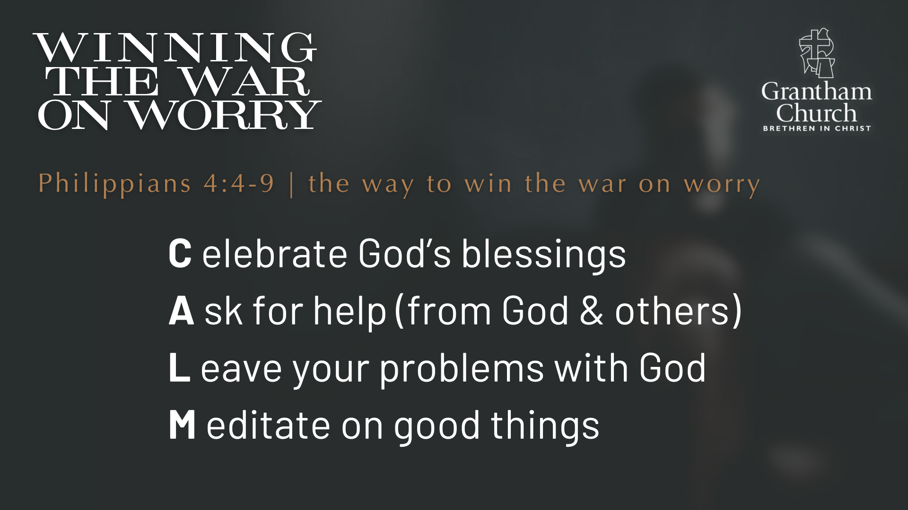
Notes:
[READ & COMMENT] – Meditate on good things
Philippians 4:8-9 – “And now, dear brothers and sisters, one final thing. Fix your thoughts on what is true, and honorable, and right, and pure, and lovely, and admirable. Think about things that are excellent and worthy of praise. Keep putting into practice all you learned and received from me—everything you heard from me and saw me doing. Then the God of peace will be with you.”
Do you hear what Paul is saying? Your mind can be battlefield. If you want peace to prevail. If you want to win the war on worry, then you must stop feeding the army of fear, hate, and anger. That leads to the dark side. You have to stop feeding the negative assumptions about others, entertaining the scary “what ifs” and dwelling on all the evil that exists in the world. Instead, you’re being invited to give those things to God in prayer and create space for meditating on good things.
What are the good things in your life? Think about that for a moment. There is a hymn we sang in the Baptist church to help us do that. It was called, Count Your Blessings:
“Count your blessings, name them one by one;
Count your blessings, see what God has done;
Count your blessings, name them one by one;
Count your many blessings, see what God has done.”
Brothers and sisters, listen to what our Lord Jesus said… [NEXT SLIDE]

Slide 11
Matthew 6:31-34 NLT
³¹ “So don’t worry about these things, saying, ‘What will we eat? What will we drink? What will we wear?’ ³² These things dominate the thoughts of unbelievers, but your heavenly Father already knows all your needs. ³³ Seek the Kingdom of God above all else, and live righteously, and he will give you everything you need. ³⁴ “So don’t worry about tomorrow, for tomorrow will bring its own worries. Today’s trouble is enough for today.”
Notes:
[READ & COMMENT ON PASSAGE]
v. 31 – worrying about the most basic needs reveals a lack of trust in the Father
v.32 – worry is a form of practical atheism, so trust the Lord
v. 33 – simplify the complexities and anxieties of life by living for Christ and the Kingdom
v. 34 – a note of irony: He is saying, “Aren’t things hard enough already? Don’t add more worries or imagined threats and fears of tomorrow to your load. Rather, seek the Kingdom and trust our loving Father. He cares for the birds in the air and clothes the flowers of the field. How much more will he care for you, his most precious child?”
Finally, here are some questions to help us reflect on what God is saying to us and help us respond to the leading of the Holy Spirit… [NEXT SLIDE]

Slide 12
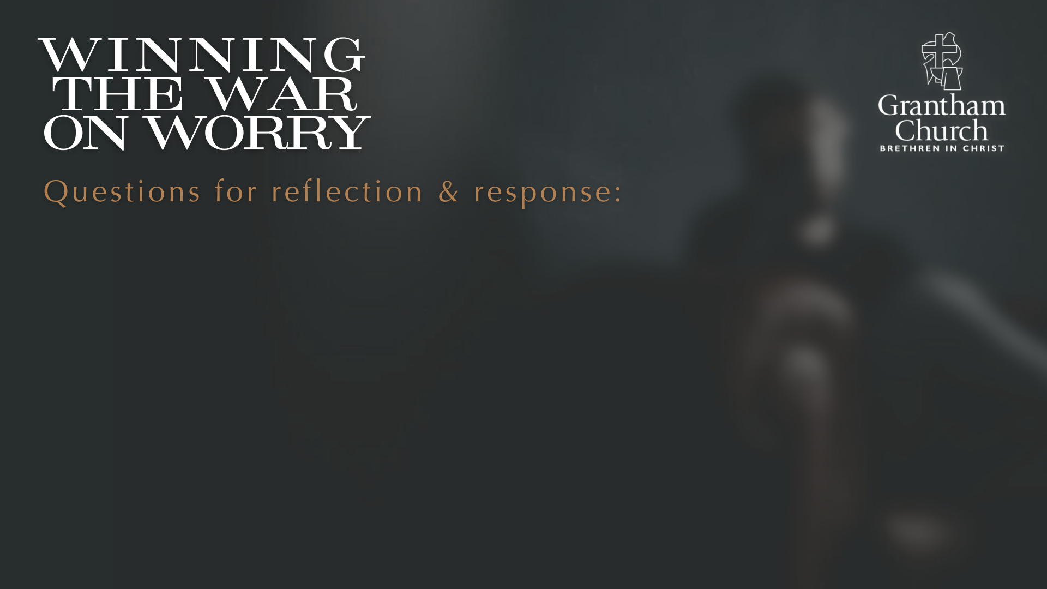

Slide 13
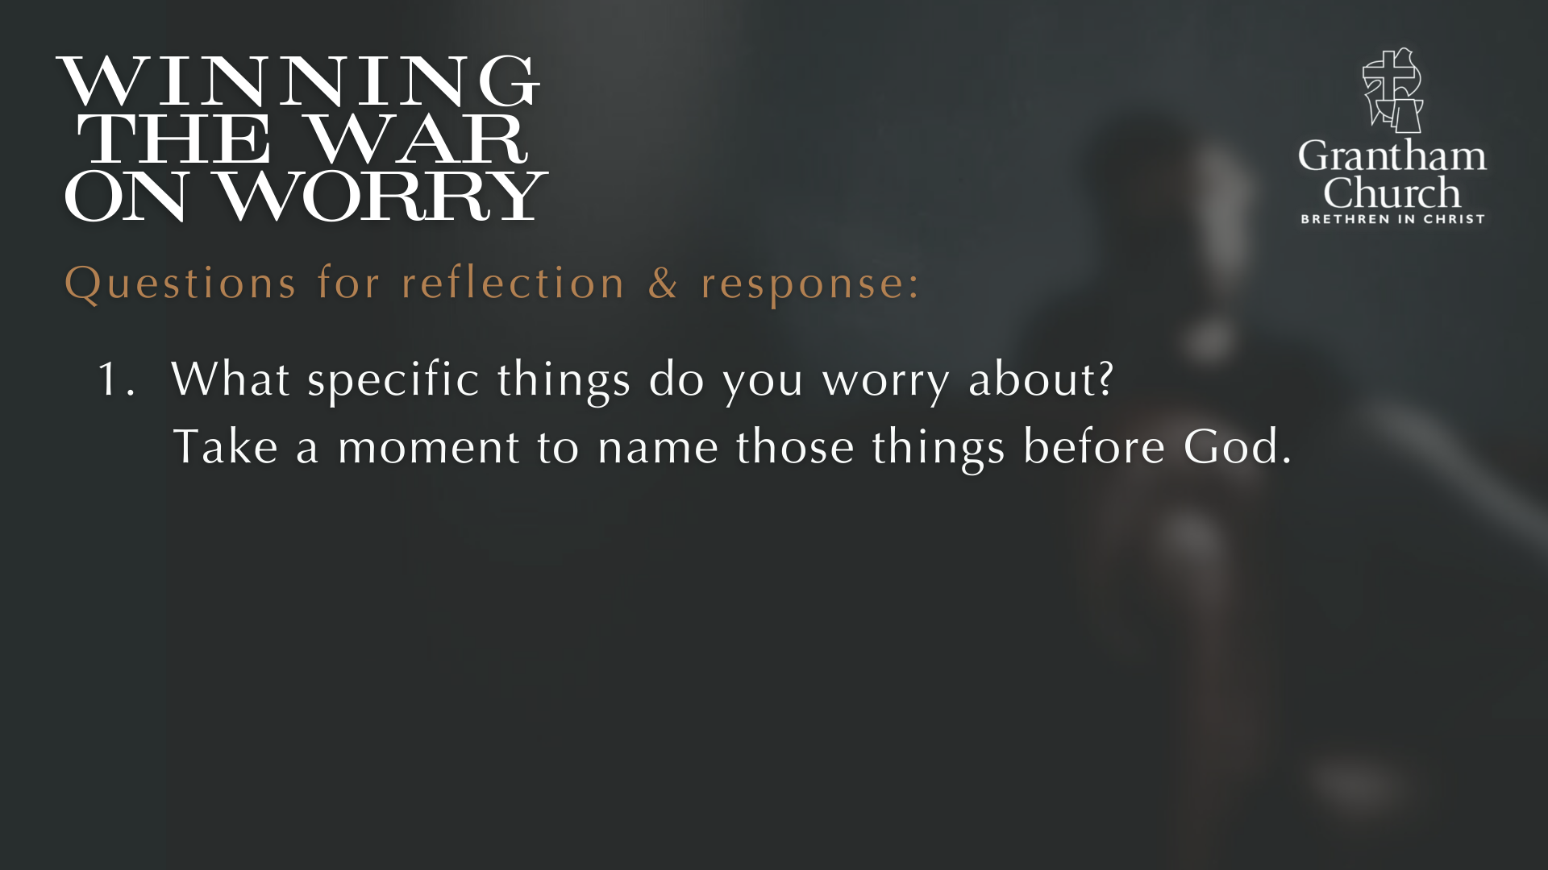

Slide 14
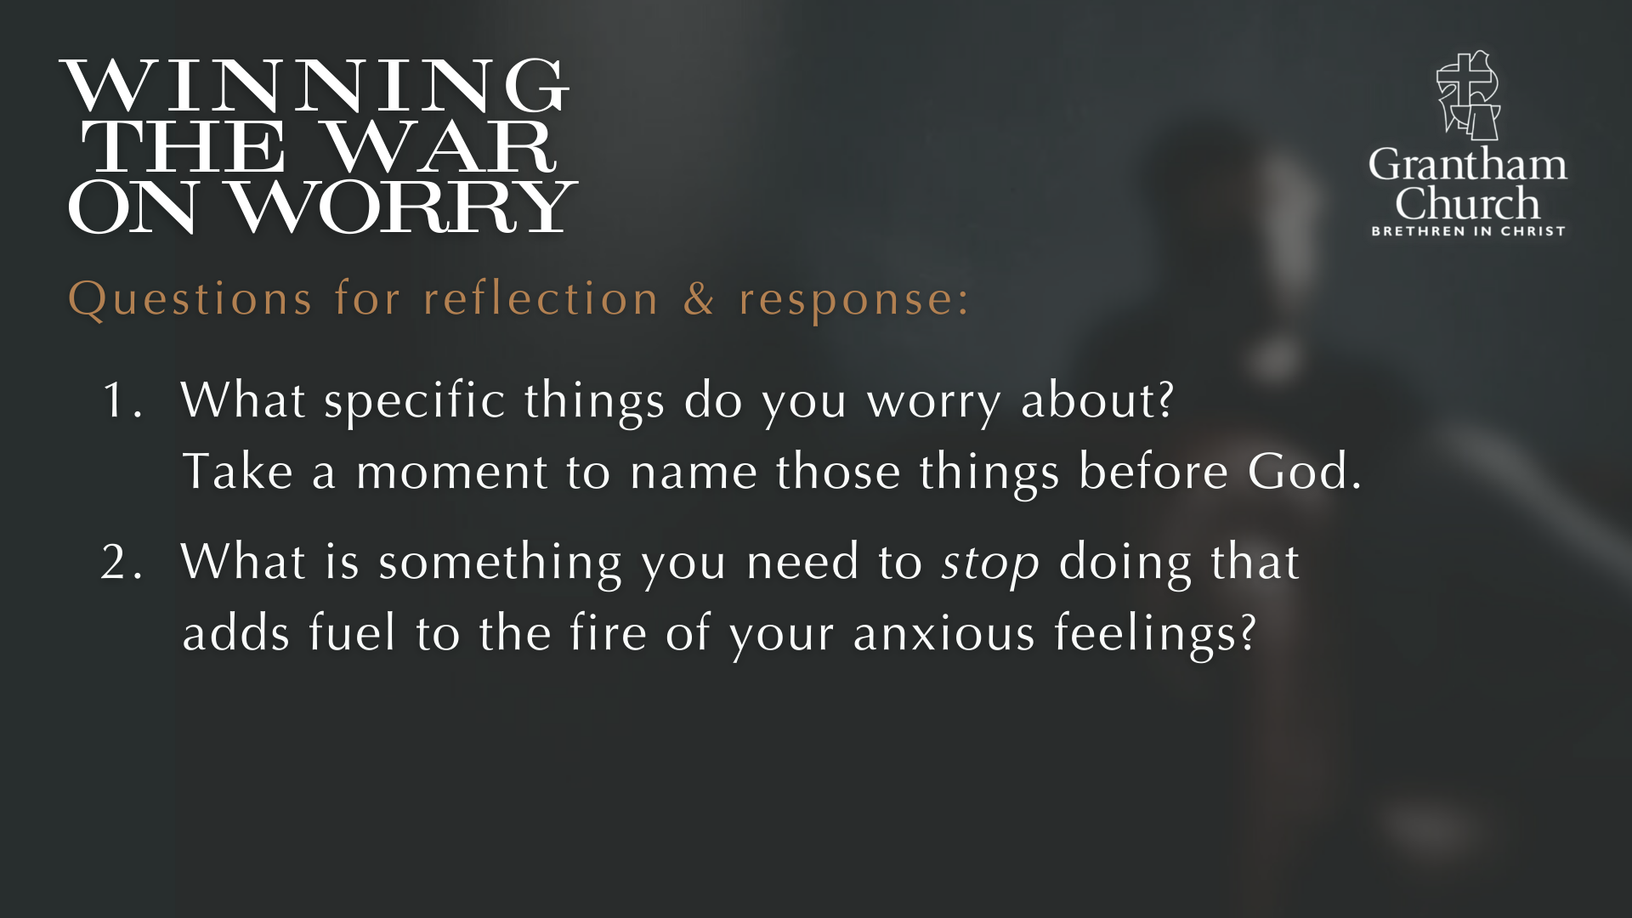

Slide 15
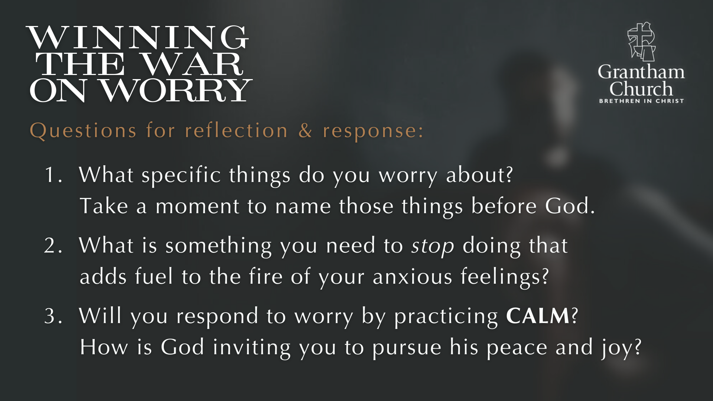
Notes:
[READ & COMMENT ON EACH QUESTION]
What specific things do you worry about? Take a moment to name those things before God.
What is something you need to stop doing that adds fuel to the fire of your anxious feelings?
Will you respond to worry by practicing CALM? How is God inviting you to pursue his peace & joy?
[CLOSING WORDS]
[NEXT SLIDE FOR CLOSING PRAYER]

Slide 16

Notes:
[CLOSING PRAYER]
Benediction
In anxiety may you find peace
In sadness may you find comfort
In sickness may you find healing
In loneliness may you find community
In busyness may you find stillness
In listening may you find wisdom
In following may you find hope
And in the One who meets all our needs
May you find rest.
Go in peace, church, to love and serve the Lord. Amen.

