Slide 1


Slide 2


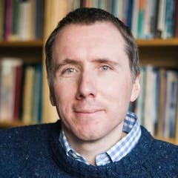
The Son of Man came
Mk 10:45 “…not to be served but to serve, and to give his life as a ransom for many”
Lk 19:10 “…to seek and to save the lost”

Slide 3
The Son of Man came
Mk 10:45 “…not to be served but to serve, and to give his life as a ransom for many”
Lk 19:10 “…to seek and to save the lost”
Luke 7:34 “…eating and drinking…”

Slide 4


Slide 5
Luke 5:27-32
After this, Jesus went out and saw a tax collector by the name of Levi sitting at his tax booth. “Follow me,”Jesus said to him, and Levi got up, left everything and followed him.

Slide 6
Then Levi held a great banquet for Jesus at his house, and a large crowd of tax collectors and others were eating with them. But the Pharisees and the teachers of the law who belonged to their sect complained to his disciples, “Why do you eat and drink with tax collectors and sinners?”
Jesus answered them, “It is not the healthy who need a doctor, but the sick. I have not come to call the righteous, but sinners to repentance.”

Slide 8

Image from the film Mean Girls

Slide 10
Luke 7:34
The Son of Man came eating and drinking, and you say, “Here is a glutton and a drunkard, a friend of tax collectors and sinners.”

Slide 11
When Jesus uses the table as a place of grace, he creates
a people who are changed
by grace.

Slide 13
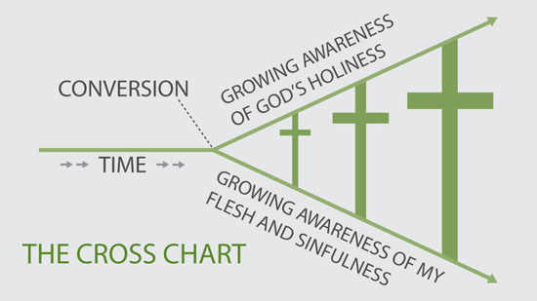
Text stuff goes here

Slide 15
Jesus uses the table as a place of grace to create
a people changed by grace who proclaim grace around their tables.

Slide 16
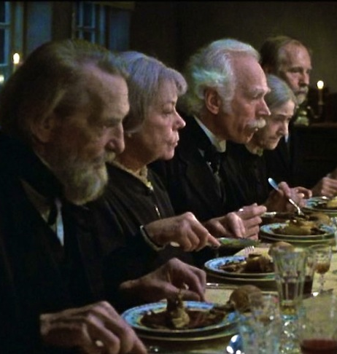


Slide 18
MEAL CHALLENGE
make your table a
place of grace

Slide 19
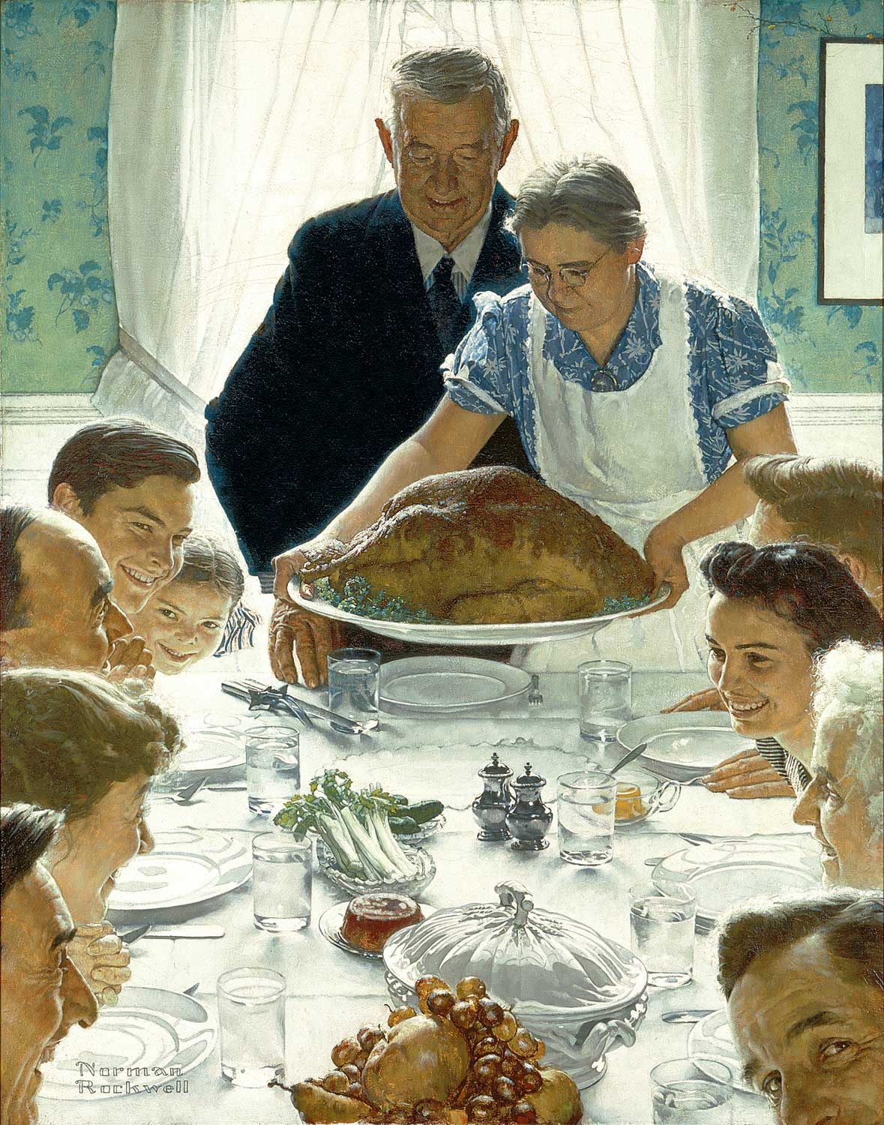

Slide 20
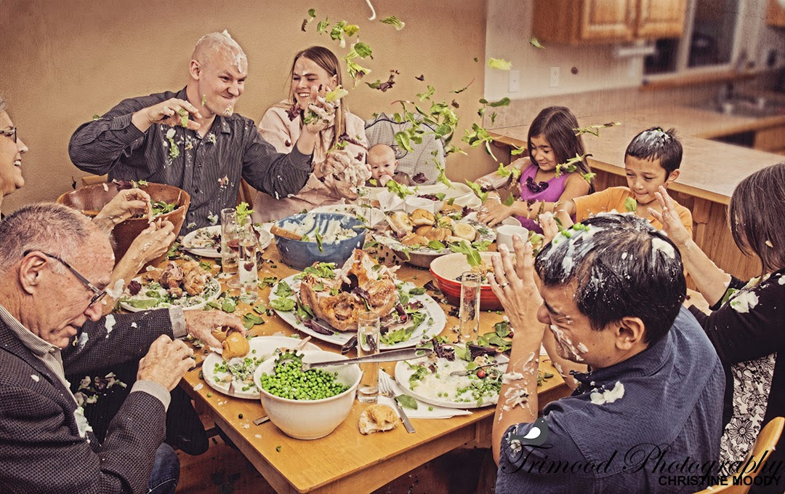

Slide 21
MEAL CHALLENGE
make your table a
place of grace

Slide 22
EVERYDAY DISCIPLE STORY

Slide 23
Questions for Reflection
If all you need is need, how can you cultivate the awareness of your need for a spiritual physician/Savior?

Slide 24
Questions for Reflection
If all you need is need, how can you cultivate the awareness of your need for a spiritual physician/Savior?
Are there any barriers you recognize that might be hindering you from opening up your home – or heart – to others?

Slide 25
Questions for Reflection
If all you need is need, how can you cultivate the awareness of your need for a spiritual physician/Savior?
Are there any barriers you recognize that might be hindering you from opening up your home – or heart – to others?
Where are you intentionally forming relationships that express the hospitality and grace of God?

