Slide 1

Notes:
[BRIEF INTRO]
Welcome
Week 3 in a 7-week fall sermon series – The Gospel of the Kingdom
Jesus said, “The kingdom of God has come near. Repent and believe the good news!” But what is this gospel of the kingdom? And what does it mean to believe it and partner with God in his Kingdom work?
If you’re just joining us for the series, using “good news” and “kingdom of God” this way: [NEXT SLIDE]

Slide 2

What is the Good News?
The gospel story of how God has been at work in the world and is now redeeming it in Jesus Christ—who will one day return to bring the fullness of the Kingdom.
What is the Kingdom of God?
The reign and rule of God on the earth, which always looks like Jesus (e.g., loving others, healing, reconciling, sacrificing self, showing mercy, doing justice, etc.).
Notes:
[READ GOOD NEWS DEFINITION]
Again, this encompasses…
The story of Israel—the OT (the larger biblical story)
The story of Jesus the Messiah (his life, teachings, death, resurrection & ascension)
The story of what Jesus continues to do through his Church (as we anticipate his return)
[READ KINGDOM OF GOD DEFINITION]
The kingdom is already, but not yet—we live in the overlap of the ages
Heaven is coming to earth; God’s space and our space will be joined in Christ’ return
And here is how I’ve been communicating the larger good news story… [NEXT SLIDE]

Slide 3
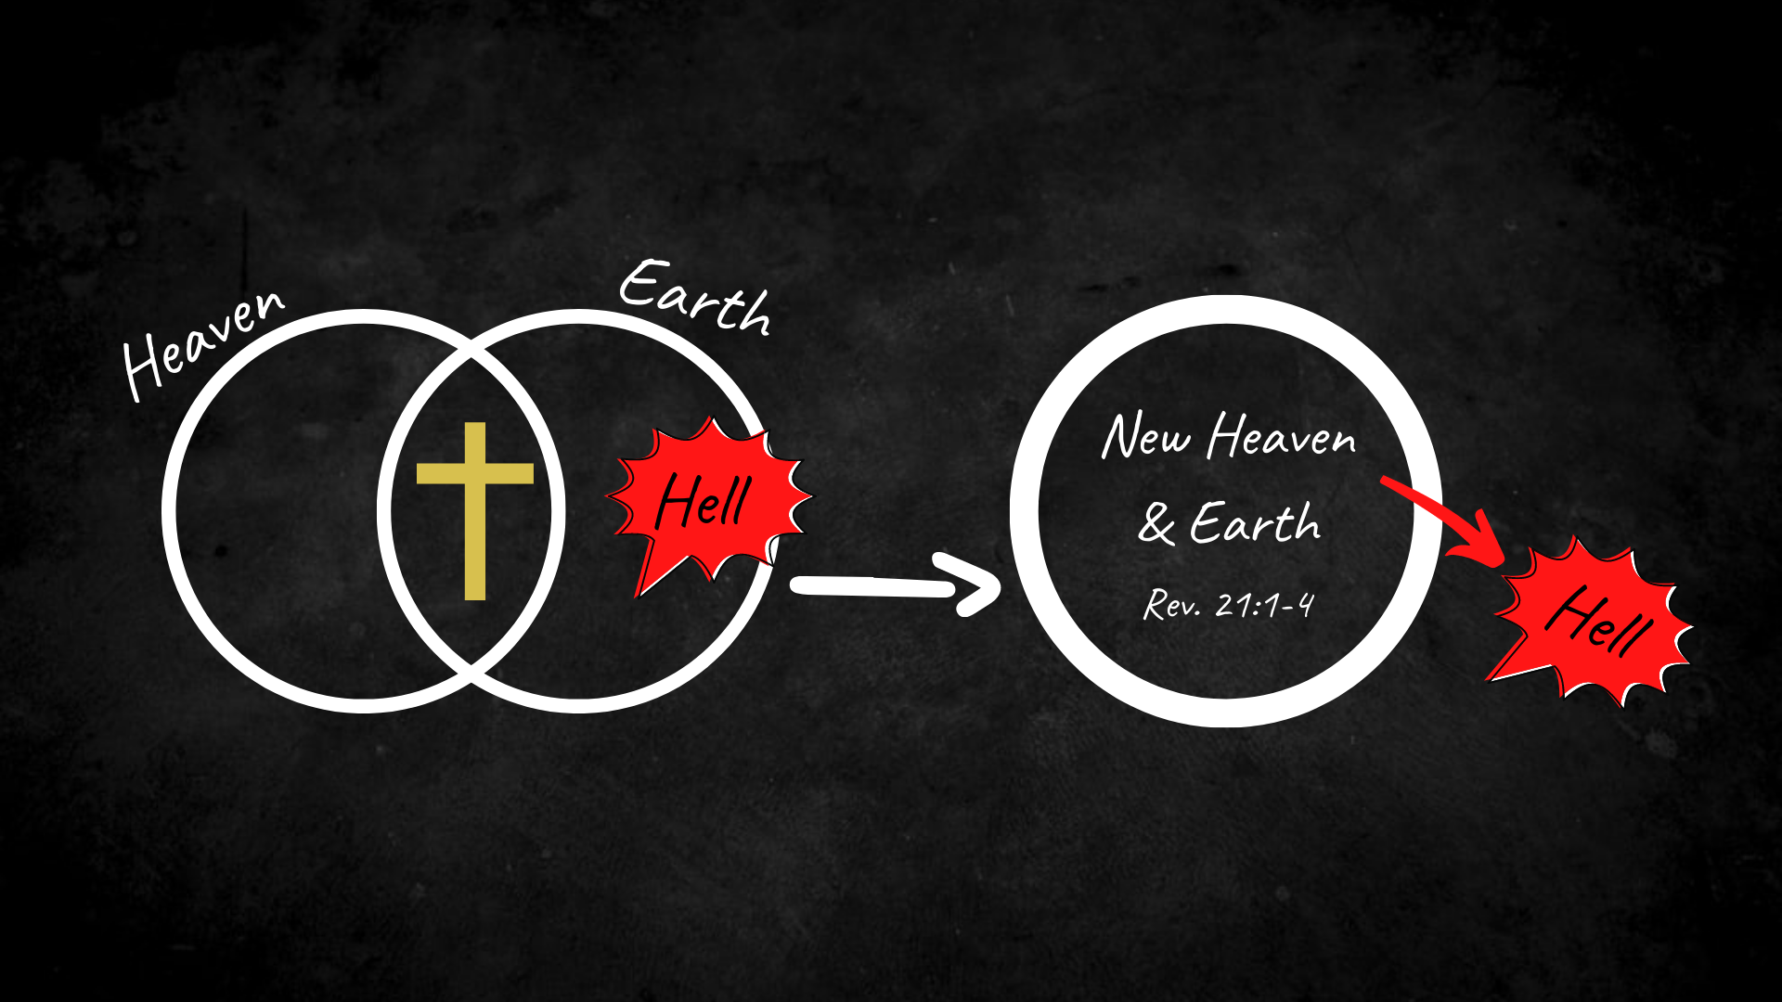
Notes:
[BRIEF COMMENTS]
Let’s keep this image in mind as we read from Colossians this morning… [NEXT SLIDE]

Slide 4
Scripture Reading
Colossians 1:15-29 NIV
Notes:
[READ & EXPOUND ON THE SCRIPTURE]
What is Paul saying?
Christ is central and supreme; he is the beginning and the end of the story
The good news is a larger redemptive story (as we’ve been seeing in the heaven to earth image), but it ultimately goes to the core of who we are, i.e, “Christ in you, the hope of glory.”
And since Christ himself is the good news, Paul is speaking of God getting the “gospel in you” and becoming all that the Lord intended for us when he made us in his image
Which is why I’ve entitled this message… [NEXT SLIDE]

Slide 5
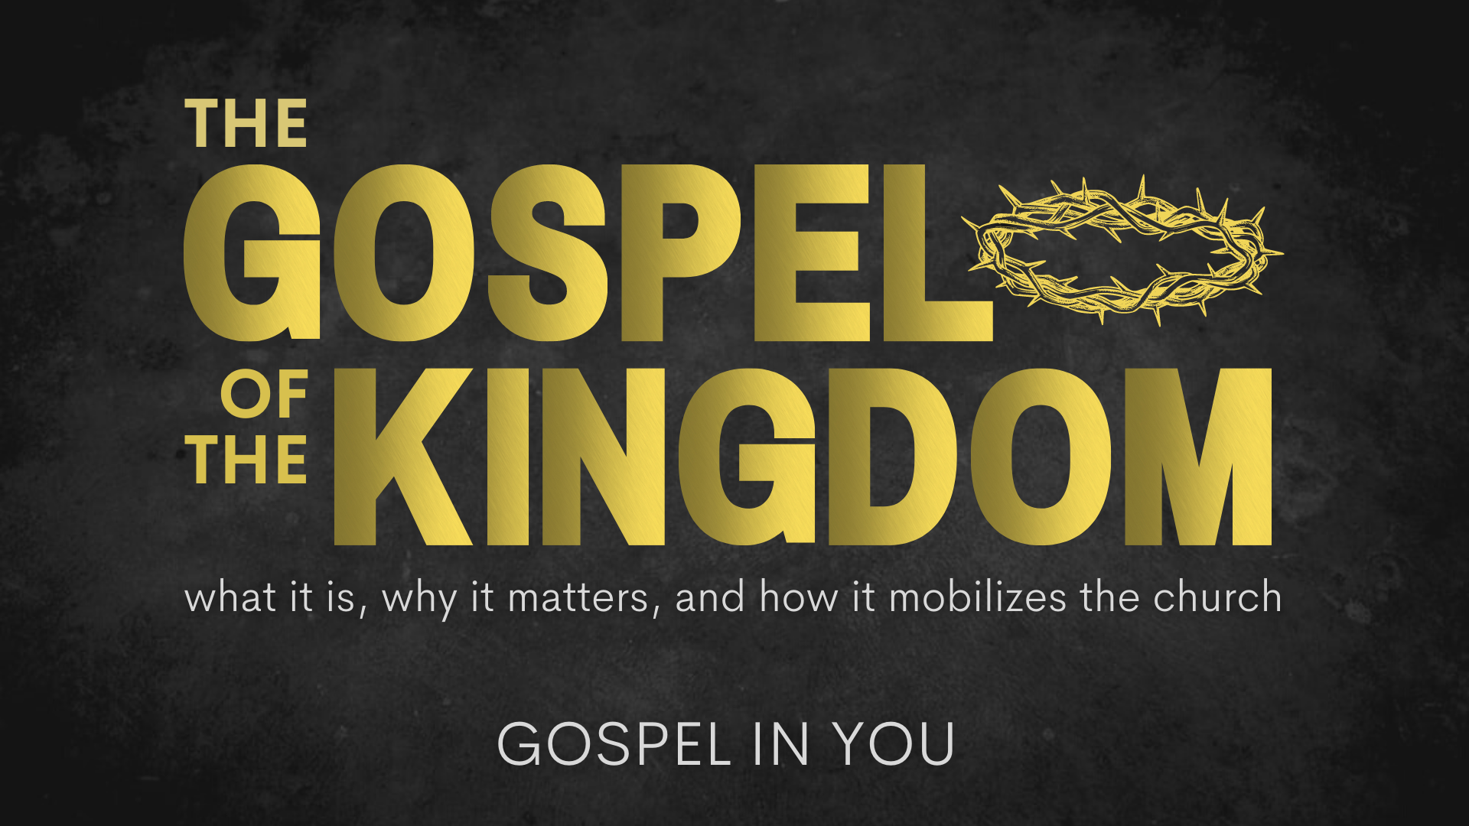
Notes:
[BRIEF COMMENTS]
And here is the claim that goes to the heart of today’s message: We can only know who God is, who we are, and how to make sense of our place in the world through Christ and the gospel.
I’m aware (and you should be aware) that this is a radically subversive thing to say today. For a variety of reasons. For example, some would say, “Who are you to claim that you can know God, and claim to know that Jesus is the only way to know the Creator of the universe? And besides, I believe the answers I’m looking for are found within—not through God, religion, an ancient book, or even a group of people or a belief system.” As you know, people seem quite content on finding their identity and creating their own meaning.
But we a believers in Christ and the gospel of the kingdom, we see things a bit differently. For starters, if we understand the message of the Bible—the larger biblical story of creation-fall-redemption-resurrection—and that this is at the heart of the good news of Jesus, we must acknowledge that we are made in God’s image but broken and not as we should be—all of us. We are in need of being transformed by the gospel. Therefore, our views, our feelings, our identity, yes even our so-called rational thinking, has been affected by sin, which has distorted reality and our understanding of who we are and what is true and good. And of course, this runs contrary to the current spirit of the age, which you’ve heard me refer to as expressive individualism.
Expressive individualism is a term used by philosophers such as Charles Taylor to talk about the way we think about being selves in our post-modern world. Expressive individualism particularly refers to the idea that in order to be fulfilled and to be an authentic person—to be genuinely me—I need to be able to express outwardly or perform publicly that which I feel I am inside. For our secular age, this is how we’re told we should think about who we are and our identity. And we should note that this is the first time in the history of humanity that we have ever thought of our selves in this way. Welcome to the decay of Western society!
But what a minute… aren’t we supposed to be honest with ourselves? Doesn’t Christianity warn against hypocrisy? What about someone like Augustine and his “expressive individualism” seen in his autobiography? Well, for Christians, our authenticity has a unique gospel aim or goal. As the author and church historian Carl Trueman points out, “Augustine's expressive individualism—his Confessions, his crying out to God—is always a result of him moving inward in order to move outward to God. He's not moving inward simply to work out how he needs to express himself to his friends and his neighbors. He's moving inward in order to reach upwards to God and to try to bring that which is inward to conformity of the external will of God.”
That’s because, “A Christian knows that inwardly he or she is sinful, and therefore needs to repent, to turn to God, to go inwards in order to turn outwards toward God and toward Christ. That's where real authenticity lies.” And so… this is where we must begin if we’re going to allow the gospel to penetrate our selves and help us to understand who we are and how God is calling us to live in his world.
But before we think more deeply about this new identity and kingdom calling we have as Christ-followers, let’s consider the many things that actually shape our identity on a regular basis. [NEXT SLIDE]

Slide 6

The Things That Shape Our Identity

Slide 7
The Things That Shape Our Identity
The words and opinions of others

Slide 8
The Things That Shape Our Identity
The words and opinions of others
Our society and culture

Slide 9
The Things That Shape Our Identity
The words and opinions of others
Our society and culture
Our hurt, pain, and failures

Slide 10
The Things That Shape Our Identity
The words and opinions of others
Our society and culture
Our hurt, pain, and failures
Our choices and behaviors

Slide 11
The Things That Shape Our Identity
The words and opinions of others
Our society and culture
Our hurt, pain, and failures
Our choices and behaviors
Our thoughts

Slide 12
The Things That Shape Our Identity
The words and opinions of others
Our society and culture
Our hurt, pain, and failures
Our choices and behaviors
Our thoughts
The story that we are living in
Notes:
[BRIEF COMMENT ON EACH POINT]
[APPLYING THE GOSPEL TO ALL]
So, let’s return to the gospel story and hear what the apostle Paul says about our identity in Christ, and what it means for how we live in the world. [NEXT SLIDE]

Slide 13
Paul, Colossians 3:1-4 NIV
¹ Since, then, you have been raised with Christ, set your hearts on things above, where Christ is, seated at the right hand of God. ² Set your minds on things above, not on earthly things. ³ For you died, and your life is now hidden with Christ in God. ⁴ When Christ, who is your life, appears, then you also will appear with him in glory.
Notes:
[BRIEF COMMENT ON EACH VERSE]
Verse 5… [NEXT SLIDE]

Slide 14
Paul, Colossians 3:5-7 NIV
⁵ Put to death, therefore, whatever belongs to your earthly nature: sexual immorality, impurity, lust, evil desires and greed, which is idolatry. ⁶ Because of these, the wrath of God is coming. ⁷ You used to walk in these ways, in the life you once lived.
Notes:
[BRIEF COMMENTS]
Verse 8… [NEXT SLIDE]

Slide 15
Paul, Colossians 3:8-10 NIV
⁸ But now you must also rid yourselves of all such things as these: anger, rage, malice, slander, and filthy language from your lips. ⁹ Do not lie to each other, since you have taken off your old self with its practices ¹⁰ and have put on the new self, which is being renewed in knowledge in the image of its Creator.
Notes:
[BRIEF COMMENTS]
v. 8 - “rid yourselves” – work it out of you
v. 10b - ”being renewed” – a Greek word that Paul seems to have invented (same prefix as the word for resurrection); meaning to “grow up, to be changed, to make new” as you come to know God in Christ more and more; it’s really just returning to the true image of your Creator.
My friends, in order to live this way (into the gospel) we must be willing to deny ourselves as Jesus said. We must refuse to live for what we want, and start living for what God wants for us and in us. Listen to what Paul wrote to the church in Corinth. He said… [NEXT SLIDE]

Slide 16
Paul, 2 Corinthians 5:15-17 NIV
¹⁵ And he [Christ] died for all, that those who live should no longer live for themselves but for him who died for them and was raised again.
¹⁶ So from now on we regard no one from a worldly point of view. Though we once regarded Christ in this way, we do so no longer. ¹⁷ Therefore, if anyone is in Christ, the new creation has come: The old has gone, the new is here!
Notes:
[READ & BRIEF COMMENTS]
This is the gospel truth about who you are in Christ. But the only way to live into this truth more and more, is to be actively resisting the forces that tell us otherwise. How do we do that? How do we apply the gospel to the competing and contrarian voices in the world. [NEXT SLIDE]

Slide 17
Getting the Gospel in You
When confronted with all the things that seek to shape your identity, you can apply the gospel by asking a few questions:

Slide 18
Getting the Gospel in You
When confronted with all the things that seek to shape your identity, you can apply the gospel by asking a few questions:
How does this compare to what the Bible says?

Slide 19
Getting the Gospel in You
When confronted with all the things that seek to shape your identity, you can apply the gospel by asking a few questions:
How does this compare to what the Bible says?
Is this consistent with my new identity in Christ?

Slide 20
Getting the Gospel in You
When confronted with all the things that seek to shape your identity, you can apply the gospel by asking a few questions:
How does this compare to what the Bible says?
Is this consistent with my new identity in Christ?
Does this help me live into the gospel story?
Notes:
[READ & BRIEF COMMENT ON EACH QUESTION]
Finally, as we reflect and respond to this message… ask yourself… [NEXT SLIDE]

Slide 21
Getting the Gospel in You
When confronted with all the things that seek to shape your identity, you can apply the gospel by asking a few questions:
How does this compare to what the Bible says?
Is this consistent with my new identity in Christ?
Does this help me live into the gospel story?

Slide 22

Questions for reflection and response:
Gospel in You

Slide 23
Questions for reflection and response:
Am I applying the Gospel to my identity?
Gospel in You

Slide 24
Questions for reflection and response:
Am I applying the gospel to my identity?
How is God inviting me to repent and believe?
Gospel in You
Notes:
[BRIEF COMMENT ON EACH]
[CLOSING WORDS]
[CLOSING PRAYER – NEXT SLIDE]

