Slide 1

Notes:
[BRIEF INTRO]
Advent series – Close to Home
While this is the last Sunday before Christmas, the series continues until Jan 2
In this series we have been exploring the idea of “home” as it relates to our faith, and particularly to the season and story of Advent. And as we’ve been saying, when we do that together, we quickly notice the “already but not yet” tension of our faith: we say and sing “O Come O Come Emmanuel” (God with us), and yet, we know that God’s promised day—our eternal home of a new glorified heaven and earth—is not yet fully realized. And it won’t be until Christ comes again. Thus, it names our deep longing for God to come close to us in the waiting and preparation.
We began the series reflecting on what it means to be “homesick” for a better world. We’ve also looked at what it means to lay the foundations of God’s home on the earth by being conduits of his blessings to others. And then last Sunday, Pastor Melissa shared how we can prepare the way for the Lord by recognizing that “you are more sinful and broken than you ever dared believe, but you are more deeply loved than you ever dared imagine.” Therefore, repentance (turning from sin & opening our hearts up to God) is necessary for God to come to us in new and fresh ways this Christmas.
That brings us now to the fourth Sunday of Advent and the next message in our series… [NEXT SLIDE]

Slide 2

Notes:
In the lectionary reading this morning, we see that after receiving the angel’s news of the coming miraculous birth of Christ, Mary retreats to Elizabeth and Zechariah’s home to digest her new calling. Mary goes seeking refuge—physical safety and emotional protection. And as the story goes, she receives a safe haven, a home for her heart and a space to reflect on her calling and voice her praise.
So, today I want to invite you to see how sanctuary and safe space are crucial for us finding our home in the Lord, and then ask us to consider how we can experience God’s love as a sanctuary and go on to be a safe place and a refuge for others.
[BRIEF PRAYER]
Please open your Bibles to… [NEXT SLIDE]

Slide 3

Scripture Reading
Luke 1:39-56 NLT
Notes:
[INVITATION TO STAND FOR SCRIPTURE READING]
[READ LUKE 1:39-56 NLT]
This is the word of the Lord. Thanks be to God
You may be seated.
[NEXT SLIDE]

Slide 4
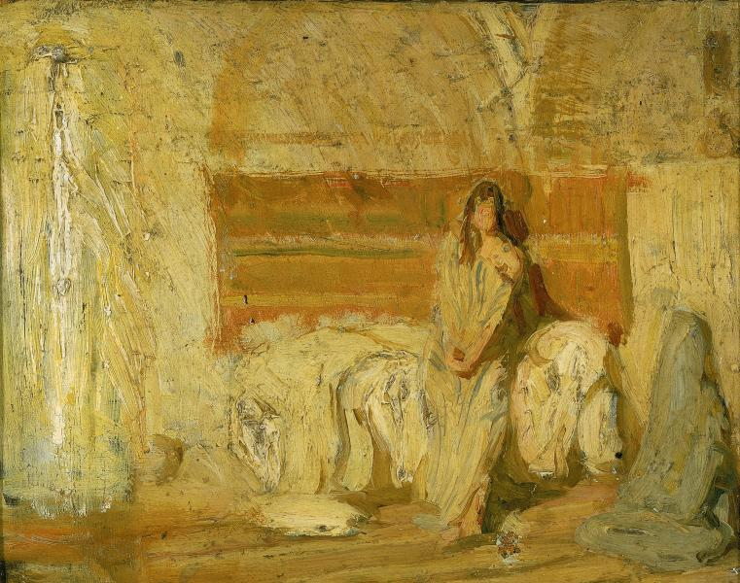
Notes:
[BRIEF COMMENTS ON HISTORY & CONTEXT]
Remember that the angel Gabriel’s message to Mary was fourfold:
She will have a son named Jesus
The child will be the Son of God and will sit on David’s throne forever
The Holy Spirit will make these things possible
And as a sign that it’s true, her relative Elizabeth is pregnant in her old age
Now, is this good news? Yes! But consider the predicament this puts Mary in as a young, betrothed, devout Jewish girl who lives in a really small village.
What happens when she starts showing?
What about Joseph? What will he say or do? Matthew tells us that once Mary told him he decided rather than accuse her and have her stoned, he would divorce her quietly
Did his first response prompt her to leave Nazareth to give him some space to think (have his dream) and her to process?
She might have easily wondered, “Am I safe here?” and wanted affirmation herself.
So, Mary sets off for Elizabeth just as soon as she can pack her bags and join the caravan, making a 70-mile trek to the Western side of Jerusalem. And then Luke tells us that Elizabeth greets Mary with joy and open arms. [NEXT SLIDE]

Slide 5
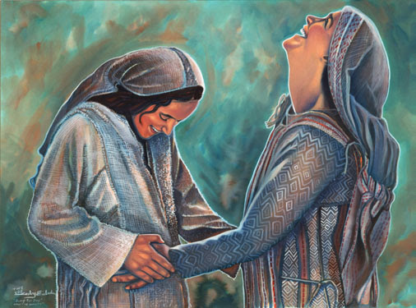
Notes:
[BRIEF COMMENTS]
We read earlier in Luke 1 about how Elizabeth greets Mary with joy and a blessing, recognizing that Mary will become the mother of the Lord. How did Elizabeth know? Luke tells us that John leaped in her womb at the sound of Mary’s voice, and that Elizabeth was then filled with the Holy Spirit. No doubt that these signs helped to confirm with them that the Messiah was coming, and that the God of Israel was fulfilling his promises.
And so consider this… it is from this encounter and the sanctuary that Elizabeth and Zechariah offer Mary that she is able to sing her song, which we call the Magnificat—a powerful song of praise expressing her belief and hope that God hasn’t only blessed her, but that he is through her Son going to bless all of the poor, the powerless, and the oppressed of the world; that God is going to confront the bullies and the profiteers of empire and finally turn the tables on the forces of darkness.
You see, first and foremost, Mary took refuge in the Lord. While she certainly would have had 1 Samuel 2 (Hanna’s song of celebration) on her mind, there are also other elements and echoes of her song from the Book of Psalms. For example… [NEXT SLIDE]

Slide 6

Psalm 9:9-10 NIV
The Lord is a refuge for the oppressed, a stronghold in times of trouble. Those who know your name trust in you, for you, Lord, have never forsaken those who seek you.
Notes:
[BRIEF COMMENT ON PASSAGE]
And I can think of other psalms expressing this experience of God…
Psalm 46:1 – “God is our refuge and strength, always ready to help in times of trouble.”
Psalm 59:16- “But as for me, I will sing about your power. Each morning I will sing with joy about your unfailing love. For you have been my refuge, a place of safety when I am in distress.”
Psalm 61:3 – “for you are my safe refuge, a fortress where my enemies cannot reach me.”
And while Mary took refuge in the love of the Lord, she also found it with Elizabeth and Zechariah. She found it in the Lord’s people, as all weary and anxious travelers ought to be able to do. Because we’re all looking for shelter in one way or another. [NEXT SLIDE]

Slide 7

O God, Gimme Shelter!
What reasons are there for seeking sanctuary?
like Mary, we might need protection and affirmation
feeling alone, afraid, and in need of grace and comfort
to share our thoughts and feelings without judgment
a safe place to process and heal from hurts or trauma
a safe place for questions (e.g., a season for renovating faith)
to know that no matter what I’ve done, I’m loved and accepted
Notes:
[BRIEF COMMENT ON EACH POINT]
Can you think back to a time when someone embodied the love of God to you and were a sanctuary and a refuge—a safe place for you to find your way?
I know there have been several folks in my journey who have been that for me—my wife Lanna has certainly been that—but one time sticks out to me as being pivotal. It was when I was 18 years old. I was running hard away from God, making some really bad decisions, and at the end of my rope. And my grandparents offered me sanctuary.
Here is a picture that captures where I was at that time. [NEXT SLIDE]

Slide 8
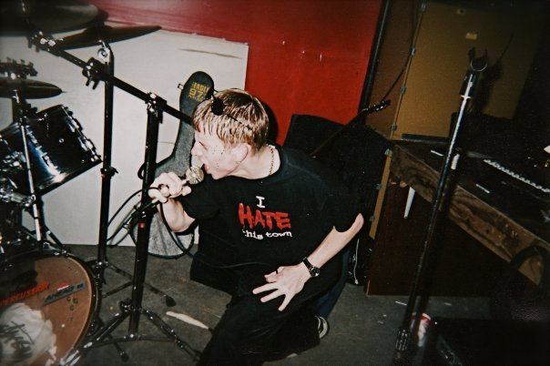
Notes:
[BRIEF COMMENTS]
Context of picture
How I was living and why
Conversations at Nana and Papa’s house
A space to confess, ask questions, and experience God’s love
My destruction was diverted, and I embraced my calling and purpose
And here is a psalm of Scripture that became my own after I surrendered to the Lord. It was before I had even known that U2 made it into a song. [NEXT SLIDE]

Slide 9
Psalm 40:1-3 NIV
I waited patiently for the Lord; he turned to me and heard my cry. He lifted me out of the slimy pit, out of the mud and mire; he set my feet on a rock and gave me a firm place to stand. He put a new song in my mouth, a hymn of praise to our God. Many will see and fear the Lord and put their trust in him.
Notes:
[BRIEF COMMENTS]
Finally, here are some questions for reflection and response… [NEXT SLIDE]

Slide 10
Questions for reflection and response:
Are you experiencing the refuge of God’s love in Christ?
Who are the people in your life who provide safe sanctuary?
How can you provide sanctuary and be a refuge for others who seek it?
Notes:
[BRIEF COMMENT ON EACH]
[CLOSING WORDS] – What is God saying to you? And what will you do about it?
[CLOSING PRAYER]

